Slide 1
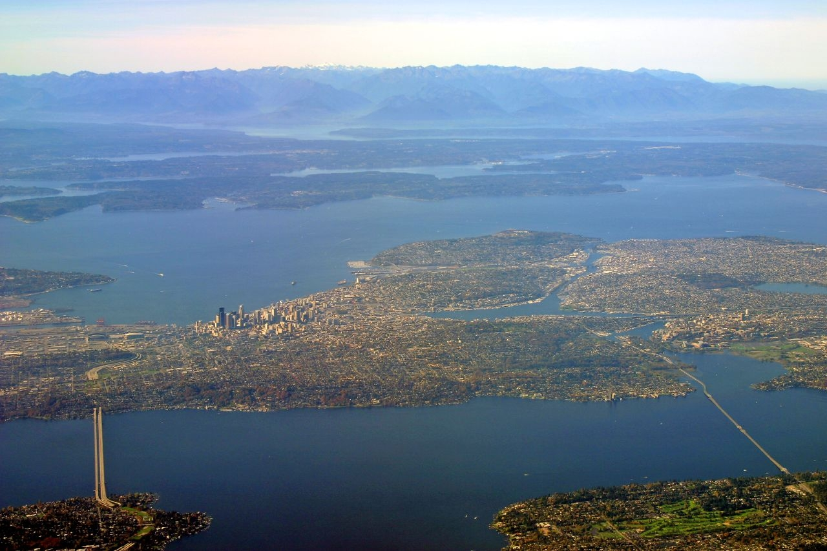
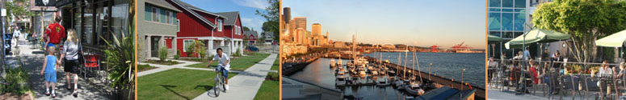

Briefing for SPC 1/9/14
Seattle’s Comprehensive Plan:
  What it is and why we have it
  How it’s working
  What’s new and what are we asking you
Notes:
VOICEOVER:
What is Seattle’s comprehensive plan? And why is it important to us?

Slide 2
Updates
Public Engagement
  Website blog
  Background Report
  January 30 – PK Seattle Big Ideas
  February 20 – UW & SPL, Making Policy Public
  2 to 3 citywide community meetings in Feb/ March
Growth Alternatives & EIS Process

Slide 3
Adopt Plan by June 2015
Early Engagement
2011 – 2012
Growth Alternatives & Assessment
1Q 2014 –
4Q 2014
Draft Plan Policies
1Q 2014–
1Q 2015
City Council Reviews Recommended Plan
1Q – 2Q 2015
Project Planning and Research
3Q 2013-
1Q 2014
Annual Amendments Spring 2013
Climate Action
Transit Communities
Healthy Food
Urban Design

Slide 4
Interdepartmental Team
Interdepartmental Team Members Role
Attend coordination meetings, approximately every other month.
Work with DPD Contact to identify issues, suggest changes, and review drafts.
Support public engagement activities:
  Share info with your community contacts and stakeholders
  Attend three large public meetings
Review and provide comments on draft materials
For Capital Departments – provide inventories and analysis of facilities to support growth
DPD Team Members Role
Manage the public engagement process
Work with City departments to draft plan policies
Consider stakeholder and community input
Deliver draft plan to Council

Slide 5
DEPARTMENT | DPD CONTACT
SDOT – Kevin O’Neill, Tony Mazzella | Kristian Kofoed
OH – Laura Hewitt-Walker | Kristian Kofoed
OED – Roque Deherrera | Patrice Carroll
OSE – Tracy Morgenstern | Brennon Staley
Parks – David Graves | Brennon Staley
SPU – Mark Jaeger | Brennon Staley
City Council – Lish Whitson, Eric McConaghy | Tom Hauger
SCL - Josh Walter | Brennon Staley
FAS – Daniel Bretzke, Randy Cox | Brennon Staley
Public Health – Amy Shuman | Tom Hauger
Neighborhoods – James Bush | Patrice Carroll
A & C – Matthew Richter | Patrice Carroll
DPD Land Use – Roberta Baker | Tom Hauger

Slide 6
Options:
SPC Role in Policy Development
Traditional role – briefings, review drafts and provide comments
Member of the Interdepartmental Team (IDT)
Designate select SPC members to work closely with DPD
Designate a committee to work closely with DPD

Slide 7
Options:
SPC Role in Outreach
Coordinated Outreach – targeting a general audience; coordinated with but distinct from DPD’s outreach (as in 1990)
Grassroots Outreach – targeting a neighborhood audience (as in 2009 for neighborhood plan status check)
Targeted Stakeholder Outreach – convening discussions and briefings for advocates with a specific interest (as in 2012 Leadership Discussions in support of Transit Communities policy)
Supporting DPD Outreach – participate in community meetings organized by DPD (as in May 2012 Comp Plan meeting at City Hall)

