Slide 1

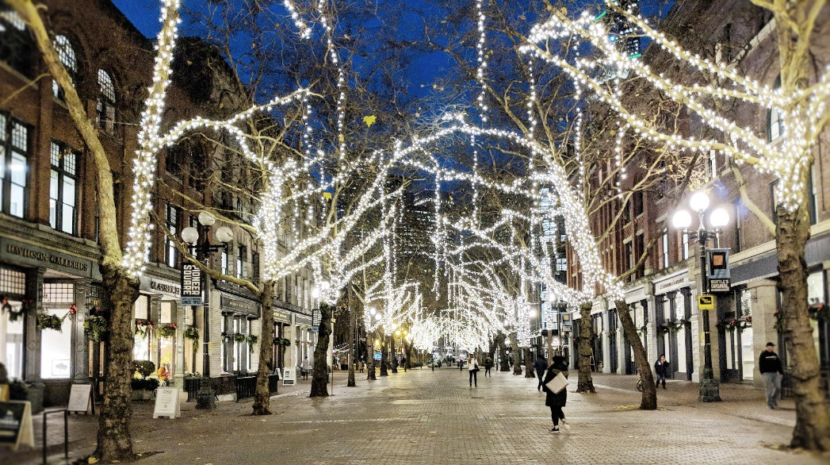
Seattle Bike Advisory Board
February 6, 2019

Slide 2
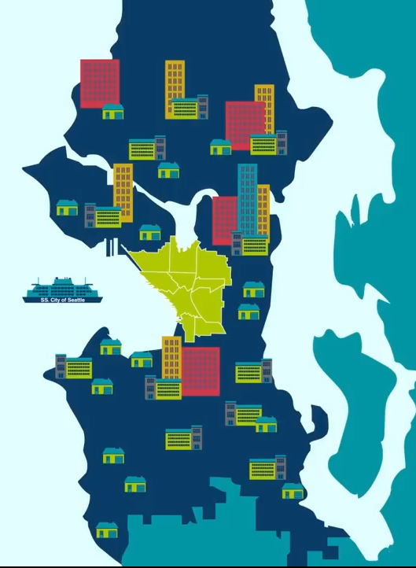

GREATER DOWNTOWN
Greater Downtown is made up of ten of the fastest growing neighborhoods in the city of Seattle:
Uptown
South Lake Union
Capitol Hill
Pike/Pine
First Hill
Denny Triangle
Belltown
Commercial Core
Chinatown International District
Pioneer Square

Slide 3




Partnership and Purpose
In coordination with the Washington State Department of Transportation and the Port of Seattle
Working together to create a shared mobility and urban design vision for the heart of Seattle that anticipates future needs in the face of significant growth and change

Slide 4
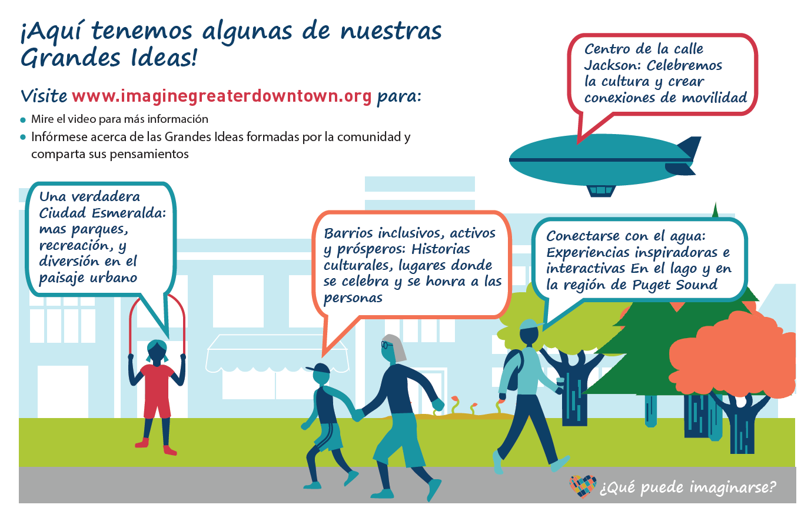
Outreach and engagement
12 community conversations and focus groups
More than 100 online comments
On street surveys in Seattle Center, Westlake, Chinatown-International District, Capitol Hill, SODO, Pioneer Square
Notes:
Traditional Engagement
Interactive website to collect ideas from the public – www.imaginegreaterdowntown.org
Pop-up events throughout greater downtown
Open Houses
City Boards and Commissions
Advisory Group
Race and Social Justice Engagement
Outreach led by Department of Neighborhoods Community Liaisons
Community Conversations
Participating in other ongoing events in diverse communities
Engagement with Native community

Slide 5
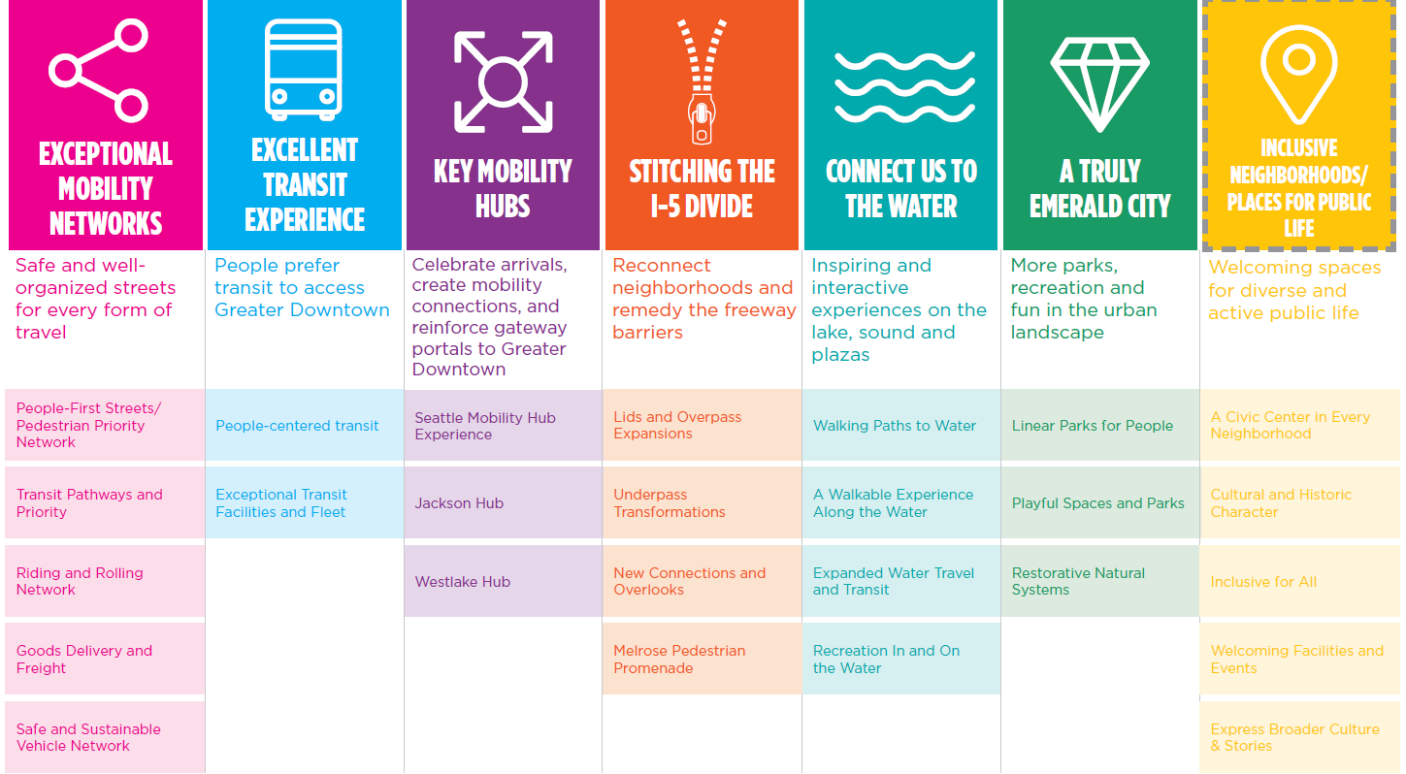
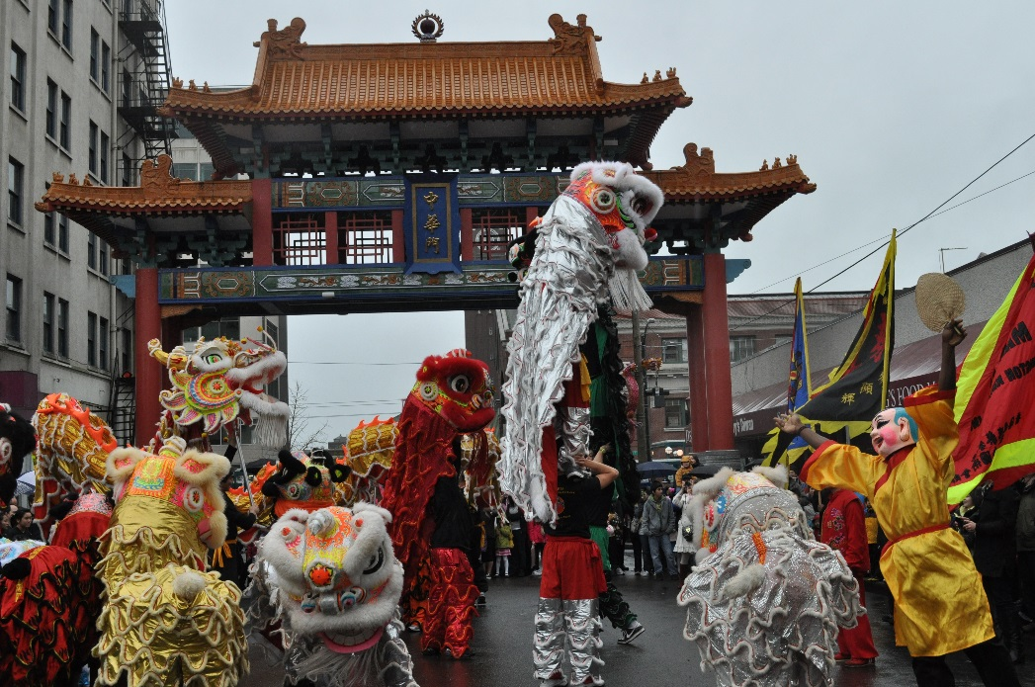
Big Ideas
Notes:
Go to www.imaginegreaterdowntown.org to find out more about each of the Big Ideas

Slide 6
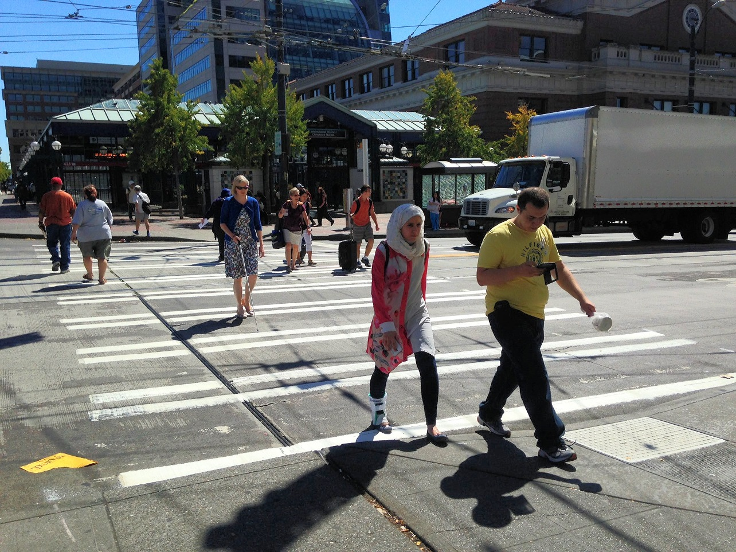
Exceptional mobility
Safe and well-organized streets for every form of travel
People-First Streets/Pedestrian Priority Network
Transit Pathways and Priority
Riding and Rolling Network
Goods Delivery and Freight
Safe and Sustainable Vehicle Network

Slide 7
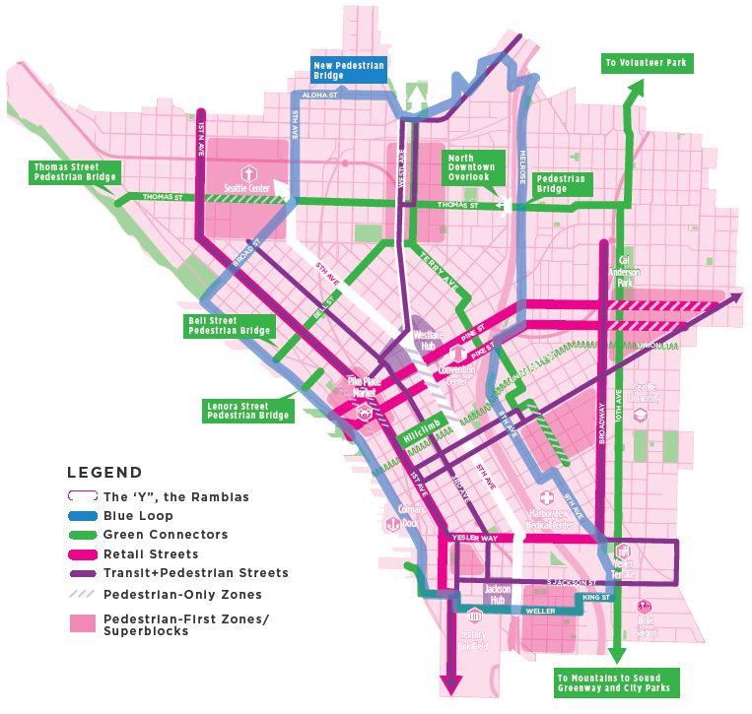
Element 1:
People-First Streets/Pedestrian Priority network

Slide 8
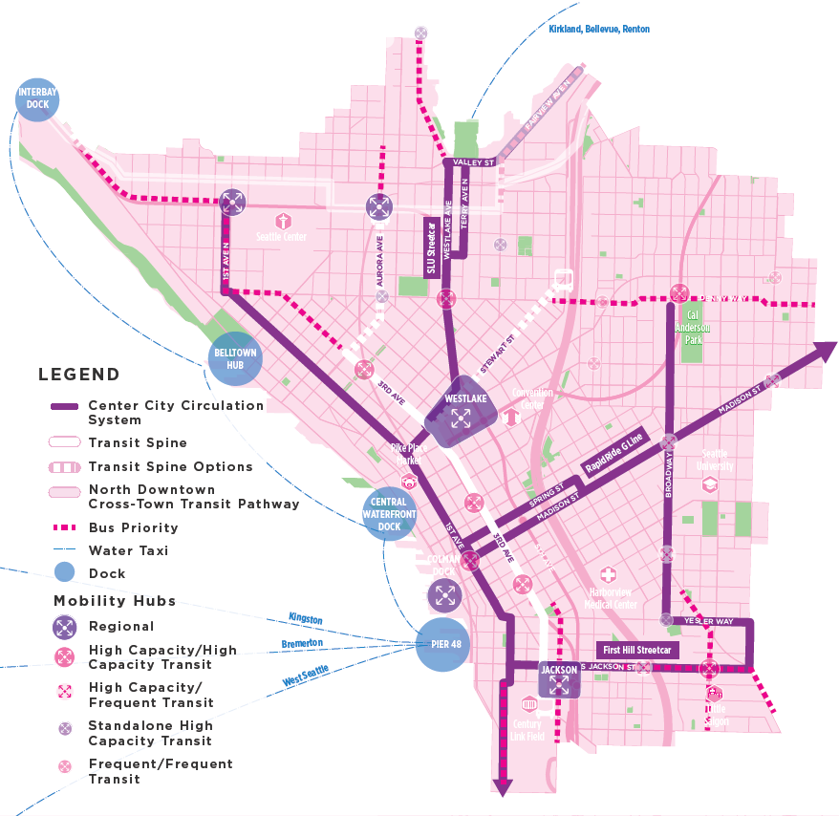
Element 2:
Transit Pathways & Operations

Slide 9
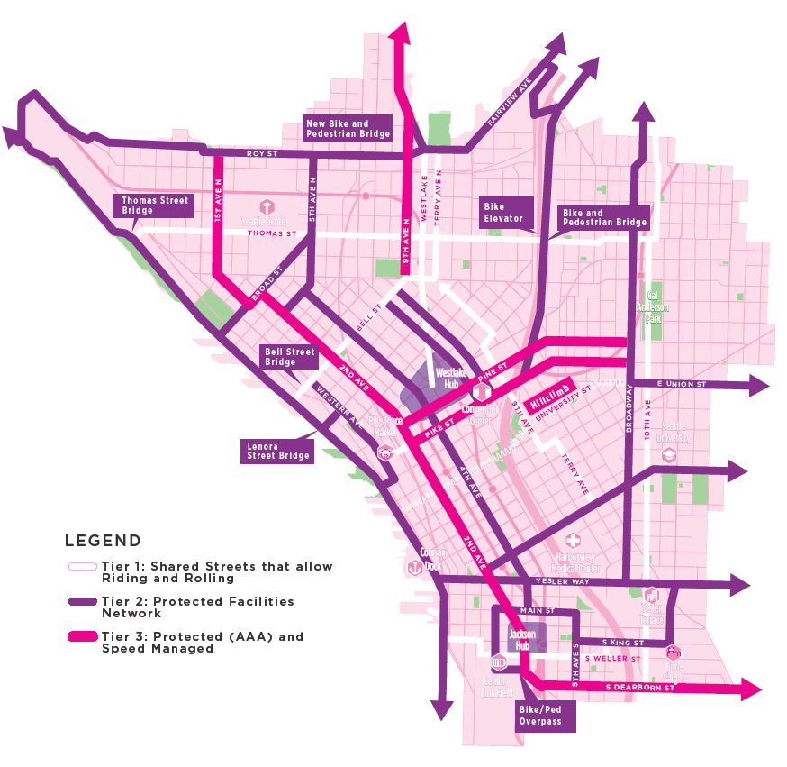
Element 3:
Riding & Rolling Network (Bicycle and micro-mobility

Slide 10
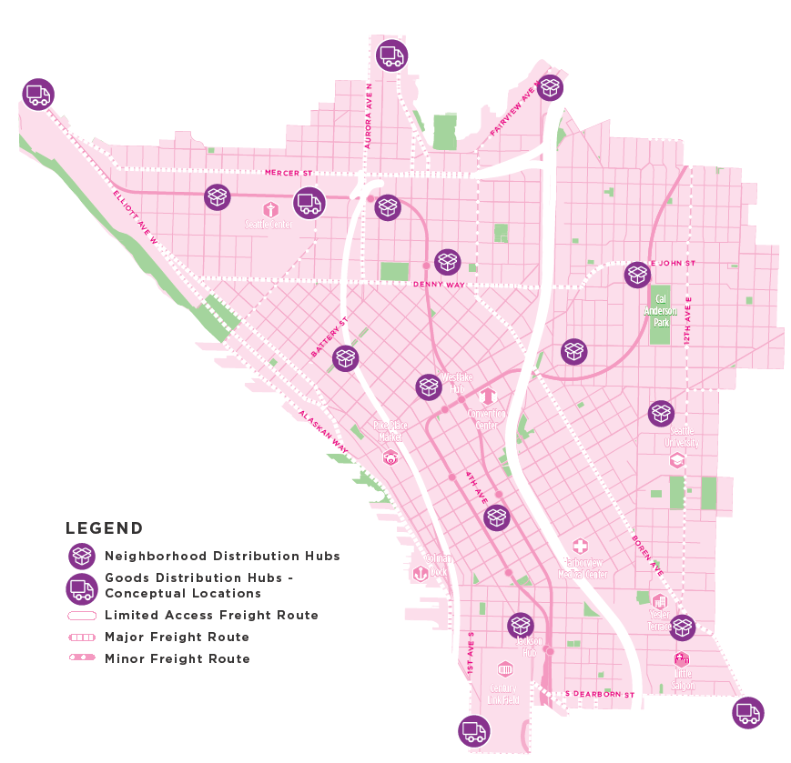
Element 4:
Goods Delivery and Freight

Slide 11
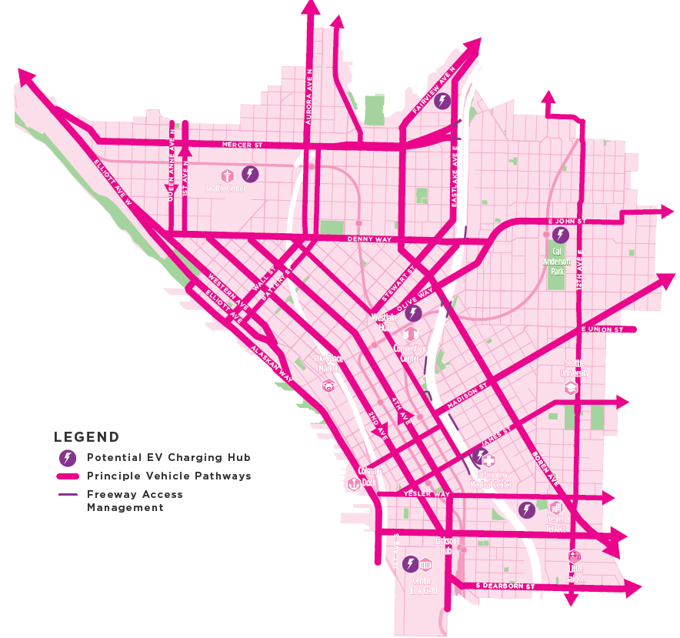
Element 5:
Safe and Sustainable Vehicle Network

Slide 12
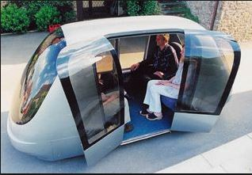
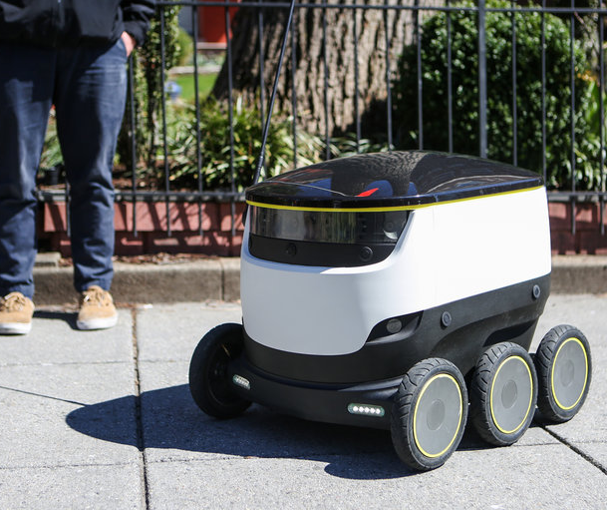
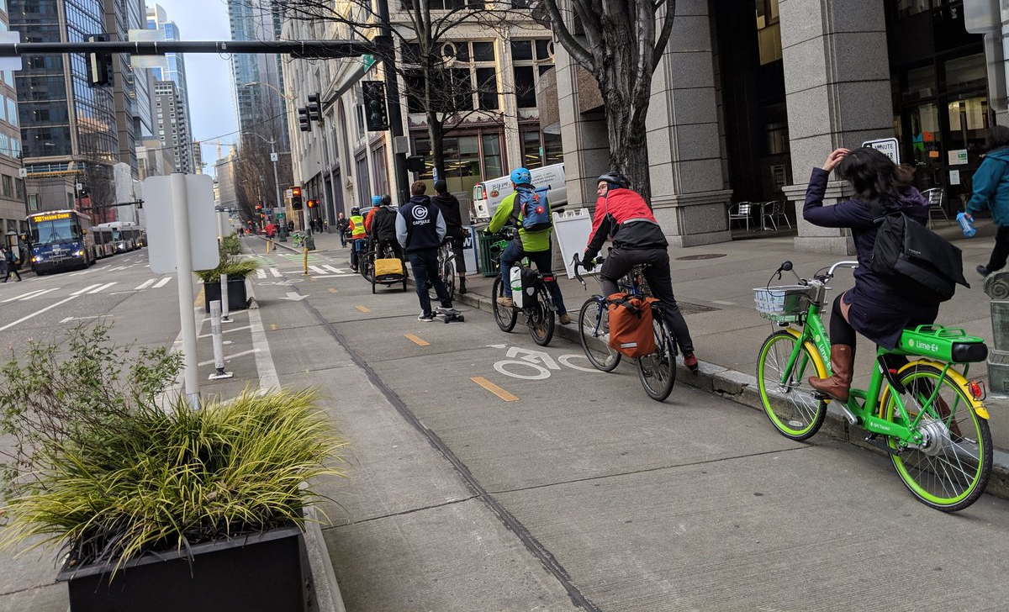
Do we have the right tiers of riding and rolling facilities? Do you agree with the street priorities?
Given the rapid change in technology, what opportunities/challenges related to new-mobility, shared-mobility and micro-mobility should we be addressing in a long range vision?

Slide 13
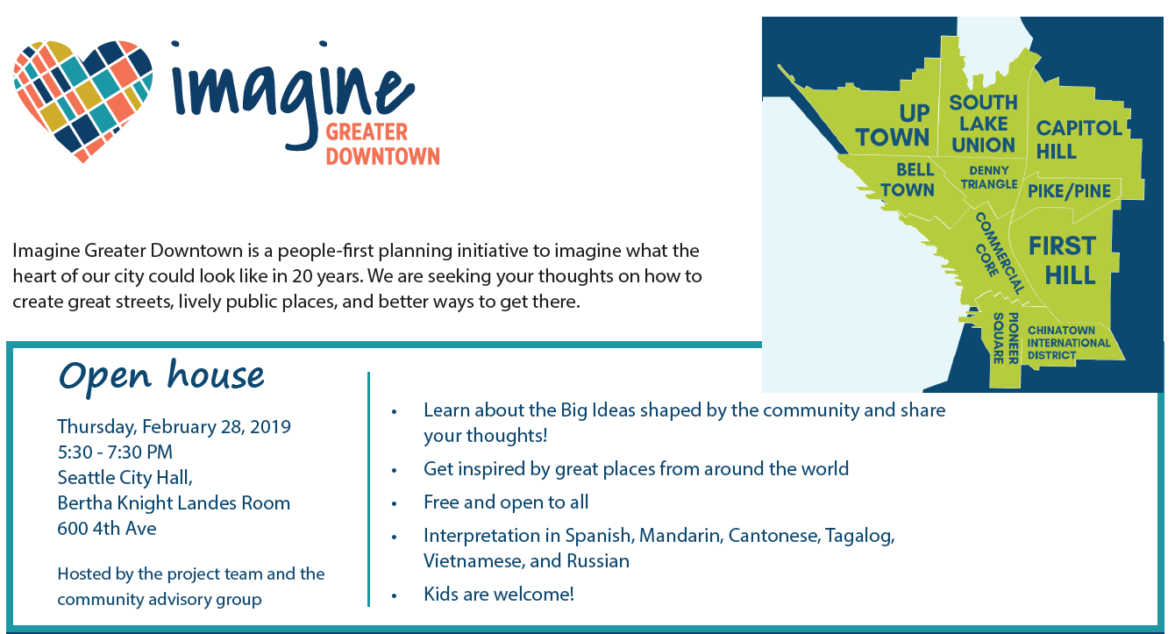
TIMELINE
January - March 2019
Prioritize big ideas and key moves
Collect public feedback on priorities
Public open house February 28
March - June 2019
Document development
Finalize plan

Slide 14


What can you imagine for the heart of Seattle?
www.imaginegreaterdowntown.org
Diane.Wiatr@Seattle.gov
Jonathan.Lewis@Seattle.gov
In coordination with The Port of Seattle and WSDOT

