Slide 1
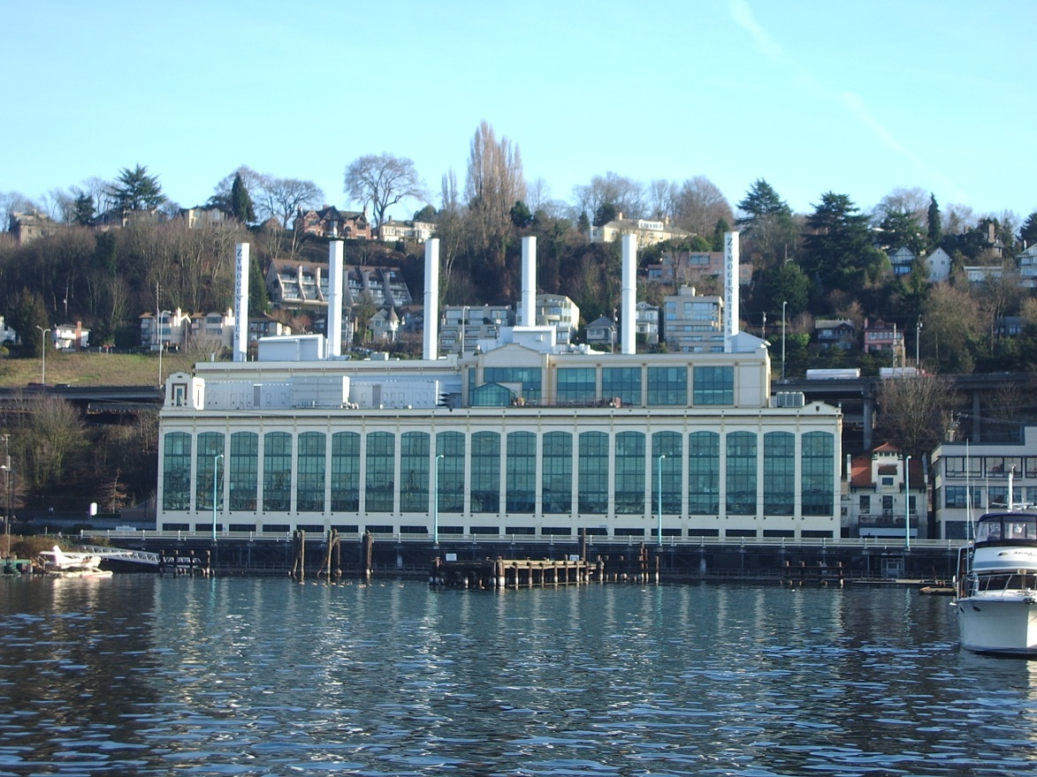

Fairview Avenue North Bridge Replacement Project
Seattle Bicycle Advisory Board
MariLyn J. Yim, P.E.
October 7, 2015

Slide 2
Our mission, vision, and core values
Mission: deliver a high-quality
transportation system for Seattle
Vision: connected people, places, and products
Committed to 5 core values to create a city that is:
Safe
Interconnected
Affordable
Vibrant
Innovative
For all
2

Slide 3
Presentation overview
Background
Project area
Existing conditions review
Project update
Next steps

Slide 4
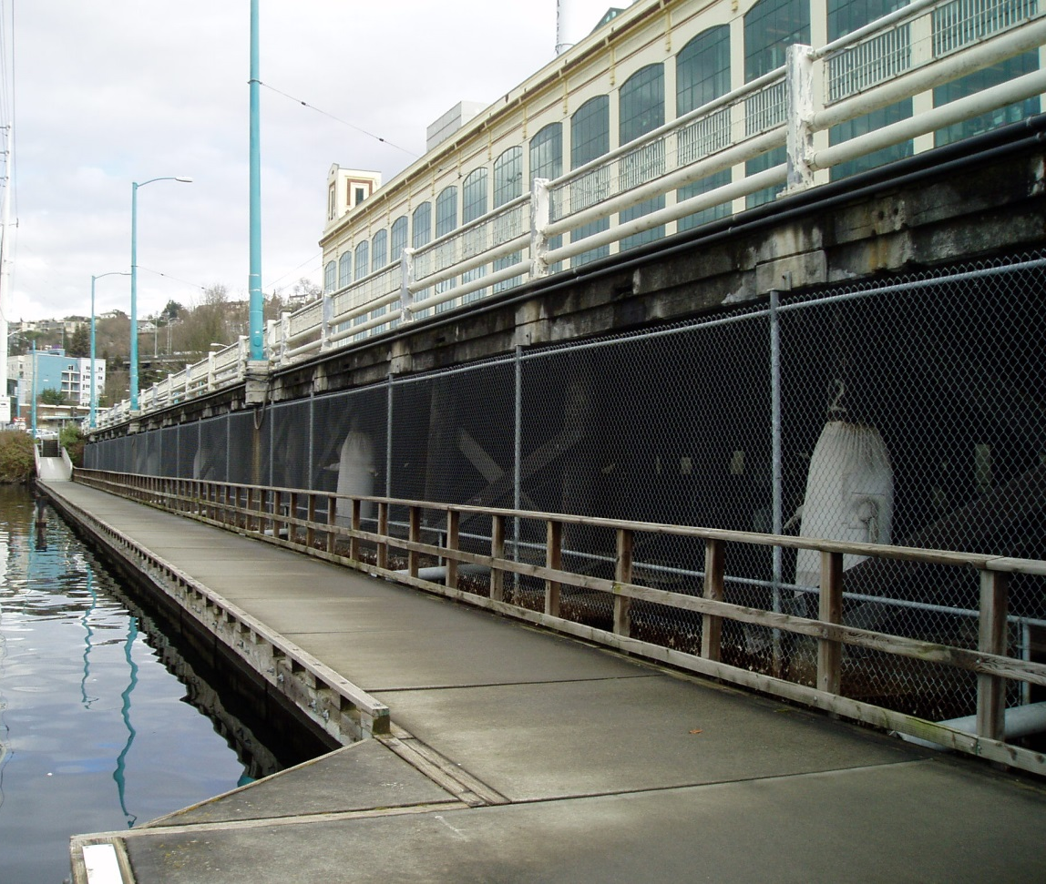
Background
The current bridge was built 65+ years ago and needs to be replaced
While safe for travel today, the timber-supported bridge is structurally deficient and seismically vulnerable
The new wider roadway configuration will better accommodate all users

Slide 5
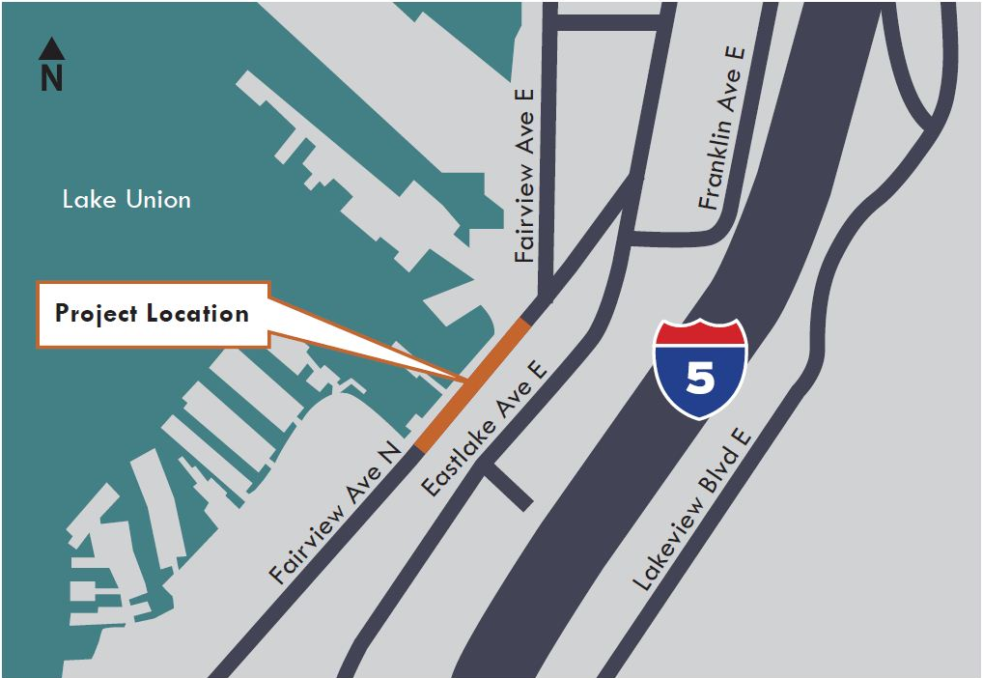
Project area

Slide 6
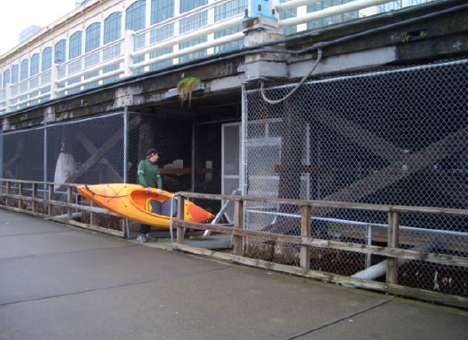
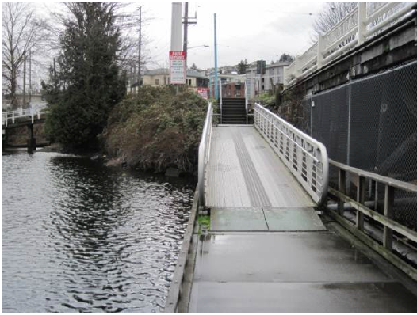
Existing conditions
Kayak launch located near ZymoGenetics
Cheshiahud Loop and floating walkway
Fairview Ave N bridge is next to historic Union Steam Plant building (ZymoGenetics)
Fairview Avenue North facing NE

Slide 7
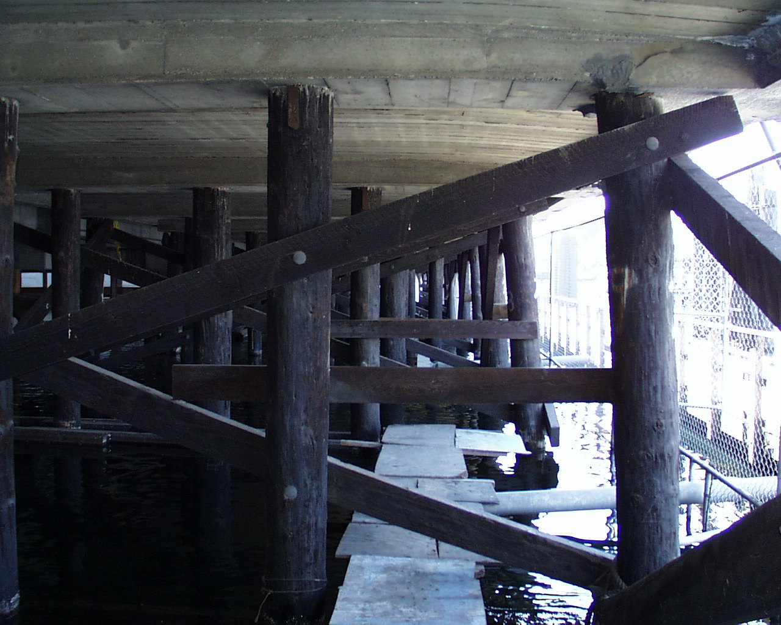
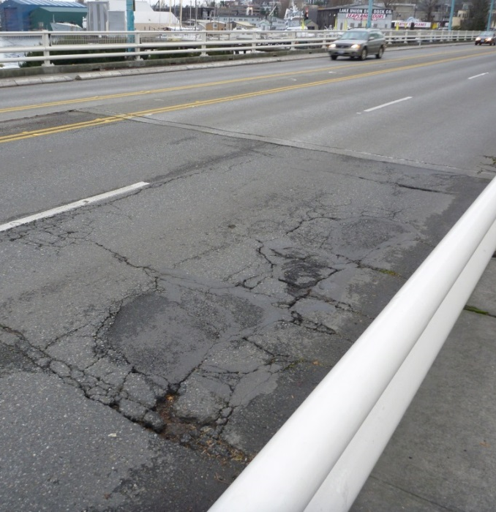
Existing conditions
Decayed timber piles
Cracked concrete and asphalt distress
Seismic vulnerability
Limited load capacity
Structural deficiencies
Fairview Avenue North facing SW
Fairview Avenue North facing NE

Slide 8
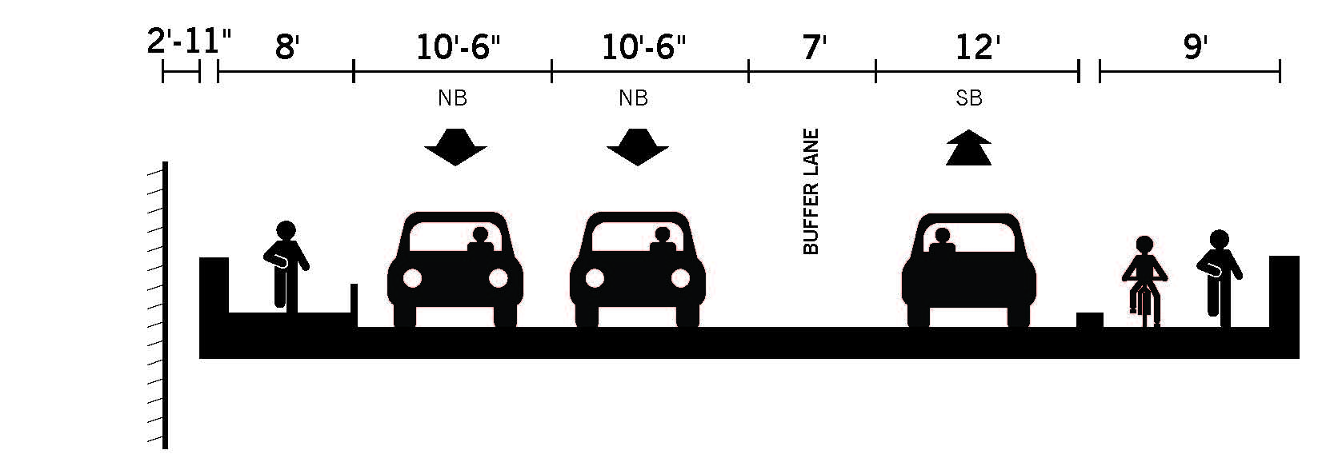
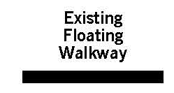
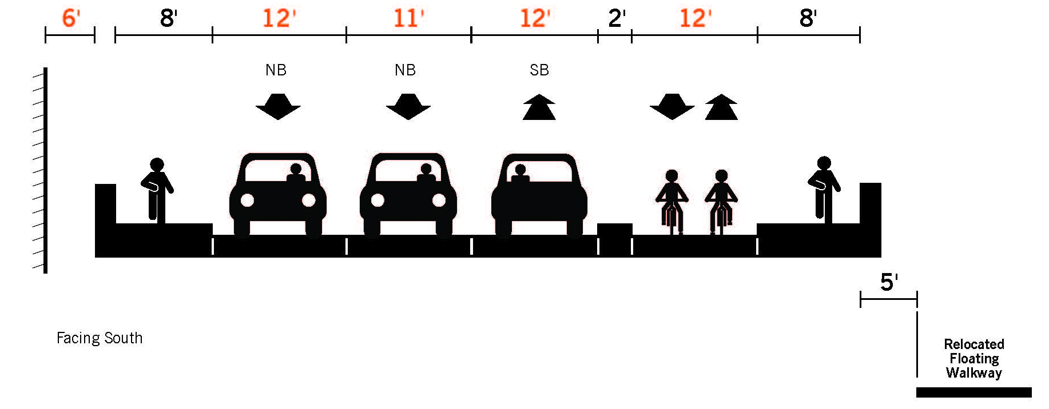
Proposed features
Existing
Future

Slide 9
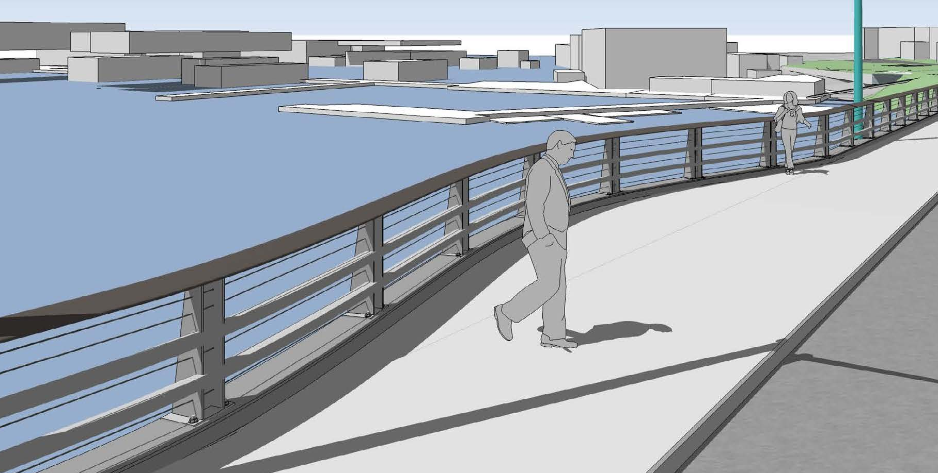
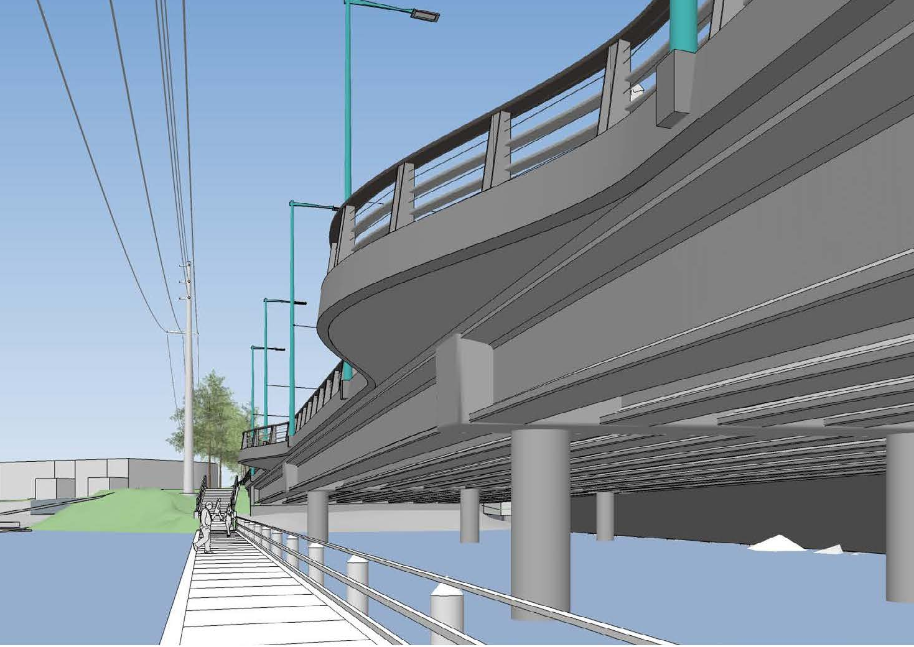
Viewing Opportunities

Slide 10
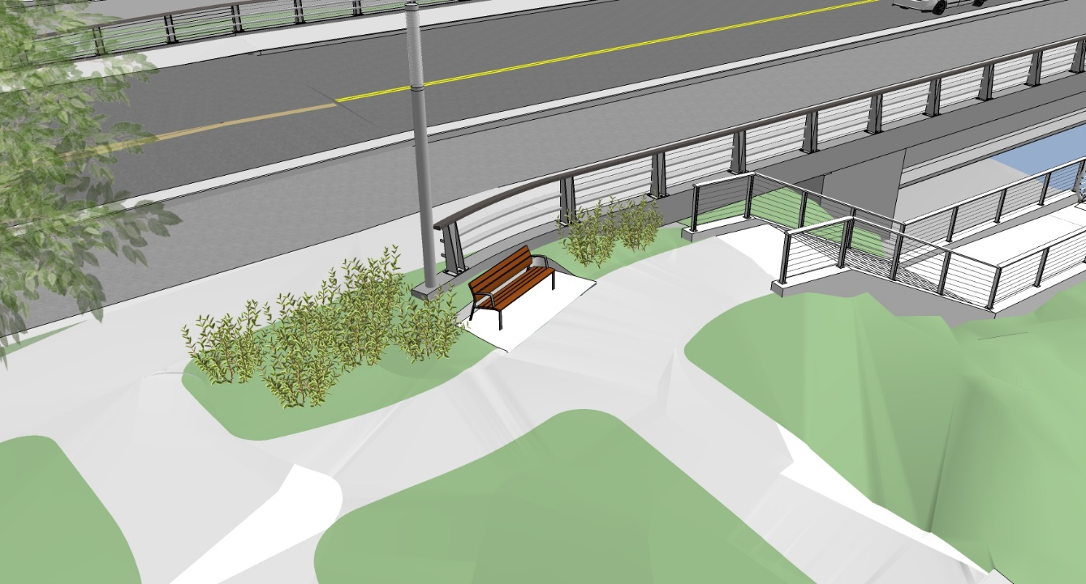
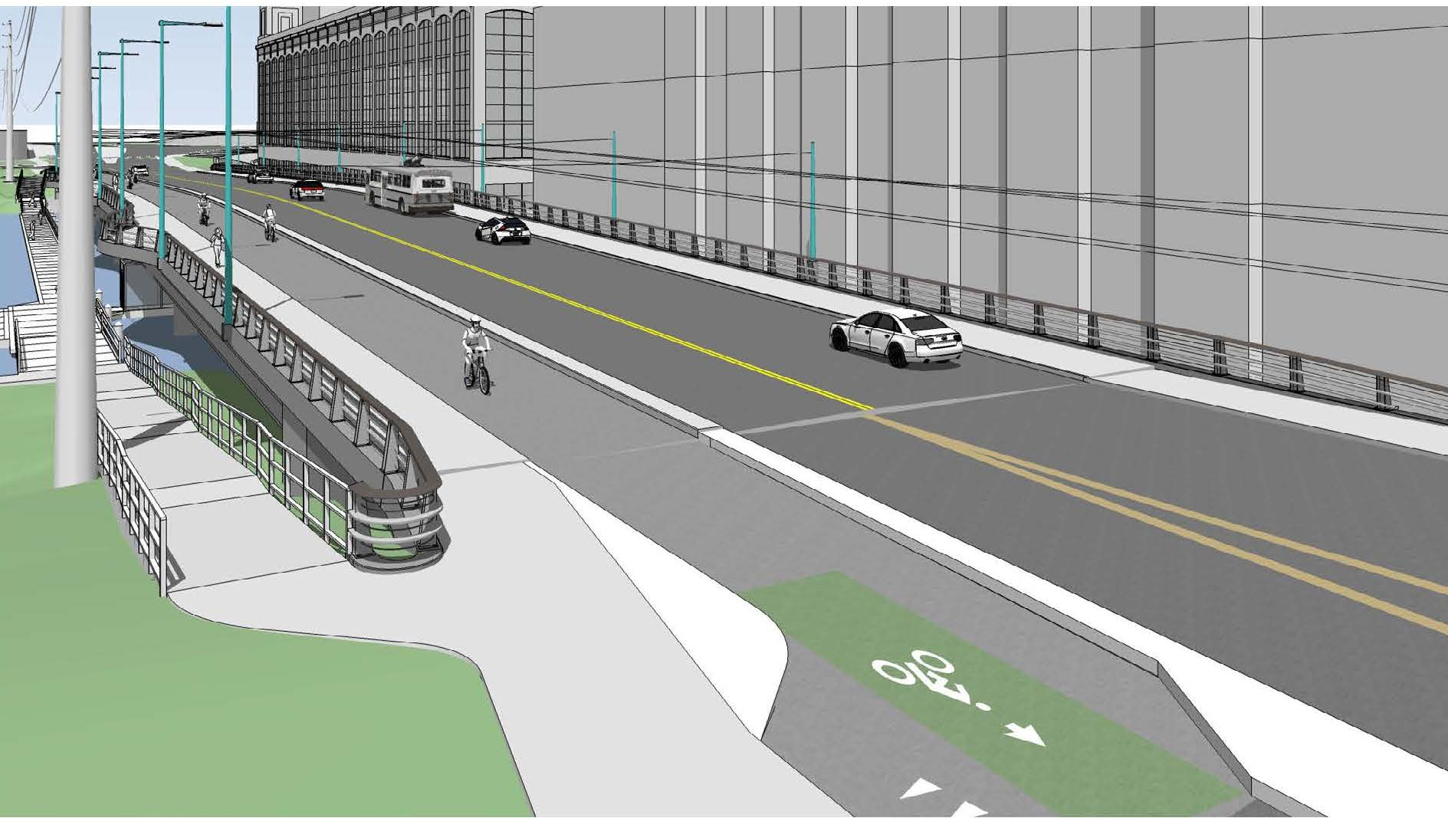
Trail Connections
Northern trail connection
Southern trail connection

Slide 11
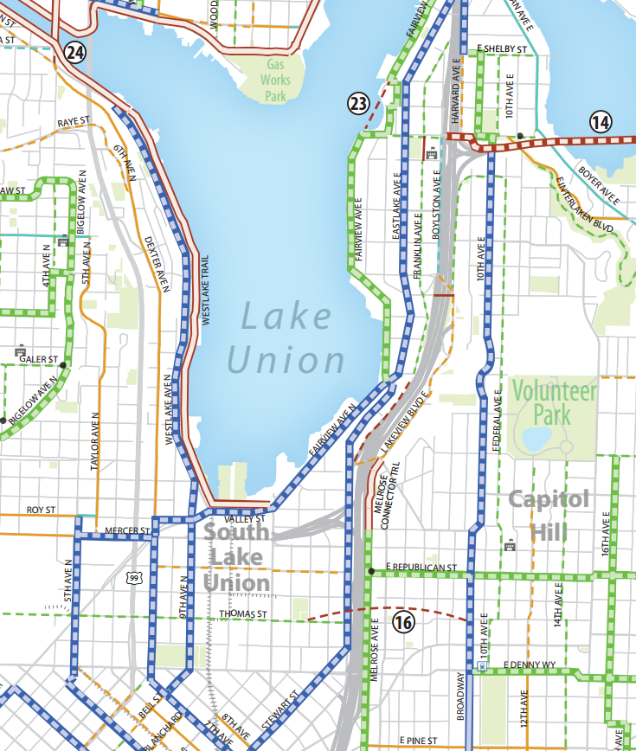
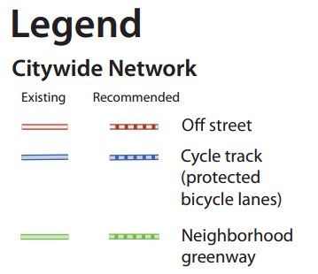
Bicycle Master Plan

Slide 12
Project Update
Originally planned to keep one lane of the bridge open during construction
  2014 Value Engineering study showed significant schedule savings if entire bridge is closed (24 months vs 15 months)
Potential construction cost savings
  SDOT is committed to using taxpayer dollars efficiently

Slide 13
Mitigating impacts
Planning detour routes
Conducting traffic analysis
Coordinating with King County Metro for bus re-routes
Remedying outstanding frustrations
  Looking at signal timing on Fairview Ave N at Aloha & Mercer streets
  Holistic approach to construction projects in the area
  ADA accessibility on pedestrian routes

Slide 14
Funding
Partially funded through Bridging the Gap and Bridge Replacement Advisory Committee (BRAC)
Total project estimate is $42 million
About $3 million needed to complete design and right of way acquisition
About $24 million needed for construction
Project included in Move Seattle levy

Slide 15
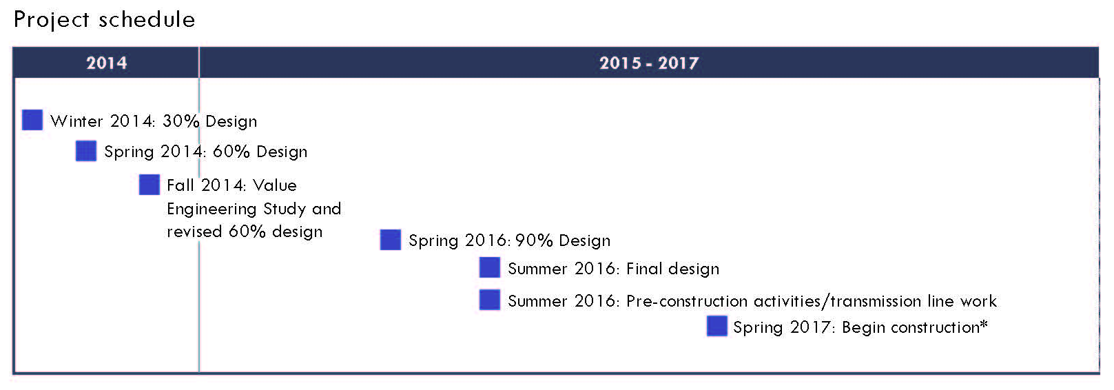
Updated project schedule
*Construction start date pending permit approval

Slide 16
Next steps
Date | Activity/action
Ongoing | Continue community outreach and targeted briefings
Ongoing | Continue coordination with agencies such as Seattle City Light and King County Metro
Summer 2015 | Continue design
Fall 2015 | Project open house
Winter 2016 | Reach 90% design

Slide 17




Questions?
FairviewBridge@seattle.gov | (206) 733-9960
www.seattle.gov/transportation/fairviewbridge.htm
www.seattle.gov/transportation

Slide 18
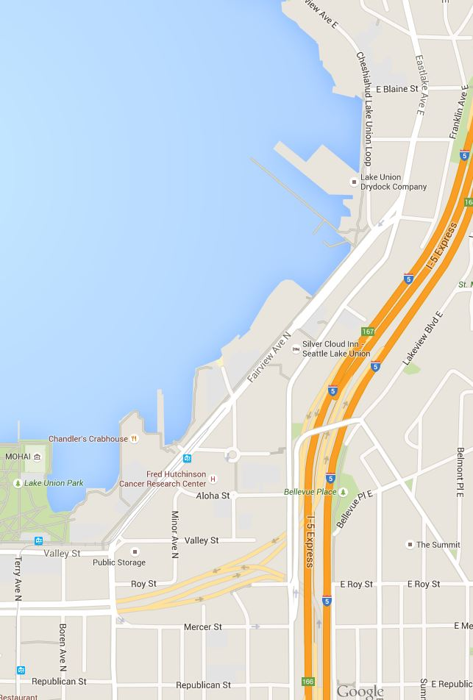
Project area

