Slide 1
Center City Bike Network
SBAB briefing objectives
Share progress report on Center City Bike Network
Describe Sounding Board
Discuss next steps

Slide 2
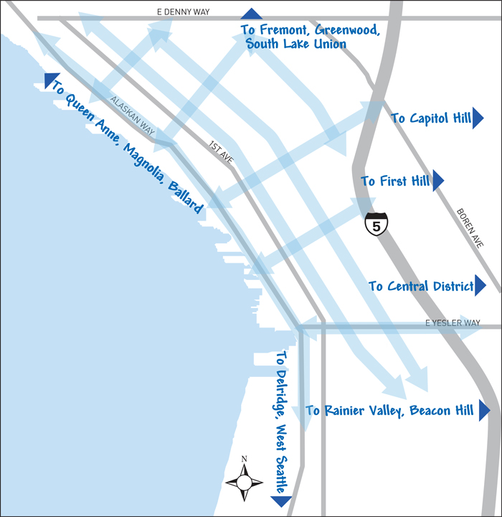
Background
SDOT is building a Center City Bike Network
One with north-south spines and east-west connections
Notes:
BMP
5 Year Implementation Plan
Center City Bike Network project

Slide 3
Technical analysis done to date
2nd Ave extension (north and south)
4th Ave continuous
5th Ave continuous
4th/5th Ave combination
7th Ave two-way
7th/8th Ave combination
8th/9th combination

Slide 4
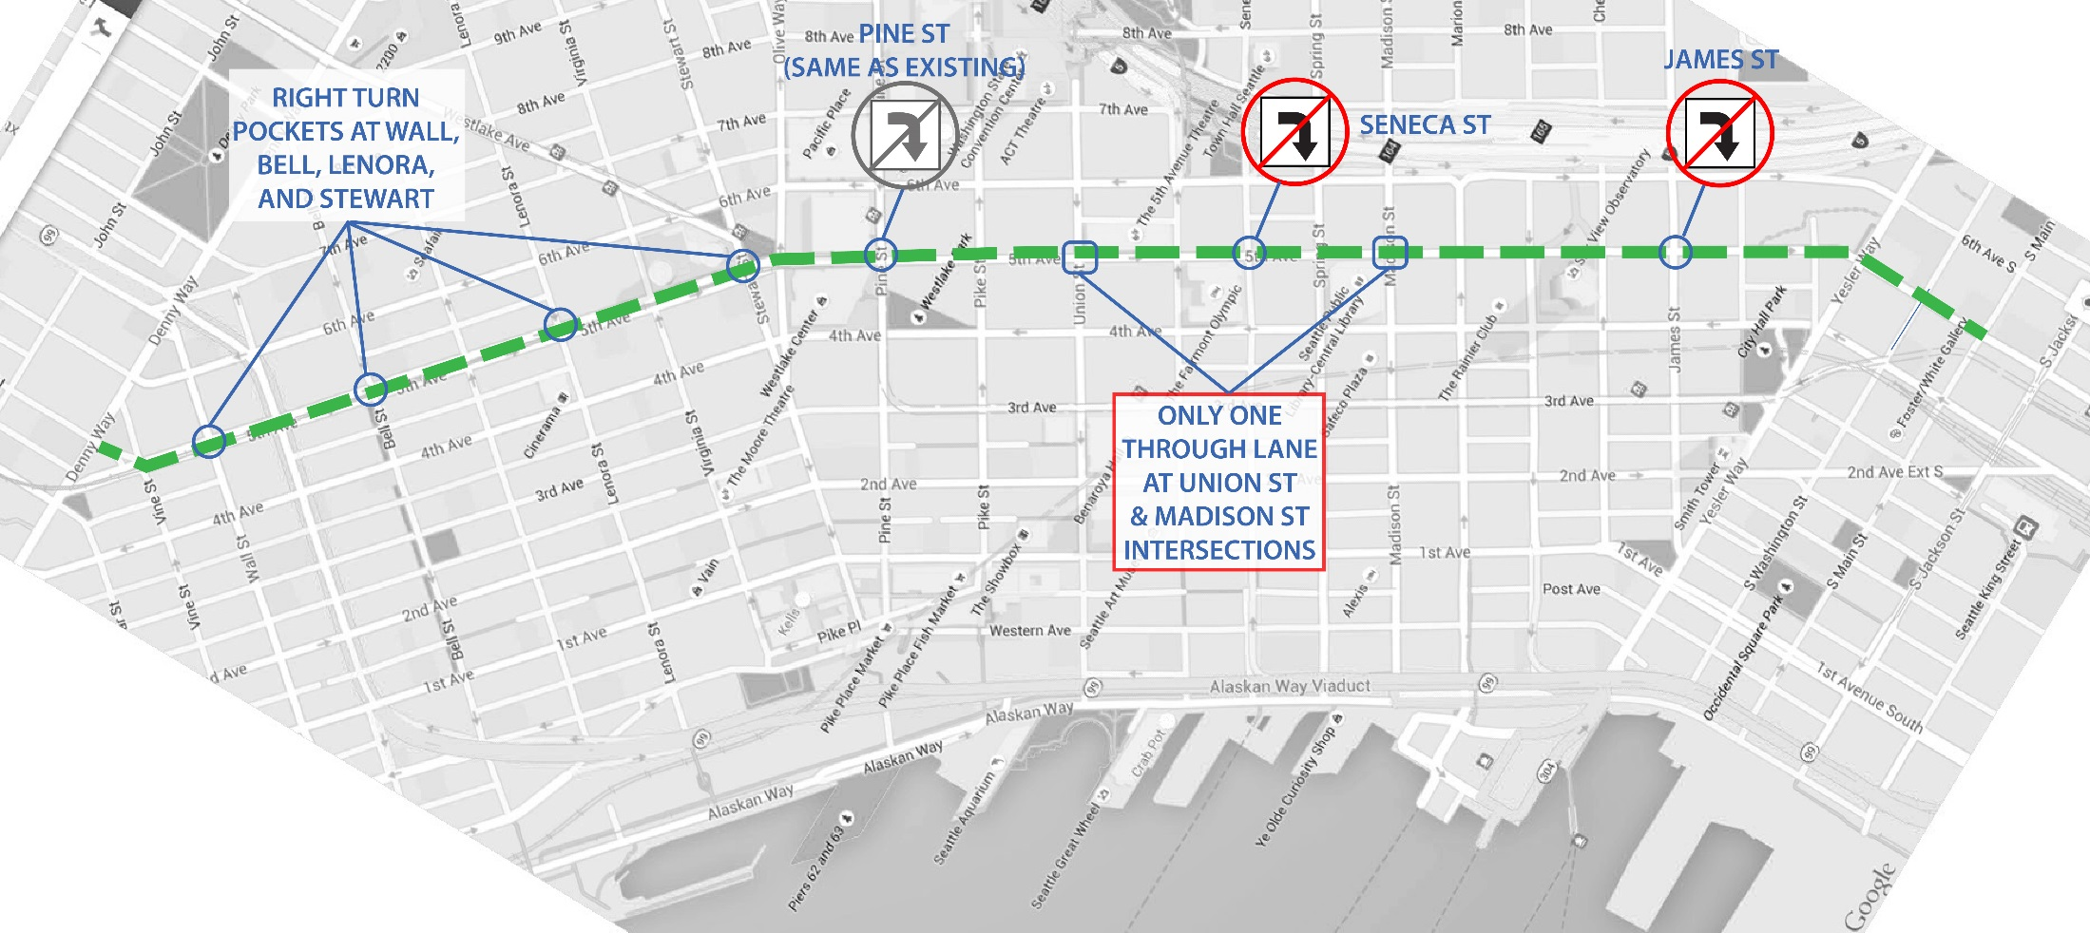
5th Ave continuous
DRAFT
Notes:
5th Ave:
Bell Street Right Turn (AM = 20veh/hr; PM = 30veh/hr)
Seneca Street Right Turn (AM = 195veh/hr; PM = 100veh/hr)
Pine Street Right Turn (Existing)
James Street Right Turn (AM = 60veh/hr; PM = 79veh/hr)

Slide 5
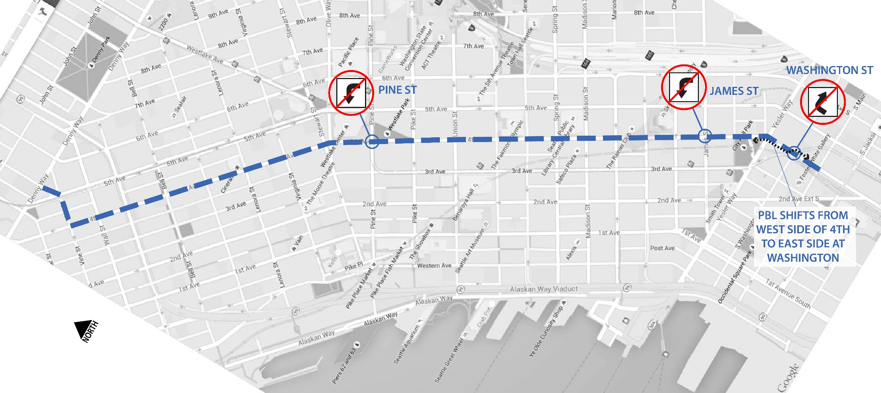
4th Ave continuous
DRAFT
Notes:
4th Ave
Washington Street Right Turn (AM = 23veh/hr; PM = 12veh/hr)
Pine Street Left Turn(AM = 63veh/hr; PM = 80veh/hr)

Slide 6
4th/5th combination
Street | Average Daily Traffic (ADT) | Grade | Opportunities/challenges
Stewart | 10,500 | 6% | Streetcar tracks; Alley access; Connects to McGraw Square Transportation Hub
Virginia | 5,200 | 6% | Potential transit corridor
Lenora | 2,000 | 4% | Potential transit corridor
Blanchard | 3,450 | 2% | Transit corridor
Bell | 2,520 | 1% | Bell Street Park

Slide 7
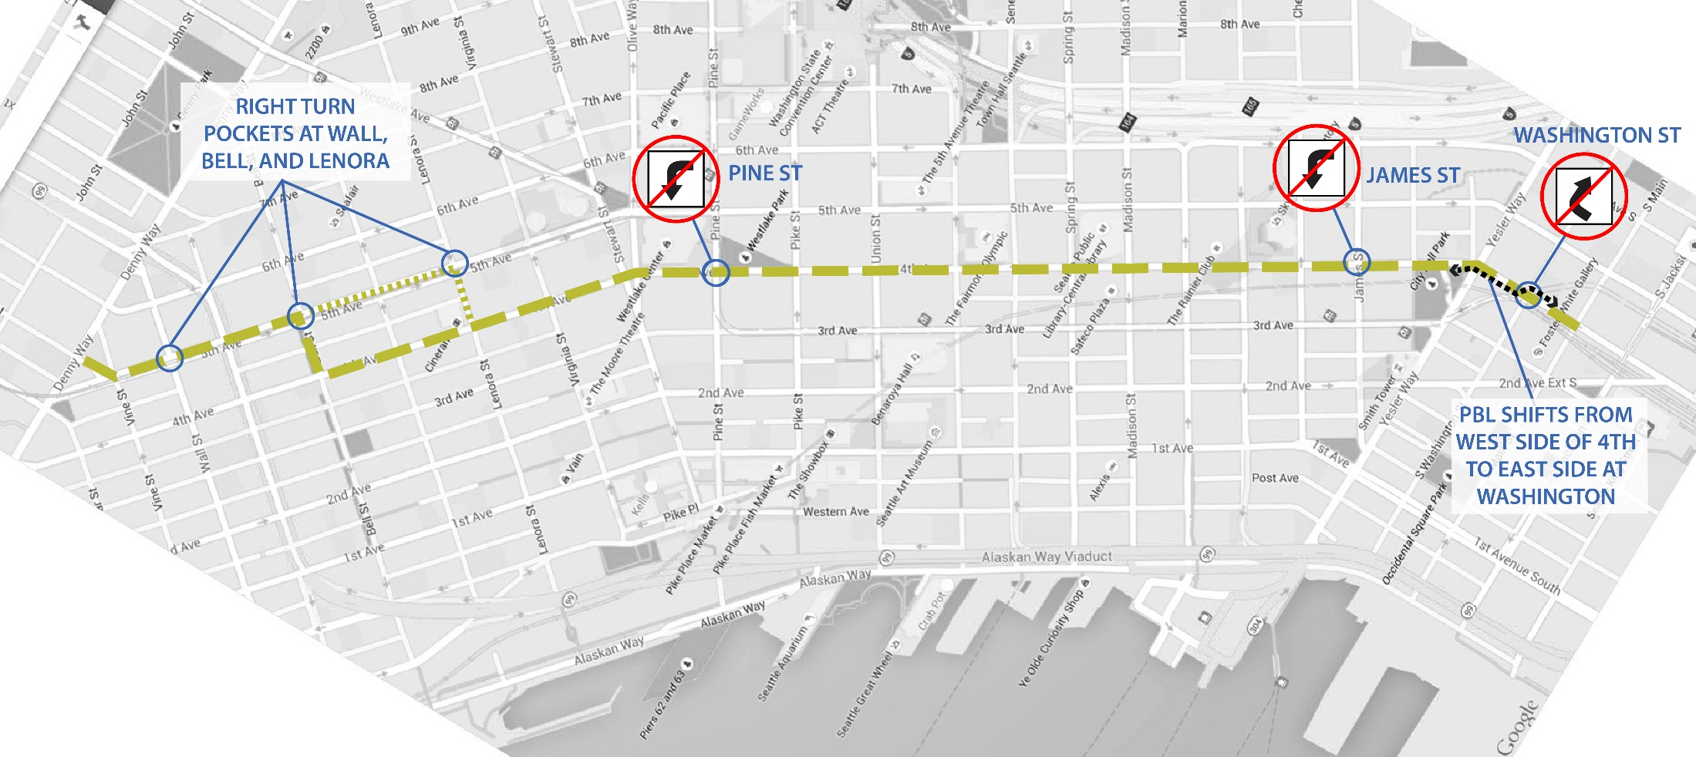
4th/5th combination
DRAFT
Notes:
5th Ave:
Bell Street Right Turn (AM = 20veh/hr; PM = 30veh/hr)
Seneca Street Right Turn (AM = 195veh/hr; PM = 100veh/hr)
Pine Street Right Turn (Existing)
James Street Right Turn (AM = 60veh/hr; PM = 79veh/hr)
4th Ave
Washington Street Right Turn (AM = 23veh/hr; PM = 12veh/hr)
Pine Street Left Turn(AM = 63veh/hr; PM = 80veh/hr)

Slide 8
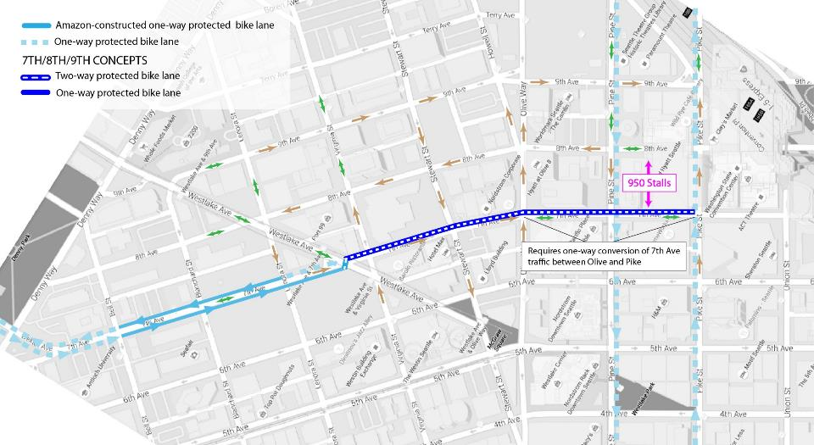
7th Ave
2-way on east side
DRAFT
Requires one-way conversion of 7th Ave traffic between Olive and Pike
Notes:
2.b: A 2-way PBL on the east side of 7th Ave, with modifications to existing traffic operations
Pros:
If 7th Ave is converted to one-way motor vehicle operation southbound, between Olive Way and Union Street, the traffic analysis results at intersections on 7th are significantly improved. Additionally, dedicated turn lanes at Pine and Pike Streets are feasible.
Cons:
Changes street grid and access patterns to I-5 via Olive and Howell Streets. Traffic impact is unknown
Operations
Parking
Crossings
Grades
Driveways

Slide 9
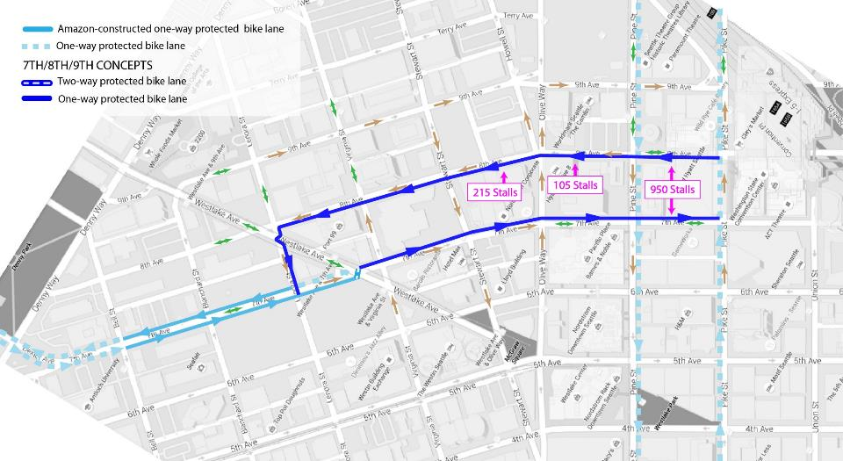
DRAFT
7th & 8th Ave
1-way couplet
*Also considering 1-way couplet with 7th Ave PBL on west side of street
Notes:
6. A 1-way PBL couplet on the west side of 8th Ave (northbound) and east side of 7th Ave (southbound)
Pros:
Option is possible with existing traffic operations on 7th.
Option results in no changes to space allocation on 8th (bike lane switches from east to west side)
Best utilization of available space
Cons
Some removal of street parking is required
Operations
Parking
Crossings
Grades
Driveways

Slide 10
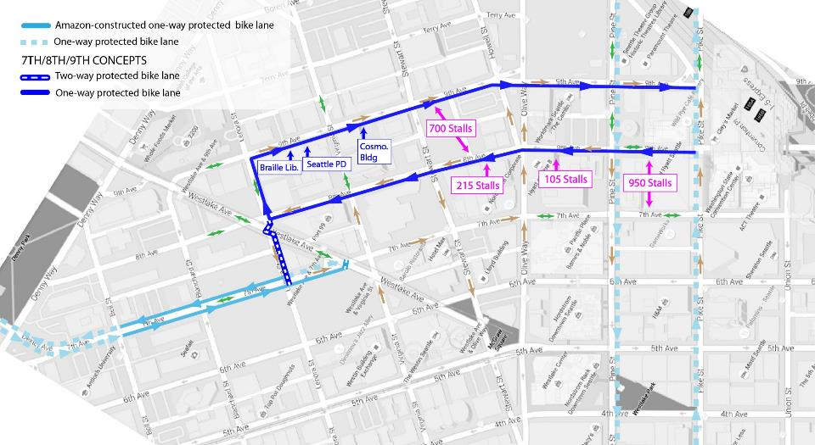
8th & 9th Ave
1-way couplet
DRAFT
Notes:
A 1-way PBL couplet on the west side of 8th Ave (northbound) and west side of 9th Ave (southbound)
Pros:
There is sufficient room on 8th Ave to create a one-way PBL, including the block between Pine and Pike, which was too narrow to accommodate a two-way facility.
Cons
Direction of couplet is reverse one-way pair on 7th Ave north of Westlake (potentially confusing)
Operations
Parking
Crossings
Grades
Driveways

Slide 11
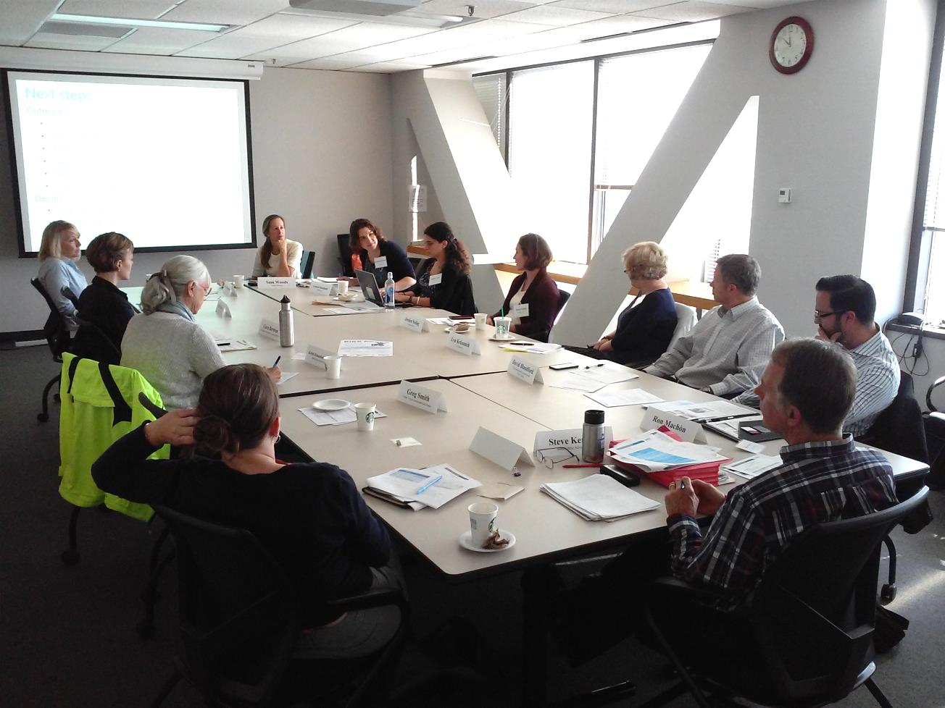
Sounding Board
IDEA Space at the Seattle Chinatown-ID PDA
Downtown Seattle Association
Visit Seattle/Seattle Convention and Visitors Bureau
Charlie’s Produce; Freight Advisory Board
Seattle Bike Advisory Board
Clise Properties
Hotel representative
Valet representative
Urban Visions Sustainable Real Estate
Alliance of Pioneer Square
Commute Seattle

Slide 12
Sounding Board role
Share knowledge and insight about existing conditions and needs
Discuss project evaluation criteria
Provide input on priorities for design and construction
Share project updates with their communities
Notes:
Three meetings to date and a bike tour

Slide 13
Center City Mobility Plan
Goal and deliverables
Goal
Meet the changing needs of a growing downtown and region by connecting people, places, and products with a reliable transportation system and an inviting public realm
Key deliverables
Prioritization framework
Funding strategy
Implementation plan for multiple time horizons:
  End of joint bus-rail transit tunnel operations (2019/2020)
  Mid-term (2023)
  Long-term (2035)
13
Notes:
Center City is growing
Surface transportation network has limited opportunities to add SOV capacity
Construction (public and private) temporarily reduces system capacity
Technology is changing mobility needs and opportunities
Major capital projects are coming online
Planning is needed to address and integrate changes

Slide 14
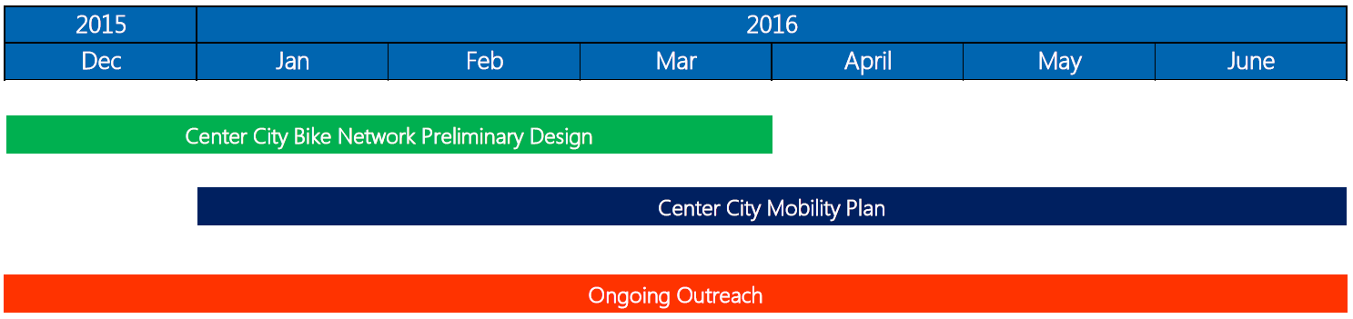
Schedule

Slide 15
Outreach questions
Advise on outreach approach: public meeting, or series of stakeholder meetings?
How would the SBAB like to be involved?

