Slide 1
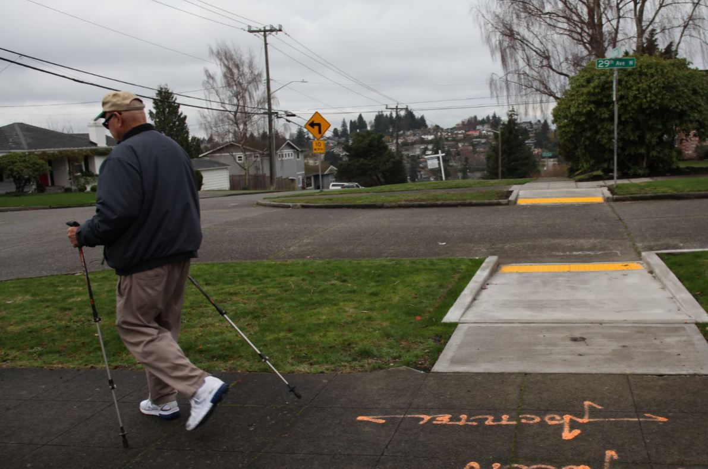

ADA Curb Ramps
SMC 23.53.006 – Pedestrian Access and Circulation
Elizabeth Sheldon
SBAB Presentation
February 6, 2018

Slide 2
Our mission, vision, and core values
Mission: deliver a high-quality
transportation system for Seattle
Vision: connected people, places, and products
Committed to 5 core values to create a city that is:
Safe
Interconnected
Affordable
Vibrant
Innovative
For all
2
Notes:
Our core values for transportation anchor to the core values that Mayor Murray has laid out in his vision (Move Seattle) for Seattle:
Safe
Interconnected
Affordable
Vibrant
Innovative

Slide 3
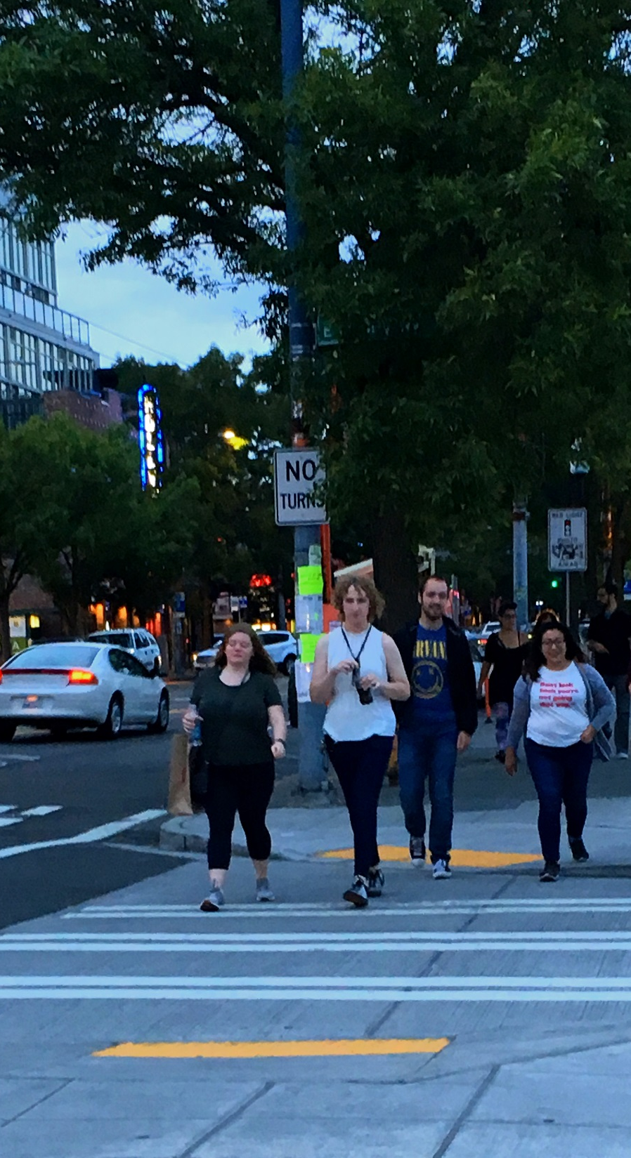
Presentation overview
Background
Existing code language
Proposal
Next steps
3
Notes:
Let the audience know the purpose of your presentation (is it purely informational, are you seeking feedback, etc). Then walk them through what you’ll be covering.

Slide 4
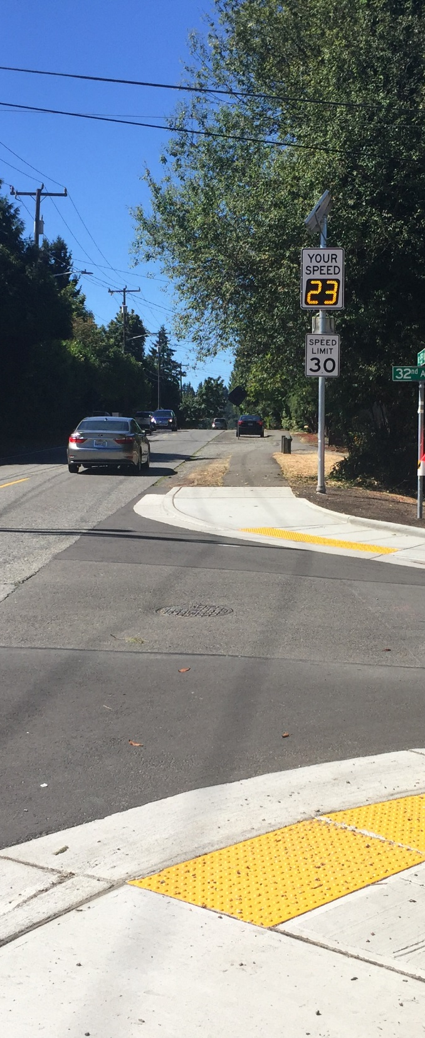
Code Section 23.53.006 – Pedestrian Access and Circulation
Sidewalk or pedestrian requirements and thresholds for new development.
Currently silent on curb ramps and curbs.
4

Slide 5
Code Section 23.53.006 – Pedestrian Access and Circulation
2007
Significant changes to align with SDOT’s 1st Pedestrian Master Plan
2009
Pedestrian Master Plan adoption
2009-2017
Minor text edits
2017
2018
Pedestrian Master Plan update
Proposed update to include curb ramps and curbs as part of the pedestrian access and circulation
5

Slide 6
Proposed Changes
Explicitly calls out curb ramps and curbs as part of the pedestrian access and circulation requirements.
Requires development in Urban Centers and Urban Villages to comply with current ROWIM standards for sidewalks, curbs, and curb ramps.
Other minor changes to other code sections for clarity.
Does not change the types of projects listed as exempt from the requirements.
6

Slide 7
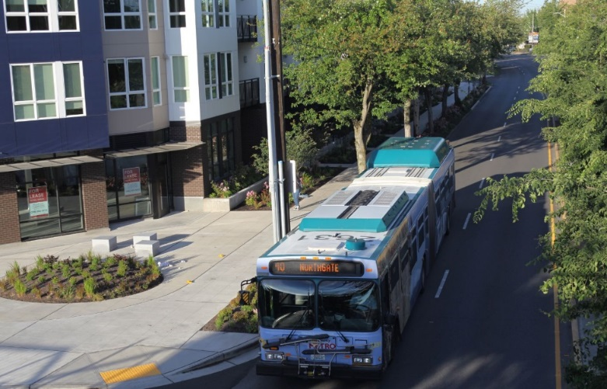
Why Change?
Developments on corner lots currently build sidewalks that may stop short of the intersection, and do not build curb ramps.
Makes the pedestrian network accessible by requiring curb ramps.
Requires curb ramps be built at corner lots, even if there is an existing sidewalk without curb ramps.
Incorporates curb ramps and curbs as a part of overall pedestrian access and circulation.
Adds clarity to the code language about curb ramps and curbs.
7

Slide 8
Next steps
4th Quarter 2017
Draft Legislation
By 2nd Quarter 2018
Outreach
By 3rd Quarter 2018
Legislation to City Council
By 1st Quarter 2018
State and Environmental Policy Act (SEPA) Review
8
Notes:
Insert a project timeline. Clarify the process and opportunities for engagement/feedback.

Slide 9




Questions?
Elizabeth.sheldon@seattle.gov | (206) 684-7945
http://www.seattle.gov/DPD/codesrules/changestocode/curbramps/whatwhy/default.htm
www.seattle.gov/transportation

