Slide 1
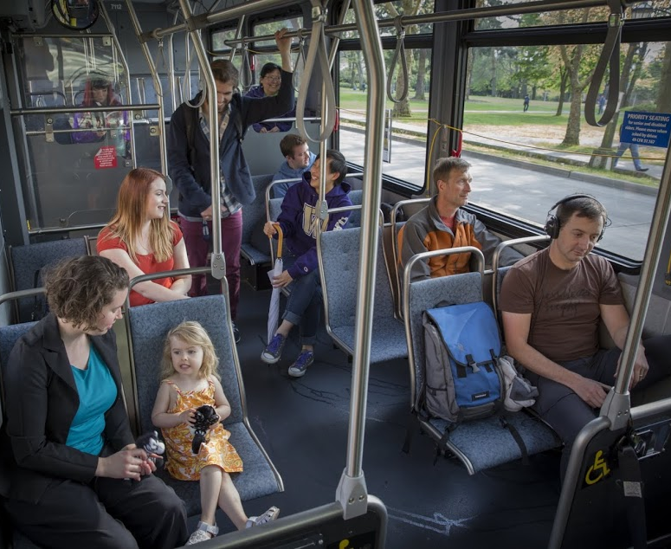



RapidRide H Line
Your Voices in Action! January 2018

Slide 2
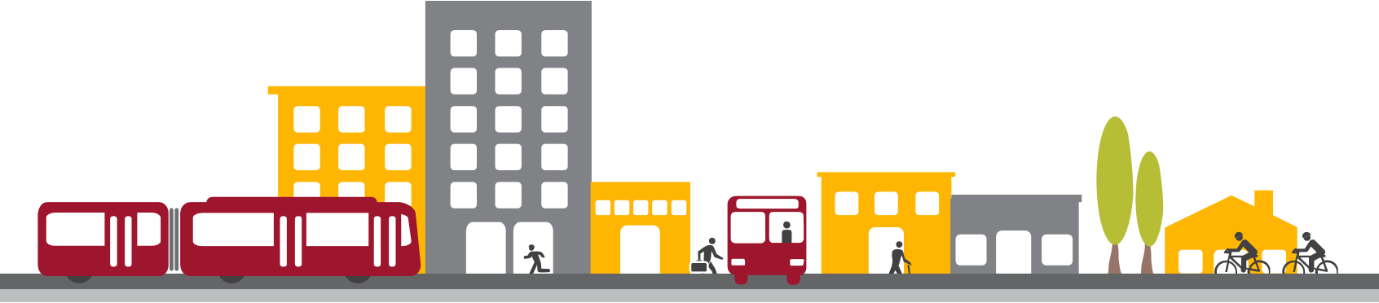

We’ve been working with people in Delridge who
Ride the bus
Walk
Bike, and
Drive
for a couple of years on how to better get them where they need to go.
2

Slide 3
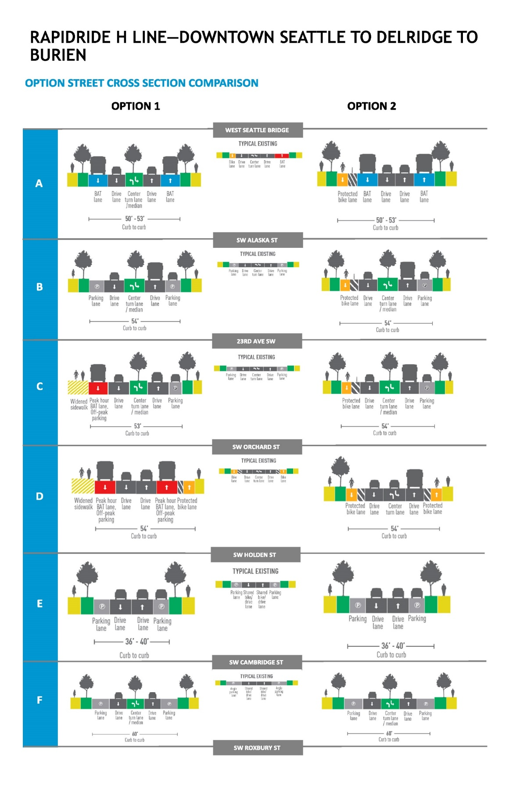
In March 2017, we unveiled 2 options for upgrading Metro Route 120 into RapidRide H and to make better connections for people walking and biking.
These options offered different ways to organize Delridge Way SW.
3

Slide 4
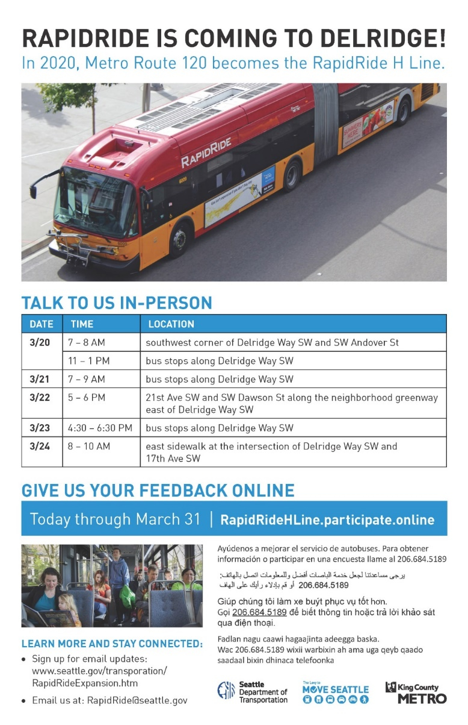
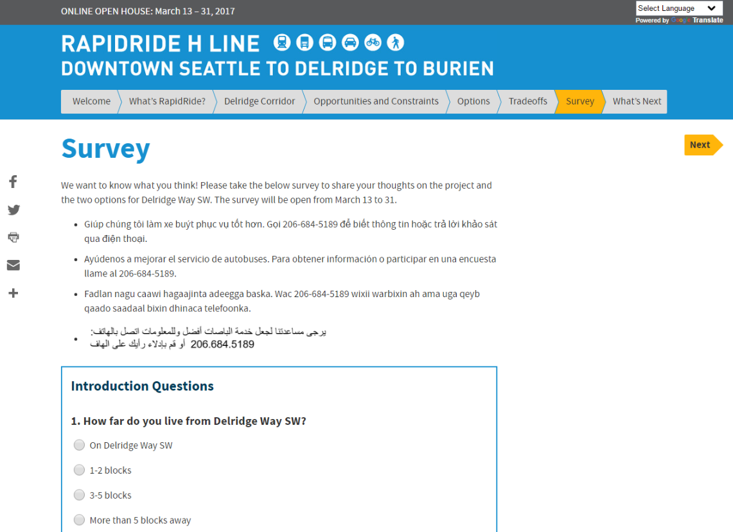
We asked people to use their voice and share what they thought.
We did this through:
Mailers, posters
Online open house
Online survey
In-person events
Community briefings
Media coverage
Bus announcements

Slide 5
We received a lot of feedback about how the street could move more people and goods:
13,430 postcards were mailed
961 individuals visited the online open house
482 individuals took the online survey
150 people talked to us about biking and riding buses on the corridor
Over 40 businesses were provided information
8 presentations were giving to community groups and advisory boards

Slide 6
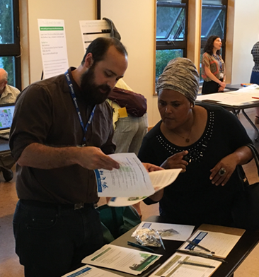
Who took the survey?
Majority lived within five blocks of Delridge Way SW (63%)
Slight majority had not engaged in prior outreach on the project (58%)
Majority were age 25-44 (64%), only 4% were 65 or older
Majority identified as White or Caucasian (68%)

Slide 7
What we heard
Consider the community’s vision of incorporating boulevard treatments along Delridge Ave SW
Strong support for prioritizing buses on Delridge Way SW
Keep and improve bus access for the most vulnerable people in the community
Metro Route 120 is an important neighborhood connector in addition to getting people downtown for work

Slide 8


What we heard:
Should there be a protected bike lane on Delridge Way SW?
54%*
Bike lanes should be ON Delridge
*Survey respondents
45%*
Bike lanes should be OFF Delridge
*Survey respondents
Face to face and survey respondents
Need to better connect neighborhood greenways to Delridge Way SW
If adding a bike lane to Delridge Way SW it should span the length, especially where neighborhood greenways are not a good option due to steep grades

Slide 9
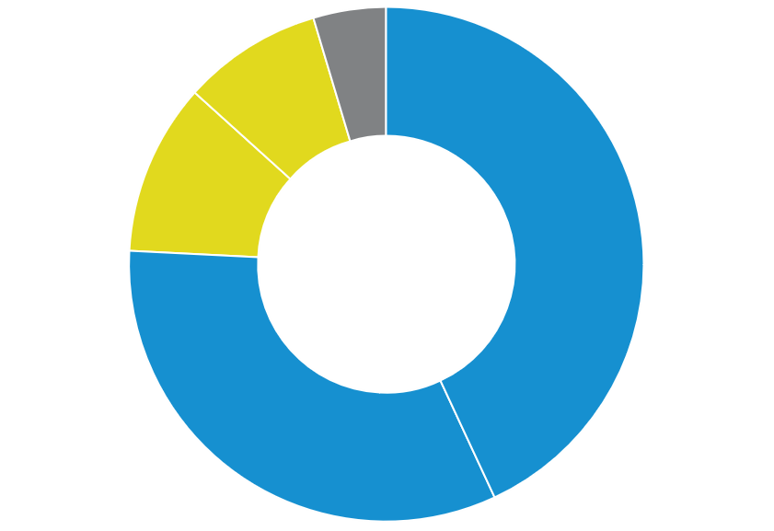
What we heard: Bus stop changes
4%
Neither
9%
Somewhat disagree
Are you okay with moving or removing some bus stops to make buses faster and arrive on time?
11%
Strongly disagree
Based on online survey results
43%
Strongly Agree
33%
Somewhat
Agree

Slide 10
What we heard: Bus stop changes
Even with 76% of online survey respondents okay with changing bus stops to make buses fast and on-time…
Concern about impacts to seniors and people with disabilities; increased walking distances combined with steep grades; and maintaining access to neighborhood destinations

Slide 11
What we heard: Street paving
Survey takers and others raised the importance of repaving Delridge Way SW.
…the current road conditions, especially the center lane, need repaving for safety and durability. Please make a priority.
The number of potholes and poor road conditions on Delridge need to be addressed

Slide 12
So what did we do with your feedback?

Slide 13
We took a hard look at what the community was most interested in…
Bus stops | 9 bus stops moved, consolidated or removed Stops go from an average of 0.2 to 0.3 miles apart Could add up to 2-min to walk times* Typical RapidRide stop distance about 0.5 miles Balances desire for fast and on-time bus service with concerns about increased walking distances
Street paving | We want to pave as much of Delridge Way SW as possible and are working on options
Partnership opportunities | Partnering with King County Metro and Department of Neighborhoods to work with Westwood-Roxhill-South Delridge community members on travel needs near transit center
* Actual time depends on rider’s origin, grades and walking ability

Slide 14
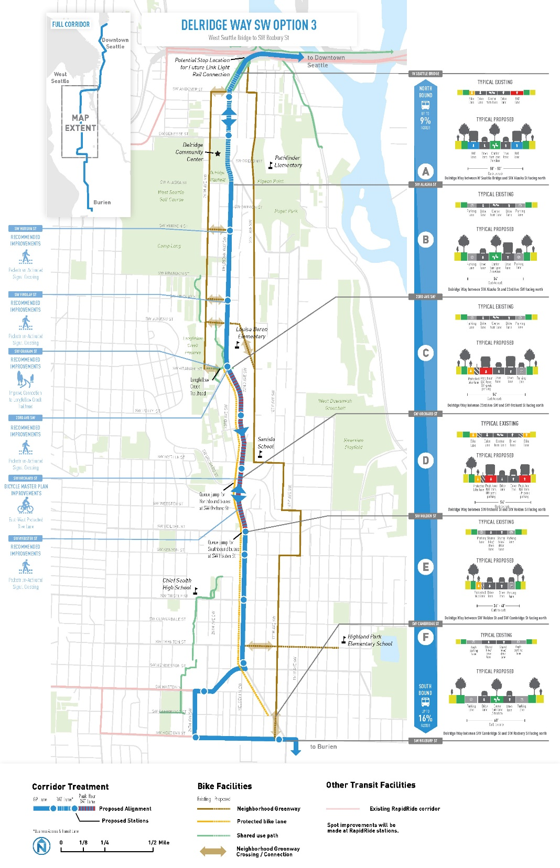
And came up with a new option that:
Adds all-day and peak-period bus-only lanes
Improves pedestrian crossings
Adds new neighborhood greenway connections and a southbound protected bike lane south of SW Graham St
Adds a new landscaped median
Keeps bus stops about 1/3 mile from each other
Supports the community’s vision of incorporating boulevard treatments
14

Slide 15
Key improvements*
 | Option 1 | Option 2 | New Option
New greenway connections | 6 | 6 | 7
Improved pedestrian crossings | 4 | 4 | 4
New ADA ramps | 17 | 17 | 17
Bus only lanes | 1.4 miles (all day) + 1.2 miles (peak hours only) | 1.4 miles (all day) | 1.4 miles (all day) + 1.2 miles (peak hours only)
Protected bike lane | 0.3 miles | 2.9 miles | 2.1 miles
Widened sidewalk Ranges from 8 – 12 feet | 0.9 miles | 0.0 miles | 0.0 miles
Landscaped median | 2.5 miles | 1.8 miles | 1.9 miles
*Numbers are based on concept design and are subject to change

Slide 16
Outcomes*
 | Option 1 | Option 2 | New Option
Bus travel time Range for north and southbound | Up to 9 – 16% faster | Up to 8 – 12% faster | Up to 9 – 16% faster
Traffic travel time Range for north and southbound | Up to 1 – 8% faster | Up to 5 – 10% slower | TBD
On-street parking | Some all-day parking converted to off-peak parking and new off-peak parking added | Up to 73% of parking retained as a mix of all-day and off-peak | Up to 71% of parking retained as a mix of all-day and off-peak
Loading zones | No loading zones removed | Small number of loading zones relocated | No loading zones removed
Street trees For any street tree removed, two trees are planted within the neighborhood | Up to 80% of street trees retained | Up to 100% of street trees retained | Up to 100% of street trees retained
*Numbers are based on concepts and are subject to change
Notes:
Option 1: Convert all-day parking to off-peak parking on the west side of Delridge from 23rd to SW Orchard St and add new off-peak parking from SW Orchard St to SW Holden St
Option 2: Up to 73% of parking retained as a mix of all-day and off-peak, removes parking on west side between SW Alaska St and SW Orchard St
Option 3: Up to 71% of parking retained as a mix of all-day and off-peak, removes parking on west side between 23rd Ave SW and SW Orchard, SW Holden St and SW Cambridge St

Slide 17
So now what?
We’re gathering input on the new option and bus station spacing
Focusing efforts on historically underserved populations and seniors
Coordinating with Metro to identify transportation needs near Westwood Village
Incorporating findings from Metro corridor-wide outreach
Refining the funding strategy and paving plan
Working with the community on project artwork

Slide 18





Stay involved!
rapidride@seattle.gov | 206-684-5189
www.seattle.gov/transportation/rapidrideexpansion.htm
www.seattle.gov/transportation

