Slide 1
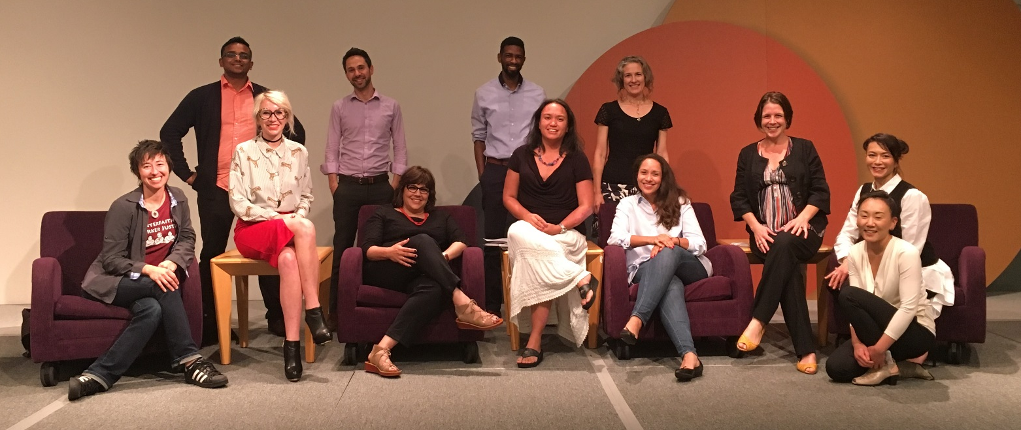

History and progress In the Making
OLS Presentation
01/18/18
City of Seattle
Office of Labor Standards

Slide 2

Advancing Workplace Equity
Community  Business  Race & Social Justice
Our mission is to advance labor standards through thoughtful community and business engagement, strategic enforcement and innovative policy development, with a commitment to race and social justice.

Slide 3
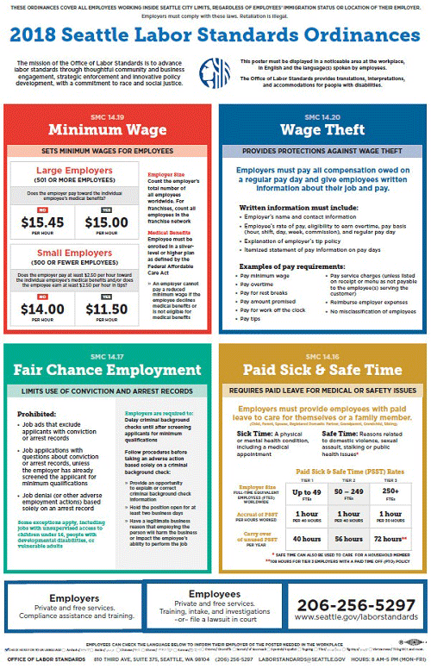
Labor Standards Enforcement
Minimum Wage Ordinance
Wage Theft Ordinance
Paid Sick and Safe Time Ordinance
Fair Chance Employment Ordinance
Secure Scheduling Ordinance
Hotel Employees Health and Safety
Initiative Ordinance

Slide 4

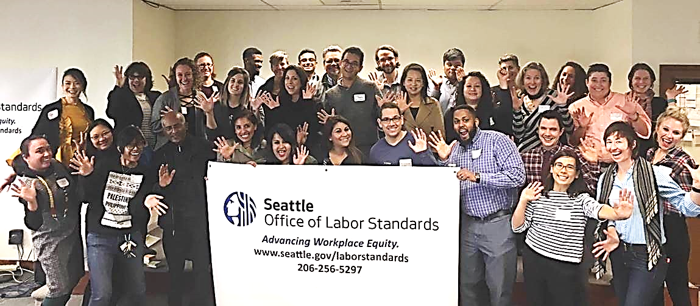
Community & Business Organizations Outreach and Education Partners

Slide 5

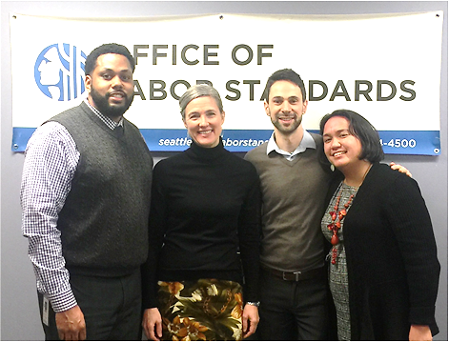
OLS Personalized Assistance
206-256-5297
Ask us!
Business.laborstandards@seattle.gov
Darius Foster, Business Liaison
Kerem Levitas, Business Liaison
Jenee Jahn, Policy Analyst
Karina Bull, Policy Manager
Workers.laborstandards@seattle.gov
Claudia Alexandra Paras, Community Liaison

Slide 6
OLS HISTORY
2012 | First Labor Standard in Seattle Paid Sick and Safe Time Ordinance goes into effect
2013 | Fair Chance Employment Ordinance
2014 | Mayor convened Income Inequality Advisory Committee to craft minimum wage policies
 | Mayor and City Council convened Labor Standards Advisory Group to address wage theft and to suggest ways to strengthen labor standards implementation
 | City Council passed legislation creating Office of Labor Standards as a new division within the Seattle Office for Civil Rights
April 1, 2015 | OLS is established as a new division within OCR Minimum Wage and Wage Theft Ordinances go into effect
2016 | Wage Theft Prevention and Labor Standards Harmonization Ordinance goes into effect
 | Hotel Employees Health and Safety Initiative passed
2017 | OLS is an independent office!! Secure Scheduling Ordinance

Slide 7
2015 Highlights
April: OLS established as separate division within OCR
April: Minimum Wage Ordinance goes into effect
April: Wage Theft Ordinance goes into effect
June: OLS’s first Director begins
July & September: OLS issued RFP for first $1 million (1 year) and announces recipients of Community Outreach and Education Fund
July – December: OLS undertakes intensive stakeholder engagement process culminating in City Council passing Wage Theft Prevention and Harmonization Ordinance in December
Expanded remedies and protections for workers
Treble damages
Tiered penalty structure
Retaliation Protections
Confidentiality Protections

Slide 8
2016 Highlights
January: Wage Theft Prevention and Labor Standards Harmonization Ordinance goes into effect
March – September: OLS, Executive, and City Council engage in 6 month collaborative stakeholder process to develop Secure Scheduling legislation, which City Council passes in September, making Seattle the second major City to have such legislation
September: OLS announces recipients of first $475k Business Outreach and Education Fund
November: Voters pass legislation for Hotel Employees Health and Safety Initiative

Slide 9
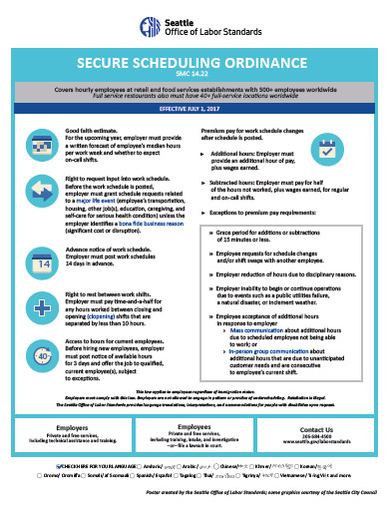
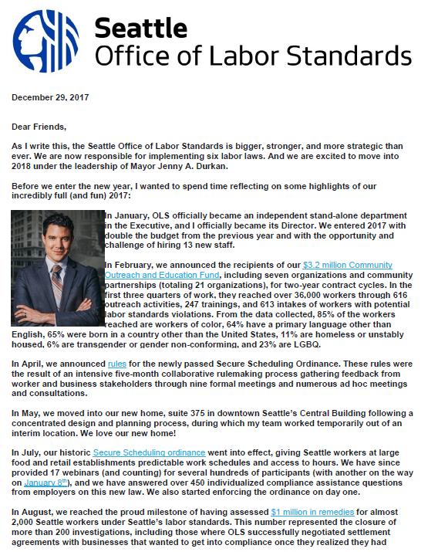
2017 HIghlights

Slide 10
2017 Highlights
January: OLS became a stand-alone Department in the Executive
February: OLS announced recipients of our 2-year $3.2 million Community Outreach and Education Fund, including 7 organizations and community partnerships (21 orgs total)
In the first three quarters of work:
Partners reached over 36,000 workers through 616 outreach activities, 247 trainings, and 613 intakes of workers with potential labor standards violations.
85% of the workers reached were workers of color, 64% had a primary language other than English, 65% were born in a country other than the United States, 11% were homeless or unstably housed, 6% were transgender or gender non-conforming, and 23% were LGBQ.

Slide 11
2017 Highlights
April: OLS announced rules for the newly passed Secure Scheduling Ordinance following a five-month collaborative rule-making process with worker and business stakeholders
May: OLS moved into our new home in Suite 375 in the Central Building following a concentrated design and planning process.
July: Seattle’s historic Secure Scheduling ordinance went into effect, giving Seattle workers at large food and retail establishments predictable work schedules and access to hours.
OLS has provided 18 webinars to date, and answered over 400 compliance assistance questions from employers. We started enforcing on day one.
August: OLS reached the milestone of having assessed $1 million in remedies for almost 2,000 Seattle workers via 200 closed investigations

Slide 12
2017 Highlights
September: OLS issued final new rules for the Minimum Wage Ordinance. Included ending the authorization for special certificates for individuals with disabilities in the City of Seattle, which had allowed for individuals with disabilities to be paid less than the minimum wage.
October: OLS announced a request for proposals for a two-year $1.4 million Business Outreach and Education Fund.
October: OLS announced revisions to Chapter 140 rules that govern our enforcement process, which included a new employee appeal process and faster response times.
We also implemented new enforcement priorities and procedures to address our increase in caseloads, enable us to be more strategic, and make the process more clear to provide better outcomes for both Seattle workers
November: OLS announced our Directed Investigation Program, whereby we can launch strategic investigations without receiving a complaint.

Slide 13
2017 Highlights
November: OLS also announced the proposed 2017 Labor Standards ordinance amending the Paid Sick and Safe Time ordinance to incorporate the more generous provisions of voter-passed, Washington Initiative 1433 establishing statewide paid sick leave.
PSST amendments voted on by City Council and signed by Mayor Durkan in December and went into effect on January 14, 2018.
OLS developed a new case management system
We also created several new outreach materials, including:
Our Commitment to Immigrants and Refugees
Employer Guide to Labor Standards Investigations
Employer Guide to Recordkeeping
How OLS Analyzes Worker Classification
2018 Workplace Poster

Slide 14
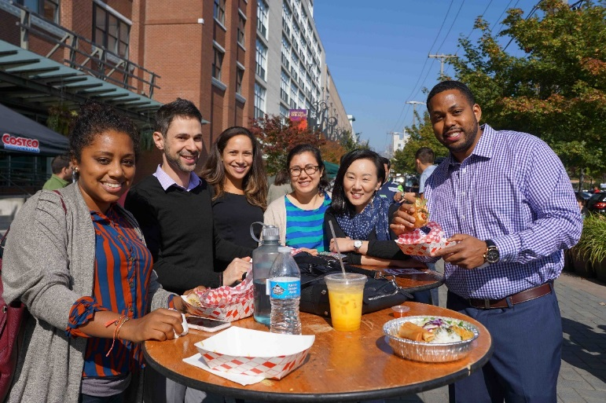
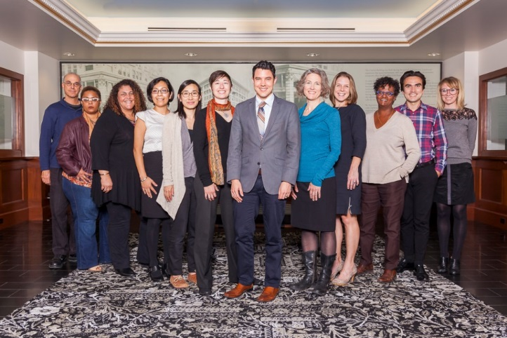
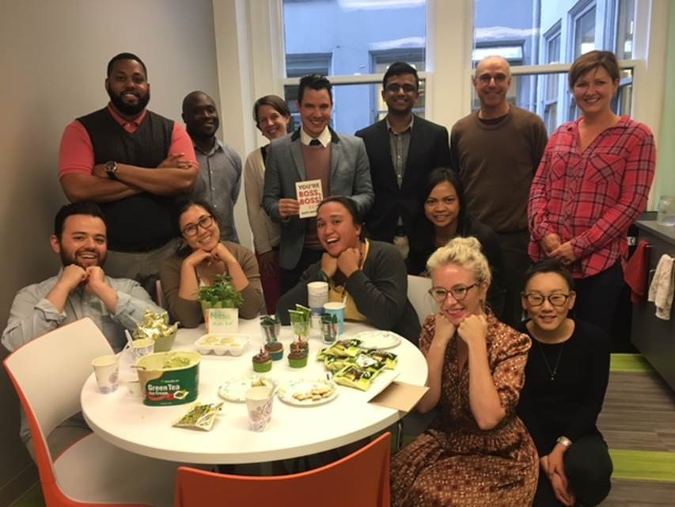
OLS Staff

Slide 15
OLS StaFF HISTORY
2017 – Independent Office
Grew from 10 to 23 FTEs (12 new staff hired in 2017)
Director; Policy Manager; Finance & HR Manager; Communications Manager; 2 Business Liaisons; Community Liaison; Investigator Supervisor; Strategic Enforcement Manager; Executive Assistant; Admin Assistant/Receptionist; Paralegal; 10 Investigators
4 staff using city’s paid parental leave
2016
10 FTEs (shared others with OCR)
Director; Senior Policy Analyst; Business Liaison; Community Liaison; Investigator Supervisor; Paralegal; 4 Investigators
2015 – New Division in OCR
7 FTES (shared others with OCR)
Director; Senior Policy Analyst; Business Liaison; Community Liaison; 4 Investigators

Slide 16
Performance Data All Ordinances - Assistance
Employer Compliance Assistance
December – 211
2017 – 1,326
Since Implementation – 7,078
Employee Inquiries
December – 99
2017 – 1,023
Since Implementation – 3,196

Slide 17
Performance data – all ordinances
Investigations Opened
2017 – 95
Since Implementation – 576
Investigations Closed
2017 – 116
Since Implementation – 413
Average # of Days to Close
December – 377
2017 – 336
Since Implementation – 210
**OLS conducts company-wide investigations

Slide 18
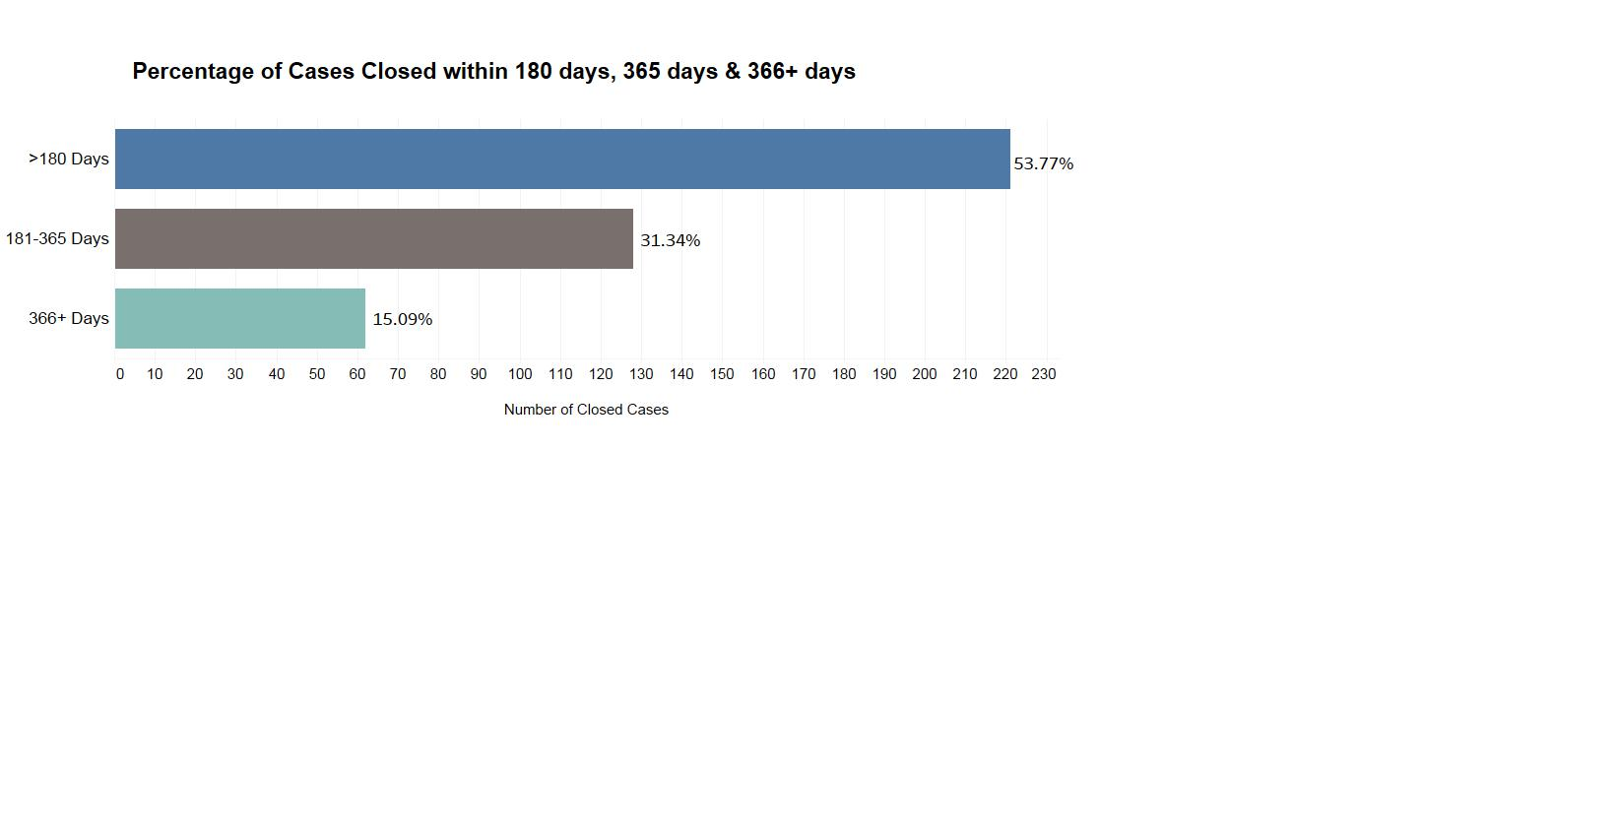
Performance data – all ordinances

Slide 19
Performance Data – all ordinances
Monetary Remedies
2017 - $504,905
Since Implementation – $1,298,805
# of Workers Receiving Remedies
2017 – 1,539 workers
Since Implementation – 2,562 workers

Slide 20
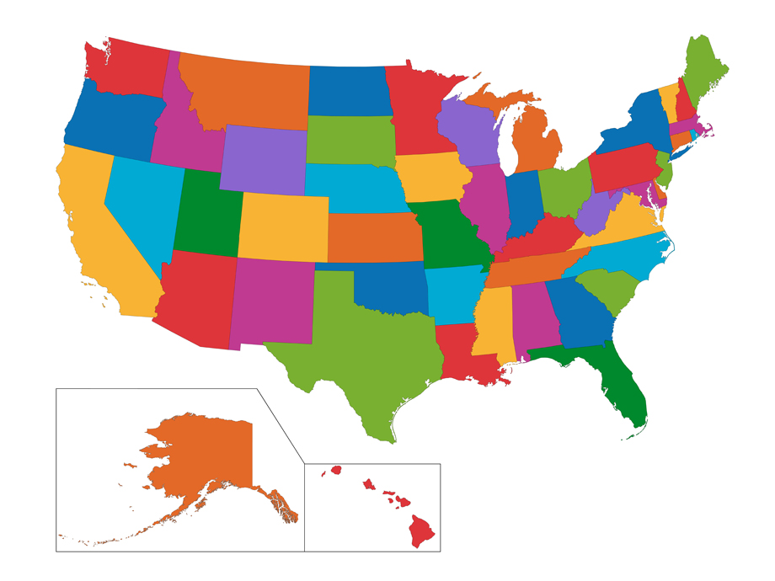
seattle
Agency - Office of Labor Standards
2018 Budget – $5,698,216 (- $2.3 million for outreach contracts = $3,398,216)
Staff – 23 employees
Director
Policy Manager
Communications Manager
HR/Finance Manager
Enforcement Manager
Enforcement Supervisor
10 Investigators
Policy Analyst
2 Business Liaisons
Community Liaison
Paralegal
2 Admin. Professionals

Slide 21
SAN FrANCIsco
Agency - Office of Labor Standards Enforcement
Budget - $5,563,136 ( - $835,000 for outreach contracts and $550,000 for payroll and compliance tracking functions = $4,178,136
Staff – 25 employees
Director
Deputy Director
Administrative Professional
2 Analysts
20 Investigators (15 – labor standards; 5 – prevailing wage)
Investigations – SF’s Minimum Wage ordinance has 365 day target for
closure – 86% of cases closed within 365 days in FY 2017

Slide 22
Labor standards implementation at local level
Reduction of funding at federal level
DOL’s removing of administrative guidance
Increased vulnerability of vulnerable communities
Seattle as Model – Laws, Enforcement, Business Support, Community Support
Technical assistance to over 30 jurisdictions
Visits from/to other jurisdictions
Participation in national policy conversations (e.g. Center for Law and Social Policy)

Slide 23
206-256-5297
2018
Onward
and
Upward!
seattle.gov/laborstandards laborstandards@seattle.gov

