Slide 1
2015 Operating Board Update:
Implementing Year 3 of the 2013-2018
Saving Water Partnership
Conservation Program
  Presented by
  Deborah Rannfeldt, Woodinville Water District
  Chair of the Conservation Technical Forum

Slide 2
Presentation Focus
Normal Presentation: Summary of recent conservation program activities
This Year’s Presentation:
  How the conservation program supported drought response
  Some key highlights of regular program

Slide 3
How the Conservation Program Supported Drought Response
Staff: Knowledgeable staff available to coordinate and support regional response
Relationships: Existing relationships helped us quickly & effectively develop & conduct outreach
Website: Existing conservation website leveraged for regional drought response (key resource for customers & media)
Programs: Provided opportunities for customers to reduce their water use (as requested by utilities)

Slide 4
Outreach Strategy
Overall Purpose:
  Make sure everyone is aware of the "drought message":
    Experiencing a drought
    Asking for 10% water use reduction (for the Voluntary Stage)
    Have suggestions on how to save water
Outreach Goals:
  Build Awareness
  Create Community Presence
  Target Messaging

Slide 5
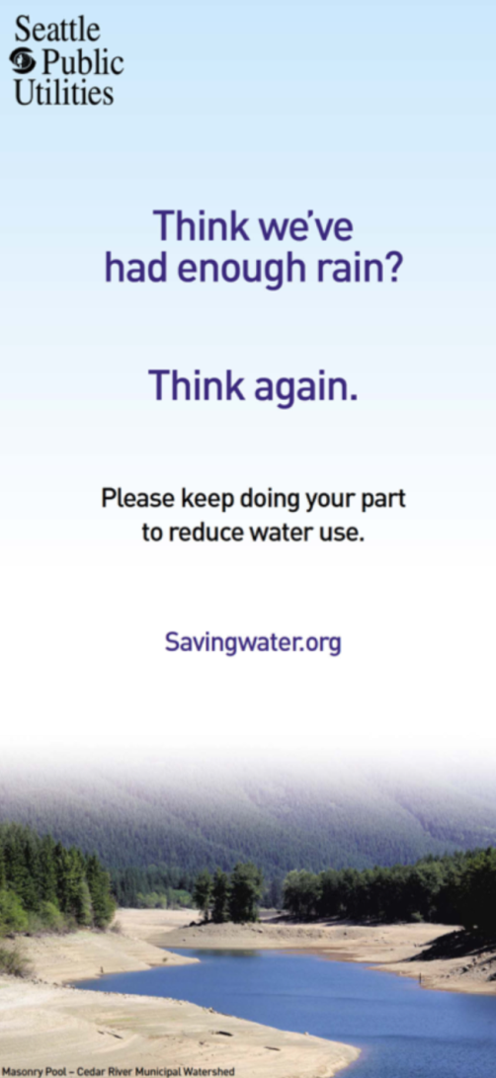
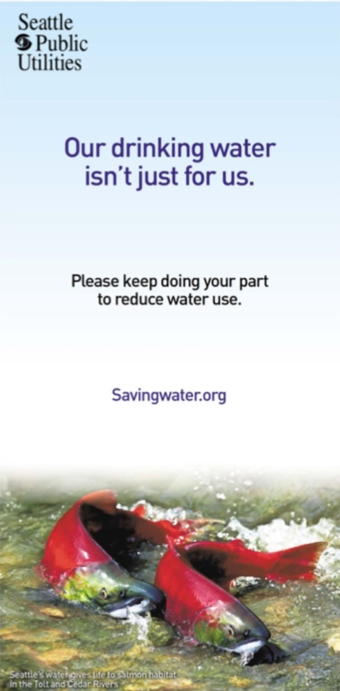
General Awareness
Traditional media ads and PSAs (TV, radio, print) including ethnic media
Press releases (updating on progress compared to 10% goal)
Social media (twitter, facebook, SPU blog)
Web presence (homepages of SavingWater.org, Seattle, SPU, SWP members)
Utility publications (bill inserts, newsletters, etc)

Slide 6
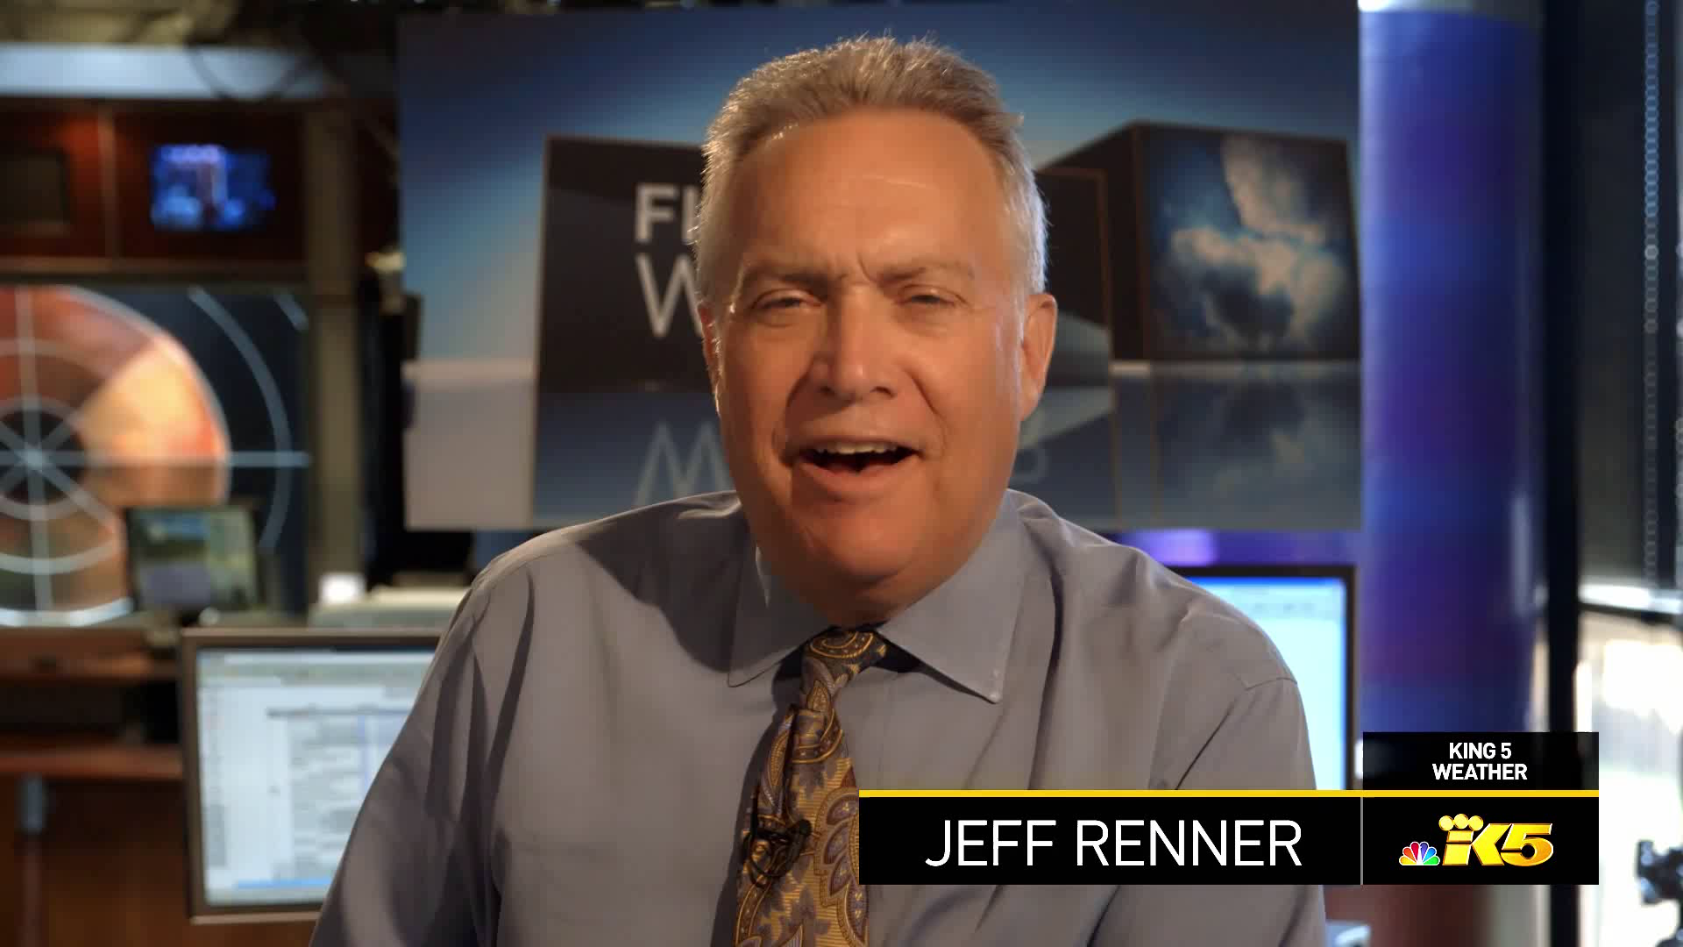
General Awareness
The region readily agreed on drought tips and promoted them through our relationships with credible spokespeople – TV Weather Forecasters

Slide 7
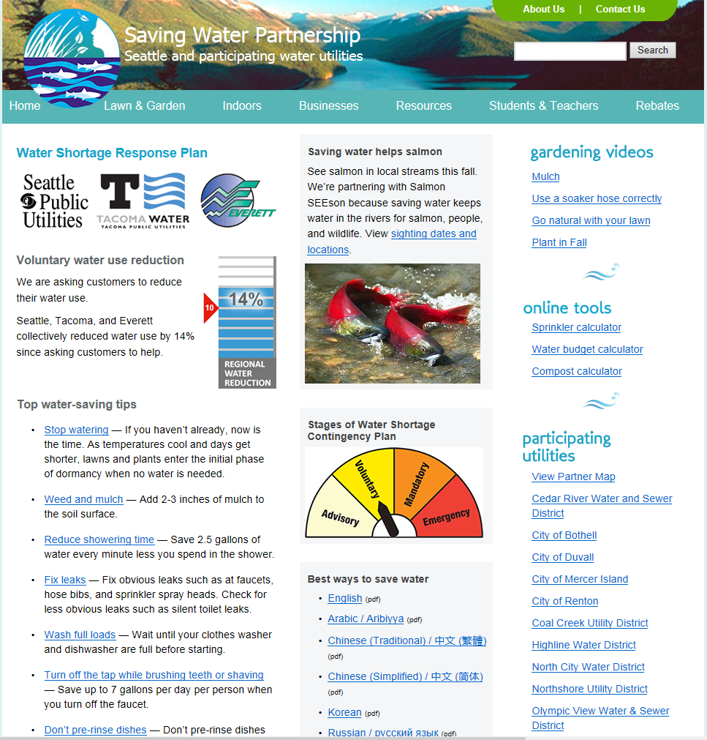
SWP Website: THE #1 Drought Resource

Slide 8
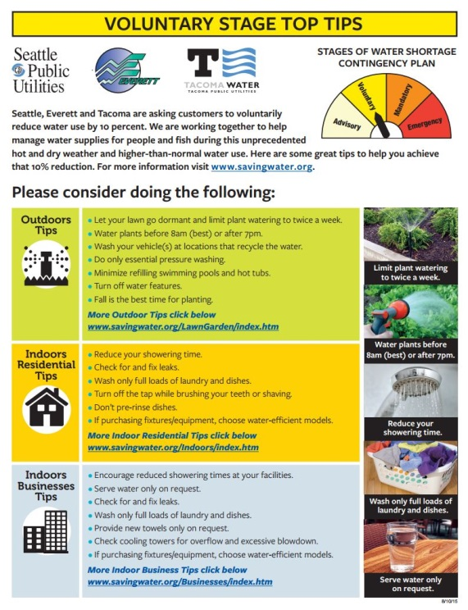
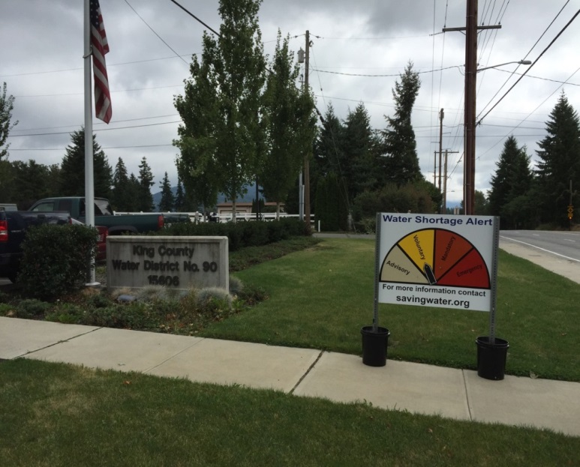
Create Community Presence
Tips Flyers & Signage:
Wholesale customers
Seattle
  Community Centers
  Libraries
  Neighborhood Centers
  Signs in Seattle City Hall
  Seattle Municipal Tower
  Community Events

Slide 9
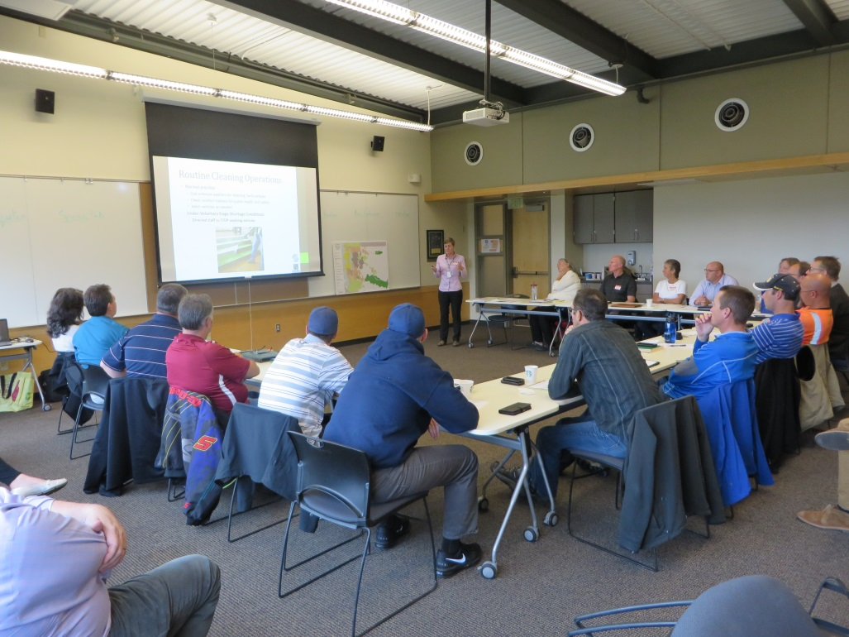
Target Messaging
Large users
Irrigation community
Non-English speakers
Business community
Environmental community
Water Shortage Advisory Group
Existing relationships helped us quickly & effectively do this target messaging

Slide 10

Target Messaging

Slide 11
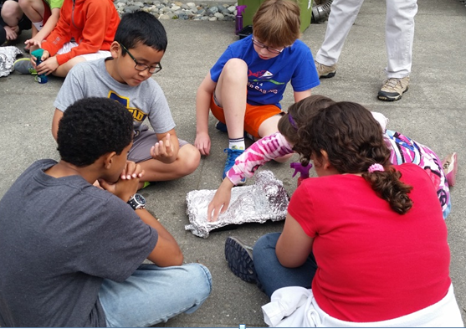
Youth Education
  Program of in-classroom presentations has graduated from pilot to full-scale
  2014-15 school year more than doubled presentations
  375 presentations; 9,600 students
  80 schools; ALL SWP members
  Some SWP members have contracts w/ Nature Vision to serve more schools in their districts

Slide 12
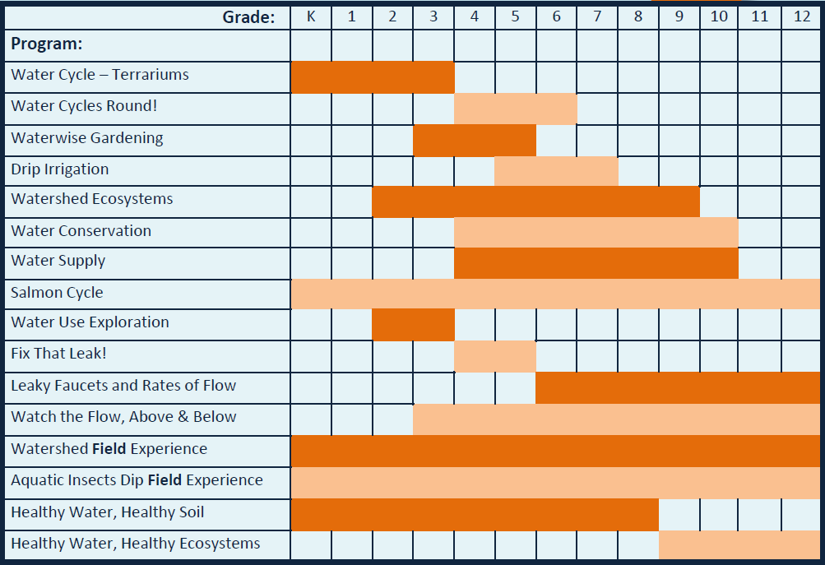
In-Classroom Presentations

Slide 13
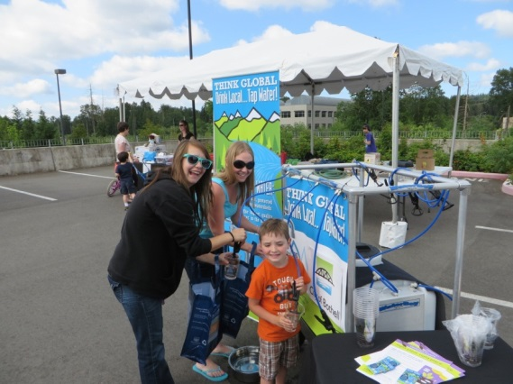
Community Education
  2015 Supported and staffed 14 community festivals.
  Added the Water Refilling Station to 9 events
  Inspired by Woodinville and North City WD efforts in 2013
  Allows festival goers to refill their water bottles with tap water
  Tap Water Msg: It’s high quality, a great value, and worth conserving
  Great response from customers!
  “Our events have been very successful this year but having the WaterBoy available to us has made them even more amazingly successful! Everyone loves the WaterBoy! Especially with the hot weather we’ve experienced.”
  - Deb Gill, WD 90

Slide 14
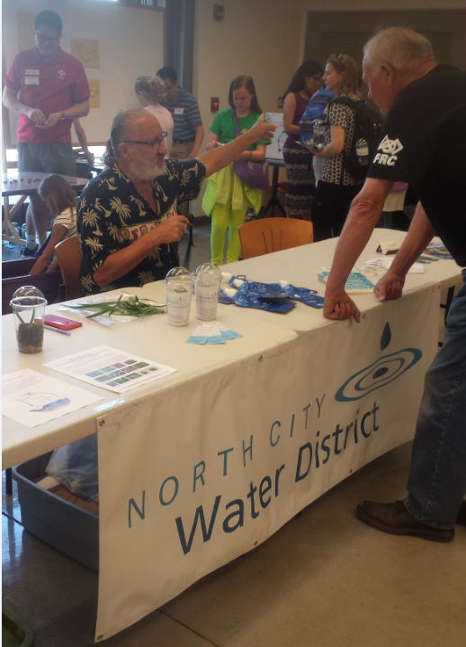
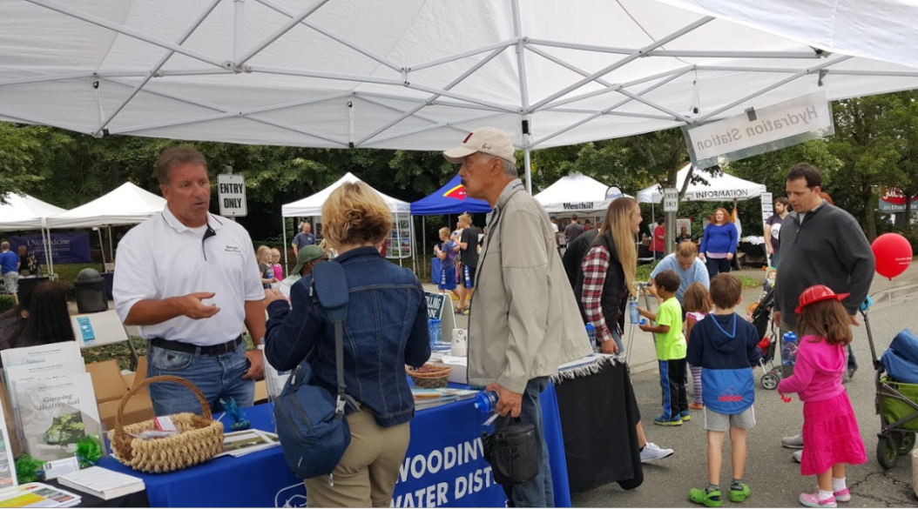
2015 Community Festivals
  Sustainamania Event – City of Bothell
  Earth Day Event - City of Duvall
  Boeing Earth Day and Commuter Fair - City of Renton
  Shoreline STEM Festival – North City WD

Slide 15
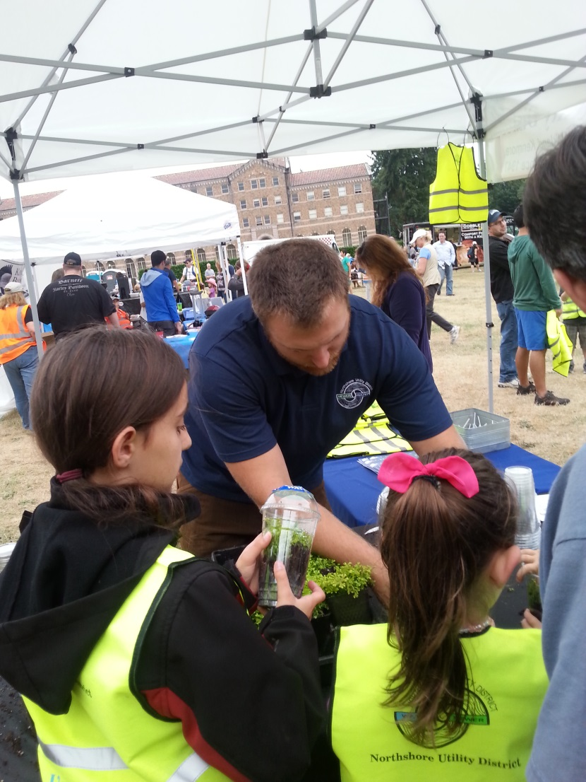
2015 Community Festivals (cont.)
  Kirkland SummerFest – Northshore UD
  Party for the Planet, U District Street Fair, International District Dragon Street Fair & Seattle Parkway – SPU
  Ida Naila National Night Out Block Watch, Maple Hills Expo National Night Out, Maplewood Estates Neighborhood Event, Maple Ridge Estates – WD 90
  Celebrate Woodinville – Woodinville WD

Slide 16


Co-Branding
Co-Branding wholesale customer name with SWP logo
  Developed co-branding options in 2014
  Implemented in print and direct mail pieces
  Served us well in producing drought fliers

Slide 17
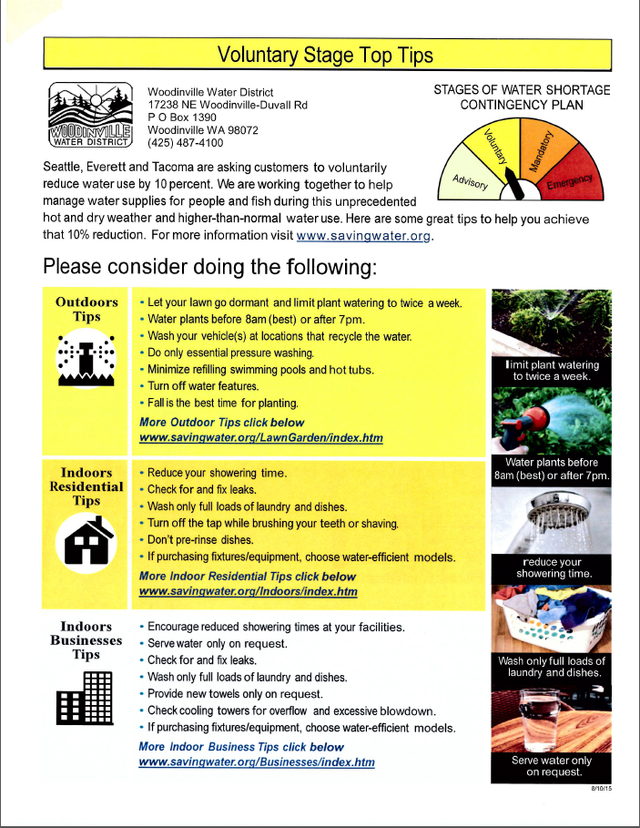
Co-Branding During Drought

Slide 18
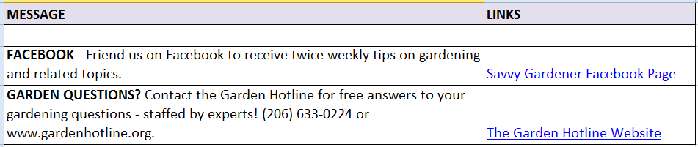
Customer Messages & Research
  Seasonal Message Repository:
  Ready-to-go newsletter articles, bill messages, Facebook posts, etc
  Members can use them in their utility-specific communications
  Arranged by season
  Available on Operating Board website
  Customer Research:
  1st Annual survey received 180 responses
  94% of respondents agree or strongly agree that using water wisely is important

Slide 19

Salmon Messaging
Partnering with King County / WRIA 8 “Salmon SEEson” campaign for 3rd year
Encourages people to go see salmon spawning in local rivers
Reminds people that saving water helps people, salmon, and wildlife
Helps fulfill resource agency & tribal agreements
This year the campaign tied us in closer because of the drought.

Slide 20
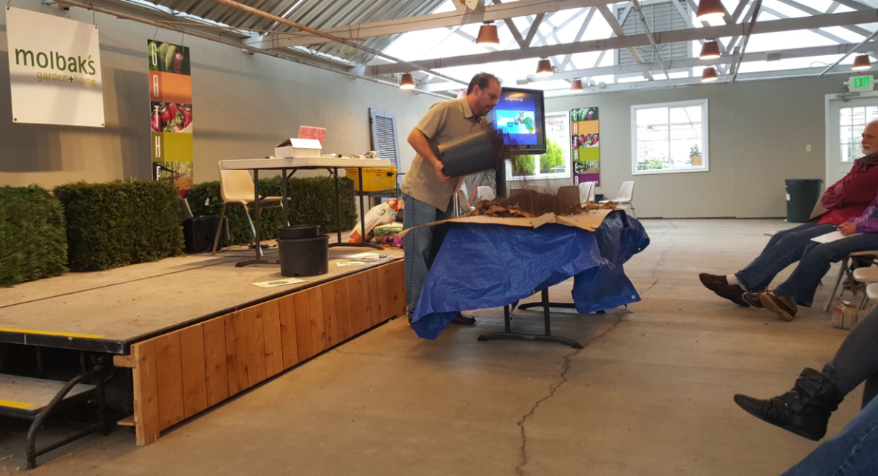
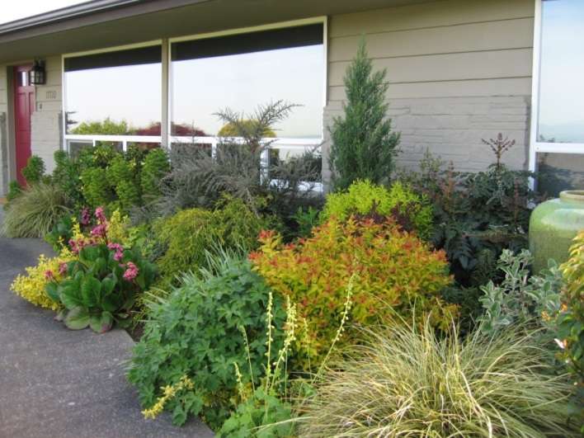
Landscape Education
Hosted 14 classes in 2014 & 14 in 2015
Staff Changes - Mark Guthrie manages landscape education and irrigation rebates
Drought messaging targeted to all customers w/ landscapes
Reached out to landscape industry and nurseries to promote drought messaging

Slide 21
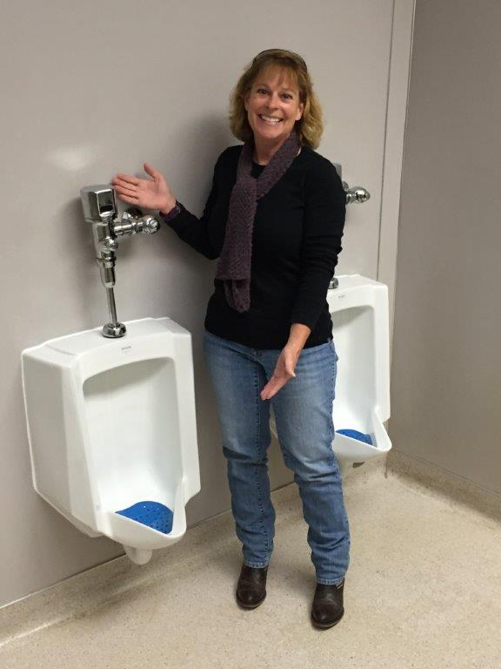
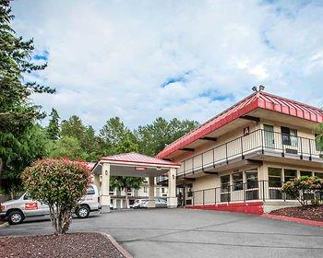
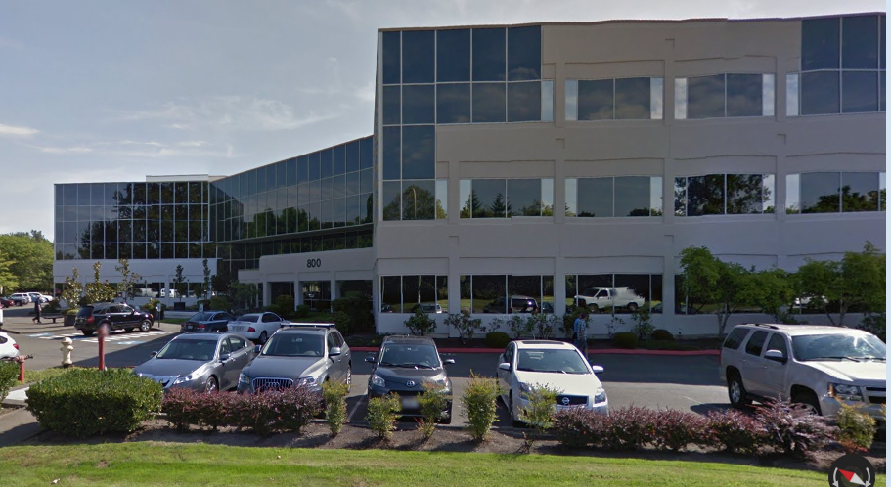
Customer Efficiency Upgrades
Available to all sectors: SF, MF, NR
Targeted outreach to commercial customers
Good response from hotels in wholesale area

Slide 22
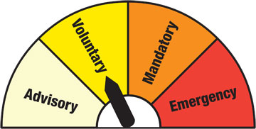
2016 Emphasis
    Scenario 1: Business as usual
      Increase number of classroom presentations
      Continue existing programs
      Etc.
    Scenario 2: Drought response
      We are preparing for this now based on lessons learned this year
      SPU staff have debriefed with the CTF and will also debrief with the Operating Board and WSAG

Slide 23
Drought Debrief with CTF
Praise for 4-stages graphic & savingwater.org
as communication tools
Tips flyer was helpful but many were already conserving since the Advisory stage
Request to receive the press release one day before it goes out
Would like better access to information shared with the Operating Board
If we continue in the Voluntary stage this fall/winter, would like continued coordination of messaging

Slide 24
Thanks and Questions
Conservation prepares the region for potential water supply challenges, helps customers use water wisely, and preserves the ethic of stewarding natural resources.

