Slide 1
2014 Operating Board Update: Implementing the 2013-2018 Saving Water Partnership Conservation Program
Presented by
Deborah Rannfeldt, Woodinville Water District
Chair of the Conservation Technical Forum

Slide 2
Presentation Outline
Purpose & focus
Reminder of role of Conservation Technical Forum (CTF) and relationship to Operating Board
Reminder of planning process
Updates on individual programs

Slide 3
Purpose & Focus
Provide an update on 2013 and 2014 YTD activities
Focus presentation on:
Areas Operating Board indicated should be emphasized
New activities
2013 SWP Annual Report provides comprehensive information

Slide 4
Conservation Technical Forum
Who’s involved – Staff from each member utility meet quarterly
Relationship to Operating Board
Operating Board sets the policy for the program (the “what”)
CTF designs the program elements (the “how”)
Established three working groups – Meet monthly or bi-monthly
Youth & Community Education
Communications
Landscape Education
Working group participants include:
Cedar River W&SD
City of Renton
North City WD
Northshore Utility District
Olympic View W&SD
Seattle Public Utilities (SPU)
Water District 119
Woodinville WD

Slide 5

Planning Process
Regional Program is key component in meeting WUE Goal
Water Use Efficiency Goal: Set through the Operating Board in 2012
Areas of Emphasis: Determined by the Operating Board
2013-2018 Strategies and Actions: Developed by the CTF
Conservation prepares the region for potential water supply challenges, helps customers use water wisely, and preserves the ethic of stewarding natural resources.
Preserving the Customer Conservation Ethic

Slide 6
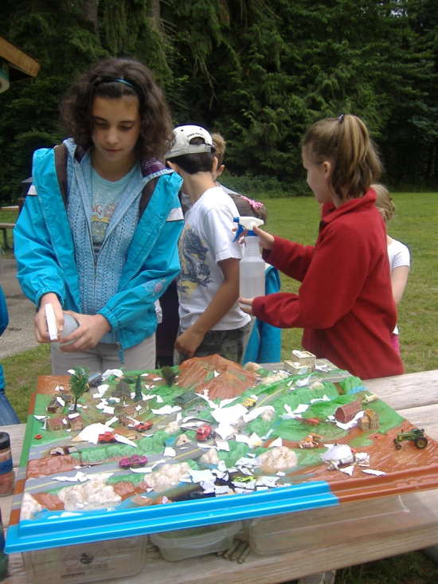
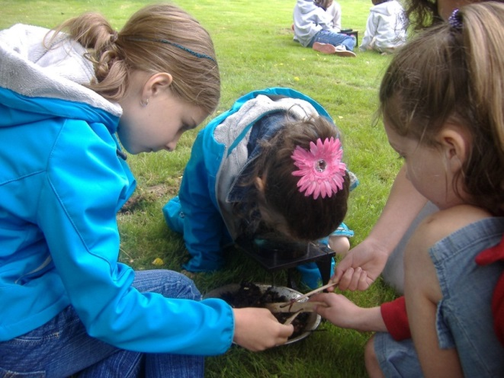
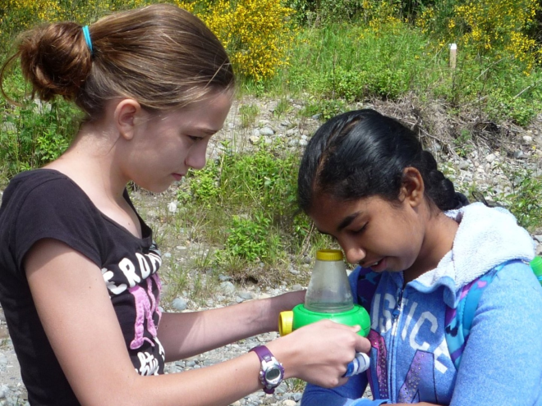
Youth Education
Launched a new program of in-classroom presentations
Hired Nature Vision; local non-profit
2013-14 pilot school year
160 presentations; 4,068 students
35 schools; 14 SWP members
2014-15 goal is to double presentations

Slide 7
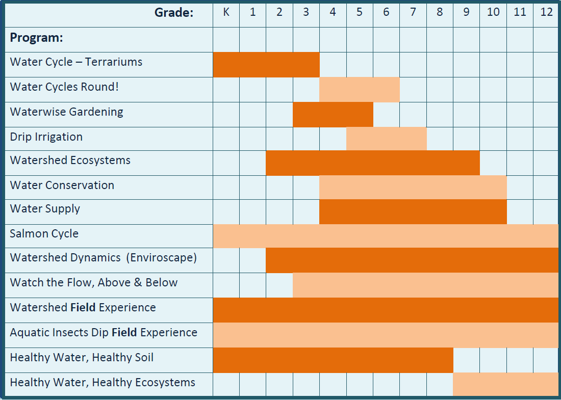
In-Classroom Presentations

Slide 8

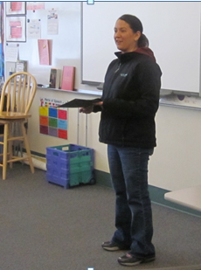
Youth Education (cont.)
Fix-A-Leak Week
Started with one-week challenge
Moving to a curriculum-based presentation

Slide 9
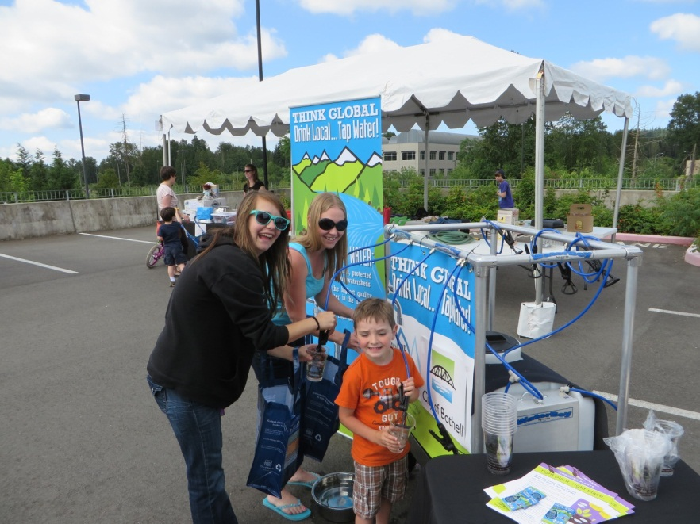
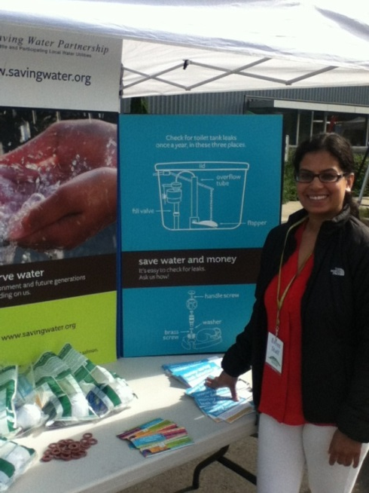
Community Education
2013 Supported and staffed community festivals
2014 Added the Water Refilling Station
Inspired by Woodinville and North City WD efforts in 2013
Allows festival goers to refill their water bottles with tap water
Tap Water Msg: It’s high quality, a great value, and worth conserving
Piloted at six festivals
Great response from customers!

Slide 10
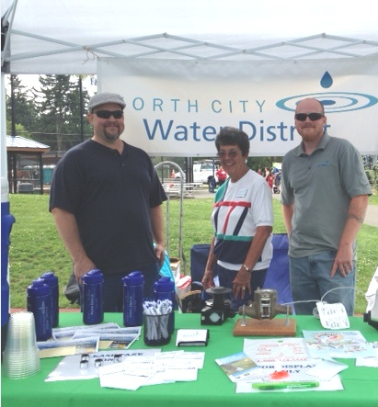
2013 Community Festivals
Sustainamania - City of Bothell
Renton River Days - City of Renton
Solar Fest at Shoreline Comm Coll - North City WD
Shoreline Science Fair – North City WD
Girl Scouts STEM Saturday – North City WD
Healthy Kids at the YMCA – North City WD
Shoreline Days – North City WD
Kenmore Music in the Park – Northshore UD
Kirkland Summerfest – Northshore UD
Central Area Festival – SPU
Pista Sa Nayon – SPU
Winter Emergency Preparedness – Woodinville WD
Celebrate Woodinville – Woodinville WD

Slide 11
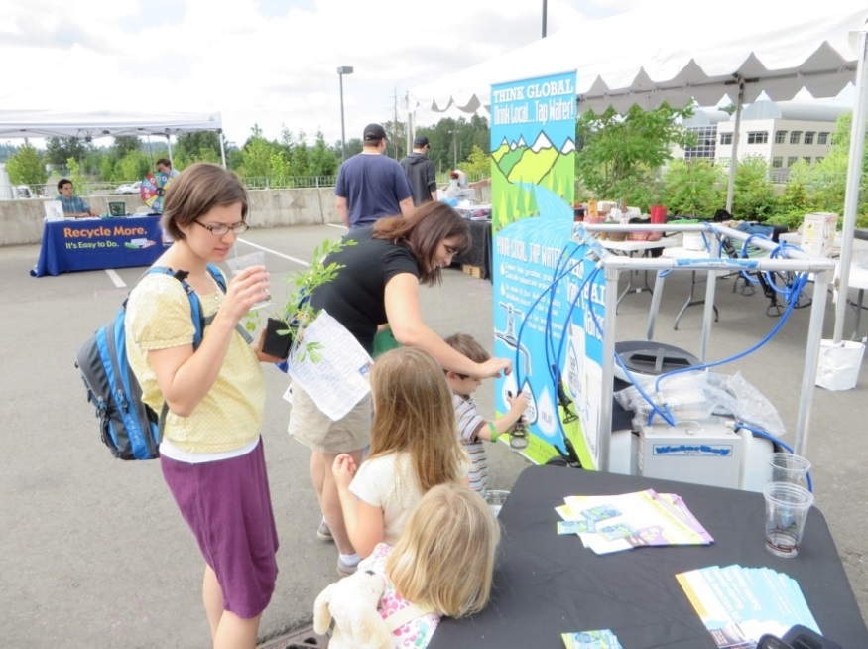
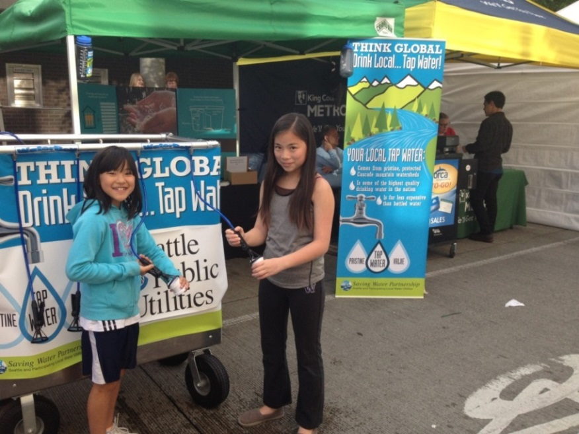
2014 Community Festivals
Sustainamania Event – City of Bothell
Earth Day Event - City of Duvall
Earth Day/Arbor Day - City of Renton
Renton River Days - City of Renton
Newcastle Days – Coal Creek UD
Shoreline Days - North City WD
Shoreline Science Fair - North City WD

Slide 12
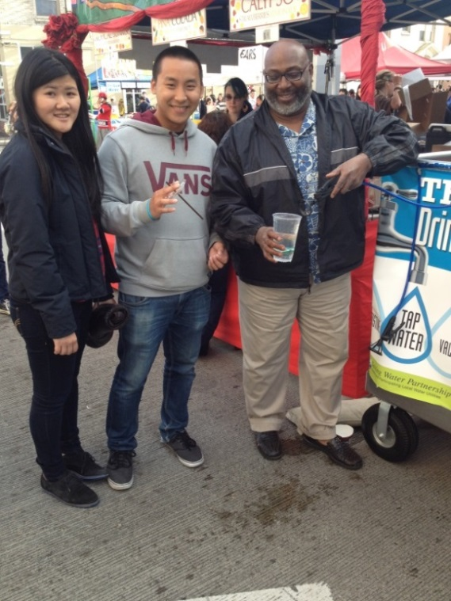
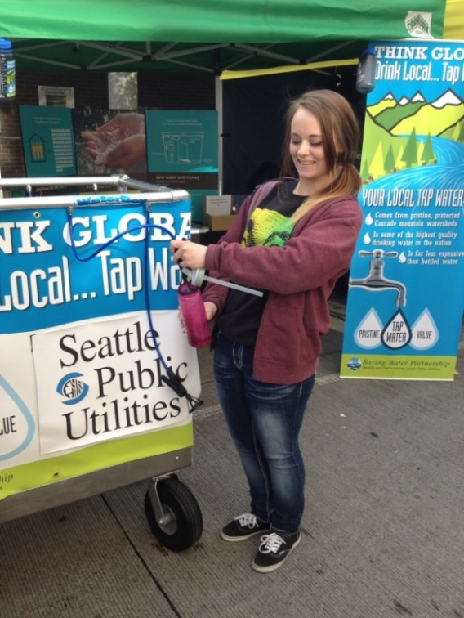
2014 Community Festivals (cont.)
Healthy Kids at the YMCA - North City WD
Kirkland SummerFest - Northshore UD
Evergreen Hospital Earth Day – Northshore UD
Green Home Tour Sustainability Stop – Northshore UD
Kenmore Music in the Park – Northshore UD
Dennyfest – Northshore UD

Slide 13
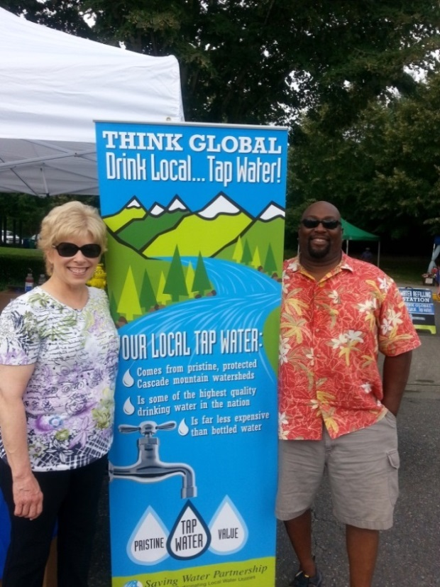
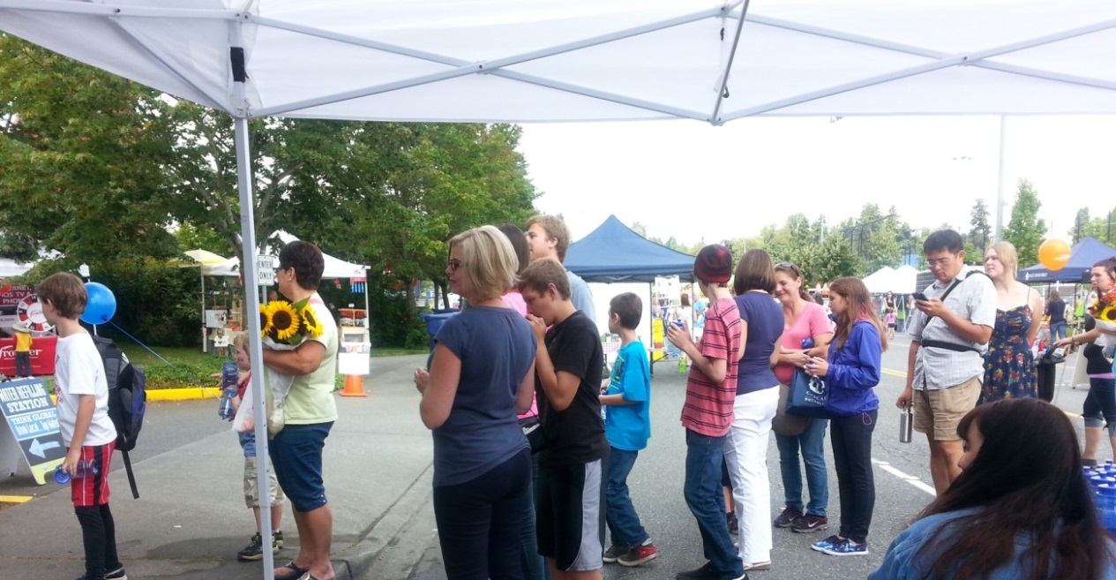
2014 Community Festivals (cont.)
Hispanic SeaFair – SPU
U District Street Fair - SPU
International District Dragon Street Fair - SPU
Duwamish River Festival – SPU
Maple Hills HOA Night Out – WD 90
Celebrate Woodinville - Woodinville WD

Slide 14

Communication w/ Customers
Language Line: Instant language interpretation available to all wholesale customers

Slide 15
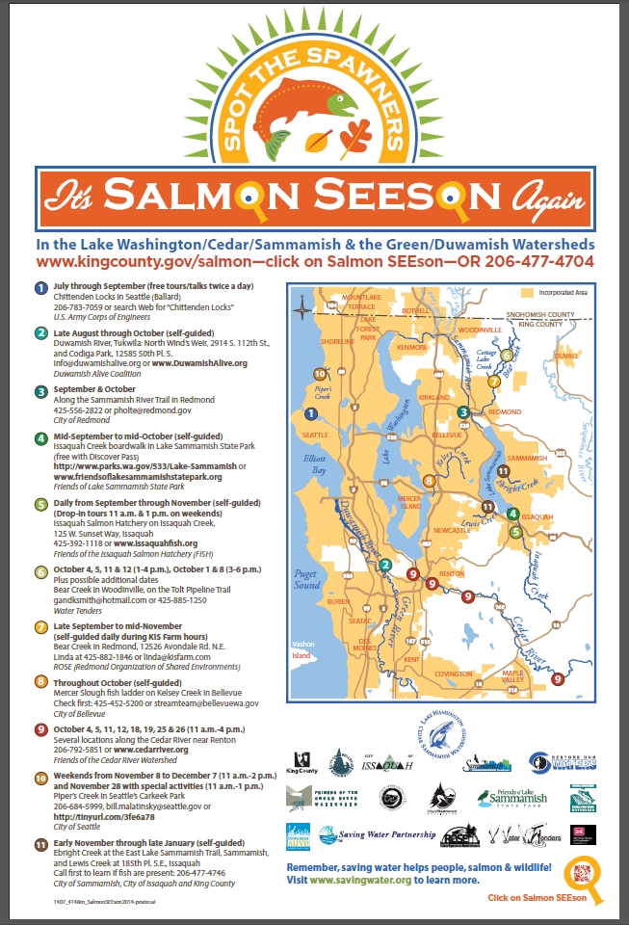
Communication w/ Customers (cont.)
Salmon Messaging:
Partnering with King County / WRIA 8 “Salmon SEEson” campaign for 2nd year
Encourages people to go see salmon spawning in local rivers
Reminds people that saving water helps people, salmon, and wildlife
Helps fulfill resource agency & tribal agreements

Slide 16
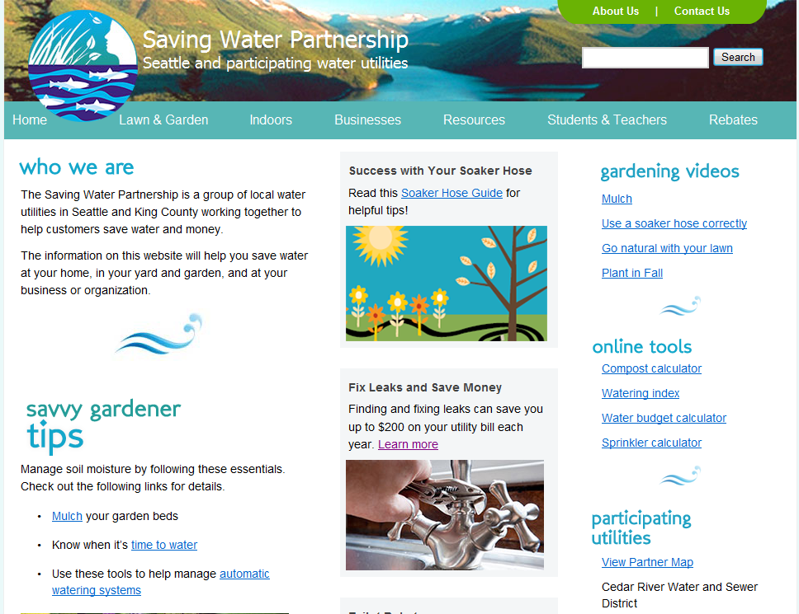
Communication w/ Customers (cont.)
Upgraded Website: Usability testing shows that the site is credible and customer-friendly

Slide 17
Communication w/ Customers (cont.)
Checking in with Customers
New Annual Survey: Planning online survey of customer attitudes – possible promotion in CCR, utility websites, etc.
King County Survey: Participating in King County Environmental Behavior Survey being fielded now
New Program Participant Surveys: Online surveys to gauge motivation for participation, satisfaction with equipment, satisfaction with program process

Slide 18
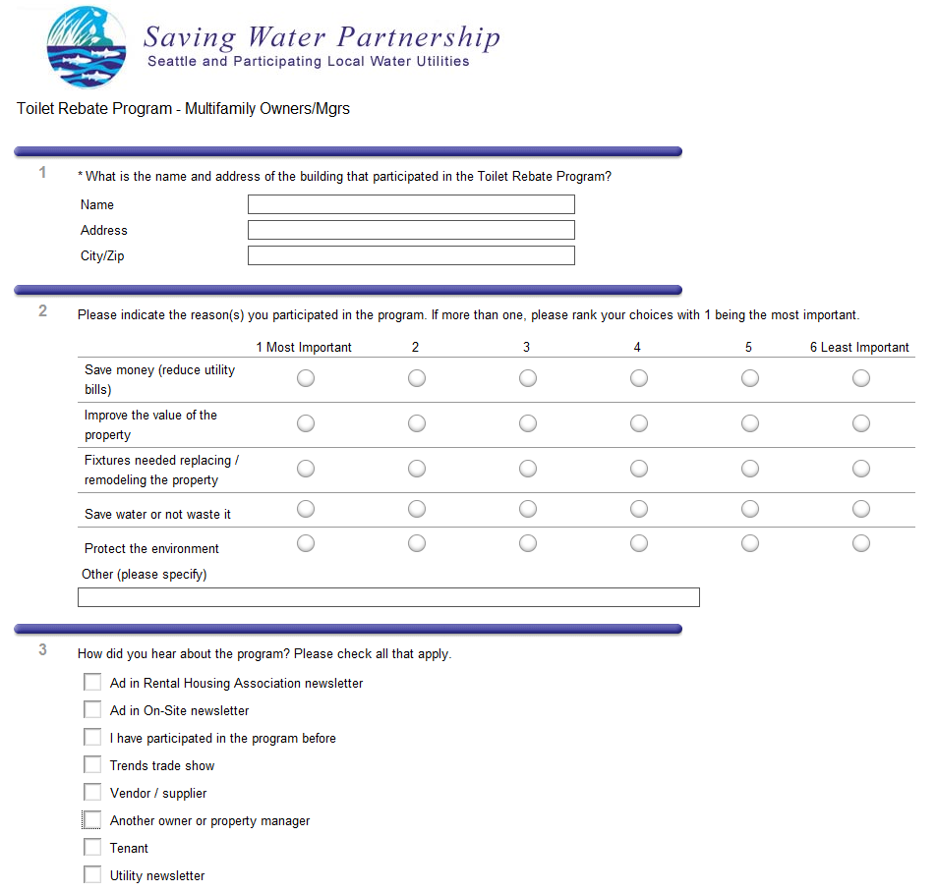
Multifamily Customer Research

Slide 19
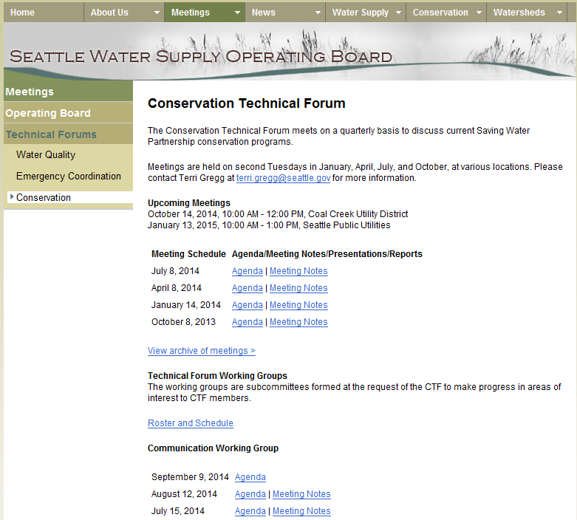
Communication with Members
Operating Board Website:
Active page on the Operating Board website
Meeting schedules, agendas & notes
Helps keep people engaged with CTF & working groups

Slide 20
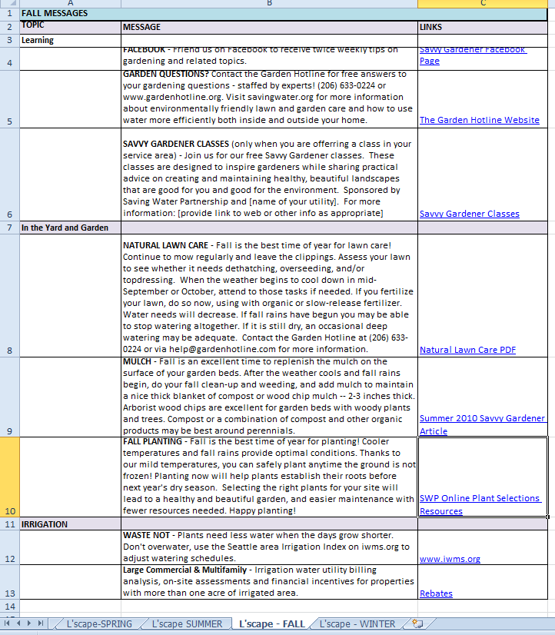
Communication with Members (cont.)
Seasonal Message Repository:
Ready-to-go newsletter articles, bill messages, Facebook posts, etc
Members can use them in their utility-specific communications
Arranged by season
Available on Operating Board website

Slide 21
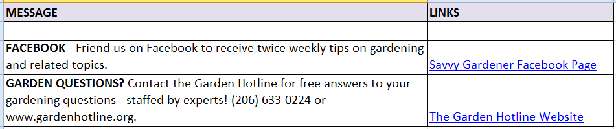
Communication with Members (cont.)

Slide 22
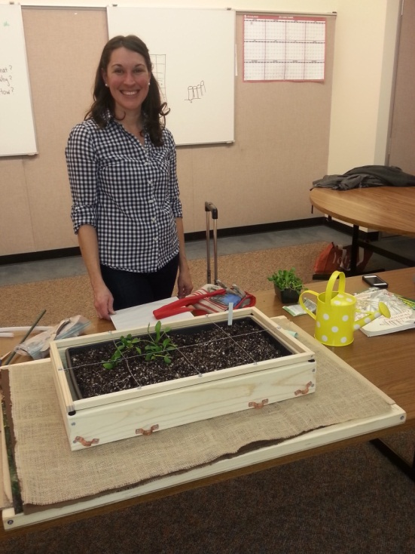
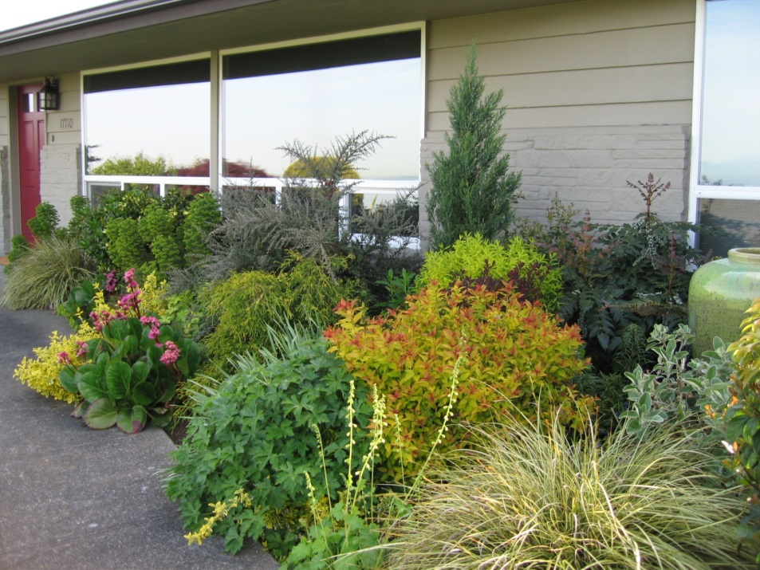
Landscape Education
Hosted 17 Savvy Gardener classes in 2013
Hosted 13 classes through September of 2014
Supporting SWP members who want to host their own classes

Slide 23
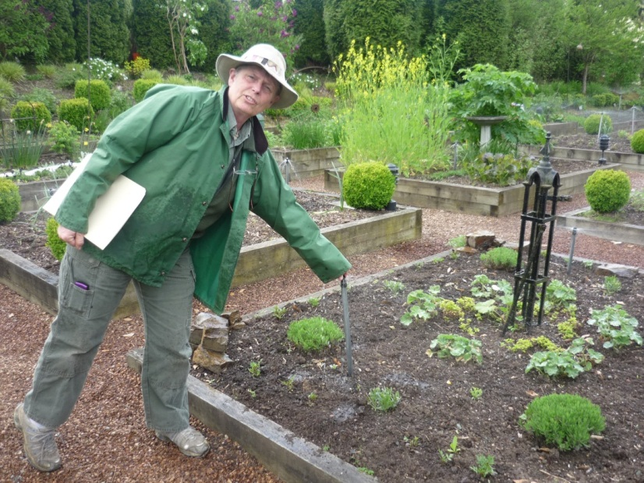
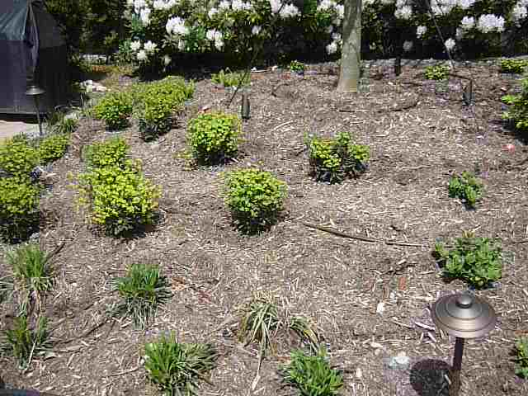
Landscape Education (cont.)
Irrigation clock programming class for homeowners
Developing outreach materials for new gardeners

Slide 24
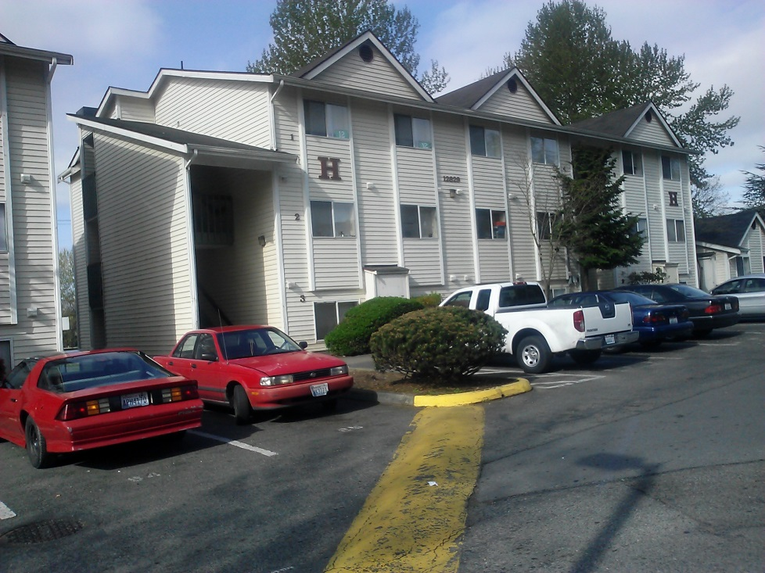
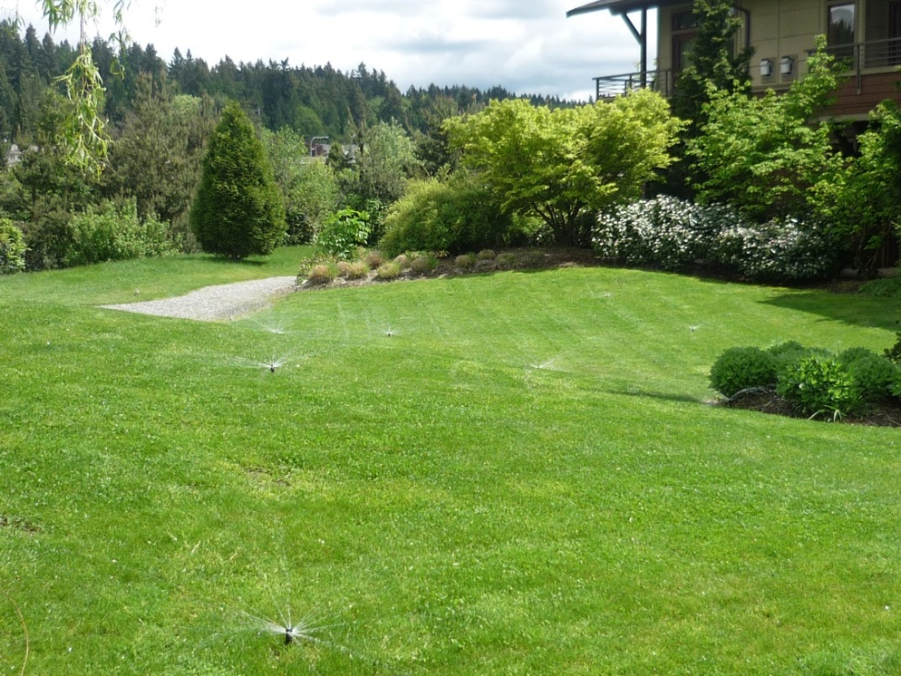
Customer Efficiency Upgrades
Single family and multifamily residential customers
Small and large commercial customers
Large irrigators

Slide 25
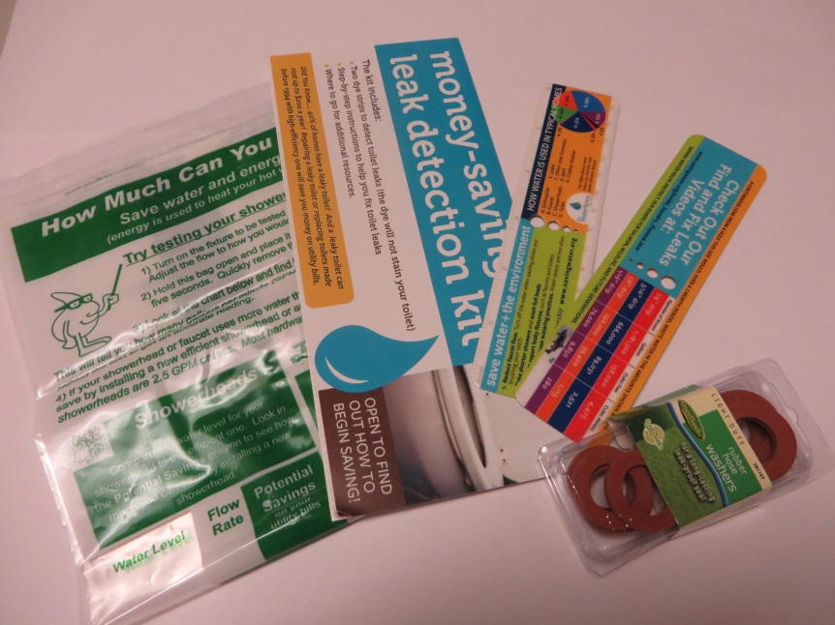
Other Services
For Customers
Hotline: 206-684-SAVE
Technical assistance for irrigation and commercial projects
Take-home items
For Partner Utilities
Water Use Efficiency Rule reporting
SWP annual report

Slide 26
2015 Emphasis
Youth and Community Education
Double number of classroom presentations
Reach all member areas
Transition Fix-a-Leak into classroom presentation
Water refilling station: more festivals; train wholesale staff
Communications
New annual regional customer research
New program satisfaction customer research
Enhance communication w/ non-English speakers (e.g. Language Line)
Landscape Education
Focus on new gardeners
Develop resources w/ broad reach (e.g. web pages & Garden Hotline)

Slide 27
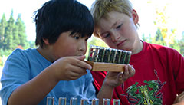
Thanks and Questions
Conservation prepares the region for potential water supply challenges, helps customers use water wisely, and preserves the ethic of stewarding natural resources.

