Slide 1
Eastside Reservoir Site Drainage and Leakage Issues

Slide 2
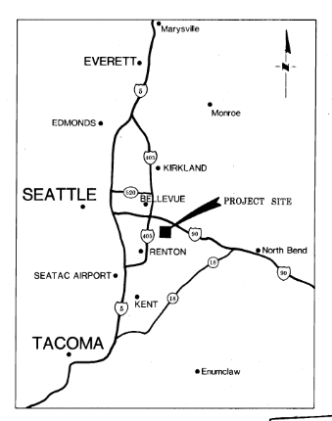
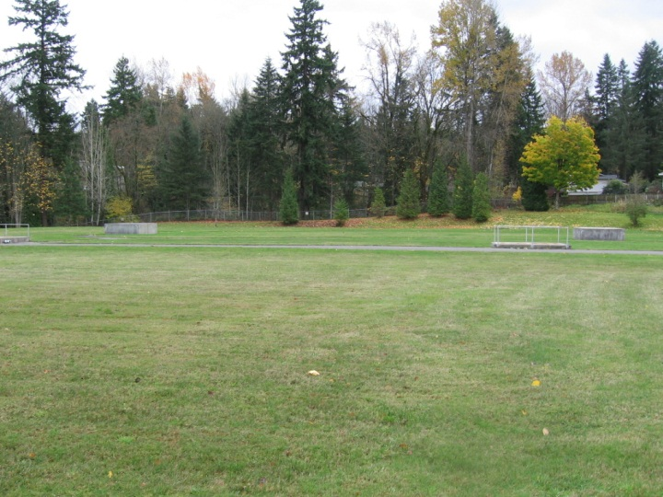
Background – Eastside Reservoir
Transmission/regional asset – in Bellevue
Buried concrete reservoir
32 million gallons
Constructed late 1980’s
2-ft soil cover, no public access

Slide 3
Issues
Groundwater leaking into reservoir (today’s topic)
Via roof-to-wall joint (direct access)
Via standing water on the soil cover (slow permeation through concrete roof)
Treated water has almost always leaked out more than AWWA standards (being addressed separately by SPU crews)

Slide 4
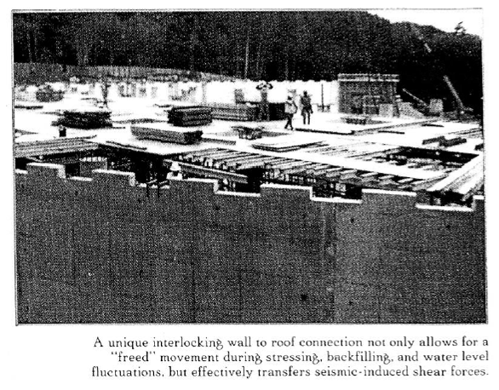
Roof-to-Wall Joint
A movable joint between roof and wall allows for roof to expand and contract separately from the wall
Different design than newer buried reservoirs
Joint is “stepped,” meant for seismic (lateral force) resistance
Seismic calcs appear to be adequate

Slide 5
Roof-to-Wall Joint
Stepped joint has filler in vertical sections

Slide 6
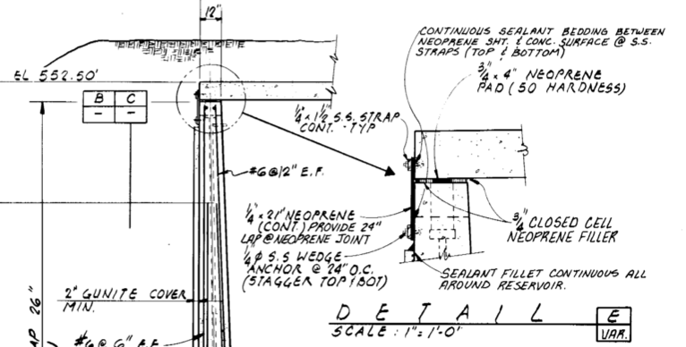
Roof-to-Wall Joint
An exterior cover over the joint is designed to prevent groundwater from entering through any gaps in the joint

Slide 7
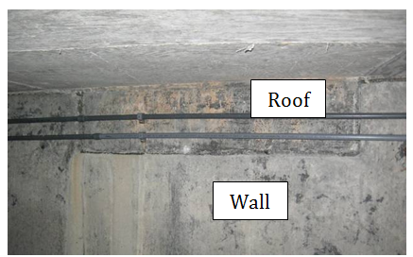
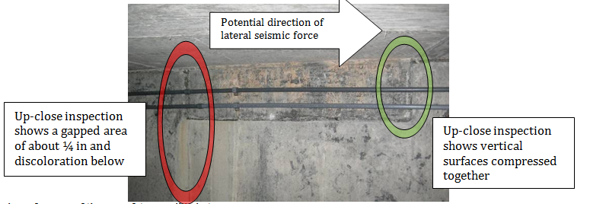
Roof-to-Wall Joint
Joint has moved laterally, resulting in gaps between vertical faces
Exterior joint cover has failed
Groundwater flowing through gaps

Slide 8
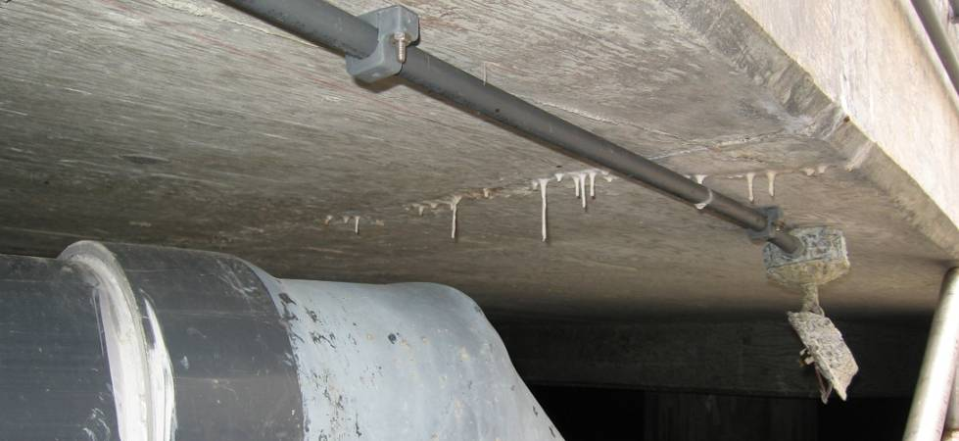
Groundwater Leaks Through Roof
Standing water after rains
No waterproofing layer over reservoir roof
No roof drain piping around perimeter
Standing water permeates slowly through roof concrete

Slide 9
Discussion
No regulatory issues with design back in 1980’s
DOH recent sanitary survey:
Roof-to-wall joint leaks are a “significant deficiency”
Roof permeation should be addressed (but not uncommon)
SPU agreed to address both issues
Can still operate reservoir while developing path forward

Slide 10
Recommendations
Roof-to-wall joint leaks
Dig up exterior joint cover and replace
Improve site drainage by adding roof drain piping in a drain trench around the perimeter
Roof permeation
Add drains on roof

Slide 11
Design – Roof Drains

Slide 12
Design – Roof Drain Ring

Slide 13
Design – Waterproofing

Slide 14
Next Steps
Work being bid now
Construction over summer 2015

