Slide 1
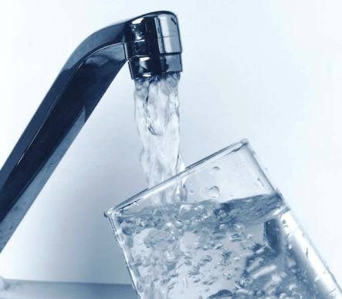
Jennifer Franklin, Emergency Operations Manager jennifer.franklin@mercergov.org Ross Freeman, Communications Manager ross.freeman@mercegov.org SPU Operating Board Mtg 6 Nov, 2014
City of Mercer Island
Boil Water Advisory Event
In effect: Sept 27 – Oct 8, 2014

Slide 2
Boil Water Advisory Event - #14-3872
In effect: Sept 27 – Oct 8, 2014
Overview
1. Objective: Establishing Incident Command
Have a Clear Command Structure
Know each agency’s decision-making authority
Proclamation signed – WAMAS or RCF for MOU’s with other agencies
Use other agencies to assist – JIC/Operations/EOC
Clear Planning Clock and contact info. for all players
IAP brief out in the beginning of Operational Period
Conference Call
Press Release
Press Conference (when needed)
SITREP provided at the end of the operational period.
Documentation – 214 forms, photos
Follow your Plan – EOC procedures and job duties checklist
Redundancy in positions – Other EM’s know how to function in your EOC
2. Objective: Notifying Public of E. Coli Health Risk / Coordination with Community & Media
3. Objective: Developing & Implementing Action Plan
MIEOC IAP should encompass Maintenance/ DOH / Public Health- Seattle & King County/ MISD / SPU Plan The IAP should drive towards end state and show the progression of actions – this is necessary for decision makers and PIO.
4. Coordinating Illness Reports
Public Health Seattle & King County is the decision-making authority in this arena
5. Establishing Criteria to lift the Advisory
Clear plan progress and steps in IAP
6. Lifting Advisory
Joint messaging with FAQ’s in place for residents, restaurants, medical offices, schools, care centers

Slide 3
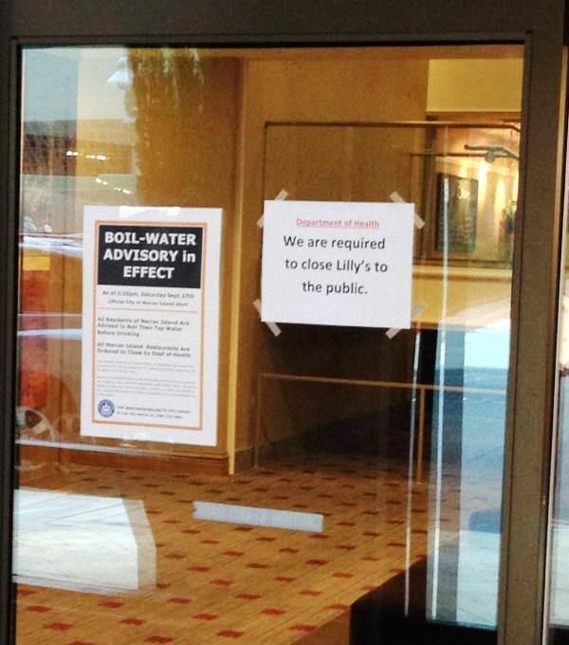
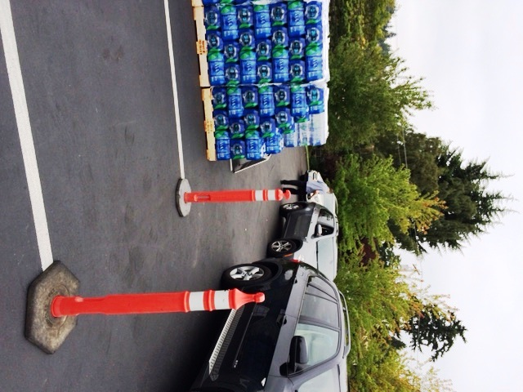
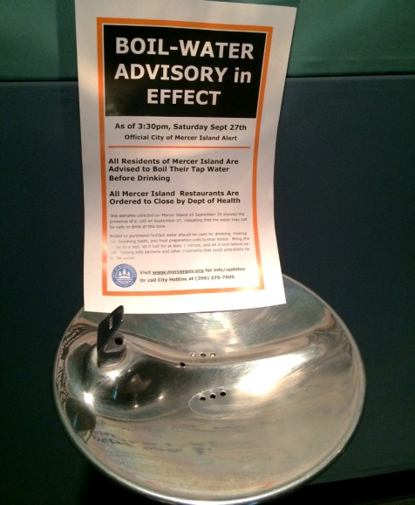
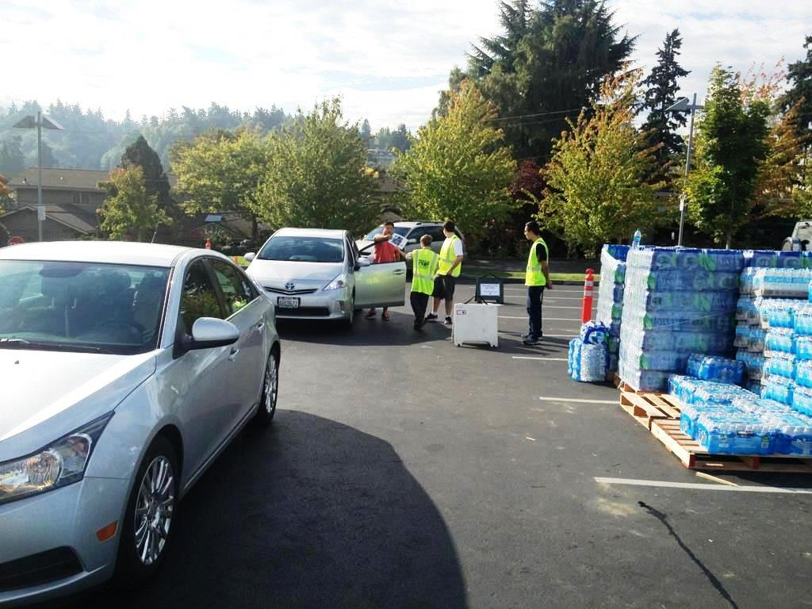
Boil Water Advisory Event - #14-3872
Managing the Incident

Slide 4
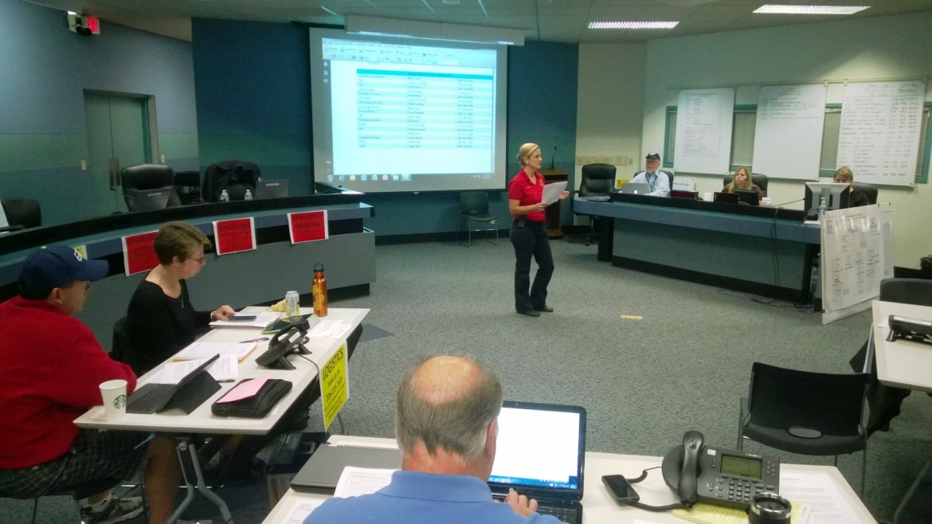
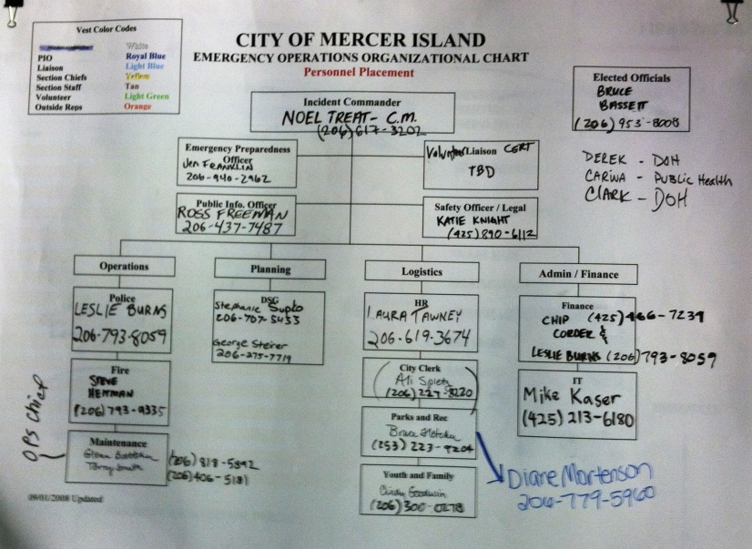
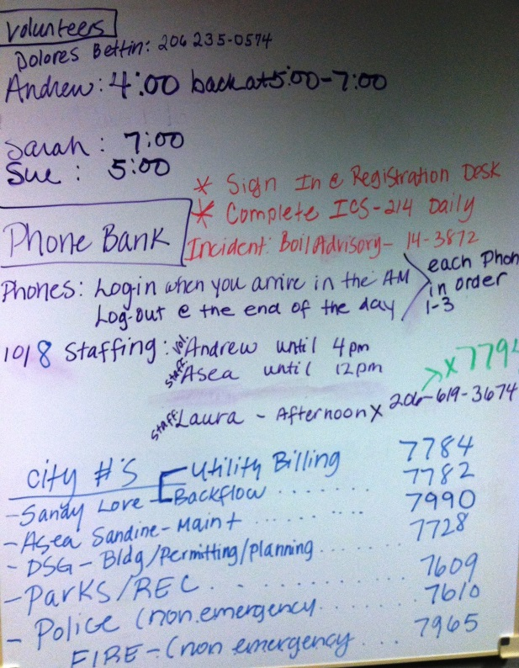
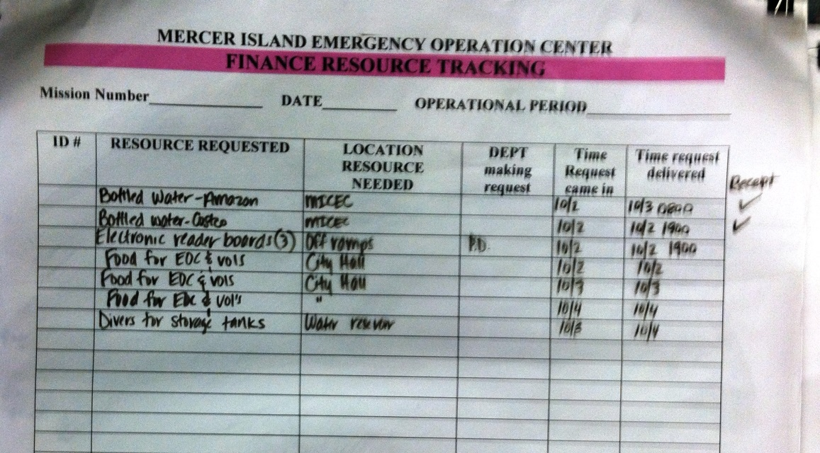
Boil Water Advisory Event - #14-3872
Managing the Incident

Slide 5
Boil Water Advisory Event - #14-3872
A “silent incident” with urgent
outbound communication needs
Notification and Media
FIRST ACTIONS
Backbone = “Reverse-911” type system
Press release
Full press conference
Interviews: live TV, radio, and phone
Postering
Public Health closures
Vulnerable pops.
Challenges & Considerations
Not completed, poor performance
Multi-author! Contact info
Ensure space available/EOC
Who’s available & do they have talking points? Elected
Who, where, waterproof?
Staffing, media intrusion
Updated lists? Calls/visits

Slide 6
Boil Water Advisory Event - #14-3872
Notification and Media
FIRST ACTIONS
Social Media
City Website
Email lists
Notifying City
Challenges & Considerations
Early & often; photos!; care & feeding; replies; NextDoor.com
Quick updates difficult; timestamp; missed deadlines
Many places, many formats; be creative (e.g. utility billing)
All-staff emails; text alerts; City Council

Slide 7
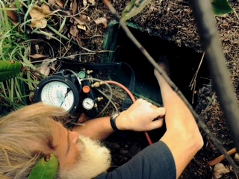
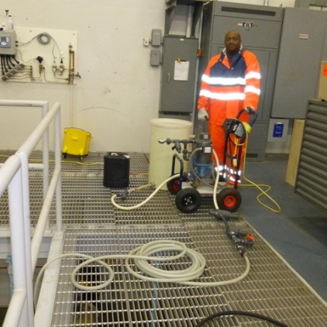
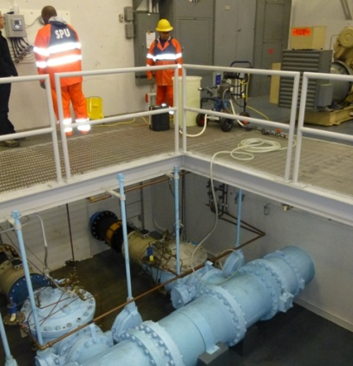
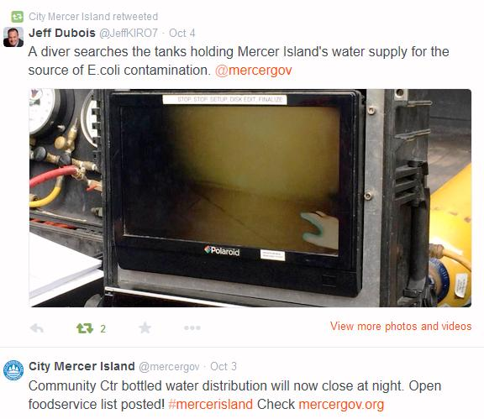
Boil Water Advisory Event - #14-3872
Notification and Media
MID-INCIDENT
Ongoing Media
Council Briefing
Challenges & Considerations
Feeding the beast; steering message; damage control; illness reports; inviting media (using ‘handlers’)

Slide 8
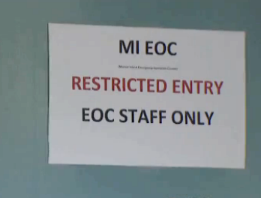
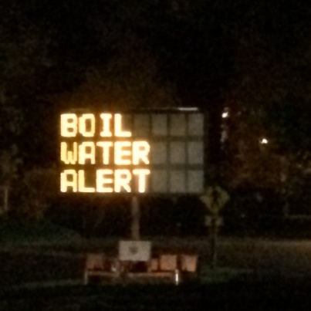
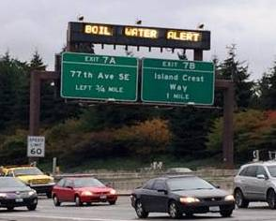
Boil Water Advisory Event - #14-3872
Notification and Media
MID-INCIDENT
Notification Improvements
Phone bank messages
Request info from public
Challenges & Considerations
Reader boards; DOT sign; larger posters; A-frames
Ensure simple & timely; public health info
Encourage people to engage (revealing backflow issues)
Quicktime Video

Slide 9
Boil Water Advisory Event - #14-3872
Notification and Media

Slide 10
Boil Water Advisory Event - #14-3872
Notification and Media
LATE-INCIDENT
Prepare FAQ’s, and “What to do when”
Plan for proactive good news stories (vols, staff)
Recovery plan, public reassurance
Plan for questions about legal and $$
Challenges & Considerations
Tough to assemble all needed guidance
Find most interested media contacts
Dine Local Campaign promo; Loans; Restaurant map
City Attorney

Slide 11
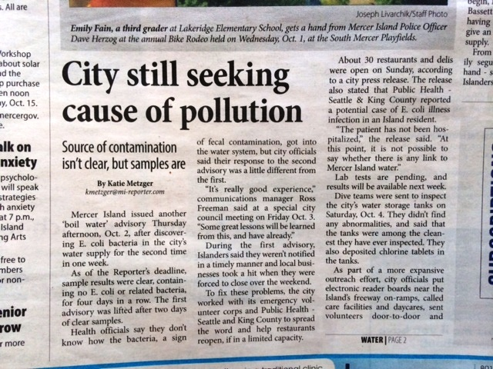
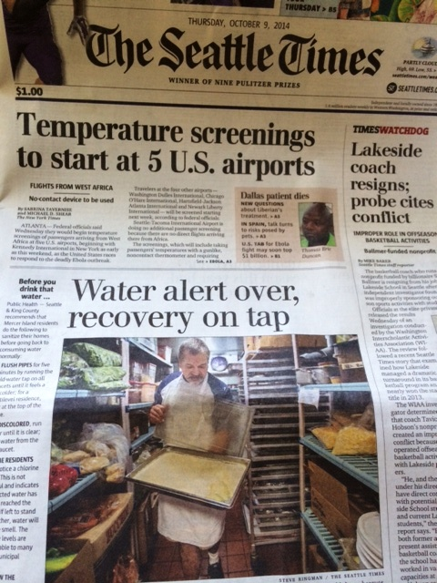
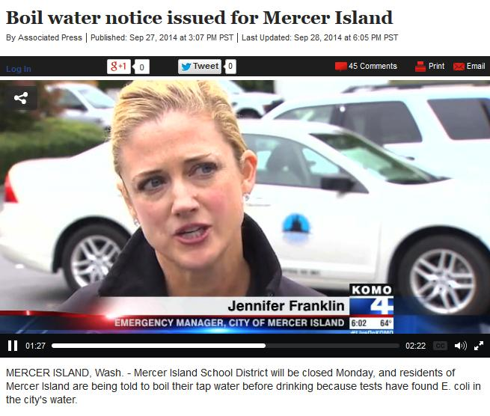
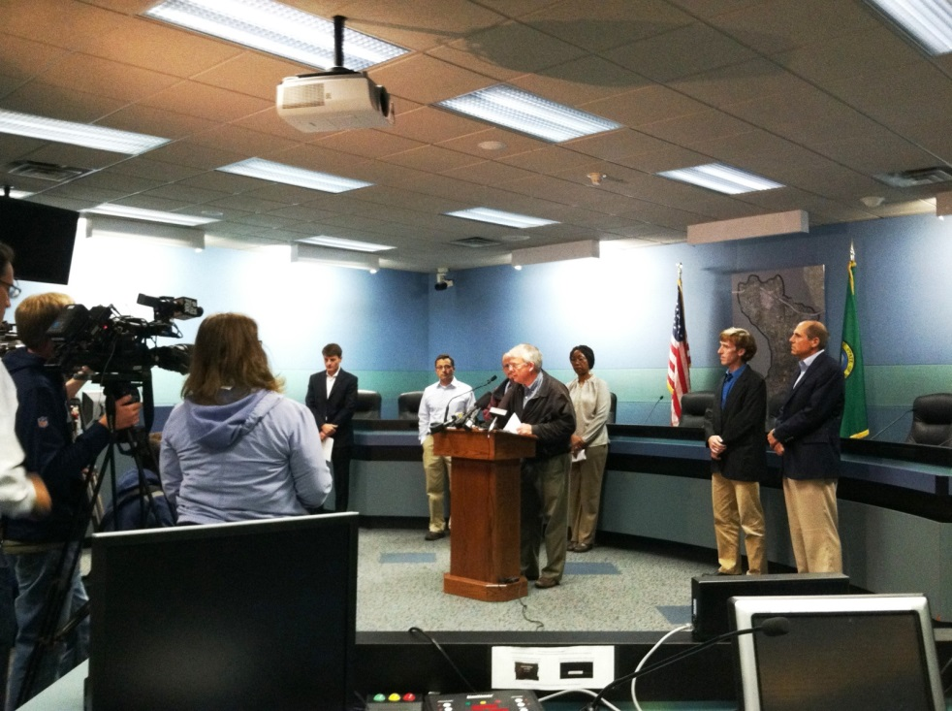
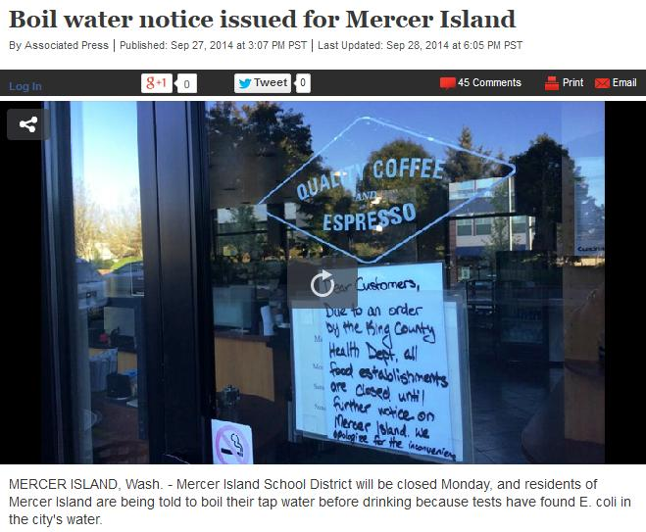
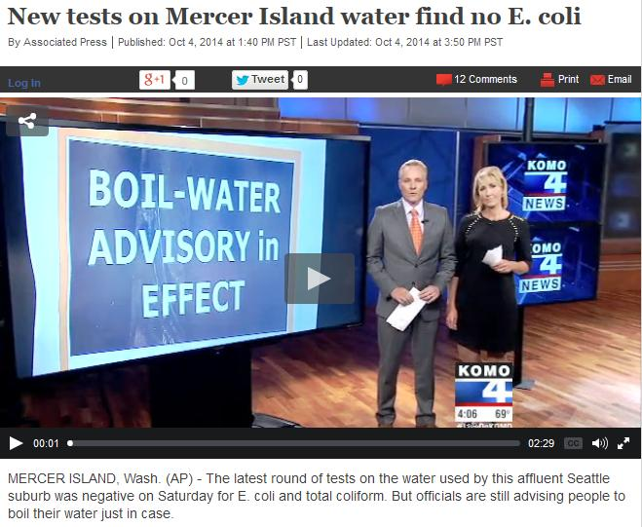
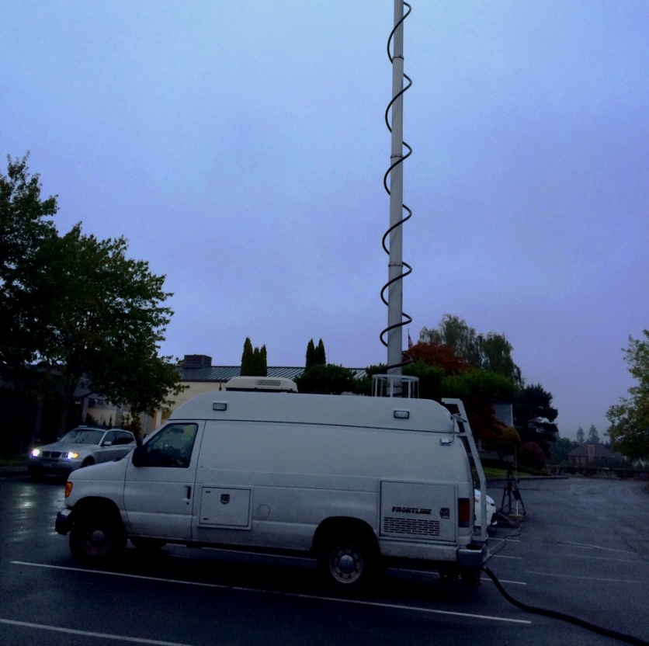
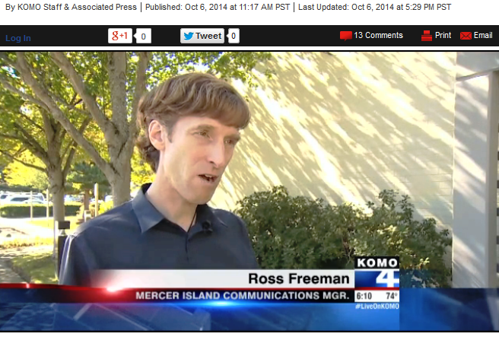
Boil Water Advisory Event - #14-3872
Notification and Media

Slide 12
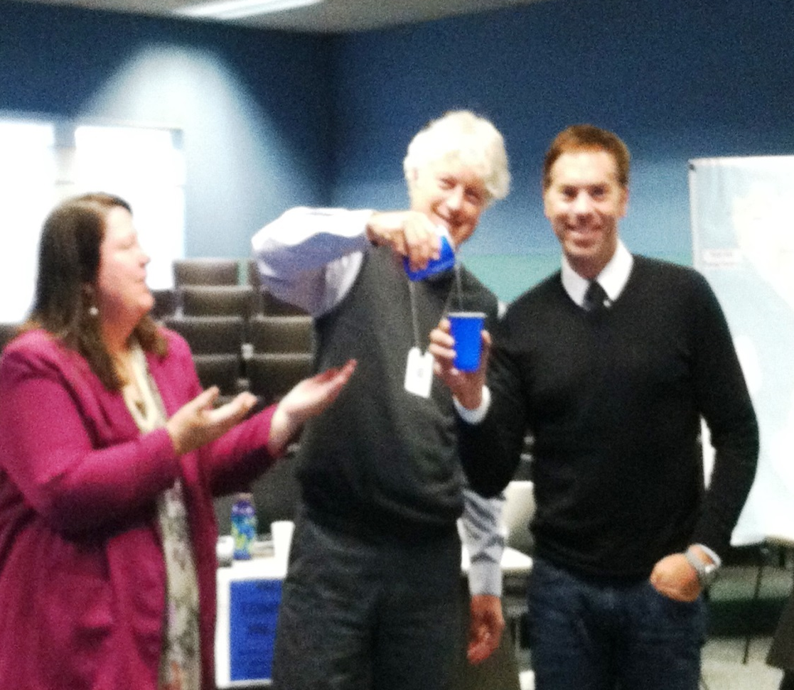
Boil Water Advisory Event - #14-3872

