Slide 1
Boil Water Notices –
Mandated vs. Precautionary
Operating Board
November 6, 2014

Slide 2
Agenda
Seattle System Overview
Mandated vs. Precautionary
Regulatory Drivers
Occurrences & Events
  Mercer Island
  Seattle main breaks with pressure loss
Impacts and Challenges

Slide 3
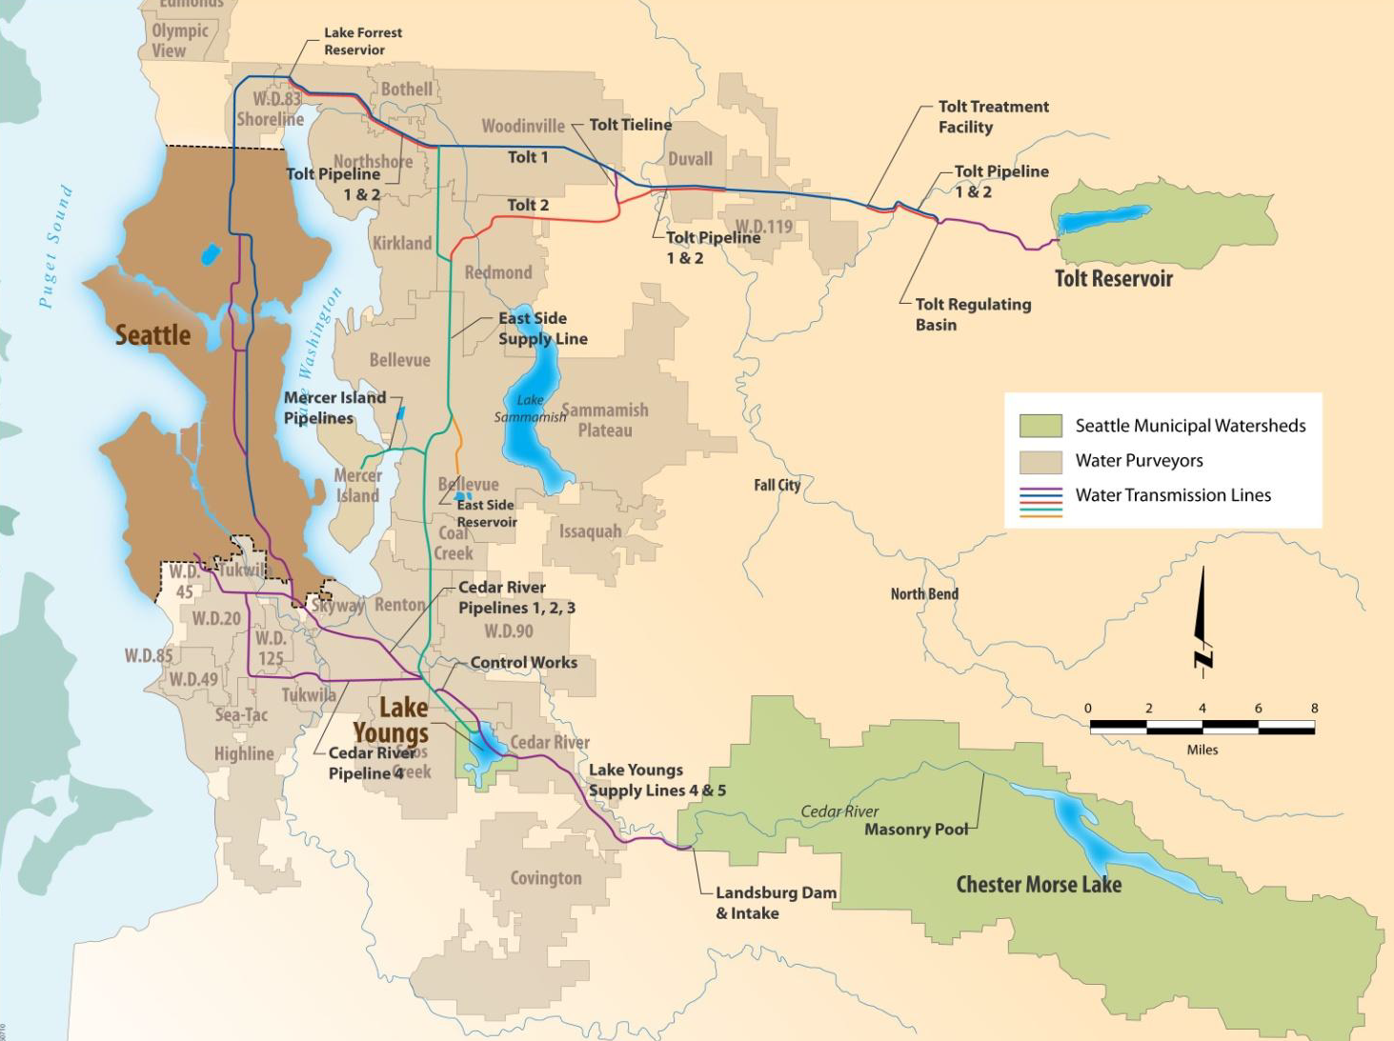
SPU Drinking Water System
Notes:
The Cedar River begins within a protected watershed on the west side of the Cascade Mountains and eventually drains into the south end of Lake Washington. The watershed area totals about 79,700 acres of which 99.7 percent is owned by SPU. The Cedar River water supply system also consists of Chester Morse Lake, the Landsburg Facilities, the Cedar Supply Pipelines, Lake Youngs, the Cedar Water Treatment Facility, the Lake Youngs Tunnel and Pump Station, and Control Works.
The South Fork Tolt River watershed has a drainage area of approximately 12,100 acres in northeastern King County. The south fork of the river eventually flows into the Snoqualmie River. The watershed is controlled by SPU, which owns 69 percent of the area. The remainder is owned by the US Forest Service. The Tolt River water supply system consists of the Tolt Reservoir, the Tolt Penstock, the Regulating Basin, the Tolt Treatment Facilities, and the Tolt Pipelines.

Slide 4
Mandated vs. Precautionary
Boil Water Notice
Contamination confirmed present
Regulatory Tier 1 Acute MCL Violation
Public Notice within 24 hrs
Applies to whole water system
Precautionary Boil Water Advisory
Contamination possible
Guidance due to pressure loss
Applies to impacted area/neighborhood

Slide 5
Regulated – TCR Compliance Flow Chart
YES
YES
YES
YES
PWS collects required ROUTINE samples?
ROUTINE sample TC+?
TC+ ROUTINE sample analyzed for FC/EC?
PWS collects REPEAT samples within 24 hrs?
NO
NO
NO
NO
M/R VIOL
No Further Action
M/R VIOL
M/R VIOL
REPEAT Samples TC+?
YES
Must continue collecting REPEAT samples until all are TC negative or an MCL is violated
TC+ REPEATS Analyzed for FC/EC?
YES
NO
No Further Action
M/R VIOL
NO
ROUTINE TC+ and REPEAT FC/EC+?
Or
ROUTINE FC/EC+ and REPEAT TC+?
Is the percent of ROUTINE TC+’s plus REPEAT TC+’s >5% of total (this is 10 or more samples for Seattle Public Utilities)
Definitions:
PWS = Public Water System
TC = Total Coliform
TC+ = Total Coliform Positive
FC = Fecal Coliform
EC = E. Coli
M/R = Monitoring/Reporting
MCL = Maximum Contaminant Level
VIOL = Violation
NO
NO
No Further Action
YES
YES
24hr Acute MCL VIOL
Monthly MCL VIOL

Slide 6
Recommended
WDOH DRAFT Guidance
Type I Break | Type II Break | Type III Break | Type IV Break
Positive pressure maintained during break | Positive pressure maintained during break | Loss of pressure at break site or limited water system depressurization elsewhere | Loss of pressure at break site and depressurization elsewhere in the system
Pressure maintained in pipe during repair | Pressure maintained at break site until pipe exposed & hole dewatered, shutdown limited to immediate valved off area, no loss of pressure elsewhere in system | Loss of pressure at the break site while the pipe is still buried or submerged / or no pressure loss at break site, but pressure loss elsewhere in the system | Loss of pressure at the break site while the pipe is still buried or submerged and widespread depressurization
No signs of contamination intrusion | Limited possibility of contamination intrusion | Possible contamination intrusion | Possible/ actual contamination intrusion

Slide 7
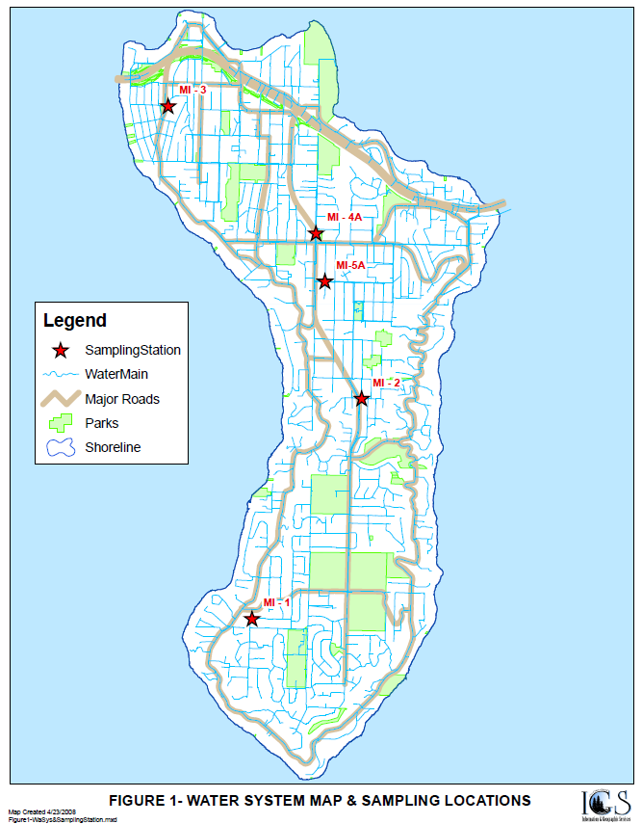
Mercer Island Boil Notice
1st E. coli detected 9/26, confirmed 9/27
  Boil notice issued 9/27
  Lifted 9/29
  Monitoring clear through 10/1
2nd E. coli detected 10/2
  Boil notice issued 10/2
  Monitoring continues
Notice Lifted 10/8
  6 consecutive days of clear samples
  Extensive inspections of vaults and valves
  System flushing
  Booster chlorination
  Sampling continues

Slide 8
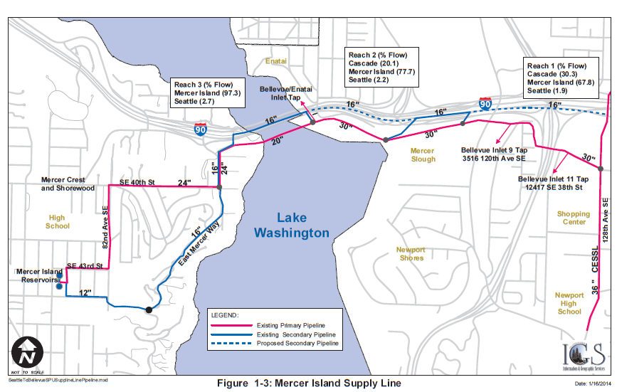
Mercer Island Boil Notice

Slide 9
Mercer Island Boil Notice
SPU Support
  Investigative sampling (collection and analysis)
    Sent positives out for speciation, strain identification next
    More than 100 samples in past 6 days
  On-site water quality engineering support multiple days
  Treatment crews to assist with booster chlorination
  Media support to initial press releases
  Participation in 2x daily conf. calls, press conferences
Observations
  Decision making by WDOH jointly with Mercer leadership
  PHSKC closely partnered with a focus on food establishments
  ICS structure maintained for event management
  Substantial support/outreach needed for:
    Media relations
    Schools and daycare
    Elder care facilities

Slide 10
SPU Main Breaks and Pressure Loss
Events in Recent years
  Beacon Hill 2008 – BWA
  Graham Hill 2012 – BWA
  University Village 2013 – No BWA
  Capitol Hill 2013 – BWA
  Sandpoint Way 2014 – No BWA

Slide 11
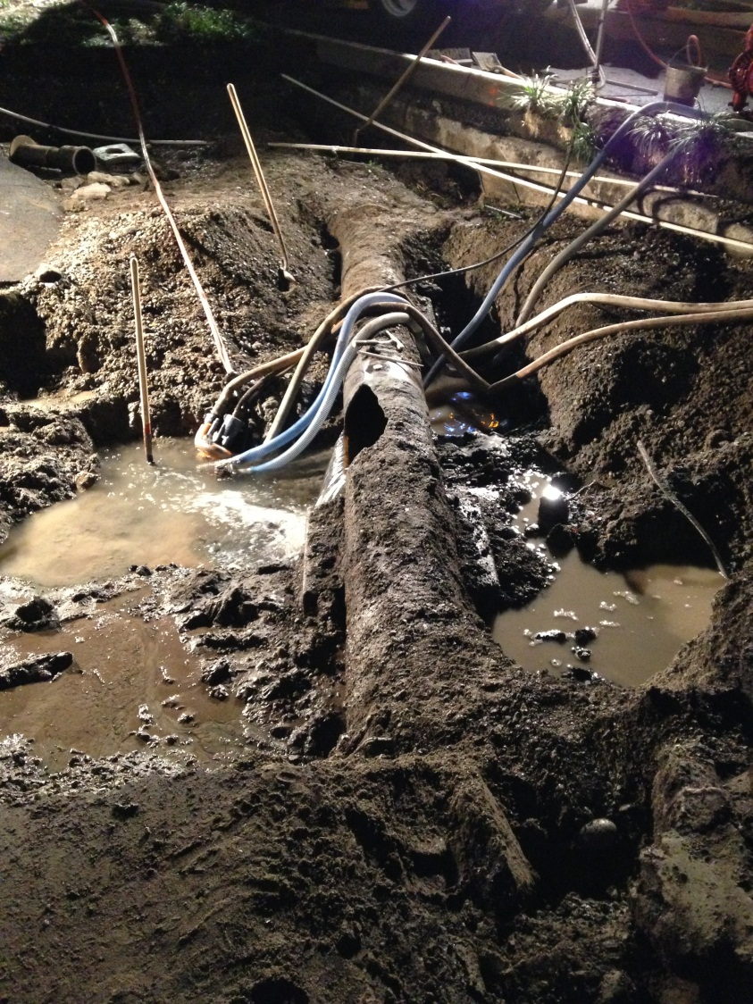
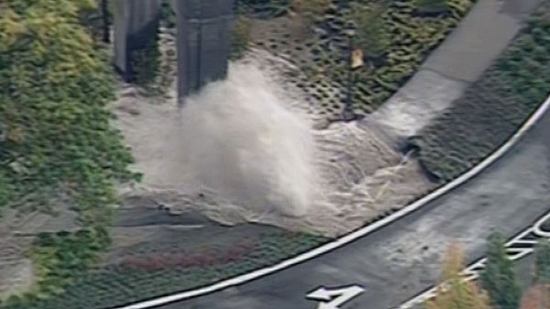
U-Village Break
10/8/13, ~ 3:00pm
16” main
Several thousand customers impacted

Slide 12
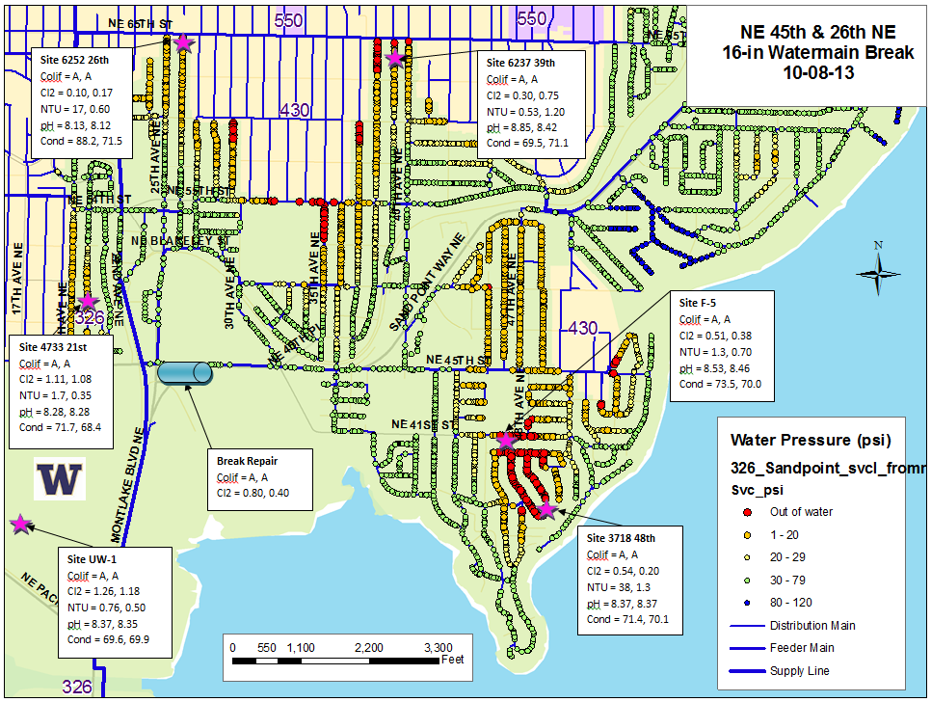
U-Village Break

Slide 13
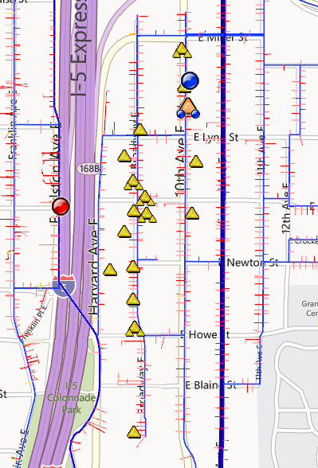
Capitol Hill Break
10th Ave E
10/30/13, ~ 3:45am
8” main
About 145 customers impacted

Slide 14
Pressure Loss Responses
At the Break Site
  Isolate break site
  Excavate, assess, repair
  Disinfect repair parts
  Flush & sample repaired section
Beyond the Break Site
  2 rounds minimum of bacterial sampling
  Evaluate potential sources of contamination
  Low velocity flushes
  Check chlorine residuals

Slide 15
Take Away’s - Impacts and Challenges
  Health protection and customer confidence are primary drivers
  Early communication to customers is essential, yet…
  Early event information is limited
  Pre-planned messaging is key
  Key customers may be more impacted
    restaurants
    schools
    medical facilities
  Requires partnering with WDOH and PHSKC
  Each event is different

Slide 16
Questions?

