Slide 1
Preliminary Regional Rate Study Results
& Remaining Rate Study Inputs
Wholesale Rate Setting
June 5, 2014 Presentation
Water Supply Operating Board

Slide 2
Overview
Preliminary Regional Rate Results
Regional O&M Costs
True Up Results
Background on Peak Season Rate

Slide 3
Rate Setting for
Seattle Regional Wholesale Contracts
Regional revenue requirement is determined by three things:
  O&M expenses (Supply and Transmission)
  Asset costs (Supply and Transmission)
  True Up balance
Allocate revenue requirement between Block and F&P customers
  Block customers are Cascade, Northshore, and Renton Conservation block
  Seattle’s distribution system is an F&P customer for rate setting purposes
Divide by F&P demand
  F&P demand is defined in contracts as 98% of water produced minus block usage
= Rate per unit

Slide 4
Preliminary Rate Study Results
Preliminary Results are based on:
  O&M from Strategic Business Plan Baseline
  6 Year CIP presented at April 3, 2014 Operating Board
  Preliminary 2013 True Up results
  Demand presented at April 2, 2014 Operating Board
 | 2014 Actual | 2015 Preliminary | 2016 Preliminary | 2017 Preliminary
Peak Rate ($/ccf) | 2.27 | 2.08 | 2.08 | 2.08
Off-Peak Rate ($/ccf) | 1.53 | 1.40 | 1.40 | 1.40
Percent Change |  | (8)% | 0% | 0%

Slide 5
Rate Drivers
 | 2015 | 2016 | 2017
Regional Cost | 2.3% | 4.4% | 2.8%
True Up Balance | (2.7)% | (5.6)% | (3.9)%
Demand | (8.0)% | 1.2% | 1.2%
Total | (8.4)% | 0.0% | 0.0%
Regional costs are increasing steadily, with a bump in 2016 for the initial close of the MLPP project
A large 2014 true up balance offsets the increase in costs
  Increased demand over 2012-2014 is the main driver of the balance
  CWA’s transition payment also a large factor

Slide 6
Rate Drivers, continued
Besides creating a positive true up balance, the increase in demand means a decrease in rates as we step from one demand line to the other

Slide 7
Northshore Fixed Block
Northshore’s block and true up balances are driven by changes in cost only
Decrease in 2015 due to New Supply Assets, which are in FCs for F&P contracts rather than rates
 | 2014 Actual | 2015 Preliminary | 2016 Preliminary | 2017 Preliminary
Fixed Block ($M) | 5.2 | 5.1 | 5.3 | 5.5
Prior Year True Up ($M) | 0.2 | 0.2 | TBD | TBD
Total ($M) | 5.4 | 5.3 | TBD | TBD

Slide 8
Rate Setting for
Seattle Regional Wholesale Contracts
Regional revenue requirement is determined by three things:
  O&M expenses (Supply and Transmission)
  Asset costs (Supply and Transmission)
  True Up balance
Allocate revenue requirement between Block and F&P customers
  Block customers are Cascade, Northshore, and Renton Conservation block
  Seattle’s distribution system is an F&P customer for rate setting purposes
Divide by F&P demand
  F&P demand is defined in contracts as 98% of water produced minus block usage
= Rate per unit

Slide 9
Regional O&M
Regional O&M is determined using an index system
  The initial amount for each category of cost (supply and transmission) was specified in the contracts. This is the “base cost” for each category
  Each of these amounts are then increased or decreased each year based on the total costs in “index activities” which were also set in the contracts (Exhibit IX)

Slide 10
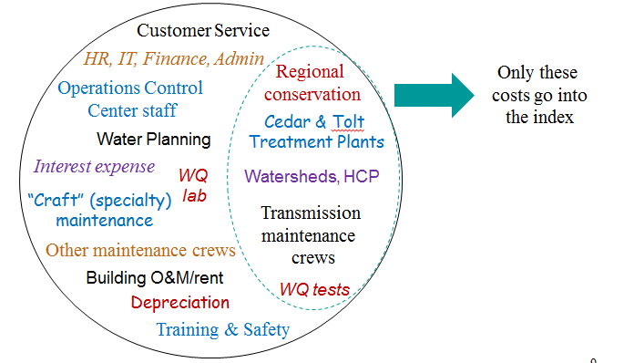
Regional O&M – What is in the index?

Slide 11
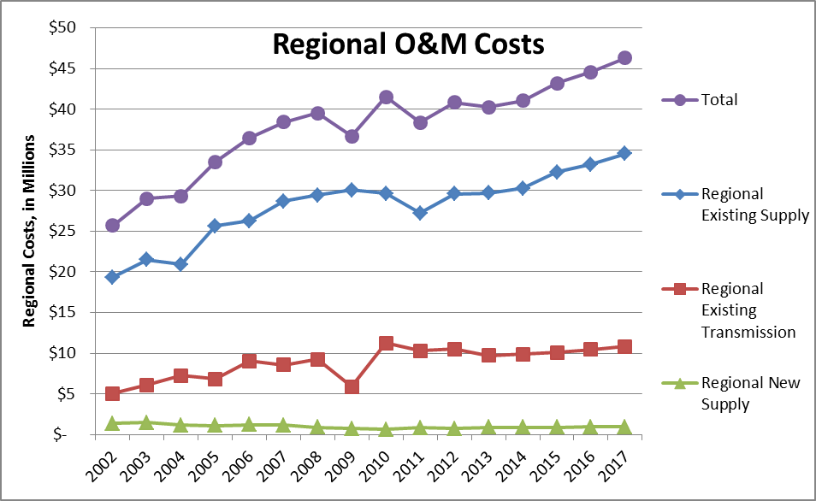
Regional O&M Cost – History & Projections

Slide 12
Rate Setting for
Seattle Regional Wholesale Contracts
Regional revenue requirement is determined by three things:
  O&M expenses (Supply and Transmission)
  Asset costs (Supply and Transmission)
  True Up balance
Allocate revenue requirement between Block and F&P customers
  Block customers are Cascade, Northshore, and Renton Conservation block
  Seattle’s distribution system is an F&P customer for rate setting purposes
Divide by F&P demand
  F&P demand is defined in contracts as 98% of water produced minus block usage
= Rate per unit

Slide 13
Regional True Up
Projected 2014 Year Ending true up balance is the beginning point for the 2015-2017 rate study
2013 True Up currently being reviewed
  Includes cumulative effect of prior year revenue adjustments
2014 revenues and costs based on same demand projection and O&M and CIP inputs as rate study
  Amounts just happen to be identical to 2013

Slide 14
Regional True Up
 | 2013 |  |  | 2014
Beginning Balance | $(6.5M) |  |  | $ 5.3
+ F&P Revenues | 78.1 |  |  | 78.1
+ CWA Transition Payment | 5.0
+ Prior Year Revenue Adjustments | (0.7)
- Regional Costs | 70.6 |  |  | 70.6
= Ending Balance | $ 5.3M |  |  | $ 12.7M

Slide 15
Rate Setting for
Seattle Regional Wholesale Contracts
Regional revenue requirement is determined by three things:
  O&M expenses (Supply and Transmission)
  Asset costs (Supply and Transmission)
  True Up balance
Allocate revenue requirement between Block and F&P customers
  Block customers are Cascade, Northshore, and Renton Conservation block
  Seattle’s distribution system is an F&P customer for rate setting purposes
Divide by F&P demand
  F&P demand is defined in contracts as 98% of water produced minus block usage
= Rate per unit
  Rate Design

Slide 16
Seasonal Component to F&P Rates
Contracts say that rates should have a seasonal differential “to encourage the efficient use of water, conservation and the timely development of new environmentally responsible water sources”
MIT Agreement requires Seattle to encourage conservation by wholesale customers and a seasonal rate is one method for this
Peak Season ratio is not necessarily cost based

Slide 17
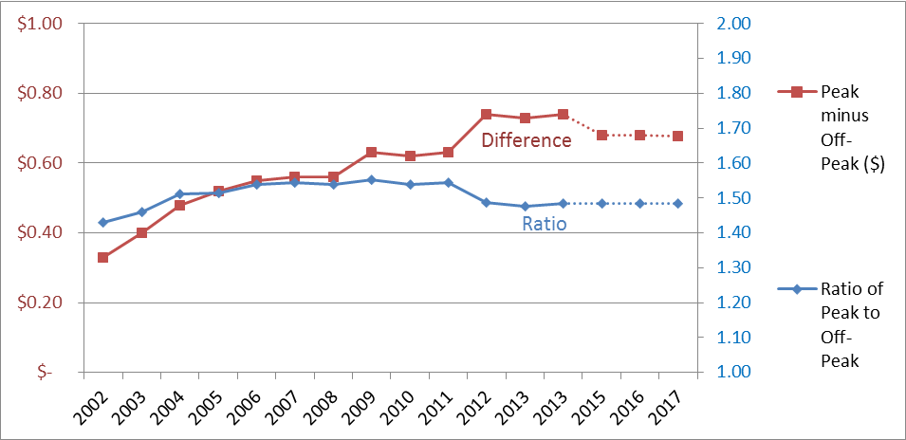
Two Views of Seasonal Differential
Ratio decreased when growth charge expired
Difference has increased as rates have increased

Slide 18
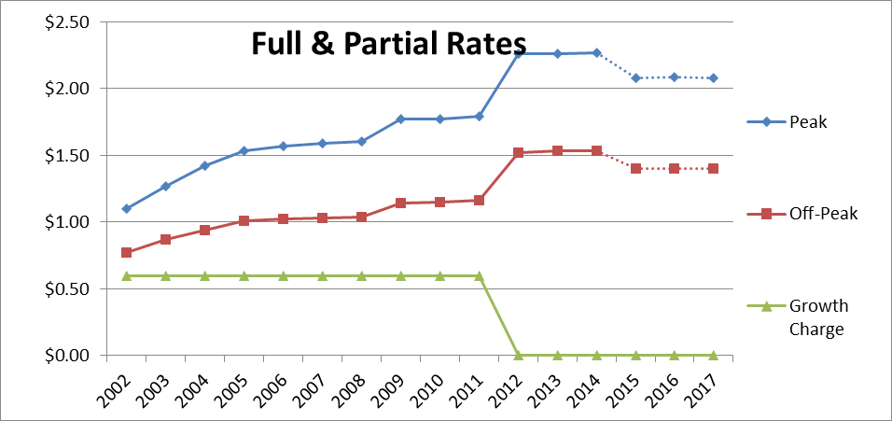
Seasonal Differential for 2015-2017
Ratio being held constant
Difference decreases due to decrease in rates

Slide 19
Next Steps and Targeted Dates
Richard Cuthbert to finish review, targeting these dates
  July 10th Operating Board presentation
  End of July for delivery of written report
Thirty days after independent review is finished, formal transmittal of proposal to Operating Board
  Includes Seattle’s Rate Study Summary document
  Targeting Sept 4th meeting
Begin Seattle City Council process
  Targeting January 1, 2015 effective date

