Slide 1
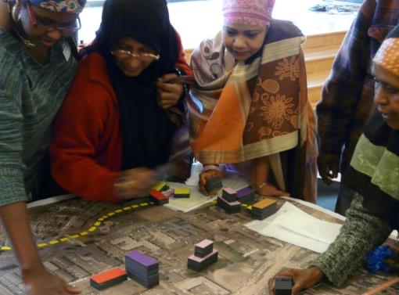

Current Neighborhood Planning
Seattle’s Evolving Approach
Current Neighborhood Planning

Slide 2
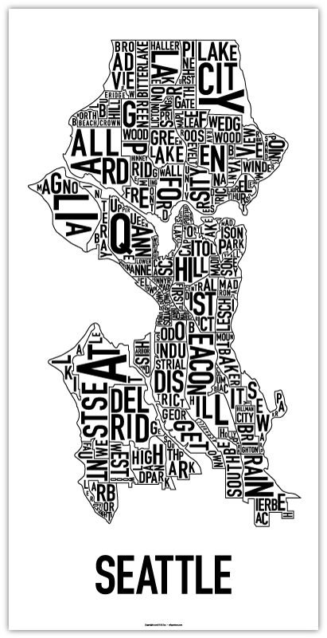
Seattle
A City of Neighborhoods
Current Neighborhood Planning

Slide 3
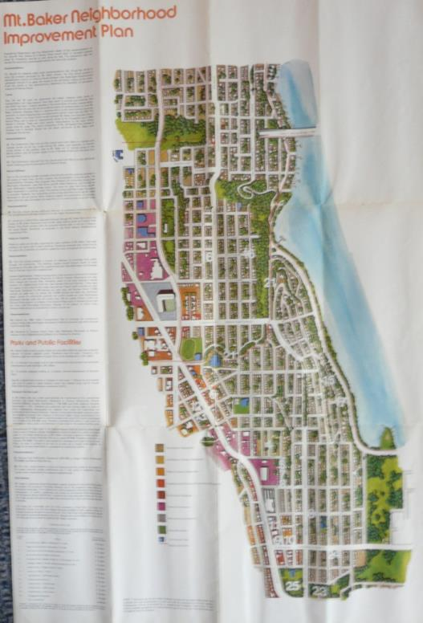
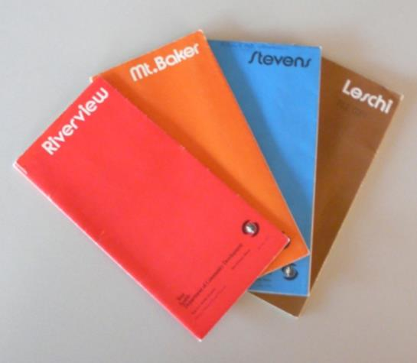
Mid-1970s
Neighborhood Improvement Program
Current Neighborhood Planning
Notes:
Metro Courtesy of Sound Transit
Aquarium photo by Frank Shaw

Slide 4
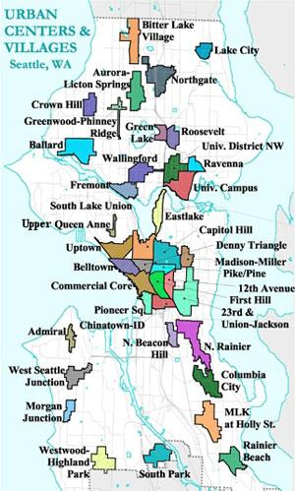
1996 - 1999
Neighborhood Planning
Growth Management Act
Vision 2020
Countywide Planning Policies
Toward a Sustainable Seattle
Urban Centers & Villages
Neighborhood Plans
Current Neighborhood Planning

Slide 5
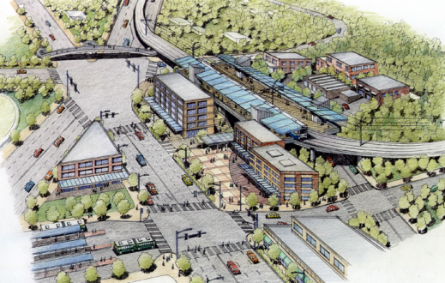
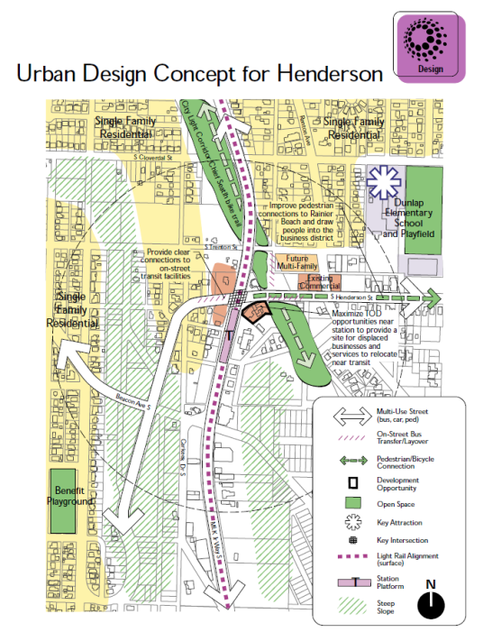
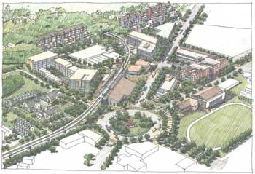
Station Area Plans 1998-2000
Light rail stations in SE Seattle
Current Neighborhood Planning

Slide 6
2008 - 2010
Neighborhood Plan Updates
City Direction
  City legislation on objectives and means.
  Neighborhood Planning Advisory Committee
Defining Objectives
  Impacts & opportunities from new light rail (TOD & Gentrification)
  Inclusivity
Public engagement
  City facilitated
  Public Outreach and Engagement Liaisons
Approval/adoption
  Plans “recognized by resolution” and policies adopted
Implementation
  Zoning legislation adopted
Current Neighborhood Planning

Slide 7
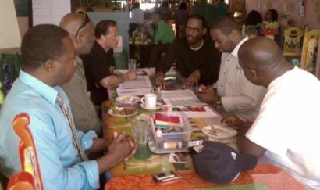
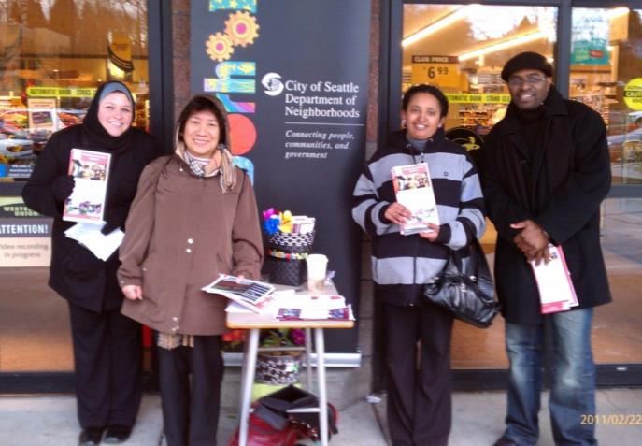
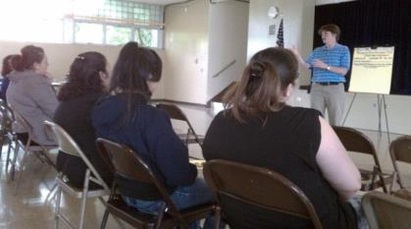
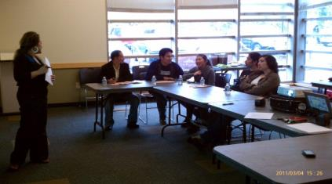
RSJI & POELs
Race & Social Justice Initiative
Public Outreach & Engagement Liaisons
African American
Hispanic
Lao
Current Neighborhood Planning

Slide 8
2010 - Present
Community Development
City Direction
  City budget legislation provides overall direction
Defining Objectives
  Community Development
  Health & Equity
  Inclusive engagement
Public engagement
  City facilitated
  Public Outreach and Engagement Liaisons.
Approval/adoption
  Plans “recognized by resolution” and policies adopted .
Implementation
  Zoning legislation adopted
  Grants
Current Neighborhood Planning
APA Atlanta

Slide 9
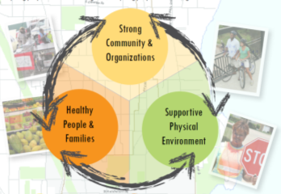
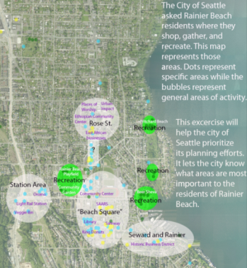

Community Development
Health & Equity
Current Neighborhood Planning

Slide 10
2010 – Present
Urban Design Frameworks
City Direction
  Led by DPD, partners include SDOT, Office of Economic Development, Office of Housing
Defining Objectives
  Focus on how physical pieces fit together – new buildings, street improvements, parks.
Public engagement
  City facilitated working groups, iterative review with broader public
Approval/adoption
  Not adopted by Council
  Establish clear direction for subsequent projects: zoning, design guidelines, streetscape plans...
Current Neighborhood Planning

Slide 11
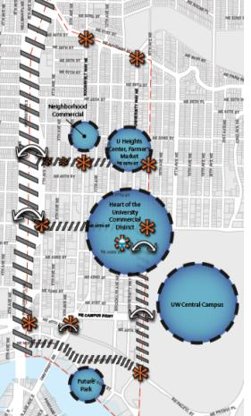
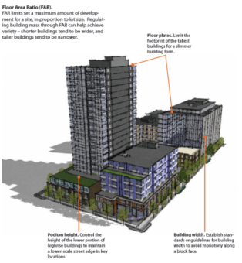
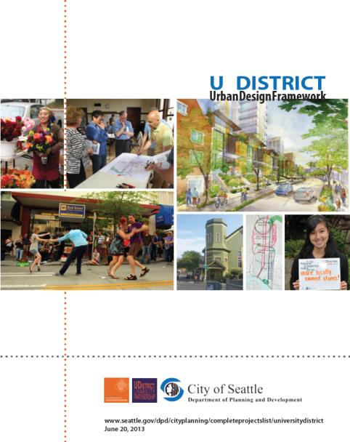
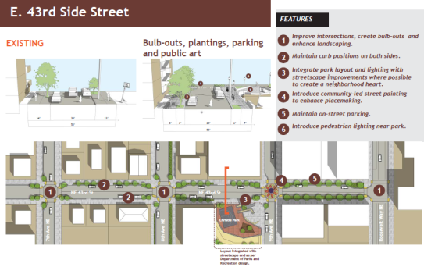
Urban Design Frameworks
Current Neighborhood Planning

Slide 12
Current planning processes
 | COMMUNITY PLANNING PROCESSES Community Development Area Planning
Most often used in… | N’hoods that want to stimulate job creation and housing development – often with fewer engaged community groups at beginning | N’hoods already experiencing significant growth, wanting to channel or fine tune how change happens– often with very active community groups
Community engagement | DPD/DON collaboration, POELs | DPD, often aligned with SDOT/OED processes
 | Shared: Stakeholder working groups, broad public outreach
Typical deliverables… Vary, depending on needs and planning histories | Community action plans | Urban Design Frameworks
 | Shared: Capacity building, Comp Plan amendments, zoning, streetscape concept plans, grants, neighborhood design guidelines
Examples | 23rd Ave, Delridge, Rainier Beach | South Lake Union, U District, Ballard
Current Neighborhood Planning

Slide 13
Common Themes
City Direction
  Evolving, but Core Values motivate City action
    community
    livability and environmental stewardship
    social equity
    economic opportunity and security
  Multi-disciplinary, interdepartmental approach
Public engagement
  Inclusive engagement. See participation from both traditional stakeholders as well as a much broader cross section
  Work with communities to set long term vision as well as realistic, obtainable results
Implementation
  Opportunistic
  Private sector roles
  Increasingly, grants & capital projects
Current Neighborhood Planning

Slide 14
Thank You
Susan McLain
Nora Liu
Dave LaClergue
Seattle Department of Planning & Development
Current Neighborhood Planning

