Slide 1
2016-17 proposed amendments to the Comprehensive Plan
Annual amendments to the Comprehensive Plan
Text
Future Land Use Map
From the Planning Land Use and Zoning committee webpage:
Applicants are encouraged to discuss policy (text) changes through the Seattle 2035 process, the City’s major update to the Comprehensive Plan, rather than submitting proposals for the annual cycle. Anyone interested in following this update process and participating should check out this web site: http://2035.seattle.gov/. Applicants should be advised that urban village map changes will likely be considered through the Housing Affordability and Livability Agenda (HALA) process in 2017, web site: http://www.seattle.gov/hala.

Slide 2
Docket Setting
Applications to Amend Comprehensive Plan to City Council – May 15th
OPCD and Planning Commission review for
docket setting
Resolution 31402
Today! Discuss whether or not amendments meet criteria?
City Council votes to set docket
Post Docket Setting…
Planning Commission and OPCD staff submit docket setting recommendations to the City Council PLUZ committee

Slide 3
Post Docket Setting
Briefs Planning Commission on recommendations
Planning Commission reviews amendments and makes recommendations to City Council
City Council votes to approve amendments in 2017
Mayor proposes amendments to the Comprehensive Plan
Post Docket Setting…
OPCD conducts review of docketed amendments

Slide 4
Docket Setting Criteria, Res. 31042
A. The amendment is appropriate for the Comprehensive Plan because:
B. The amendment is legal under state and local law.
C. It is practical to consider the amendment because:
D. If the amendment would change a neighborhood plan, it either is the result of a neighborhood review process or can be reviewed by such a process prior to final Council consideration of the amendment.
E. The amendment is likely to make a material difference in a future City regulatory or funding decision.

Slide 5
#1 – S. Holgate Street (Not Recommend)
Amend the North Rainier neighborhood Plan and future land use map to allow rezones of single-family areas to multifamily areas.
Proposal does not meet Criteria A5. This proposal would be better addressed through the public process associated with City Council’s review and consideration of the Mayor’s Recommended Comprehensive Plan – 2035. The Plan proposes a single future land use map category for all parcels within an Urban Village/Center, thus removing the need to change the land use category in the North Rainier Hub Urban Village.

Slide 6
#2 – Congregation Beth Shalom
(Not Recommend)
Amend the Future Land Use Map from Single Family and Multifamily to Commercial/Mixed Use in the Wedgwood neighborhood
Proposal doesn’t meet criteria A5. The proposal would be better addressed through the Mandatory Housing Affordability Implementation program and SDCI’s Wedgwood planning process.

Slide 7
#3 – NW 48th Street (Not Recommend)
Amend the Ballard-Interbay Northend Manufacturing Industrial Center Boundary to remove one block and amend the Future Land Use Map from Industrial to Commercial/Mixed Use.
Proposal doesn’t meet criteria A5. The proposal would be better addressed through the Mayor’s Task Force on Industrial lands and associated policies to be developed by that Task Force and considered by Council.

Slide 8
#4 – W Bertona Street (Not Recommend)
Amend the Ballard-Interbay Northend Manufacturing Industrial Center Boundary to remove one parceland amend the Future Land Use Map from Industrial to Commercial/Mixed Use
Proposal doesn’t meet criteria A5. The proposal would be better addressed through the Mayor’s Task Force on Industrial lands and associated policies to be developed by that Task Force and considered by Council

Slide 9
#5 –Seattle Chinatown/ International District Policies (Recommend)
Amend the Chinatown/International District Neighborhood Plan’s cultural and economic vitality policies.
Proposal meets criteria and warrants further study.

Slide 10
#6 –Eastlake Avenue E (Not Recommend)
Amend the Eastlake Residential Urban Village and the South Lake Union Urban Center Boundaries and the Future Land Use Map from Industrial to Commercial/Mixed Use.
Proposal doesn’t meet criteria A5. The proposal would be better addressed through the Mayor’s Task Force on Industrial lands and associated policies to be developed by that Task Force and considered by Council

Slide 11
#7 –S Columbian Way (Recommend)
Amend the Future Land Use Map from Single Family to Commercial/Mixed-Use or Multifamily
Proposal meets criteria and warrants further study.

Slide 12
#8 –Open and Participatory Government
(Not Recommend)
Add an Open and Participatory Government Element to the Comprehensive Plan
Proposal doesn’t meet criteria C4. This proposal has been considered and rejected for docketing several times.

Slide 13
#9 –Race and Social Equity
(Not Recommend)
Amend the definitions of “Marginalized People” and “Equitable Development”
Proposal doesn’t meet criteria A5 .The proposal would better be addressed through the public process associated with City Council’s review and consideration of the Mayor’s Recommended Comprehensive Plan - 2035

Slide 14
#10 –Neighborhood Planning
(Not Recommend)
Amend the Neighborhood Planning Element related to funding of neighborhood-initiated planning efforts
Proposal doesn’t meet criteria C4. This proposal has been considered previously and rejected. Furthermore, it would be better addressed as a budgetary decision (Criteria A4)

Slide 15
#11 –Heavy Vehicles
(Not Recommend)
Amend the Transportation Element related to impacts to roads and bridges from heavy vehicles
Proposal doesn’t meet criteria A5 .The proposal would better be addressed through the public process associated with City Council’s review and consideration of the Mayor’s Recommended Comprehensive Plan - 2035. Language relating to heavy vehicles is addressed in the Transportation Element of that Plan.

Slide 16
#12 –Urban Trails Map
(Not Recommend)
Amend the Seattle Urban Trails System Map to recreate the historic bicycle and pedestrian path system around Eastlake
Proposal doesn’t meet criteria A5 .The proposal would better be addressed through the public process associated with City Council’s review and consideration of the Mayor’s Recommended Comprehensive Plan - 2035. The Urban Trails map is not included in the Mayor’s Recommended Plan – 2035. Furthermore, this amendment was rejected by Council in 2012 (Criteria C4)

Slide 17
#13 –Pedestrian grade separations
(Not Recommend)
Amend the Transportation Element to discourage pedestrian grade separations.
Proposal doesn’t meet criteria C4. This proposal has been considered and rejected multiple times.

Slide 18
#14 –Growth Monitoring
(Not Recommend)
Amend the Comprehensive Plan related to monitoring and responding to growth in urban centers and villages
Proposal doesn’t meet criteria A5 .The proposal would better be addressed through the public process associated with City Council’s review and consideration of the Mayor’s Recommended Comprehensive Plan - 2035. That Recommended Plan does address monitoring of development activity in the Growth Strategy.

Slide 19
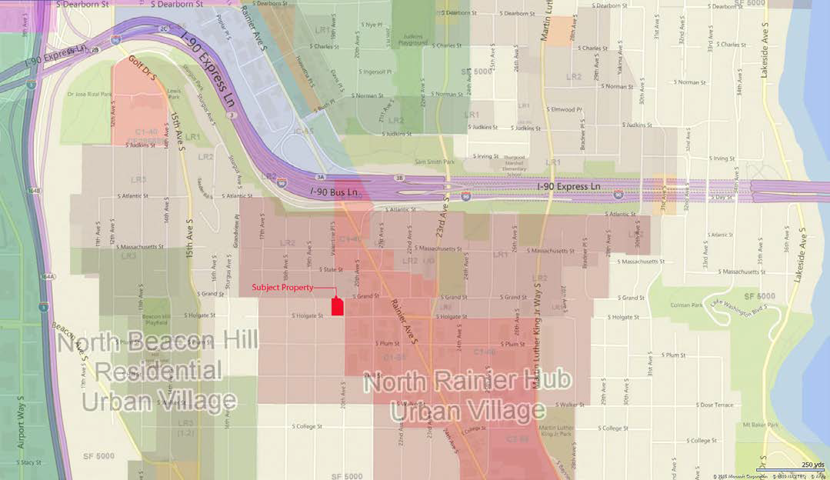
S Holgate Street

Slide 20
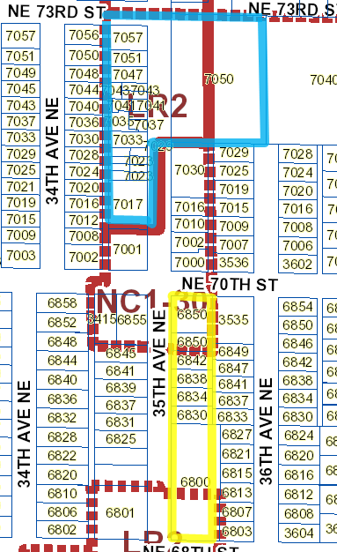
Congregation
Beth Shalom

Slide 21
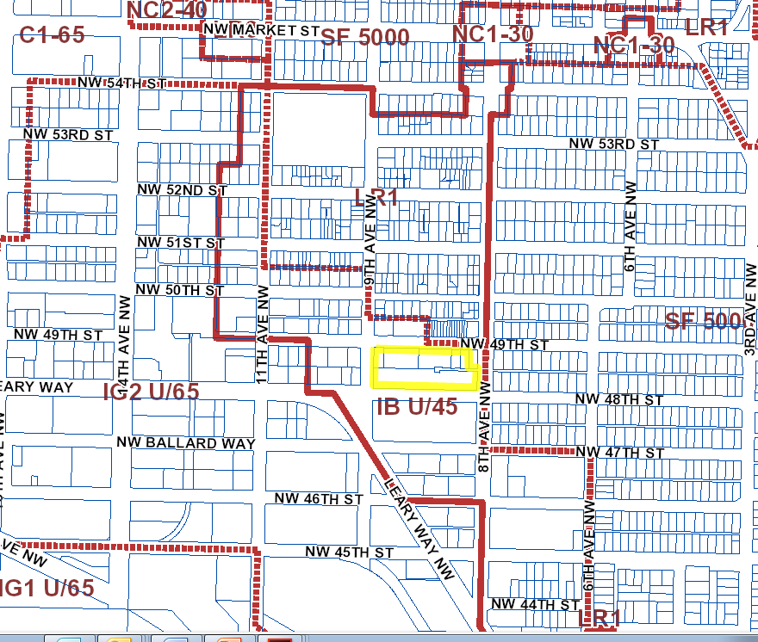
NW 48th
Street

Slide 22
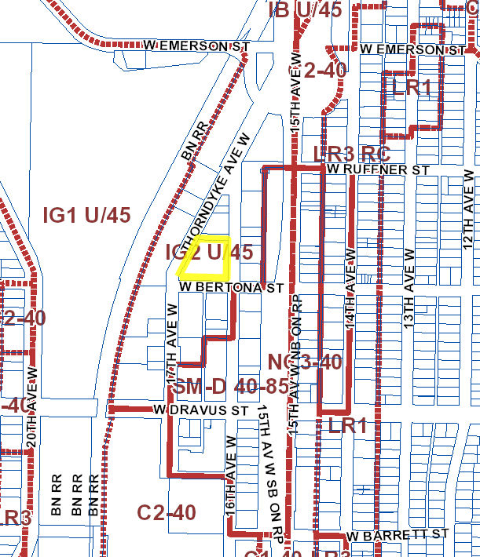
1616
W Bertona St.

Slide 23
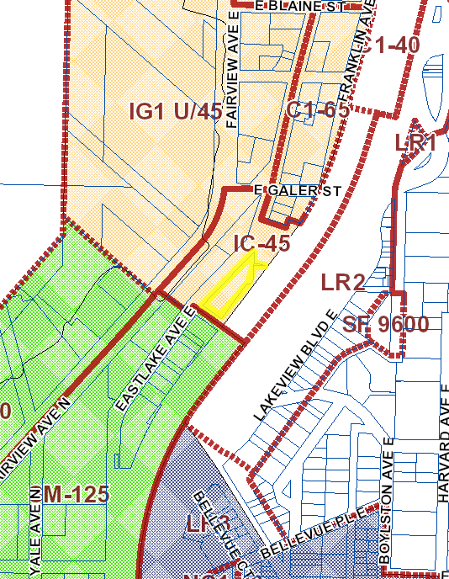
1208 Eastlake Ave E

Slide 24
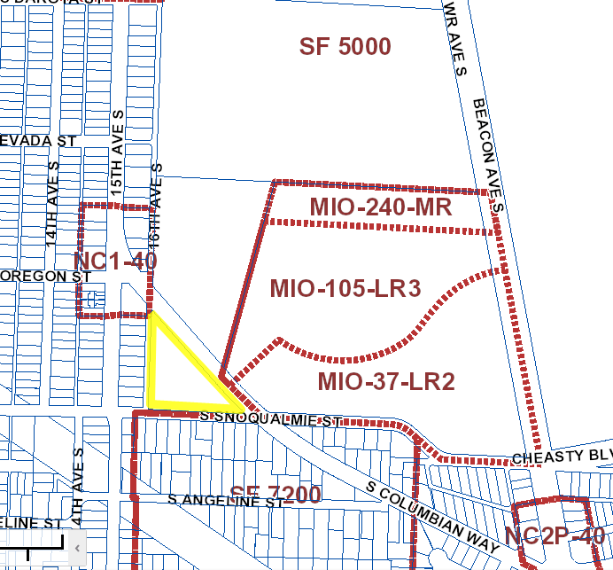
1625 S
Columbian Way

