Slide 1
Swift/Myrtle/Othello
Mini Mobility Study
Presentation by:Johairah Bongato and Cooper Berrysmith

Slide 2
Goals
Identify safety concerns for pedestrians and cyclist along the corridor
Provide feedback for the improvement of streetscape conditions
Determine areas to target for future improvements
Display the need for a safe and attractive walking and bicycling environment for pedestrians along the corridor
Share survey data from the Major Taylor Project students

Slide 3
Current conditions
Unsafe connection from Georgetown to Othello station
Road needs to be repaved: potholes, curbs smashed by big trucks
Poor visibility for pedestrians and cyclist
Unsafe speeds for automobiles interacting w/pedestrians
Inadequate pedestrian and cyclist infrastructure

Slide 4
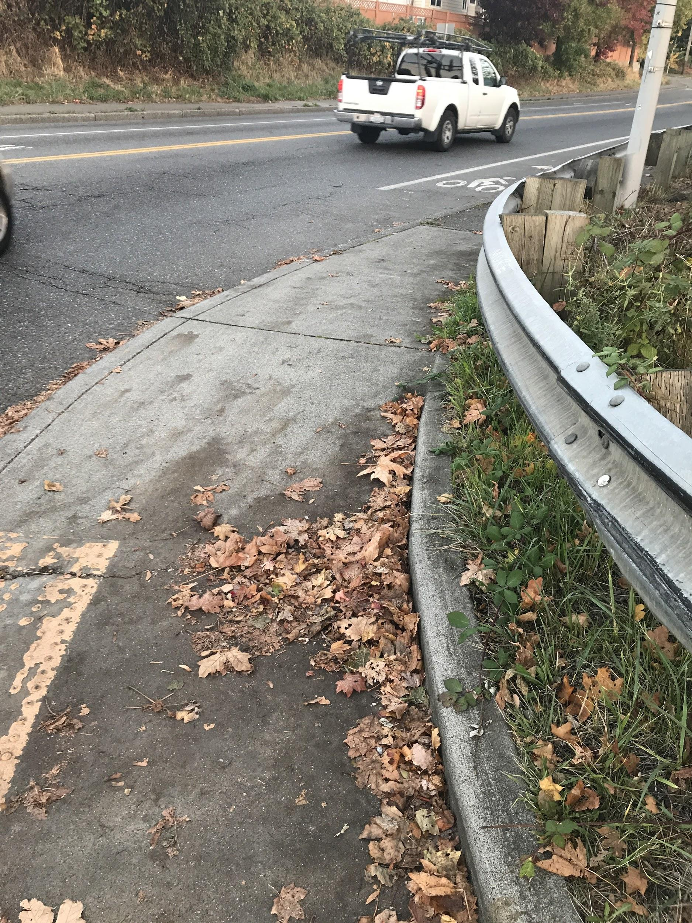
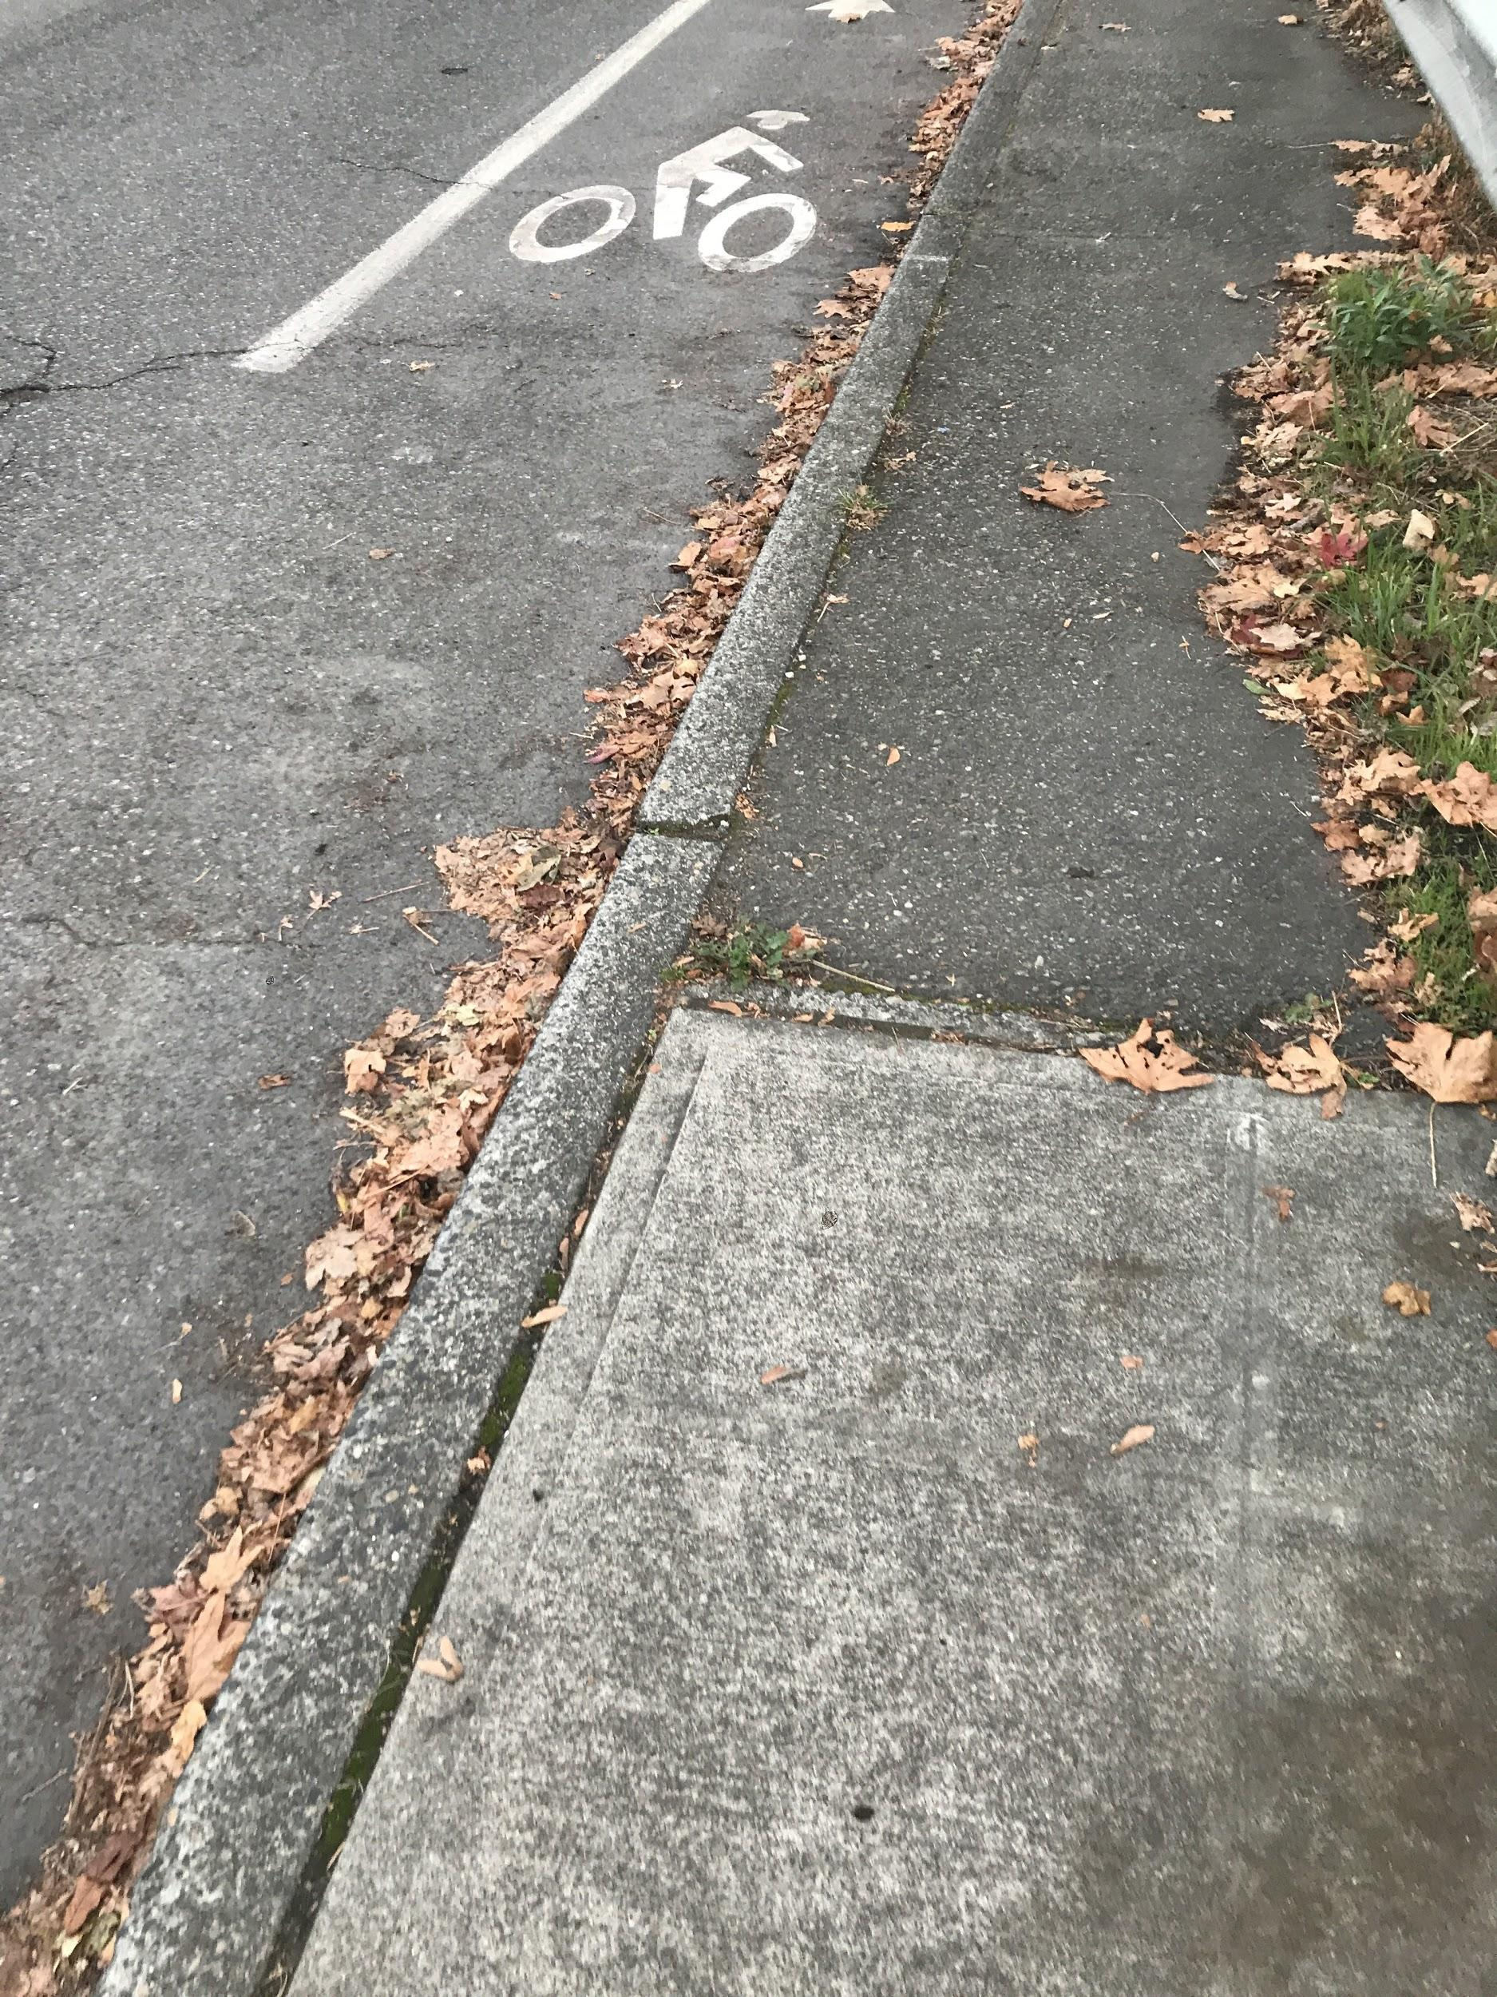
Right turn hazzard onto Swift from Albro

Slide 5
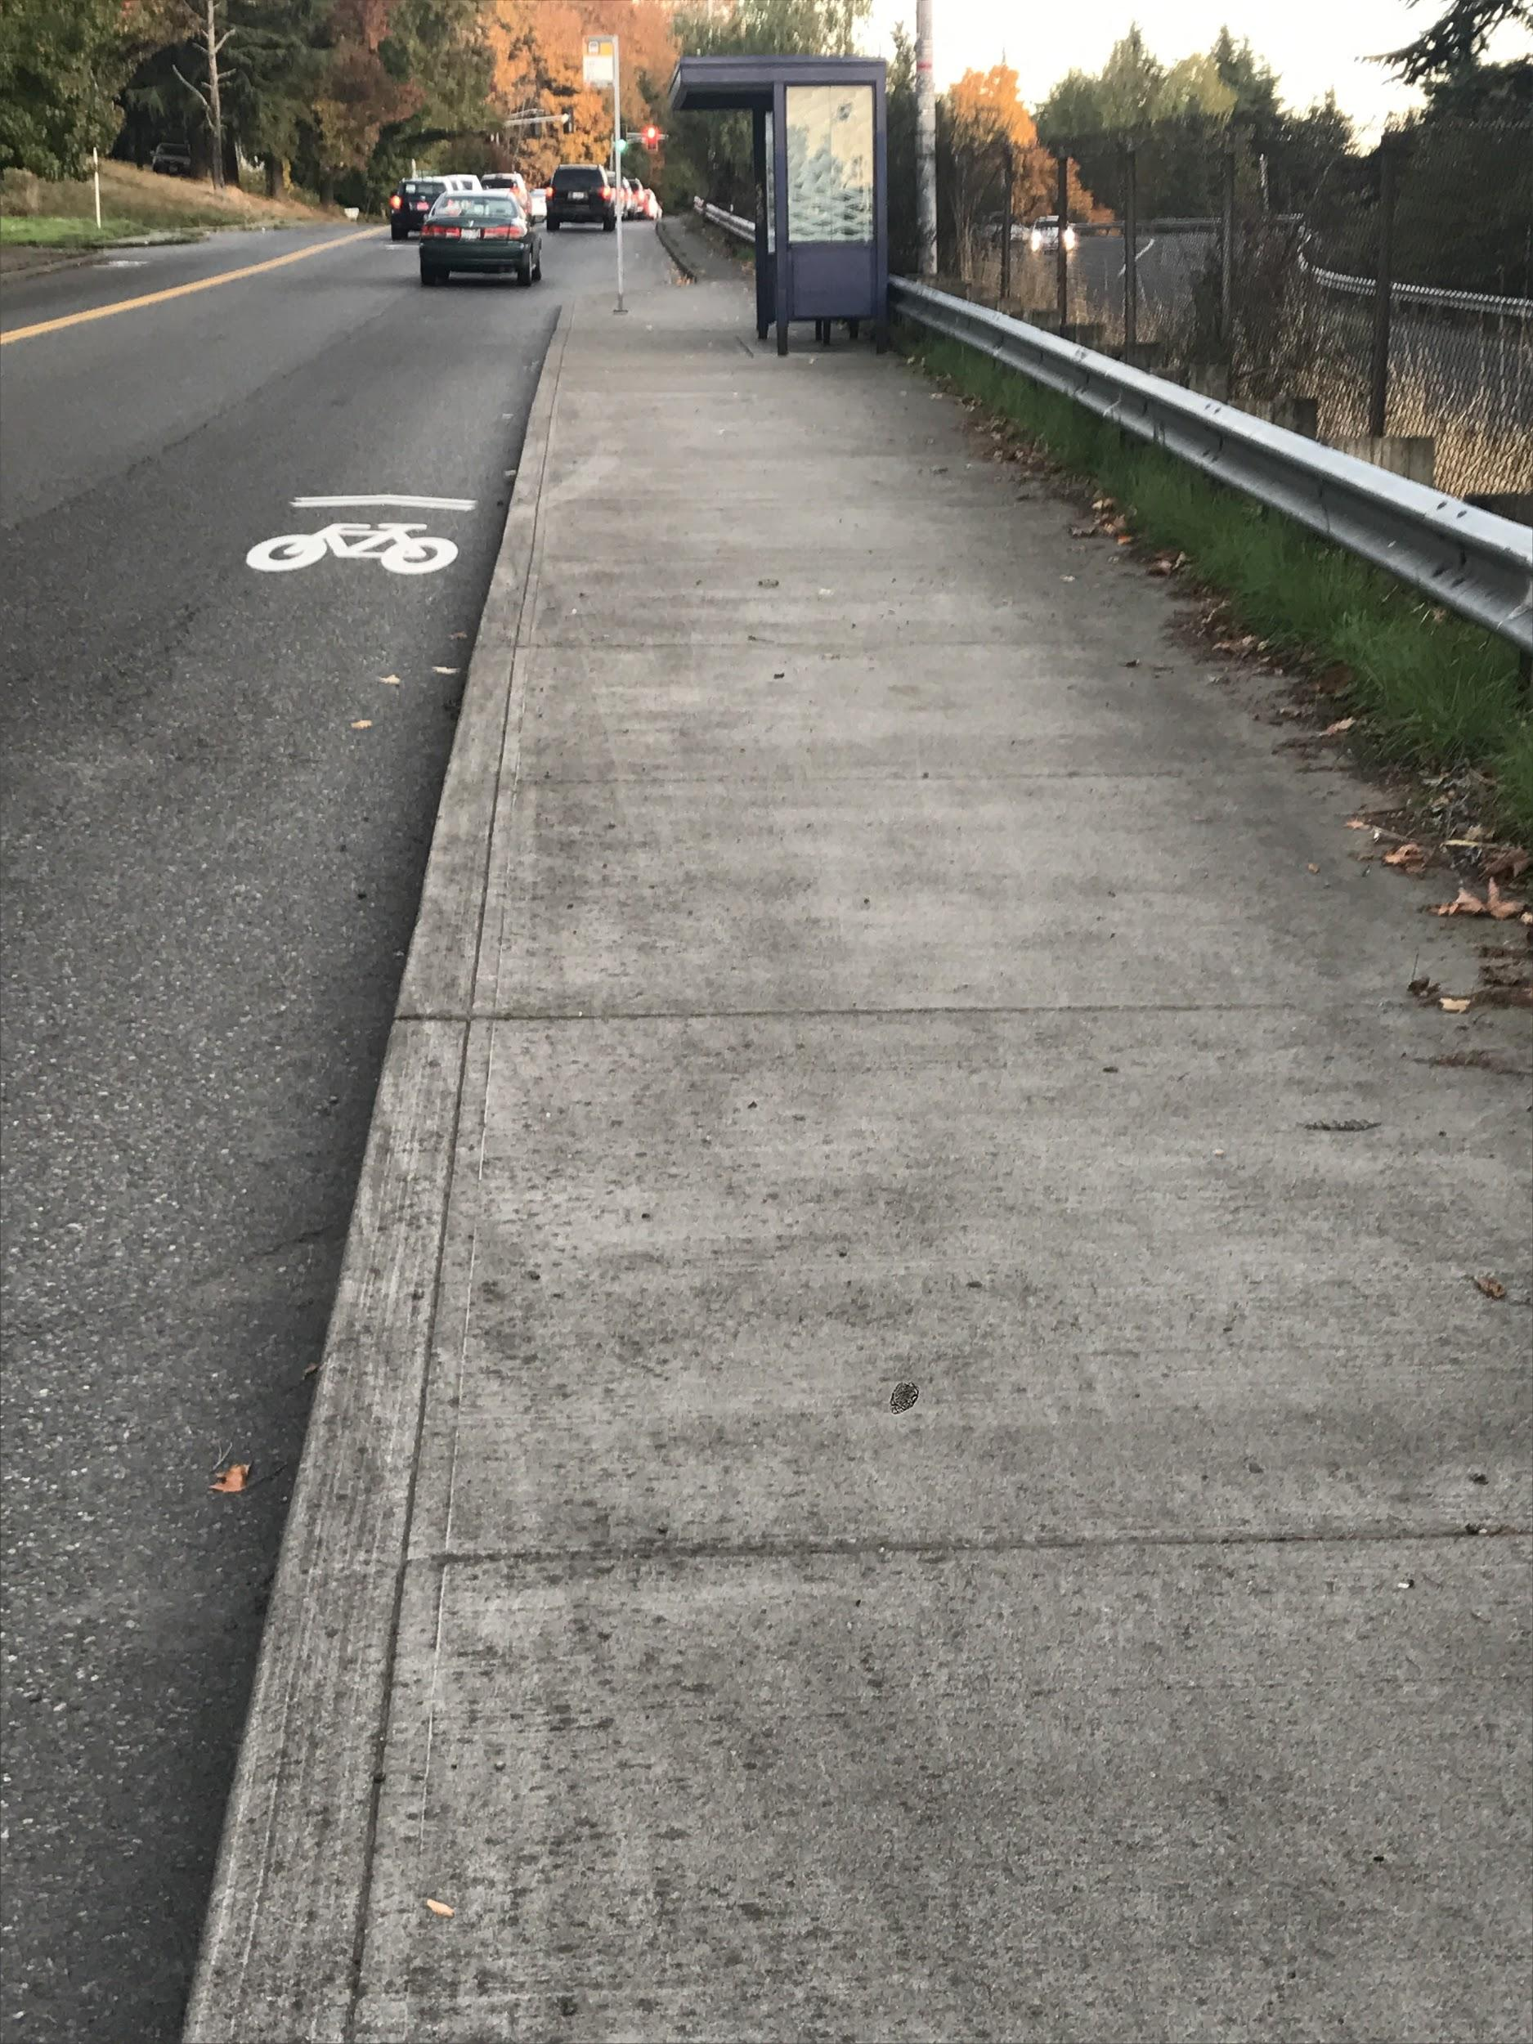
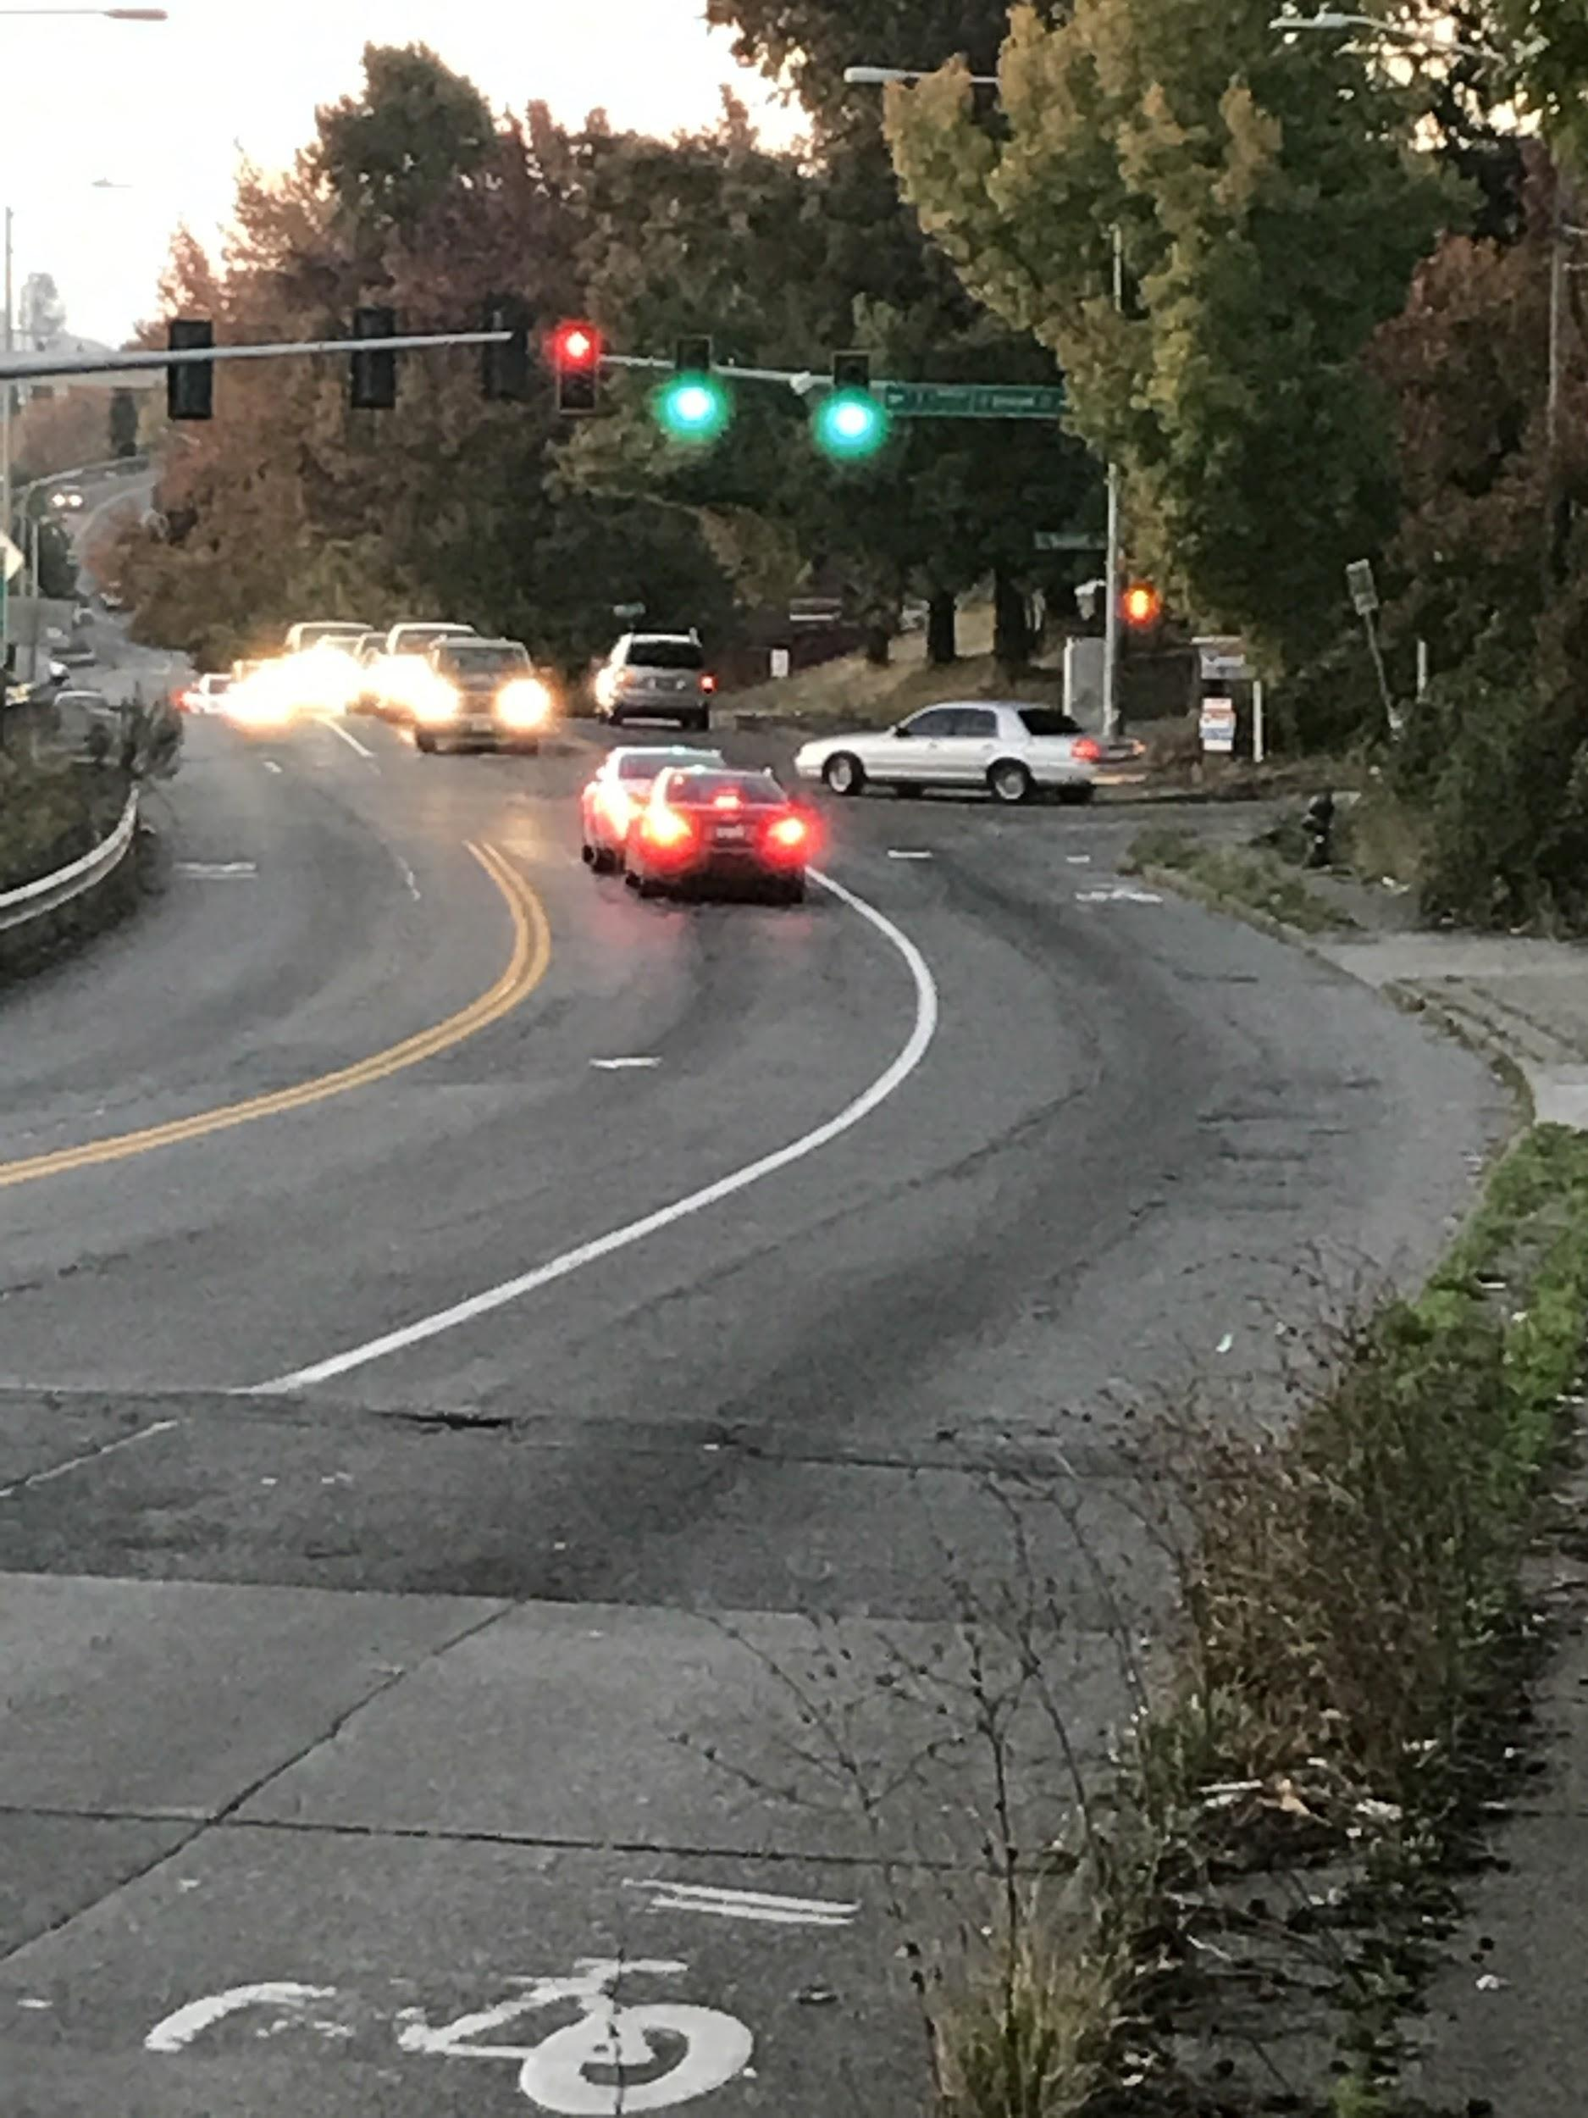
Left image:
Bike lane ends and cyclist get squeezed off the road
Right image:
Poor visibility at Swift and Graham

Slide 6
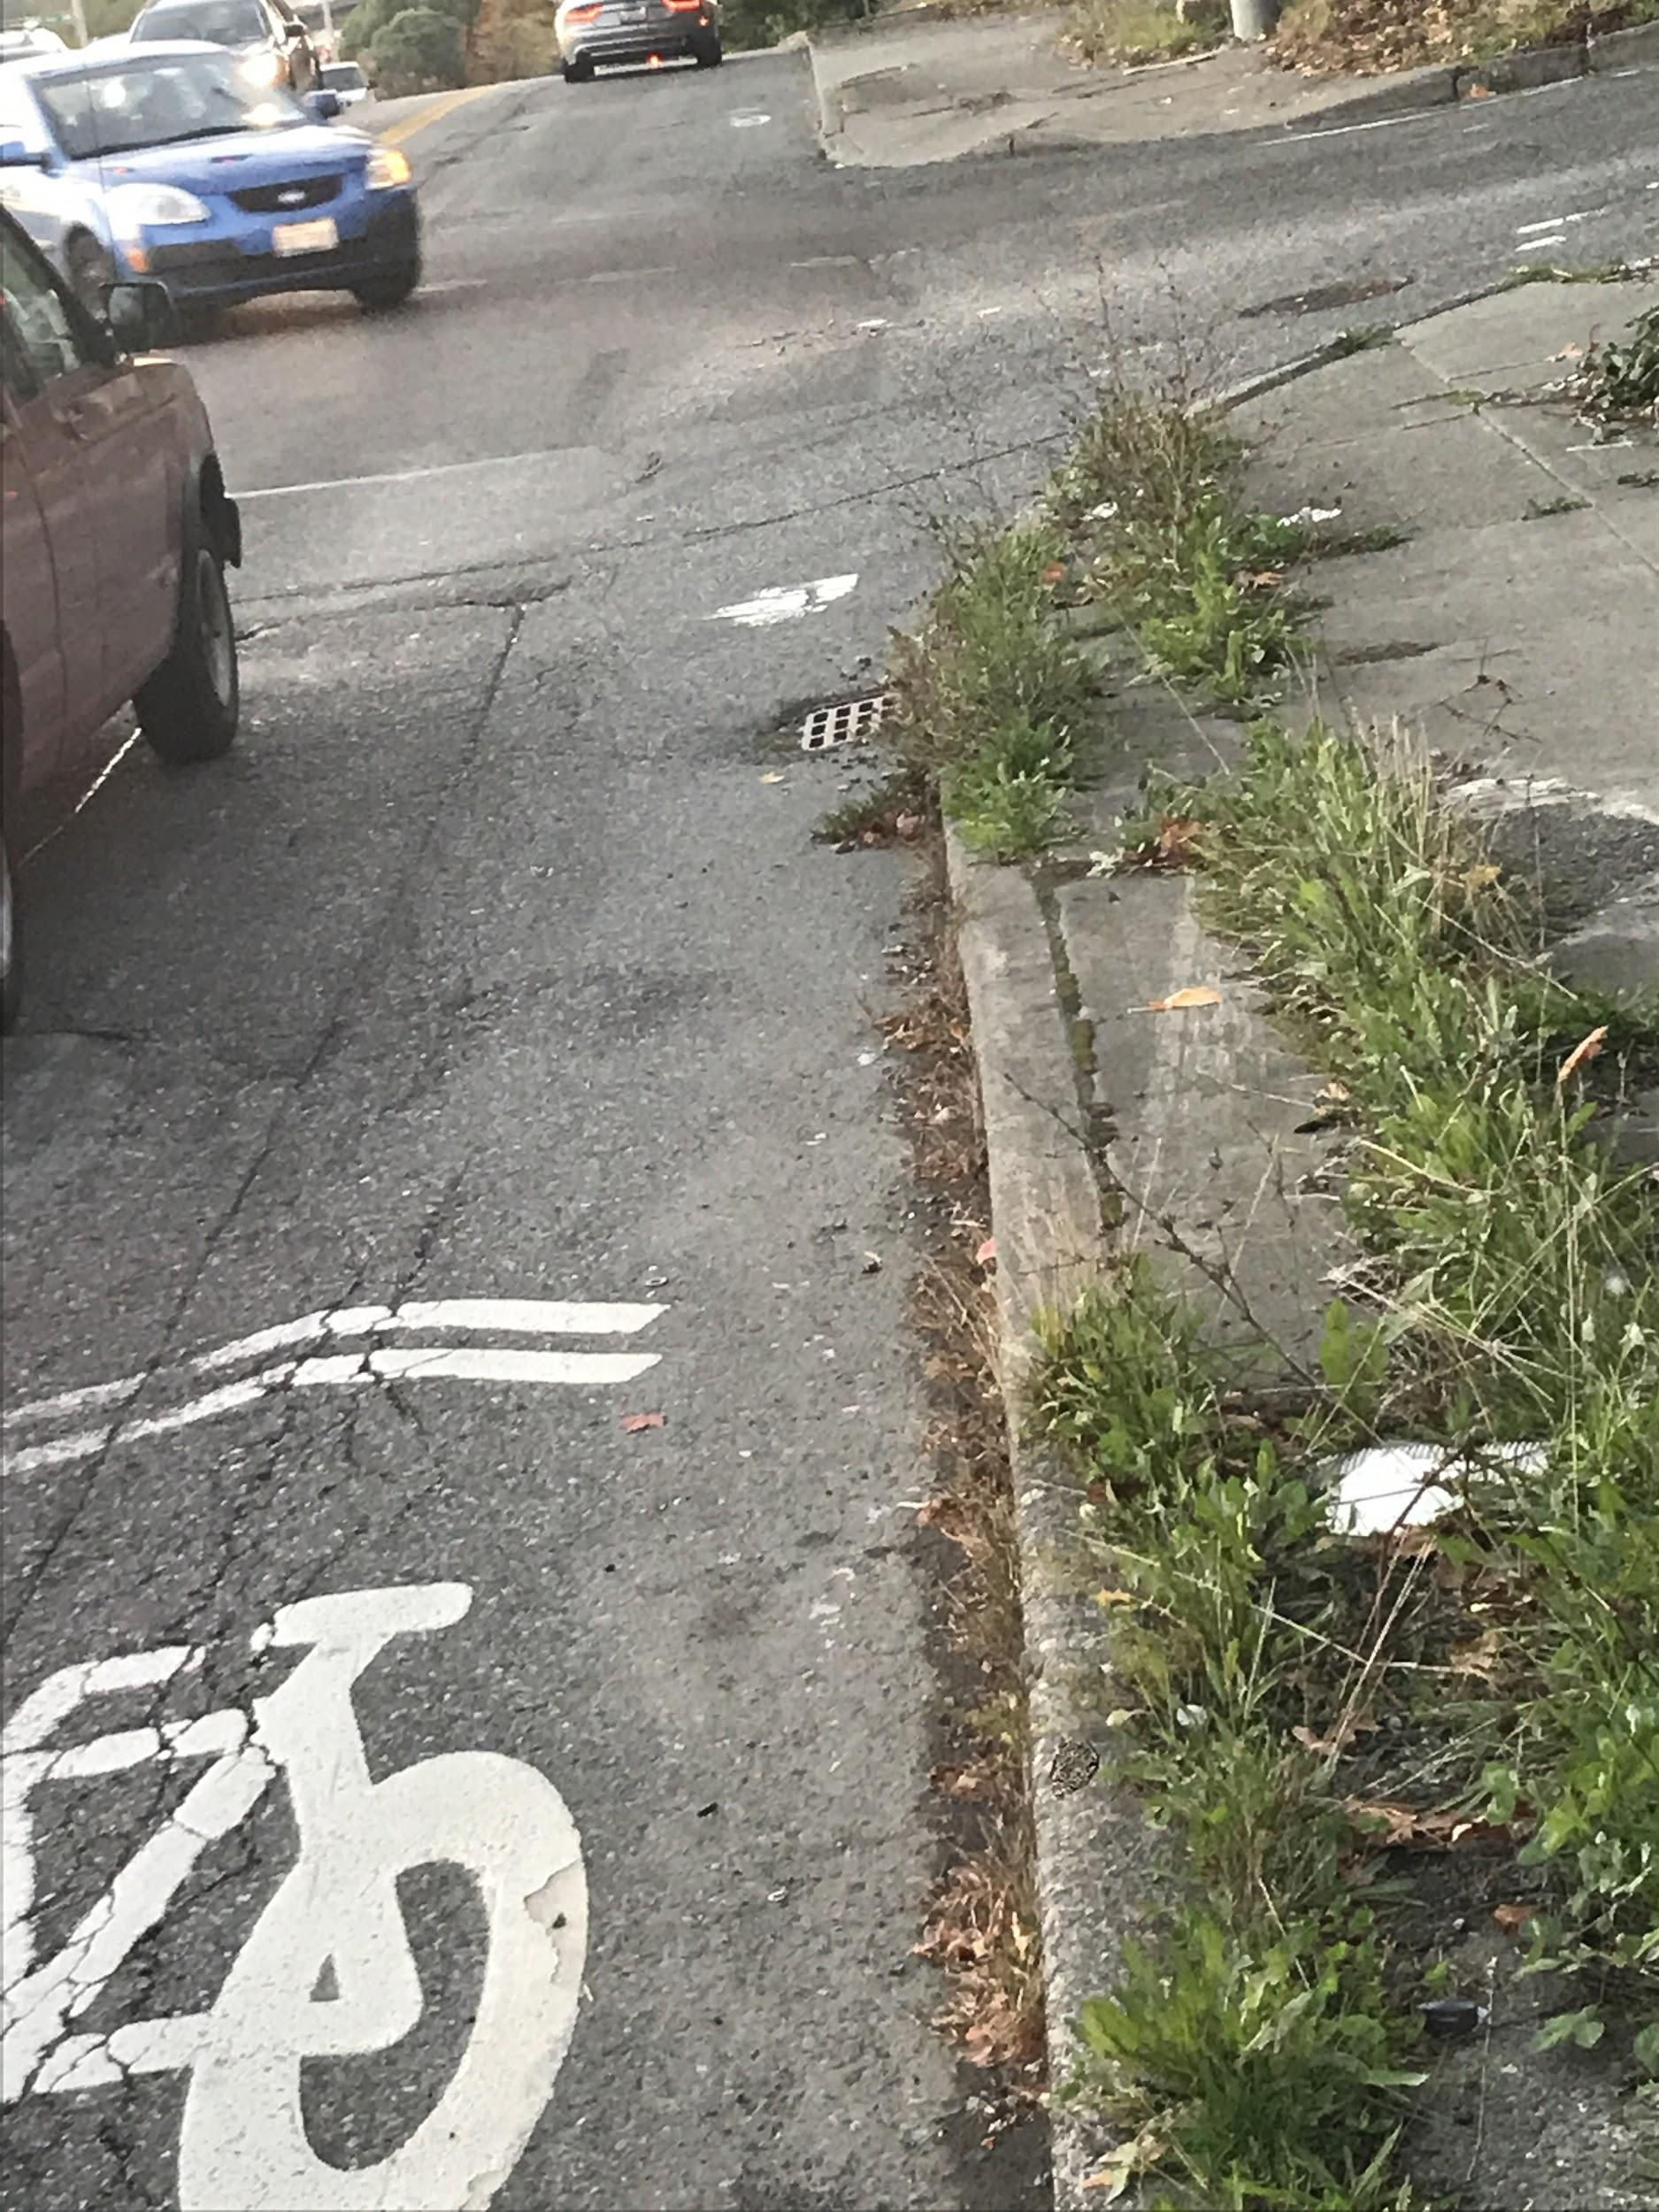
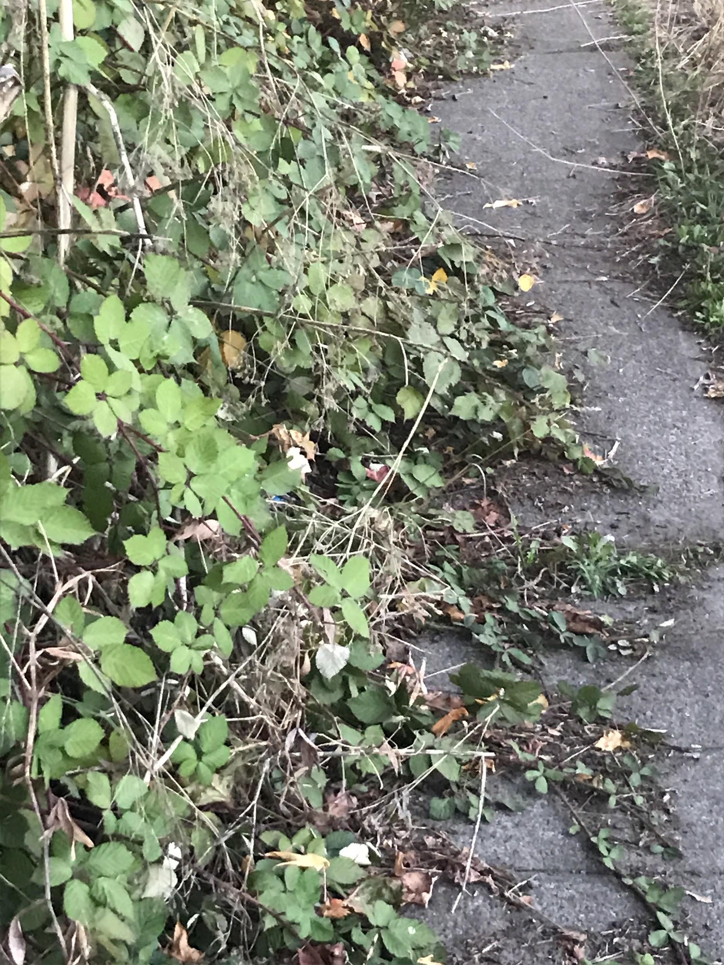
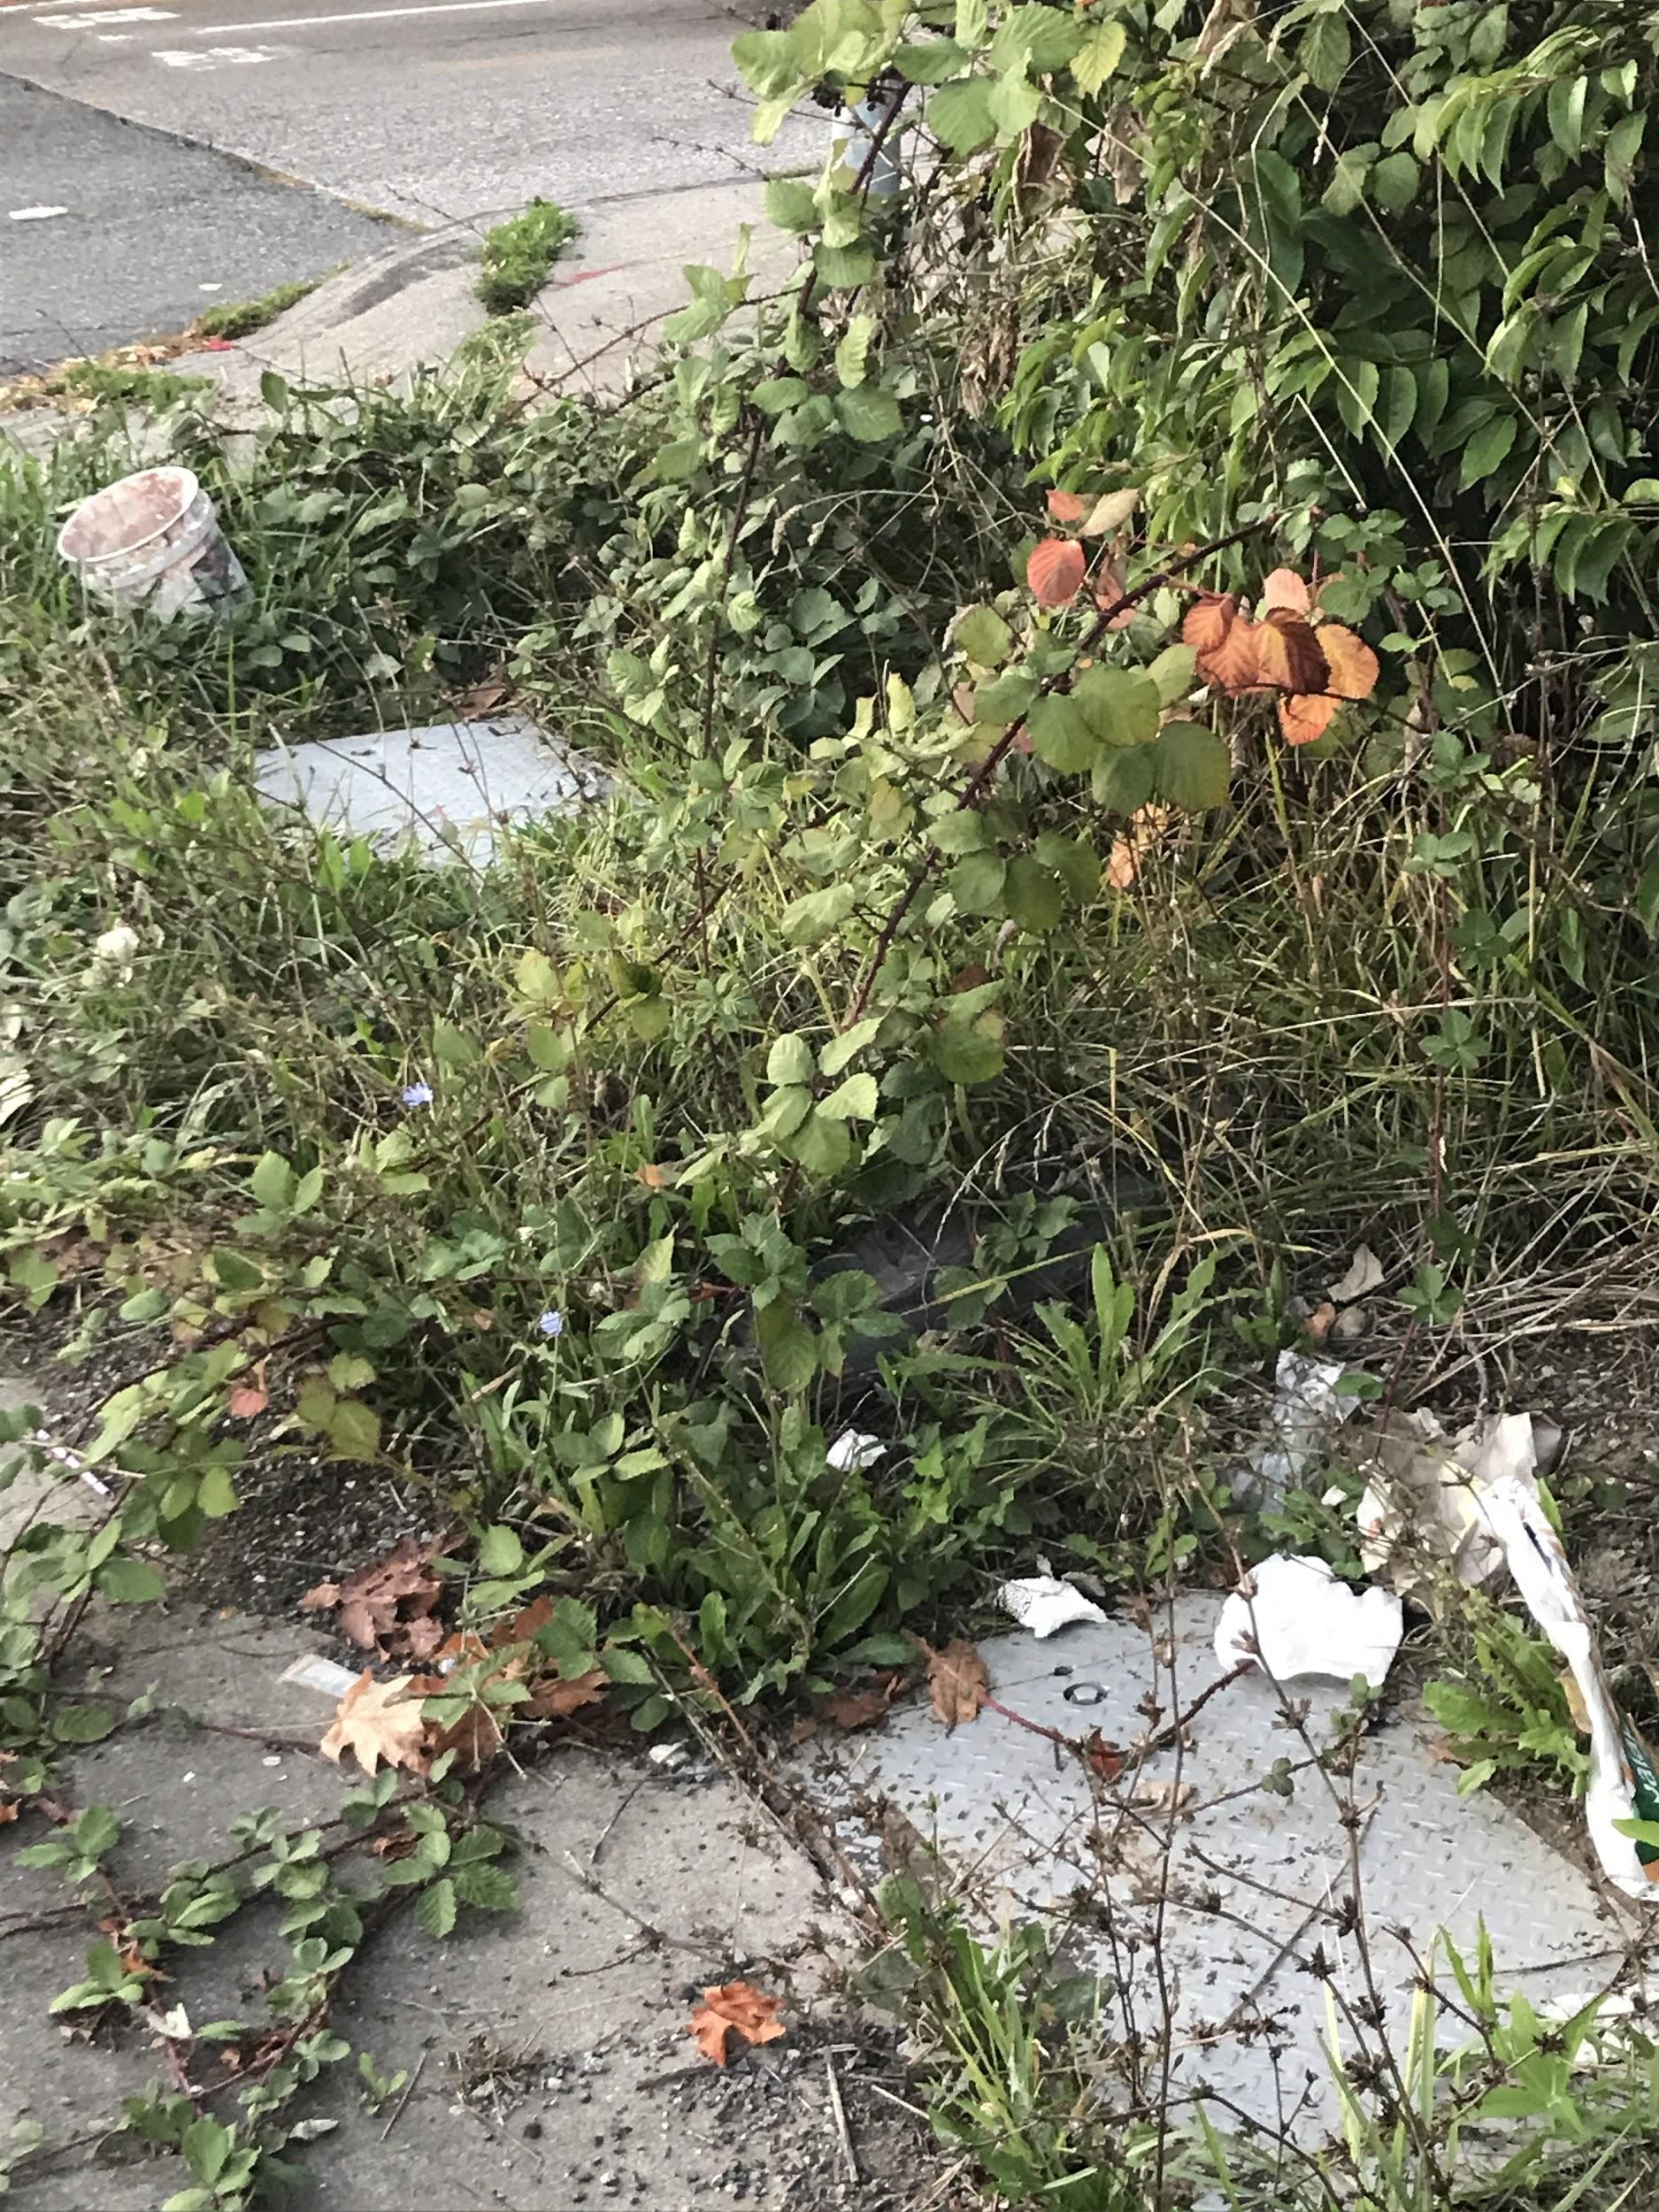
The corner of Graham and Swift…..Yikes
Notes:
The curb and sidewalk have suffered from this sharp right turn. Big trucks constantly jump the curb. Would require a stop on right signal for bicyclist.

Slide 7
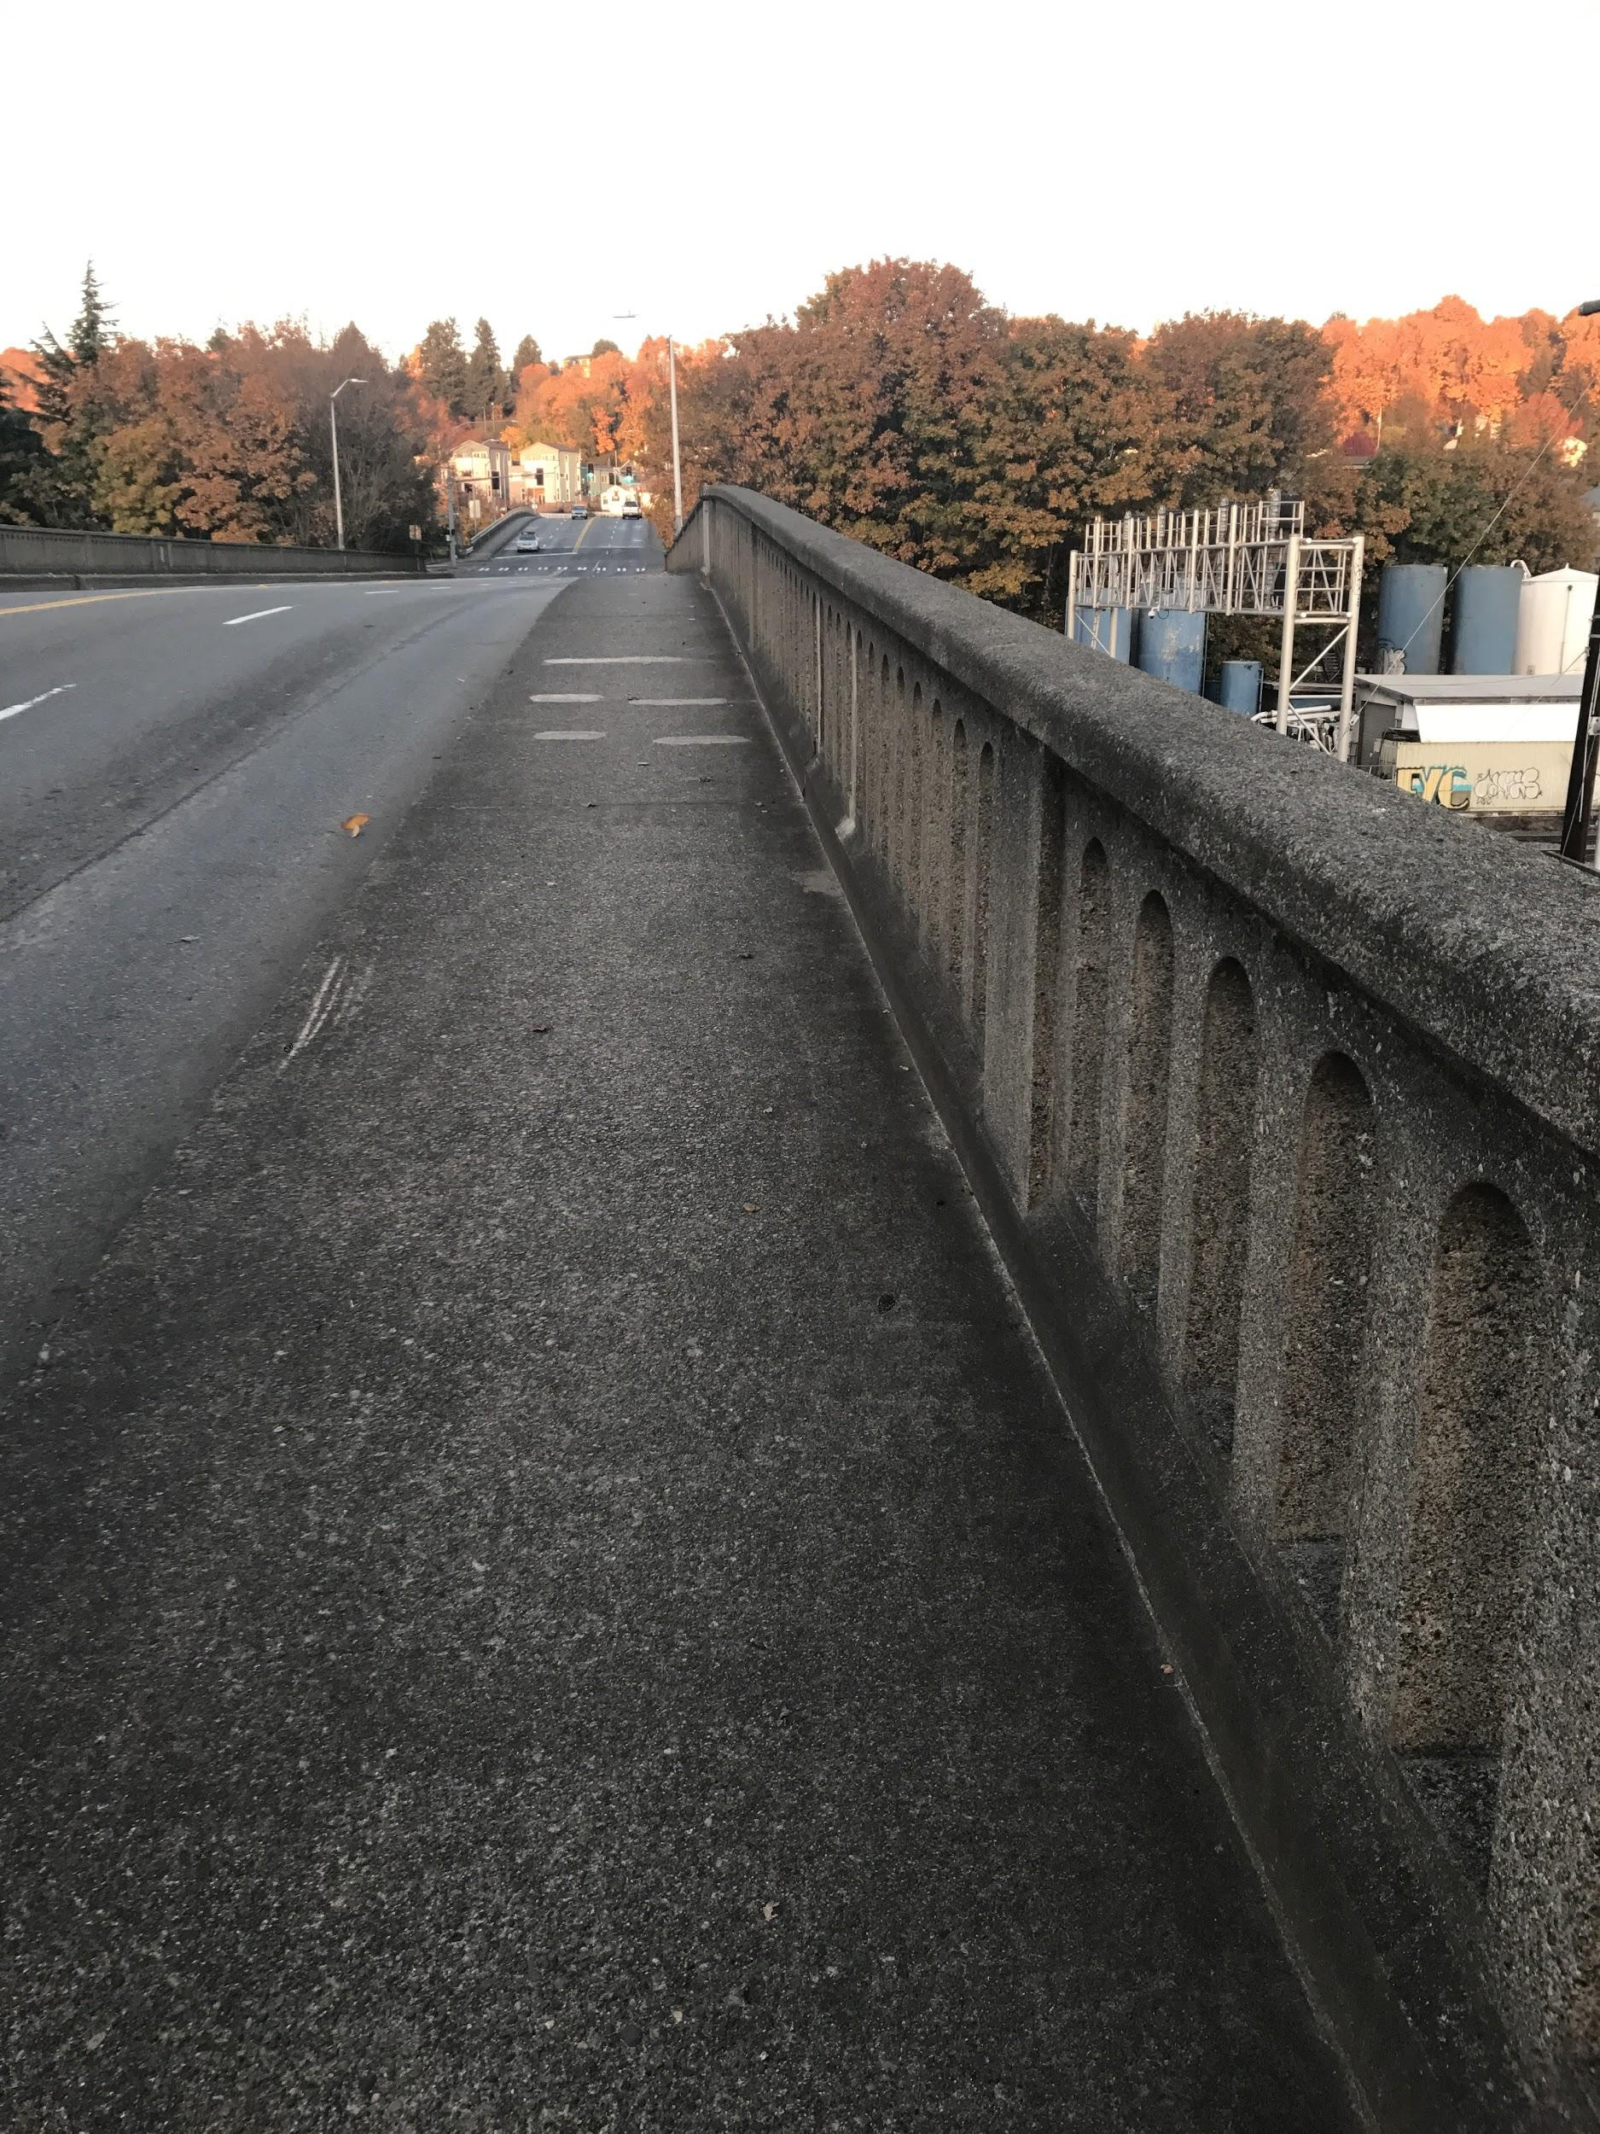
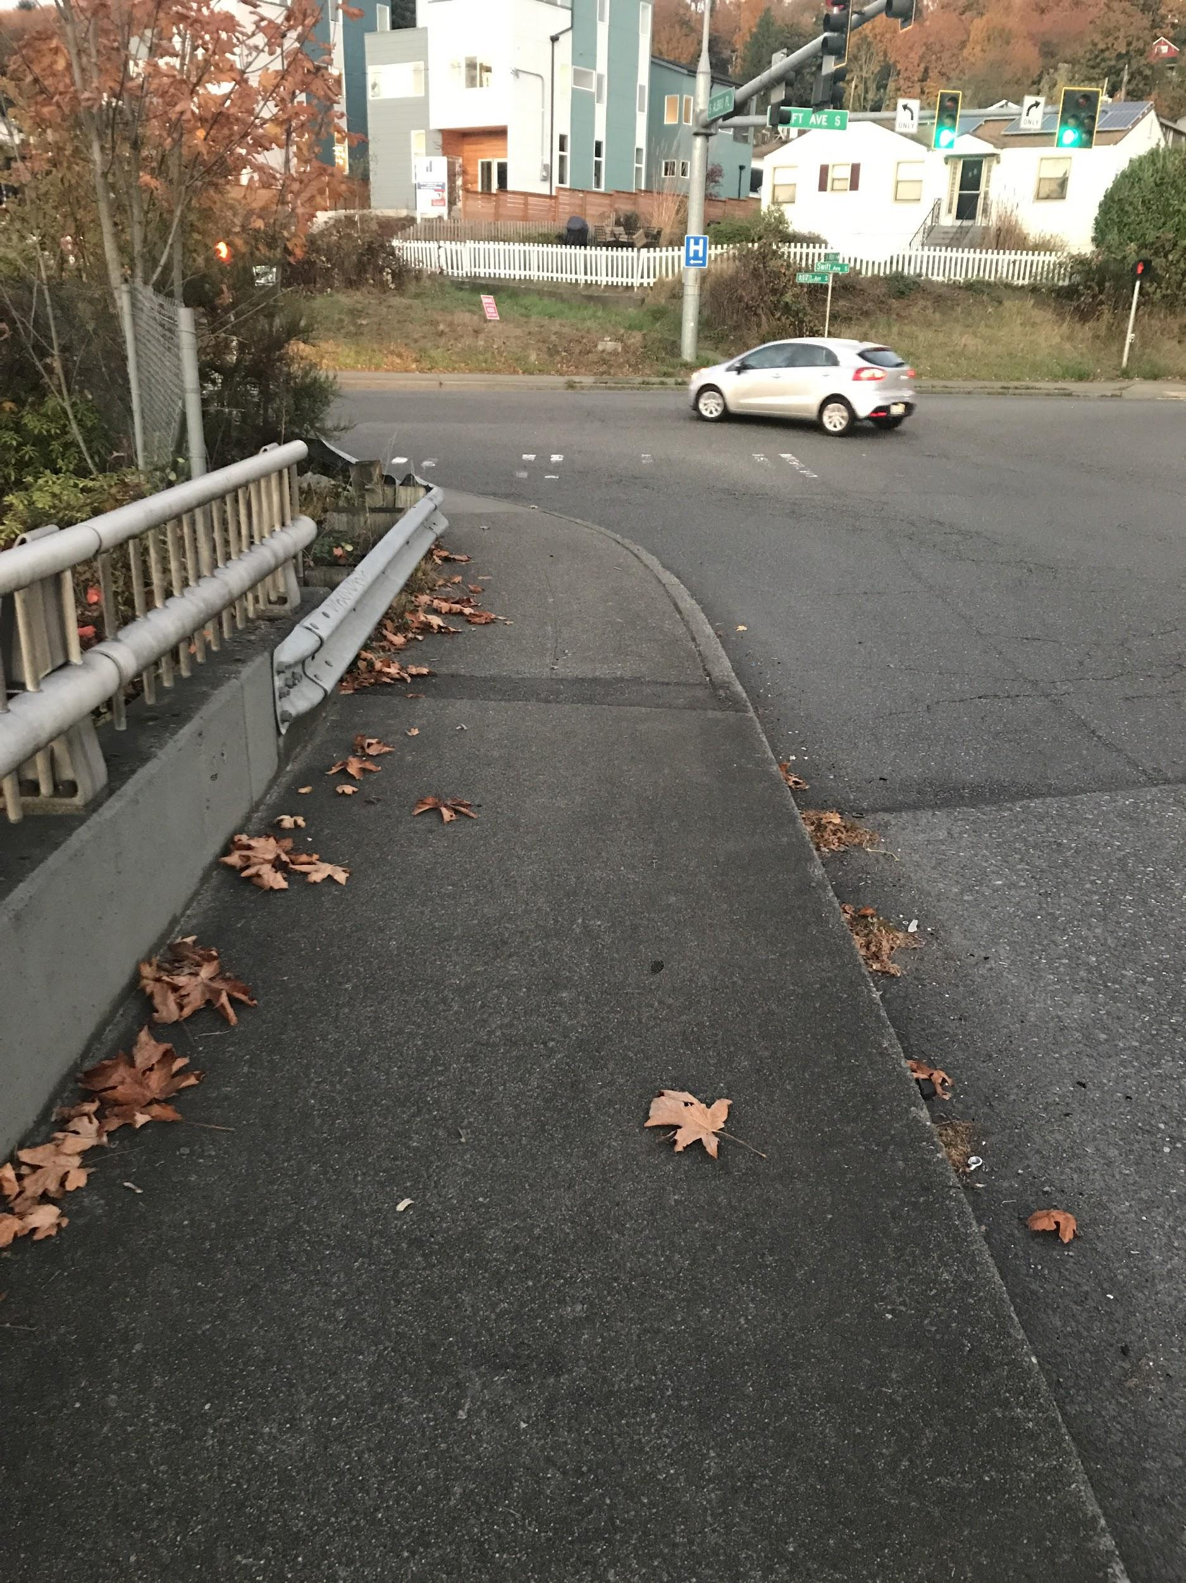
Out of Georgetown Into Georgetown
Left image:
Potentially the sidewalk could be marked off as a pedestrian/bicycle path. Extremely high curb.
Right image:
Path from Swift could continue from Georgetown to South Park
Notes:
Students noted that the sidewalk in front of the turning car could be a bike lane then at the signal you could cross safely onto the sidewalk.

Slide 8
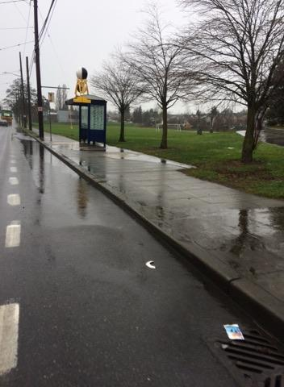
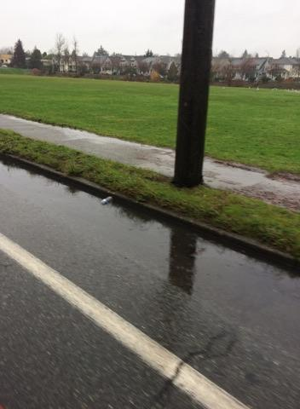
S Myrtle St: Flooded areas after light rain

Slide 9
Cracks on Road, Potholes

Slide 10
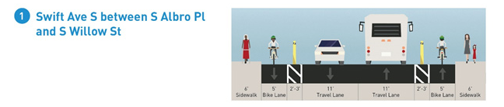
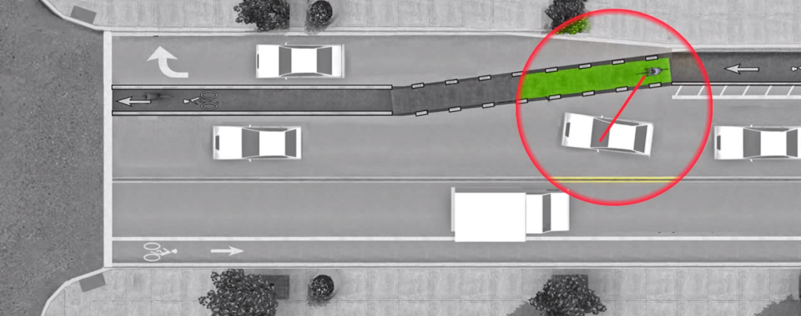
“Project Overview: Typical Cross Sections.” Swift Avenue S / S Myrtle Street / S Othello Street Paving Project, 30 May 2017
Road width in project is wider than actual road (~35 ft)
Lane dividers take up space, poles would suffice
Sidewalk unrealistically wide, also takes up space
Turn pocket for freeway entrance

Slide 11
“Project Overview: Typical Cross Sections.” Swift Avenue S / S Myrtle Street / S Othello Street Paving Project, 30 May 2017
Section 2 same ideas as section 1
Section 3 needs no changes to actual road

Slide 12
Actions Needed
Benefits:
Smoother/safer commute
Clearer visibility
Less swerving to avoid road hazards
Concerns:
How to add road width (limited space)
Bus stops and bike lanes
*applies to all sections*
Remove bushes/weeds
Clean road debris regularly (trash/loose concrete) by sending street sweepers
Improve road conditions (repave/patch)

Slide 13
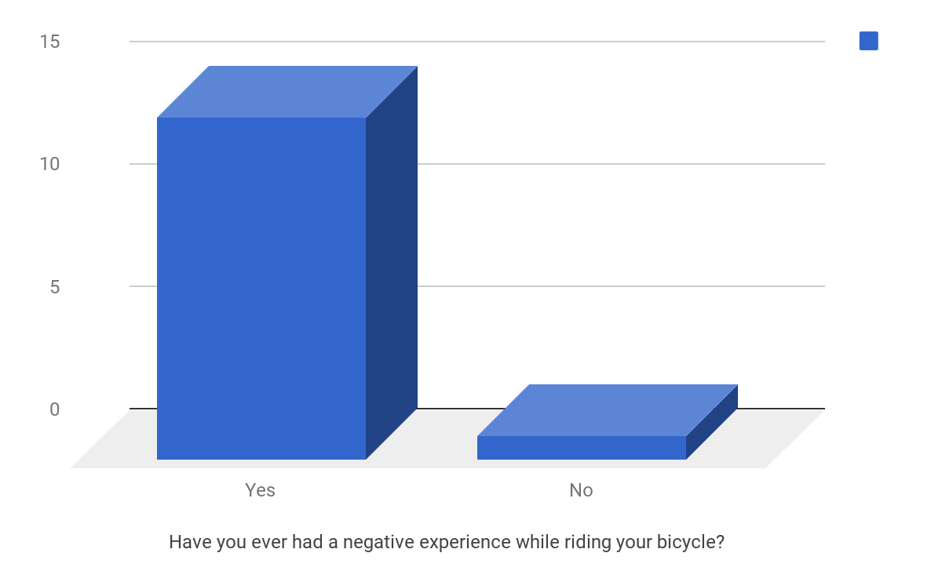

Slide 14
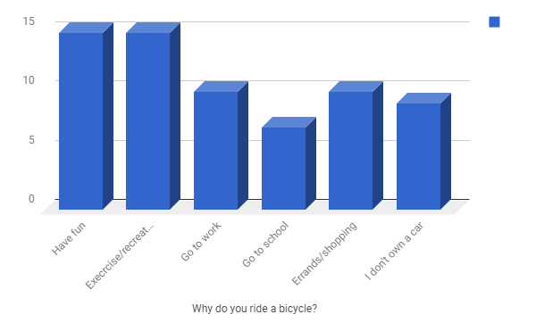

Slide 15
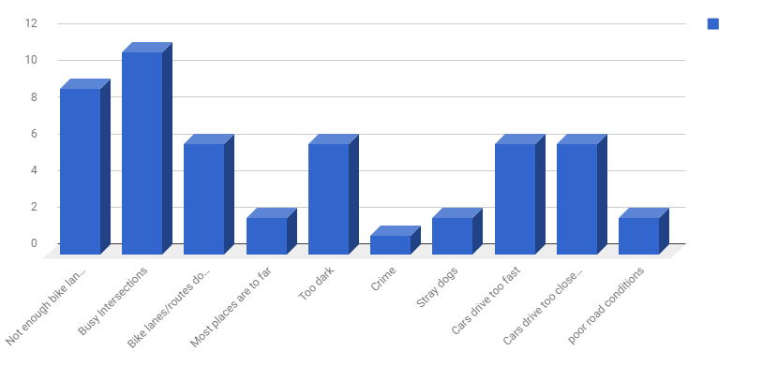

Slide 16
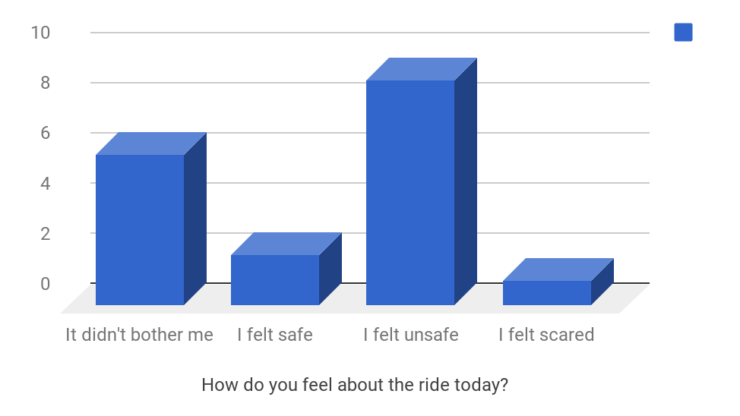

Slide 17
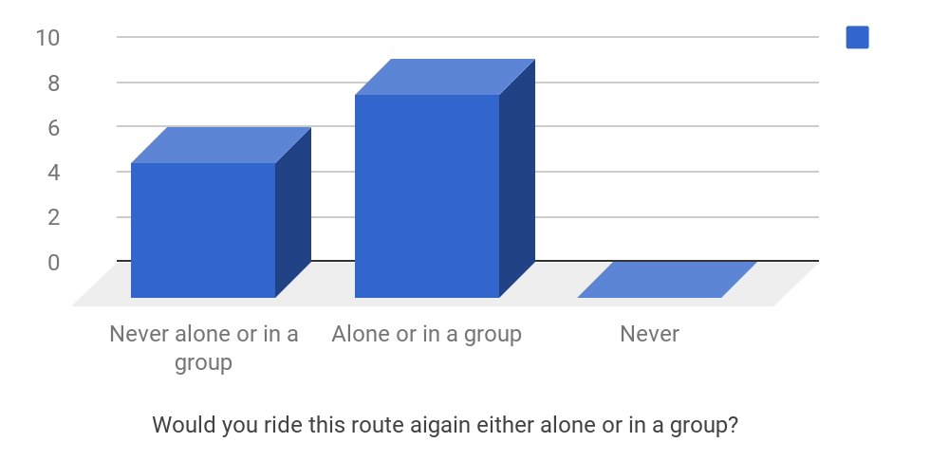

Slide 18

Thanks to Cascade and The Major Taylor Project students

