Slide 1
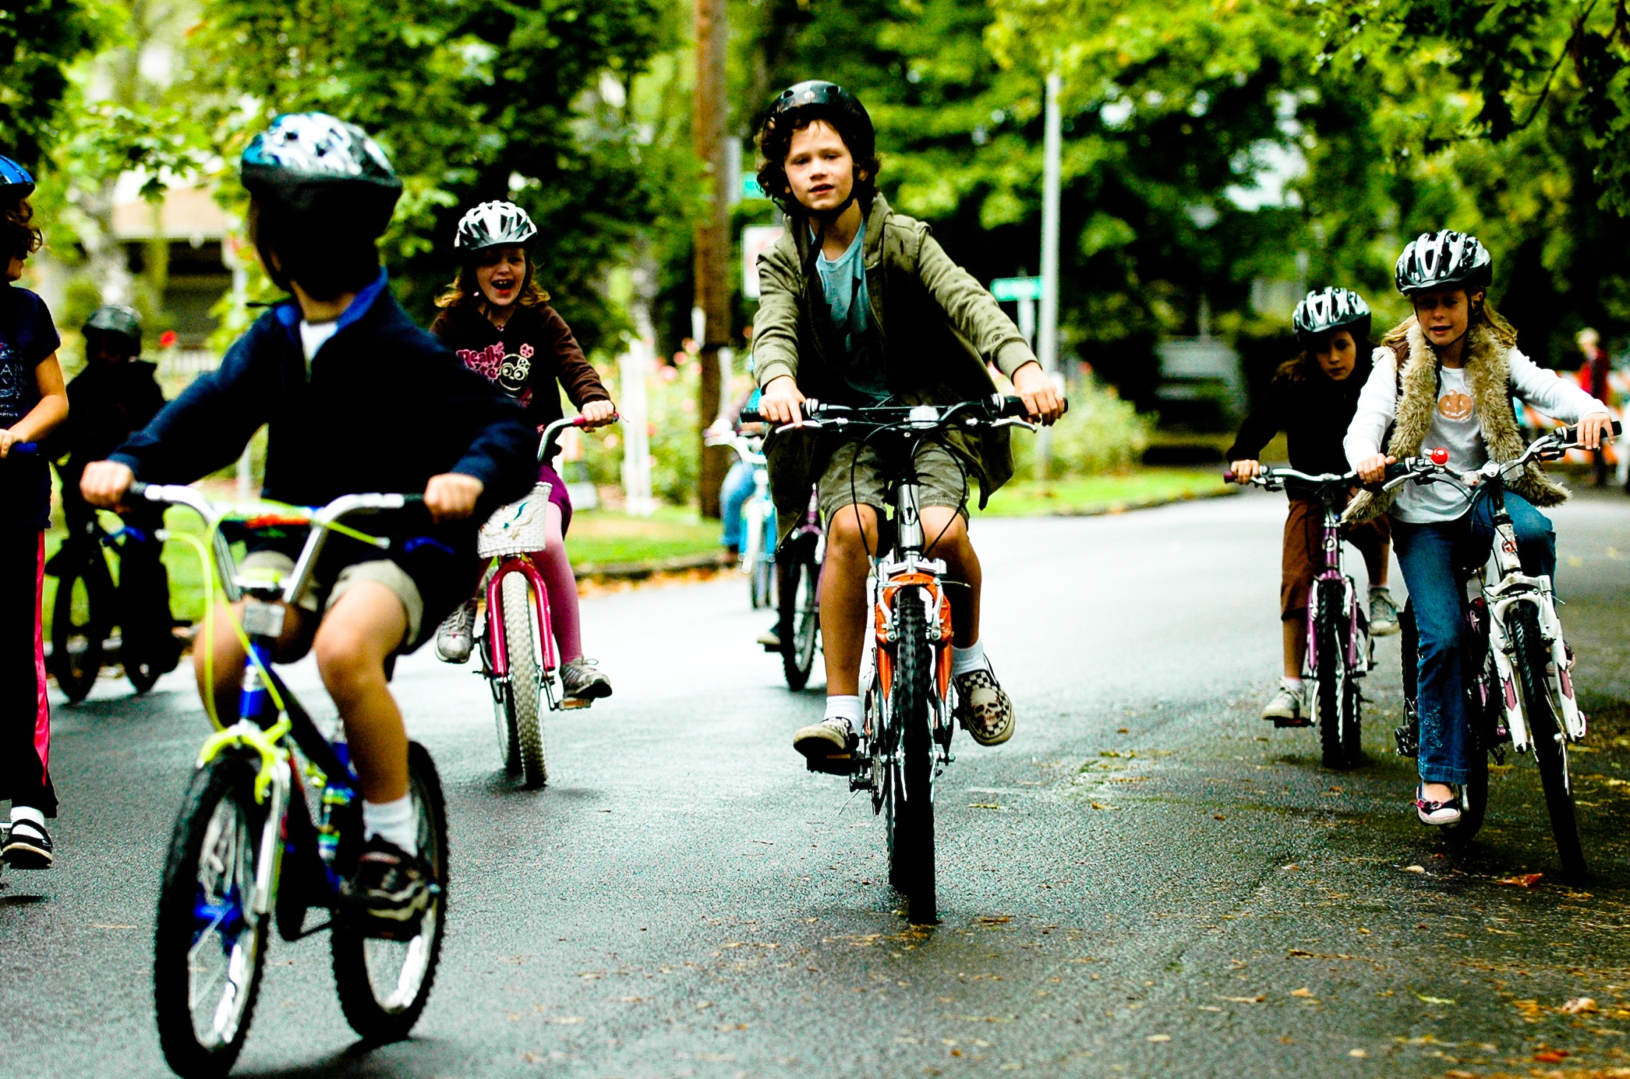
Rainier Valley Safety & Bicycle Projects
Vision Zero and Neighborhood Greenways
Seattle Bicycle Advisory Board
Summer Jawson & Jim Curtin
January 06, 2015

Slide 2
Presentation overview
Update on the Rainier Valley North – South Neighborhood Greenway
Rainier Ave South – Road Safety Corridor
Discussion
2

Slide 3
Rainier Valley North – South Neighborhood Greenway
Connects the I-90 Lid Trail to Rainier Beach Library
6.2 miles
10 Arterial Crossing
4 SRTS Partnerships
10 Park Connections
1 NPSF Partnership
3

Slide 4
Improvements to Greenway
Since the Most Promising Route was published in September there have been:
4 Route Re-alignments
Modifications to arterial crossing improvements
Addition of pedestrian scale lighting to trail improvements
4

Slide 5
Greenway Improvements at Othello
Crossing Beacons
Curb Bulbs
Trail Improvements and Lighting
Route realignment
5

Slide 6
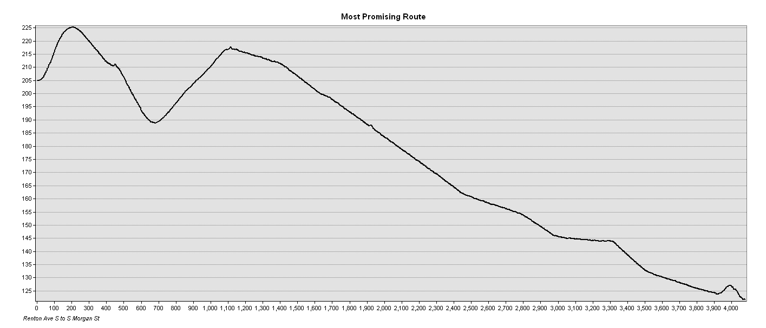
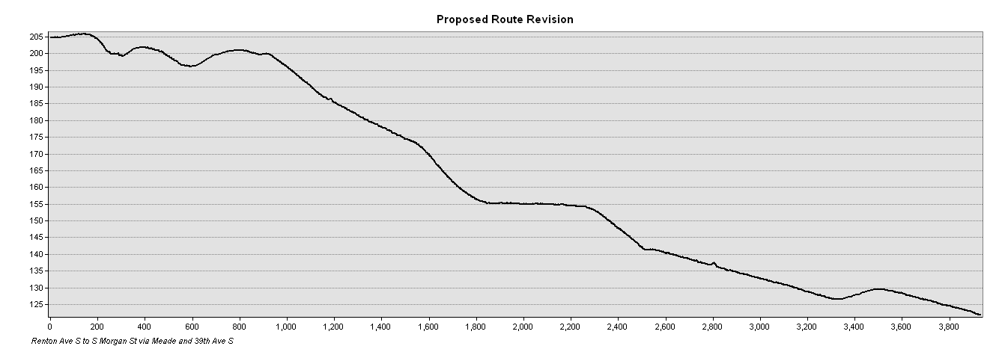
Hillman City Realignment
Avoids 30 feet of unnecessary elevation change
6

Slide 7
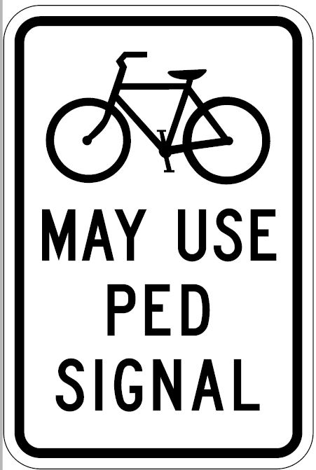
Rainier Ave S Crossing
Leading Pedestrian Interval signal prioritizes non-motorized crossings
Lower volume street
Fewer turning conflicts
Bicycle activation of pedestrian signal
Evaluating inclusion of bicycle lean rail
7

Slide 8
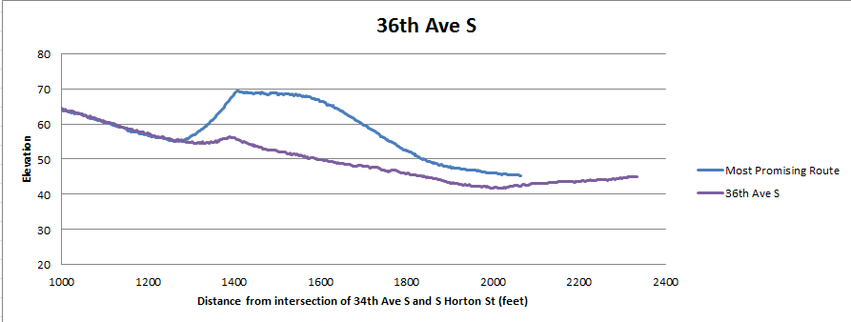
36th Ave S Realignment
Avoids steep grade and 10 feet of unnecessary elevation change
8

Slide 9
Rainier Ave S Road Safety Corridor
9

Slide 10
Questions?
summer.jawson@seattle.gov | (206) 648-8264
jim.curtin@seattle.gov | (206) 648-8874
www.seattle.gov/transportation/bike.htm
http://www.seattle.gov/transportation/rainieraves.htm

