Slide 1
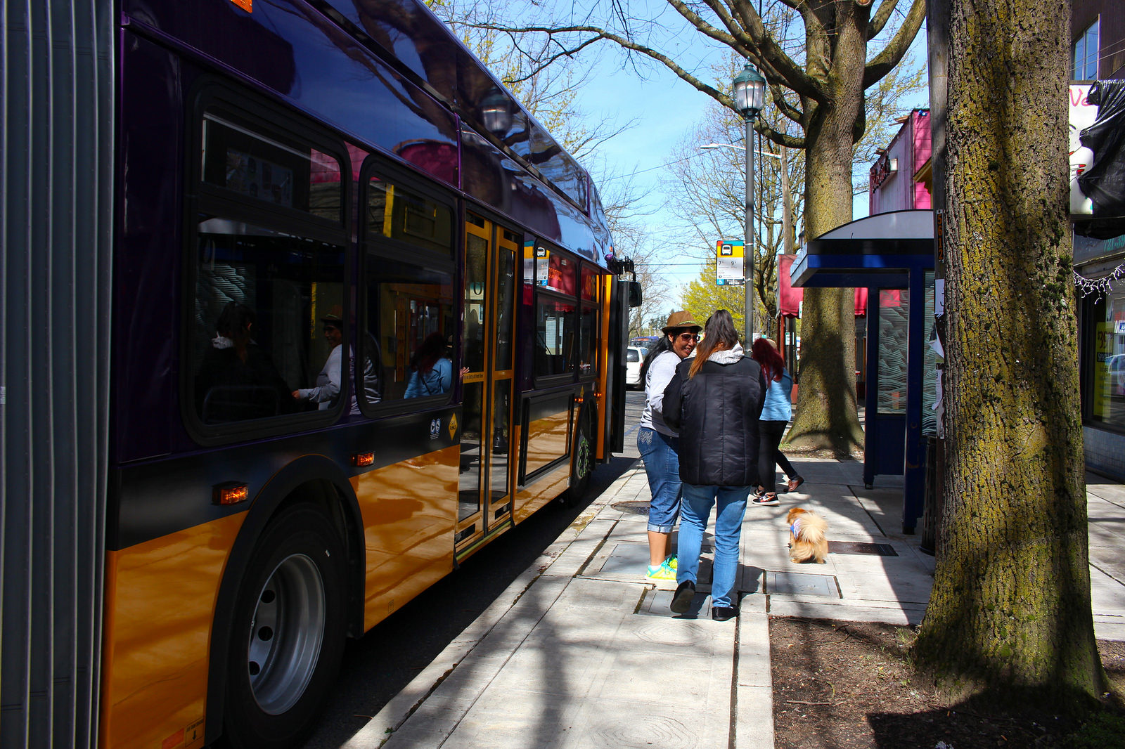



The Future of Rainier Ave S
Dawn Schellenberg, Alison Townsend, James Le, Alex Keheri
Seattle Bicycle Advisory Board
March 7, 2018

Slide 2
Our mission, vision, and core values
Mission: deliver a high-quality
transportation system for Seattle
Vision: connected people, places, and products
Committed to 5 core values to create a city that is:
Safe
Interconnected
Affordable
Vibrant
Innovative
For all
2
Notes:
Our core values for transportation anchor to the core values that Mayor Murray has laid out in his vision (Move Seattle) for Seattle:
Safe
Interconnected
Affordable
Vibrant
Innovative

Slide 3
Presentation overview
RapidRide overview
Options development process
Tonight’s focus: Bike integration & Vision Zero
Option comparison
Next steps
3
Notes:
Focusing on project section components with possible bike features

Slide 4
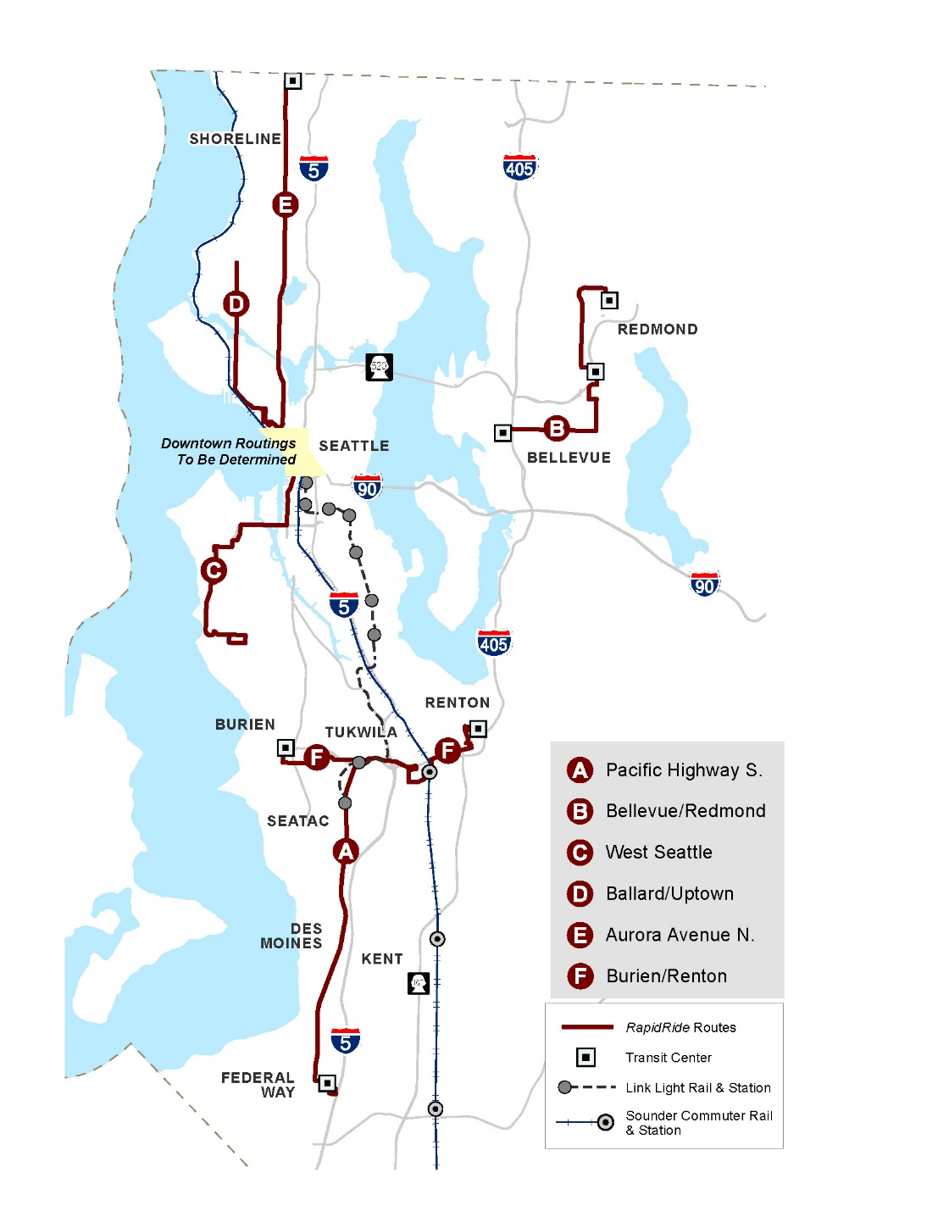

Metro RapidRide brand
Current system
Launched 2010
Best of Metro
  Simple
  Frequent service
  Always there
6 current lines
13 new lines planned
  7 in Seattle
  6 in suburban King County
  All open by 2025
Even more lines by 2040
4
Notes:
PAUL
Future of the city relies on transit, and RapidRide is a cornerstone of transit expansion

Slide 5
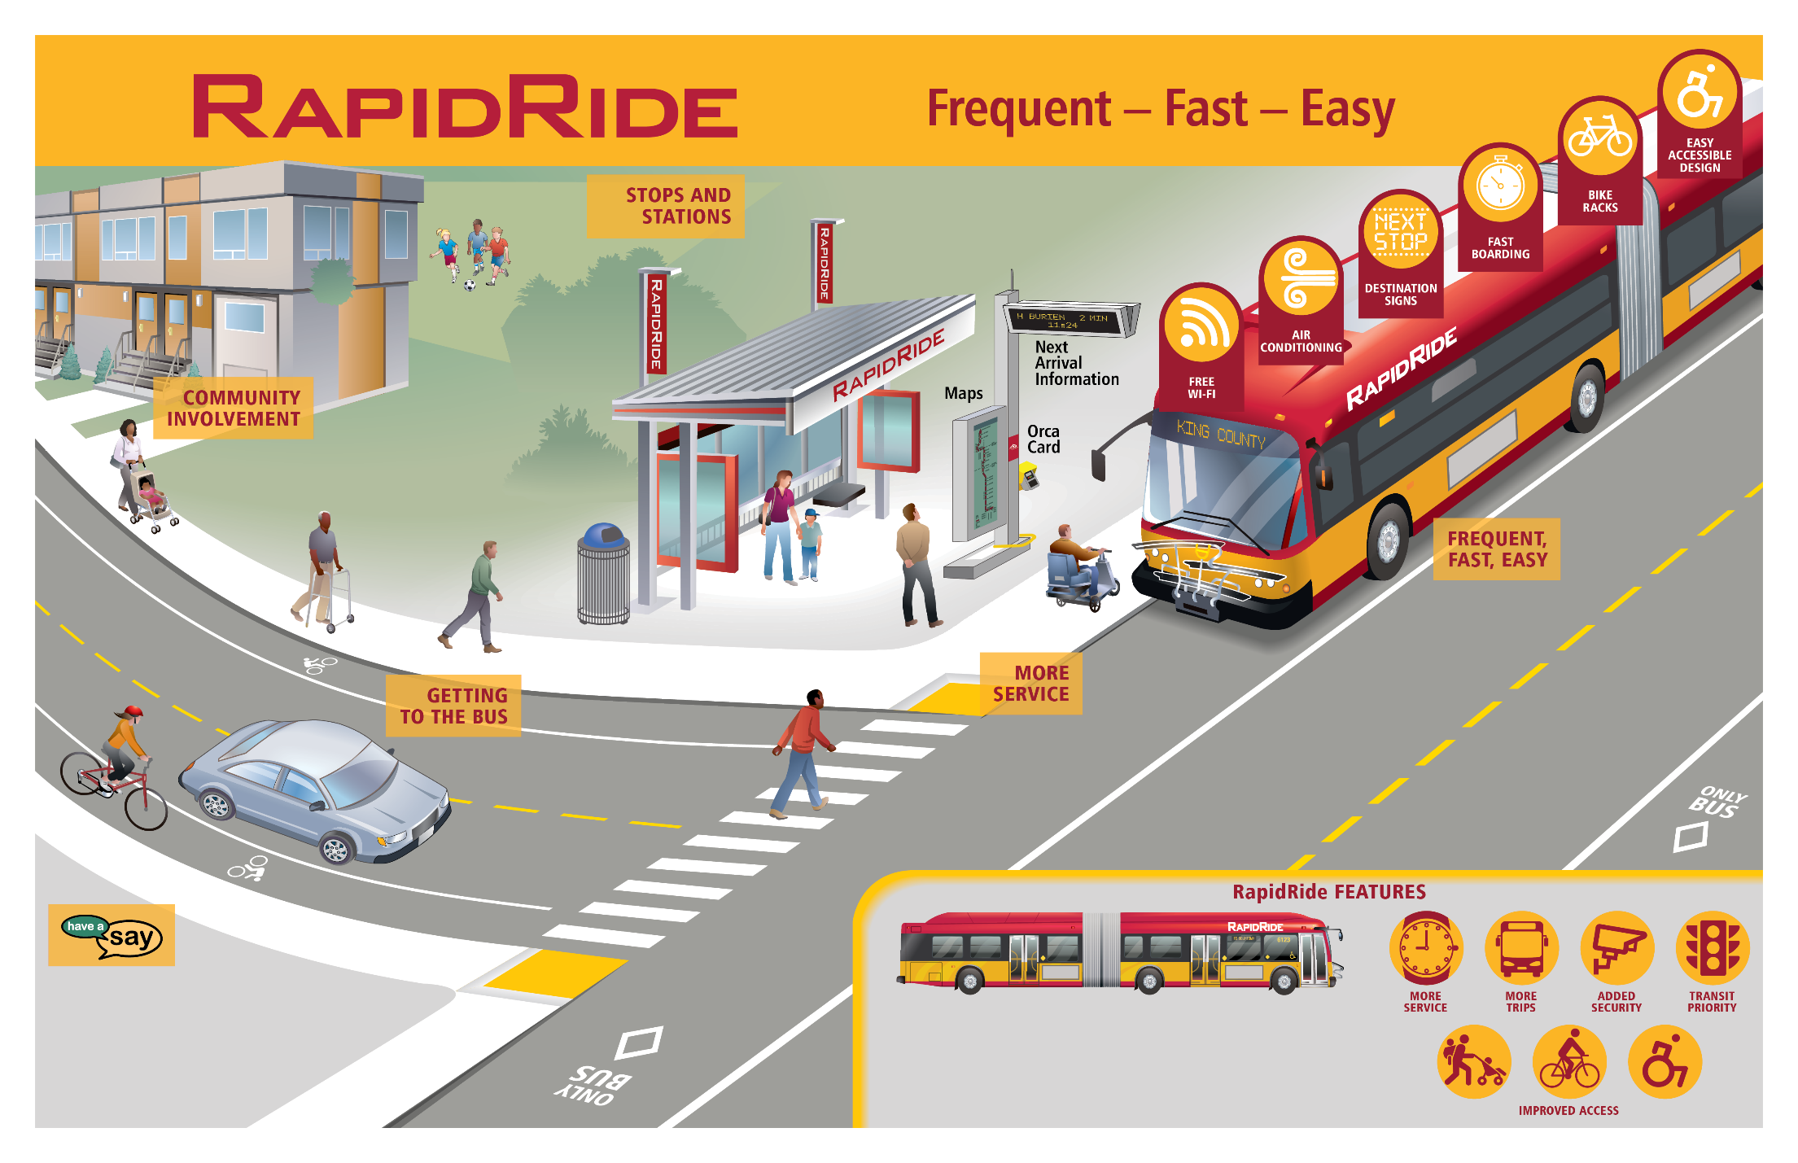
Premium service features
Notes:
Pay before boarding
Wi-fi on bus
Air conditioning

Slide 6
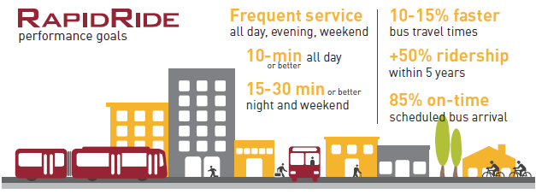
RapidRide in Seattle: Performance goals
10-15% faster
bus travel times
Frequent service
all day, evening, weekend
10-min or better all day
15-30 min or better night and weekend
+50% ridership
within 5 years
85% on-time
scheduled bus arrival
Notes:
One most frequent in system
Improve reliability and peak period travel time

Slide 7
RapidRide Rainier Line

Slide 8
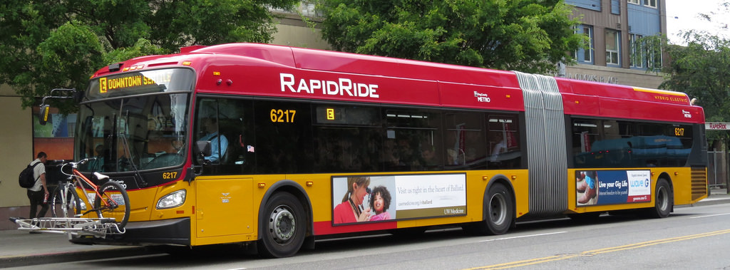
RapidRide project purpose
Provide buses that come more often with faster, easy-to-use service
Create a more comfortable experience at stations and on the bus
Improve connections for people walking or biking to the bus, and to light rail stations
Enhance safety for all users of the corridor

Slide 9
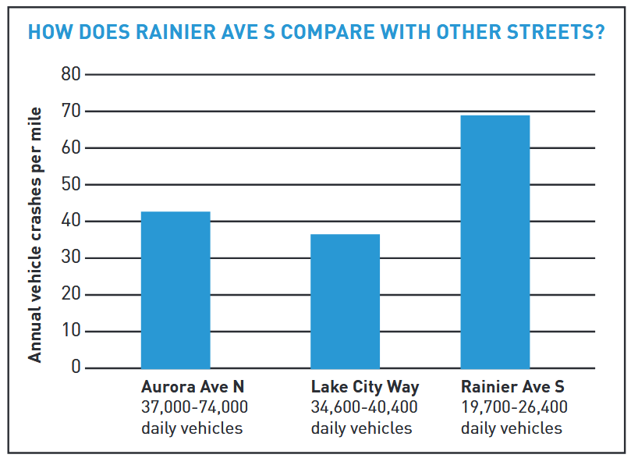
Vision Zero & Rainier Ave S
3,600 collisions in 10 years
Average 1 crash per day taking 45 minutes to clear

Slide 10

Metro Route 7
Upgrading Route 7 to RapidRide
Metro and Seattle are teaming up to improve Route 7 to become a RapidRide Line.
Downtown Seattle to
Rainier Beach
One of highest ridership routes in Seattle
11,000 riders a day
7.5 miles long, 76 bus stops*
Average travel time: ~75 min in PM peak, ~53 min during day
On-time arrival: ~80%
* 1.6 miles, 16 stops, 30 minute headways in the Prentice Loop
Proposed route change

Slide 11
What we’ve heard—common themes
Route 7 is a community asset
Consider Vision Zero and encourage calm, consistent vehicles speeds at all times of the day
“No comparable bike routes to Rainier Ave S between I-90 and Mt Baker Station”
“No comparable bike routes to Rainier Ave S between I-90 and Mt Baker Station”
Improve intersections for all travelers
Consider future development and the type of travelers Rainier Ave S will serve
On-street parking is important for multifamily units adjacent to Rainier Ave
Consider future development and the type of travelers Rainier Ave S will serve

Slide 12
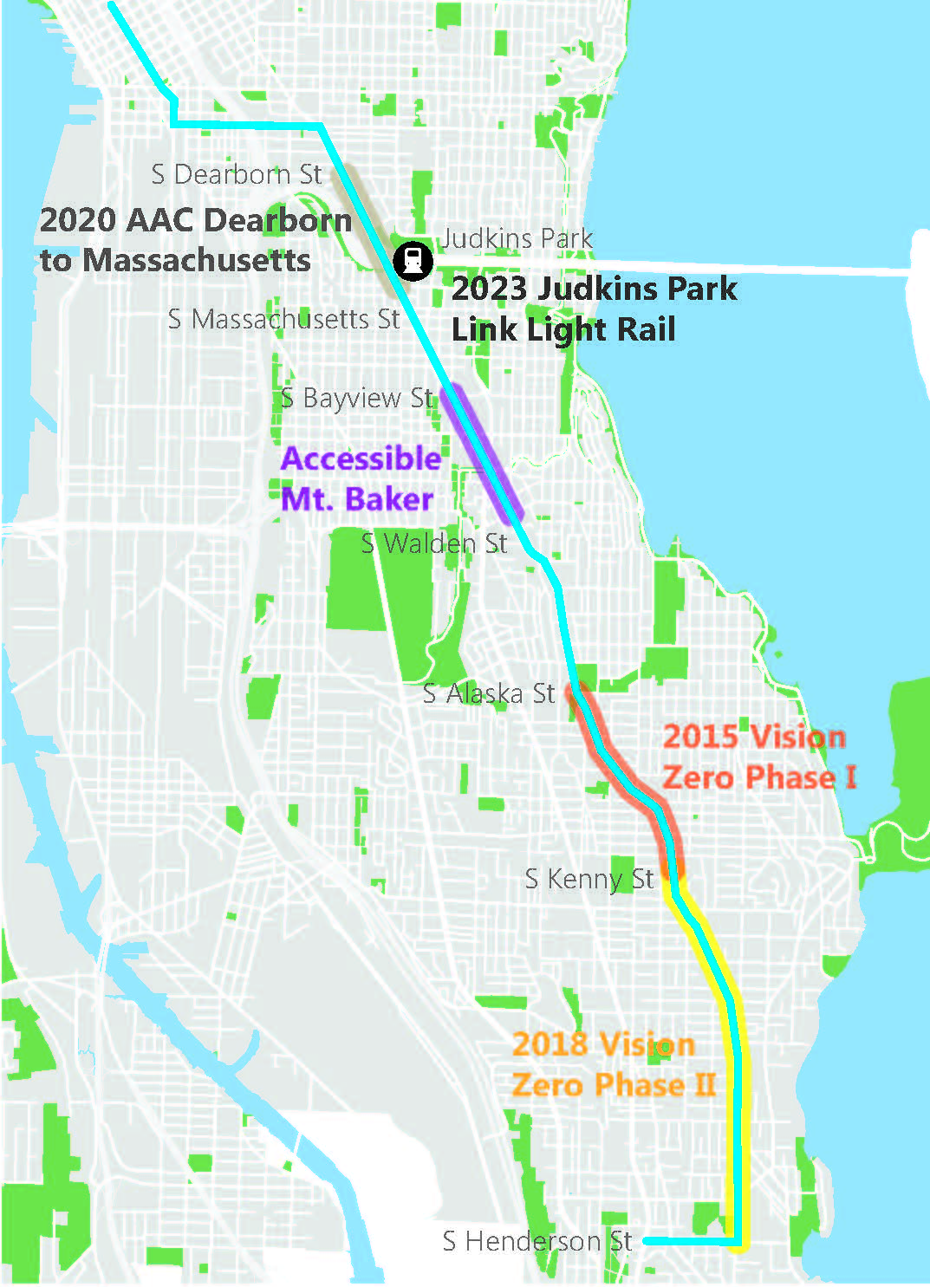
Assumptions
Meet RapidRide in Seattle’s performance measures
25,000 ADT is upper threshold for lane reduction
Complete continuous bike facilities along corridor
11 ft. travel lanes preferred for freight and transit
RapidRide constructed prior to Accessible Mt. Baker
No right-of-way purchases
12

Slide 13
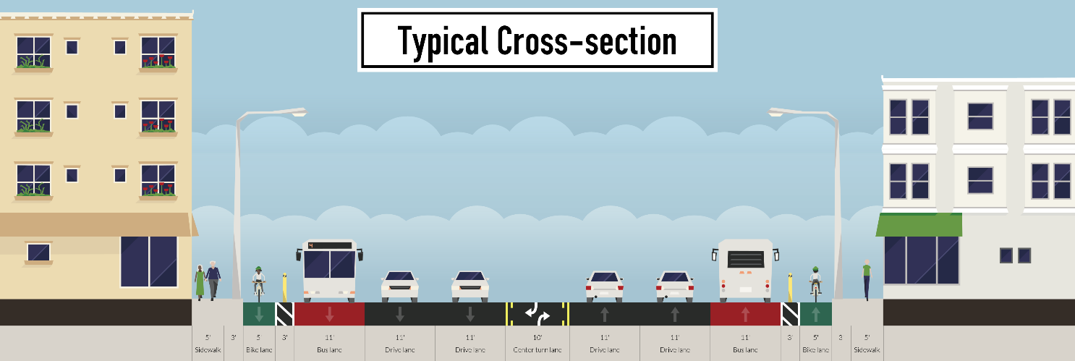
Option development process
Modal plans recommendations: bus lanes, bike lanes and major truck route (500+ trucks/day)
Existing conditions considered
Assumptions applied
Metro and other project partners involved
Outcome: 10 options moved forward
Woah!
108’

Slide 14
North Section
Massachusetts to Bayview

Slide 15
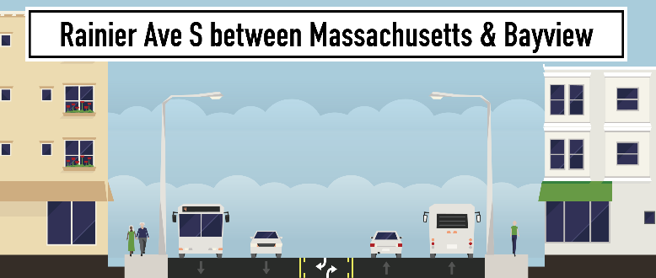
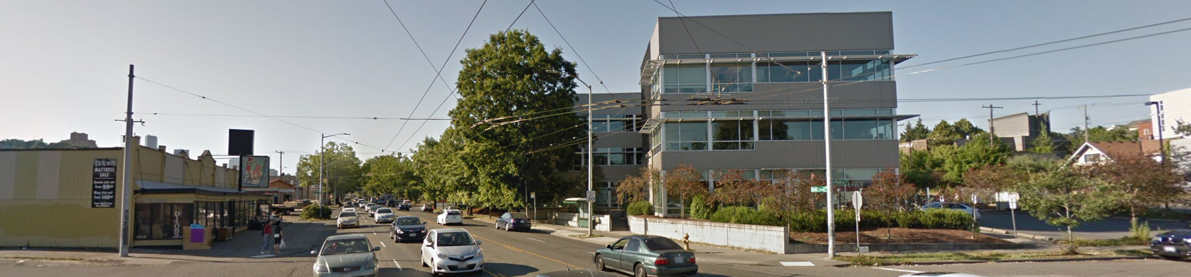
Considerations
Dixon’s Furniture
Rainier Ave S at S Plum St
Street is 52 feet wide
36,500 vehicles a day, northbound congestion in AM
Generally, highest transit delay
85th percentile speeds: 39MPH
260 crashes in 3 years
I-90 on-ramps
Future light rail station
Notes:
8 fatal/serious, 50% involved pedestrians
Rear ends, sideswipe, angles most common

Slide 16
Option 1
Valentine Pl S
S Grand St
21st Ave S
S Walker St
24th Ave S
All left-turns restricted in both directions

Slide 17
Option 2
Valentine Pl S
21st Ave S
S Walker St
All left-turns restricted in both directions

Slide 18
Option 3
Valentine Pl S
S Grand St
& PBL
All left-turns restricted in both directions
& PBL

Slide 19
Outcomes
Numbers are based on concepts and subject to change
 | Option 1 | Option 2 | Option 3
Bus travel time PM peak for northbound | Up to 4 min faster | Up to 2 min slower | Up to 3 min faster
Bus travel time PM peak for southbound | Up to 1 min faster | Up to 2 min slower | Up to 2 min slower
Bus reliability | Improved | Little or no change | Improved
Traffic travel time PM peak both directions | Up to 2 min slower | Up to 2 min slower | Up to 2 min slower
All ages and abilities bike facility | Included | Included | Included
Left turn access | Restricted (some design flexibility) | Restricted | Restricted (some design flexibility)
Freight access | 10.5 feet | 11 feet | 10.5 feet
Left turn restrictions could potentially cause diversion on to neighborhood streets

Slide 20
Bus lane & bike lane option
Evaluated, but not planned for advancement based on operational and safety challenges

Slide 21
Bus lane & bike lane option
Outcomes
Bus travel time Northbound PM | Up to 3 min faster
Bus Reliability | Improved
Traffic travel time PM peak for both directions | 10+ minutes & significant diversion
All ages and abilities bike facility | Not included
Left turns access | Restricted
Freight access | 10 feet
Bus travel time Northbound PM | Increased
Bus Reliability | Decreased
Traffic travel time Range for north and southbound | Increased
All ages and abilities bike facility | Not included
Left turns access | Restricted
Freight access | 11 feet
Outcomes are based on concepts and are subject to change

Slide 22
Mid Section—Vision Zero Phase 1 & 2

Slide 23
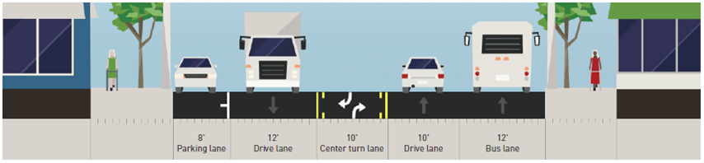
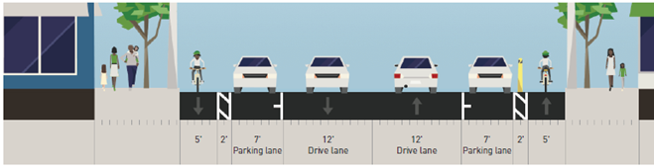
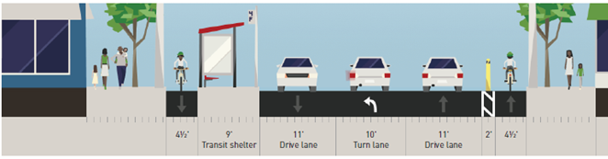
Rainier Phase 2 - alternatives
Alternative 1 – Northbound BAT lane
Alternative 2 – Protected Bike Lanes
Cross section between major intersections
Cross section at major intersections

Slide 24
Rainier Phase 2 – Survey outreach
Rainier Valley demographics
(ACS 2010-2014)
Who we heard from
(SurveyMonkey Q1 2017)

Slide 25
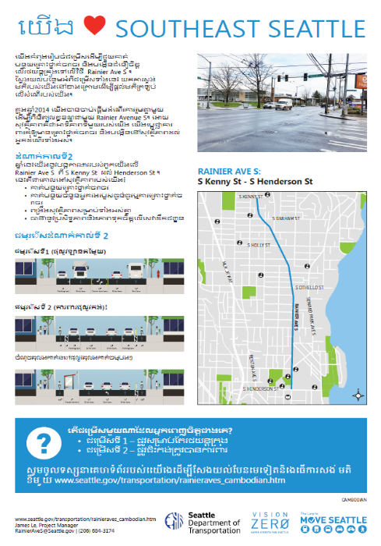
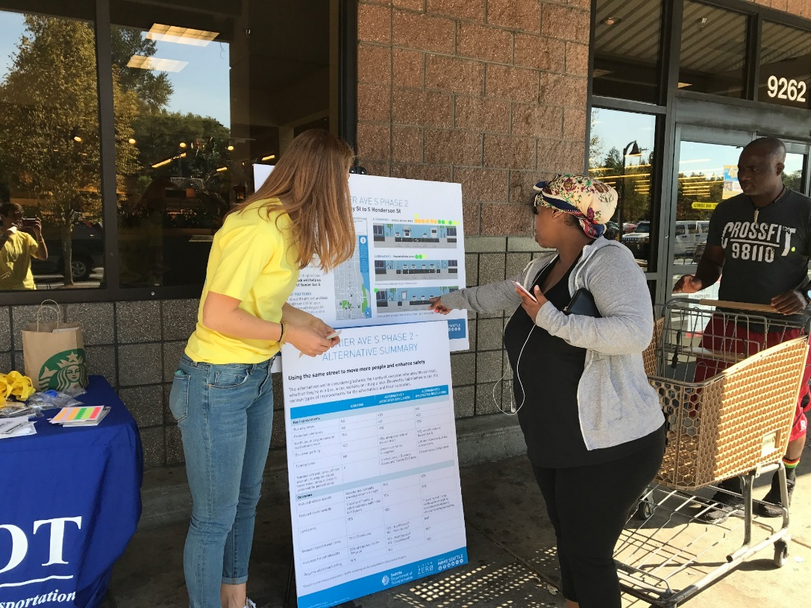
Rainier Phase 2 - results
Outreach
Responses vary depending on outreach method
Operations
Alternative 1 – some traffic delay, particularly southbound
Alternative 2 – significant traffic delay
Center turn lane important due to side street access demand

Slide 26
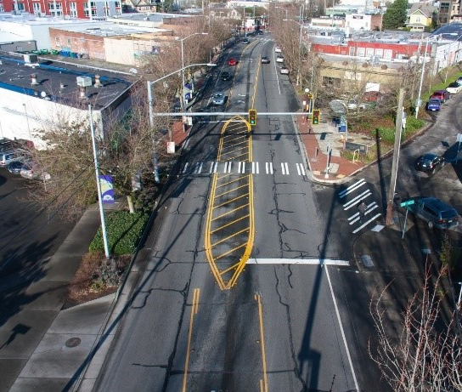
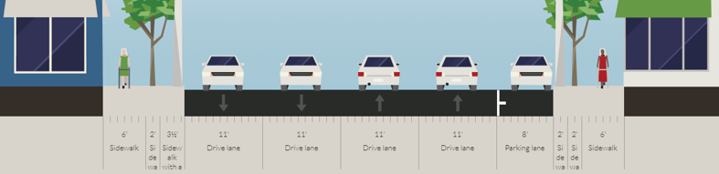
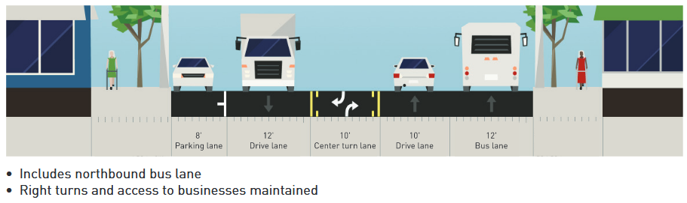
Rainier Ave S between S Alaska & S Henderson Streets
Completed in 2016
Alaska to Kenny
Installation Fall 2018
Kenny to Henderson
Today
Future
RapidRide will include station and other possible civil improvements and may consider additional transit improvements

Slide 27
South Section—Henderson St

Slide 28
Possible route change
Reroute line to Rainier Beach Light Rail Station, install overhead wire and add bike lanes
Option 1
Option 2

Slide 29

Engaging the community
Upgrading Metro Route 7 with RapidRide could change:
Bus station locations
Transit speed and reliability improvements on S Jackson St
Rainier Ave S and S Henderson St designs
Where route ends (Rainier Beach Light Rail Station or S Prentice St)
SDOT and Metro want to know what works best for the community
Public comment timeframe: March through April

Slide 30
Next steps
Date | Schedule
March 19 | Launch online open house, tabling, briefings
April 8 | Comment period closes
Summer/Fall 2018 | Options recommended for design
Fall 2018 | Install Vision Zero changes between Kenny & Henderson
As soon as 2021 | RapidRide Rainier Line opening

Slide 31




Questions?
RapidRide@seattle.gov
http://www.seattle.gov/transportation/southeastseattle.htm

Slide 32
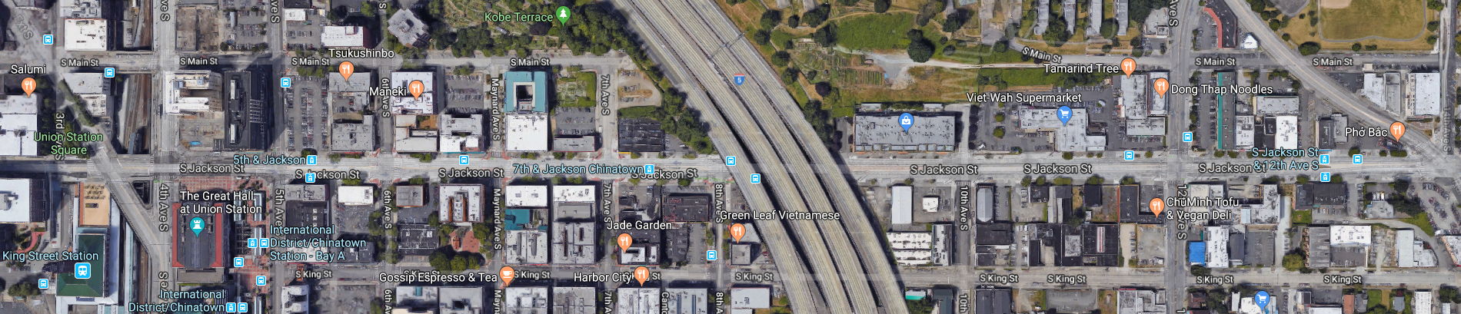
S Jackson Street
Bus stations could be consolidated, or RapidRide could ‘skip stops’ to help with reliability
4th Ave S
S Jackson St
Rainier Ave S

Slide 33
Key improvements (north section)
 | Option 1 | Option 2 | Option 3
Bus only lanes (miles) | 1.5 | 0.1 | 0.9
New greenway connections (miles) | 0.9 | 0.8 | 0.8
Protected bike lane (miles) | 0.0 | 1.0 | 0.8
Improved pedestrian crossings | 1 | 3 | 1
Numbers are based on concept design and are subject to change

Slide 34
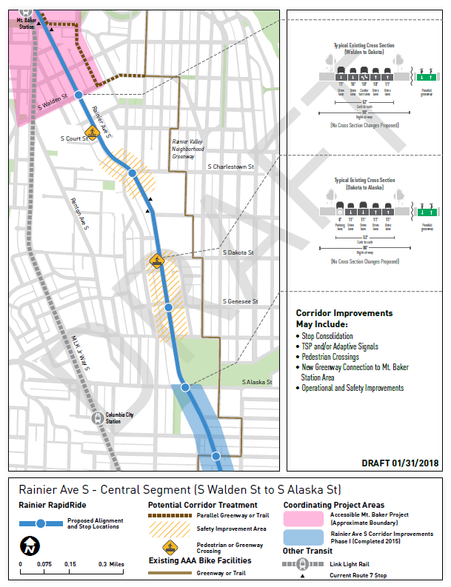
Walden to Alaska

Slide 35
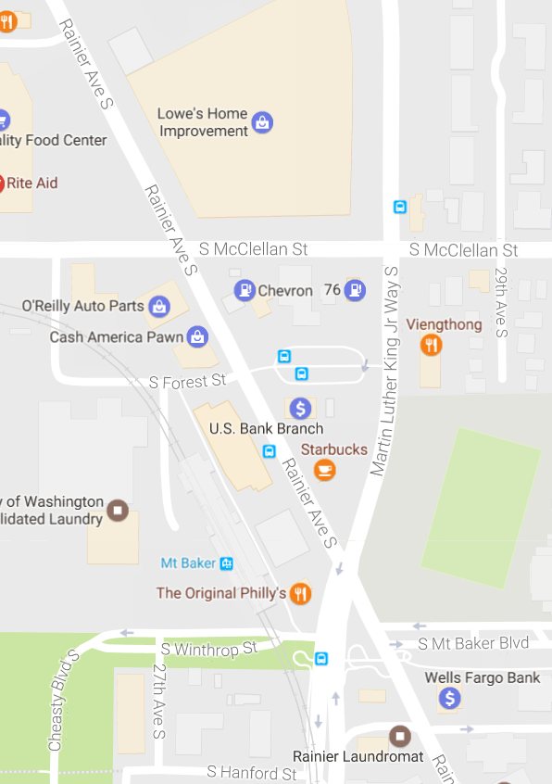
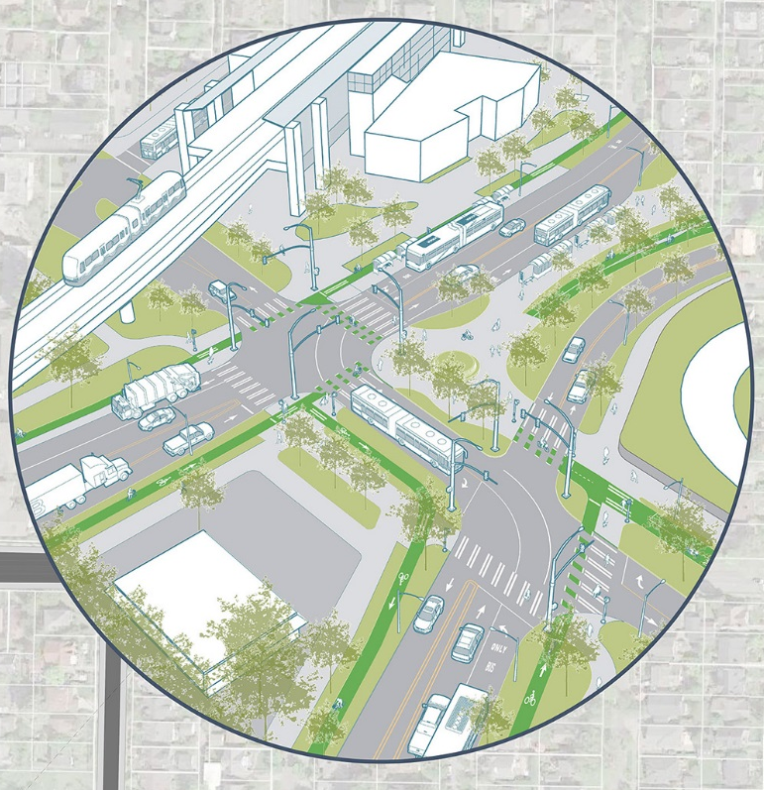
Accessible
Mt Baker
Improve bus, walking and biking connections to light rail
Opportunity for new place for people to gather
Separate Martin Luther King Jr Way and Rainier Ave S

