Slide 1



Yesler Bridge Rehabilitation
Construction: spring 2016 – fall 2017
Seattle Bicycle Advisory Board
Amanda Tse
April 6, 2016
Notes:
Hello all, thank you for the opportunity to present to you tonight. My name is Amanda Tse and I’m the Project Manager for this project for the Seattle Department of Transportation, otherwise known as SDOT.

Slide 2
Our mission, vision, and core values
Mission: deliver a high-quality
transportation system for Seattle
Vision: connected people, places, and products
Committed to 5 core values to create a city that is:
Safe
Interconnected
Affordable
Vibrant
Innovative
For all
2
Notes:
Our core values for transportation anchor to the core values that Mayor Murray has laid out in his vision (Move Seattle) for Seattle:
Safe
Interconnected
Affordable
Vibrant
Innovative

Slide 3
Presentation overview
Background
Project area
Existing conditions
Construction impacts
Next steps
3
Notes:
Today, we will go over:
A brief history of the Yesler Way Bridge
Its location
The current conditions of the bridge
The final design
Construction impacts
Public outreach
And the construction schedule

Slide 4
Background
1910
Built in 1910
Over 100 years old
One of the first permanent steel bridges constructed by the City of Seattle
4
Notes:
To provide some background on the project, the Yesler Way Bridge over 4th Ave S was built in 1910, and has served the Pioneer Square neighborhood for over a century.
Based on historical research, it may be the first permanent steel roadway bridge constructed in the City.
The Yesler Way Bridge Rehabilitation Project will address safety and maintenance risks associated with this aging structure, while preserving the its unique and historic design elements.

Slide 5
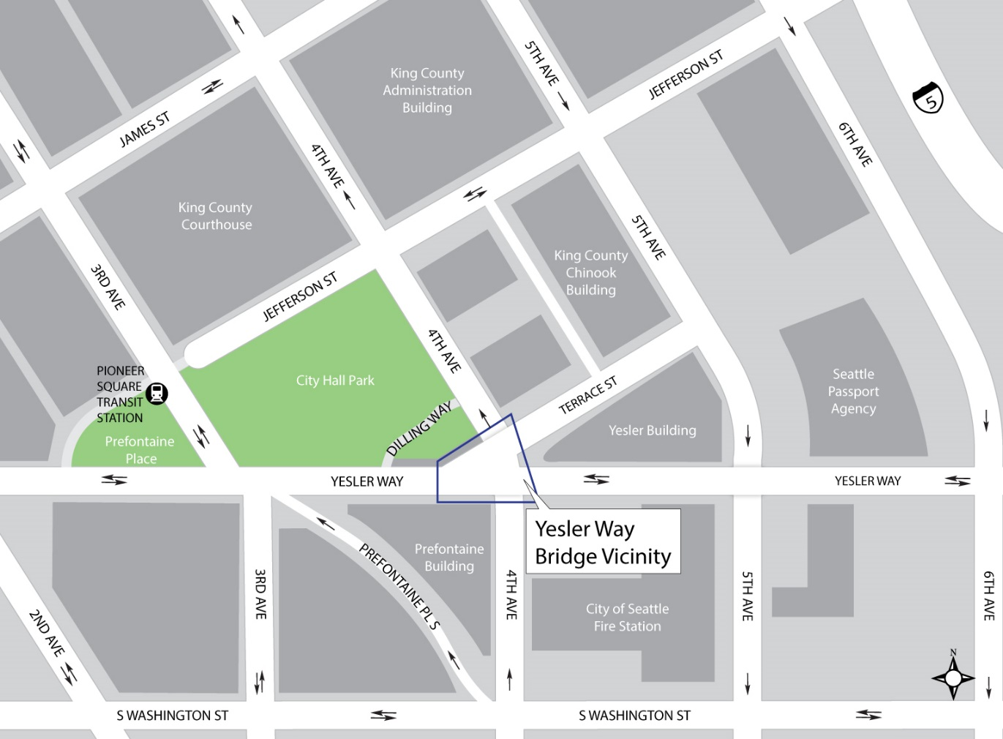
Project area
5
Notes:
The Yesler Way Bridge is located over 4th Avenue S at the intersection of Yesler Way and Terrace Street, just a few blocks north of Seattle’s King Street Station.
The bridge is an essential part of Seattle’s history and plays a vital role in connecting:
Commuters, workers and businesses in the surrounding area and
Residents of nearby neighborhoods, including Yesler Terrace, the Central District, International District and Pioneer Square

Slide 6
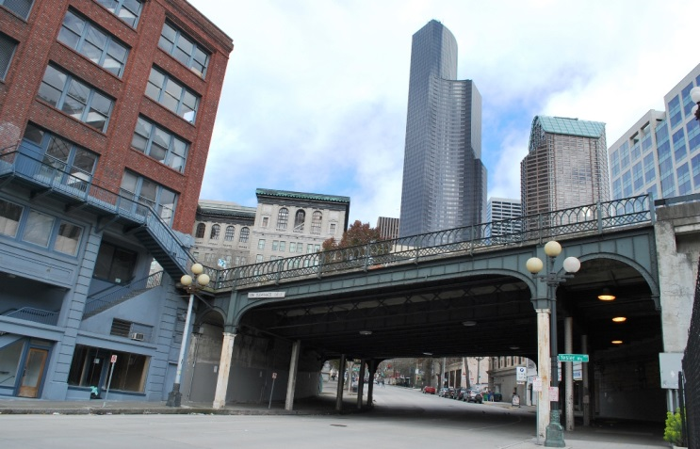
Why rehabilitate the Yesler Way Bridge?
6
Notes:
So, one of the questions you may be thinking is “Why this bridge?” Some key concerns with the existing bridge include:
The many elements that have deteriorated over time – with significant rust, corrosion and cracking
Very old girders that have been hit repeatedly by passing traffic
A fracture critical bridge with a high risk of collapse because it doesn’t have structural redundancy
A bridge that doesn’t meet current safety or seismic standards
The two main goals for the project are to rehabilitate the bridge to meet safety standards (and address those issues I just mentioned) while also preserving its historic elements.
“Why rehabilitate the bridge instead of replacing it?” you may ask. The bridge has historic elements that would be lost if the bridge was replaced entirely. Rehabilitating the bridge allows the historic elements to be maintained.
The project team worked closely with the Pioneer Square Preservation Board (PSPB) and the International Special Review District Board to identify the key character-defining features of the bridge. We will continue to work closely with both boards.

Slide 7
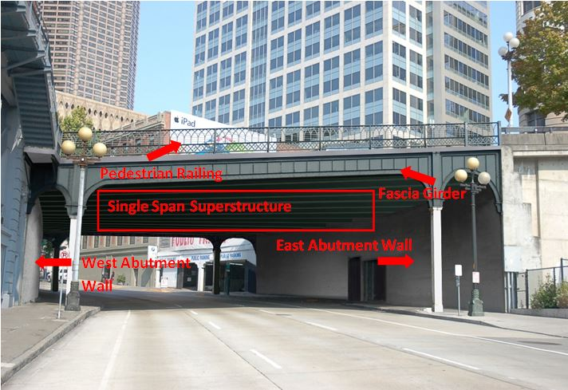
Final Bridge Design
7
Rendering, looking north from 4th Ave S
Notes:
You may be wondering what the rehabilitated bridge will look like. This is a rendering of the design. Notice, it looks very similar to how the bridge looks today. I’ll highlight a few of the design features that will change.
The first one is the installation of a single span superstructure in lieu of the existing three spans.
With a single span superstructure, the four interior steel columns currently in place will no longer be needed to support the bridge. Also, the bridge will be raised between 1.5 and 2 feet to increase vertical clearance and prevent the girders from being hit by tall vehicles.
Since the interior columns will be removed, the east abutment wall will be rehabilitated and the west abutment wall will be fully replaced, both to support heavier loads.
Lastly, we propose to remove, refurbish and reinstall the north and south fascia girders to eliminate any corrosion and ultimately preserve the historic character of the bridge.
ADDITIONAL INFO
It may be necessary to fabricate small segments of the fascia girders to replace badly deteriorated sections using period-appropriate materials and finishes.
This will require removal of approximately seven feet of the top portion of the wall to be replaced with a new concrete end diaphragm. This is required to reduce the lateral forces and the associated overturning moments on the east abutment wall and to address sliding instability.

Slide 8
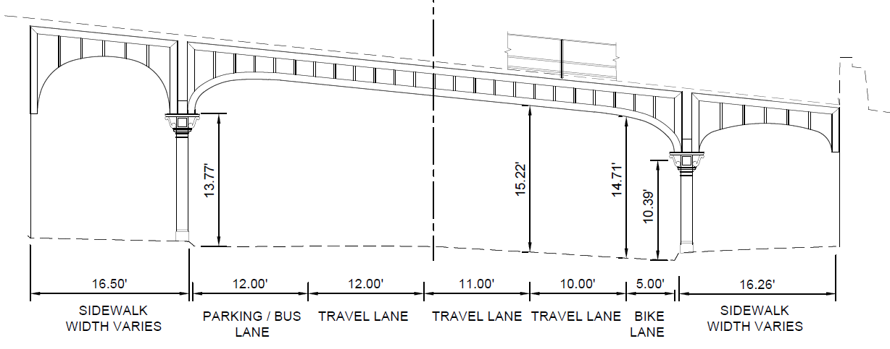
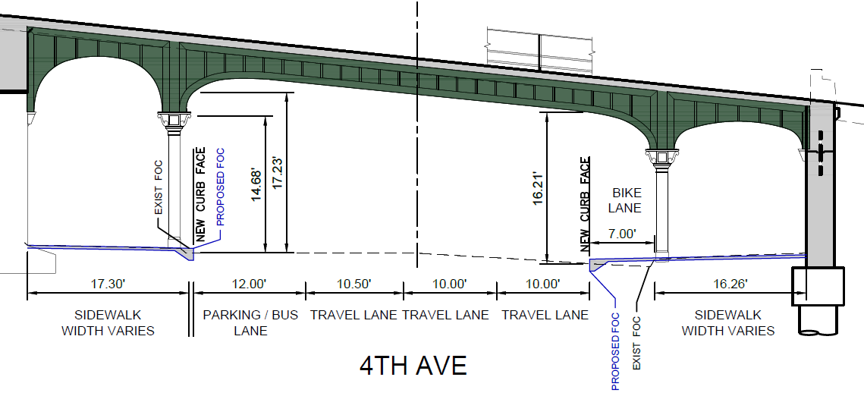
Bicycle Improvements
8
Notes:
As part of the project, we are adding a separated and raised bike lane on the east side of 4th Ave
This improvement contributes to objectives of the Bike Master Plan, including:
Completing and maintaining a safe, high-quality bicycle network of on-street facilities throughout the city (Objective 1)
Integrating bicycle facilities with all travel modes (Objective 2)
Building on-street separated facilities (Objective 4)
Implement actions to support and promote bicycle riding (Objective 6)

Slide 9
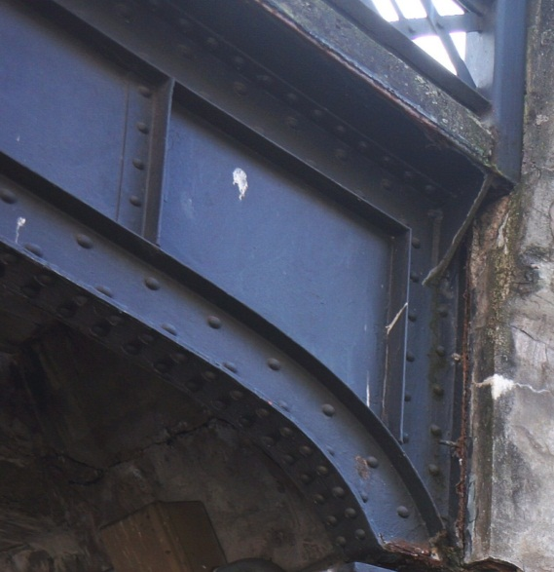
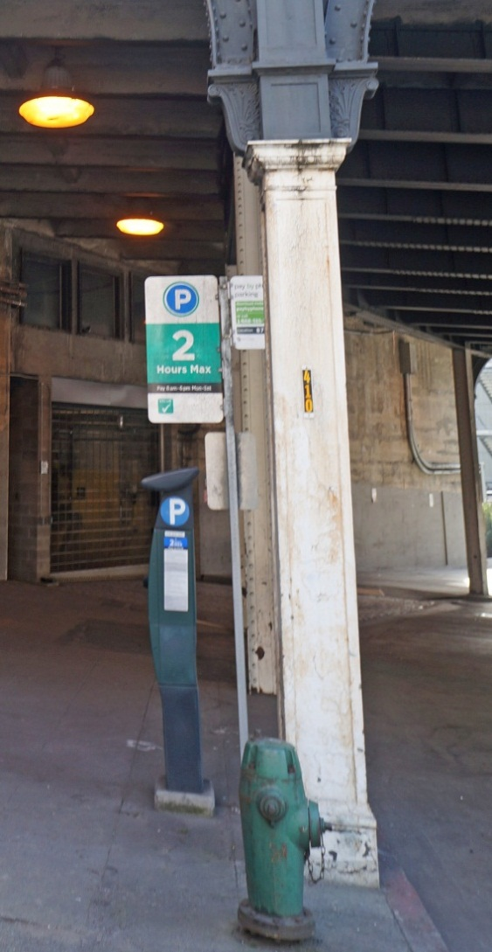
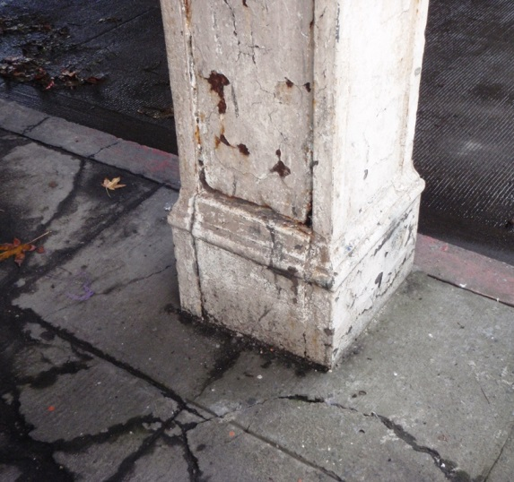
Historic Elements
Fascia girder
Fascia girder columns
Cladding
9
Notes:
Here are a few pictures of some historic elements that are deteriorating and will be rehabilitated as part of the project.
The first photo on the left shows part of the fascia girder. For the most part, all of the other bridge elements support the fascia girder.
The photo in the middle is of a fascia girder column.
The photo on the right shows the cladding.
In addition, other bridge elements – like the capitals and corbels – will be treated to maintain the long-term integrity of this historic structure.

Slide 10
What to expect during construction
Street and sidewalk closures
Detour routes for:
  Bicyclists
  Transit
  Vehicles
  Pedestrians
Parking impacts
Noise, dust, and vibration typical of construction
10

Slide 11
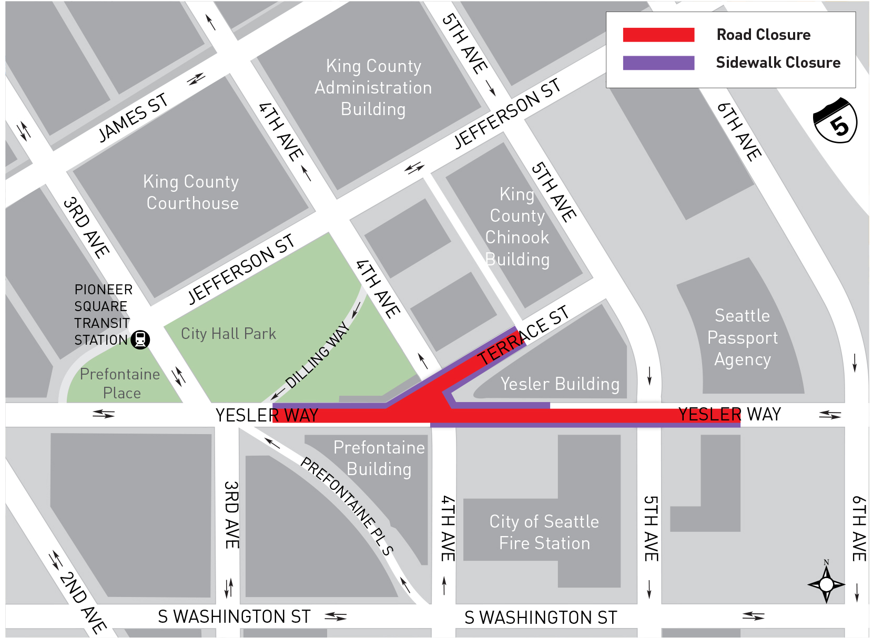
Street and Sidewalk Closures
11
Notes:
The biggest impact to bicyclists will be street closures during construction.
During construction:
Yesler Way will be closed in both directions between 3rd Ave and midway between 5th Ave and 6th Ave
Terrace St will be closed to through traffic, open to local access
4th Ave will have ongoing lane closures and occasional full nighttime and weekend closures
Sidewalks on either side of 4th Ave will have alternating closures

Slide 12
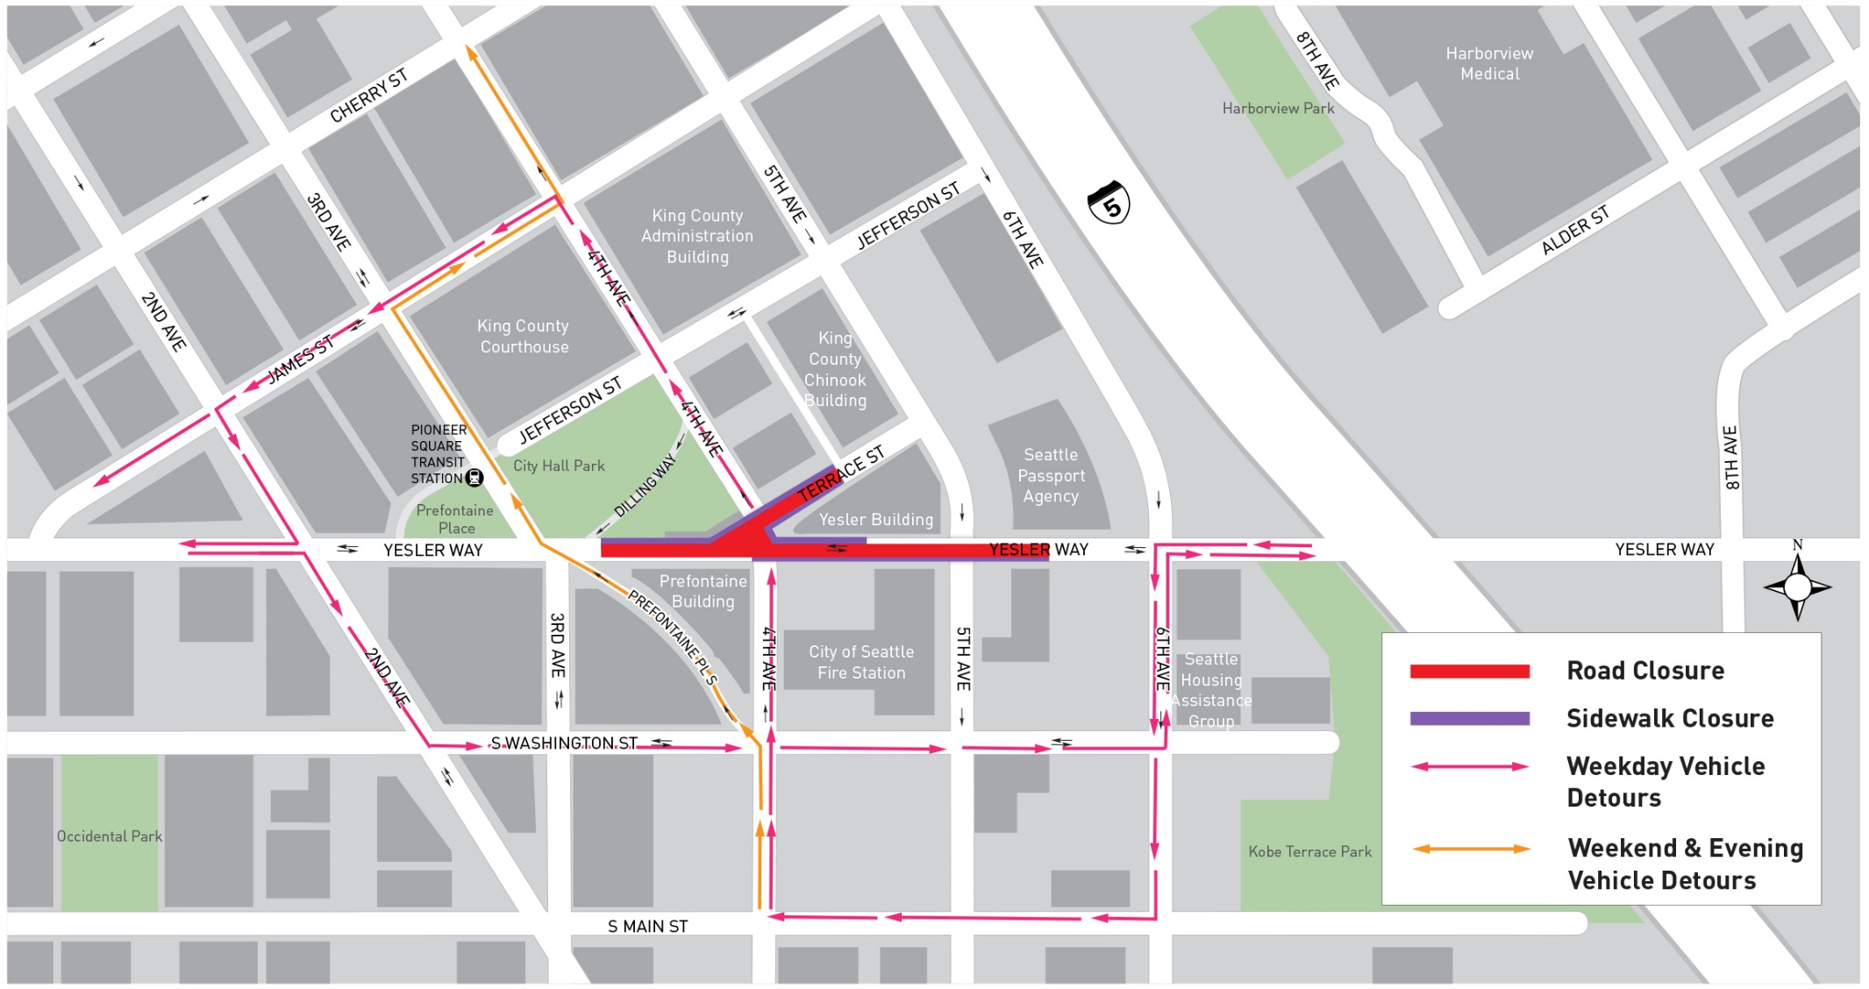
Bicycle and Vehicle Detours
12
Notes:
Bicycle and vehicle detour routes will vary depending on the day of the week and time of day. Detour signs will be posted to help direct traffic.
For vehicles and cyclists traveling westbound on Yesler Way, the main detour route will be:
Turn left from Yesler Way onto 6th Ave
Turn right onto S Main St
Turn right onto 4th Ave
From 4th Ave you can take Prefontaine PL S back to Yesler Way or got to James St and turn left
For vehicles and cyclists traveling eastbound on Yesler Way, the main detour route will be:
Turn right onto 2nd Ave
Turn left onto S Washington St
Turn left onto 6th Ave
Turn right onto Yesler Way

Slide 13
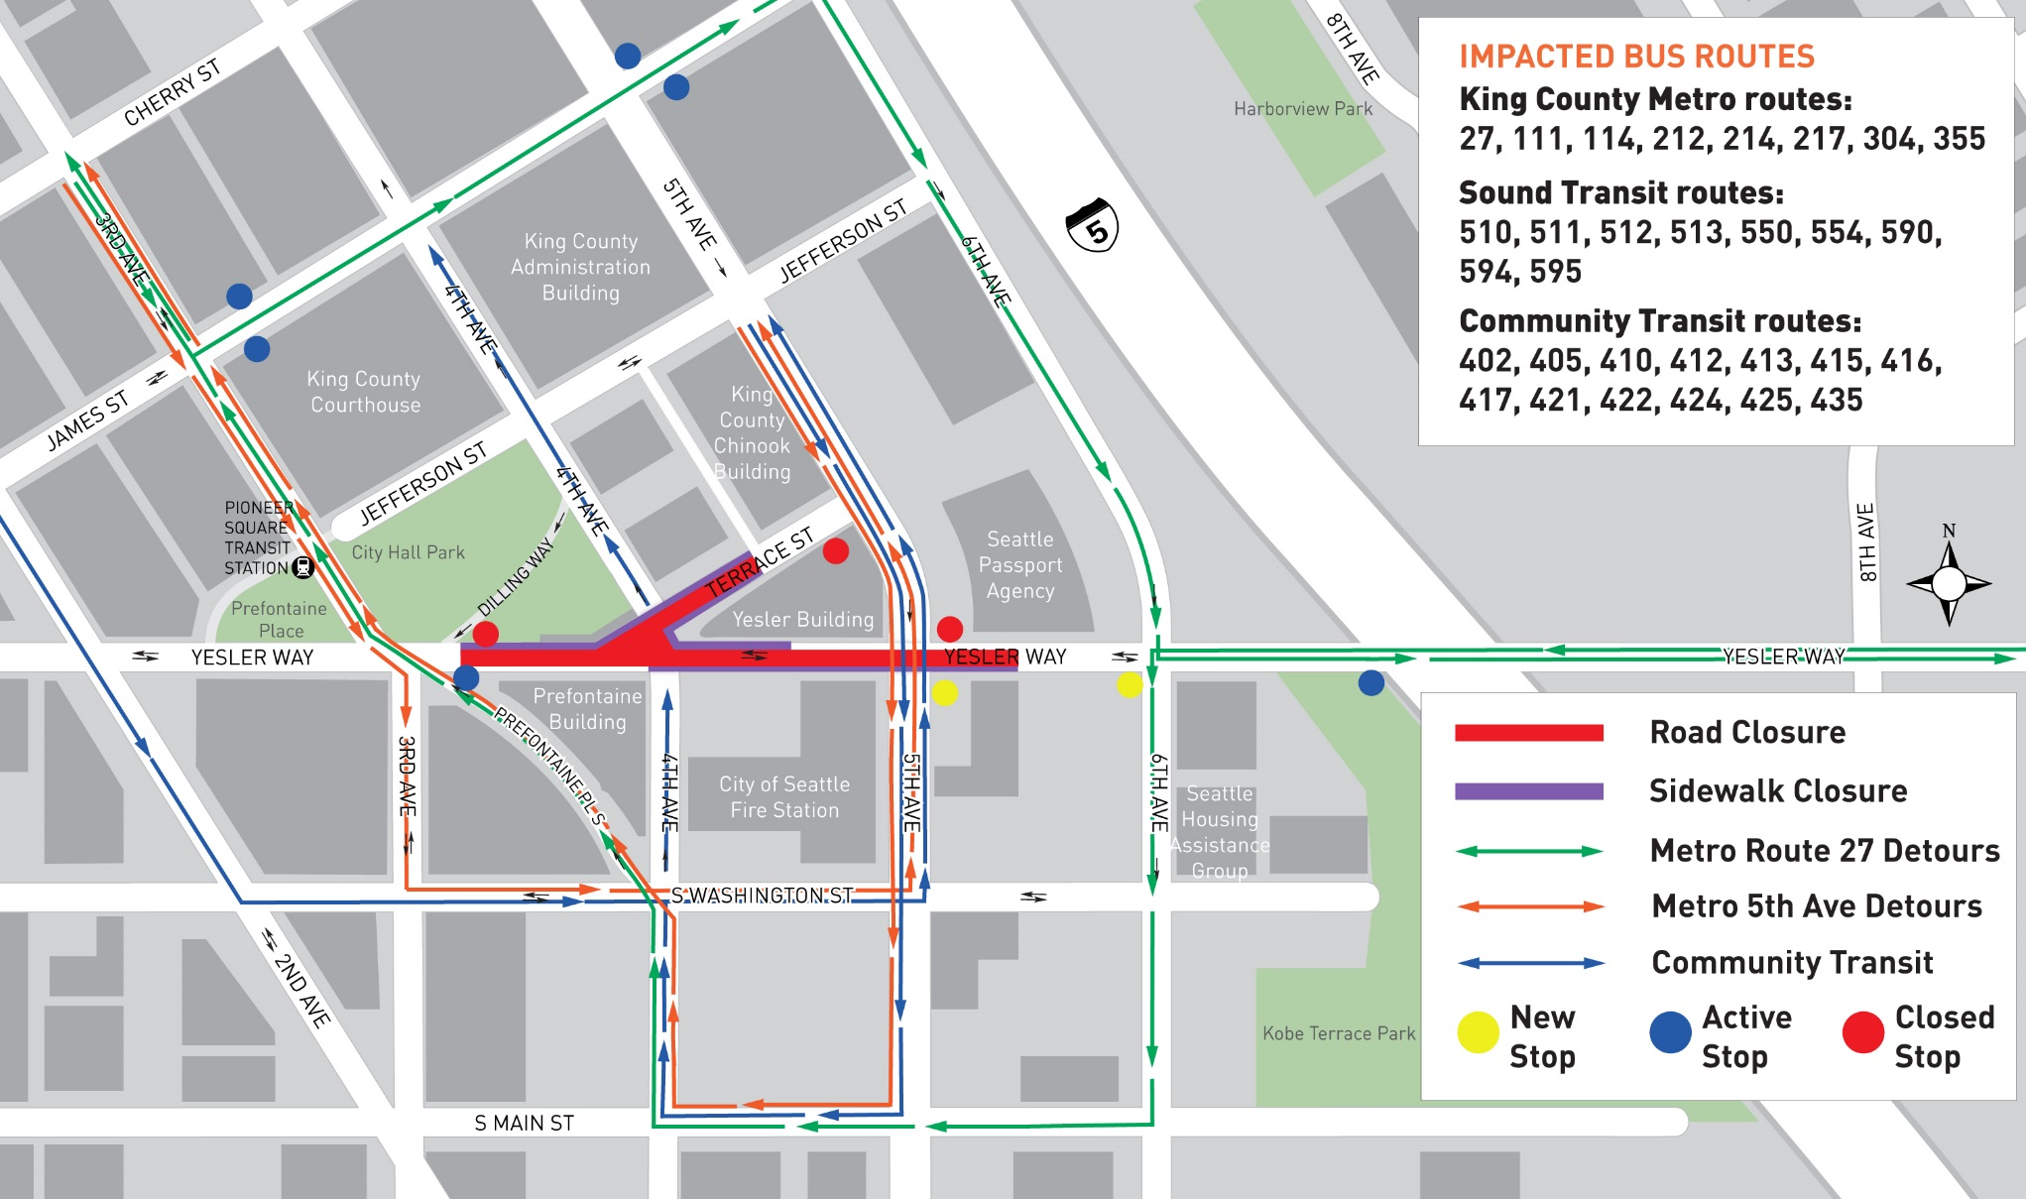
Transit Detours
13
Notes:
Some transit routes will be affected during construction
Some bus stops will be temporarily relocated
Transit agencies will notify their riders as appropriate
BACKPOCKET INFO
Impacted transit routes:
King County Metro routes: 27, 111, 114, 212, 214, 217, 304, 355
Sound Transit routes: 510, 511, 512, 513, 550, 554, 590, 594, 595
Community Transit routes: 402, 405, 410, 412, 413, 415, 416, 417, 421, 422, 424, 425, 435

Slide 14
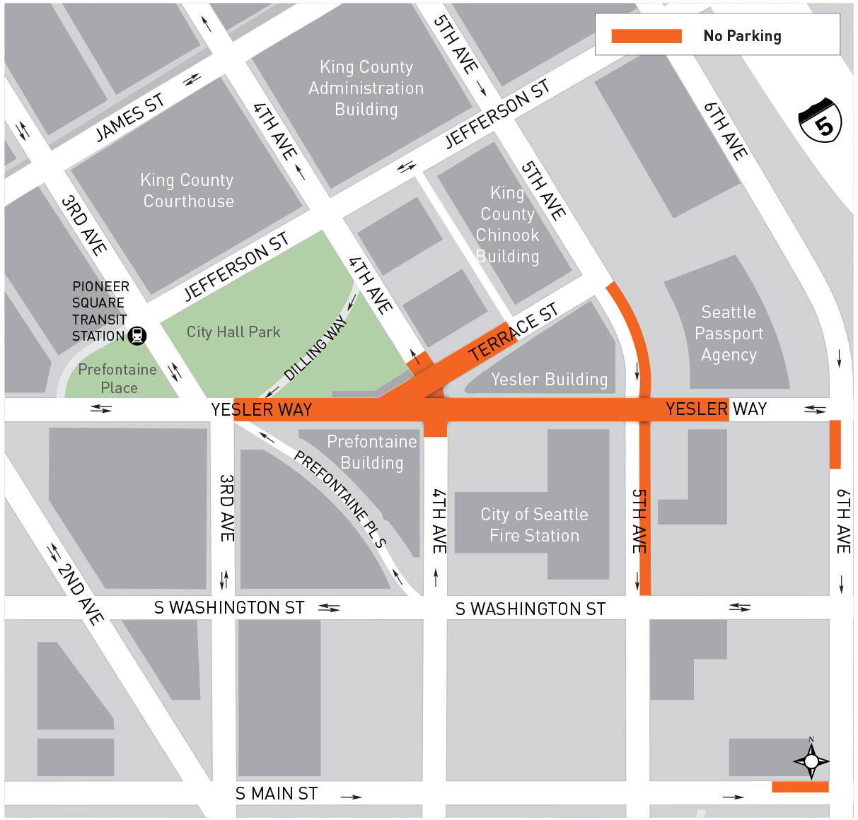
Parking During Construction
14
Notes:
There will be no parking:
In the construction area along Yesler Way between 3rd Ave and midway between 5th Ave and 6th Ave
Along Terrace St from the alley to Yesler Way
Beneath the bridge on 4th Ave
In the east curb lane of 5th Ave between Washington and Terrace St
On the west side of 6th Ave immediately south of Yesler Way
On the north side of Main St immediately west of 6th Ave

Slide 15
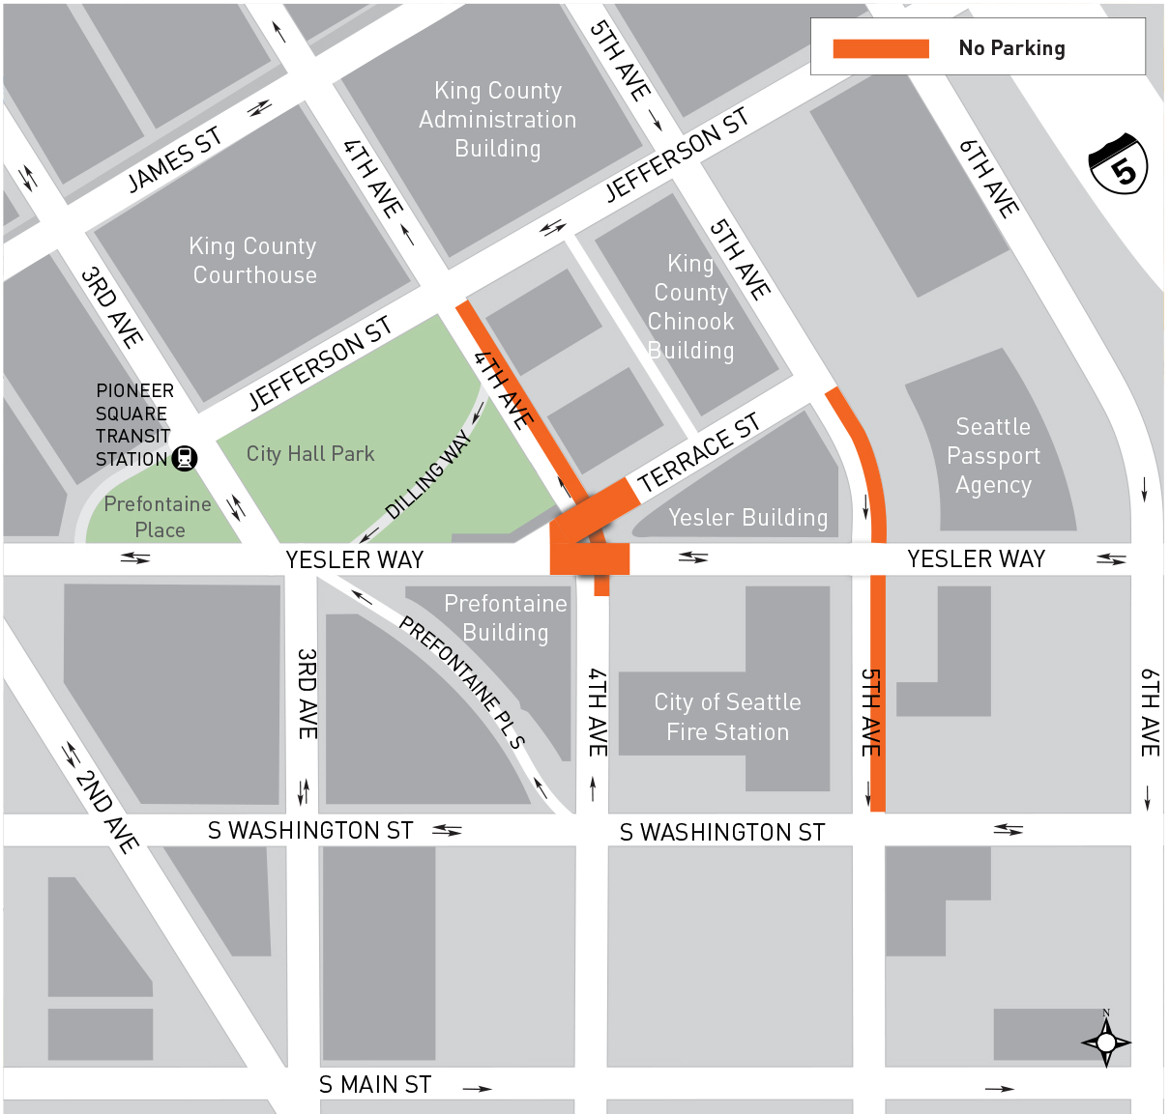
Parking After Construction
15
Notes:
Parking will no longer be allowed on the bridge
A few parking spaces will be removed on both Yesler Way and Terrace St immediately adjacent to the bridge
Parking will no longer be allowed on the east side of 4th Ave between S Washington and Jefferson Streets
Parking will no longer be allowed in the east curb lane of 5th Ave between S Washington and Terrace St

Slide 16
Funding
Total cost $19.8 million
  Bridging the Gap transportation levy
  Federal Highway Bridge Program
16
Notes:
The total budget for the Yesler Bridge Rehabilitation Project is $19.8 million.
Funding comes from a couple of sources:
The “Bridging the Gap” transportation levy that was approved by voters in November 2006
A grant from the Federal Highway Bridge Program

Slide 17
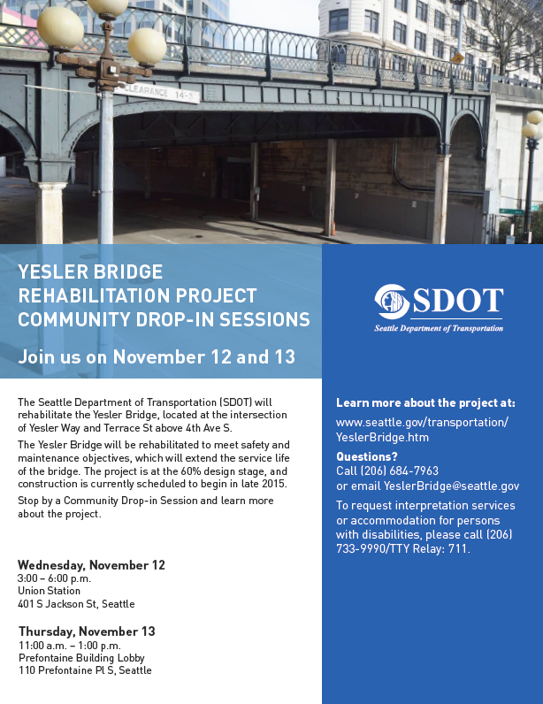
Outreach
Briefings
Drop-in sessions
Email updates & fliers
Open house
  April 12, 2016
  4 – 6:30 PM
  Yesler Community Center
17
Notes:
SDOT is committed to engaging with the community and helping them adjust to this long-term construction.
We have been in contact with local businesses, building managers, and other stakeholders for the past two years.
We had a community open house in May 2015 and held several drop-in session in the project area.
We are hosting a community open house on April 12
Due to the historic significance of the bridge, the team will been working closely with the Pioneer Square Preservation Board and the International Special Review District Board to balance safety with preservation and mitigate project impacts on historic resources in the neighborhood.

Slide 18
Schedule
Open house (April 12)
Construction starts as soon as May
Tentative end to construction in fall 2017

Slide 19





Questions?
YeslerBridge@seattle.gov | (206) 684-7936
www.seattle.gov/transportation/YeslerBridge.htm
www.seattle.gov/transportation
Notes:
Thank you for your time. We will now be answering any questions or concerns that you may have.

