Slide 1

2015 Bicycle Amenity Survey
Inventory Findings

Slide 2

About Commute Seattle

Slide 3
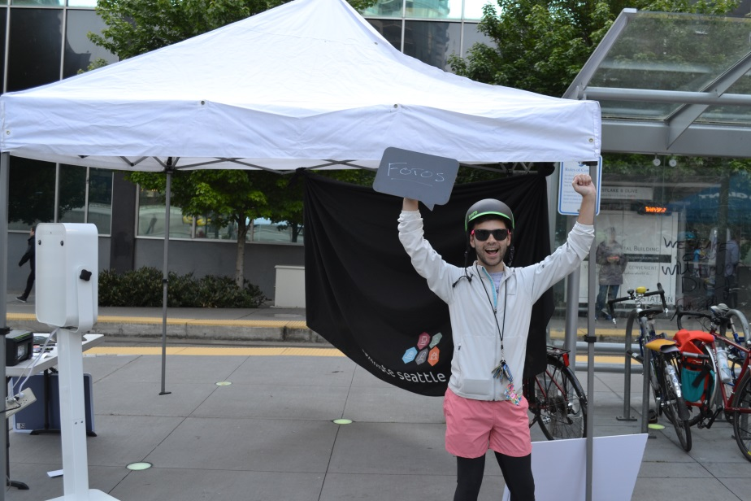
Who are we?
Vision:
Create a more livable, sustainable, and economically competitive Seattle
Mission:
Help downtown users live
more and drive less by
improving access and
mobility to and within
downtown
Notes:
Presenter: Joe

Slide 4
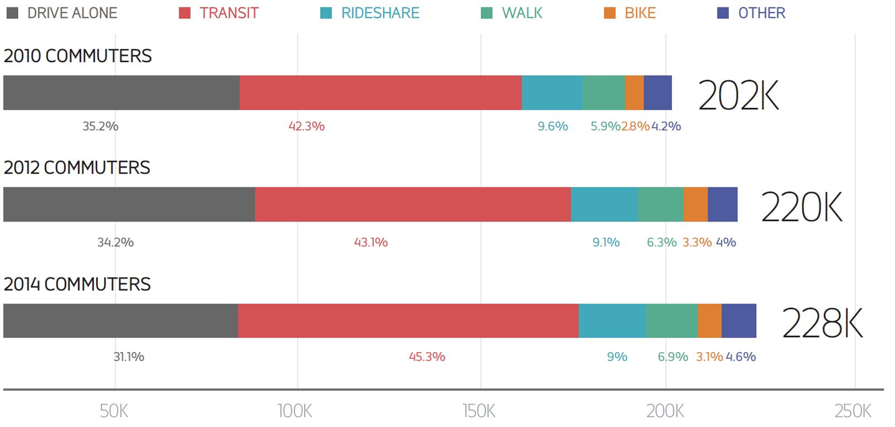
2015 Seattle Commuting Trends
45% of commuters taking transit
Only 31% of commuters driving alone, an all-time low
Due to job growth, just as many cars on the road
Notes:
Presenter: Joe

Slide 5
2010 Bicycle Amenities Study

Slide 6
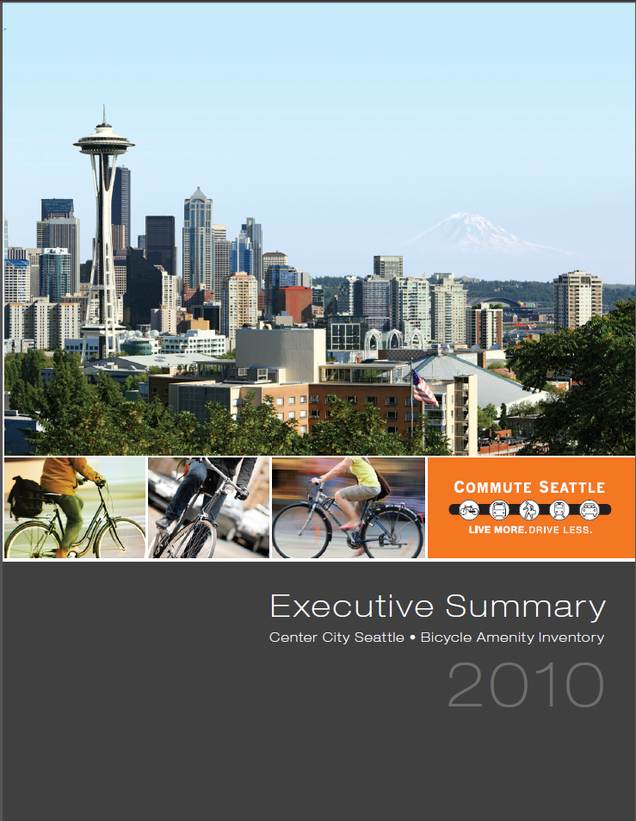
Key Findings
  22.6% buildings with bike parking
  5,872 parking spots

Slide 7
The Assessments

Slide 8
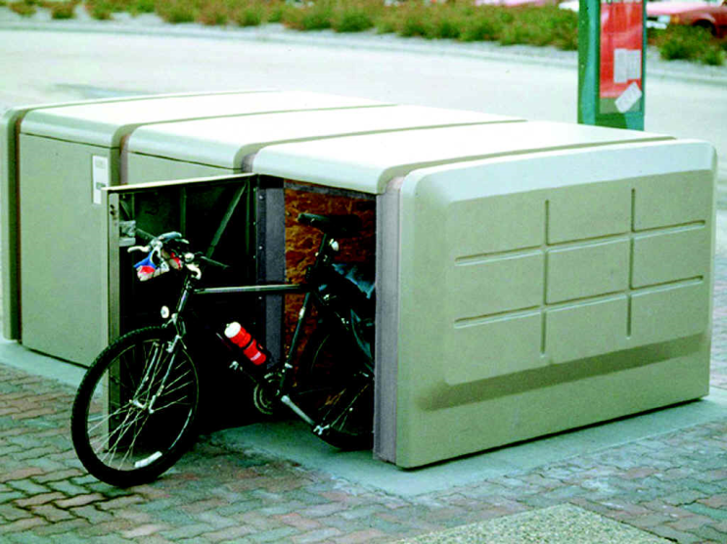
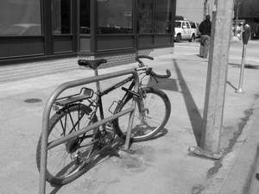
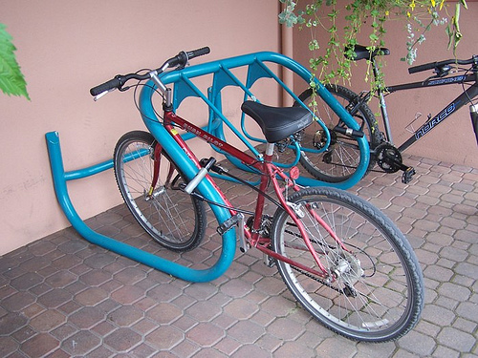
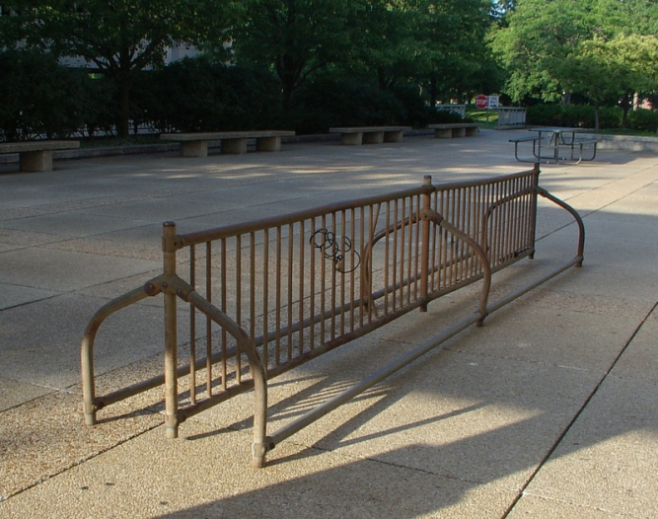
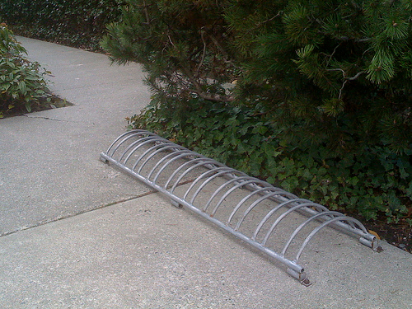
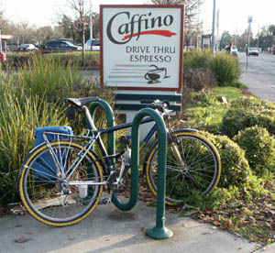
Quality & Rack Type

Slide 9
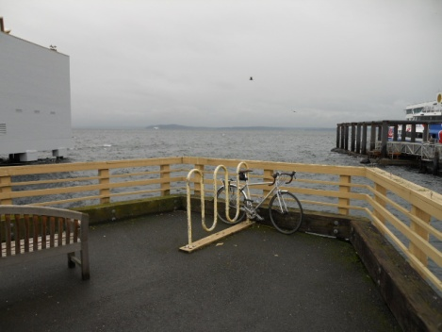
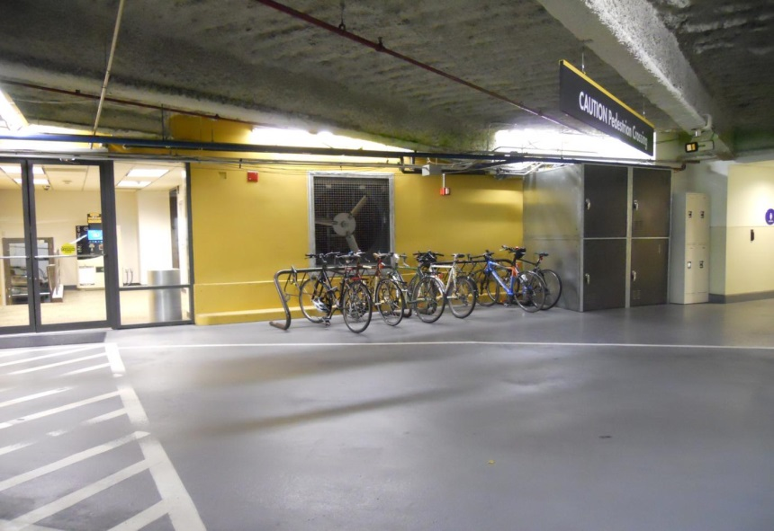
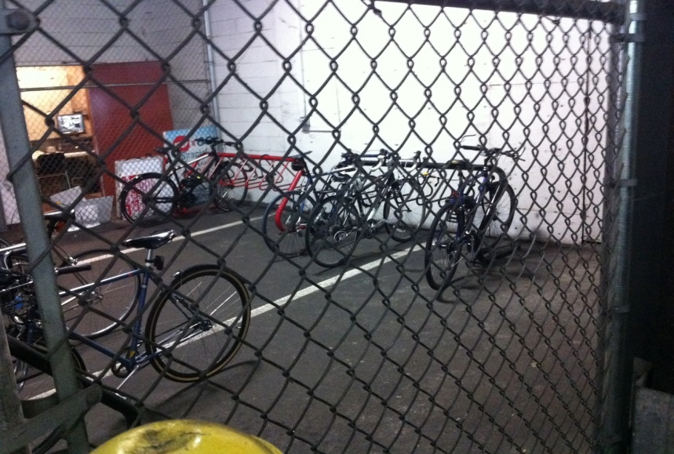
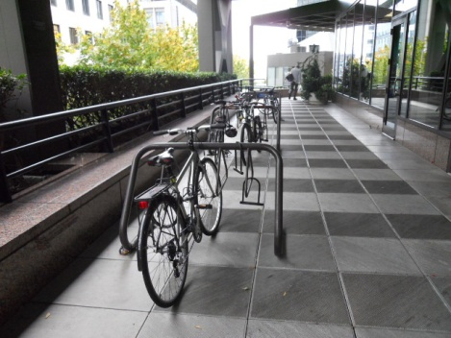
Weather Protection
& Security
Photos: Commute Seattle

Slide 10
Assessing The Racks
WEATHER PROTECTION
1-2-3
SECURITY
0-2-3
QUALITY
Preferred/Not
Score (A, B, C)

Slide 11
Preparing and Conducting 2015 Study

Slide 12
Seattle Youth Employment Program
Over the course of the summer, we employed eight different youth to conduct the survey field work
5 of these from the Mayor’s Youth Employment Initiative

Slide 13
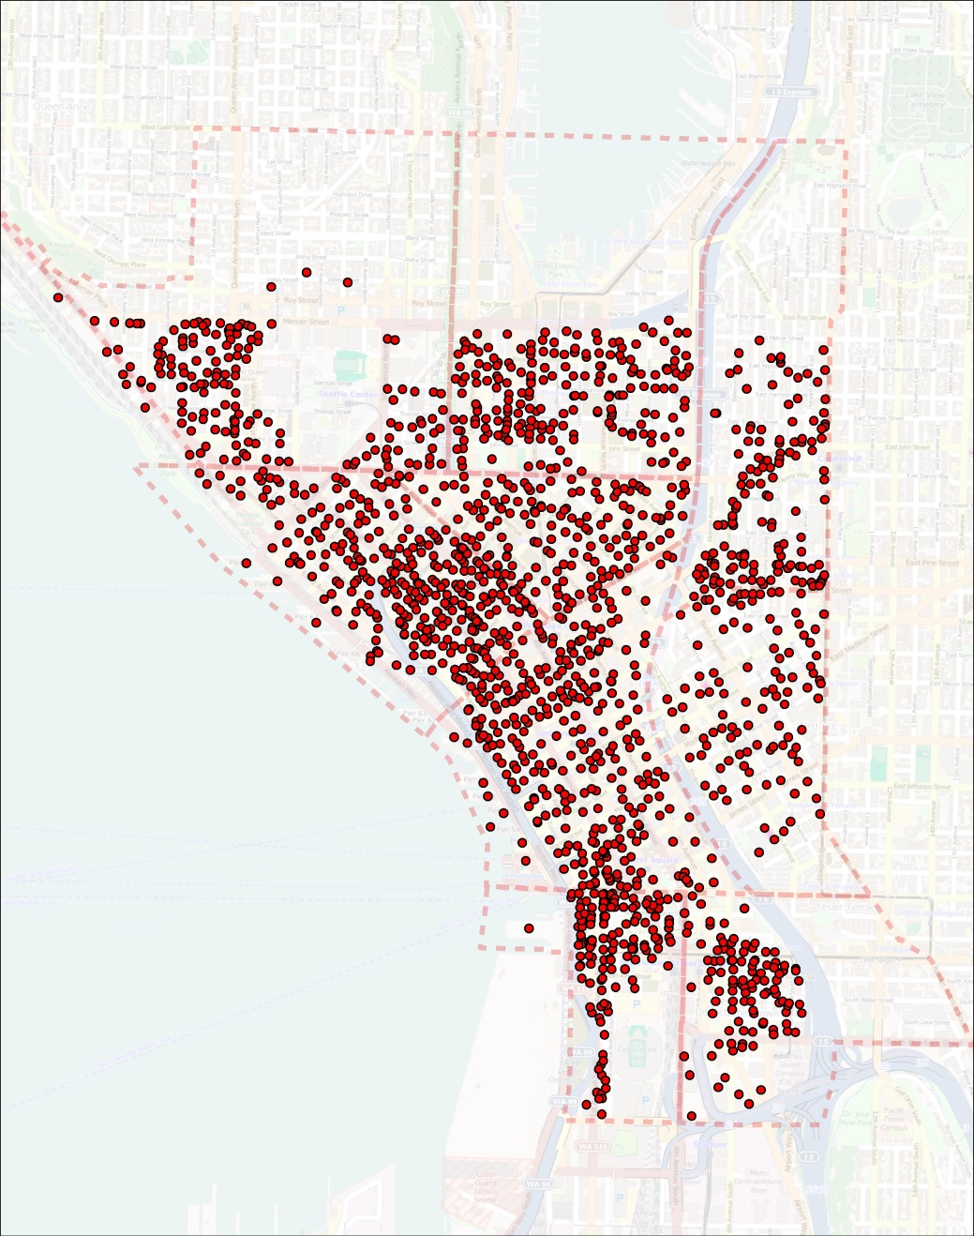
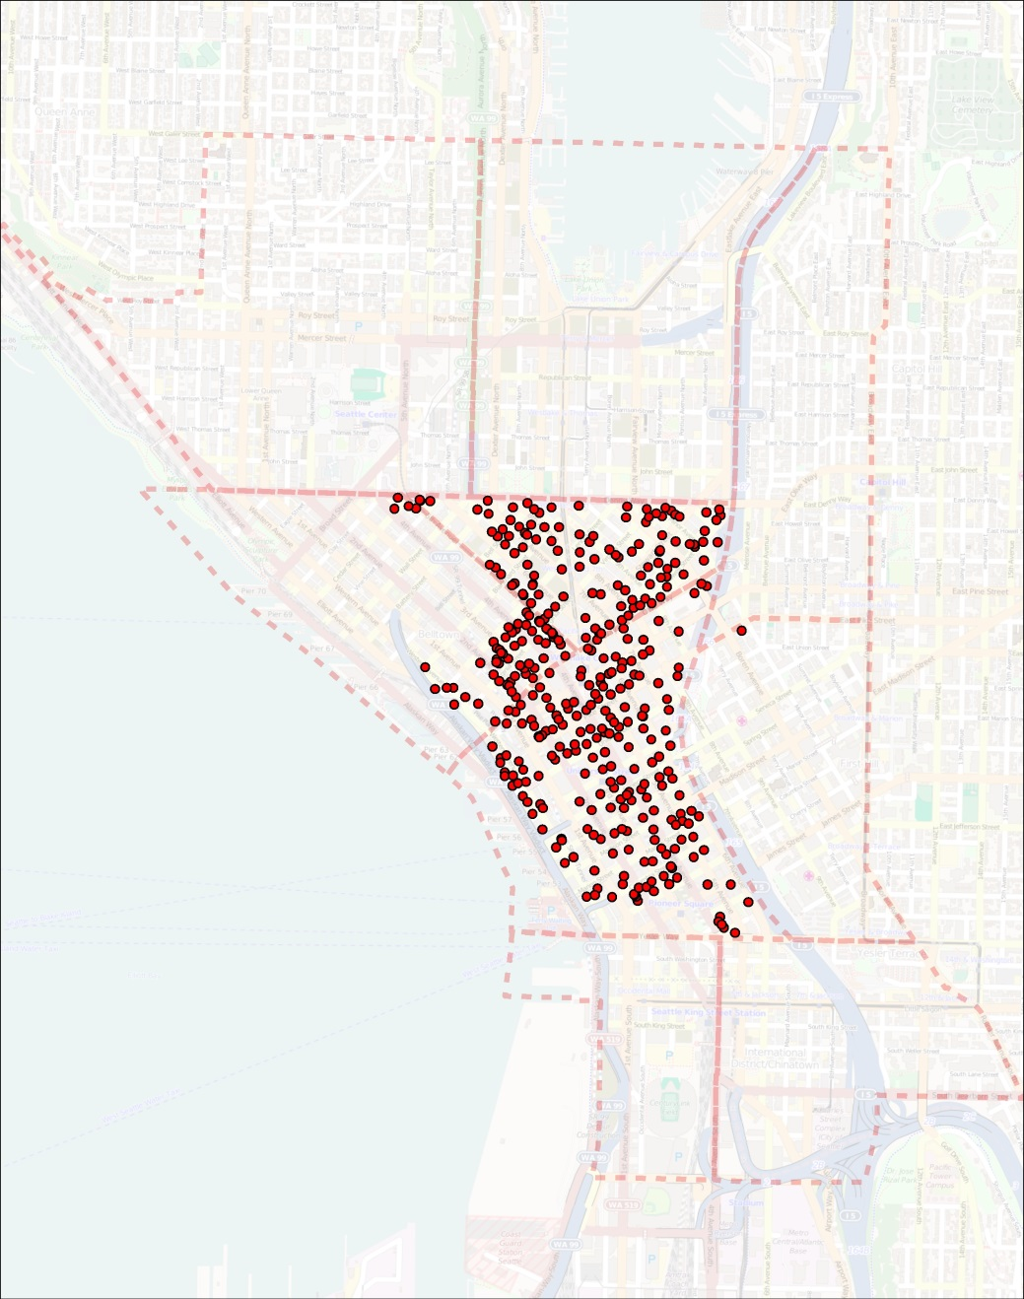
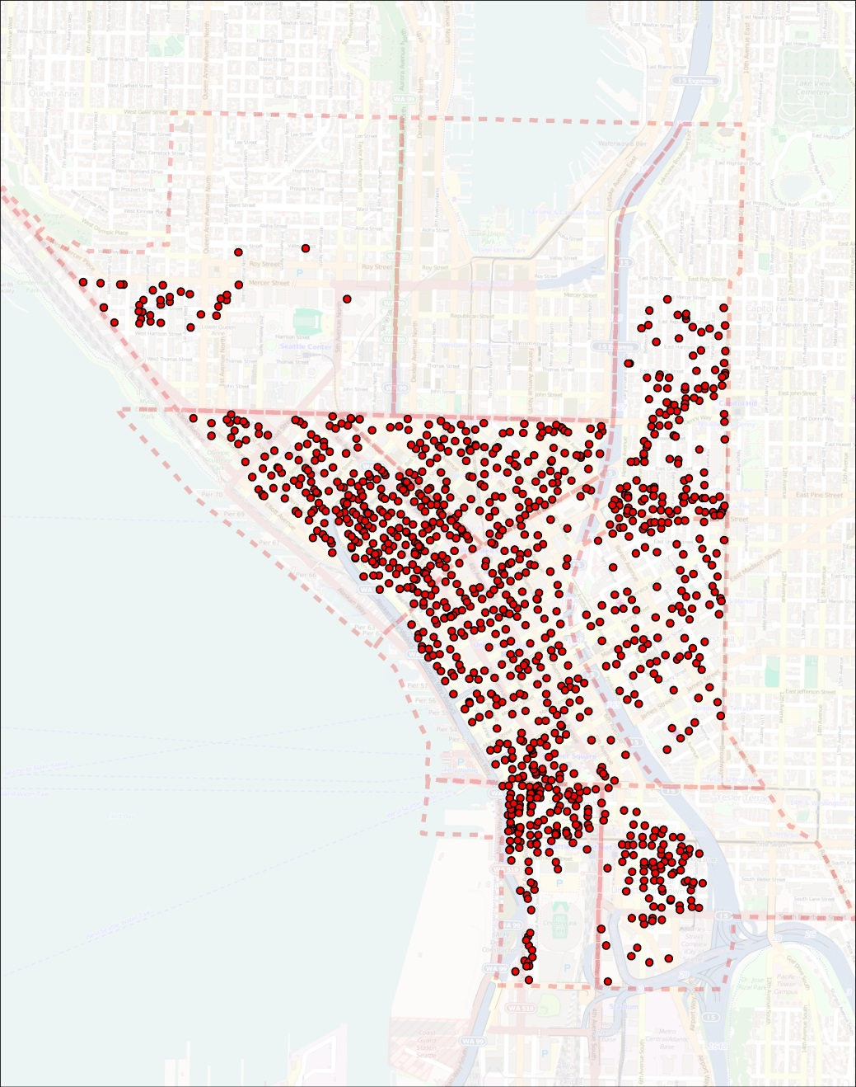
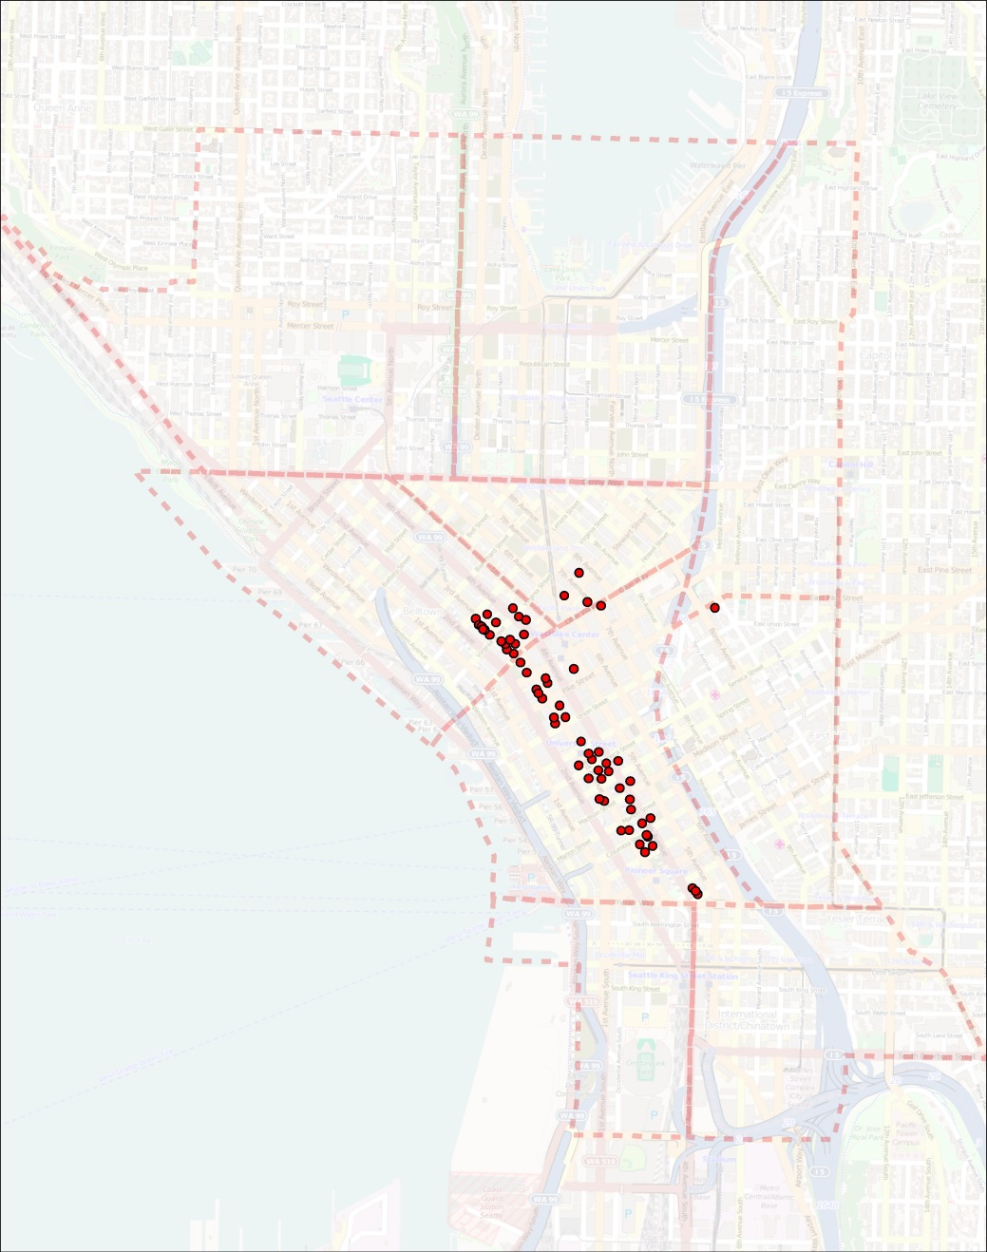
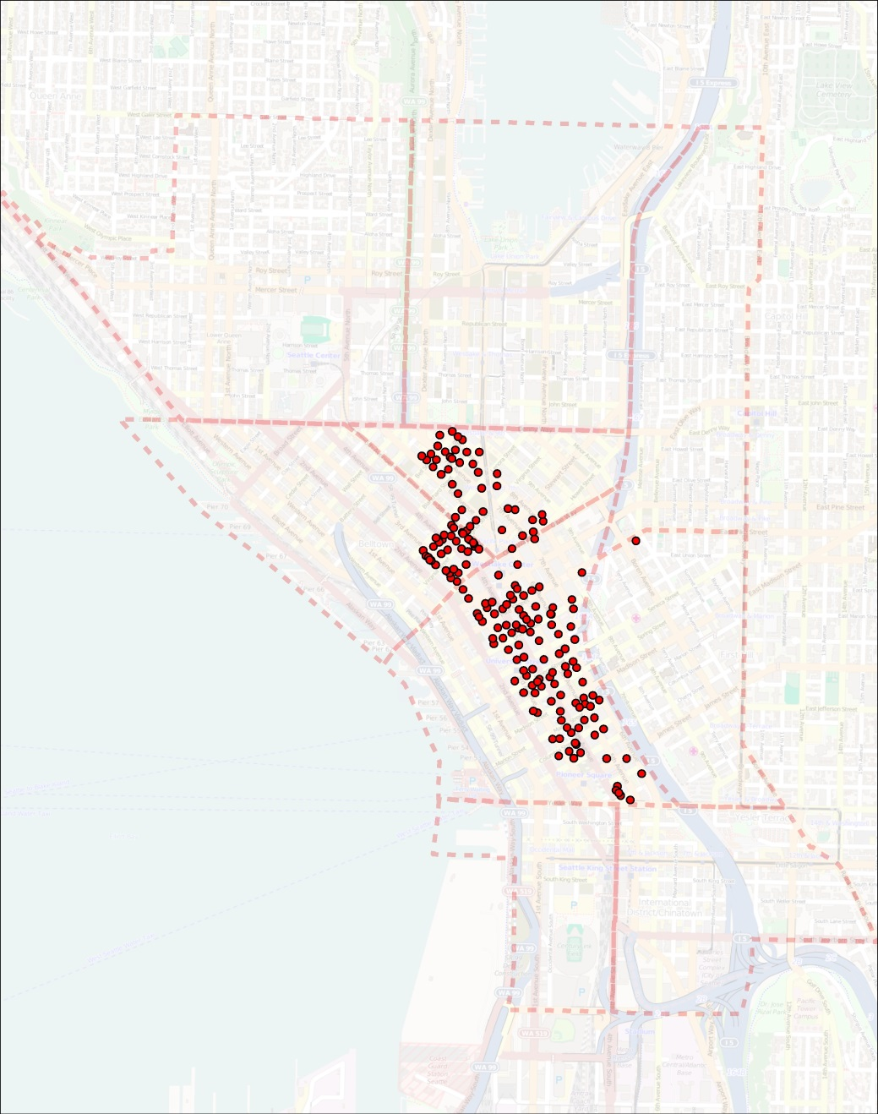
Into the Field

Slide 14
Compiling 2015 & Comparing to 2010

Slide 15
Overall Capacity
Neighborhood | Actual Capacity |  | Total Difference | Percent Gain or Loss
 | 2010* | 2015
Belltown | 495 | 765 | 270 | 55%
Capitol Hill | 110 | 286 | 176 | 160%
Chinatown-International District | 97 | 161 | 64 | 66%
Commercial Core | 2442 | 3009 | 567 | 23%
Denny Triangle | 798 | 1289 | 491 | 62%
First Hill | 595 | 548 | -47 | -8%
Pioneer Square | 343 | 526 | 183 | 53%
South Lake Union | 691 | 1510 | 819 | 119%
Uptown | 301 | 525 | 224 | 74%
Totals | 5872 | 8619 | 2747 | 47%
49% Increase in Capacity
* 2010 numbers adjusted by removing residential buildings identified in 2015 study

Slide 16
Buildings with Infrastructure
Neighborhood | Buildings With Racks |  | Percent Gain or Loss | Buildings With Showers |  | Percent Gain or Loss | Buildings With Lockers |  | Percent Gain or Loss
 | 2010* | 2015 |  | 2010* | 2015 |  | 2010* | 2015
Belltown | 29 | 37 | 28% | 17 | 32 | 88% | 9 | 37 | 311%
Capitol Hill | 4 | 12 | 200% | 1 | 5 | 400% | 0 | 6
Chinatown-International District | 6 | 6 | 0% | 1 | 4 | 300% | 2 | 7 | 250%
Commercial Core | 92 | 97 | 5% | 36 | 76 | 111% | 30 | 82 | 173%
Denny Triangle | 26 | 35 | 35% | 13 | 23 | 77% | 8 | 21 | 163%
First Hill | 20 | 23 | 15% | 5 | 20 | 300% | 3 | 18 | 500%
Pioneer Square | 16 | 17 | 6% | 10 | 16 | 60% | 9 | 17 | 89%
South Lake Union | 22 | 41 | 86% | 14 | 38 | 171% | 13 | 38 | 192%
Uptown | 24 | 20 | -17% | 8 | 17 | 113% | 6 | 21 | 250%
Totals | 239 | 288 | 21% | 105 | 231 | 120% | 80 | 247 | 209%
Buildings with Racks
+22%
Buildings with Showers
+121%
Buildings with Lockers
+210%
* 2010 numbers adjusted by removing residential buildings identified in 2015 study

Slide 17
Rack Quality
Neighborhood | A-Grade |  |  | B-Grade |  |  | C-Grade
 | 2010 Capacity | 2015 Capacity | % Gain or Loss | 2010 Capacity | 2015 Capacity | % Gain or Loss | 2010 Capacity | 2015 Capacity | % Gain or Loss
Belltown | 305 | 421 | 38% | 169 | 326 | 93% | 21 | 18 | -14%
Capitol Hill | 10 | 38 | 280% | 100 | 46 | -54% | 0 | 202 | 100%
Chinatown-International District | 88 | 133 | 51% | 9 | 15 | 67% | 0 | 13 | 0%
Commercial Core | 1781 | 2439 | 37% | 526 | 447 | -15% | 135 | 94 | -30%
Denny Triangle | 496 | 893 | 80% | 287 | 269 | -6% | 15 | 64 | 327%
First Hill | 352 | 516 | 47% | 201 | 72 | -64% | 42 | 135 | 221%
Pioneer Square | 279 | 402 | 44% | 56 | 119 | 113% | 8 |  | -100%
South Lake Union | 585 | 1174 | 101% | 88 | 291 | 231% | 18 | 45 | 150%
Uptown | 144 | 360 | 150% | 148 | 139 | -6% | 9 | 10 | 11%
Totals | 4040 | 6376 | 58% | 1584 | 1724 | 9% | 248 | 581 | 134%
A +58%
B +9%
C +134%

Slide 18
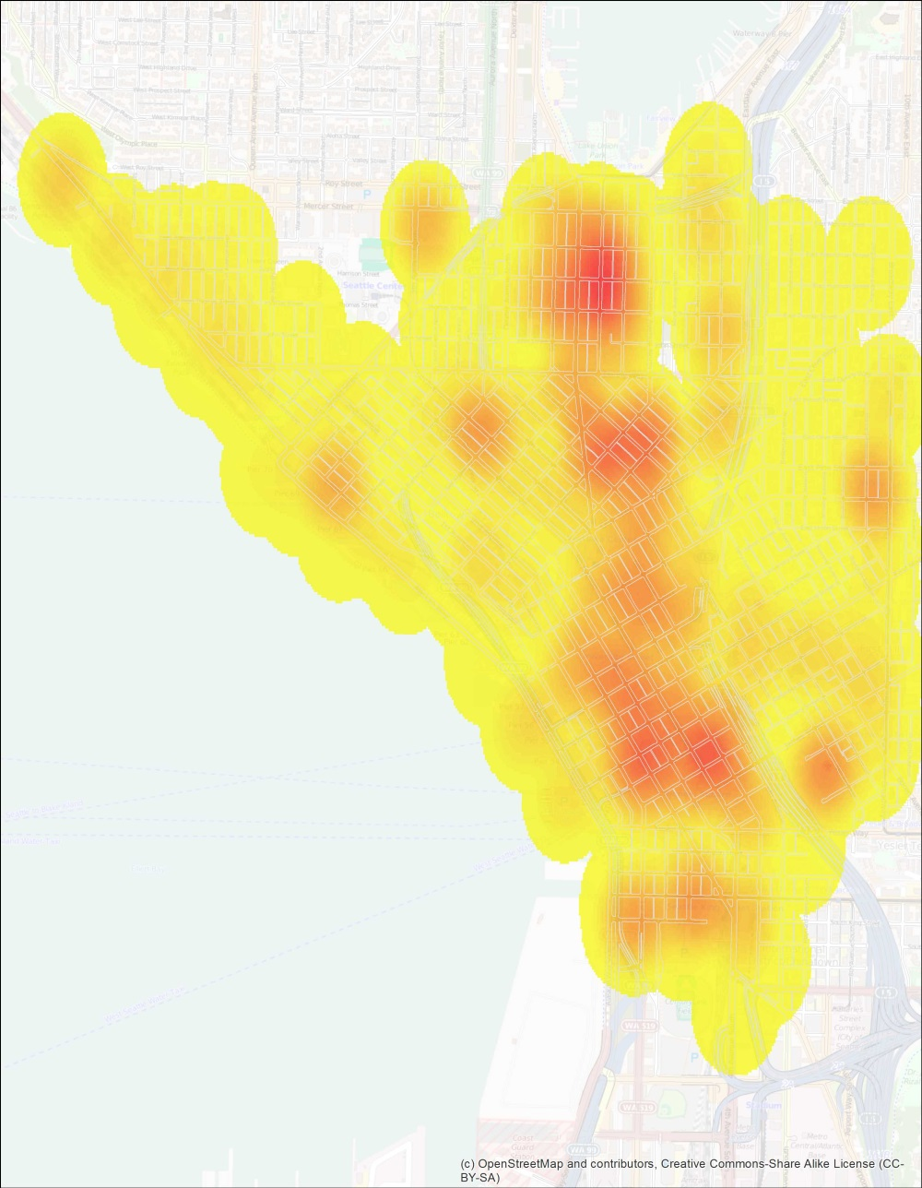
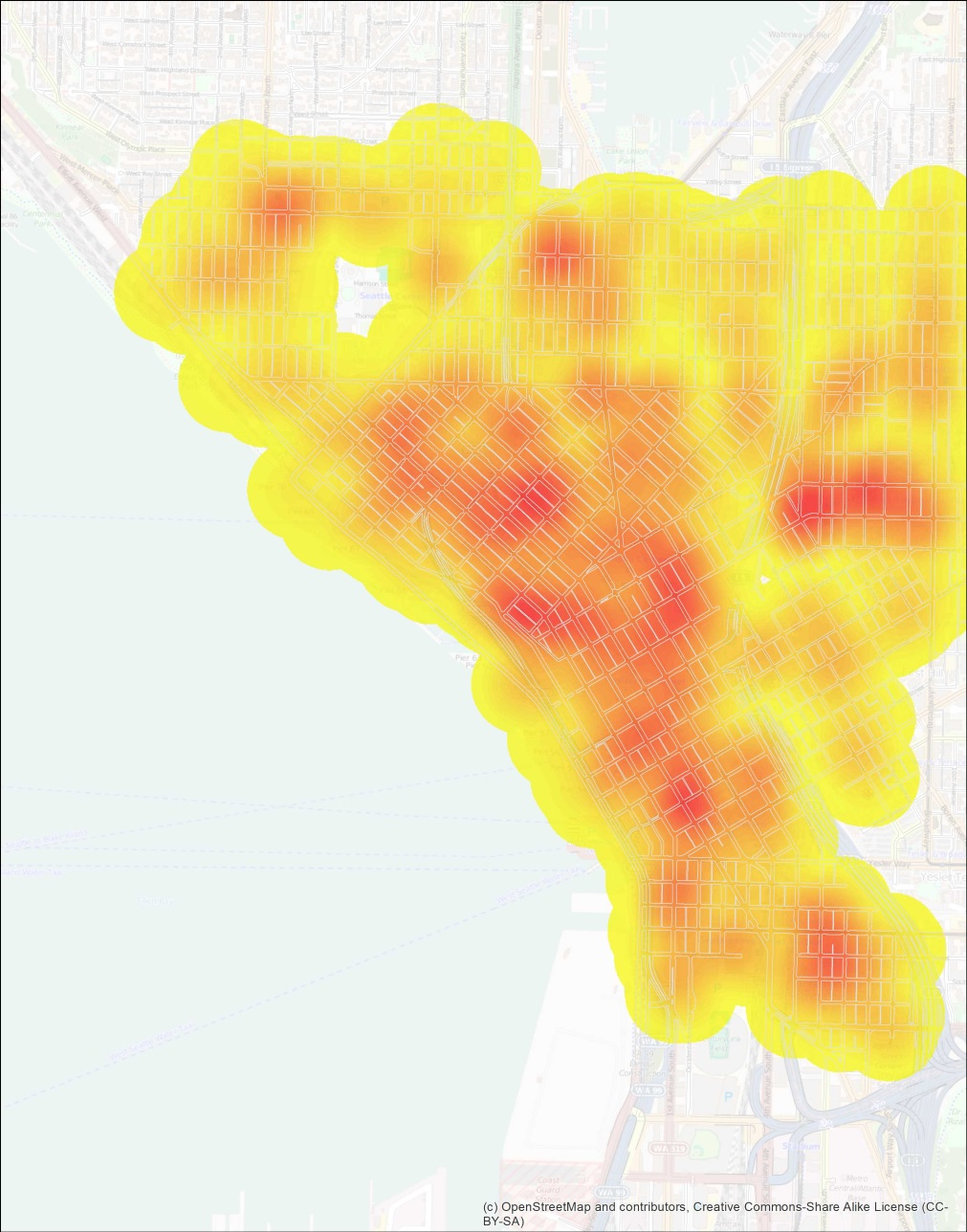
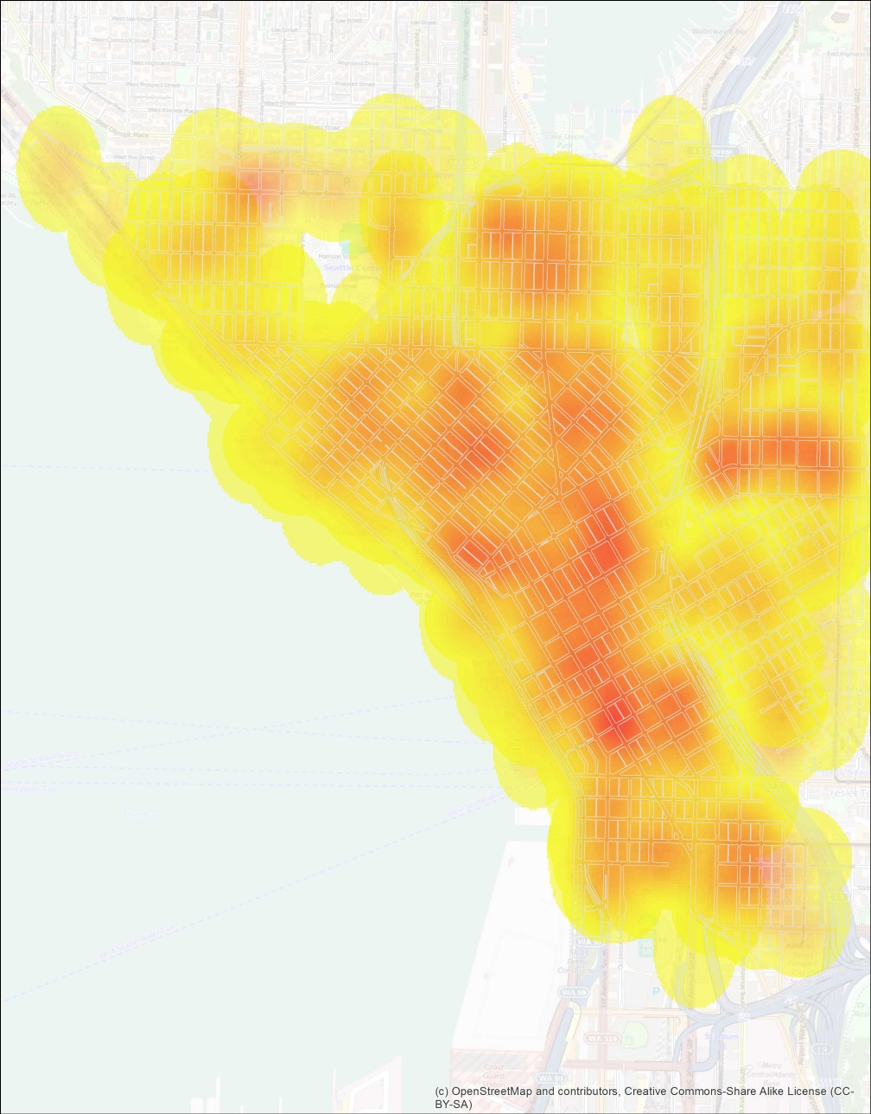
Density of Capacity
Private
Public
Private &
Public

Slide 19
Conclusion
2010
2015
Buildings
w/Racks
22%
29%
Overall
Capacity
5,872
8,723
Adequacy
51%
53%

Slide 20
Conclusion
Observations
2010—No clear connection between demand and supply w/ property managers
2015—Although capacity was not found in many buildings where it was found in 2010, it was more than made up for by capacity added.
In many cases, where successful & adequate bike parking had been installed, more parking was being added.

Slide 21
Jeffrey Linn
jeffl@commuteseattle.com
jeffrey@spatialities.com

