Slide 1
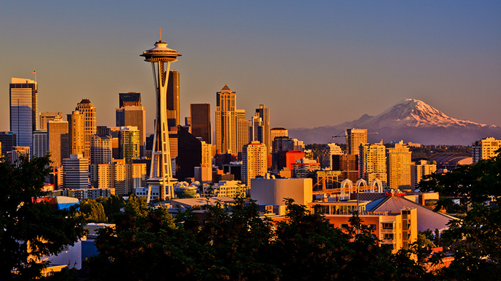
RSJI VISION:
Racial disparities have been eliminated
and racial equity achieved.
MISSION
End institutional racism in city government.
Promote inclusion and full participation of all residents.
Partner with the community and other groups to achieve racial equity.

Slide 2
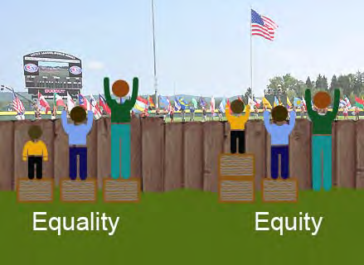
EQUALITY vs. EQUITY
Notes:
EQUITY
Everyone gets what they need based on context (history, present conditions and desired future outcomes).
An equality of outcomes.
Non-housing example of equity:
School math curriculum: Advanced students get an advanced curriculum and struggling students get a different curriculum. Both curricula meet students where they’re at and provide them with challenges so they can learn and grow. The two groups get what they need.

Slide 3
Why approach
equity through
the lens of race?

Slide 4
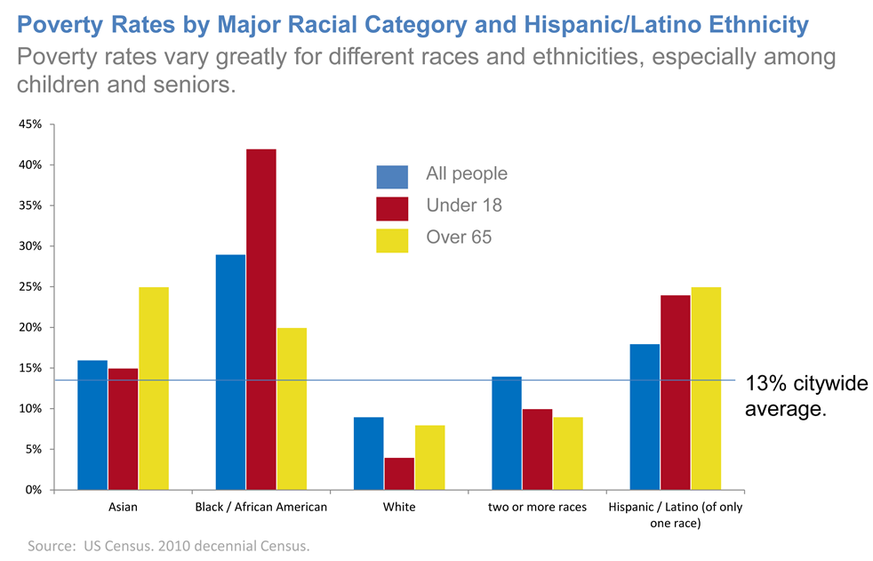
Racial Disparities

Slide 5
RSJI strategies
Ensure racial equity in City programs & services.
Work with community-based organizations
to end structural racism.
Form partnerships for racial equity with government, other groups, the private sector and philanthropy.

Slide 6
RSJI structure
Every Seattle City department is responsible for:
Incorporating racial equity into its own programs, services, policies, etc.
Creating an annual RSJI work plan.
Maintaining an RSJI Change Team.
Using RSJI tools, e.g. the Racial Equity Toolkit.
Interdepartmental teams work together on
key equity issues, e.g. criminal justice, education, and equitable development.

Slide 7
How can an organization or board build racial equity?
Understand how
we perpetuate racism.
Understand our power
and our opportunity.
Listen and be accountable to communities of color.
Implement policies and practices
that have racially equitable outcomes.
Ensure racial diversity in membership;
develop our existing and emerging leaders.

