Slide 1
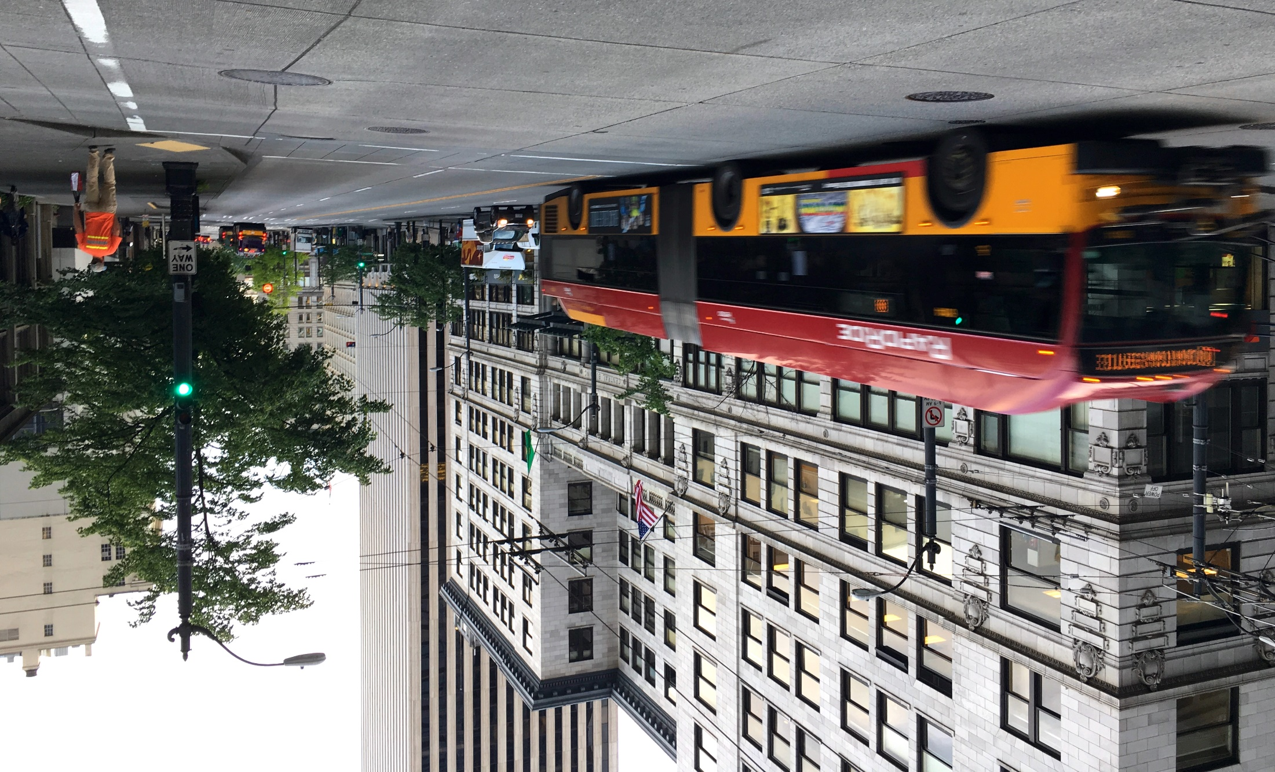



RapidRide H Line
Coming to Delridge
Seattle Bicycle Advisory Board
Therese Casper & Malva Slachowitz
February 2018

Slide 2
Our mission, vision, and core values
Mission: deliver a high-quality
transportation system for Seattle
Vision: connected people, places, and products
Committed to 5 core values to create a city that is:
Safe
Interconnected
Affordable
Vibrant
Innovative
For all
2
Notes:
Our core values for transportation anchor to the core values that Mayor Murray has laid out in his vision (Move Seattle) for Seattle:
Safe
Interconnected
Affordable
Vibrant
Innovative

Slide 3
Presentation overview
RapidRide network
Tonight’s focus: RapidRide H in Delridge & bike facilities
Community involvement
Options being considered
Next steps
3
Notes:
Let the audience know the purpose of your presentation (is it purely informational, are you seeking feedback, etc.). Then walk them through what you’ll be covering.

Slide 4
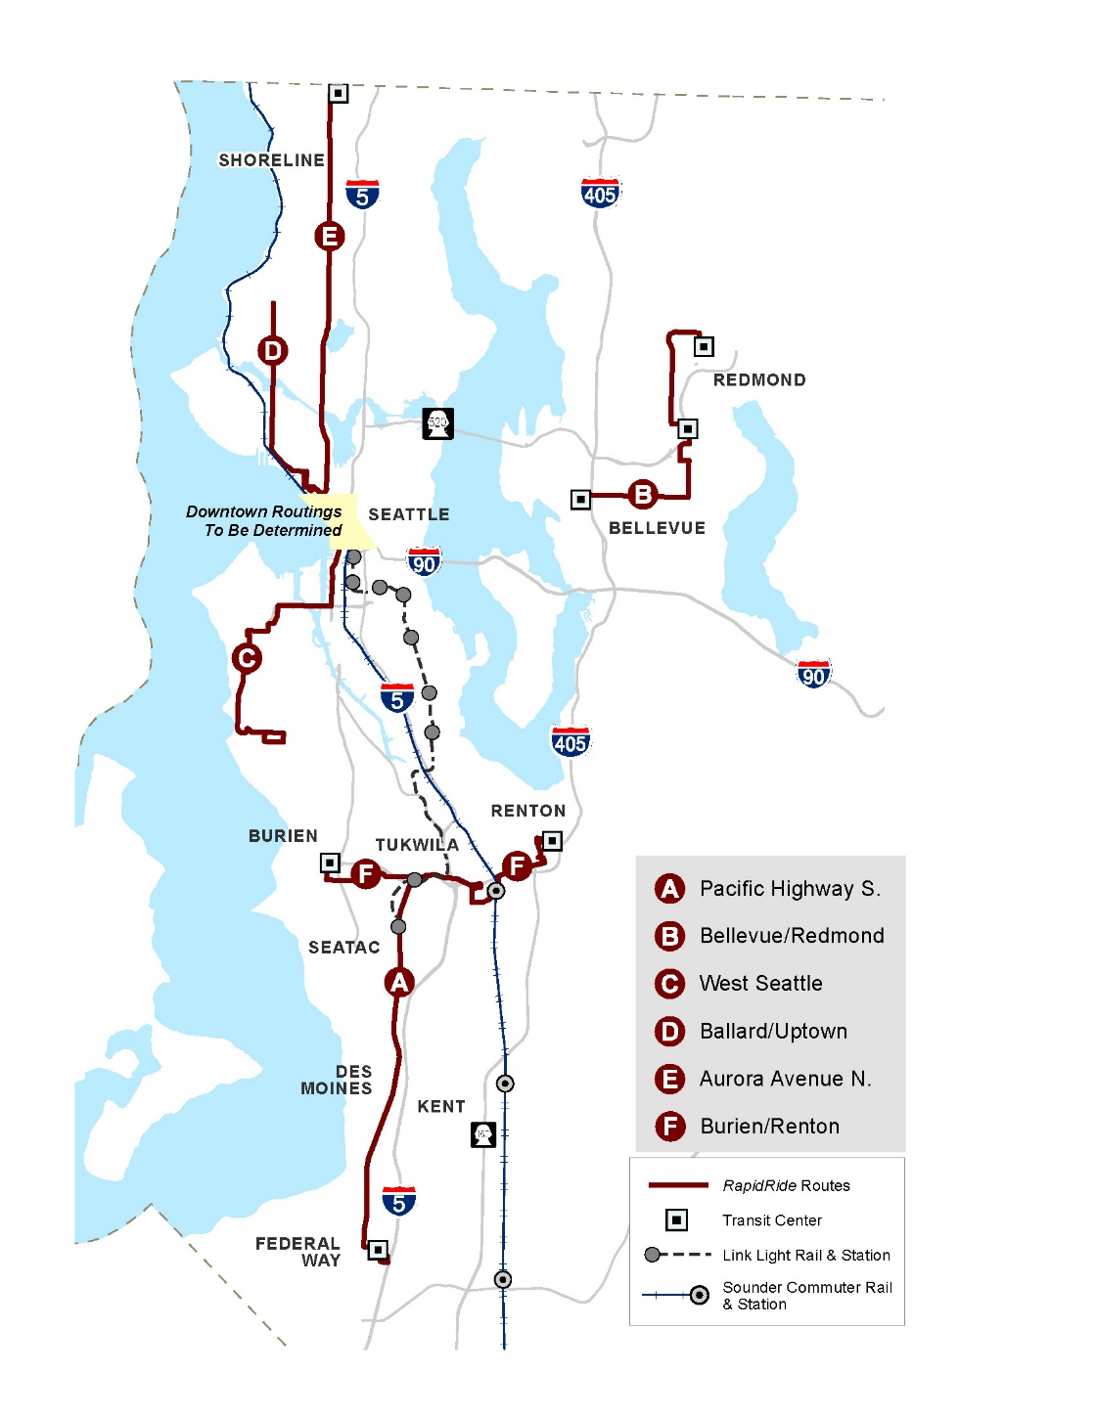

Metro RapidRide brand
Current RapidRide system
- launched 2010
Best of Metro
  Simple
  Frequent service
  Always there
6 current lines
13 new lines planned
  7 in Seattle
  6 in suburban King County
  All open by 2025
Even more lines by 2040
4
Notes:
PAUL
Future of the city relies on transit, and RapidRide is a cornerstone of transit expansion

Slide 5
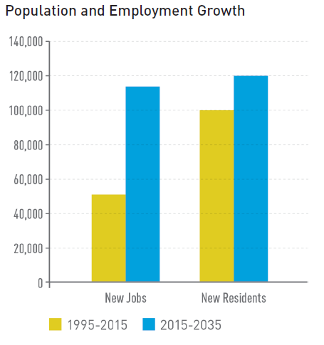
Why RapidRide?
Population and employment growing
In next 20 years:
  120,000 new residents
  115,000 new jobs
5
Notes:
PAUL
Future of the city relies on transit, and RapidRide is a cornerstone of transit expansion

Slide 6
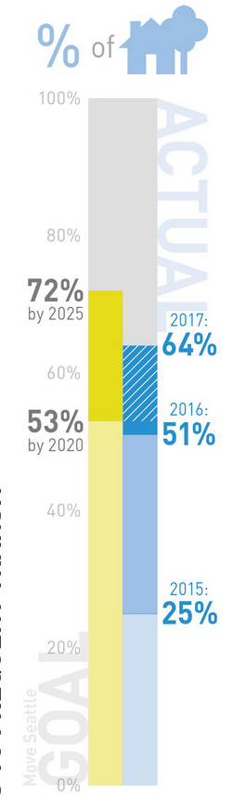
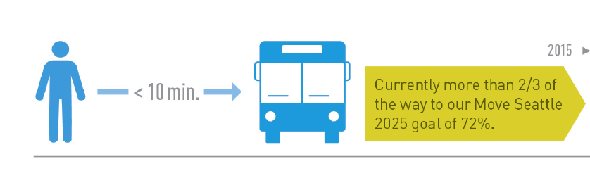
Why RapidRide?
Achieves promise of Move Seattle:
72% of households with 10-minute all-day service within a 10-minute walk from their home
6
Notes:
PAUL
Future of the city relies on transit, and RapidRide is a cornerstone of transit expansion

Slide 7
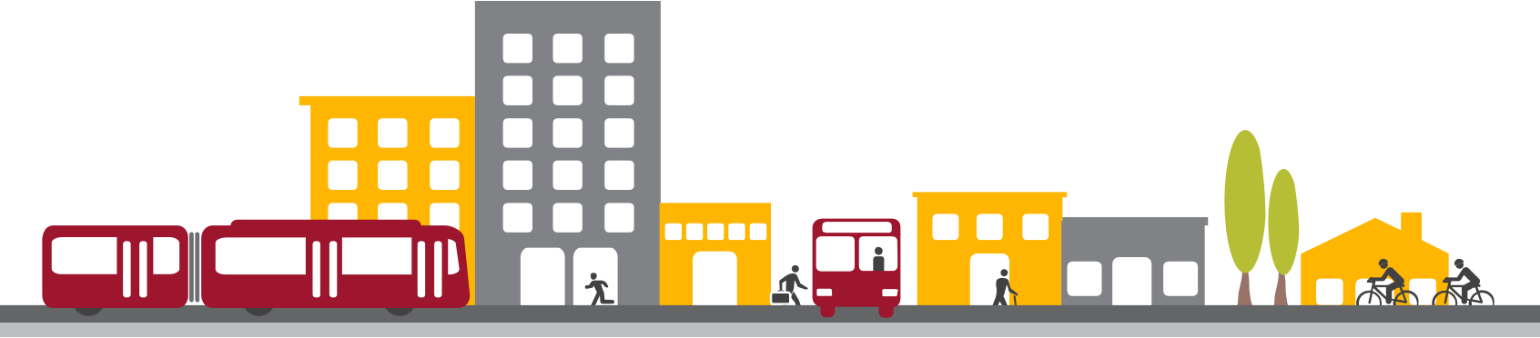
Benefits of the program
Faster transit speed, reliability and frequency
Multimodal network with connections to light rail, streetcar, and buses
Diverse neighborhoods linked to downtown transit hubs, employment, and shopping districts

Slide 8
RapidRide H

Slide 9
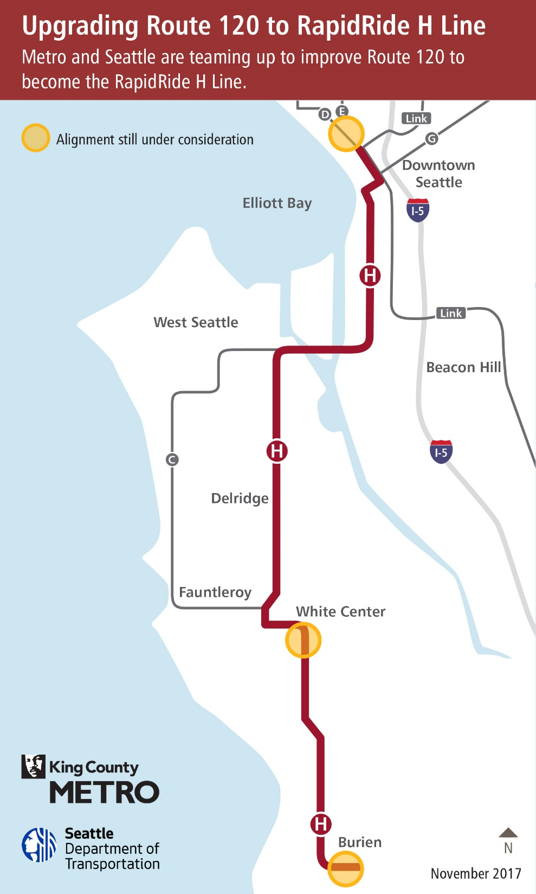
Metro Rte. 120
Burien to Downtown Seattle
13 miles long
80 bus stops
Over 9,200 weekday rides
5,600 Saturday rides
3,900 Sunday rides

Slide 10
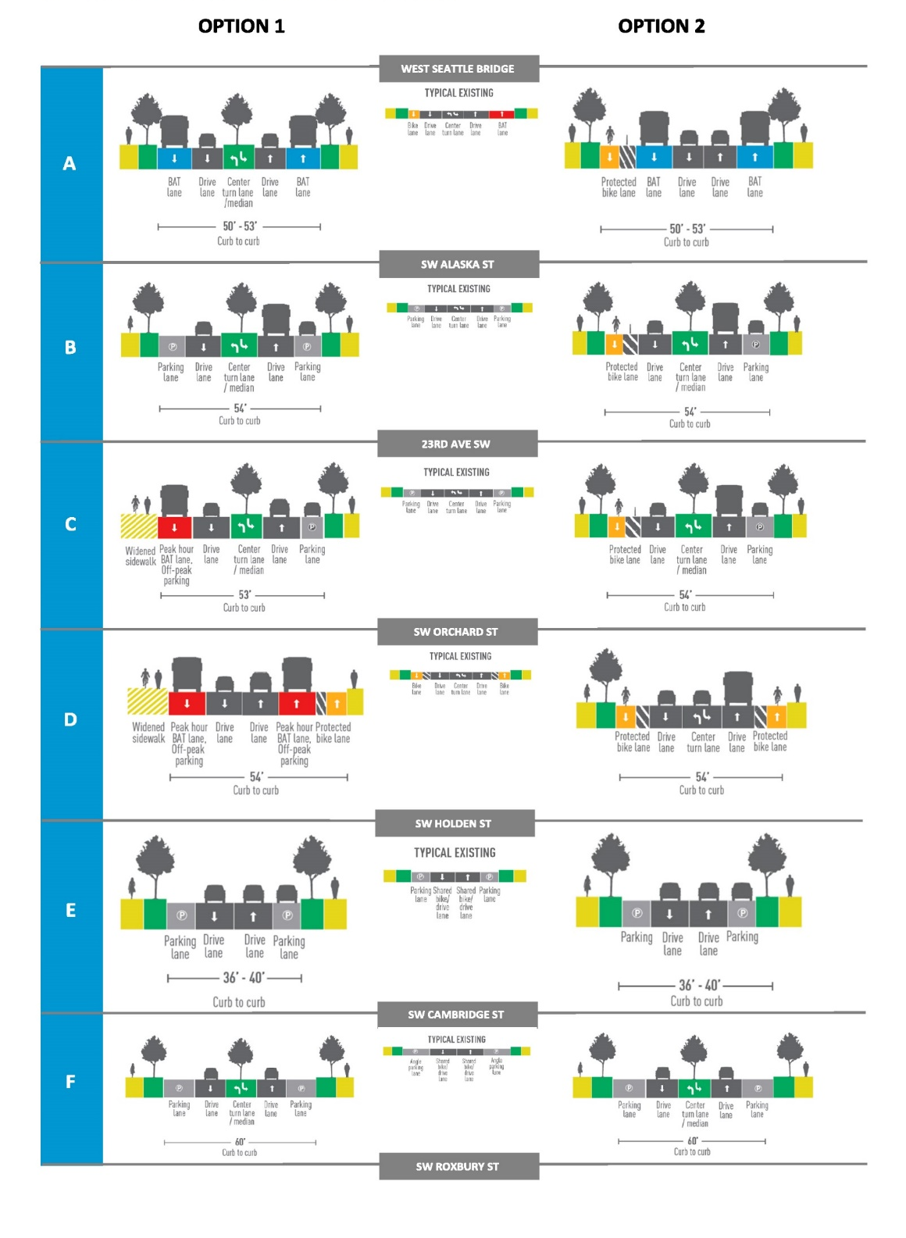
Redesigning Delridge Way SW
2 options unveiled in March 2017
Offered different ways to organize the street
10

Slide 11
March 2017 outreach overview
13,430 postcards were mailed
961 individuals visited the online open house
482 individuals took the online survey
150 people talked to us about biking and riding buses on Delridge Way SW
Over 40 businesses were provided information
8 presentations were giving to community groups and advisory boards

Slide 12
What we heard
Consider the community’s vision of incorporating boulevard treatments along Delridge Ave SW
Strong support for prioritizing buses on Delridge Way SW
Keep and improve bus access for the most vulnerable people in the community
Metro Route 120 is an important neighborhood connector in addition to getting people downtown for work

Slide 13
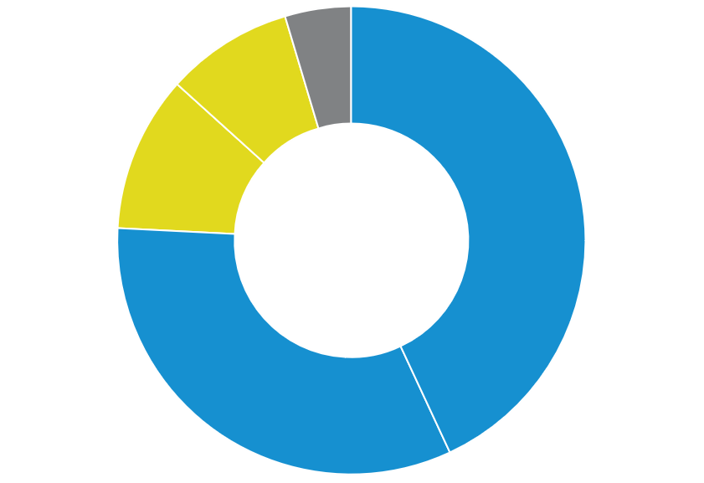
What we heard: Bus stop changes
4%
Neither
9%
Somewhat disagree
Are you okay with moving or removing some bus stops to make buses faster and arrive on time?
11%
Strongly disagree
Based on online survey results
43%
Strongly Agree
33%
Somewhat
Agree

Slide 14


What we heard: Street paving
    Survey takers and others raised the importance of repaving Delridge Way SW.
      Current road conditions, especially the center lane, need repaving for safety and durability.
      The number of potholes and poor road conditions on Delridge need to be addressed

Slide 15

What we heard: Bike Lanes
54%*
Bike lanes should
be ON Delridge
*Survey respondents
45%*
Bike lanes should be OFF Delridge
*Survey respondents
Face to face and survey respondents
  Need to better connect neighborhood greenways to Delridge Way SW
  If adding a bike lane to Delridge Way SW it should span the length, especially where neighborhood greenways are not a good option due to steep grades

Slide 16
Came up with Option 3
Adds bus-only lanes
Adds new neighborhood greenway connections and a southbound protected bike lane south of SW Graham St
16

Slide 17
Key improvements
 | Option 1 | Option 2 | New Option
New greenway connections | 6 | 6 | 7
Improved pedestrian crossings | 4 | 4 | 4
New ADA ramps | 17 | 17 | 17
Bus only lanes | 1.4 miles (all day) + 1.2 miles (peak hours only) | 1.4 miles (all day) | 1.4 miles (all day) + 1.2 miles (peak hours only)
Protected bike lane | 0.3 miles | 2.9 miles | 2.1 miles
Widened sidewalk Ranges from 8 – 12 feet | 0.9 miles | 0.0 miles | 0.0 miles
Landscaped median | 2.5 miles | 1.8 miles | 1.9 miles
Numbers are based on concept design and are subject to change

Slide 18
Outcomes
 | Option 1 | Option 2 | New Option
Bus travel time Range for north and southbound | Up to 9 – 16% faster | Up to 8 – 12% faster | Up to 9 – 16% faster
Traffic travel time Range for north and southbound | Up to 1 – 8% faster | Up to 5 – 10% slower | TBD
On-street parking | Some all-day parking converted to off-peak parking and new off-peak parking added | Up to 73% of parking retained as a mix of all-day and off-peak | Up to 71% of parking retained as a mix of all-day and off-peak
Loading zones | No loading zones removed | Small number of loading zones relocated | No loading zones removed
Street trees For any street tree removed, two trees are planted within the neighborhood | Up to 80% of street trees retained | Up to 100% of street trees retained | Up to 100% of street trees retained
Numbers are based on concepts and are subject to change
Notes:
Option 1: Convert all-day parking to off-peak parking on the west side of Delridge from 23rd to SW Orchard St and add new off-peak parking from SW Orchard St to SW Holden St
Option 2: Up to 73% of parking retained as a mix of all-day and off-peak, removes parking on west side between SW Alaska St and SW Orchard St
Option 3: Up to 71% of parking retained as a mix of all-day and off-peak, removes parking on west side between 23rd Ave SW and SW Orchard, SW Holden St and SW Cambridge St

Slide 19
Bike Improvements

Slide 20
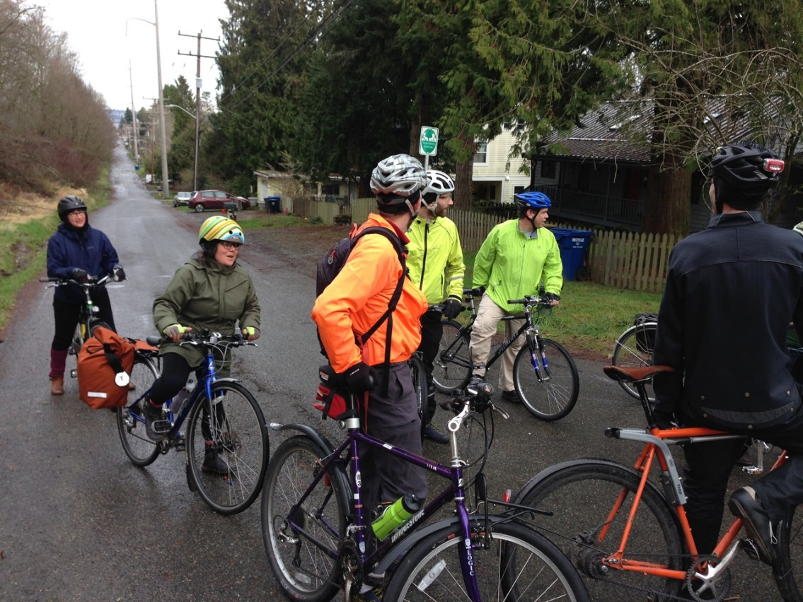
Proposed bike route
January 19 bike ride to discuss proposed route

Slide 21
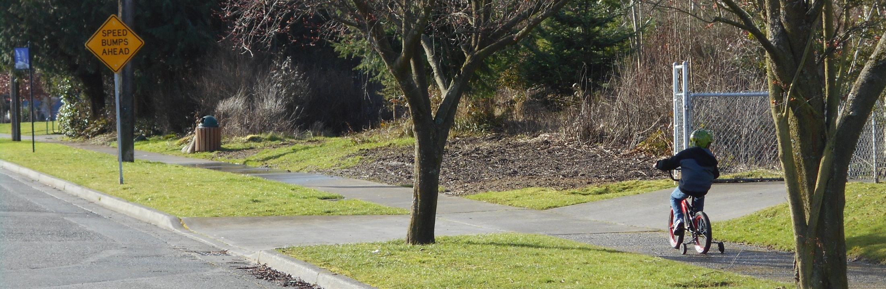
26th Ave SW Greenway
Input: Discourage cut-thru traffic by improving speed humps and restrict left-turn from eastbound Genesee to northbound 26th Ave with diverter
Action: Upgrading and adding speed humps and considering feasibility of restricting turn

Slide 22
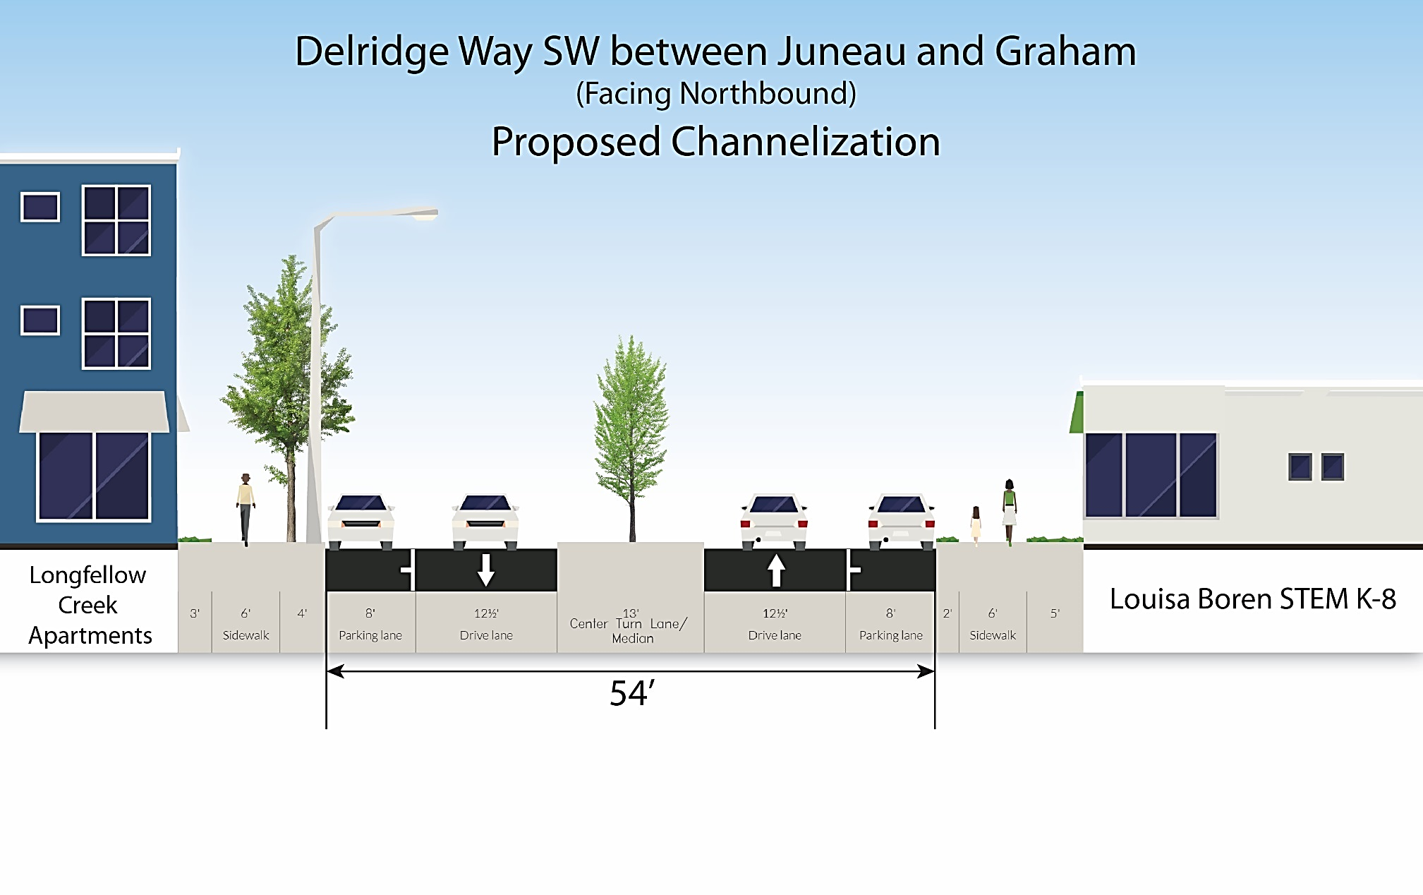
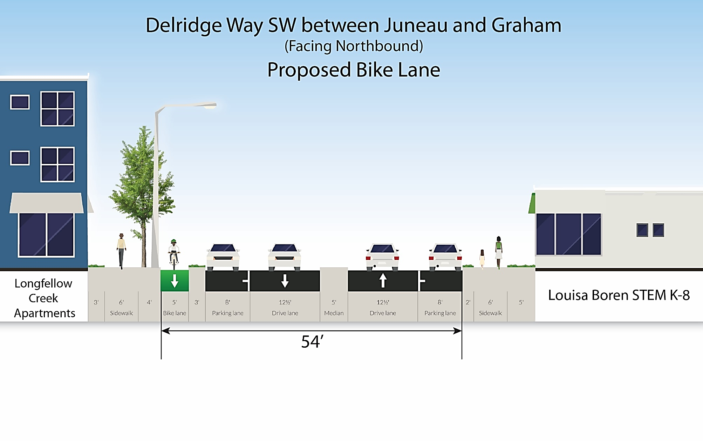
Southbound Delridge Way Protected Bike Lane (PBL)
No PBL
With PBL
Input: Extend the southbound PBL north from Graham to Juneau
Action: Work with adjacent school on access needs and collect data

Slide 23
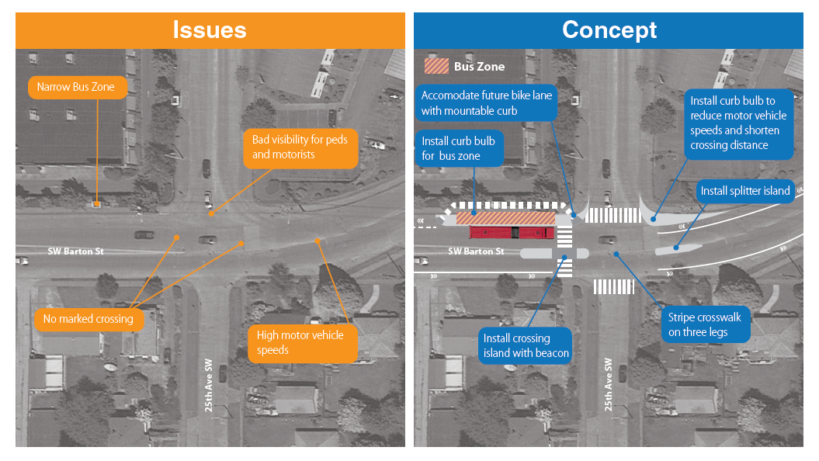
Access and safety improvements to Westwood Village
Concept under consideration
SW Barton St & 25th Ave SW

Slide 24
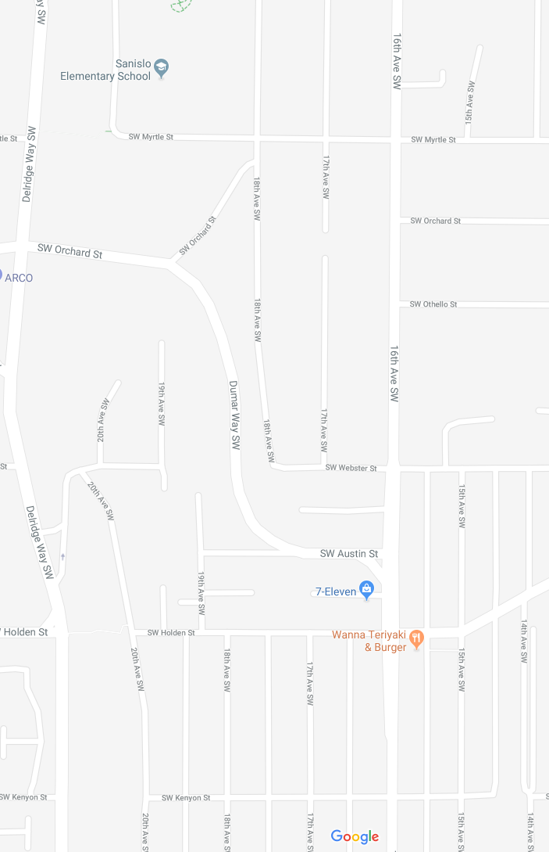
21st Ave SW Greenway
Install a switchback ramp & barrier at top of stairs.
If not feasible consider new connection on 18th Ave SW
Input:
PBL or improved westside sidewalk
Action: Develop high-level concepts and cost estimates
PBL or 10’ mixed path/sidewalk

Slide 25
So now what?
Gather input on the new option and bus station spacing (Delridge comments due February 9, 2018)
Focus on underserved populations and seniors
Identify transportation needs near Westwood Village
Incorporate Metro corridor-wide outreach results
Refine funding strategy and paving plan
Work with the community on project artwork

Slide 26




Stay involved!
rapidride@seattle.gov | 206-684-5189
www.seattle.gov/transportation/rapidrideexpansion.htm
www.seattle.gov/transportation

