Slide 1
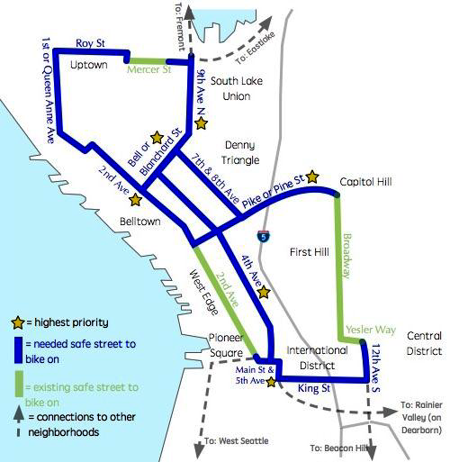
BASIC BIKE NETWORK 2017
Cascade Bicycle Club and Seattle Neighborhood Greenways Basic Bike Network Priorities

Slide 2
CURRENT TIMELINE – April 2018
2019/20 Construct
2018 Study
2019/20/21 Construct
2020 Construct
2018 Construct
2020 Construct
2017 Construct
2021 Construct
2017 Construct
2018 Study
2021 Construct
2019 Construct
2019 Construct

