Slide 1
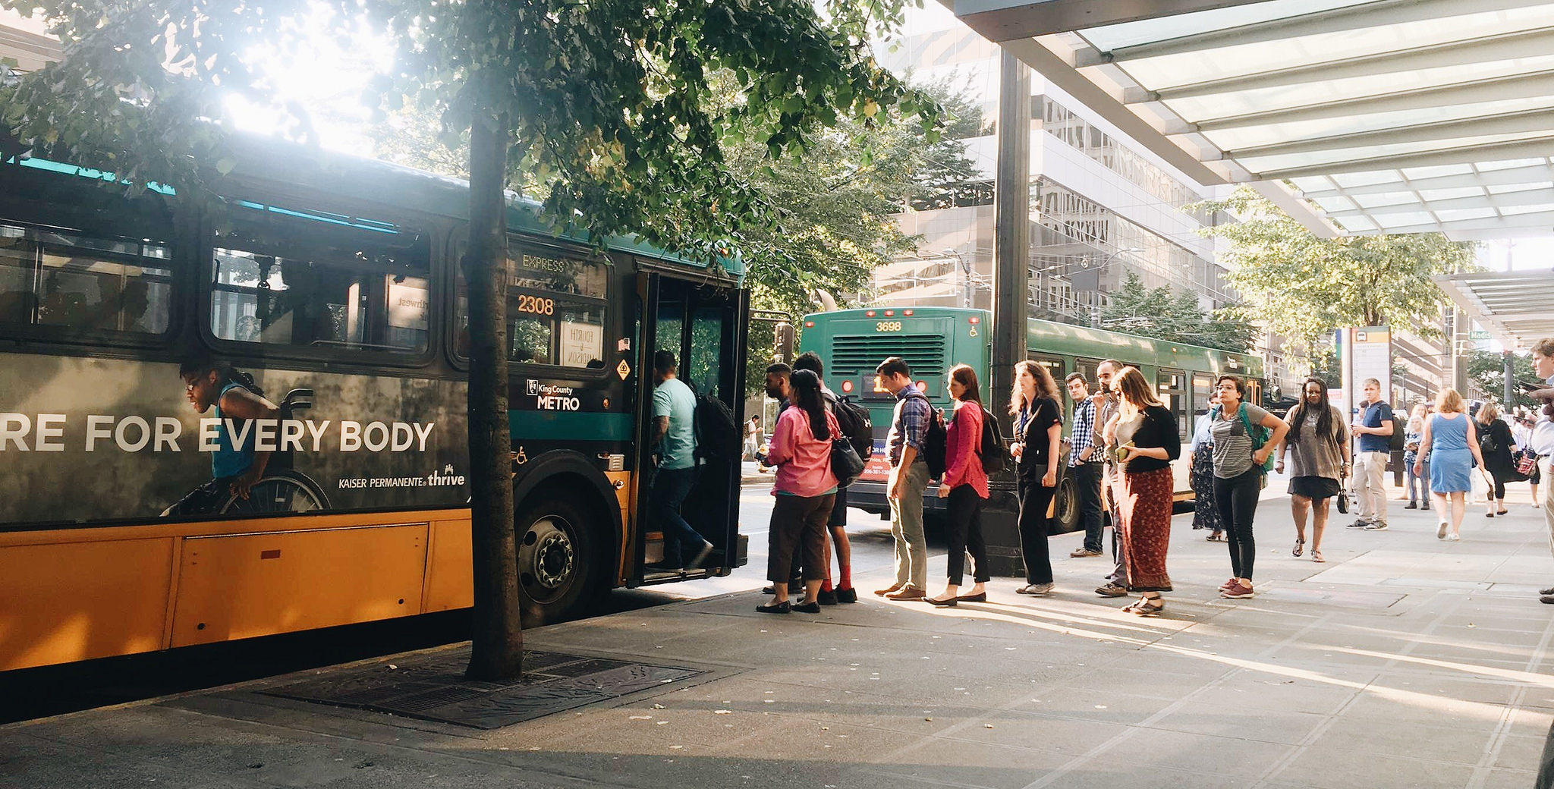
Delridge Way SW RapidRide H Line
30% Design Update
City Council Sustainability & Transportation Committee
Lorelei Williams, C.J. Holt, Maria Koengeter, Ben Hansen
March 5, 2019

Slide 2
Our mission, vision, and core values
Mission: deliver a high-quality transportation system for Seattle
Vision: connected people, places, and products
Committed to 5 core values to create a city that is:
Safe
Interconnected
Affordable
Vibrant
Innovative
For all

Slide 3
Presentation overview
Background, schedule
City Council proviso
Project area
Existing conditions
30% Design
Schedule
Community engagement
Stormwater code compliance
SDOT/Metro coordination
Cost estimates, funding
Next steps

Slide 4
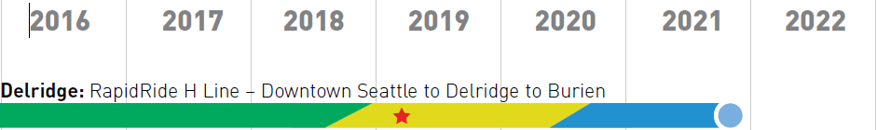



Background, schedule
Planning
2015 – existing conditions workshop
2016 – modal priorities workshop
2017 – existing conditions report
2017 – design options 1 and 2
2018 – design option 3
Design
2018 – 10% design
2019 – 30% design

Slide 5
City Council proviso
Proviso
Green Sheet 49-1-A-1-2018
Directs SDOT to report to Sustainability & Transportation Committee at 30% design milestone
Requests clear definition of sidewalk and bicycle design elements
Requests design baseline reflects continued community engagement and input
Progress since July 2018 Council briefing
Conducted 10% design outreach
Advanced design from 10% to 30% and responded to 10% design feedback
Added paving into design and assessed stormwater requirements

Slide 6
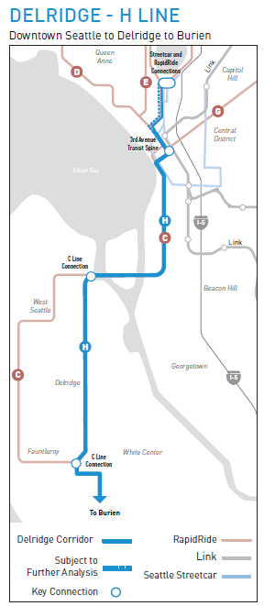
Project area
Metro
RapidRide H Line
implementation
South Lake Union to Burien via Delridge
Three overlapping projects
King County Metro RapidRide H Line Implementation
SDOT Delridge Way SW Paving
SDOT Delridge Way SW Transit-Plus Multimodal Corridor
SDOT
Paving, utility upgrades
Delridge Way SW
(north end)
SDOT
Street rechannelization
Transit/bike/walk corridor
Delridge Way SW (West Seattle Bridge to SW Roxbury St)

Slide 7
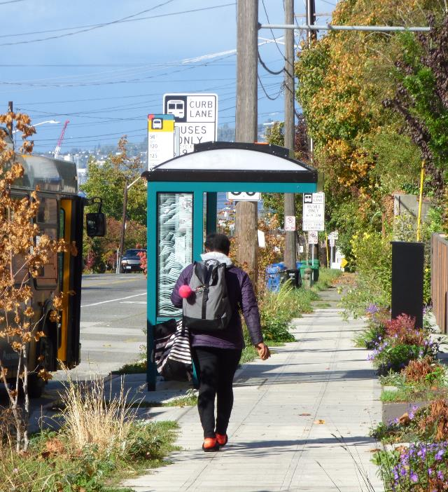
Existing conditions
Delridge Way SW project area
4 miles of principal arterial
5+ feet of sidewalk on both sides
Mix of bike lanes and sharrows
Mix of unrestricted parking and prohibited parking areas
Average daily traffic
  19,000 north end
  9,000 south end
King County Metro Route 120
Connects South Lake Union, downtown Seattle, Delridge, White Center, and Burien
9,200 trips each weekday, 5,600 on Saturdays, and 3,900 on Sundays.
Serves 80 bus stops

Slide 8
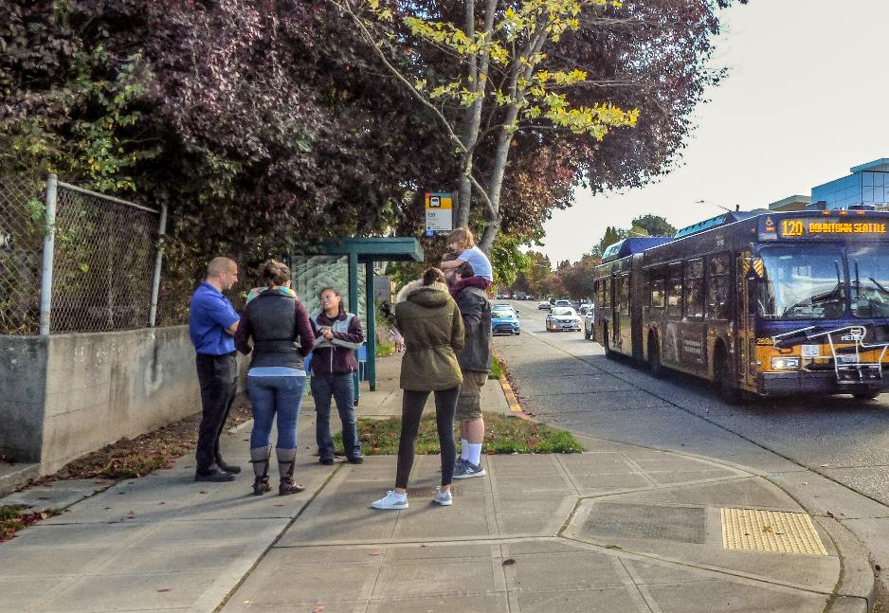
30% Design
SDOT Delridge Way SW
Transit-Plus Multimodal Corridor
Transit
Bicycle
Pedestrian
Paving
Parking
Utilities

Slide 9
30% Design - Cross sections
Andover-Alaska
Alaska-23rd
23rd-Orchard
Existing
Peak bus lane
Off-peak parking
Proposed

Slide 10
30% Design – Cross sections
Orchard-Holden
Holden-Cambridge
Cambridge-Roxbury
Existing
Peak bus lane
Off-peak parking
Peak bus lane
Off-peak parking
Proposed

Slide 11
Community engagement – fall 2018
What we heard | Status
Pave the street | Done: Included in project scope
Extend protected bike lane to SW Juneau St | Done: Included in design
Modify 17th Ave SW neighborhood greenway toward: - 18th Ave SW to avoid staircase - 16th Ave SW for more direct route | Done: Design complete, installation this year In-process: Evaluating design alternatives for 60% design decision
Install east-west neighborhood greenway to connect north-south neighborhood greenways | Done: Completed in 2018
Add additional marked crosswalks at: - SW Hudson St - SW Findlay St - SW Graham St | Done: Included in design Done: Included in design Done: Included in design
Relocate new RapidRide station from SW Findlay St to SW Brandon St | In-process: Discussing with Metro for 60% design decision
Extend inbound bus lane south of SW Alaska St | In-process: Evaluating design alternatives for 60% design decision
Allow parking adjacent to Louisa Boren school | Done: Included in design
Allow night, weekend parking by Youngstown Cultural Center | In-process: Evaluating design alternatives for 60% design decision
Allow parking on west side in south end | Not included in design
Add traffic calming in White Center business district | In-process: Evaluating design alternatives for 60% design decision

Slide 12
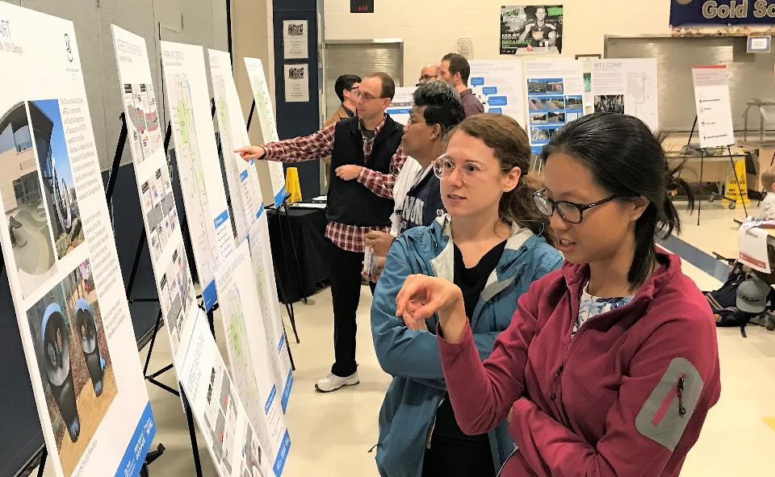
Stormwater code compliance
Status
Original design of stormwater work required by Seattle Stormwater Code came in over budget
Design team undertook value engineering process and recommend design to keep project within budget and comply with code
Possible strategies for compliance
Use 30% value engineering recommendation of building off-site stormwater infrastructure to reduce cost and schedule impacts
Complete an alternative compliance agreement with Seattle Public Utilities if alternative project is identified
Limit paving scope to reduce cost and schedule impacts, coordinate with Sound Transit’s future light rail station at Delridge

Slide 13
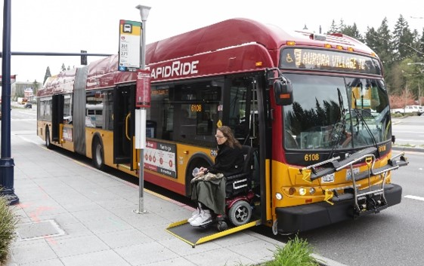
SDOT/Metro coordination
Metro’s funding contribution being developed as part of interagency agreement for 60% design milestone
SDOT is using $14 million funding assumption as placeholder at 30% design milestone
Metro has committed to September 2021 H Line service opening date
Infrastructure work for paving and stormwater infrastructure upgrades could impact schedule
SDOT and Metro have committed to coordinate community engagement work

Slide 14
Cost estimate, funding
30% cost estimate
Funding
Transit/multimodal | $30.5 M
Move Seattle Levy: Transit/multimodal | $9.5 M
Local vehicle license fee | $0.3 M
Regional Mobility Grant | $10 M
King County Metro | $14 M**
Move Seattle Levy: Paving | $38.5 M
Paving | $27.5 M
Stormwater | $10-12 M
Total project cost estimate | $68-70 million*
*Preliminary design costs assume implementation of value engineering stormwater compliance strategy
Total Project Funding | $72.3 million
*Currently under negotiation and subject to change

Slide 15
Next steps
Date | Activity/action
Spring 2019 | 60% design milestone, outreach
Spring 2019 | Develop alternative compliance agreement with SPU
Spring 2019 | Finalize SDOT/Metro funding and delivery agreement
Fall 2019 | Final Design
2020 | Construction begins
2021 | Project complete – RapidRide H Line service begins

Slide 16

Questions?
delridgetransit@seattle.gov | (206) 684-8105
www.seattle.gov/transportation/delridgetransit
www.seattle.gov/transportation

Slide 17
Reference slides

Slide 18
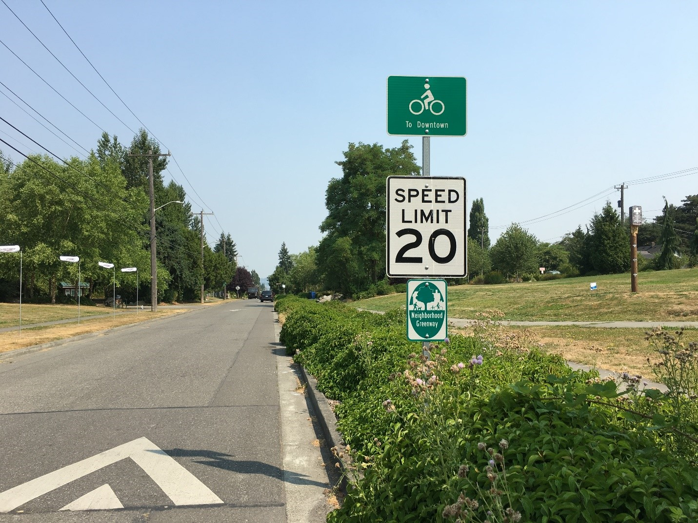
Proposal
SDOT Delridge Way SW Transit-Plus Multimodal Corridor
Bicycle design details
Improve bicycle connections and access to RapidRide stops; enhance bicyclist safety along the corridor
Continuous all ages and abilities route for people biking from West Seattle Bridge Trail to White Center
Add 2.1 miles of protected bike lanes
Add 6 new neighborhood greenway connections between existing bike facility and new RapidRide stations
Install new east-west neighborhood greenway connecting the two existing, north-south ones
Remove segments of Delridge Way SW bike lane without connections

Slide 19
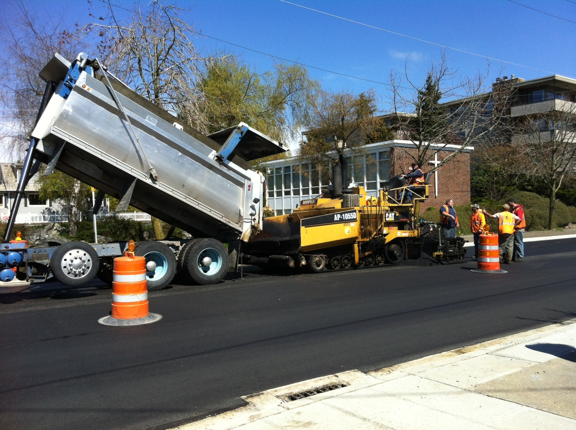
Proposal
SDOT Delridge Way SW Paving
10.1 lanes miles of new paving
Pothole and spot repair
Arterial Roadway Maintenance Levy funds
Triggers stormwater code compliance
Coordination with Sound Transit 3 planning of new Delridge light rail station

Slide 20
Proposal
King County Metro RapidRide H Line
Buses will come more often and be more reliable (on-time)
More service will be added at night and on weekends
Bus stops upgraded with lighting, real-time arrival information, off-board ORCA card readers, and more.
Low floor buses with three doors, air conditioning, wi-fi, automated ‘next stop’ display, improved interior design
All RapidRide buses are accessible
Connects South Lake Union, downtown Seattle, Delridge, White Center, and Burien

Slide 21
Community engagement
Fall 2018
10% design outreach push
Mailing, open house, social media, online survey
SDOT advisory board briefings (Transit, Pedestrian, Bike)
Equity approach
Outreach subconsultants include The Vida Agency, G3 Associates, Rule 7, and Latina Creative bring expertise to the team
In-language materials
In-language, face-to-face meetings
In-language social media posting, advertising
In-language business discussions
Language line available for staff

