Slide 1
Street Use 101 and Q&A Session – Q3 2021
External Workshop
SDOT Street Use
Melody Berry
Notes:
Welcome to the SDOT Street Use Utility workshop

Slide 2
Our vision, mission, and core values
Vision: Seattle is a thriving equitable community powered by dependable transportation
Mission: to deliver a transportation system that provides safe and affordable access to places and opportunities
Committed to 6 core values:
Equity
Safety
Mobility
Sustainability
Livability
Excellence

Slide 3
Street Use 101
Temporary No Park permit requirements and process overview
Traffic Control Plan requirements overview
Holiday season reminders:
Seasonal lighting permit process
Holiday moratorium process
New help articles
Accela how-to’s:
How to set the permit priority
Conditions overview – what are they and how to resolve them
Corrections document - how to download and respond w/demo
Corrections Response condition – how to upload and satisfy the condition w/demo
Stuck in Awaiting Corrections tips
Job start rules
How to submit and reschedule a job start w/demo on utility permits
Amendment’s overview
Upcoming Total Days in ROW options to track uses
Virtual coaching
How to get help
Open Q&A

Slide 4
Webinar rules of conduct
Please only use the Q&A Chat to ask questions during the presentation
Any questions not answered in the Q&A Chat can be asked again in the open Q&A session at the end of the webinar
If you would like to be unmuted to ask a question, please request that in the Q&A Chat

Slide 5
If work is removing paid parking from the public, SDOT recovers the lost revenue for those removed spaces through a Temporary No Park (TNP) permit
If you are using barricade signs in a paid area, you are still responsible for the reservation fees and must submit a TNP request
Street Use permits have a new requirement to ensure a TNP permit is applied for before we issue our permit when paid parking is removed
To satisfy the Temporary No Parking Confirmation condition on your Street Use permit, you must upload one of the following documents:
A copy of the Application Received email
A screen image of the application record details page
A copy of the permit
A copy of a signed billing agreement
A copy of an email from Traffic staff indicating no reservation needed
TNP permits can be applied for only up to 90 days in advance of your start date
TNP record may not be approved until closer to your confirmed start date
Temporary No Park requirements and process overview

Slide 6
Temporary No Park requirements and process overview
What your Temporary No Parking zone WILL do for you
It will provide space for your construction or construction staging
It will provide space for loading/unloading of materials related to your project
It will provide space for storage containers or dumpsters
What your Temporary No Parking Zone WILL NOT do for you
Will not provide reserved parking spaces for worker’s vehicles

Slide 7
Temporary No Park requirements and process overview
Long Term or Short Term? How do you know?
Short-term requests is anything less than 30 and does not require removing street signs or pay station devices.
There is a process for extending the request for additional days, but this must be done before the current request expires.
Additional questions related to short term requests may be directed to bobby.lindsey@seattle.gov
Long-term requests is anything longer than 30 days and/or requires removal of street signs or pay station devices. The long-term requests are coordinated through SDOT Curb Space Management by emailing fred.perez@seattle.gov

Slide 8
Traffic Control Plan (TCP) requirements
TCPs are required when:
Work impacts sidewalk, bike lane, and/or travel lane mobility on an arterial street
Work impacts sidewalk, bike lane, and/or travel lane mobility on any street within a Construction Hub
At the discretion of SDOT if the work poses a significant mobility impact
TCPs must meet the minimum requirements listed in CAM 2111 and the current version of the Traffic Control Manual

Slide 9
Traffic Control Plan (TCP) tips
To minimize corrections cycles when a (TCP) is required, be sure to follow these tips:
Channelization shown on the TCP must meet current conditions
Channelization on the TCP Base Map Tool may not be current
You can use the cameras found on the SDOT Traveler’s Map to confirm current channelization
If you’re in an area that doesn’t have cameras, perform a site visit to confirm current channelization
If you need to close the sidewalk:
Ensure the pedestrian reroute or detour has the correct signs at the right locations
Provide a narrative on why pedestrian access cannot be maintained per CAM 2110 and the 10-2015 Director’s Rule
If you need to close a bike lane:
Provide a narrative on why bike access cannot be maintained
If you need to close a Protected Bike Lane (PBL):
Bike traffic cannot be merged with traffic and a detour must be provided
If you need to submit a revised TCP:
Ensure all comments were addressed

Slide 10
TCP Top 5 Requirements
Accurate base map
Work description
Work hours duration (Proposed)
Work area dimensions: length x width
Naming convention, phasing/after hours/detour plans

Slide 11
Template

Slide 12
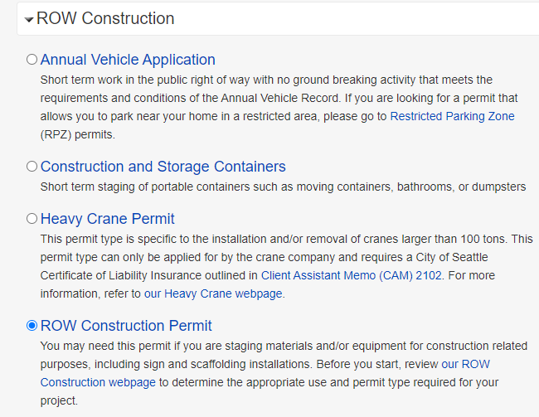
Seasonal lighting requirements
Information on street lighting can be found in our guidance document, Client Assistant Memo (CAM) 2301
Street lighting installations that need to use a scissor or mobile lift or will remain on the trees longer than 3 months must apply for a ROW Construction permit (use type Seasonal Lighting).
Please note in project description if requesting permission for long-term application – Urban Forestry review is required!
Information on how to apply for that type of permit can be found on our ROW Construction permit website
Step by step instructions on how to apply for a ROW Construction permit in Accela can be found in the How Do I Submit a ROW Construction Application help article

Slide 13
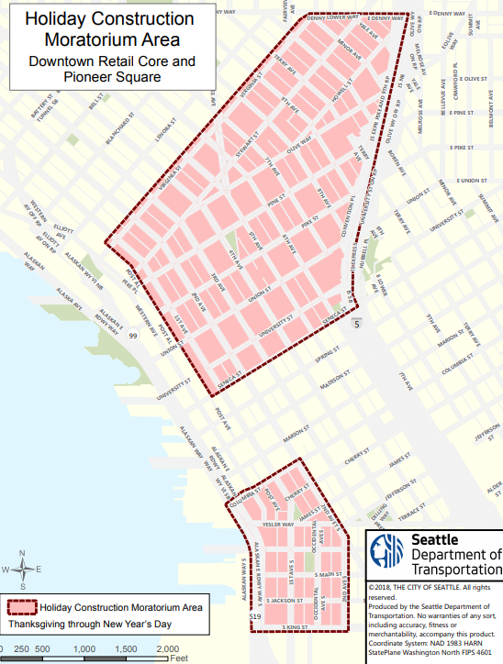
Holiday moratoriums
Information on holiday construction moratoriums and how to apply for an exception can be found in CAM 2107
There are two holiday construction moratoriums coming up this year:
The Downtown Retail Core, which includes Pioneer Square.
This moratorium starts Thanksgiving Day and ends on New Year’s Day (January 1).
Downtown + Pioneer Square Holiday Moratorium Waiver Due Dates:
August 31st, 2021 (Priority)
September 30th, 2021 (Final Submission)

Slide 14
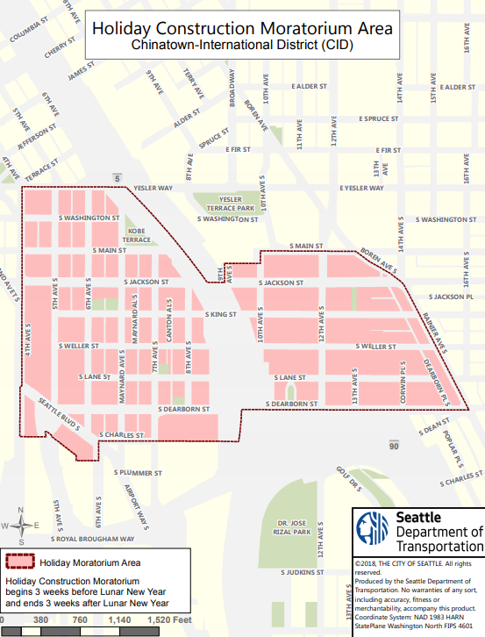
Holiday moratoriums
The Chinatown-International District (CID). This moratorium starts three weeks before Lunar New Year and ends three weeks after.
This year’s Lunar New Year moratorium starts January 12th, 2022, and ends February 22nd, 2022
Chinatown-International Holiday Moratorium Waiver Due Date:
December 1st, 2021 (Final Submission)

Slide 15
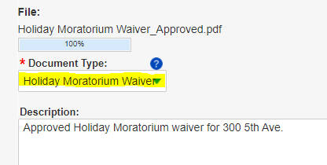
Holiday moratoriums
To apply for a holiday moratorium exception:
Complete the Holiday Construction Moratorium Exception Request Form
Email the completed form to SDOTConstructionHub@seattle.gov
If the form is submitted in Accela or emailed to the Street Use reviewer, the Street Use reviewer will route the form for you
If the exception is approved, upload the approved document to Accela using a Document Type of Holiday Moratorium Waiver
The Holiday Construction Moratorium Exception must be approved before the Street Use permit can be approved during the moratorium period

Slide 16
New help articles!
How Do I Make a Contact Change Request
How to request a change to an existing contact on a Street Use permit before and after issuance
For information on how to add a contact, refer to our How Do I Give Someone Access to My Record help article
What Changes Can I Make on My Street Use Application or Permit
This help article provides guidance on how to do the following in the Seattle Services Portal:
Submit updated documents after the application has been submitted
Submit an amendment request
Submit a job start notification and schedule inspections after the initial inspection has been passed
Pay fees on your application or permit

Slide 17
New help articles!
How to Apply for a Storage and Construction Container permit
How to apply for a permit to stage a storage container for residential moves and short-term dumpsters for on-site construction projects such as tenant improvements
How to Provide or Reschedule a Job Start Notification help article
Updated to outline the steps on how to reschedule the job start and show the new 6-month timeline to schedule the job start on utility permits

Slide 18
How to set the Permit Priority
We have a new Permit Priority section in the Related Information (Step 4) page of the application
If the work supports one of the below priorities, select the corresponding permit priorities in this section:
Emergency response – Emergency
In support of a SDOT or other Transportation Project – Critical
In support of an Office of Housing approved 100% Affordable Housing project – Affordable Housing

Slide 19
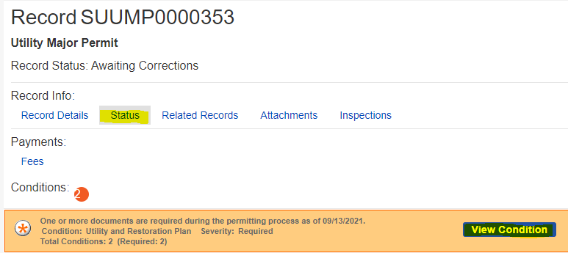
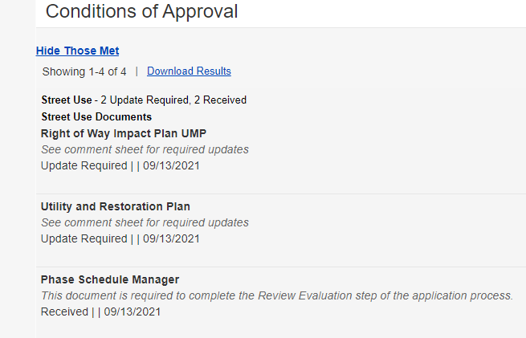
Conditions overview
What is a condition on a Street Use record?
A condition is what Street Use uses to communicate when additional information is needed and/or when a document needs to be revised
When is a condition required?
A condition can be required to apply, to respond to corrections, or before issuance
How do I know when a condition is required?
Required conditions can be found on the Status tab of the record
The type, status, and due information can be found by clicking the View Condition button
Condition Name = Document Name
Notes from the reviewer
Status
Date the condition was applied
If not due at the current workflow step, when it’s due can be found here

Slide 20
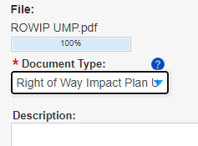
Conditions overview
Unmet Condition
Condition Name = Document Name
How does a condition get met?
A condition is met when a document type that matches the condition name is uploaded onto the record
If there are multiple conditions, a document will need to be uploaded for each condition
How do I know a condition has been met?
The status of the condition will change once Accela has processed a document upload (sometimes can take 30-60 seconds and you may need to refresh)
For correction cycles, the record status will also change when all conditions are met
The page may need to be refreshed for the record status to change
Status
Document Upload (Document Type = Condition Name)
Upload a document with the same name as the unmet condition
Met Condition
Status

Slide 21
Corrections document and how to download it
The Corrections document is the Street Use Comment Sheet
To download the Street Use Comment Sheet:
Click on the Attachments tab of your permit
Find the most current Corrections document in the attachments list
Click on the document blue hyperlink
Download to your computer
Also access to the printed permit and marked up documents
a
b
c
Notes:
After the fees are paid (or are billed), the permit automatically issues and the permit Status updates to Issued in My Records list.
The applicant can now make changes to the permit using the Make Changes link that shows in My Records list as well as in the record itself.
This change request creates an Amendment record.
Let’s click on the Make Changes button to view the amendment types available.
​

Slide 22
Corrections document and how to respond
Update information and plans per each comment
Add a note on how you responded to each comment in the Applicant Response column of the Street Use Comment Sheet
Upload the completed Street Use Comment Sheet as the Corrections Response document to the record
Notes:
After the fees are paid (or are billed), the permit automatically issues and the permit Status updates to Issued in My Records list.
The applicant can now make changes to the permit using the Make Changes link that shows in My Records list as well as in the record itself.
This change request creates an Amendment record.
Let’s click on the Make Changes button to view the amendment types available.
​

Slide 23
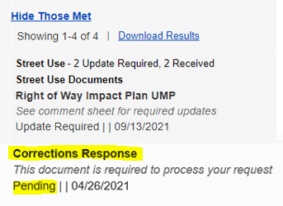
Corrections Response document and condition
When the reviewer wants the Street Use Comment Sheet to be returned with your responses added, they will add the Corrections Response condition
To satisfy the Corrections Response condition, you must upload the completed Street Use Comment Sheet as the Corrections Response document

Slide 24
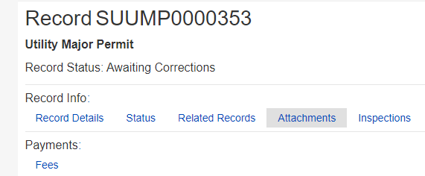
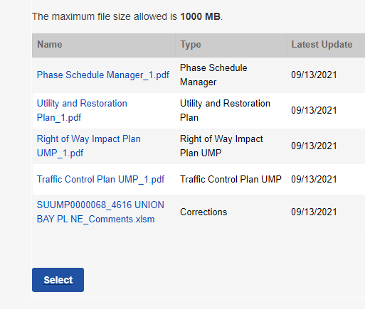
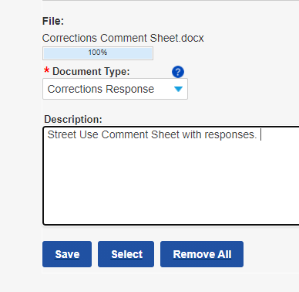
Corrections Response document and how to upload
1
Go to the Attachments tab of your record
Scroll down the Attachments page and click the Select button
Go through the steps to upload the completed Street Use Comment Sheet
Select the Corrections Response Document Type
Click the Save button
2
4
5

Slide 25
Corrections and Corrections Response concept review
Corrections document = Street Use Comment Sheet
Corrections Response document = Street Use Comment Sheet with Applicant Responses
To satisfy the Corrections Response condition, upload the completed Street Use Comment Sheet as the Corrections Response Document Type

Slide 26
Demo
How to view the Corrections Response condition
How to download a Corrections document
How to complete the Corrections document
How to upload the completed Corrections document as the Corrections Response document
What it looks like when the Corrections Response condition has been satisfied

Slide 27
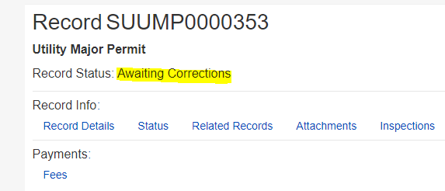
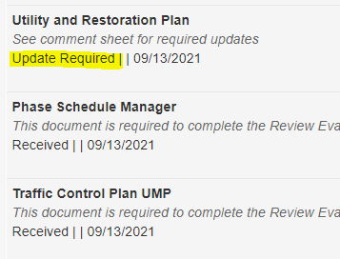
Stuck in Awaiting Corrections?
Here’s what to look for:
Have your documents fully uploaded?
The upload is complete when the Latest Update date changes from Pending to today's date
If the record status still hasn’t changed, refresh the page
Are there any unmet conditions? If yes:
Check to see that the Document Type(s) chosen matches the name of the condition
Check to see if there is another document that needs to be uploaded to satisfy an unmet condition
Latest Update date on the Attachments page
A condition with a status of Update Required or Pending is unmet

Slide 28
Resources on document uploads and responding to Corrections
If the record status does not change to Corrections Submitted, double check that all conditions have been met. If you are still having trouble, email our support team at dot_su_ssportal_questions@seattle.gov
Below are helpful how-to articles on these subjects:
How to Find the Status of a Record
What Does the Banner (Conditions of Approval) on My Record Mean
How to Respond to Street Use Corrections
How to Upload a Document
What Changes Can I Make on My Street Use Application or Permit

Slide 29
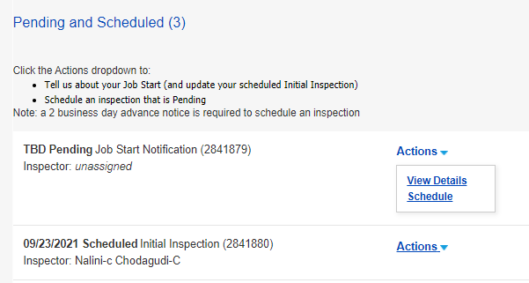
Job start rules
The Initial Inspection is scheduled for 5 business days after the Issued Use Start Date
The Job Start Notification re-schedules the Initial Inspection
If the Job Start Notification does not get scheduled, the inspector may visit the site on the scheduled date of the Initial Inspection
Instructions on how to schedule or re-schedule the Job Start Notification can be found on the How to Provide or Reschedule a Job Start Notification help article
Pending Job Start Notification
Originally Scheduled Initial Inspection
Rescheduled Initial Inspection
Scheduled Job Start Notification

Slide 30
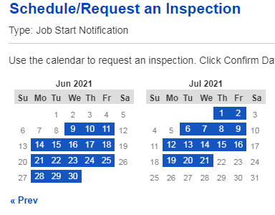
Job start rules
For non-utility permits, the job start can be scheduled 30 business days from the day you are scheduling

Slide 31
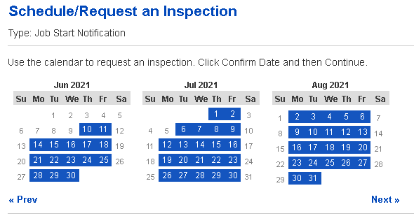
Job start rules
For utility permits, the job start can be scheduled through the permit expiration date

Slide 32
Job start rules concept review
Initial Inspection Scheduled 5 Bus Days After Issued Start Date
Issued End Date or Permit Expiration Date
Issued Use Start Date
The Initial Inspection will automatically schedule 5 business days after the Issued Use Start Date
The Job Start Notification re-schedules the Initial Inspection
After the Initial Inspection has been completed, the Job Start Notification is no longer available to schedule in the Seattle Services Portal
Email the assigned inspector to re-schedule the next inspection
Notes:
Job Start reschedules must be 2 business days in advance

Slide 33
Demo – Utility Permit
Where to find the scheduled Initial Inspection
How to schedule a Job Start Notification to change the date of the Initial Inspection if pending
How to reschedule a job start to change the date of the Initial Inspection if pending
How to reschedule a job start when the Initial Inspection has been passed
Scenario 1: Work is before the Permit Expiration date (contact inspector)
Scenario 2: Work is after the Permit Expiration date (apply for an Extension Amendment)

Slide 34
Other inspections that need to be scheduled
Scheduled Inspections | When Required
Site | Inspection required outside the normal Interim Inspection cadence.
Curb Ramp | Inspection to confirm new curb ramps meet ADA requirements.
Mark Out | Inspection to request SDOT to mark-out restoration limits.
Restoration | Inspection to ensure restoration meets current requirements.

Slide 35
Amendments after issuance overview
An Amendment on an issued permit is used to request a change to application information (e.g., contacts), scope of work, dates, duration etc.
Changes to a permit not yet issued are done with a Corrections Cycle
Amendments have different (shorter) process steps than an initial application
Documents are not required for an Amendment, but can be optionally uploaded
We may require a document to be uploaded (e.g., Change Existing Contact Form), but Accela does not ask for it at this time
When an Amendment is issued, it updates information on its Parent (initial) permit record
Notes:
Today in Hansen, you have a concept of extensions and modifications. Accela amendments are similar.
Keep in mind that Amendments are used to request changes to issued permits.
If a permit has not yet been issued, changes to the application are handled through a Corrections Cycle, as is discussed in the Review Basics class.
Once a record (permit) is Issued in Accela, a customer can request a change using an Amendment.
In Hansen, permit changes send the issued permit “backwards” to an earlier Hansen Stage.
In Accela, the parent permit stays in the issued status. The new amendment record has its own workflow and status. When the amendment is issued, the parent is updated.
There are different types of amendments, some of which have a very limited scope and one which allows pretty much any change to be requested.
Remember that an amendment is a REQUEST to update an issued permit, just because the applicant submits an amendment doesn’t mean their issued permit will always be updated.
All amendments (except withdrawal) must be approved by SU Staff, just like an application.
If an amendment does not issue, maybe it gets denied or the customer doesn’t pay, the parent permit is not updated.
It is also possible to have an amendment which relates to an application rather than to an issued permit – we will talk about that today as well.

Slide 36
Amendment Type | When Available | Description
ROW Withdrawal | Initiated-Closeout | Withdraw an application
Enable Access | Initiated-Closeout | Add a contact to a record to grant them the ability to manage documents and respond to corrections
Revision | Issued | Amend the scope of work, extend a use(s), change an existing contact
ROW Date Change | Issued | Change the start date of a use(s) before the Issued Use Start Date
ROW Extension | Issued | Extend the Issued Use End Date or Permit Expiration Date of a use(s)
Notes:
Here are the Amendments we will discuss today.

Slide 37
Revision Amendment Rules
Revision Amendments are required for:
Scope of work changes
New uses
Revised uses
Change of square footage in a space(s)
Change of method of installation
Existing contact changes
Notes:
Job Start reschedules must be 2 business days in advance

Slide 38
Date Change Amendment Rules
New Use Start Date
Issued End Date or Permit Expiration
Issued Use Start Date
Work is taking place before the Issued Use Start Date
Requires a Date Change Amendment
In Hub areas, change in dates need to be coordinated directly with the Hub Coordinator at least 10 business days before working
Notes:
Job Start reschedules must be 2 business days in advance

Slide 39
Extension Amendment Rules
New Start Date
Issued Use Start Date
Issued End Date or Permit Expiration Date (Utility Permits)
Work is taking place after the Issued End Date for non-utility permits or the Permit Expiration Date for utility permits
Requires an Extension Amendment
In Hub areas, change in dates need to be coordinated directly with the Hub Coordinator at least 10 business days before working
Notes:
Job Start reschedules must be 2 business days in advance

Slide 40
Utility Permit Amendment Rules
Issued Use Start Date
Permit Expiration Date
If the issued dates change within the 6-month expiration period:
No amendment is required
In Hub areas, change in dates need to be coordinated directly with the Hub Coordinator at least 10 business days before working
Notes:
Job Start reschedules must be 2 business days in advance

Slide 41
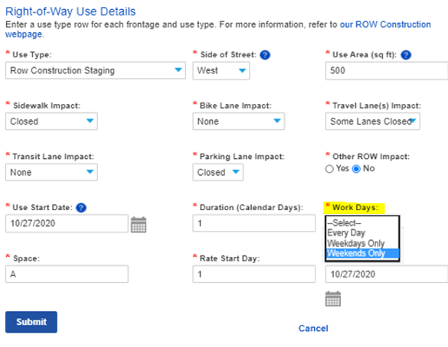
Upcoming Total Days in the ROW option to track uses
With our R2 Accela launch in Nov 2020, we added options to track uses with Work Days options
However, these options didn’t give an option for less than 5-days a week

Slide 42
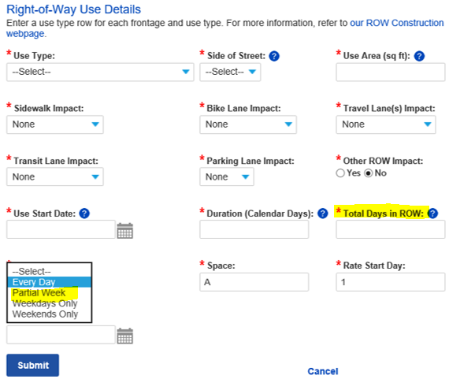
Upcoming Total Days in the ROW option to track uses
Beginning October 28th, you will have the ability to let us know how many total days you are working in the right-of-way
News Total Days in ROW field is how many days you will be in the right-of-way
Used to calculate use fees
Not required for SIP or ROW Maintenance records
New Partial Week option under Work Days
Informational only, no impact on use fees

Slide 43
Virtual coaching
Since our permit counters are still closed, we are working to improve our virtual customer service
Virtual 1x1 coaching is now available with ROWM and Major reviewers during the below hours:
10:30am-noon
1-3pm
Virtual coaching is available by the below methods:
Virtual meeting using Webex
Phone meeting
To request virtual coaching:
Email SDOTPermits@seattle.gov or
Call the Street Use phone line at 206-684-5253

Slide 44
How to get help on our websites
Our websites have been updated to walk you through the process
You can also find a link to the Seattle Services Portal on the right panel of every website
http://www.seattle.gov/transportation/permits-and-services/permits
Access to the Portal can be found on the right panel of every webpage
To stay informed on Street Use updates, you can sign-up to receive our monthly newsletter

Slide 45
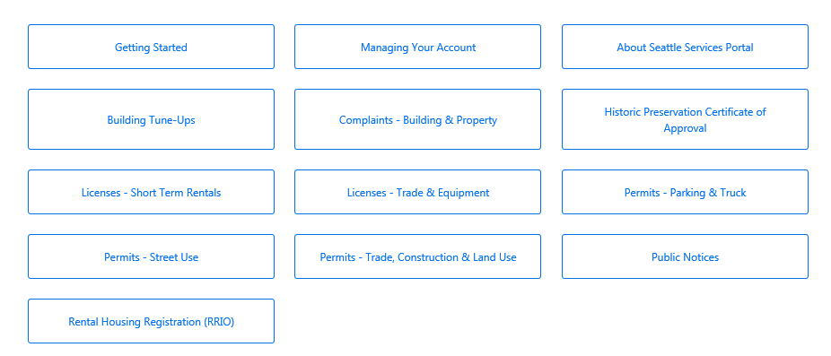
How to get help on the SSP Help Center
You can find many help articles on how to navigate the Seattle Services Portal from the Help Center
Get familiar with these three sections:
Getting Started
Managing Your Account
Permits - Street Use
2
Notes:
When a user needs help, they can access the Help Center articles by clicking on Help.
The banner is available throughout the portal, and Help can be accessed at any time simply by clicking on the Help button.

Slide 46
How to get help if you can’t find the answer
Email dot_su_ssportal_questions@seattle.gov for:
General Seattle Service Portal navigation
Contact cleanup or fix needs
Help on responding to Corrections, uploading documents, scheduling inspections etc.
If you think an error has occurred in the Seattle Services Portal
Email dot_permits@seattle.gov for:
General inquiries and coaching
Contact changes for permits or amendments in process
Application changes for unassigned records
Fee disputes
Email SeattleServices_ITHelp@seattle.gov for Seattle Services Portal account issues

Slide 47
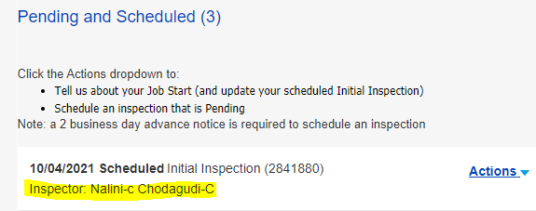
How to get help
Where to find the assigned reviewer on the Status tab
Email the assigned reviewer for:
Application changes for permits or amendments in process
Corrections required response clarification on
Permit status inquiries outside the posted permit timelines
Email the assigned inspector for:
Job start changes after the Initial Inspection has passed
Inspection questions including notification, inspection results etc.
Scheduling an on-site meeting
Where to find the assigned inspector on the Inspections tab

Slide 48
Open Q&A

Slide 49
Questions?
Melody.Berry@seattle.gov
www.seattle.gov/transportation

