Slide 1

Street Use 101 and Q&A Session – Q1 2021
External Workshop
SDOT Street Use
Melody Berry
Notes:
Welcome to the SDOT Street Use Utility workshop

Slide 2
Our vision, mission, and core values
Vision: Seattle is a thriving equitable community powered by dependable transportation
Mission: to deliver a transportation system that provides safe and affordable access to places and opportunities
Committed to 6 core values:
Equity
Safety
Mobility
Sustainability
Livability
Excellence

Slide 3
Street Use 101
Street Use permit process steps overview
How to request changes to an in-process application
Target dates vs. overall process time
How to respond to corrections
Utility permits
  UMP thresholds overview
  Use vs. permit expiration rules
  How to manage inspections during the 6-month expiration period
  New Side Sewer/Drainage process
New Change Existing Contact Form
New grant access functionality
New permit priority section on the application
Traffic Control Plan tips
How to get help
Open Q&A

Slide 4
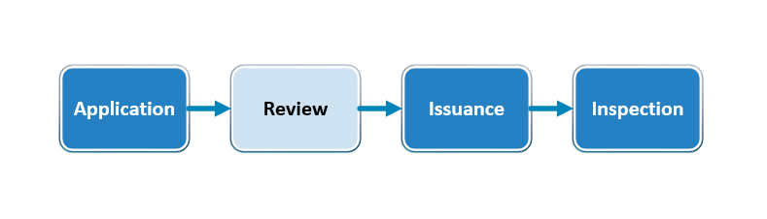
Street Use permit process steps
Street Use has three review process types:
Simple Reviews: For short term uses with minimal impacts to the right-of-way or some amendments. The Simple Review process has fewer steps than other review processes and does not have the external secondary review functionality.
Notes:
Examples include block parties, staging moving containers, extension amendments, and date change amendments.

Slide 5
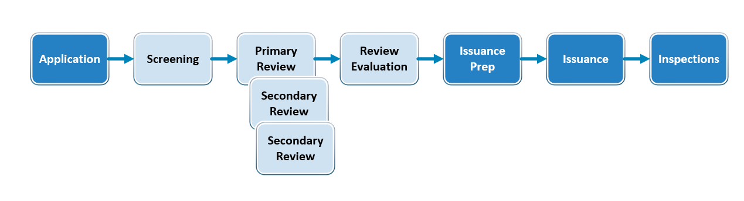
Street Use permit process steps
Full Reviews: Most Street Use permits follow the Full Review process. The Full Review process allows us to route to external secondary reviews (e.g., Traffic Control Plan, Hub Coordination, Roadway Structures etc.) depending on the mobility and infrastructure impact of the work. If there are no external secondary reviews required, the permit process will be shorter.

Slide 6
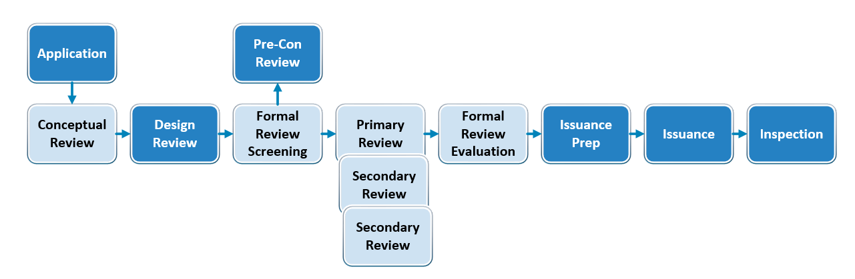
Street Use permit process steps
Street Improvement Reviews: Street Improvement Permits (SIPs) have their own review process due to the complexity of the work. SIP reviews have three review phases: Conceptual Review (30%), Design Review (60%), and Formal Review (90%) + Pre-Construction. SIP Lite permits skip the Design Review phase.
Notes:
SIP reviews have three review phases: Conceptual Review, Design Guidance, and Formal Review and Pre-con. One review cycle includes the Screening, Primary Reviewer, Secondary Reviewer(s) (if applicable) and Review Evaluation steps for each review phase.
SIP Reviews follow the below steps. Due to the complexity of this review process, the Conceptual Review, Design Guidance, and Pre-Con review phases do not show all review cycle steps.

Slide 7
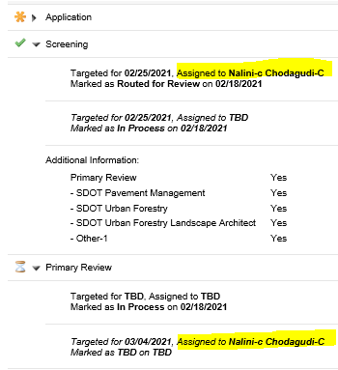
How to request changes to an in-process application
Once an application is submitted, there is no way to edit the application information from the Seattle Services Portal
To request changes to an in-process application , email the assigned reviewer
You can find the assigned reviewer on the Screening or Primary Review tasks
Notes:
If there is no assigned reviewer yet, email SDOTPermits

Slide 8
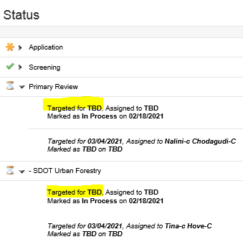
Target dates vs. overall process time
Just as SDCI does, we use target dates to prioritize and assign steps of the permit process
The Targeted For date found on each permit step on the Seattle Services Portal are target dates based on goals that we established for “typical” permit step timelines
This is the target date for that step only

Slide 9
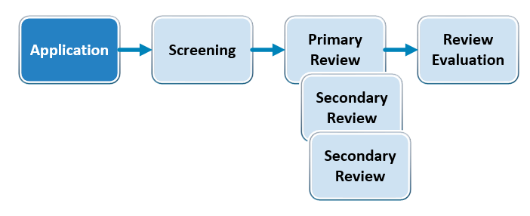
Target dates vs. overall process time
Each step of the review process has a target date assigned
The overall timeline of a review cycle includes the “typical” time to process each permit step and may vary by permit type
One review cycle includes the shown steps

Slide 10
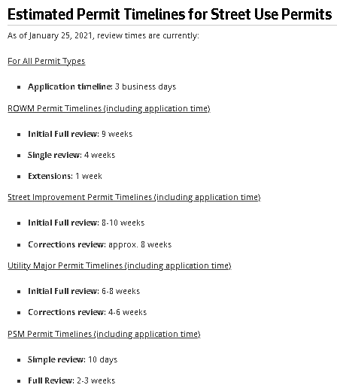
Target dates vs. overall process time
Instead of reporting overall permit timelines, we report average review cycle timelines
Street Use publishes review cycle timelines monthly in the Street Use Newsletter and on most of our websites
If the work is complex and/or in an urban or construction dense area, plan for more than one review cycle

Slide 11

Utility Major Permit Thresholds
If your project meets one or more of the following thresholds, you will need to apply for a Utility Major Permit:
  Geographic work larger than a one-block radius
  Any project that contains complex technical issues* (e.g., deep excavations) that may have an impact to existing city assets and/or infrastructure
  Installation of gas mainlines greater than 2-inches in diameter
  Installation of a utility line longer than 100 linear feet on a non-arterial or arterial street including alleys
    Exception: Installation of a utility line up to 300 lineal feet on a non-arterial street or alley in a single family or low-rise zone can be permitted under a Minor Utility permit.
  Removal of underground storage tank
  Environmental remediation work or removal of contaminated soils
  Work that triggers ADA curb ramp installation due to utility work (e.g., utility and telecom pole removal/installation at intersections)
  Directional or horizontal boring method of installation
*We may require an UMP beyond the thresholds outlined above in consideration of complexity of the work including proximity to existing infrastructure or assets.
Notes:
Public main installations (e.g., water, storm, sewer etc.) are now permitted under a Street Improvement Permit (SIP). Refer to our Street Improvement Permits website for more information on the SIP process.

Slide 12


Utility use vs. permit expiration dates
Information about the use and permit expiration rules on utility permits can be found on our Utility Work in the Right-of-Way website
Utility permits now have a 6-month expiration period to allow phases of construction to be completed within a 6-month long period
Extending a use(s) during the 6-month expiration period is only required if the duration of the work exceeds the initial issued duration
If work needs to happen after the permit expiration date, an amendment will need to be submitted
Date changes or extensions in Hub areas: If the initial use dates change within the 6-month expiration period or you need to extend the permit, the new dates need to be scheduled with the Hub coordinator prior to beginning work by emailing SDOTConstructionHub@seattle.gov

Slide 13
Utility use vs. permit expiration dates
These are the current use and permit expiration rules:
Initial issuance:
  The Use Expiration = Use Start Date + Duration
  The Permit Expiration = Latest Use Expiration Date + 6-months
Amendment issuance before the Latest Use Expiration Date:
  The Use Expiration = Use Start Date + Duration
  The Permit Expiration = Latest Use Expiration Date + 6-months

Slide 14
Utility use vs. permit expiration dates
Amendment issuance after the Latest Use Expiration Date:
  The Use Expiration = Use Start Date + Duration
  The Permit Expiration = Date of Issuance + 6-months

Slide 15
How to manage inspections during the 6-month expiration period
Most Street Use inspections are requested through the Seattle Services Portal via Inspection Notifications
The Initial Inspection is scheduled or re-scheduled via the Job Start Notification. Here are some rules on how that should be managed:
Schedule or re-schedule Job Start before Use Start Date:
  The Use Start Date is the beginning of the issued use period
  The Job Start Notification will not be available to be scheduled prior to the issued Use Start Date
  You will need to apply for a Date Change Amendment if the work is beginning before the issued Use Start Date
Schedule or re-schedule Job Start after Use Start Date and before Use Expiration Date:
  You can schedule or re-schedule the Job Start Notification any time before the Use Expiration Date
  The Job Start Notification can be scheduled 30 business days from the date you are making the change
Notes:
Job Start reschedules must be 2 business days in advance

Slide 16
How to manage inspections during the 6-month expiration period
Schedule or re-schedule Job Start after Use Expiration Date:
  The Job Start Notification cannot be rescheduled after the Use Expiration Date
  If you need to change the date of the Initial Inspection after the Use Expiration Date, contact your District Inspector directly
  To avoid this, find a way to pro-actively manage the Job Start Notifications after issuance
The Restoration Inspection is scheduled or re-scheduled via the Restoration Notification. This should be requested for final restoration work.
Here are some helpful Help Center articles:
  How to Provide a Job Start Notification to Street Use
  How to Request a Street Use Inspection

Slide 17
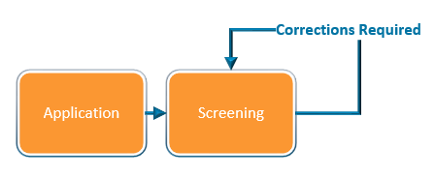
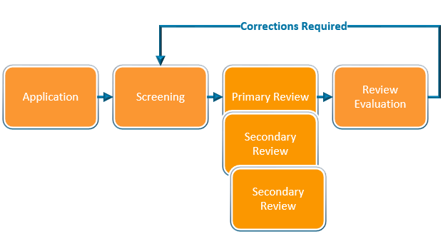
How to respond to corrections
Corrections can be required in the Screening or Review Evaluation task
Once the task is set to request corrections, the record status will change from In Process to Awaiting Corrections
Notes:
Moving on… Now, I will walk you through how to apply for a change (an amendment) to an issued permit.

Slide 18
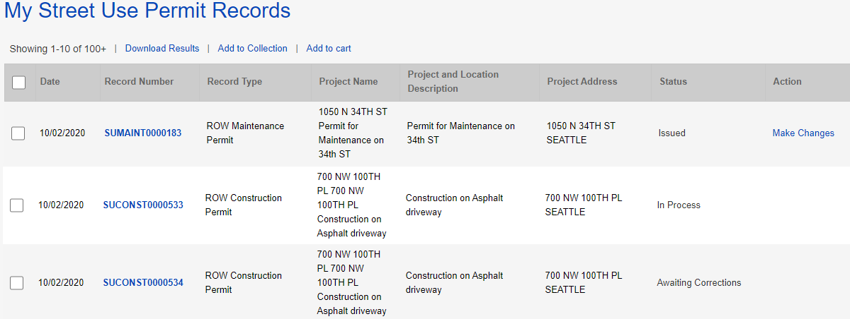
How to respond to corrections
How to respond to corrections
From the My Records page, the Status of the permit will show as Awaiting Corrections
Click on the blue hyperlink permit number
1
2
Notes:
Moving on… Now, I will walk you through how to apply for a change (an amendment) to an issued permit.

Slide 19
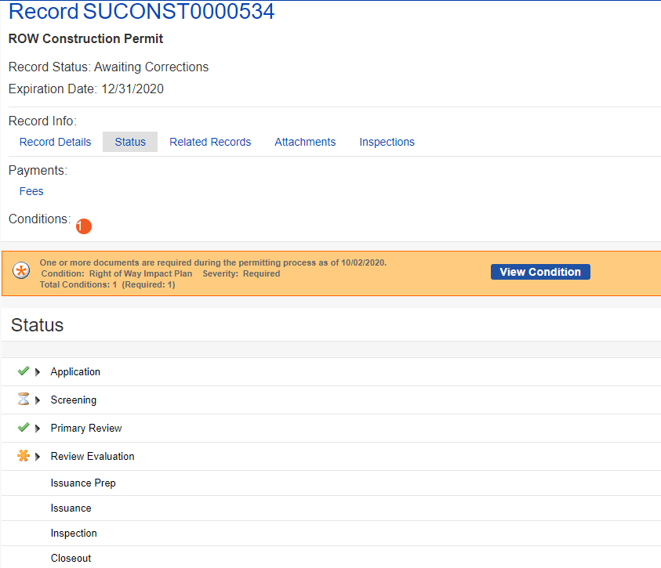
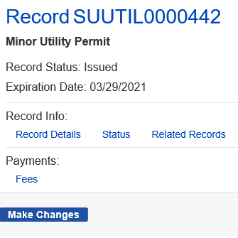
How to respond to corrections
3
How to respond to corrections
Click on the Status tab
  The red banner will indicate what document is required
  Click on the View Condition button for more information about each document/condition
  The Review Evaluation task shows an asterisk indicating there has been at least one corrections cycle
  The Screening task shows as In Process with the hourglass because that is the beginning of the review process
b
a
c
d
Notes:
Moving on… Now, I will walk you through how to apply for a change (an amendment) to an issued permit.

Slide 20
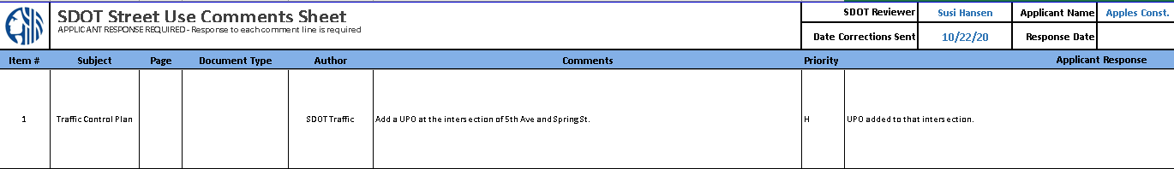
Corrections and Corrections Response documents
The Corrections document is the Street Use Comment Sheet
The Corrections Response document is the Street Use Comment Sheet with your responses added
If there is a Corrections Response condition requirement, you will need to upload the Street Use Comment Sheet with your responses
Notes:
After the fees are paid (or are billed), the permit automatically issues and the permit Status updates to Issued in My Records list.
The applicant can now make changes to the permit using the Make Changes link that shows in My Records list as well as in the record itself.
This change request creates an Amendment record.
Let’s click on the Make Changes button to view the amendment types available.
​

Slide 21
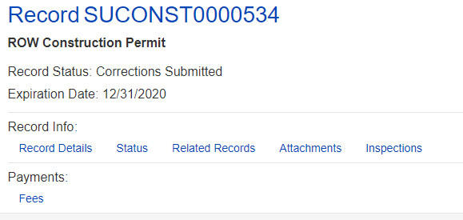
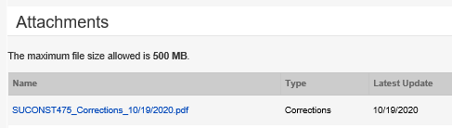
How to find the Street Use Comment Sheet and other documents
Also access to the printed permit and marked up documents
To download the Street Use Comment Sheet:
  Click on the Attachments tab of your permit
  Find the most current Corrections document in the attachments list
  Click on the document blue hyperlink
  Download to your computer
  Add responses to the Street Use Comment Sheet
  Repeat for any other documents needed (e.g., marked up plans, printed permit etc.)
  When revised documents are ready, upload the Street Use Comment Sheet with your responses as the Corrections Response document
a
b
c
Notes:
After the fees are paid (or are billed), the permit automatically issues and the permit Status updates to Issued in My Records list.
The applicant can now make changes to the permit using the Make Changes link that shows in My Records list as well as in the record itself.
This change request creates an Amendment record.
Let’s click on the Make Changes button to view the amendment types available.
​

Slide 22
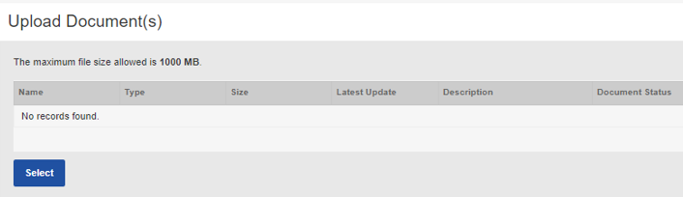
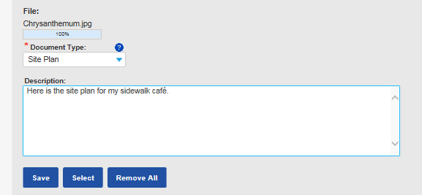
How to respond to corrections
4
How to respond to corrections
Click the Attachments tab
    Click the Select button
    Choose the desired document from your computer
    From the Document Type drop-down menu, select the type of document required by the condition(s)
    Tip: For us to perform efficient plan review, only upload PDF documents.
    Add a description (optional)
    Click the Save button
    To upload another document, repeat these steps
a
c
d
e
Notes:
Moving on… Now, I will walk you through how to apply for a change (an amendment) to an issued permit.

Slide 23
How to respond to corrections
How to respond to corrections
Once all required documents have been uploaded and there are no more conditions due to submit corrections, the status of your permit will change from Awaiting Corrections to Corrections Submitted
5
Notes:
Moving on… Now, I will walk you through how to apply for a change (an amendment) to an issued permit.

Slide 24
What to do when the record status is still Awaiting Corrections
If the record status still says Awaiting Corrections:
  Verify that there are no other conditions required
  Verify that the document type uploaded matches the name of the condition
  For Converted Permits:
    Most converted permits that were in a correction cycle had a Corrections Response condition applied
    If the requested document is not the Street Use Comment Sheet, you must still upload the revised document as the Corrections Response document to satisfy the condition
Notes:
Moving on… Now, I will walk you through how to apply for a change (an amendment) to an issued permit.

Slide 25
Minor Utility – Side Sewer/Drainage Permit
Minor Utility – Side Sewer/Drainage permits
Used to permit side sewer (installation, lining, repair and replacement) drainage lines (installation and replacement), curb weep holes and staging and restoration in the right-of-way
Now can be applied for at any time or requested as part of the SDCI side sewer permit
If applied for through the SDCI side sewer permit, the SDCI Site Plan will map to the SDOT permit
Requires the ROWIP only at application (only MU use type that doesn’t require a Site Plan in addition to)
Will follow normal permit review process
Can’t be issued until the SDCI side sewer permit is issued
Record ID: SUUTIL0000001
Hansen Use Code | Accela Use Type
51F | Side Sewer/Drainage
51G | Privately Owned Utility
51I | Exploratory Excavation
51I | Environmental Remediation
51M/40 | Pavement Restoration
Most 51’s | Utility Infrastructure
51I | Monitoring Well
51Z | Small Wireless Facility
Notes:
Most of the uses are the same as what you had in Hansen, but some have been combined or split out.
A change for Accela, use types are available on more than one record. For example: Sidewalk / driveway maintenance < 100 can also be done on the maintenance record
Big shifts:
Combined 31 and 44 – staging of things with and without wheels
44 Crane > 100 Ton on the construction record is only for operation after installation, the installation requires a heavy crane permit
Combined 50 and 50A – can take care differences through the mobility impacts settings
Exploratory excavation added to construction so customers don't always have to get a separate (utility) permit for that - it is also under utility
Miscellaneous is used for work in unimproved ROW, or when something new comes up that is not covered under an existing use type
Note: Sq ft = 100 is included in the > 100 sq ft use
[MA] Applicants (external customers) will not see the Accela Use Code value in the Seattle Services Portal, they will only see/know the Use Type name.

Slide 26
New side sewer permit process
Option 1: Contractor applies for SDCI side sewer permit first
Contractor applies for SDCI permit
Contractor requests that a SDOT permit is created
SDOT permit application is created after the SDCI permit is issued
SDOT reviews permit per normal business practice

Slide 27
New side sewer process – Opt. 1
If Yes is selected, a SDOT application will be created when the SDCI permit is issued
Existing SDOT permit numbers can be added manually. Accela will auto populate if a SDOT permit is auto created.
New Side Sewer Section on SDCI’s permit – how to request a SDOT permit be created after the SDCI permit is issued
Will map to the SDOT use row information if a SDOT permit is auto created

Slide 28
New side sewer permit process
Option 2: Contractor applies for SDOT side sewer permit first
Contractor applies for SDOT permit
SDOT reviews permit per normal business practice, but holds up issuance until SDCI permit is issued
Contractor applies for SDCI permit
SDCI issues permit
SDOT issues permit after Contractor submits
SDCI permit document

Slide 29
New side sewer process summary
    More information about how to apply for the SDOT side sewer permit can be found in the How do I Submit an Application for a Street Use Side Sewer Permit Help Article
    Allows contractors to apply for the SDOT side sewer permit early to align issuance events (recommended if a TCP is required and in a Hub area)
    Allows contractors to apply for both permits from one application
    Allows SDOT to review per normal Minor Utility permit business process
    Will use indicated duration instead of the pre-determined 180 and 540 days
    Decouples fees – each department collects fees separately
    SDOT and SDCI no longer require the applicant/contractor to be a RSSC
Notes:
Also working on a Side Sewer FAQ help article that will be out soon

Slide 30
New Change Existing Contact Form
Contact changes after permit issuance can be requested by applying for a Revision Amendment
Until now, you only had an opportunity to request the contact change(s) in the Amendment Description box
We have developed a new Change Existing Contact Form that you can upload to your Revision Amendment
You will have to use the document type of Other Documents when uploading the new Change Existing Contact Form
To request a contact change when the application is in-process, email the Change Existing Contact Form to SDOTPermits@seattle.gov

Slide 31
New grant access functionality
We have a new amendment type named Street Use Enable Access that allows you to add an additional contact on the Parent Permit and all related Amendments that gives them access to the following:
  Respond to Corrections
  Submit amendments
  Upload and view documents
To add an additional contact, you must know the email address associated with that contact’s Seattle Services Portal account
This amendment cannot be used to change existing contacts
You can start using this amendment now by following the steps in the How Do I Give Someone Access to My Permit help article

Slide 32
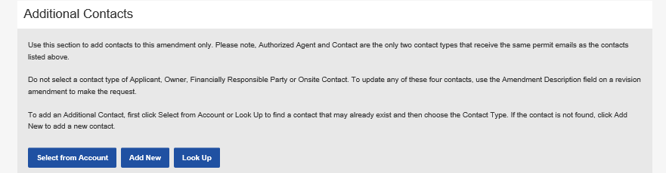
New grant access functionality
There is also new functionality on the General, Revision, Date Change and Extension amendments to add an additional contact to that amendment only
There is a new Additional Contacts section on the Contacts page of the amendment application
For the additional contact to get access, the contact that is added must be associated with their Seattle Services Portal account

Slide 33
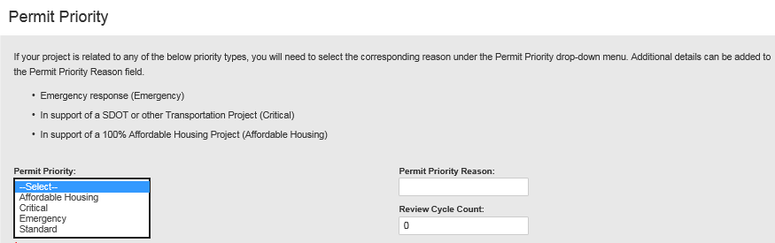
New Permit Priority application section
We have a new Permit Priority section on the Related Information (page 4) page of the application
If the work is a public health or safety emergency, supports an approved Affordable Housing project, or is part of a transportation corridor improvement project, you can set the permit priority related to the listed priority reasons
SDOT will expedite permits for these priority reasons

Slide 34
Traffic Control Plan tips
To minimize corrections cycles when a Traffic Control Plan is required, be sure to follow these tips:
  Ensure your TCP meets Client Assistant Memo (CAM) 2111 and the City of Seattle Traffic Control Manual for In-Street Work
  Ensure the channelization shown on the TCP meets current conditions
    Channelization on the TCP Base Map Tool may not be current
    You can also use the cameras found on the SDOT Traveler’s Map
  If you need to close the sidewalk, ensure the pedestrian reroute or detour has the correct signs at the right locations
    Pedestrian reroutes and detours must meet Client Assistant Memo (CAM) 2110
  Protected Bike Lanes (PBLs) closures require a detour and bike traffic cannot be merged with traffic
  For any sidewalk or bike lane closures, provide a narrative for the closure and why mobility cannot be provided

Slide 35
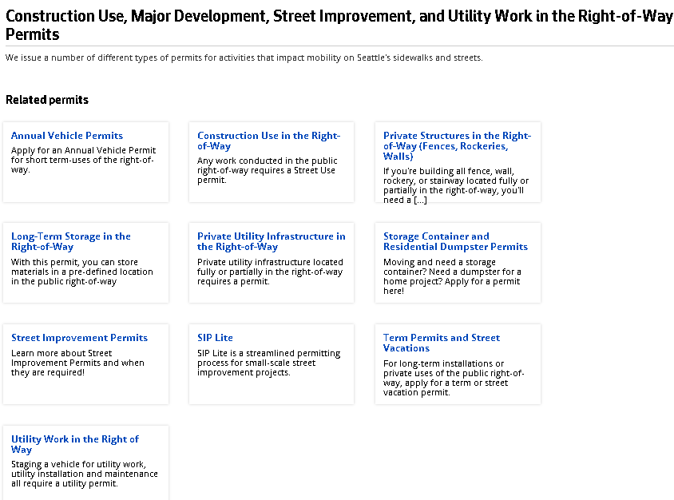
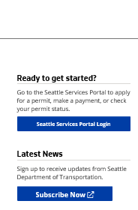
How to get help on our websites
Our websites have been updated to walk you through the process
You can also find a link to the Seattle Services Portal on the right panel of every website
http://www.seattle.gov/transportation/permits-and-services/permits
Access to the Portal can be found on the right panel of every webpage
To stay informed on Street Use updates, you can sign-up to receive our monthly newsletter
Notes:
When a user needs help, they can access the Help Center articles by clicking on Help.
The banner is available throughout the portal, and Help can be accessed at any time simply by clicking on the Help button.

Slide 36
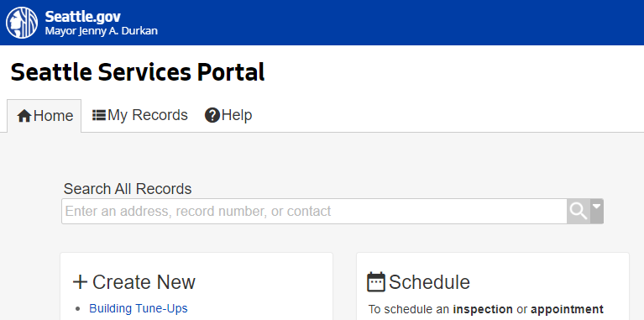
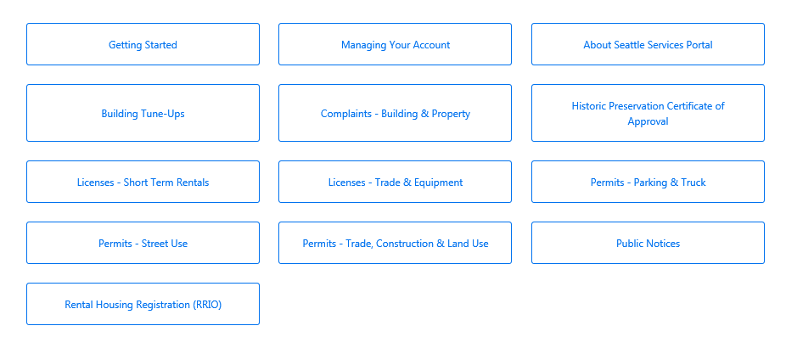
How to get help on the SSP Help Center
You can find many help articles on how to navigate the Seattle Services Portal from the Help Center
Get familiar with these three sections:
    Getting Started
    Managing Your Account
    Permits - Street Use
2
Notes:
When a user needs help, they can access the Help Center articles by clicking on Help.
The banner is available throughout the portal, and Help can be accessed at any time simply by clicking on the Help button.

Slide 37
How to get help if you can’t find the answer
Email dot_su_ssportal_questions@seattle.gov for:
  General Seattle Service Portal navigation
  Help accessing or understanding your converted permits
  Have contact cleanup or fix needs
  Help navigating the Seattle Services Portal or understanding the status of your converted permit
Email dot_permits@seattle.gov for:
  General inquiries and coaching
  Contact changes for permits or amendments in process
  Fee disputes
Email the assigned reviewer for:
  Application changes for permits or amendments in process
  Corrections required response clarification on converted permits
  Permit status inquiries outside the posted permit timelines
Email SeattleServices_ITHelp@seattle.gov for Seattle Services Portal account issues

Slide 38

Open Q&A

Slide 39

Questions?
Melody.Berry@seattle.gov
www.seattle.gov/transportation

