Slide 1
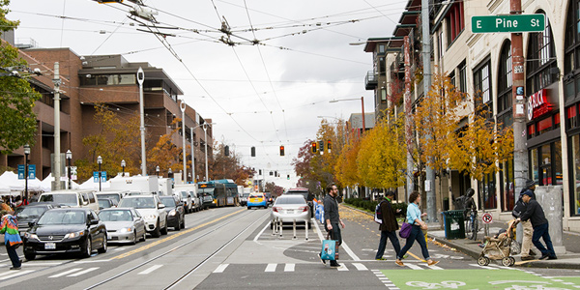
Street Improvement Permits in the Seattle Services Portal
External Workshop
SDOT Street Use
Melody Berry, Diana Holloway, Sailaja Tumuluri and Jonathan Williams
Notes:
Welcome to the SDOT Street Use Utility workshop

Slide 2
Our vision, mission, and core values
Vision: Seattle is a thriving equitable community powered by dependable transportation
Mission: to deliver a transportation system that provides safe and affordable access to places and opportunities
Committed to 6 core values:
Equity
Safety
Mobility
Sustainability
Livability
Excellence

Slide 3
Workshop overview
Accela launch overview
Upcoming events
Final Plat permit overview
SIP overview
Inspections overview and how to schedule an inspection
How to get help after launch
How to apply for a SIP permit
How to respond to corrections and find documents
SIP process steps and document requirements
How to schedule a pre-con meeting
How to pay fees
How to find the status of a permit

Slide 4
Permitting system replacement goals
Improve transparency and predictability
Automate functionality to gain efficiencies
Integrate permit processes with SDCI and other departments

Slide 5
Accela launch overview
SDOT’s last implementation into Accela will be the weekend of November 7th, 2020
Traffic, Public Space Management, and Annual Vehicle permits are already in Accela
Come November, the remainder of Street Use permits will be in Accela

Slide 6
Permit types - what’s coming in November
ROWM Permits
ROW Construction (today’s Construction Use)
ROW Maintenance (new)
Heavy Crane (new)
Minor Utility
Major Permits
Utility Major
Street Improvement
Final Plat

Slide 7
Launch Schedule

Slide 8
Upcoming events
Date, Time | Topic
Sept 14th, 1-2pm | Inspection and Notifications Types Overview
Oct 19th, 3-4pm | Seattle Services Portal (SSP) Overview
Oct 26th, 2-3:30pm | Utility Permit Overview
Oct 28th, 3-4:30pm | Construction Permit Overview
Oct 30th, 11:30am-12:30pm | Street Improvement Permit Overview
Nov 3rd, 11am-12pm | Amendment Types Overview
Week of Nov 9th and 16th | General Q&A’s Sessions
One workshop per topic
Each workshop will be held virtually using Webex Events and recorded
Q&A sessions will be a 1-hour live event once or twice a week using Webex Events
Stay informed with our monthly newsletter and Accela 2 Updates website

Slide 9
Final Plat Permit
Accela Use Type | Use Description | Hansen Use Codes
Final Plat | Final Plat review & Council approval | 45P
Final Plat permit :
Used to facilitate the final plat process for new full subdivisions
Uses the full workflow
These records bypass issuance and goes directly to closed once the process is complete
Record ID: SDOTPLAT0000001
Required Documents
Approved Preliminary Plat
Covenants Conditions and Restrictions
Current Title Report
Final Plat
Final Plat Mylar
Hearing Examiner Decision Report
Letter of Authorization
Other Documents
Statement of Financial Responsibility

Slide 10
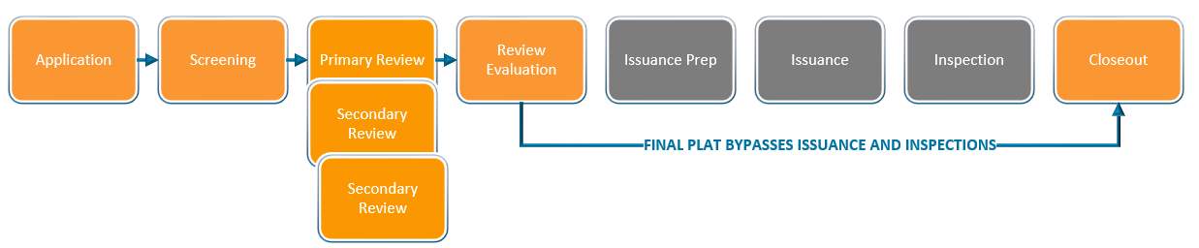
Final Plat permit process steps

Slide 11
Street Improvement Permit and Use Types
Accela Use Type | Use Description | Hansen Use Codes
SIP | Commercial/Residential construction | 45/45A
SIP Lite | Non-utility ADA ramps, small scale street improvements | 45B
SIP Public Main | Storm, sewer and water main extensions | 51A
Street Improvement permit :
Used to permit street improvements required by the Land Use code or other related codes (Stormwater etc.)
Uses the SIP workflow
All amendments available after issuance
Record ID: SUSIP0000001

Slide 12
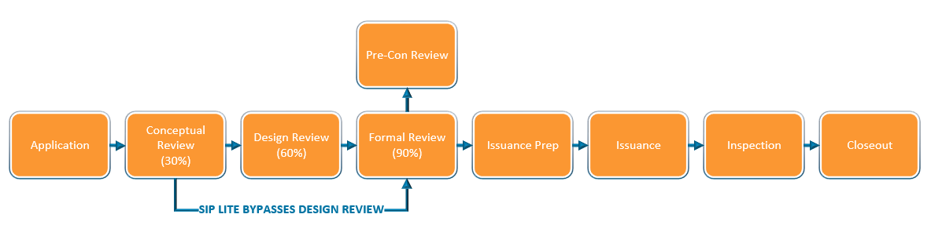
Street Improvement Permit (SIP) steps

Slide 13
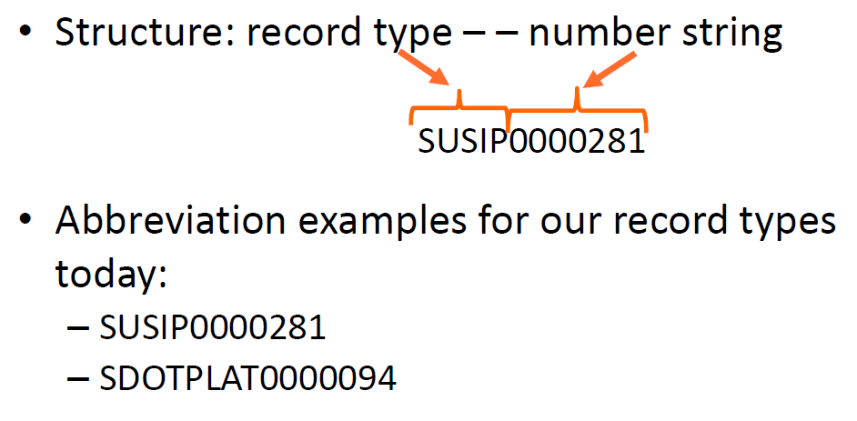
Final Plat and SIP Accela permit numbers decoded
Notes:
Here are the high level steps to applying for a Minor Utility permit and Utility Major permit.

Slide 14
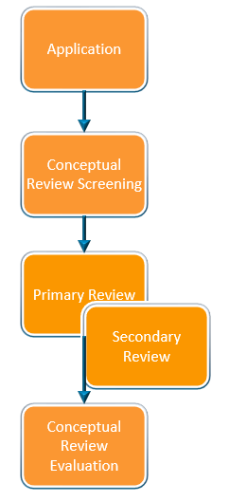
SIP Conceptual Review (30% Review Phase)
Required Documents at Application
30% SIP Plans
Letter of Authorization
The Conceptual Review phase is led by Development Review and will include the following:
SDCI coordination on Land Use code requirements, design review process/departures, and street improvement exceptions
Early coordination with outside SDOT divisions and SPU Solid Waste
Ensure 30% conceptual plan follows early guidance and coordination, code requirements, and standards
Determines what SIP use type fits the project
Optional Documents at Conceptual Review Screening
Preliminary Assessment Report
SIP Lite Eligibility Form

Slide 15

SIP Lite Thresholds
If your projects meets any of the below criteria, it will be reviewed as a SIP Lite:
New or revised curb ramps required by the Land Use Code or during construction of a development project
Combination of new or revised curb ramps required by the Land Use Code or during construction of a development project + associated pedestrian improvements < 2,000 s.f.
Street improvements (e.g. curb and sidewalk) < 2,000 s.f.
Small scale alley improvements < 2,000 s.f.
*Any street improvements that require more than 2,000 s.f. of new or replaced impervious surface in the right-of-way will need to go through the full SIP process.

Slide 16
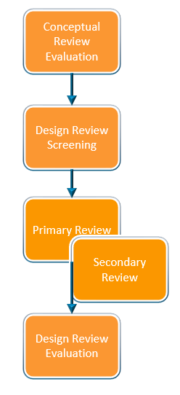
SIP Design Review (60% Review Phase)
The Design Review phase is only required for the SIP and SIP Public Main use types and is led by the SIP Project Manager and will include the following:
Design Guidance meeting
60% SIP plans approval
Approval of SDCI Building Intake
Required Documents at Design Review
Project Scope and Details Form
Base Map Checklist
Survey Checklist
Survey Basemap
60% Complete SIP Checklist
60% SIP Plans
For SIP use type only: On-site Stormwater Calculator
Optional Documents at Design Review
Comprehensive Drainage Report
Geotechnical Report
Street Lighting Level Calculations
Structural Calculations
Water Availability Certificate
Watermain Contract Signed

Slide 17

SIP Formal Review (90% Review Phase)
The Formal Review phase is led by the SIP Project Manager and will include the following:
100% SIP plans approval
Bond estimate
Required Documents at Formal Review
90% Complete SIP Checklist
90% Complete SIP Lite Checklist
90% SIP Plans
Optional Documents at Formal Review
Design Commission Recommendation
Environmental Impact Statement
Seattle Fire Marshal Permit
SEPA Checklist
ADA MEF Form
Letter of Intent
100% Approved Plans

Slide 18
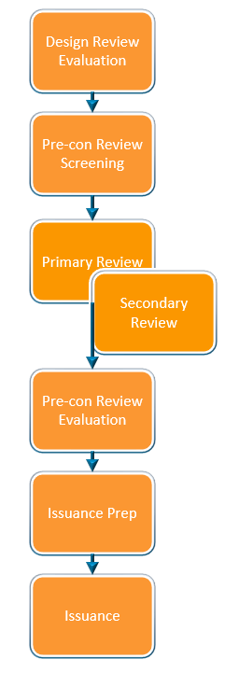
SIP Pre-con Review
Required Documents at Pre-con Review
Right-of-Way Impact Plan (ROWIP)
Phase Schedule Manager
Pre-Construction Material Submittal Form
RAMS Forms
Optional Documents at Pre-con Review
Traffic Control Plan
The Pre-con Review phase is led by the SIP Project Manager and will include the following:
Construction impacts and schedule review
Materials review and approval
Hand off to SIP inspector
Progression to Issuance Prep or Issuance

Slide 19
Other SIP Documents
Document Type | Document Description | When it’s Required Along the Permit Path
Pavement Moratorium Waiver | Required when construction is on a newly paved street per the Right-of-way Opening and Restoration Rules (ROWORR) | Conceptual Review Screening
Holiday Moratorium Waiver | Required when construction is during a Holiday Construction Moratorium per CAM 2107 | Formal Review Screening
Temporary No Parking Confirmation (Paid Parking Permit) | If paid parking is impacted by the project, some sort of proof that a parking permit has been submitted | Formal Review Evaluation
Historic District Certificate of Approval | Based on project location and impact per the Department of Neighborhoods Historic Districts website | Formal Review Evaluation
Bond | Bond in the amount determined in Formal Review | Issuance Prep
Certificate of Insurance | Required per CAM 2102 | Issuance Prep
Indemnity Agreement | Required when there is a proposed encroachment | Issuance Prep
Corrections Response | Street Use Comments Sheet with responses | Any Review Phase Screening if there is a corrections cycle
Notes:
TNP Confirmation can be one of the following:
A copy of the Application Received email
A screen image of the application record details page
A copy of the permit
A copy of a signed billing agreement
A copy of an email from Traffic staff indicating no reservation needed

Slide 20
Application steps from the Portal
Select Permit Type
Enter
Project Address
Add Contacts
Enter Project & Location Description
Enter Related Information
Upload Required Docs
Review Application
Information
Submit & Thank You

Slide 21
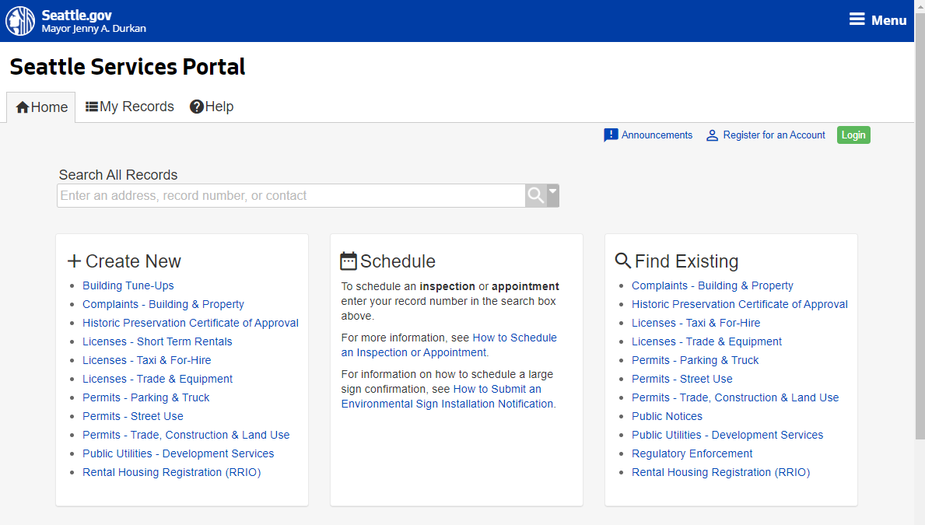
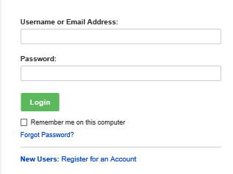
How to apply for a Street Improvement Permit
How to apply for a SIP permit
Go to the Seattle Services Portal
Click on the Login button
Enter your username and password and click on the Login button
Note: If you don’t have an account, see our Seattle Services Portal Overview recording and PowerPoint presentation.
2
3

Slide 22


To login or not to login
What you can do if you login if you are a permit contact or delegate:
  Apply for applications
  Withdraw an application
  View and upload documents
  Respond to Corrections
  Make changes to an issued permit
  Assign delegates
What you can do if you are not logged in and not a permit contact or delegate:
  Search for permits
  View permit information except documents
  Make payments
  Schedule an inspection

Slide 23
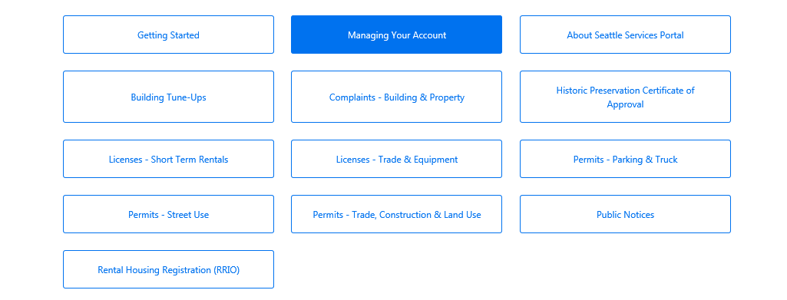
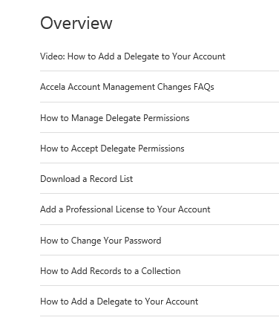

How to add and manage contact delegates
3
For more information about delegates:
Go to the Seattle Services Portal
Click on the Help link
Click on Managing Your Account
Read and/or view the highlighted articles and video on delegates
4

Slide 24
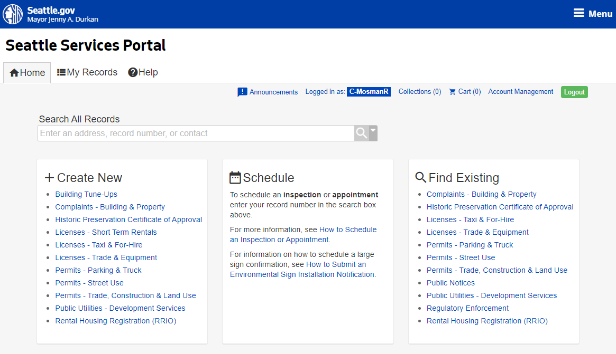
How to apply for a Street Improvement Permit
How to apply for a SIP permit
  Under the Create New section, click on the Permits – Street Use link
4

Slide 25
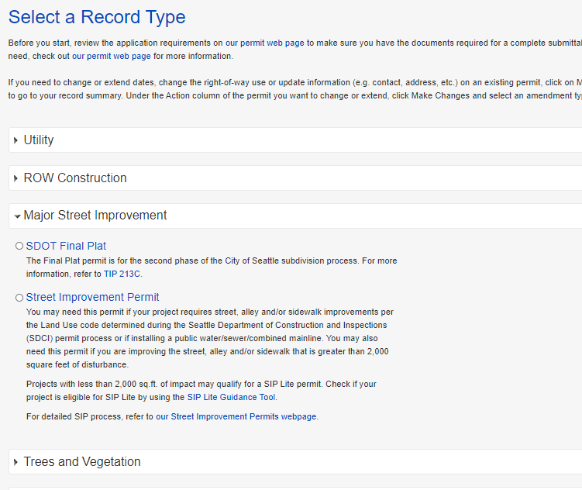

How to apply for a Street Improvement Permit
How to apply for a SIP permit
  Expand the Major Street Improvement section
  Select the desired permit type
  Click on the Continue Application button
5
Help text includes website links to find more information about each permit type
6
7

Slide 26
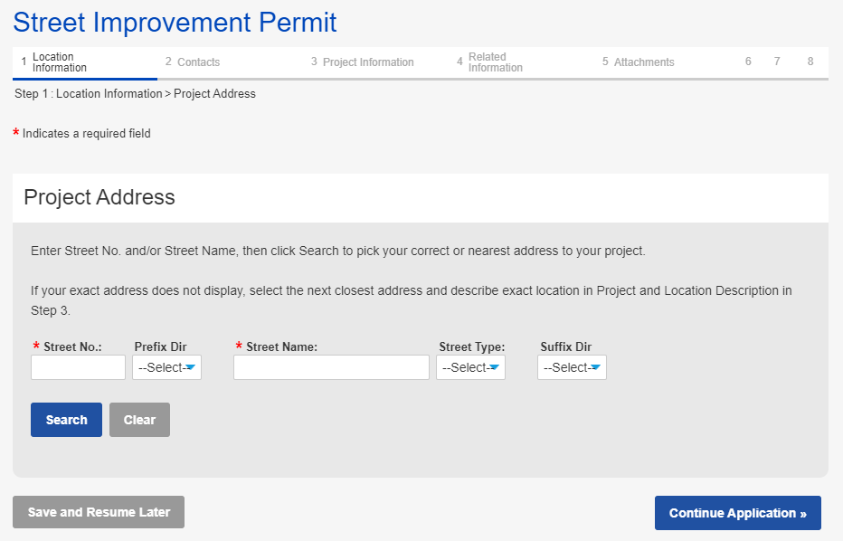
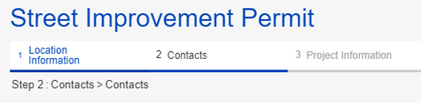


Application page overview
Application steps
Indicates what step you are on and what steps you have already completed
Required field
Moves you to the
next step
You can save at any step and resume later if needed
Notes:
Here are the high level steps to applying for a Minor Utility permit and Utility Major permit.

Slide 27
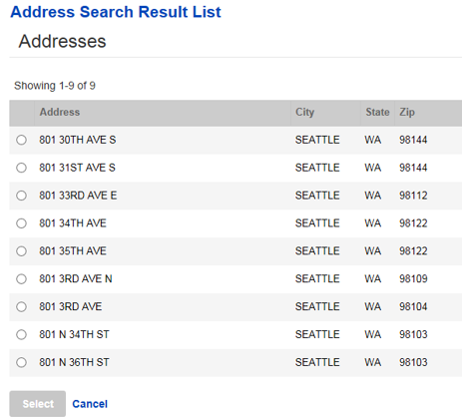
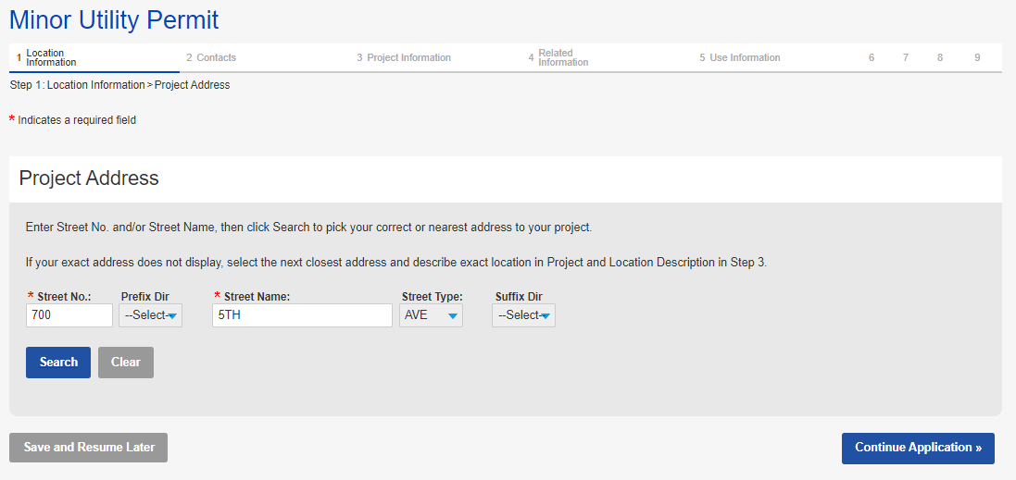



How to apply for a Street
Improvement Permit
How to apply for a SIP permit
  To enter the Project Address:
    Enter information in the required fields and click the Search button
    If there is not an exact match: from the pop-up window, select the correct address and click the Select button
  Click on the Continue Application button
a
c
If the street name is a number, only enter the number
b
9

Slide 28
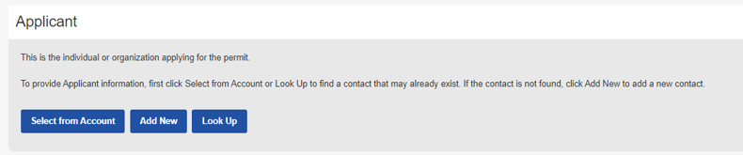
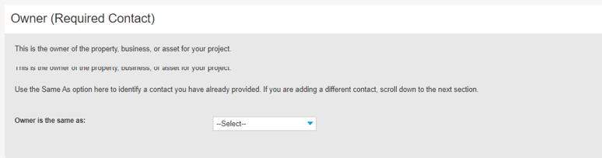
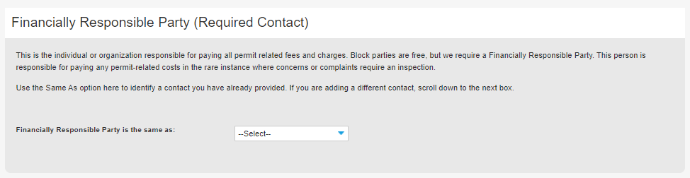
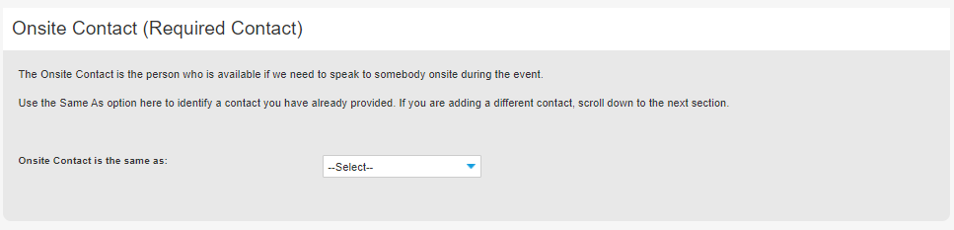
Contacts overview
Select from Account: Auto-populates the contact associated with the login account
Add New: You will need to create a new contact (do this cautiously)
Look Up: Search for an existing contact
On every Street Use permit, there are 4 required contacts:
  Applicant: The individual applying for the permit
  Owner: Property, business or asset/infrastructure owner (note: owner can be transferred to a different entity civilly)
  FRP: The organization responsible for paying all related fees and charges
  Onsite Contact: The individual who Street Use calls to respond to events (e.g. storm response)
After one contact is added, you can also use the Same As drop down menu to select a previously added contact

Slide 29
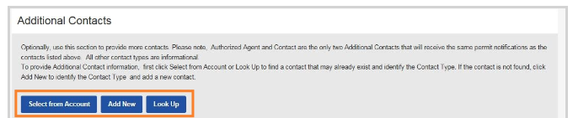
Contacts overview
You can also add the following additional contacts as needed:
  Arborist
  Architect
  Authorized Agent
  Contact
  Contractor
  Engineer
  Vending Operator
Select from Account: Auto-populates the contact associated with the login account
Add New: You will need to create a new contact (do this cautiously)
Look Up: Search for an existing contact
Authorized Agent and Contact receive all permit correspondence

Slide 30
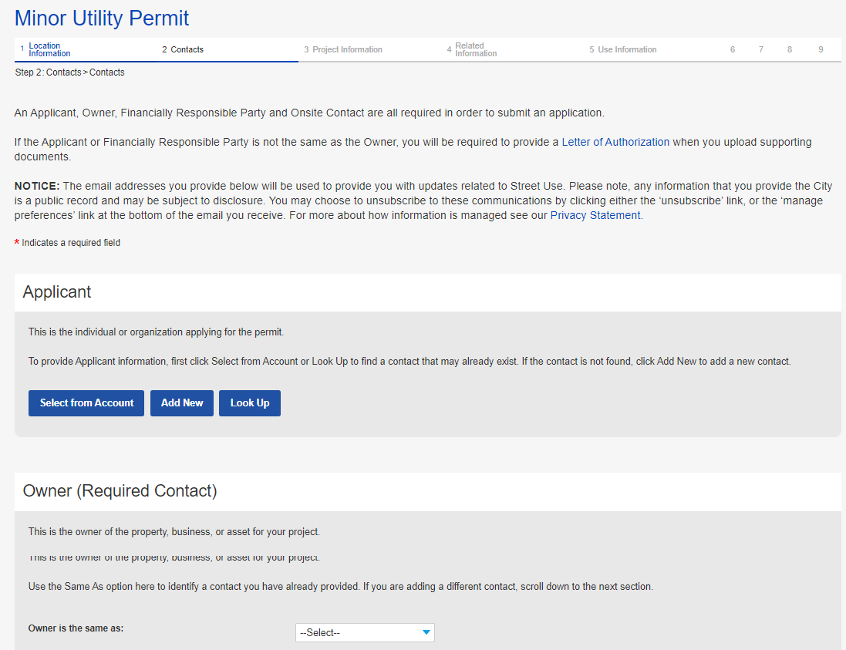
How to apply for a Street Improvement Permit
How to apply for a SIP permit
  Enter all required contacts:
    Applicant
    Owner
    Financially Responsible Party (FRP)
    Onsite
10
Notes:
Optionally, if there is an exact match, there will not be

Slide 31
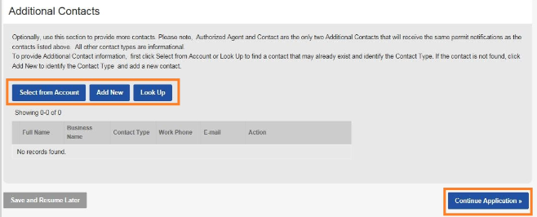
How to apply for a Street Improvement Permit
How to apply for a utility permit
  Optionally, enter additional contacts
  Click on the Continue Application button
11
12
Notes:
Optionally, if there is an exact match, there will not be

Slide 32
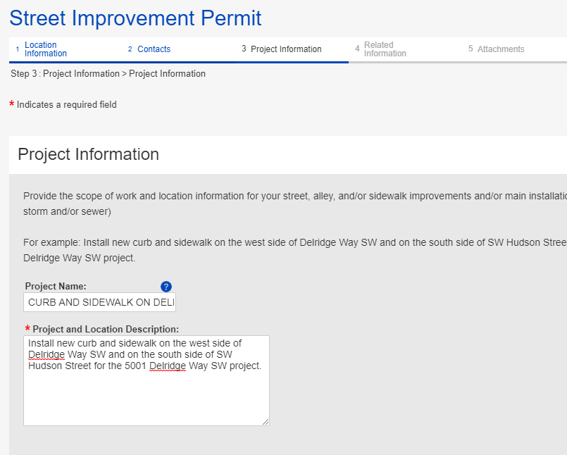
How to apply for a Street Improvement Permit
The top section describes what we want in a project and location description with an example
How to apply for a SIP permit
  Enter Project Name and Project and Location Description
  Click on the Continue Application button
13
14
Notes:
Optionally, if there is an exact match, there will not be

Slide 33
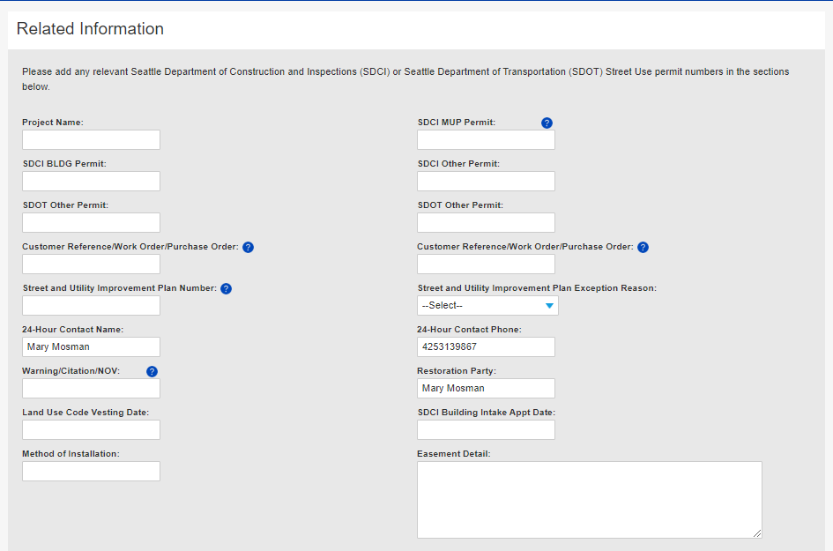
How to apply for a Street Improvement Permit
How to apply for a SIP permit
  Enter the following Related Information:
    Related permit numbers
    Related project information
    24-Hour contact information (defaults to Applicant)
    Restoration Party (defaults to Owner)
    Enforcement number
    If applicable, Land Use Code Vesting and SDCI Building Intake Appt Dates
    If applicable, easement details
a
Prints on the invoice
b
c
e
d
f
g
Notes:
Optionally, if there is an exact match, there will not be

Slide 34
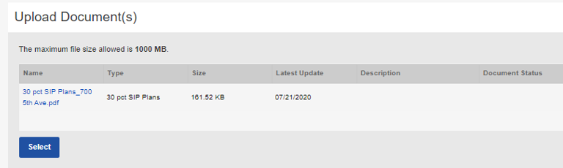
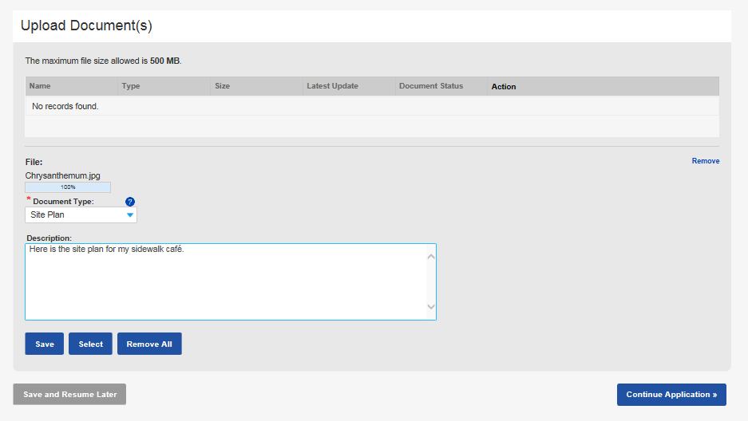
How to apply for a Street Improvement Permit
How to apply for a SIP permit
  Upload all required documents:
    Click the Select button
    Choose the desired document from your computer
    From the Document Type drop-down menu, select the type of document you are uploading
    Tip: For us to perform efficient plan review, only upload PDF documents.
    Add a description (optional)
    Click the Save button
    To upload another document, click the Select button
a
c
d
e
f
Notes:
Optionally, if there is an exact match, there will not be

Slide 35
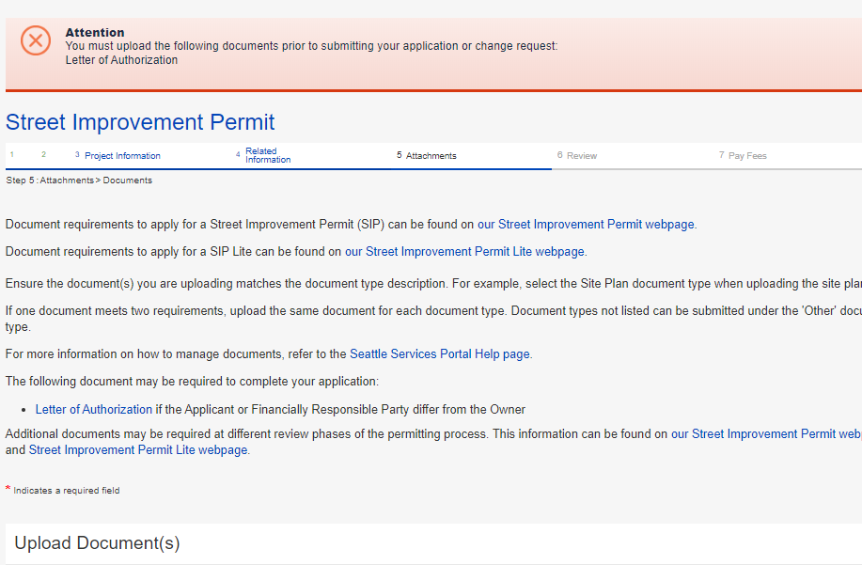
How to apply for a Street Improvement Permit
If you click Continue Application before all required documents are uploaded, this banner will turn red alerting you what documents are still required to upload.
How to apply for a SIP permit
  Once all required and desired documents are uploaded, click the Continue Application button
17
Notes:
Optionally, if there is an exact match, there will not be

Slide 36
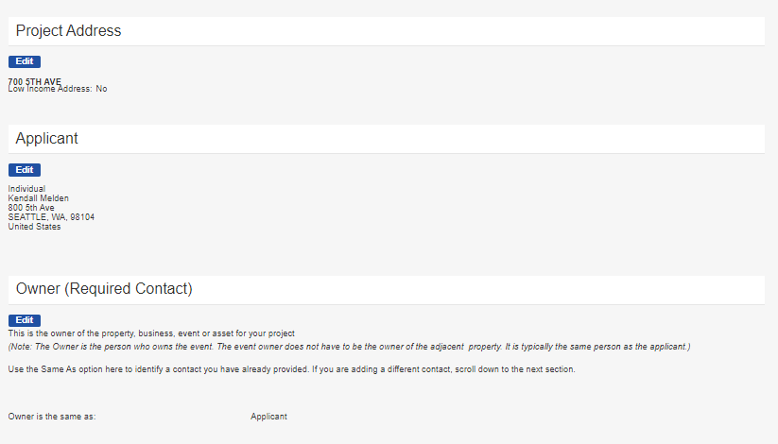
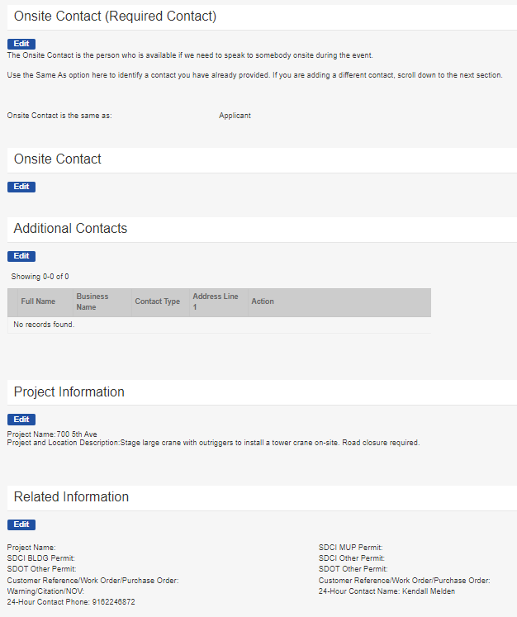
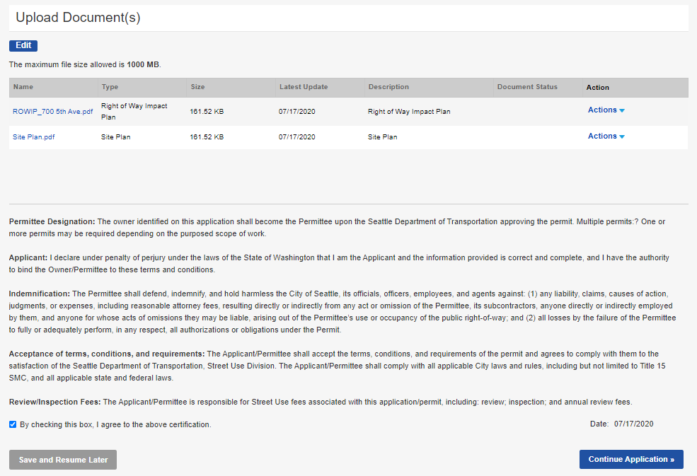
How to apply for a Street Improvement Permit
How to apply for a SIP permit
  Go through all application pages to ensure information is accurate (use the Edit button to make changes)
  Once the application is ready to submit:
    Check the terms of agreement box
    Click the Continue Application button
a
b
36
Notes:
Optionally, if there is an exact match, there will not be

Slide 37
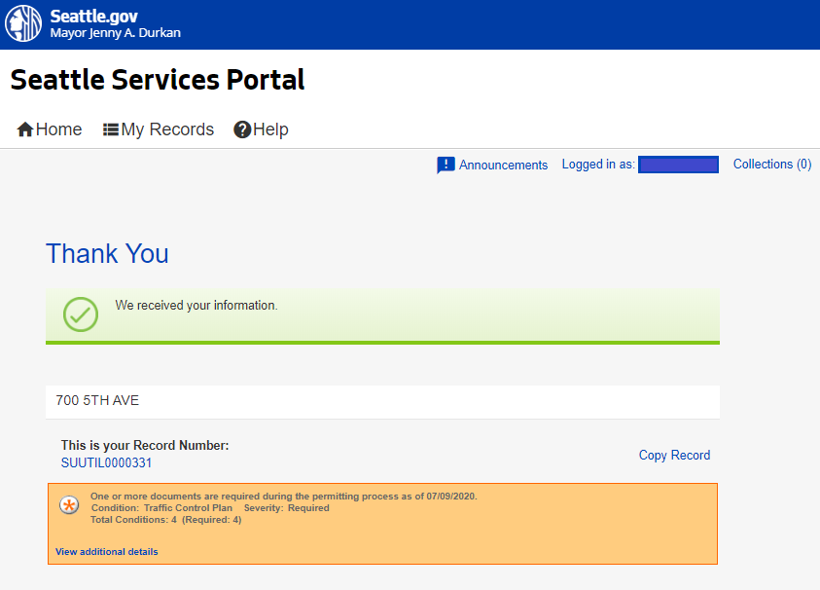
How to apply for a Street Improvement Permit
How to apply for a SIP permit
  Once the application is submitted, you will receive a Thank You confirmation with your Record Number noted
  You can open the permit by clicking on the blue hyperlink permit number
If there are additional documents required later in the permit process, it will show in this box.
20
37
Notes:
Same process for UMPs except document requirements will be different.

Slide 38
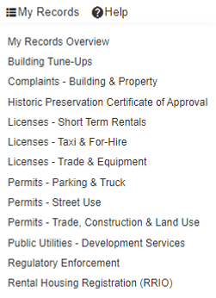
How to find the status of your permit
How to find the status of your permit
You can find your permit in two ways:
  Find the permit under the My Records page, either in My Records Overview or in Permit – Street Use
  Searching for the individual record under Find Existing in Permits – Street Use
a
b
Notes:
When the task status is changed to Additional Information Required, the applicant receives an email saying that a new document is needed.
When the applicant then goes to his/her SSP account, this is what he/she will see…Additional Info Requested.

Slide 39
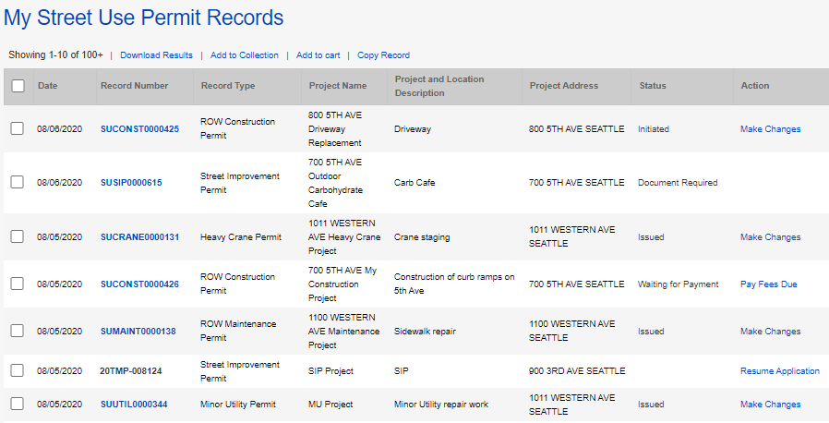

How to find the status of your permit
How to find the status of your permit from the My Records page
  The status of the permit will show in the Status column
a
Notes:
When the task status is changed to Additional Information Required, the applicant receives an email saying that a new document is needed.
When the applicant then goes to his/her SSP account, this is what he/she will see…Additional Info Requested.

Slide 40
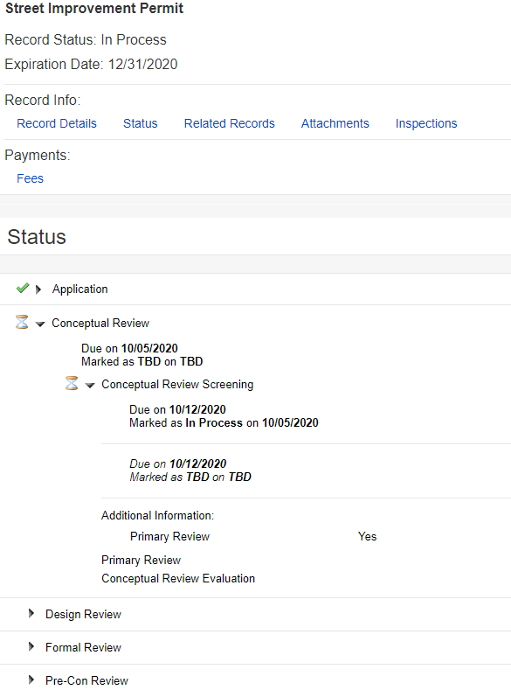
How to find the status of your permit – Conceptual Review
a
How to find the status of your permit
From the individual permit:
  Click on the Status tab
  The Application task is shown as complete with a green check
  The Conceptual Review Screening task is shown as in process with an hourglass
  When you expand the Conceptual Review Screening task, you can see the due date, history of the task processing and the active Primary Review task
  The next task is Primary Review and then Conceptual Review Evaluation
  Upcoming tasks are below
b
c
d
e
f
Notes:
When the task status is changed to Additional Information Required, the applicant receives an email saying that a new document is needed.
When the applicant then goes to his/her SSP account, this is what he/she will see…Additional Info Requested.

Slide 41
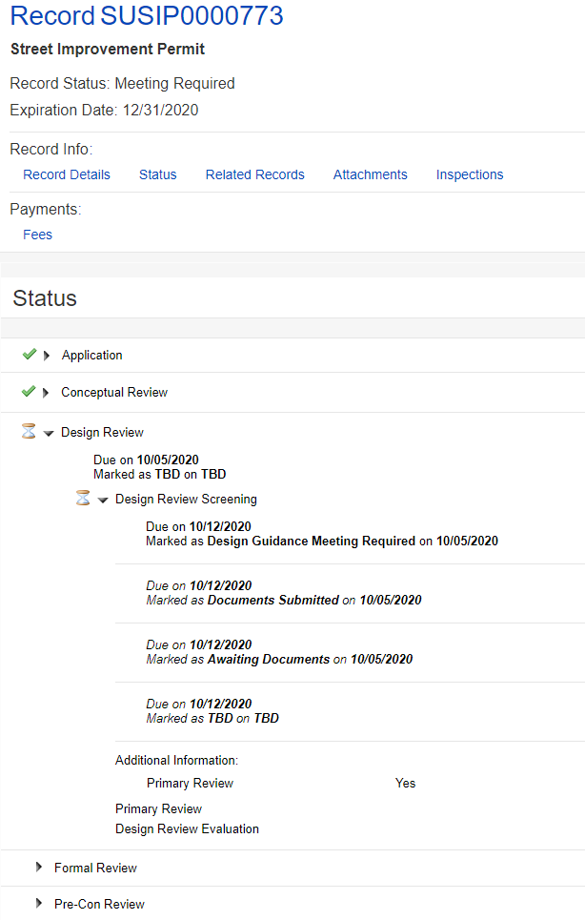

How to find the status of your permit – Design Review (DG Meeting)
How to find the status of your permit
From the Status tab on the individual permit:
  The Conceptual Review task shows complete with a green check
  The Design Review task shows as in process with an hourglass
  Once all required documents are submitted for the Design Review Screening task, the record status will change from Awaiting Documents to Documents Submitted
  If the SIP PM determines a Design Guidance meeting is required, the record status will change from Documents Submitted to Design Guidance Meeting Required
  When the Design Guidance meeting is scheduled, the status will change from Design Guidance Meeting Required to Awaiting Design Guidance Meeting with the date of a due date as the meeting date
  The next tasks are Primary Review and Design Review Evaluation that will be completed after the Design Guidance meeting is held
a
b
e
d
c
f
Notes:
When the task status is changed to Additional Information Required, the applicant receives an email saying that a new document is needed.
When the applicant then goes to his/her SSP account, this is what he/she will see…Additional Info Requested.

Slide 42
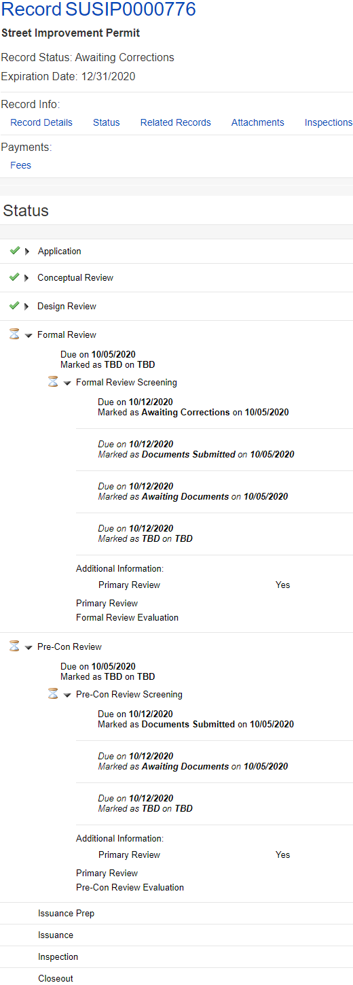

How to find the status of your permit – Formal Review
How to find the status of your permit
From the Status tab on the individual permit:
  The Design Review task shows complete with a green check
  The Formal Review task shows as in process with an hourglass
  Once all required documents are submitted for the Formal Review Screening task, the record status will change from Awaiting Documents to Documents Submitted
  If there is a corrections cycle, the record status will change from Documents Submitted to Awaiting Corrections
  When revised documents and the Corrections Response document is submitted, the record status will change from Awaiting Corrections to Corrections Submitted
  The next tasks are Primary Review and Formal Review Evaluation that will be completed after the Design Review Evaluation task is completed
a
e
b
d
c
f
Notes:
When the task status is changed to Additional Information Required, the applicant receives an email saying that a new document is needed.
When the applicant then goes to his/her SSP account, this is what he/she will see…Additional Info Requested.

Slide 43
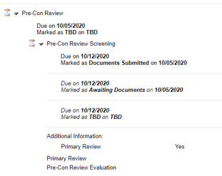
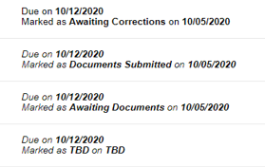
How to find the status of your permit – Pre-con Review
How to find the status of your permit
From the Status tab on the individual permit:
  The Design Review task shows as complete with a green check
  Both the Formal Review and Pre-Con Review tasks show as in process with an hourglass
  Once all required documents are submitted for the Pre-con Review Screening task, the record status will change from Awaiting Documents to Documents Submitted
  If there is a corrections cycle, the record status will change from Documents Submitted to Awaiting Corrections
  When revised documents and the Corrections Response document is submitted, the record status will change from Awaiting Corrections to Corrections Submitted
  The next tasks are Primary Review and Pre-con Review Evaluation
  The Pre-con process can be completed before or after the Formal review process is complete
a
b
e
d
c
f
Notes:
When the task status is changed to Additional Information Required, the applicant receives an email saying that a new document is needed.
When the applicant then goes to his/her SSP account, this is what he/she will see…Additional Info Requested.

Slide 44
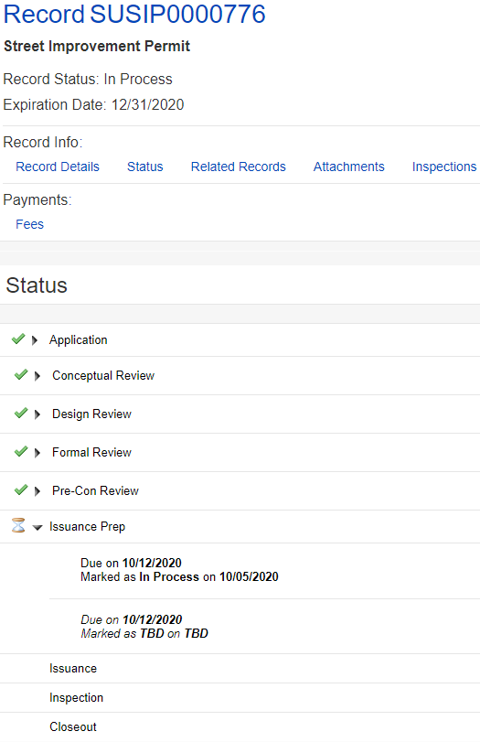
How to find the status of your permit – Issuance Prep
How to find the status of your permit
From the Status tab on the individual permit:
  All previous tasks show as complete with a green check
  The Issuance Prep task shows as in process with an hourglass
  Typically documents reviewed during Issuance Prep have previously been submitted (e.g. bond, indemnity agreement) and the task status will stay as In Process unless a corrections is required, or the SIP PM indicates there is still a missing document to be submitted
  Once all documents are approved during Issuance Prep, the permit will sit in the Waiting for Payment record status until all fees due are paid
a
b
c
d
Notes:
When the task status is changed to Additional Information Required, the applicant receives an email saying that a new document is needed.
When the applicant then goes to his/her SSP account, this is what he/she will see…Additional Info Requested.

Slide 45
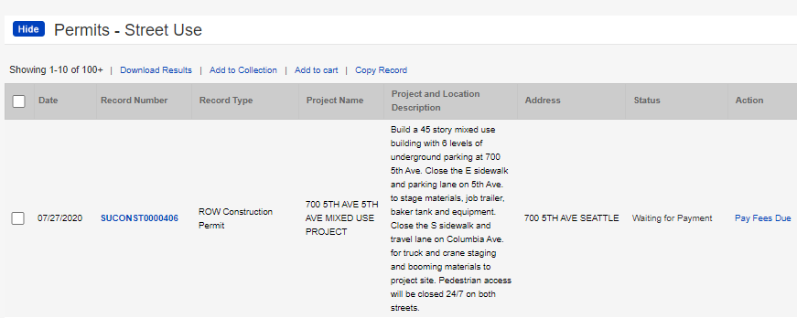
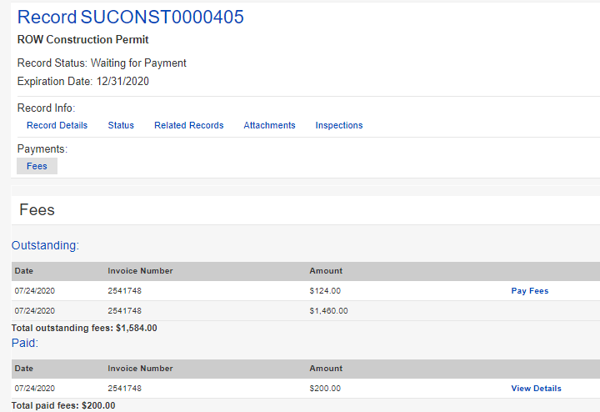
How to pay fees
1
How to pay fees that are due before issuance
  From your My Records:
    The status will show as Waiting for Payment
    Click the Pay Fees Due link
  From the permit:
    Click on the Fees tab
    Click the Pay Fees link
a
b
2
a
b
Notes:
Once an application has been reviewed and approved, the customer receives an email letting them know the permit is ready to issue and waiting for payment. Fees can be paid online. Online payment only allows full payment and only credit cards.
Remember, for billed customers, the permit is issued without payment.
If it’s a free permit, the customer receives an email stating that the permit has been issued and is ready for printing.
Now let’s look at the Fees tab on the record.

Slide 46
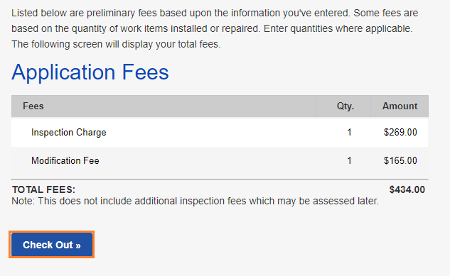
How to pay fees
How to pay fees
  This will take you to the fees due for that application
  To pay for these fees, click on the Check Out button
  Tip: Partial payments are not allowed.
4
Notes:
Once an application has been reviewed and approved, the customer receives an email letting them know the permit is ready to issue and waiting for payment. Fees can be paid online. Online payment only allows full payment and only credit cards.
Remember, for billed customers, the permit is issued without payment.
If it’s a free permit, the customer receives an email stating that the permit has been issued and is ready for printing.
Now let’s look at the Fees tab on the record.

Slide 47
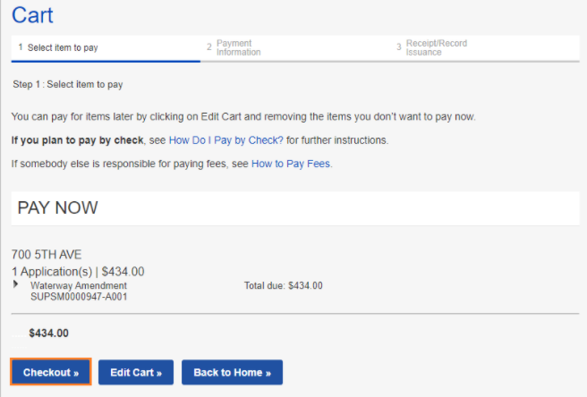
How to pay fees
How to pay fees
  This will take you to your cart
  To pay all fees in your cart, click the Checkout button
  If you have fees in your cart for multiple permits, you can edit those fees by clicking the Edit Cart button
6
7
Notes:
Once an application has been reviewed and approved, the customer receives an email letting them know the permit is ready to issue and waiting for payment. Fees can be paid online. Online payment only allows full payment and only credit cards.
Remember, for billed customers, the permit is issued without payment.
If it’s a free permit, the customer receives an email stating that the permit has been issued and is ready for printing.
Now let’s look at the Fees tab on the record.

Slide 48
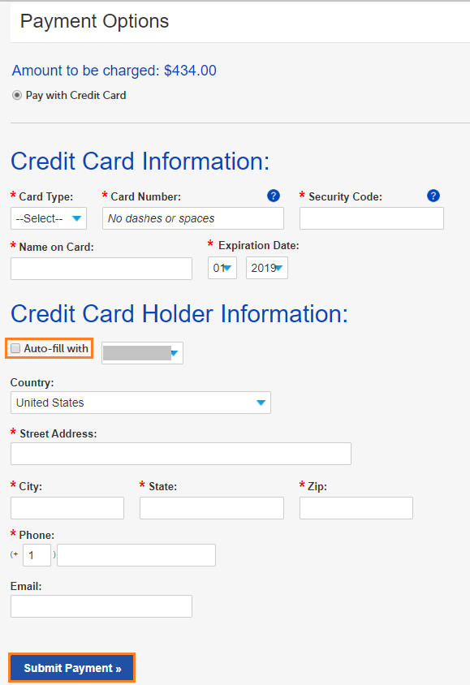
How to pay fees
How to pay fees
  Enter credit card information
  If the credit card billing information is the same as the address on the Portal account, check the box next to Auto-fill with
  If you don’t use the Auto-fill with option, enter all required information
  Click the Submit Payment button to make the payment
8
9
10
11
Notes:
Once an application has been reviewed and approved, the customer receives an email letting them know the permit is ready to issue and waiting for payment. Fees can be paid online. Online payment only allows full payment and only credit cards.
Remember, for billed customers, the permit is issued without payment.
If it’s a free permit, the customer receives an email stating that the permit has been issued and is ready for printing.
Now let’s look at the Fees tab on the record.

Slide 49
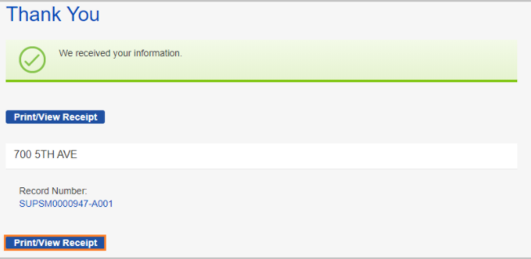
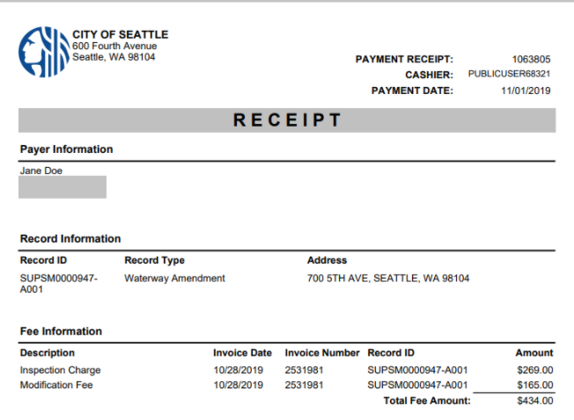
How to pay fees
12
How to pay fees
  This confirmation will show if the payment is successful
  To print and/or view your receipt, click the Print/View Receipt button
  Once all fees are paid, the permit will automatically issue
13
Notes:
Once an application has been reviewed and approved, the customer receives an email letting them know the permit is ready to issue and waiting for payment. Fees can be paid online. Online payment only allows full payment and only credit cards.
Remember, for billed customers, the permit is issued without payment.
If it’s a free permit, the customer receives an email stating that the permit has been issued and is ready for printing.
Now let’s look at the Fees tab on the record.

Slide 50

How to schedule a Pre-con meeting
Process change highlights:
  Most projects will complete the pre-con review process prior to permit issuance
  Pre-con meetings will be held after permit issuance
To request a pre-con meeting, email the SIP PM after permit issuance
  The SIP PM will schedule a pre-con meeting and invite the assigned SIP Inspector and other applicable City Inspectors to the meeting.
  All inspection requests will happen through Accela and SIP Inspector will be the main point of contact
  Most pre-con meetings will be held virtually through MS Teams or WebEx

Slide 51
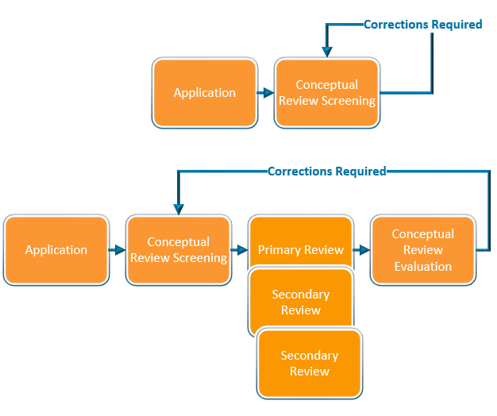
How to respond to corrections
Corrections can be required in the Screening or Review Evaluation task for each review phase
Once the task is set to request corrections, the record status will change from In Process to Awaiting Corrections
Notes:
Moving on… Now, I will walk you through how to apply for a change (an amendment) to an issued permit.

Slide 52
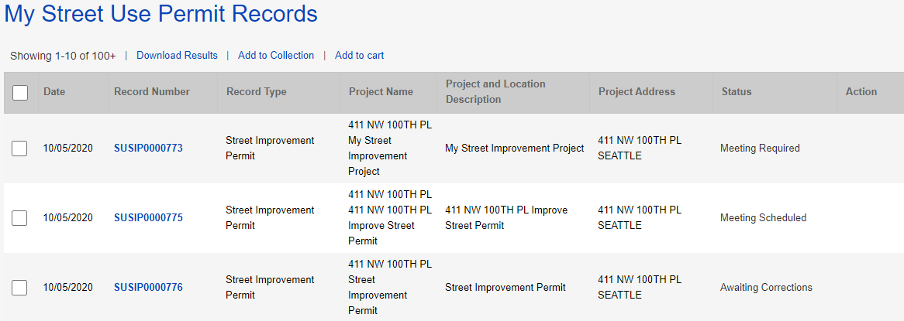
How to respond to corrections
How to respond to corrections
From the My Records page, the Status of the permit will show as Awaiting Corrections
Click on the blue hyperlink permit number
1
2
Notes:
Moving on… Now, I will walk you through how to apply for a change (an amendment) to an issued permit.

Slide 53



How to respond to corrections
How to respond to corrections
Click on the Status tab
  The red banner will indicate what document is required
  Click on the View Condition button for more information about each document/condition
  The Review Evaluation task shows an asterisk indicating there has been at least one corrections cycle
  The Screening task shows as In Process with the hourglass because that is the beginning of the review process
3
a
b
d
c
Notes:
Moving on… Now, I will walk you through how to apply for a change (an amendment) to an issued permit.

Slide 54

Corrections and Corrections Response documents
The Corrections document is the Street Use Comment Sheet
The Corrections Response document is the Street Use Comment Sheet with your responses added
If there is a Corrections Response condition requirement, you will need to upload the Street Use Comment Sheet with your responses
Notes:
After the fees are paid (or are billed), the permit automatically issues and the permit Status updates to Issued in My Records list.
The applicant can now make changes to the permit using the Make Changes link that shows in My Records list as well as in the record itself.
This change request creates an Amendment record.
Let’s click on the Make Changes button to view the amendment types available.
​

Slide 55


How to find the Street Use Comment Sheet and other documents
Also access to the printed permit and marked up documents
To download the Street Use Comment Sheet:
  Click on the Attachments tab of your permit
  Find the most current Corrections document in the attachments list
  Click on the document blue hyperlink
  Download to your computer
  Add responses to the Street Use Comment Sheet
  Repeat for any other documents needed (e.g. marked up plans, printed permit etc.)
  When revised documents are ready, upload the Street Use Comment Sheet with your responses as the Corrections Response document
a
b
c
Notes:
After the fees are paid (or are billed), the permit automatically issues and the permit Status updates to Issued in My Records list.
The applicant can now make changes to the permit using the Make Changes link that shows in My Records list as well as in the record itself.
This change request creates an Amendment record.
Let’s click on the Make Changes button to view the amendment types available.
​

Slide 56

How to respond to corrections
4
How to respond to corrections
Click the Attachments tab
    Click the Select button
    Choose the desired document from your computer
    From the Document Type drop-down menu, select the type of document required by the condition(s)
    Tip: For us to perform efficient plan review, only upload PDF documents.
    Add a description (optional)
    Click the Save button
    To upload another document, repeat these steps
a
c
d
e
Notes:
Moving on… Now, I will walk you through how to apply for a change (an amendment) to an issued permit.

Slide 57

How to respond to corrections
How to respond to corrections
Once all required documents have been uploaded and there are no more conditions due to submit corrections, the status of your permit will change from Awaiting Corrections to Corrections Submitted
5
Notes:
Moving on… Now, I will walk you through how to apply for a change (an amendment) to an issued permit.

Slide 58


How to make a change to a permit
How to make a change to an issued permit
  If the permit is in the Issued stage, under Action, Click on the Make Changes link
  From the record page, click on the Make Changes button
1
2
Notes:
Once an application has been reviewed and approved, the customer receives an email letting them know the permit is ready to issue and waiting for payment. Fees can be paid online. Online payment only allows full payment and only credit cards.
Remember, for billed customers, the permit is issued without payment.
If it’s a free permit, the customer receives an email stating that the permit has been issued and is ready for printing.
Now let’s look at the Fees tab on the record.

Slide 59

How to make a change to a permit
How to make a change to an issued permit
  Select the appropriate amendment (aka modification) type
  Click the Continue Application button to start the amendment application process
3
Only used when the Pre-con is not completed prior to issuance (e.g. King County CSO projects)
4
Notes:
Once an application has been reviewed and approved, the customer receives an email letting them know the permit is ready to issue and waiting for payment. Fees can be paid online. Online payment only allows full payment and only credit cards.
Remember, for billed customers, the permit is issued without payment.
If it’s a free permit, the customer receives an email stating that the permit has been issued and is ready for printing.
Now let’s look at the Fees tab on the record.

Slide 60


How to make a change to a permit
How to withdraw an application
  If the permit is in the Initiated stage, under Action, Click on the Make Changes link
    Tip: This is only available between application submitted and when SU staff claims the application for processing.
  Select SU Withdrawal
  Click the Continue Application button to start the withdrawal
1
2
3
Notes:
Once an application has been reviewed and approved, the customer receives an email letting them know the permit is ready to issue and waiting for payment. Fees can be paid online. Online payment only allows full payment and only credit cards.
Remember, for billed customers, the permit is issued without payment.
If it’s a free permit, the customer receives an email stating that the permit has been issued and is ready for printing.
Now let’s look at the Fees tab on the record.

Slide 61
Inspections by permit type
 | ROW Construction | Minor Utility | Heavy Crane | ROW Maintenance | SIP | UMP
Initial | X | X | X | X | X | X
Interim - Amend | X | X | - | - | X | X
Interim | X | X | - | - | X | X
Site | X | X | X | X | X | X
Reinspection | X | X | X | X | X | X
Restoration | X | X | - | X | X | X
Curb Ramp | - | - | - | - | X | X
Off Hours | X | X | X | X | X | X
Mark Out | X | X | - | X | X | X
Pre-Con Meeting | X | X | X | X | X | X
Final | X | X | X | X | X | X
SDOT Asset | X | X | - | - | X | X
Utility | X | X | - | - | X | X
Acceptance | X | X | - | X | - | X
Bond Release | - | - | - | - | X | X

Slide 62

SIP Inspection Type Changes
A change in inspection types to align processes across different permit types:
The Final inspection indicates all work is complete, the right-of-way is clear, and all infrastructure is properly installed
The Bond Release inspection indicates the asset has been accepted and restoration is functioning without defect after the 12- month warranty period

Slide 63
Notifications by permit type
 | ROW Construction | Minor Utility | Heavy Crane | ROW Maintenance | SIP | UMP
Job Start | X | X | X | X | X | X
Site | X | X | X | X | X | X
Restoration | X | X | - | X | X | X
Curb Ramp | - | - | - | - | X | X
Mark Out | X | X | - | X | X | X
Off Hours* | X | X | X | X | X | X
Pre-Con Meeting* | X | X | X | X | X | X

Slide 64


How to schedule an inspection not available on the Portal
Pre-con Meeting
  Required on UMPs and SIPs only
    For SIPs, the SIP Project Manager will schedule
    For UMPs, the assigned inspector will schedule
  To request a Pre-con Meeting for non-UMP and non-SIP permits, email the assigned St Use Inspector
Off-Hours
  Work outside of normal working hours, 8:00 AM - 5:00 PM Monday through Friday
  3-business days in advance notice required
  Email DOT_StUse_OffHours_Inspection@seattle.gov

Slide 65



How to schedule an inspection from the Portal
1
How to schedule an inspection
Click the Inspections tab
In the Inspections section on the permit select Actions and then Schedule
Tip: You do not have to be logged in to schedule an inspection.
2

Slide 66

How to schedule an inspection from the Portal
How to schedule an inspection
Select date on the calendar in the timeframe allotted based on the issued start date and duration and click the Continue button
The contact for the inspection will default to the Applicant
To update the onsite contact for this inspection, click Change Contact and fill out the required information
Click the Submit button

Slide 67

How to schedule an inspection from the Portal
How to schedule an inspection
Add notes for the inspector (e.g. time of day, details of work etc.)
Click the Finish button

Slide 68

How to schedule an inspection from the Portal
How to reschedule an inspection
On the Inspections tab on the permit, select Actions and then Reschedule
Follow the previous steps on how to schedule an inspection
Note: a 2-business day notice is required to schedule or reschedule an inspection.
9

Slide 69


How to get to the
Portal from our webpages
Starting November 9th, our permit webpages will have updated information to guide you through the Accela permit process
You can also find a link to the Portal on the right panel of every webpage
http://www.seattle.gov/transportation/permits-and-services/permits
Access to the Portal can be found on the right panel of every webpage
Notes:
When a user needs help, they can access the Help Center articles by clicking on Help.
The banner is available throughout the portal, and Help can be accessed at any time simply by clicking on the Help button.

Slide 70

Help Center
1
How to find help on the Portal
From the Seattle Services Portal home page, click on Help
Click on any of these pages:
    Getting Started
    Managing Your Account
    Permits - Street Use
2
Notes:
When a user needs help, they can access the Help Center articles by clicking on Help.
The banner is available throughout the portal, and Help can be accessed at any time simply by clicking on the Help button.

Slide 71
Upcoming events
Date, Time | Topic
Sept 14th, 1-2pm | Inspection and Notifications Types Overview
Oct 19th, 3-4pm | Seattle Services Portal (SSP) Overview
Oct 26th, 2-3:30pm | Utility Permit Overview
Oct 28th, 3-4:30pm | Construction Permit Overview
Oct 30th, 11:30am-12:30pm | Street Improvement Permit Overview
Nov 3rd, 11am-12pm | Amendment Types Overview
Week of Nov 9th and 16th | General Q&A’s Sessions
One workshop per topic
Each workshop will be held virtually using Webex Events and recorded
Q&A sessions will be a 1-hour live event once or twice a week using Webex Events
Stay informed with our monthly newsletter and Accela 2 Updates website

Slide 72

Questions?
Melody.Berry@seattle.gov
www.seattle.gov/transportation

