Slide 1

Seattle Services Portal (SSP) Overview
External Workshop
SDOT Street Use
Melody Berry, Tina Hove and Dale Sijera
Notes:
Welcome to the SDOT Seattle Services Portal (SSP) overview

Slide 2
Our vision, mission, and core values
Vision: Seattle is a thriving equitable community powered by dependable transportation
Mission: to deliver a transportation system that provides safe and affordable access to places and opportunities
Committed to 6 core values:
Equity
Safety
Mobility
Sustainability
Livability
Excellence

Slide 3
Workshop overview
Accela launch overview
Upcoming events
How to get help after launch
How to create a new permit application
How to find the status of a permit
How to pay fees
How to schedule an inspection
Seattle Services Portal navigation overview
How to set up a new user account
Communication through the permit process
Permit process steps
How to set up a new user account and link to a converted contact
Login overview and contact delegates
Permit conversion overview
How to find the status of an inspection
How to make a change to a permit

Slide 4
Accela launch overview
Accela is a new permit system that will replace Hansen 7
Accela meets the following city, department, and division goals:
    Improved consistent, predictable, and transparent permitting and inspections
    Improved online user experience
    Integrate systems for users across departments

Slide 5
Accela launch overview
SDOT’s last implementation into Accela will be the weekend of November 7th, 2020
Traffic, Public Space Management, and Annual Vehicle permits are already in Accela
Come November, the remainder of Street Use permits will be in Accela

Slide 6
Permit types - what’s coming in November
ROWM Permits
ROW Construction (today’s Construction Use)
ROW Maintenance (new)
Heavy Crane (new)
Minor Utility
Major Permits
Utility Major
Street Improvement
Final Plat

Slide 7
Launch Schedule

Slide 8
Upcoming events
Date, Time | Topic
Sept 14th, 1-2pm | Inspection and Notifications Types Overview
Oct 19th, 3-4pm | Seattle Services Portal (SSP) Overview
Oct 26th, 2-3:30pm | Utility Permit Overview
Oct 28th, 3-4:30pm | Construction Permit Overview
Oct 30th, 11:30am-12:30pm | Street Improvement Permit Overview
Nov 3rd, 11am-12pm | Amendment Types Overview
Week of Nov 9th and 16th | General Q&A’s Sessions
One workshop per topic
Each workshop will be held virtually using Webex Events and recorded
Q&A sessions will be a 1-hour live event once or twice a week using Webex Events
Stay informed with our monthly newsletter and Accela 2 Updates website

Slide 9
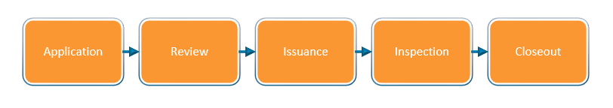
Permit process steps – Simple permits
Simple permit types:
ROW Maintenance

Slide 10
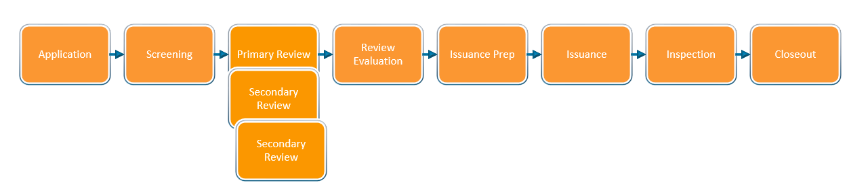
Permit process steps – Full review permits
Full review permit types:
ROW Construction
Heavy Crane
Minor Utility
Utility Major
Final Plat

Slide 11
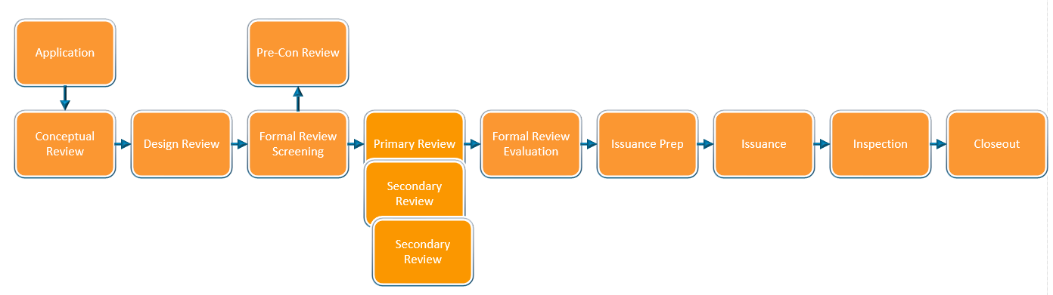
Permit process steps – Street Improvement Permits (SIPs)

Slide 12

Communication through the permit process
Process Step (Task) | Task Status | Workflow Type | Permit Types
Application | Received | All | All
Application | Additional Info Requested | All | All
Review | Additional Info Requested | Simple | ROW Maintenance
Review | Waiting for Payment and Issued | Simple | ROW Maintenance
Screening and Review Evaluation | Corrections Required | Full and SIP | ROW Construction, Heavy Crane, Minor Utility, Utility Major, SIP
Review Evaluation | Waiting for Payment and Issued | Full and SIP | ROW Construction, Heavy Crane, Minor Utility, Utility Major, SIP
Inspection | Most Inspection Results (does not include waived) | All | All
Accela will automatically send emails at these steps of the process

Slide 13
Communication through the permit process
To receive these automatic emails, you will have to be one of the following permit contacts:
  Applicant (Required)
  On-Site Contact (Required)
  Financially Responsible Party (Required)
  Owner (Required)
  Authorized Agent (Optional)
  Contact (Optional)

Slide 14
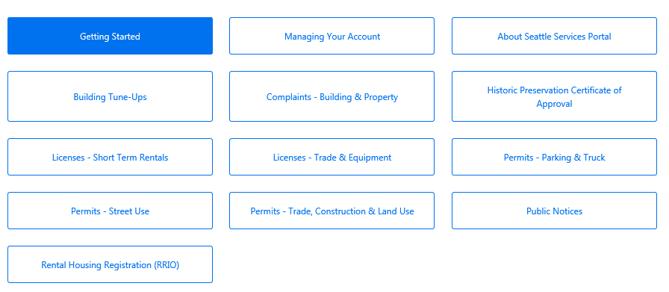

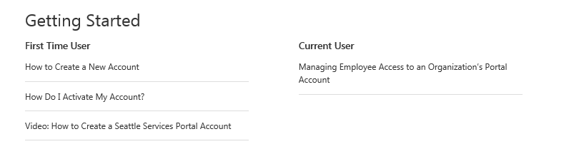

How to set up a new user account
  To create a new user account:
  Go to the Seattle Services Portal
  Click on the Register for an Account link in the upper right-hand corner
  Click on the Help link
  Follow the steps in the How to Create a New Account Help article and/or video on the Portal in the Help Center
4

Slide 15
How to set up a new user account
  To create a new user account:
  After you create your account, go to your verification email
  Click on the link in the email you receive. This link will take you to login page on the Portal
  Go to the Help Center by clicking on the Help link on the Seattle Services Portal home page
  Follow the steps in the How Do I Activate a New Account Help article and/or video on the Portal in the Help Center
7

Slide 16
How to set up a new user account and link to a converted contact
  You will only be able to view your converted permit(s) if your user account links to a converted contact
  This can be difficult if you are not sure what contact information is on your permit or if you had multiple contacts created in Hansen

Slide 17
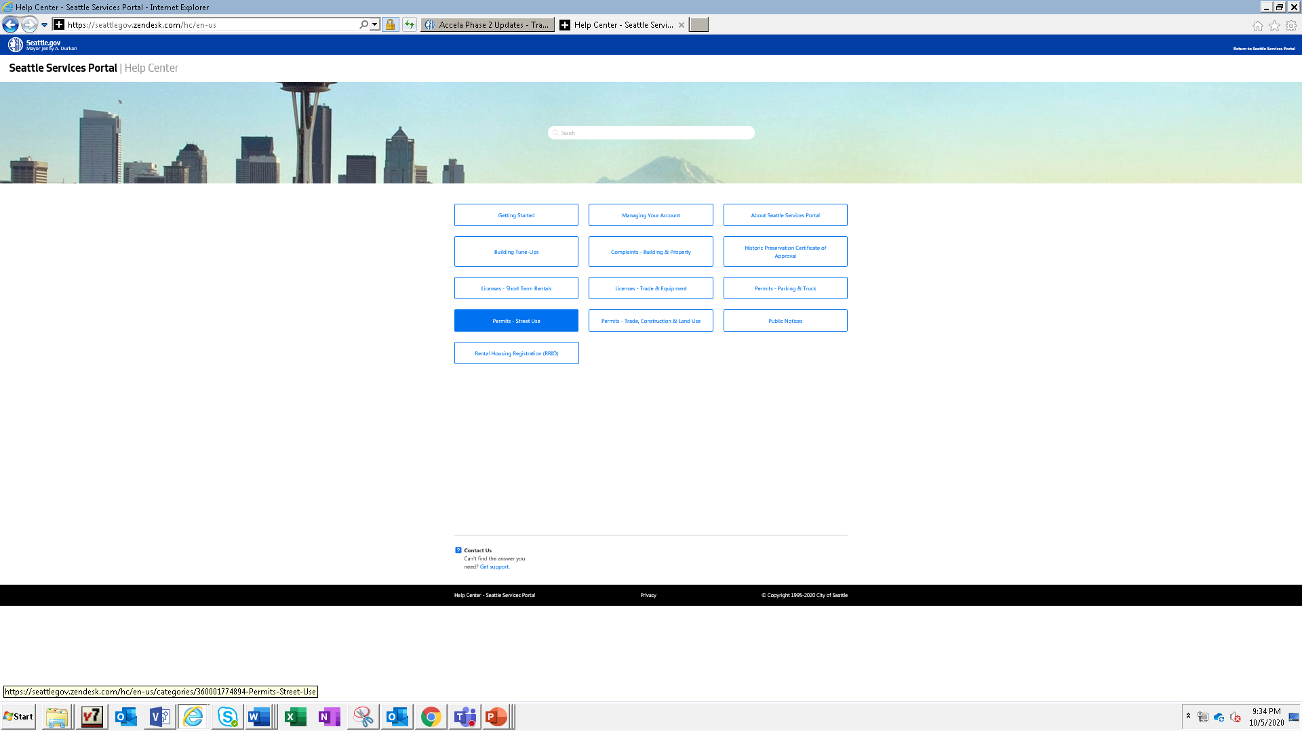
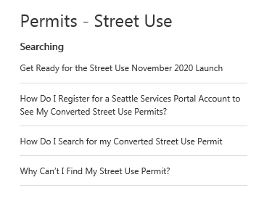
How to set up a new user account and link to a converted contact
  To create a new user account to link to a converted contact to see your converted permits:
  Go to the Seattle Services Portal
  Click on the Help link
  Follow the steps in the How Do I Register for a Seattle Services Portal Account to See My Converted Street Use Permits Help article
3

Slide 18
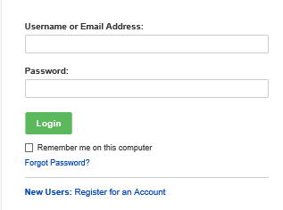
How to login
How to login into the Portal:
  Go to the Seattle Services Portal
  Click on the Login button
  Enter your username and password created in the registration process
  Click on the Login button
  If you forgot your password, click on the Forgot Password? link to reset

Slide 19


To login or not to login
What you can do if you login if you are a permit contact or delegate:
  Apply for applications
  Withdrawal an application
  View and upload documents
  Respond to Corrections
  Make changes to an issued permit
  Assign delegates
What you can do if you are not logged in and not a permit contact or delegate:
  Search for permits
  View permit information except documents
  Make payments
  Schedule an inspection

Slide 20
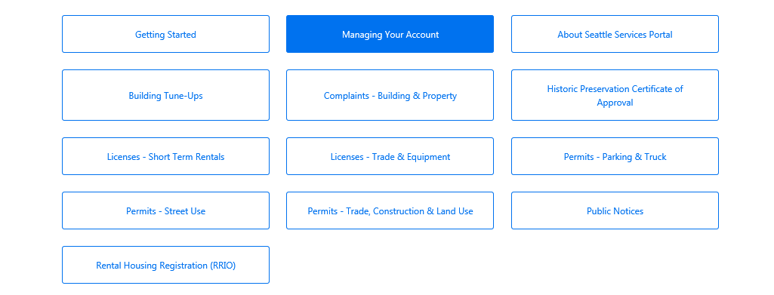
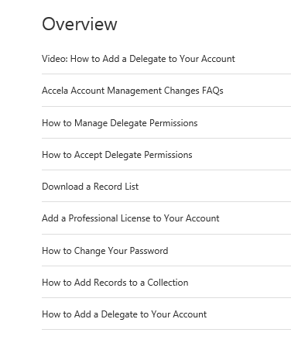
How to add and manage contact delegates
3
For more information about delegates:
Go to the Seattle Services Portal
Click on the Help link
Click on Managing Your Account
Read and/or view the highlighted articles and video on delegates
4

Slide 21
Permit conversion overview
All open permits will be converted into Accela
  Note: In process modification requests will show as issued permits after conversion
The Accela permit number will reference the Hansen number (i.e. X12345) in the new record ID template
ROW Construction (Construction Use) | Minor Utility | Utility Major Permit (UMP) | Street Improvement Permit (SIP)
SUCONSTX12345 | SUUTILX12345 | SUUMPX12345 | SUSIPX12345

Slide 22

Permit conversion overview
Permit conversion notification:
  Our high-volume applicants (e.g. PSE, SPU, SCL, KC, most of the telecoms etc.) will receive a spreadsheet noting all converted permits
  For the rest of our applicants:
    Permits initiated in 2020: all permit contacts will receive an email
    Permits initiated in 2019 or earlier: only the Financially Responsible Party (FRP) will receive an email

Slide 23
How to find a converted permit
To find your converted permit in Accela:
  Go to the Seattle Services Portal
  Click on the Help link
  Follow the steps in the How Do I Search for my Converted Street Use Permit Help article
3

Slide 24
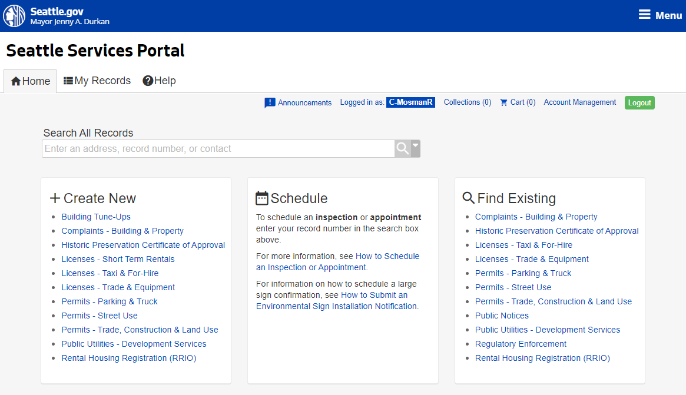
Seattle Services Portal navigation
Home page
  My Records page
  Help center
  Search for all Accela permits
  Apply for a new record
  Schedule an inspection
  Find existing records
  Logout
1
2
3
7
4
5
6
Notes:
This is the home page for the Seattle Services Portal. It is used by all customers who access Accela.
The white banner at the top is available on all pages.
Users can click on the tabs to navigate to the Home page, their Records, or to get Help.
On the Home page, users can
Create a new application
Request or Schedule an inspection or let us know about a job start. The actual scheduling is done from within the record.
Search for or Find an Existing permit.
Search All Records is global and returns a lot of results. (This can be confusing if you are trying to find something specific.)
Find Existing is more specific and allows the user to search for specific permit types like SDCI Building permits or Traffic Parking or Street Use.

Slide 25
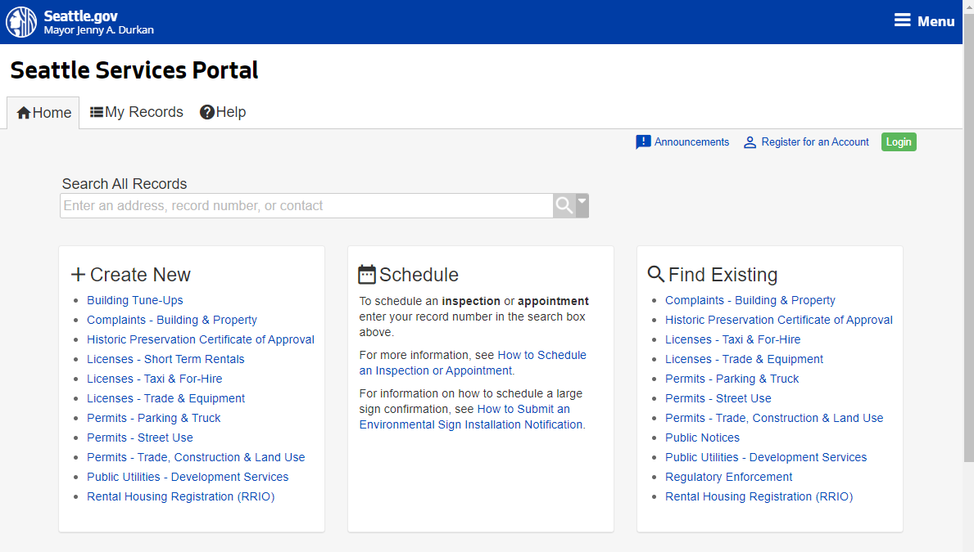
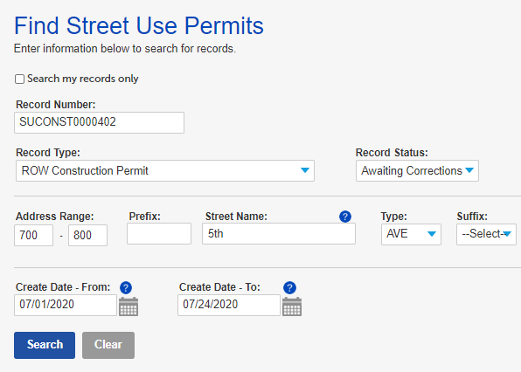
Seattle Services Portal navigation
You can find the status of your permit in two ways:
Option 1: Find an existing Street Use permit by searching for the record
  Under the Find Existing section, click on the Permits – Street Use link
  If you know the permit number, enter it in the Record Number field
    Tip: To avoid the zeros, use the % symbol (e.g. SUCONST%402)
  If you don’t know the permit number, use any of these fields to search:
    Record Type
    Record Status
    Address
    Creation Date
  Click the Search button
1
2
a
b
c
d
4
Notes:
Clicking on Find Existing takes you to a search page where you can enter additional search criteria for finding records related to Street Use.
You can limit the search to only records you’re a contact or delegate on by checking the checkbox.
You can search for a specific record based on Record Type, such as all your construction permits, or address.
<Instructor note: point of possible confusion for customers>Record status is hard for customers to use unless they understand their records well, they may pick the wrong status and not get the results they expect. Leave as default “-Select”.
Records can also be found using their create date.

Slide 26
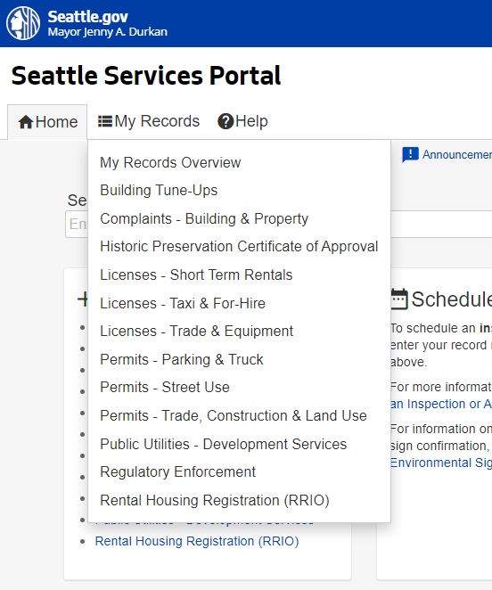
Seattle Services Portal navigation
Option 2: Find your existing records in the My Records page
  Under the My Records section, click on the Permits – Street Use link
1
Notes:
Now, let’s click on the My Records tab. My Records list can be accessed from almost anywhere in the portal. It is in the header. Clicking on it opens a list of options for filtering your records.
The My Records Overview has all your records, grouped by the categories showing in this menu.
Permits – Trade, Construction, and Land Use has SDCI records. Permits – Parking & Truck has all your traffic records.
To see only your Street Use records, we have a category specifically for that – Permits – Street Use.

Slide 27
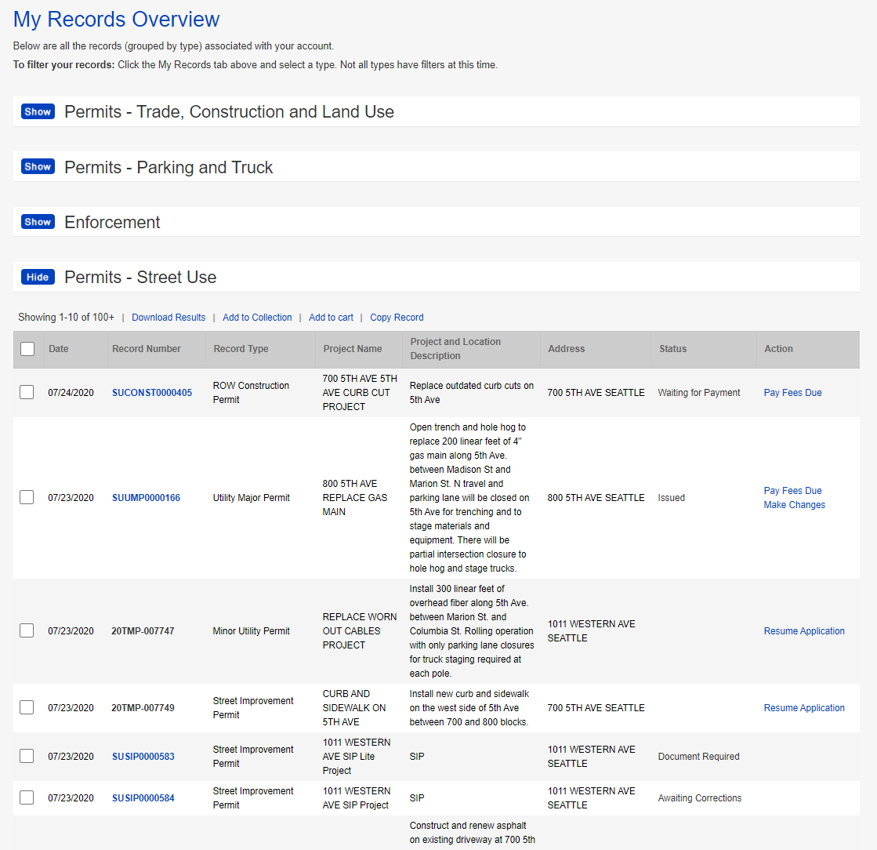
Seattle Services Portal navigation
2
Option 2: Find your existing records in the My Records page
  Next to the Permits – Street Use section, click on the Show button to expand your list
Notes:
Now, let’s click on the My Records tab. My Records list can be accessed from almost anywhere in the portal. It is in the header. Clicking on it opens a list of options for filtering your records.
The My Records Overview has all your records, grouped by the categories showing in this menu.
Permits – Trade, Construction, and Land Use has SDCI records. Permits – Parking & Truck has all your traffic records.
To see only your Street Use records, we have a category specifically for that – Permits – Street Use.

Slide 28
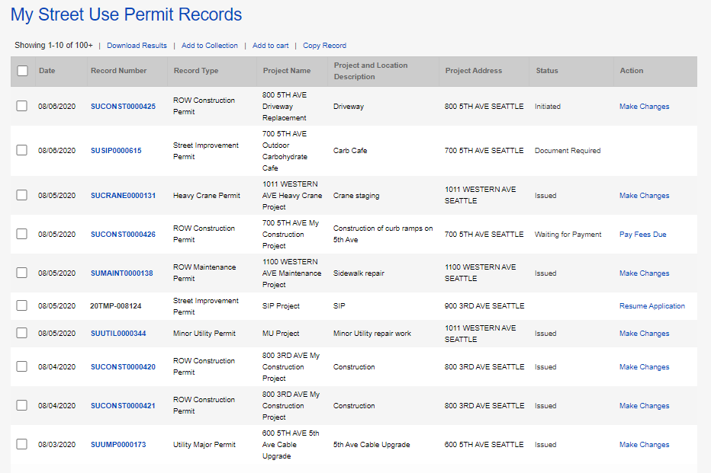
Seattle Services Portal navigation
Option 2: Find your existing records in the My Records page
  Find the status of a completed application
  Apply for amendment to an initiated or issued permit
  Resume an incomplete application
3
4
5
Notes:
On My Records Overview page, you see a list of all your records in the system:
The records are grouped by their module. You can hide and show areas to help find and focus on what you are looking for.
All categories show as collapsed. Click the Show button to expand a category. Click the Hide button to collapse a category.
When we expand the Permits – Street Use group:
We can see the user’s Record Numbers.
The TMP numbers are records that have been started but not yet submitted.
We also see this user has a variety of Street Use records for Street Improvement and Right Of Way Construction.
The Address of the records displays and is sortable, as are most columns.
The next column shows the Status of submitted records, such as Waiting for Payment or Awaiting Corrections. In the Status, you can see that one record has required documents that need to be submitted and another one has a document that needs resubmitted.
In the Actions column, applicants can take actions like Pay Fees or Make Changes to permits. Actions column is for Applicants Only.
The last column is the Action column and links to actions the user can take.
The exception is when a record is Awaiting Corrections. On those records, they need to
open the record by clicking on the blue Record Number link and then
upload a document from within the record.

Slide 29
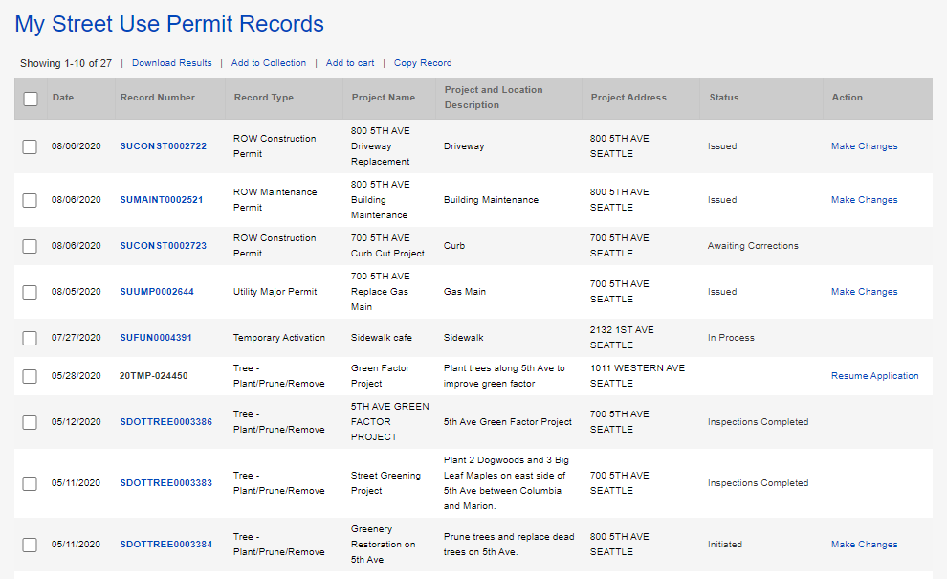
How to find the status of your permit
Find the status of your permit
  The record status will show on your My Records list
  Open the permit by clicking on the permit number hyperlink
1
2
Notes:
On My Records Overview page, you see a list of all your records in the system:
The records are grouped by their module. You can hide and show areas to help find and focus on what you are looking for.
All categories show as collapsed. Click the Show button to expand a category. Click the Hide button to collapse a category.
When we expand the Permits – Street Use group:
We can see the user’s Record Numbers.
The TMP numbers are records that have been started but not yet submitted.
We also see this user has a variety of Street Use records for Street Improvement and Right Of Way Construction.
The Address of the records displays and is sortable, as are most columns.
The next column shows the Status of submitted records, such as Waiting for Payment or Awaiting Corrections. In the Status, you can see that one record has required documents that need to be submitted and another one has a document that needs resubmitted.
In the Actions column, applicants can take actions like Pay Fees or Make Changes to permits. Actions column is for Applicants Only.
The last column is the Action column and links to actions the user can take.
The exception is when a record is Awaiting Corrections. On those records, they need to
open the record by clicking on the blue Record Number link and then
upload a document from within the record.

Slide 30
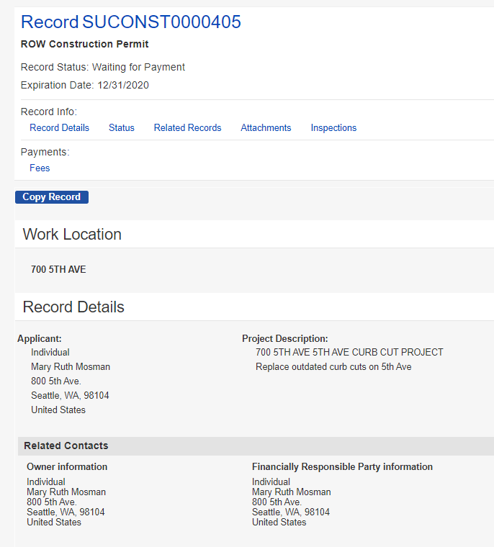

How to find the status of your permit
a
Find the status of your permit
  The Record Details page shows the following:
    Record Status and Expiration Date
    Other available pages
    Fees page
    Make Changes button where you can apply for an amendment
    Application information summary
3
c
b
d
e
Notes:
Now let’s look at our application. When you first open your record from your list, your screen is divided into halves.
The top half is always there. Notice your Record Status and the navigation options under Record Info and Payments. The bottom half varies depending on what navigation view you choose.
Each tab shows different information.
The record opens to the Record Details tab. This tab is a summary of the record – the contacts, project address and description, application information, and use
The Status tab displays a list of all tasks for the record and whether they are Completed, In Progress, or still Outstanding
The Related Records tab displays all related records, like amendments, and has links to them
Attachments tab is where users can view uploaded documents, upload new or corrected documents, and download or print a copy of their permit
The Inspections tab displays Completed inspections, lists Pending or Scheduled inspections, provides a way for users to tell us about their Job Start and allows users to schedule Pending inspections
The Fees tab allows users to view outstanding fees and pay them and view receipts on paid items
Users can also take other actions on their records from this page:
Once a permit is issued the user can click Make Changes to amend the record, such as extend dates or request a scope change.

Slide 31
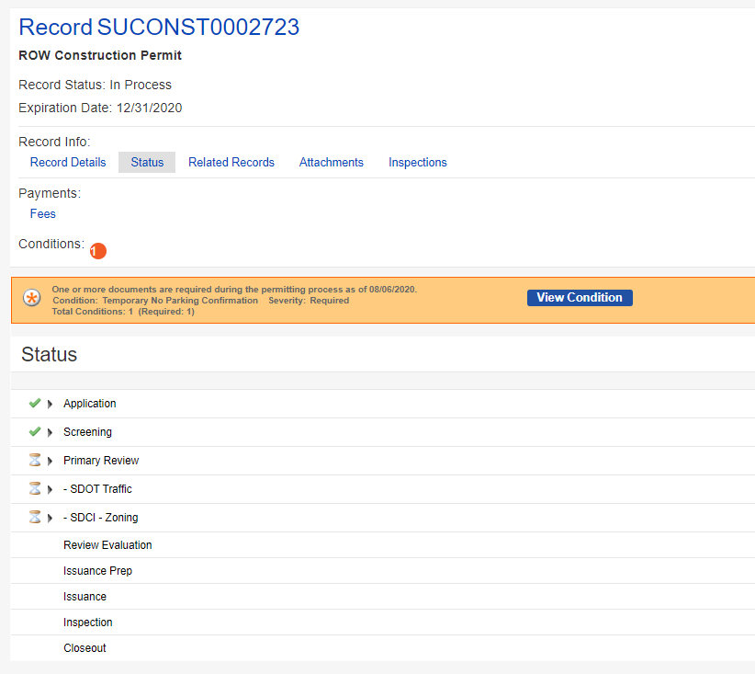
How to find the status of your permit
4
Find the status of your permit
  Click on the Status tab
  The status of each workflow step will show:
    Complete steps will show a green check mark
    In Process steps will show an hourglass
    Upcoming steps will be blank
  Required documents will show in the red banner
6
a
b
c
Notes:
Here in Status you can see the lifecycle of your application – (1) The green check marks show where your record has been), (2) The hourglass timer shows where the record is now and (3) The remainder is what is left (no icon.)
Here you can see that Application and Screening are complete. There are 3 active tasks - a Primary Review and two others. Those tasks underneath the primary are your secondary reviewers. Below, the steps w/o icons, are up and coming tasks that are outstanding.
Once the permit is issued, all tasks except Closeout are complete, like the screenshot on the left.
(NOTE: Only if asked: Expiration date is set by Accela. It has no purpose until after the record is issued. Once issued, the expiration date is updated to reflect the latest date for all uses, or the 6-month window for utilities.)

Slide 32
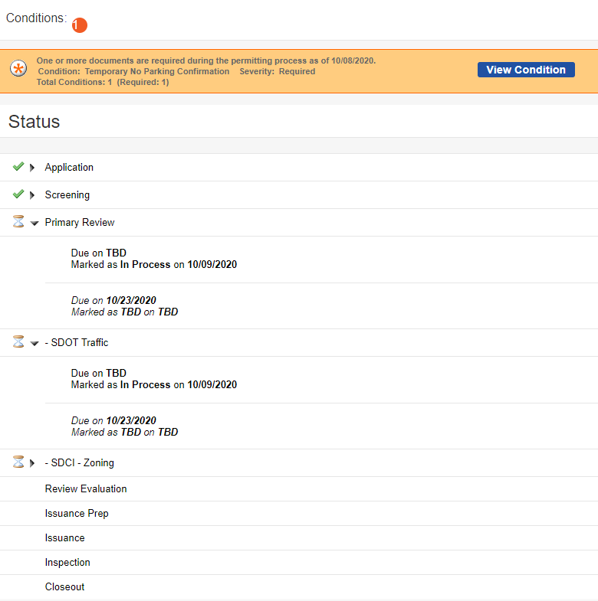
How to find the status of your permit
Find the status of your permit
  Click on a review stop to find the additional information
    Status
    Due date
a
7
b
Notes:
Here in Status you can see the lifecycle of your application – (1) The green check marks show where your record has been), (2) The hourglass timer shows where the record is now and (3) The remainder is what is left (no icon.)
Here you can see that Application and Screening are complete. There are 3 active tasks - a Primary Review and two others. Those tasks underneath the primary are your secondary reviewers. Below, the steps w/o icons, are up and coming tasks that are outstanding.
Once the permit is issued, all tasks except Closeout are complete, like the screenshot on the left.
(NOTE: Only if asked: Expiration date is set by Accela. It has no purpose until after the record is issued. Once issued, the expiration date is updated to reflect the latest date for all uses, or the 6-month window for utilities.)

Slide 33
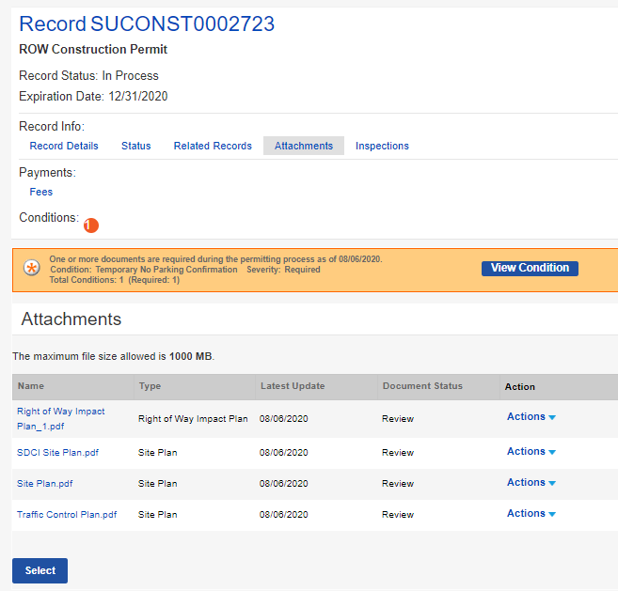
How to find the status of your permit
8
Find the status of your permit
  Click on the Attachments tab
  The status of each document will show in the Document Status column
9
Notes:
Documents are found in the Attachments tab. This is where the customer sees all their documents. Those that have been provided by them, those that have been marked up by the reviewers with feedback, as well as other documents, like the permit.
Documents that are uploaded display with the Document Status they are currently in.
Attachments is also where an applicant would upload additional documents (e.g. Certificate of Insurance) not required at application.
Some system generated documents display to the customer – things like permits.
Only contacts on the record and their delegates can view the documents or select new or updated documents to upload.
Lets move on to, how to make a correction.

Slide 34
How to create a new application
Create a new Street Use permit application
  Under the Create New section, click on the Permits – Street Use link
1
Notes:
Start an application on the Home page. You must be logged-in, to create a new application.
Log in using the Login button on the top right of the page
Under Create New, click Permits – Street Use

Slide 35
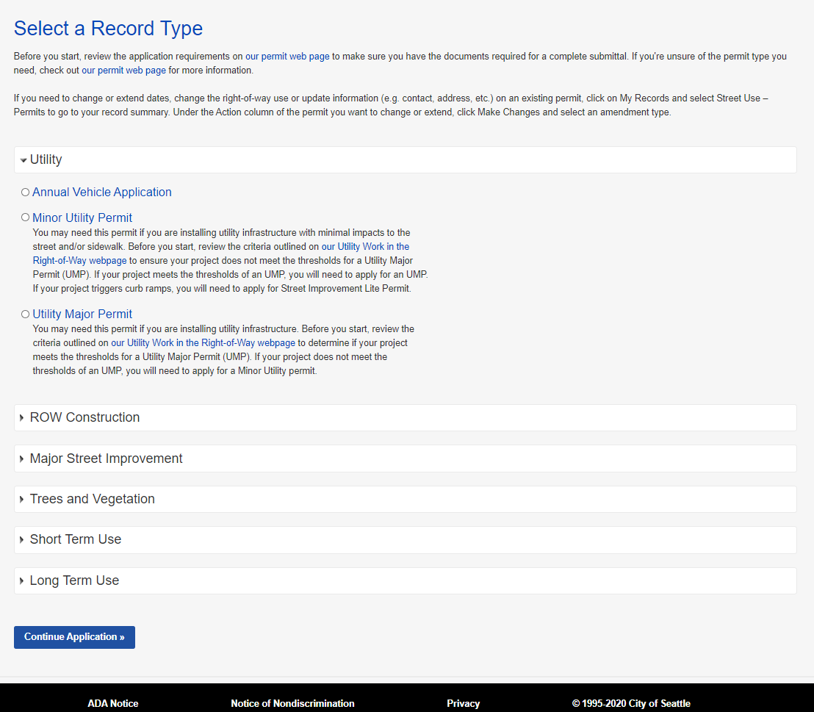
How to create a new application
a
Create a new Street Use permit application
  Determine the appropriate permit type:
    Go to our permit website and click on the permit webpage button
    Click on any permit section to expand the help text
  Once the right permit type is determined, click on the circle next to that permit type and click on the Continue Application button
b
3
Notes:
On the Select a Record Type page, record (application) types are grouped together to make them easier to find; e.g., Minor Utility Permit and Utility Major Permit are under the Utility group. Expand a group to view the record types available in that category
A record may be viewable in more than one category, when appropriate, e.g. Annual Vehicle and Construction and Storage Containers
Each Record Type also has helper text to explain what type of work that application/permit type covers (true for Annual Vehicle too)
For this example we are selecting 1. ROW Construction 2. Applicant selects the record type they want to create; e.g., ROW Construction Permit, and then 3. Clicks Continue Application to progress to the next page of the application process.
Moving on, we will walk you through how to find existing permits.

Slide 36
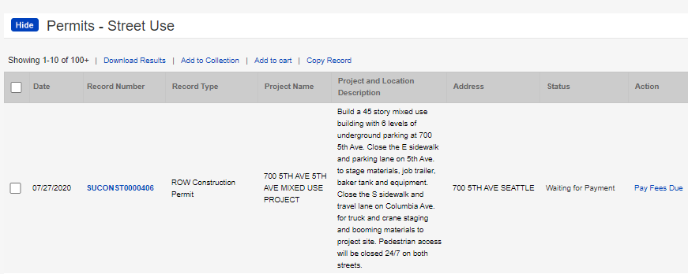
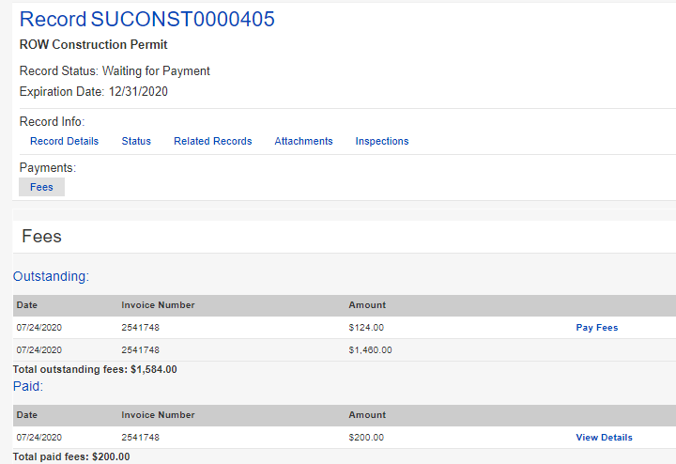
How to pay fees
1
How to pay fees that are due before issuance
  From your My Records:
    The status will show as Waiting for Payment
    Click the Pay Fees Due link
  From the permit:
    Click on the Fees tab
    Click the Pay Fees link
a
b
2
a
b
Notes:
Once an application has been reviewed and approved, the customer receives an email letting them know the permit is ready to issue and waiting for payment. Fees can be paid online. Online payment only allows full payment and only credit cards.
Remember, for billed customers, the permit is issued without payment.
If it’s a free permit, the customer receives an email stating that the permit has been issued and is ready for printing.
Now let’s look at the Fees tab on the record.

Slide 37
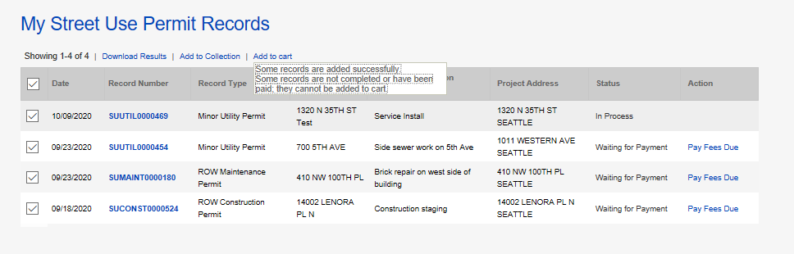

How to pay fees - Invoiced fees after issuance
ii
How to pay fees after issuance
  From your My Records list:
    The status will show as Waiting for Payment
    You can select records to pay by either:
      Clicking the Pay Fees Due link under Action of one permit; OR
      Checking the boxes of multiple permits and clicking Add to Cart
i
a
  Tip: For option b-ii, if there are records that are not ready for payment, they will not be added to the cart.
Notes:
Once an application has been reviewed and approved, the customer receives an email letting them know the permit is ready to issue and waiting for payment. Fees can be paid online. Online payment only allows full payment and only credit cards.
Remember, for billed customers, the permit is issued without payment.
If it’s a free permit, the customer receives an email stating that the permit has been issued and is ready for printing.
Now let’s look at the Fees tab on the record.

Slide 38
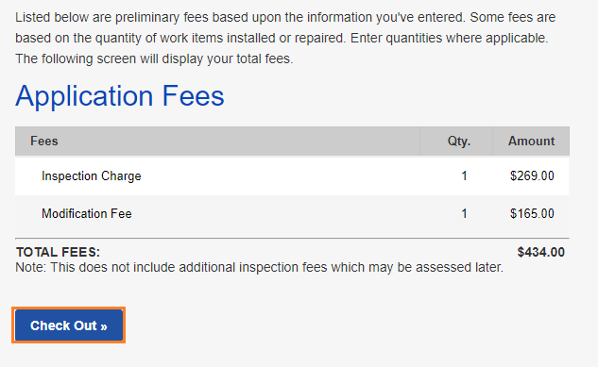
How to pay fees
How to pay fees
  This will take you to the fees due for that application
  To pay for these fees, click on the Check Out button
  Tip: Partial payments are not allowed.
4
Notes:
Once an application has been reviewed and approved, the customer receives an email letting them know the permit is ready to issue and waiting for payment. Fees can be paid online. Online payment only allows full payment and only credit cards.
Remember, for billed customers, the permit is issued without payment.
If it’s a free permit, the customer receives an email stating that the permit has been issued and is ready for printing.
Now let’s look at the Fees tab on the record.

Slide 39
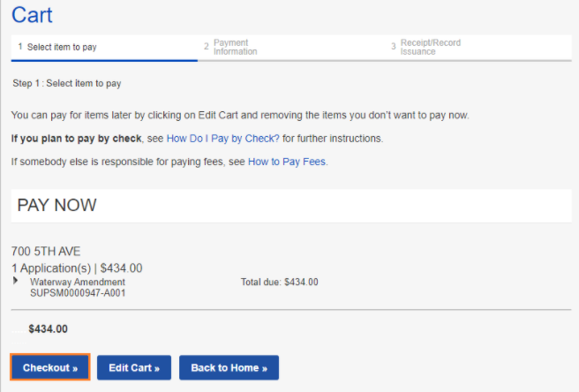
How to pay fees
How to pay fees
  This will take you to your Cart
  To pay all fees in your cart, click the Checkout button
  If you have fees in your cart for multiple permits, you can edit those fees by clicking the Edit Cart button
6
7
Notes:
Once an application has been reviewed and approved, the customer receives an email letting them know the permit is ready to issue and waiting for payment. Fees can be paid online. Online payment only allows full payment and only credit cards.
Remember, for billed customers, the permit is issued without payment.
If it’s a free permit, the customer receives an email stating that the permit has been issued and is ready for printing.
Now let’s look at the Fees tab on the record.

Slide 40
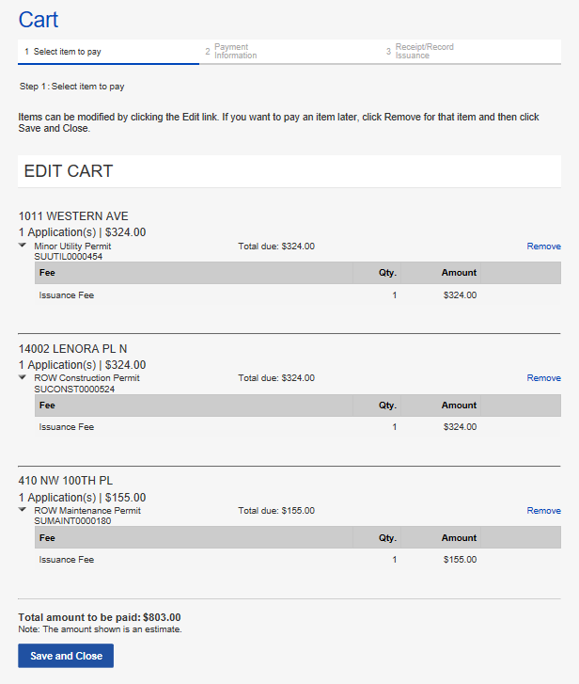
How to pay fees
How to edit your cart
  To remove a fee from you cart, click the Remove link
  Click the Save and Close button to complete payment
1
2
Notes:
Once an application has been reviewed and approved, the customer receives an email letting them know the permit is ready to issue and waiting for payment. Fees can be paid online. Online payment only allows full payment and only credit cards.
Remember, for billed customers, the permit is issued without payment.
If it’s a free permit, the customer receives an email stating that the permit has been issued and is ready for printing.
Now let’s look at the Fees tab on the record.

Slide 41
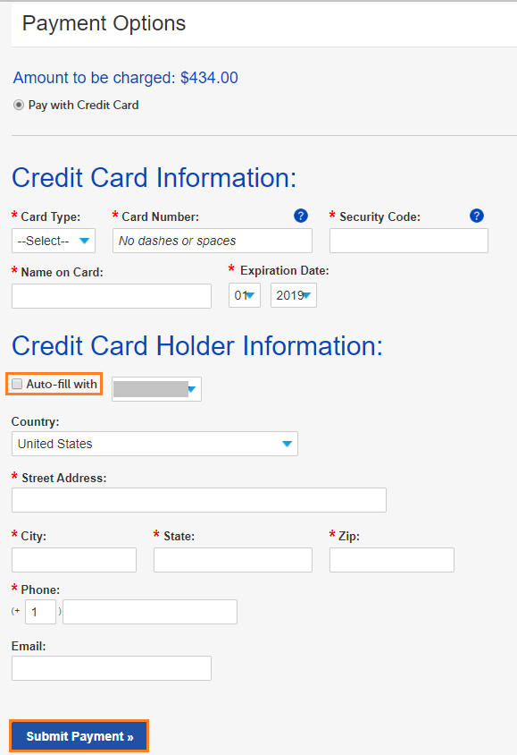
How to pay fees
How to pay fees
  Enter credit card information
  If the credit card billing information is the same as the address on the Portal account, check the box next to Auto-fill with
  If you don’t use the Auto-fill with option, enter all required information
  Click the Submit Payment button to make the payment
8
9
10
11
Notes:
Once an application has been reviewed and approved, the customer receives an email letting them know the permit is ready to issue and waiting for payment. Fees can be paid online. Online payment only allows full payment and only credit cards.
Remember, for billed customers, the permit is issued without payment.
If it’s a free permit, the customer receives an email stating that the permit has been issued and is ready for printing.
Now let’s look at the Fees tab on the record.

Slide 42
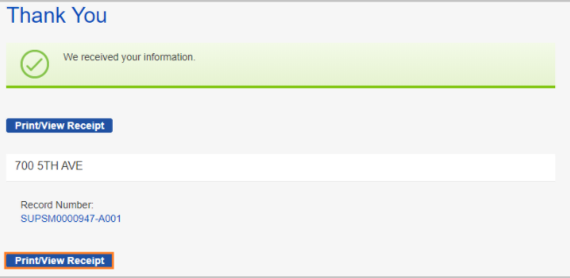
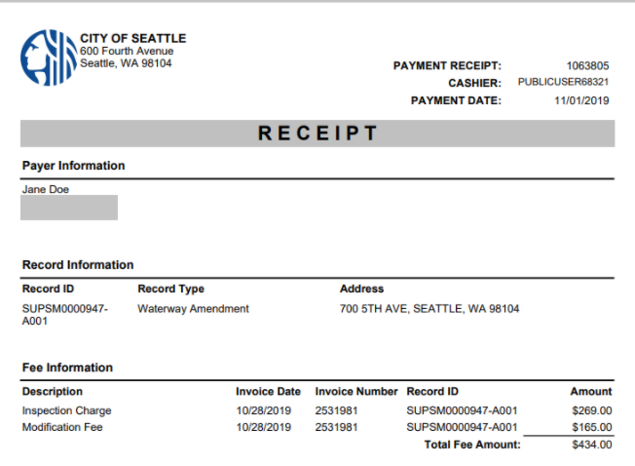
How to pay fees
12
How to pay fees
  This confirmation will show if the payment is successful
  To print and/or view your receipt, click the Print/View Receipt button
13
Notes:
Once an application has been reviewed and approved, the customer receives an email letting them know the permit is ready to issue and waiting for payment. Fees can be paid online. Online payment only allows full payment and only credit cards.
Remember, for billed customers, the permit is issued without payment.
If it’s a free permit, the customer receives an email stating that the permit has been issued and is ready for printing.
Now let’s look at the Fees tab on the record.

Slide 43
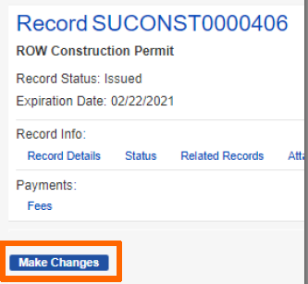
How to make a change to a permit
1
How to make a change to an issued permit
  If the permit is in the Issued stage, under Action, Click on the Make Changes link
  From the record page, click on the Make Changes button
2
Notes:
Once an application has been reviewed and approved, the customer receives an email letting them know the permit is ready to issue and waiting for payment. Fees can be paid online. Online payment only allows full payment and only credit cards.
Remember, for billed customers, the permit is issued without payment.
If it’s a free permit, the customer receives an email stating that the permit has been issued and is ready for printing.
Now let’s look at the Fees tab on the record.

Slide 44
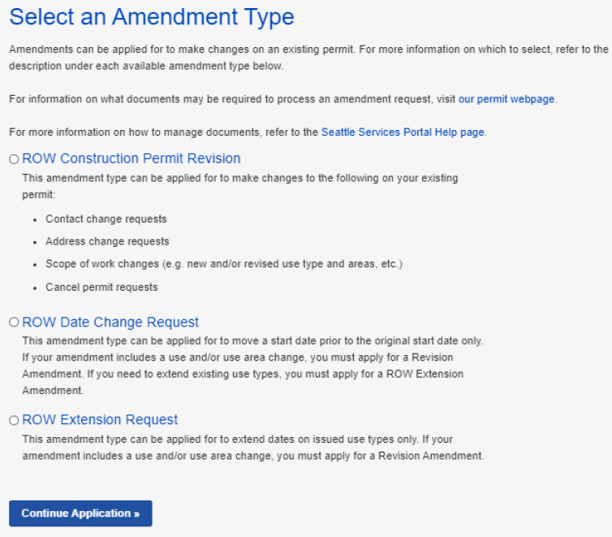
How to make a change to a permit
How to make a change to an issued permit
  Select the appropriate amendment (aka modification) type
  Click the Continue Application button to start the amendment application process
3
4
Notes:
Once an application has been reviewed and approved, the customer receives an email letting them know the permit is ready to issue and waiting for payment. Fees can be paid online. Online payment only allows full payment and only credit cards.
Remember, for billed customers, the permit is issued without payment.
If it’s a free permit, the customer receives an email stating that the permit has been issued and is ready for printing.
Now let’s look at the Fees tab on the record.

Slide 45
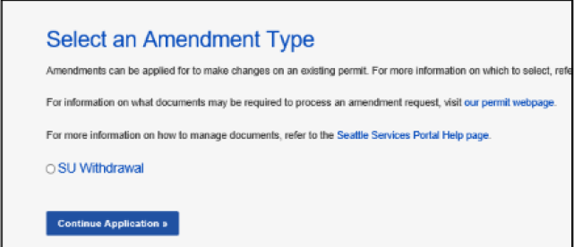
How to make a change to a permit
1
How to withdrawal an application
  If the permit is in the Initiated stage, under Action, Click on the Make Changes link
    Tip: This is only available between application submitted and when SU staff claims the application for processing.
  Select SU Withdrawal
  Click the Continue Application button to start request the withdrawal
2
3
Notes:
Once an application has been reviewed and approved, the customer receives an email letting them know the permit is ready to issue and waiting for payment. Fees can be paid online. Online payment only allows full payment and only credit cards.
Remember, for billed customers, the permit is issued without payment.
If it’s a free permit, the customer receives an email stating that the permit has been issued and is ready for printing.
Now let’s look at the Fees tab on the record.

Slide 46
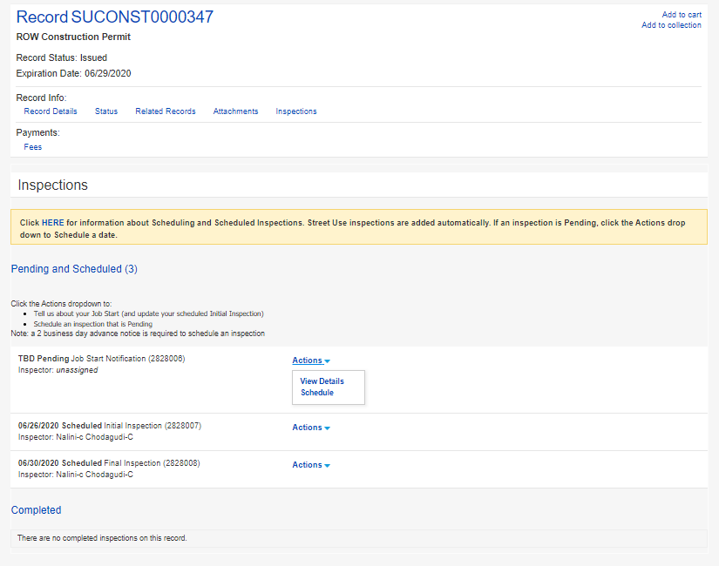
How to schedule an inspection
1
How to schedule an inspection
Click the Inspections tab
In the Inspections section on the permit select Actions and then Schedule
Tip: You do not have to be logged in to schedule an inspection.
2

Slide 47
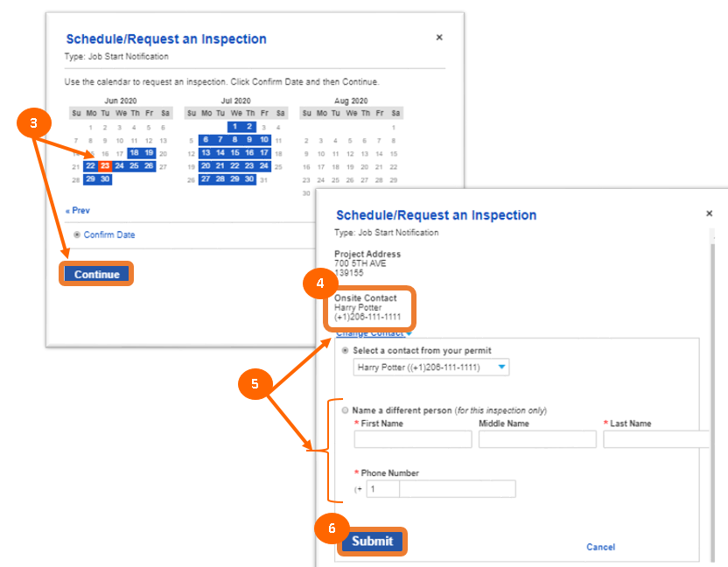
How to schedule an inspection
How to schedule an inspection
Select date on the calendar in the timeframe allotted based on the issued start date and duration and click the Continue button
The contact for the inspection will default to the Applicant
To change the contact, click Change Contact and fill out the required information
Click the Submit button

Slide 48
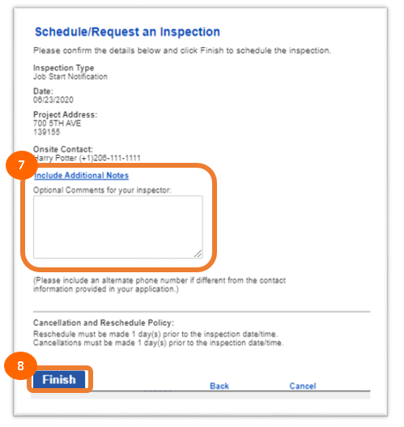
How to schedule an inspection
How to schedule an inspection
Add notes for the inspector (e.g. time of day, details of work etc.)
Click the Finish button

Slide 49
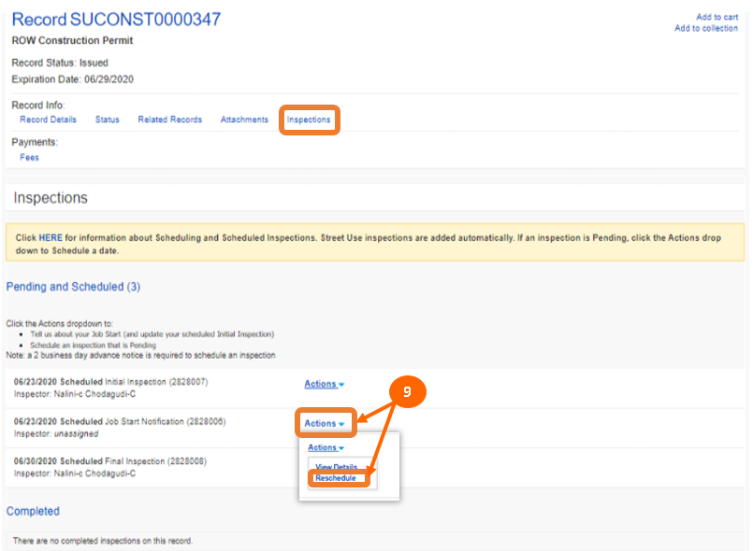
How to schedule an inspection
How to reschedule an inspection
On the Inspections tab on the permit, select Actions and then Reschedule
Follow the previous steps on how to schedule an inspection
Note: a 2-business day notice is required to schedule or reschedule an inspection.

Slide 50
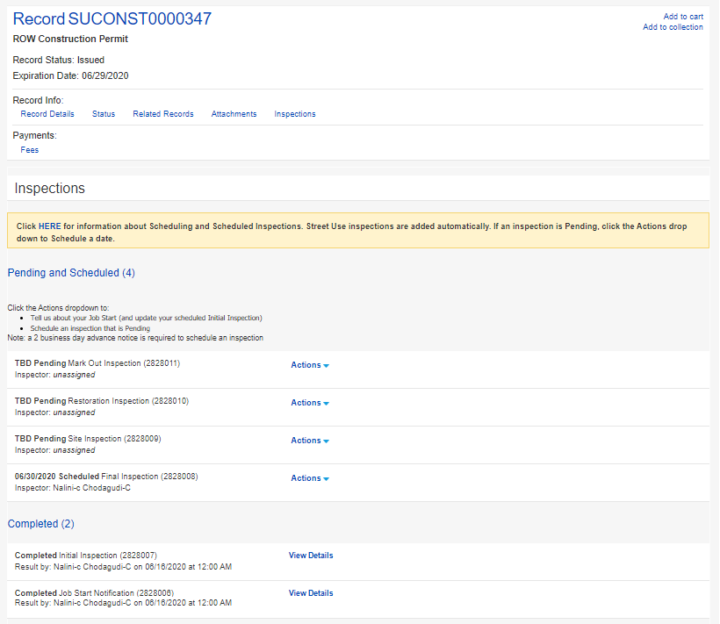
How to find the status of inspections
1
How to find the status of an inspection
On the permit, click the Inspections tab
Pending and scheduled inspections will show up in the Pending and Scheduled section
Waived and completed inspections will show up in the Completed section
2
3

Slide 51
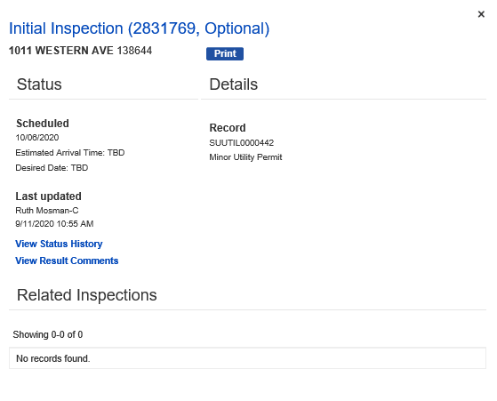
How to find the status of inspections
4
How to find the status of an inspection
To find details about an inspection, click on View Details
Further details can be viewed by clicking the View Status History or View Results Comments links
5

Slide 52
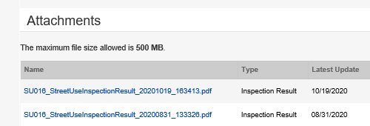
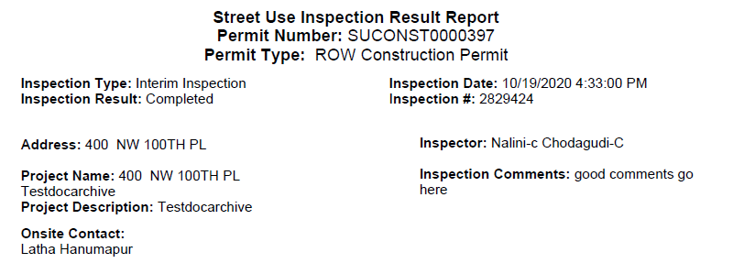
How to find the inspection result report
1
How to find the inspection result report
On the permit, click the Attachments tab
Click on the desired report hyperlink
The inspection result report will pop up for viewing
2
3

Slide 53
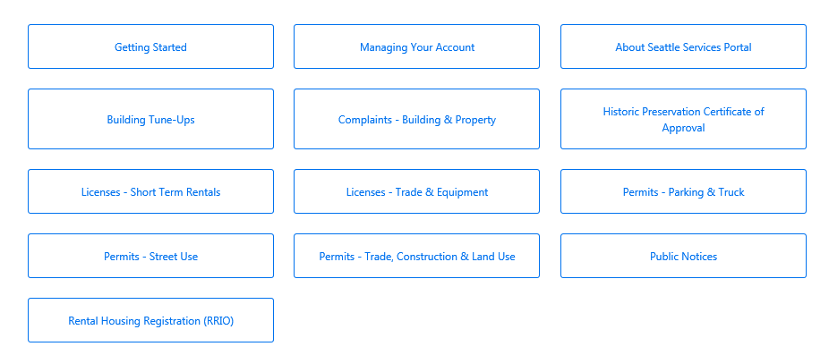
How to find help after launch
1
How to find help on the Portal
From the Seattle Services Portal home page, click on Help
Click on any of these pages:
    Getting Started
    Managing Your Account
    Permits - Street Use
2
Notes:
When a user needs help, they can access the Help Center articles by clicking on Help.
The banner is available throughout the portal, and Help can be accessed at any time simply by clicking on the Help button.

Slide 54
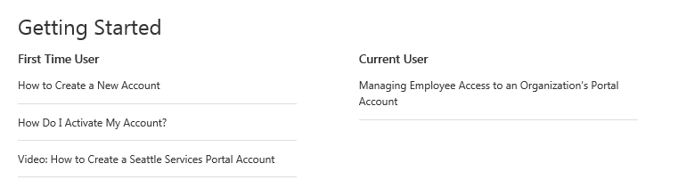
How to find help after launch
Under Getting Started, the following topics have Help articles and a bonus video
  How to create a new account
  How to activate an account
  How to manage employee access for an Organization’s Portal account
Notes:
When a user needs help, they can access the Help Center articles by clicking on Help.
The banner is available throughout the portal, and Help can be accessed at any time simply by clicking on the Help button.

Slide 55

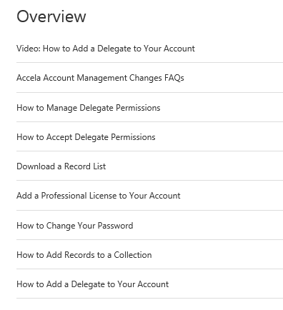
How to find help after launch
Under Managing Your Account, the following topics have Help articles and a bonus video
  Account management FAQ’s
  How to manage delegate permissions
  How to accept delegate permissions
  Download a record list
  Add a professional license to your account
  How to change your password
  How to add records to a collection
Notes:
When a user needs help, they can access the Help Center articles by clicking on Help.
The banner is available throughout the portal, and Help can be accessed at any time simply by clicking on the Help button.

Slide 56
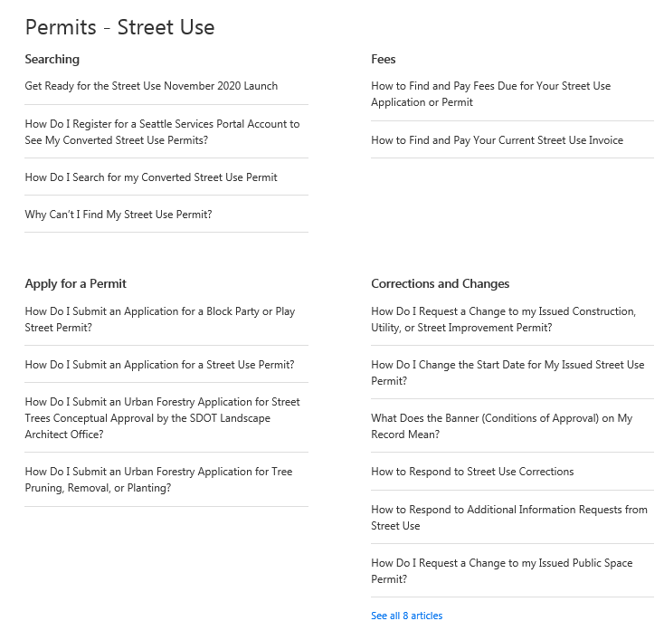
How to find help after launch
Under Permits – Street Use, the following topics have Help articles
  Searching
  How to pay fees
  How to apply for a permit
  How to respond to a Corrections cycle
  How to request a change to a permit (aka amendment)
  Record information
  Inspections
Notes:
When a user needs help, they can access the Help Center articles by clicking on Help.
The banner is available throughout the portal, and Help can be accessed at any time simply by clicking on the Help button.

Slide 57
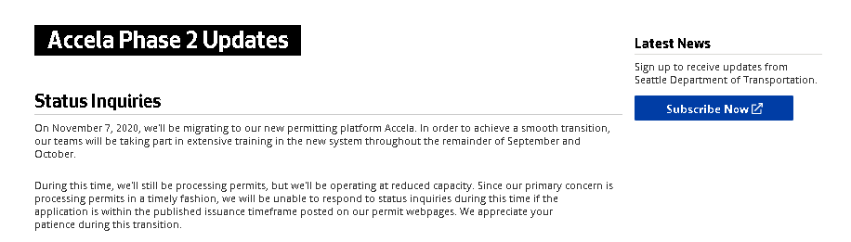
How to find help after launch
How to find help on our website
Go to our Accela Phase 2 Updates website (http://www.seattle.gov/transportation/permits-and-services/permits/updates) to find information on the following:
  Previously recorded external training workshops and materials
  Launch support information (e.g. Accela phone line and email)
  Changes to help support (e.g. IT support, new Portal help articles etc.)
Notes:
When a user needs help, they can access the Help Center articles by clicking on Help.
The banner is available throughout the portal, and Help can be accessed at any time simply by clicking on the Help button.

Slide 58
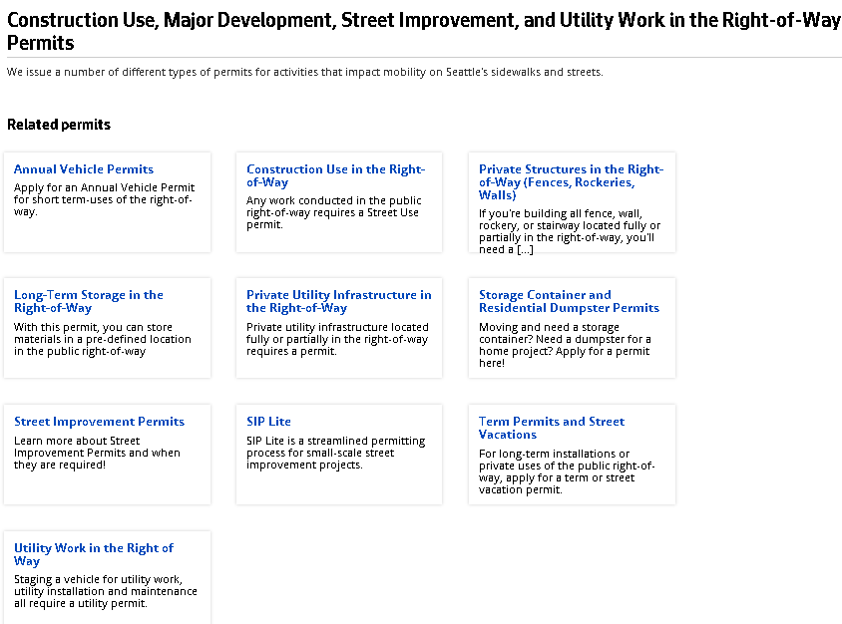
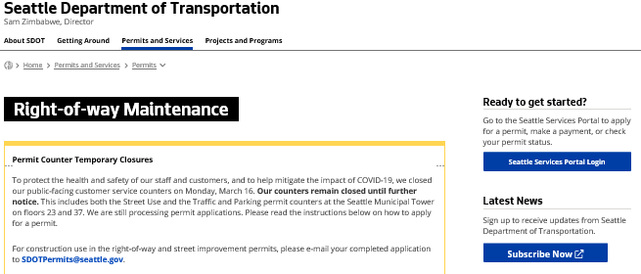
How to find help
after launch
How to find help on our website
Go to our updated permit type pages (http://www.seattle.gov/transportation/permits-and-services/permits) to find information on the following:
    Permit thresholds
    Required documents
    What information needs to be on a document
    Plan templates
    Client Assistant Memos
Access to the Portal can be found on the right panel of every webpage
Notes:
When a user needs help, they can access the Help Center articles by clicking on Help.
The banner is available throughout the portal, and Help can be accessed at any time simply by clicking on the Help button.

Slide 59

Questions?
Melody.Berry@seattle.gov
www.seattle.gov/transportation

