Slide 1

Construction Permits in the Seattle Services Portal
External Workshop
SDOT Street Use
Melody Berry, Judy Connors, Sean Bucy and William Bou
Notes:
Welcome to the SDOT Street Use Utility workshop

Slide 2
Our vision, mission, and core values
Vision: Seattle is a thriving equitable community powered by dependable transportation
Mission: to deliver a transportation system that provides safe and affordable access to places and opportunities
Committed to 6 core values:
Equity
Safety
Mobility
Sustainability
Livability
Excellence

Slide 3
Workshop overview
Accela launch overview
Launch schedule
How to respond to corrections and how to find documents
How to find the status of a permit
How to apply for a construction permit
ROW Maintenance permit overview and document requirements
ROW Construction permit overview and document requirements
Heavy Crane and ROW Construction process steps
Upcoming events
Application steps from the Portal
Stand alone curb cut permit process changes
Heavy Crane permit overview and document requirements
How to make changes to an issued permit
Inspections overview and how to schedule an inspection
How to get help after launch
ROW Maintenance process steps
Pre-review meetings overview (old ROWM DG meetings)

Slide 4
Permitting system replacement goals
Improve transparency and predictability
Automate functionality to gain efficiencies
Integrate permit processes with SDCI and other departments

Slide 5
Accela launch overview
SDOT’s last implementation into Accela will be the weekend of November 7th, 2020
Traffic, Public Space Management, and Annual Vehicle permits are already in Accela
Come November, the remainder of Street Use permits will be in Accela

Slide 6
Permit types - what’s coming in November
ROWM Permits
ROW Construction (today’s Construction Use)
ROW Maintenance (new)
Heavy Crane (new)
Minor Utility
Major Permits
Utility Major
Street Improvement
Final Plat

Slide 7
Launch Schedule

Slide 8
Upcoming events
Date, Time | Topic
Sept 14th, 1-2pm | Inspection and Notifications Types Overview
Oct 19th, 3-4pm | Seattle Services Portal (SSP) Overview
Oct 26th, 2-3:30pm | Utility Permit Overview
Oct 28th, 3-4:30pm | Construction Permit Overview
Oct 30th, 11:30am-12:30pm | Street Improvement Permit Overview
Nov 3rd, 11am-12pm | Amendment Types Overview
Week of Nov 9th and 16th | General Q&A’s Sessions
One workshop per topic
Each workshop will be held virtually using Webex Events and recorded
Q&A sessions will be a 1-hour live event once or twice a week using Webex Events
Stay informed with our monthly newsletter and Accela 2 Updates website

Slide 9
ROW Maintenance Permit and Use Types
Hansen Use Code | Accela Use Type
29C/31B | Dumpster/Storage Container
27/31/44 | Building Maintenance
55 | Sidewalk/Driveway Maintenance < 100 Sf
ROW Maintenance permit :
Used to permit short-term uses of the right-of-way including small sidewalk repairs, building maintenance, residential dumpsters and storage containers
No use fees associated with these uses
Uses the simple workflow
Only the Withdrawal, Date Change and Extension amendments available
Record ID: SUMAINT0000001
Document Type | Required When | Notes
Right of Way Impact Plan | At Application | Right-of-way closures with details per CAM 2116
Letter of Authorization | At Application | Required if Applicant or FRP contact is different from the Owner contact
Note: If the use is needed for longer than 90 days or requires a Traffic Control Plan, you will need to apply for a ROW Construction permit.
Notes:
Most of the uses are the same as what you had in Hansen, but some have been combined or split out.
A change for Accela, use types are available on more than one record. For example: Sidewalk / driveway maintenance < 100 can also be done on the maintenance record
Big shifts:
Combined 31 and 44 – staging of things with and without wheels
44 Crane > 100 Ton on the construction record is only for operation after installation, the installation requires a heavy crane permit
Combined 50 and 50A – can take care differences through the mobility impacts settings
Exploratory excavation added to construction so customers don't always have to get a separate (utility) permit for that - it is also under utility
Miscellaneous is used for work in unimproved ROW, or when something new comes up that is not covered under an existing use type
Note: Sq ft = 100 is included in the > 100 sq ft use
[MA] Applicants (external customers) will not see the Accela Use Code value in the Seattle Services Portal, they will only see/know the Use Type name.

Slide 10
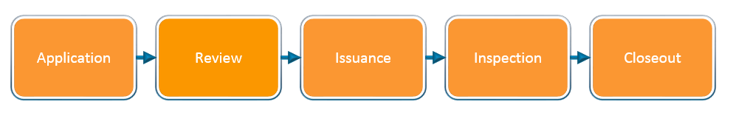
ROW Maintenance simple permit process steps

Slide 11
Heavy Crane and Use Type Overview
Hansen Use Code | Accela Use Type
44 | Crane > 100 Ton
Heavy Crane permit :
Used to permit the installation and removal of cranes >100 tons
Requires valid insurance per Heavy Crane Insurance Requirements
Uses the full workflow
Only the Withdrawal, Date Change and Extension amendments available
Record ID: SUCRANE0000001
Notes: The staging and operation of already installed heavy cranes (>100 tons) are permitted under a ROW Construction permit.
If the work is in a Hub, any date change or extension amendment request requires a Hub review.
Notes:
Most of the uses are the same as what you had in Hansen, but some have been combined or split out.
A change for Accela, use types are available on more than one record. For example: Sidewalk / driveway maintenance < 100 can also be done on the maintenance record
Big shifts:
Combined 31 and 44 – staging of things with and without wheels
44 Crane > 100 Ton on the construction record is only for operation after installation, the installation requires a heavy crane permit
Combined 50 and 50A – can take care differences through the mobility impacts settings
Exploratory excavation added to construction so customers don't always have to get a separate (utility) permit for that - it is also under utility
Miscellaneous is used for work in unimproved ROW, or when something new comes up that is not covered under an existing use type
Note: Sq ft = 100 is included in the > 100 sq ft use
[MA] Applicants (external customers) will not see the Accela Use Code value in the Seattle Services Portal, they will only see/know the Use Type name.

Slide 12
Heavy Crane Document Requirements
Document Type | Document Description | When it’s Required Along the Permit Path
Right of Way Impact Plan | Row-of-way closures with details per CAM 2116 | Application – cannot submit without uploading this document
Certificate of Insurance | Insurance requirements per CAM 2102 with limits of liability minimums of $5M for heavy load mobile cranes and $10M for tower and self-erecting cranes | Application – cannot submit without uploading this document
Letter of Authorization | Required if Applicant or FRP contact is different from the Owner contact | Application – cannot submit without uploading this document
Traffic Control Plan | Temporary traffic control plan per CAM 2111 and the City of Seattle Traffic Control Manual for In-Street Work | Either at Application if the street category is manually set to Arterial or at Screening when the reviewer verifies work is on an arterial or any street in a Hub
Temporary No Parking Confirmation (Paid Parking Permit) | If paid parking is impacted by the project, some sort of proof that a parking permit has been submitted | Review Evaluation
Other documents | Based on project location and impact: Historic District CoA, Holiday Moratorium Waiver per CAM 2107, Pavement Moratorium etc. | Review Evaluation
Corrections Response | Street Use Comments Sheet with responses | Screening – cannot submit Corrections Submitted if this is required
Notes:
TNP Confirmation can be one of the following:
A copy of the Application Received email
A screen image of the application record details page
A copy of the permit
A copy of a signed billing agreement
A copy of an email from Traffic staff indicating no reservation needed

Slide 13
ROW Construction Permit and Use Types Overview
Hansen Use Code | Accela Use Type
25 | New/Replace Asphalt Driveway
26/26A | New/Replace Concrete Driveway
29B | Overhead Weather Protection
29B | Sign/Banner
31/44 | Row Construction Staging
31D | Inaccessible Row Construction Staging
34/35 | Clear And Grub/Grading
38/40/51M | Pavement Restoration
41 | Transit Facility
44 | Crane > 100 Ton Operation
44 | Boom/Lift/Crane < 100 Ton
47 | Curb Crossing
50/50A | Scaffolding/Covered Ped Walkway
44/51I | Environmental Remediation
51I | Exploratory Excavation
52C/AVP | Seasonal Lighting
54/54A | Miscellaneous
54A | Private Drainage Facility
54C | Barricades
55 | Sidewalk/Driveway Maintenance < 100 Sf
55A | Sidewalk/Driveway Maintenance > 100 Sf
ROW Construction permit :
Used to permit the use of the right-of-way for construction purposes
Can also be used to permit the repair or improvement of the street scape if it does not meet the thresholds of a SIP (≥2,000 sq. ft.)
Uses the full workflow
All amendments available after issuance
Record ID: SUCONST0000001

Slide 14
ROW Construction Document Requirements
Document Type | Document Description | When it’s Required Along the Permit Path
Right of Way Impact Plan | Row-of-way closures with details per CAM 2116 | Application – cannot submit without uploading this document
Site Plan | Installation details per CAM 2116, only required for some uses (e.g. scaffolding and transit facilities) | Application – cannot submit without uploading this document if it’s required for that use type
Letter of Authorization | Required if Applicant or FRP contact is different from the Owner contact | Application – cannot submit without uploading this document
Traffic Control Plan | Temporary traffic control plan per CAM 2111 and the City of Seattle Traffic Control Manual for In-Street Work | Either at Application if the street category is manually set to Arterial or at Screening when the reviewer verifies work is on an arterial or any street in a Hub
Technical Plan | Additional plan or information based on the use and impact (e.g. structural calculations or geotechnical report) per CAM 2116 | Screening
Temporary No Parking Confirmation (Paid Parking Permit) | If paid parking is impacted by the project, some sort of proof that a parking permit has been submitted | Review Evaluation
Other documents | Based on project location and impact: Historic District CoA, Holiday Moratorium Waiver per CAM 2107, Pavement Moratorium etc. | Review Evaluation
Corrections Response | Street Use Comments Sheet with responses | Screening – cannot submit Corrections Submitted if this is required
Notes:
TNP Confirmation can be one of the following:
A copy of the Application Received email
A screen image of the application record details page
A copy of the permit
A copy of a signed billing agreement
A copy of an email from Traffic staff indicating no reservation needed

Slide 15
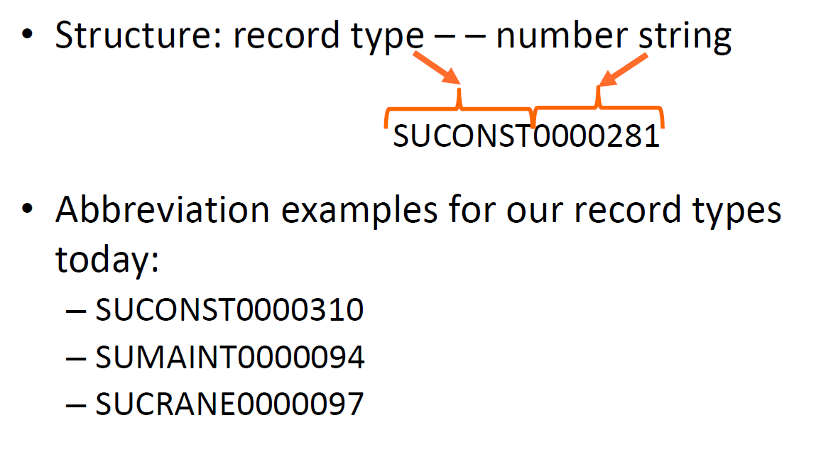
Construction Accela permit numbers decoded

Slide 16
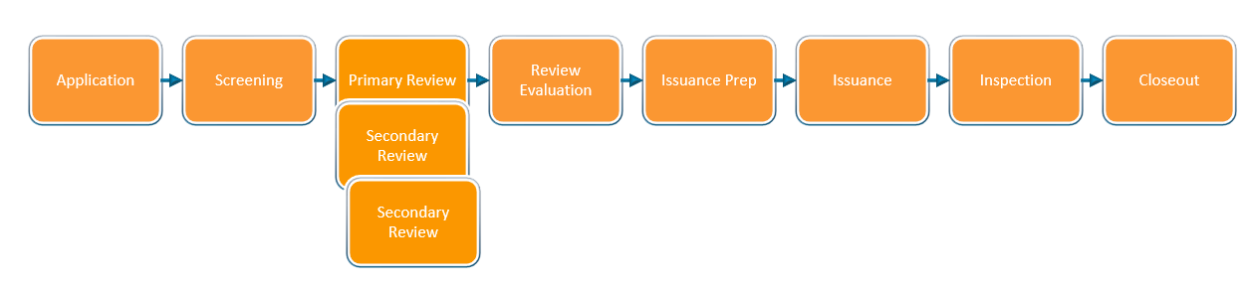
Heavy Crane and ROW Construction permit process steps
Review Process

Slide 17
Application steps from the Portal
Select Permit Type
Enter
Project Address
Add Contacts
Enter Project & Location Description
Enter Related Information
Add Use Details
Upload Required Docs
Review Application Information
Submit & Thank You

Slide 18
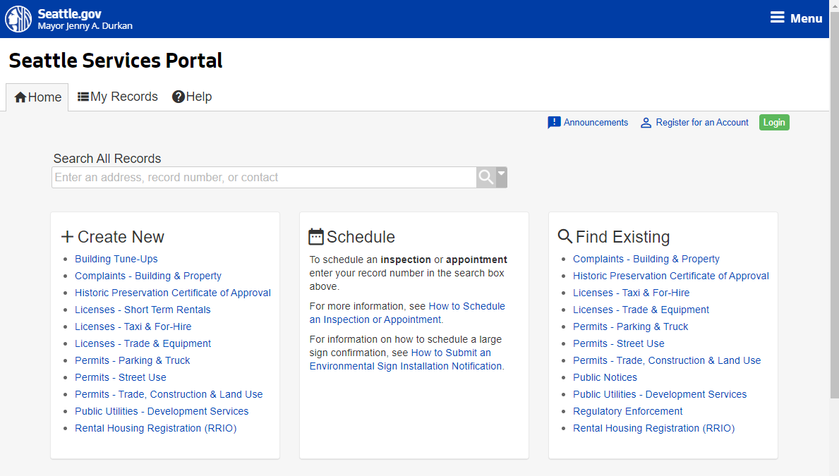
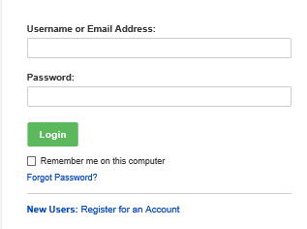
How to apply for a construction permit
How to apply for a construction permit
Go to the Seattle Services Portal
Click on the Login button
Enter your username and password and click on the Login button
Note: If you don’t have an account, see our Seattle Services Portal Overview recording and PowerPoint presentation.
2
3

Slide 19


To login or not to login
What you can do if you login if you are a permit contact or delegate:
  Apply for applications
  Withdraw an application
  View and upload documents
  Respond to Corrections
  Make changes to an issued permit
  Assign delegates
What you can do if you are not logged in and not a permit contact or delegate:
  Search for permits
  View permit information except documents
  Make payments
  Schedule an inspection

Slide 20
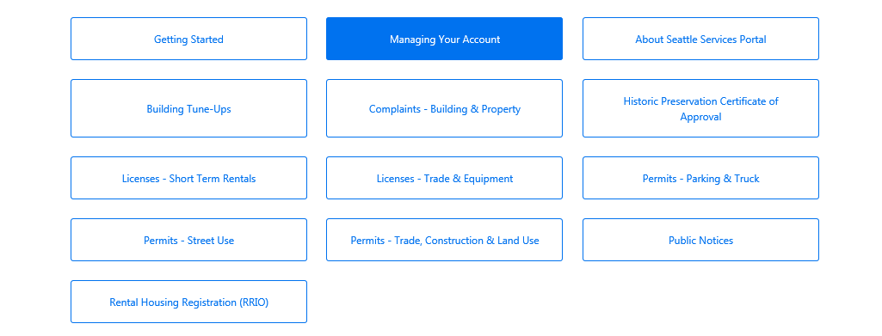
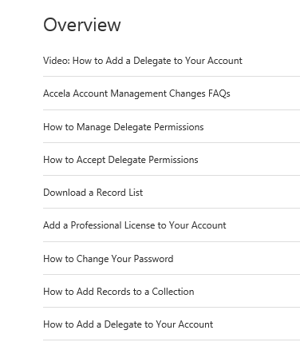

How to add and manage contact delegates
3
For more information about delegates:
Go to the Seattle Services Portal
Click on the Help link
Click on Managing Your Account
Read and/or view the highlighted articles and video on delegates
4

Slide 21
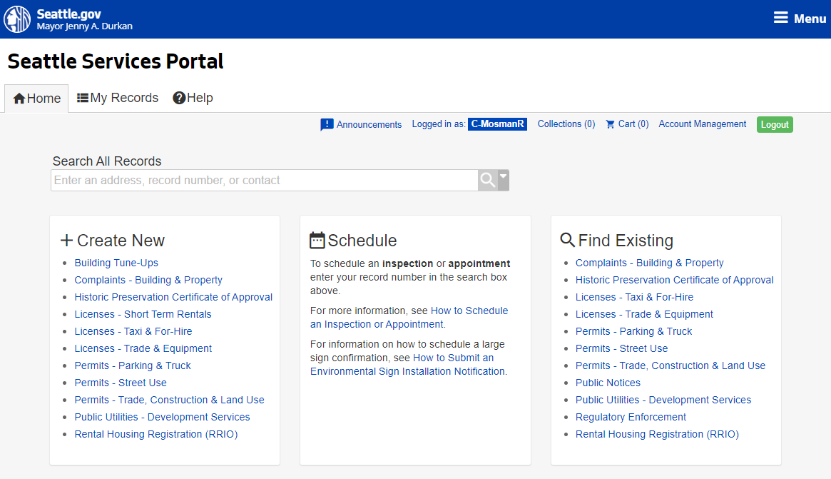
How to apply for a construction permit
How to apply for a construction permit
  Under the Create New section, click on the Permits – Street Use link
4

Slide 22
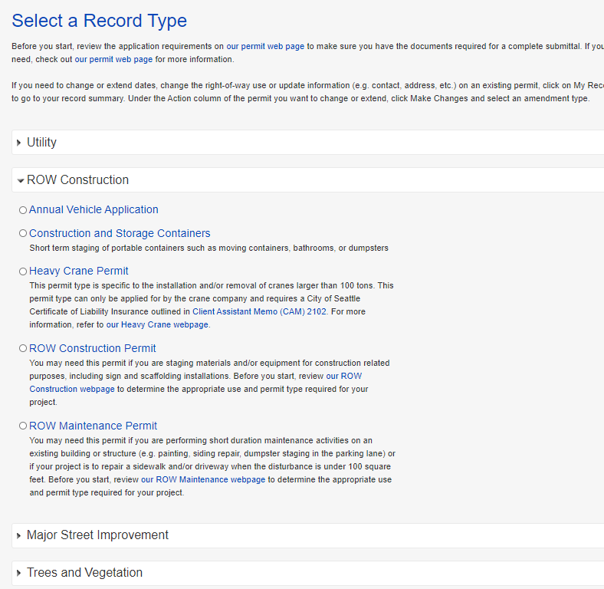

How to apply for a construction permit
5
How to apply for a construction permit
  Expand the ROW Construction section
  Determine the appropriate permit type:
    Click on the associated webpage links to determine the appropriate permit type
  One the permit type is determined, click on the circle next to that permit type and click on the Continue Application button
a
7

Slide 23
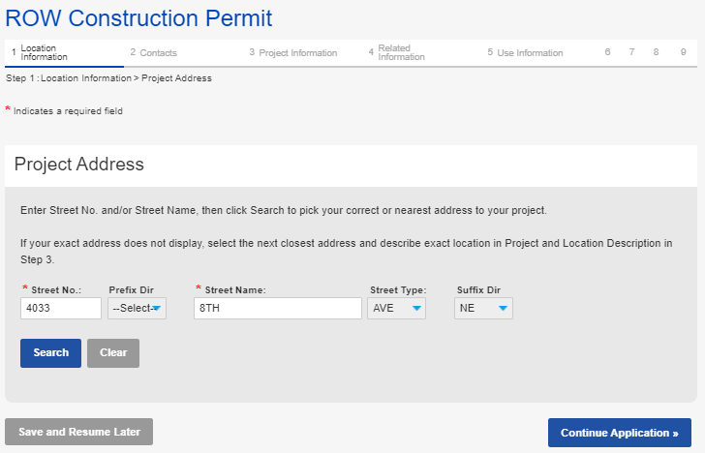
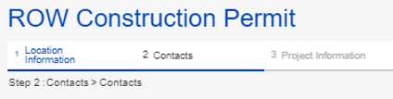
Application page overview
Application steps
Indicates what step you are on and what steps you have already completed
Required field
Moves you to the
next step
You can save at any step and resume later if needed

Slide 24
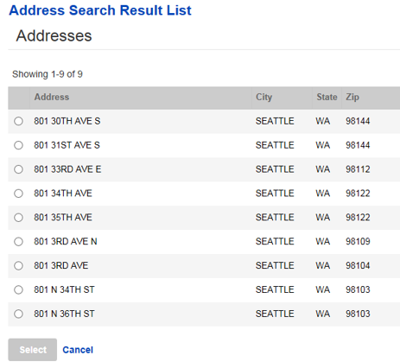


How to apply for a construction permit
How to apply for a construction permit
  To enter the Project Address:
    Enter information in the required fields and click the Search button
    If there is not an exact match: from the pop-up window, select the correct address and click the Select button
  Click on the Continue Application button
a
c
b
If the street name is a number, only enter the number
9

Slide 25
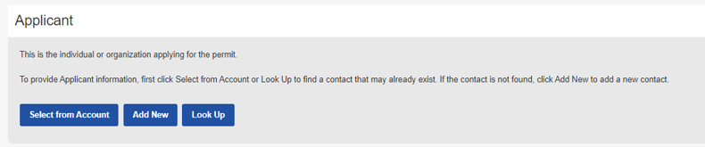
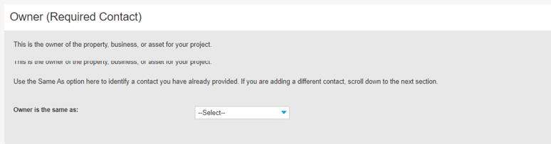
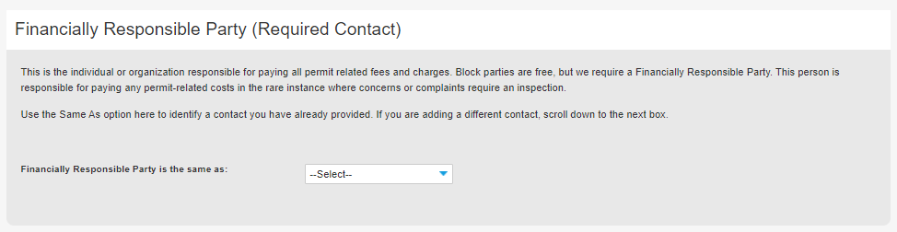
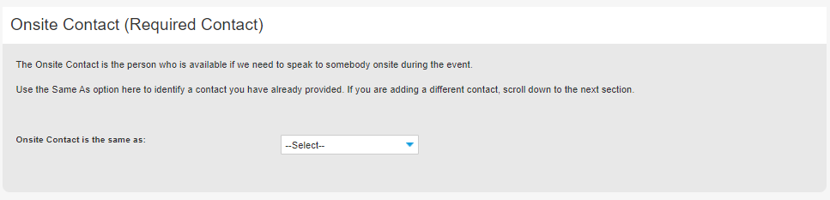
Contacts overview
Select from Account: Auto-populates the contact associated with the login account
Add New: You will need to create a new contact (do this cautiously)
Look Up: Search for an existing contact
On every Street Use permit, there are 4 required contacts:
  Applicant: The individual applying for the permit
  Owner: Property, business or asset/infrastructure owner (note: owner can be transferred to a different entity civilly)
  FRP: The organization responsible for paying all related fees and charges
  Onsite Contact: The individual who Street Use calls to respond to events (e.g. storm response)
After one contact is added, you can also use the Same As drop down menu to select a previously added contact

Slide 26
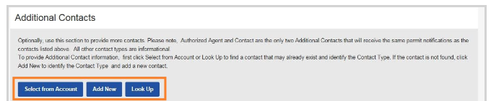
Contacts overview
You can also add the following additional contacts as needed:
  Arborist
  Architect
  Authorized Agent
  Contact
  Contractor
  Engineer
  Vending Operator
Select from Account: Auto-populates the contact associated with the login account
Add New: You will need to create a new contact (do this cautiously)
Look Up: Search for an existing contact
Authorized Agent and Contact receive all permit correspondence

Slide 27
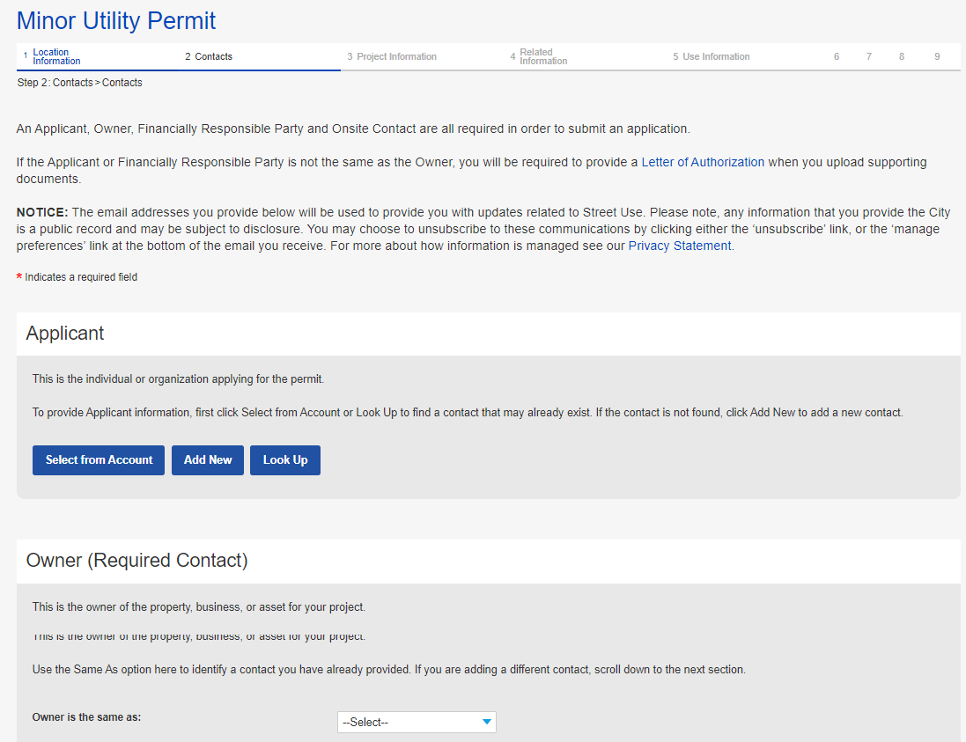
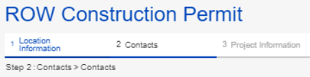
How to apply for a construction permit
How to apply for a construction permit
  Enter all required contacts:
    Applicant
    Owner
    Financially Responsible Party (FRP)
    Onsite
10
Notes:
Optionally, if there is an exact match, there will not be

Slide 28
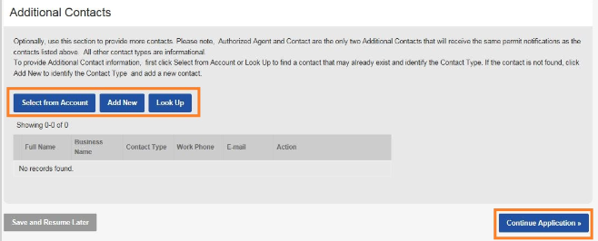
How to apply for a construction permit
How to apply for a construction permit
  Optionally, enter additional contacts
  Click on the Continue Application button
11
12
Notes:
Optionally, if there is an exact match, there will not be

Slide 29
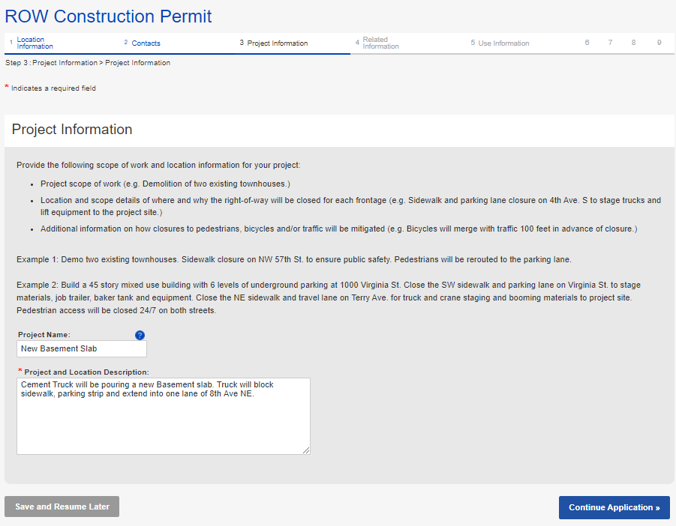
How to apply for a construction permit
The top section describes what we want in a project and location description with some examples
How to apply for a construction permit
  Enter Project Name and Project and Location Description
  Click on the Continue Application button
13
14
Notes:
Optionally, if there is an exact match, there will not be

Slide 30
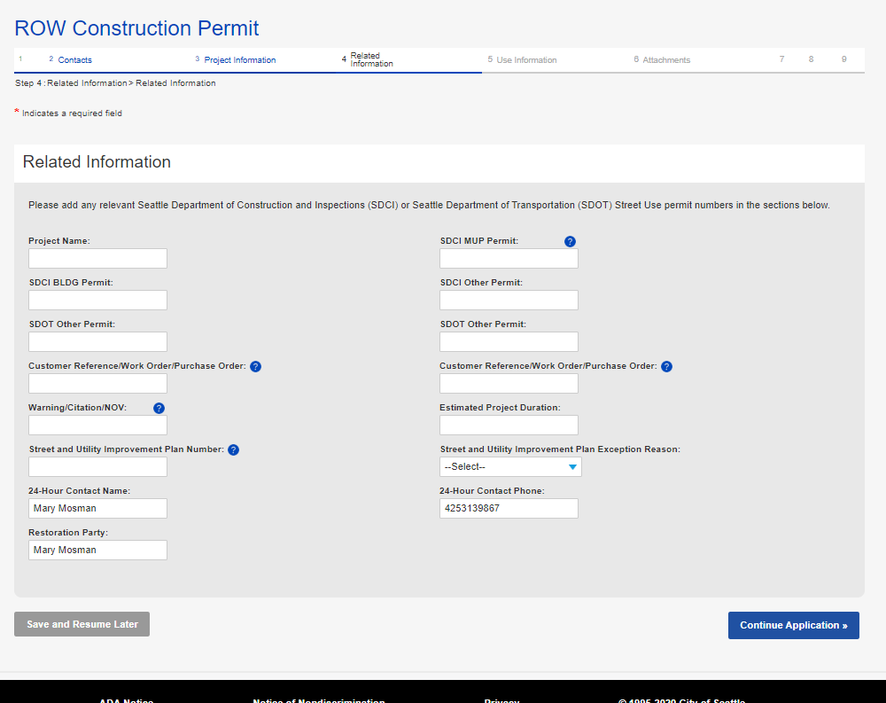
How to apply for a construction permit
How to apply for a construction permit
  Enter the following Related Information:
    Related permit numbers
    Related project information
    24-Hour contact information (defaults to Applicant)
    Restoration Party (defaults to Owner)
a
Prints on the invoice
b
c
d
Notes:
Optionally, if there is an exact match, there will not be

Slide 31
Use fee methodology changes
Use Fee Rate Changes Summary
Mobility/Safety Factors
Facility and Use | Current (2019) | Nov 9th, 2020 | Delta
Transit Blocked | $0.015 | $0.20 | +$0.185
Bike Blocked | $0.015 | $0.20 | +$0.185
Pedestrian Blocked | $0.015 | $0.20 | +$0.185
Pedestrian Impacted | $0.010 | $0.10 | +$0.090
Density Factors
Facility and Use | Current (2019) | Nov 9th, 2020 | Delta
Urban Center | $1.00 | $1.10 | +$0.10
Urban Village | $0.70 | $0.70 | -
Neither | $0.40 | $0.20 | -$0.20
Increased factors for blocked transit, bike, and pedestrian facilities
Increased factor for working in an Urban Center
Reduced fees for work outside urban zones and on non-arterial streets
31
Notes:
2005-2018 model
Fees charged in 10-day increments
Cost did not differentiate by location or impact to the traveling public
Methodology did not change over a long period of time to ensure cost recovery or evolving policy and modal priorities
2019 model
Pros:
Charged by day instead of 10-day increment
Targeted department priorities by adding additional factors to work in Urban Centers and Villages and to work that closed modal priority segments (transit, bike and sidewalk)
Cons:
Added level of complexity to estimation and data entry
Increased rates for projects on non-arterial streets outside Urban zones
Did not add enough impact to transit, bike and sidewalks to reduce duration and level of impact

Slide 32
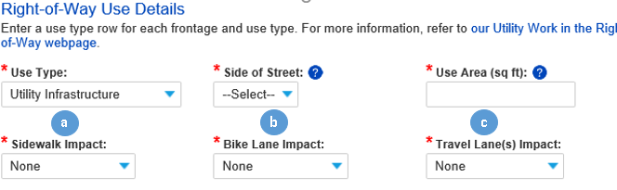
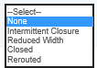
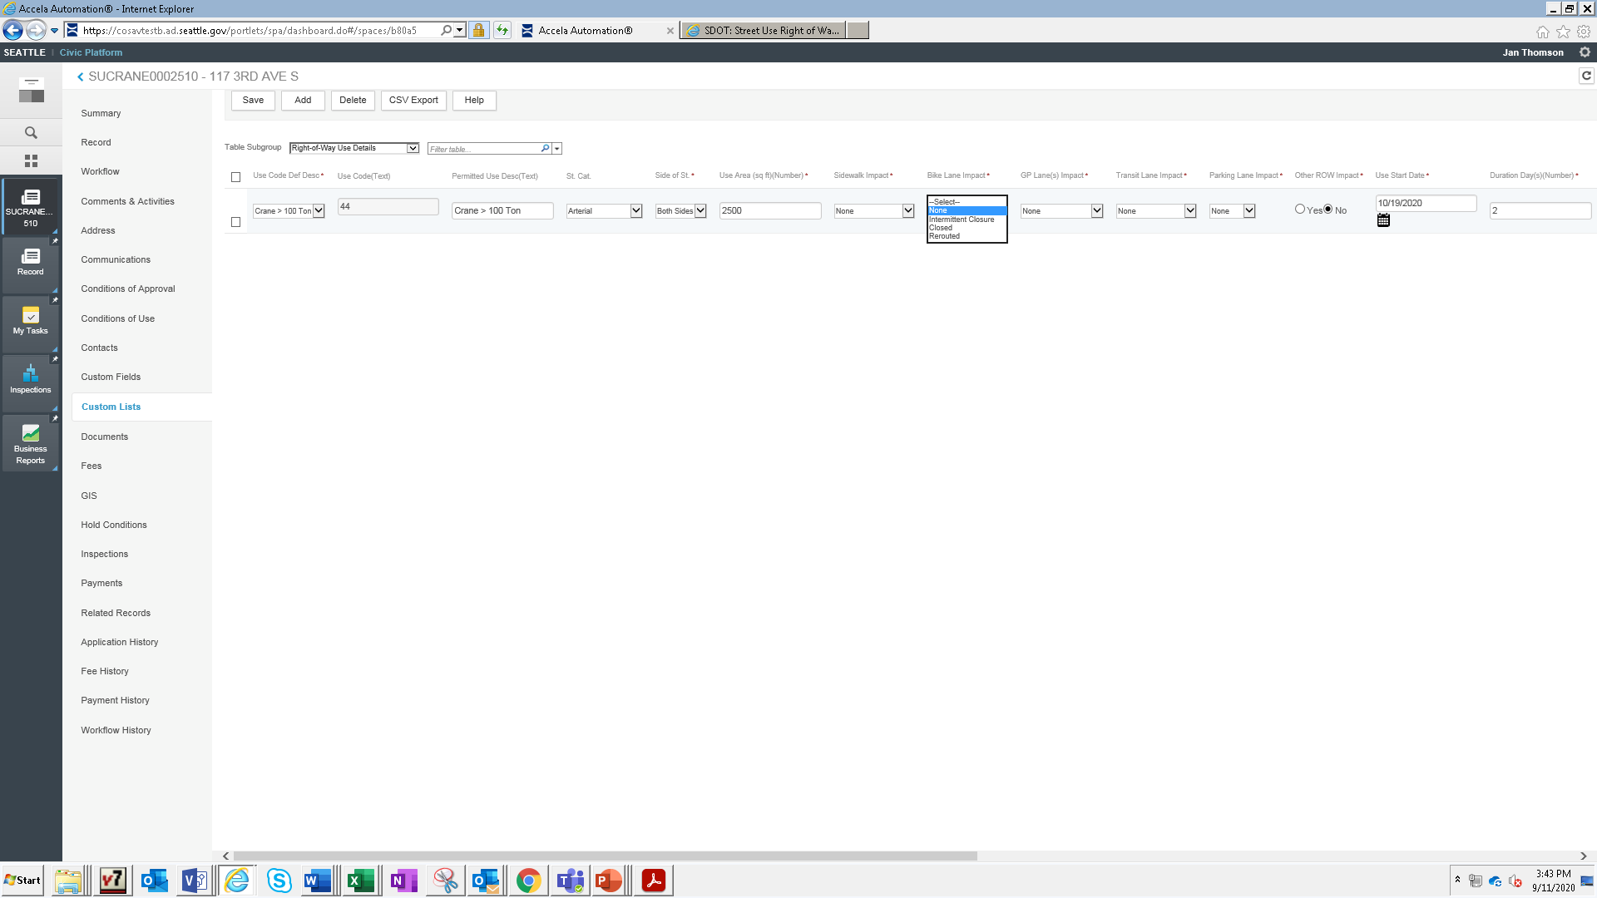


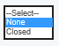
Use fee methodology changes
The calculation has been revised to allow the following impacts to be summed at the frontage level:
  Sidewalk Impact = Concrete sidewalk or asphalt pathway
  Bike Lane Impact = 24/7 dedicated bike lane
  Travel Lanes Impact = General purpose travel lanes
  Transit Lane Impact = 24 hour dedicated bus or other transit lanes
  Parking Lane Impact
  Other ROW = Gravel shoulder, planting strip etc.
Impact Option Definitions:
Intermittent closure = Short-term (less than 5 mins) closures 3 times or less an hour to stop the traveling public using a flagger or UPO
Reduced width = For s/w: partial sidewalk closure with at least a 4’ pedestrian pathway per ADA; For GP lane: reduced width travel lane while maintaining vehicular traffic
Rerouted = The traveling public has been routed to a different part of the street scape
Closed = Completely closed to the traveling public
Some Lanes Closed = 1 or more travel lanes closed
All Lanes Closed = All travel lanes closed; traffic must be rerouted
d
e
f
Notes:
For presentation only classes

Slide 33

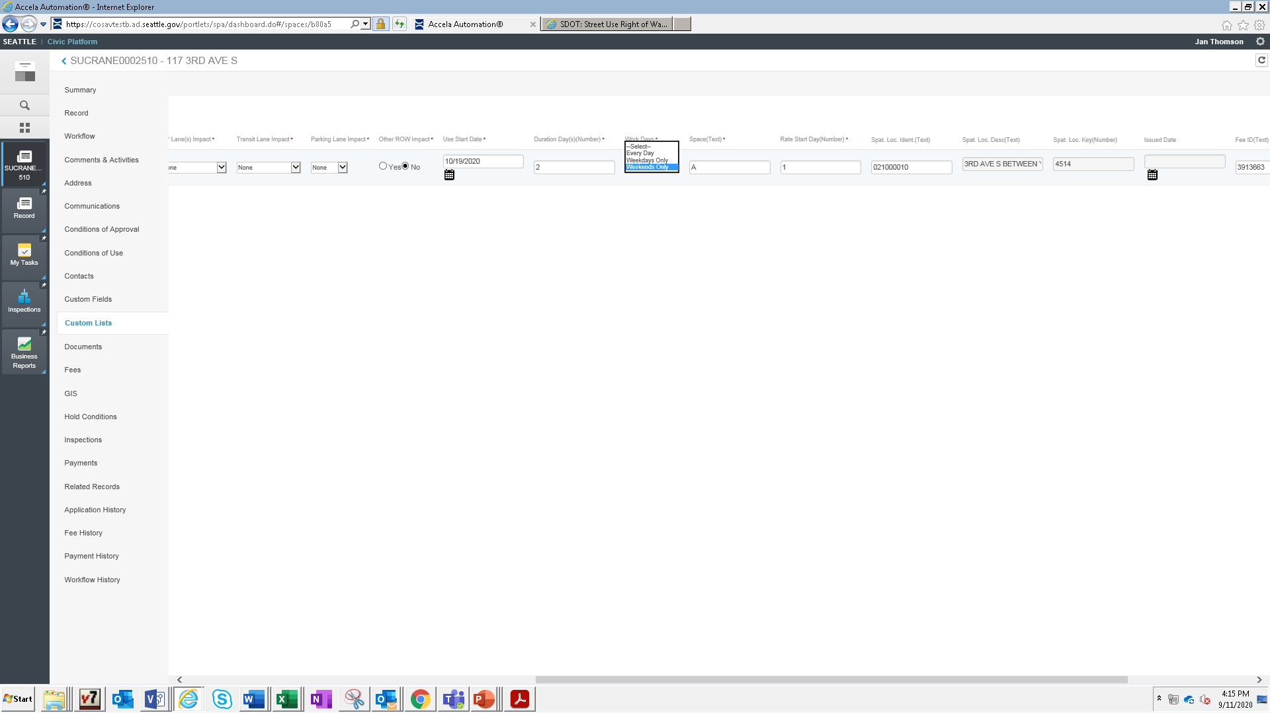
Use fee methodology changes
New section to select when work will be occurring to help manage long or intermittent durations:
  Work Days:
    Every Day = weekdays and weekends
    Weekdays Only = Monday - Friday
    Weekends Only = Saturday and Sunday
a
Notes:
For presentation only classes

Slide 34
Use fee methodology changes
Use Fee Rate Changes Summary
Mobility/Safety Factors
Facility and Use | Current (2019) | Nov 9th, 2020 | Delta
Transit Blocked | $0.015 | $0.20 | +$0.185
Bike Blocked | $0.015 | $0.20 | +$0.185
Pedestrian Blocked | $0.015 | $0.20 | +$0.185
Pedestrian Impacted | $0.010 | $0.10 | +$0.090
Density Factors
Facility and Use | Current (2019) | Nov 9th, 2020 | Delta
Urban Center | $1.00 | $1.10 | +$0.10
Urban Village | $0.70 | $0.70 | -
Neither | $0.40 | $0.20 | -$0.20
Some impact types (transit, bike and pedestrian) have a Mobility and Safety Factor added at the use level if that impact type is blocked or impacted:
  Blocked = Closed
  Impacted = Reduced Width
Although the new equation allows us to sum all closures at the frontage level, you will want to separate out impacts with factors from impacts without factors
1

Slide 35
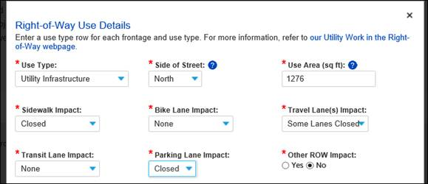
Use fee methodology changes
Example 1: Construction project on a non-arterial for 10 days
Since non-arterial streets do not incur use fees for the first 30 days, you can sum up all closures under one line

Slide 36
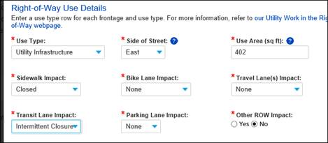
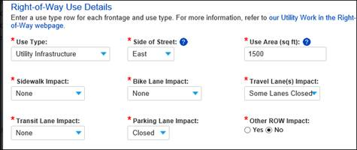
Use fee methodology changes
Example 2: Construction project on an arterial for 60 days
Since arterial streets incur use fees on day one, separate lines with:
  One line that has impacts with Mobility and Safety Factors (sidewalk, bike lane and transit lane)
  Tip: The combination of Sidewalk + Reduced Width has a lower factor, that combination should always be a separate use row.
  One line that has impacts with no Mobility and Safety Factors (GP lanes, parking lane and other ROW impact)
a
b

Slide 37
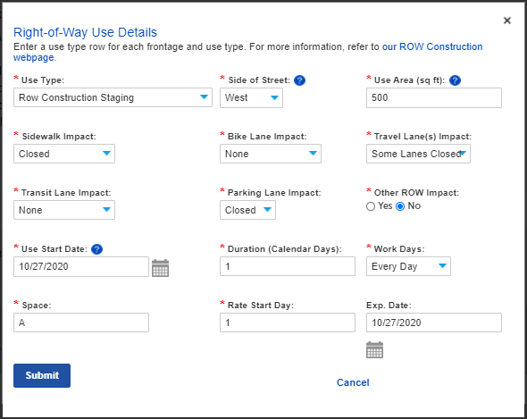
How to apply for a construction permit
How to apply for a construction permit
  Enter at least one-use type row:
    From the Use Type drop-down menu, select the appropriate use type
    Enter Side of Street
    Tip: For road closures, select Both Sides.
    Enter Use Area
    Note what mobility type is impacted
    Enter Use Start Date
    Enter Duration
    From the Work Days drop-down menu, indicate when work will occur
  Click on the Submit button
a
b
c
d
e
f
g
18
Notes:
Optionally, if there is an exact match, there will not be

Slide 38
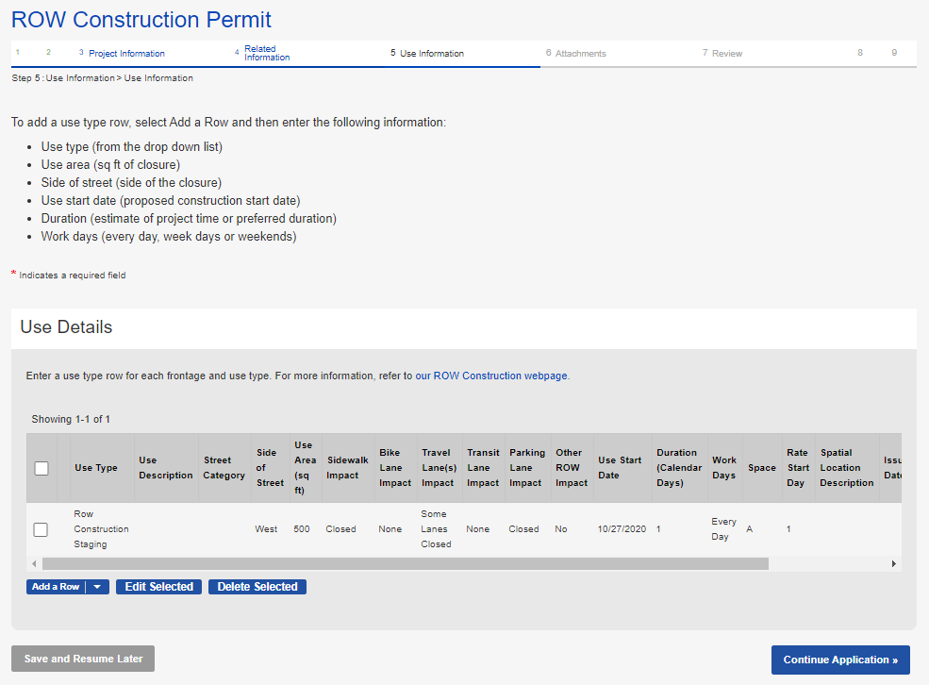
How to apply for a construction permit
How to apply for a construction permit
  To add another use type row, click the Add a Row button
  Once all use types rows are entered, click on the Continue Application button
19
20
Notes:
Optionally, if there is an exact match, there will not be

Slide 39
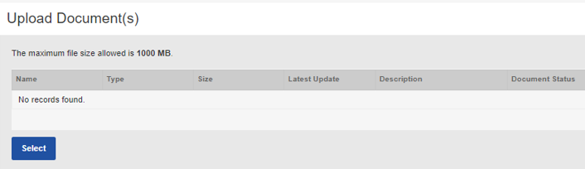
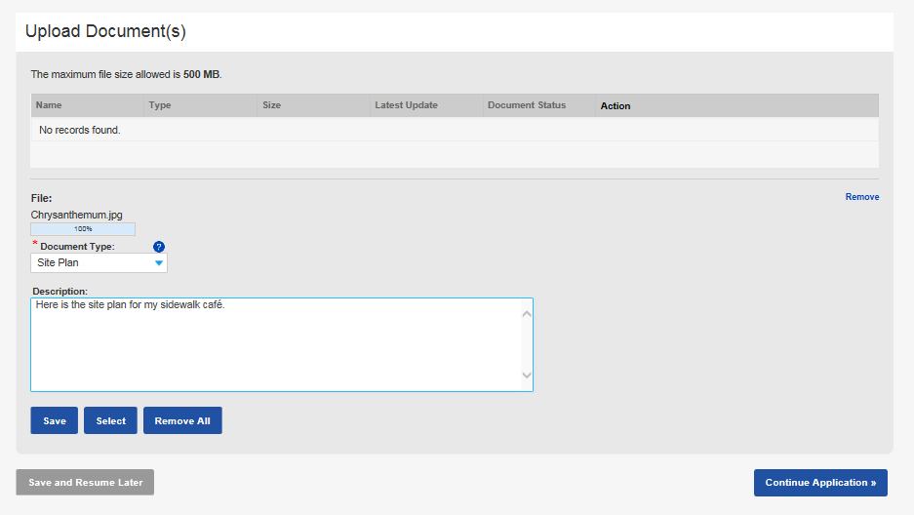
How to apply for a construction permit
How to apply for a construction permit
  Upload all required documents:
    Click the Select button
    Choose the desired document from your computer
    From the Document Type drop-down menu, select the type of document you are uploading
    Tip: For us to perform efficient plan review, only upload PDF documents.
    Add a description (optional)
    Click the Save button
    To upload another document, click the Select button
a
c
d
e
f
Notes:
Optionally, if there is an exact match, there will not be

Slide 40
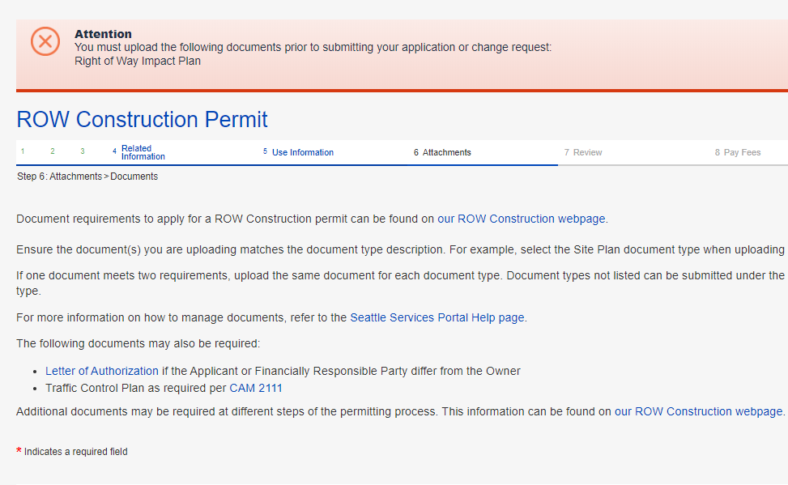
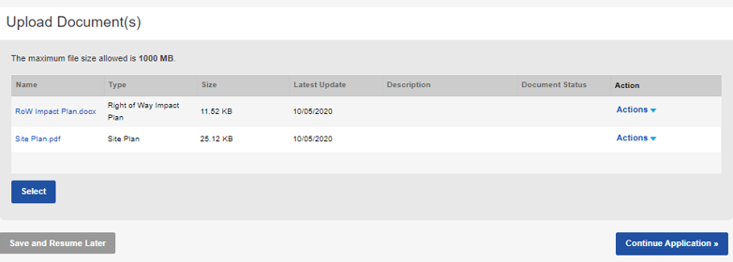
How to apply for a construction permit
If you click Continue Application before all required documents are uploaded, this banner will turn red alerting you what documents are still required to upload.
How to apply for a construction permit
  Once all required and desired documents are uploaded, click the Continue Application button
22
Notes:
Optionally, if there is an exact match, there will not be

Slide 41
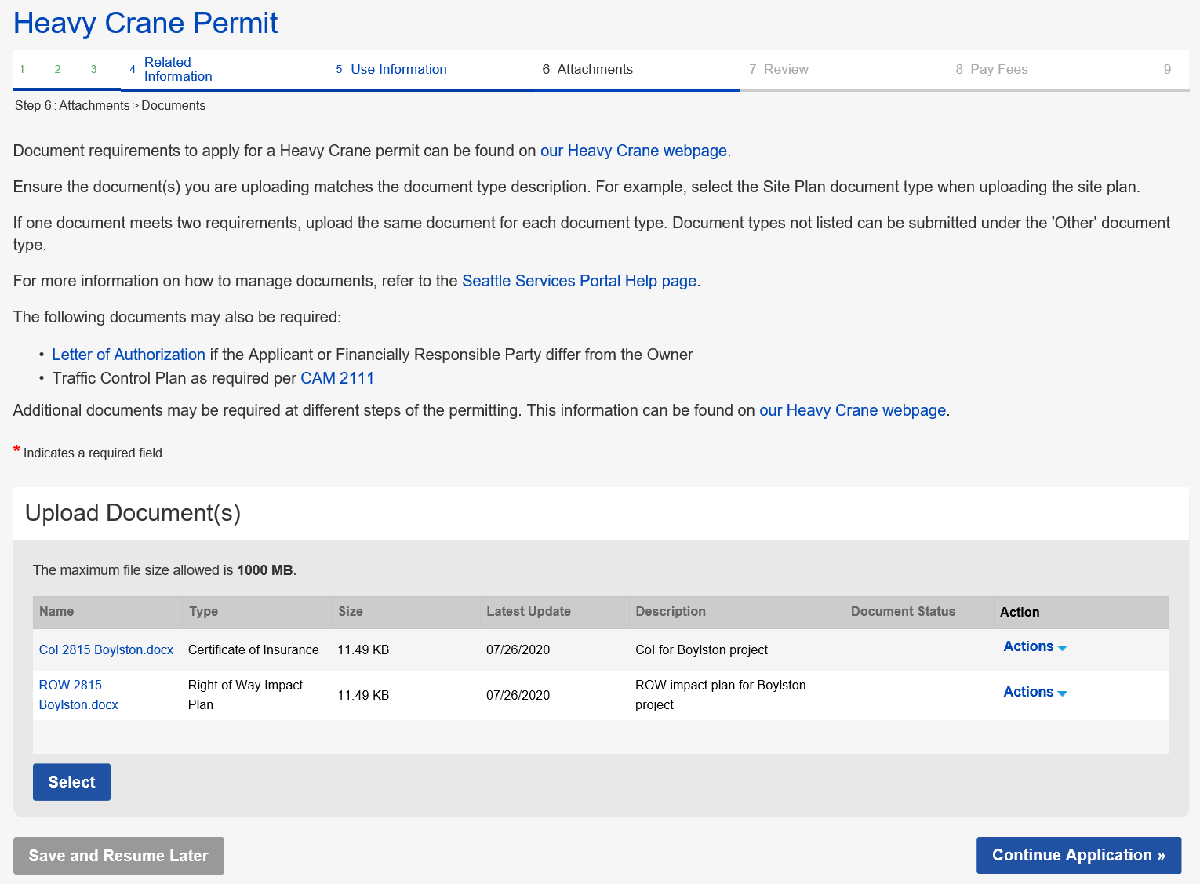
How to apply for a construction permit
For the Heavy Crane application, the Certificate of Insurance (CoI) is also required

Slide 42
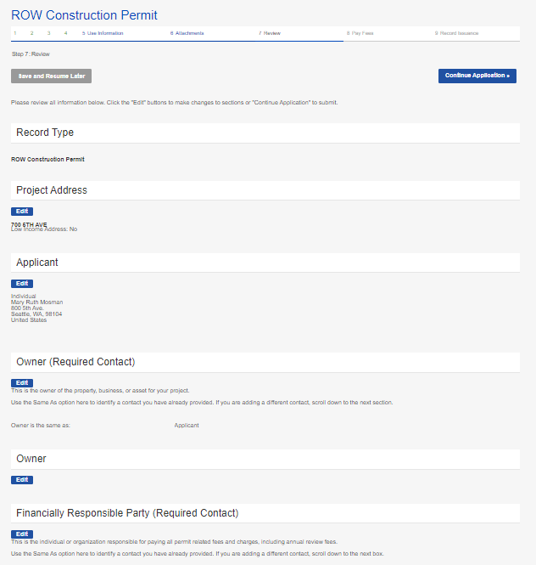
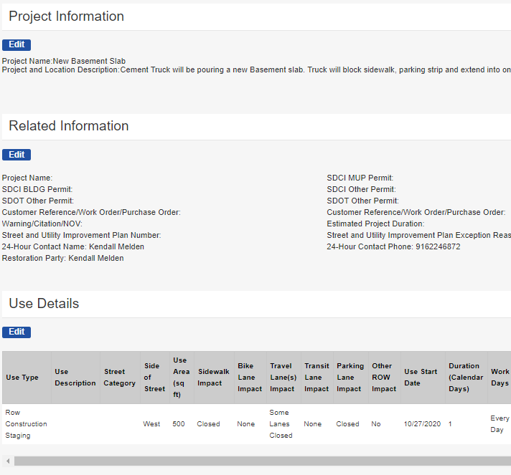
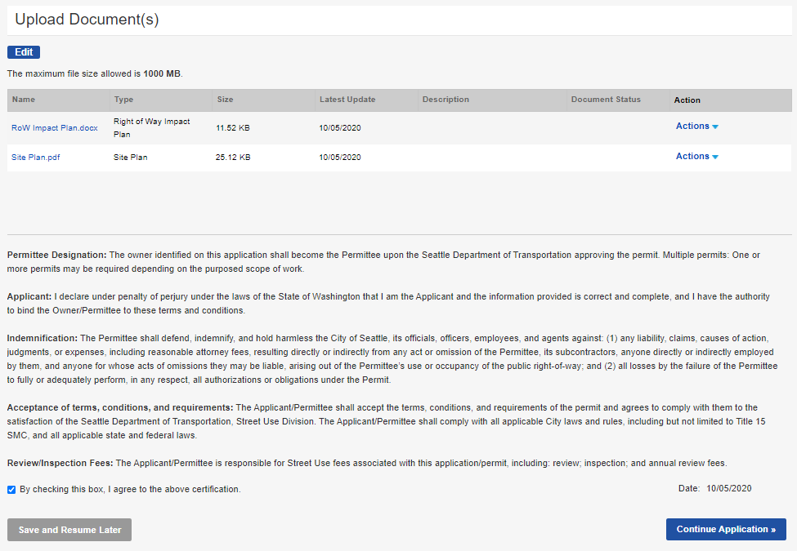
How to apply for a construction permit
How to apply for a construction permit
  Go through all application pages to ensure information is accurate (use the Edit button to make changes)
  Once the application is ready to submit:
    Check the terms of agreement box
    Click the Continue Application button
a
b
42
Notes:
Optionally, if there is an exact match, there will not be

Slide 43
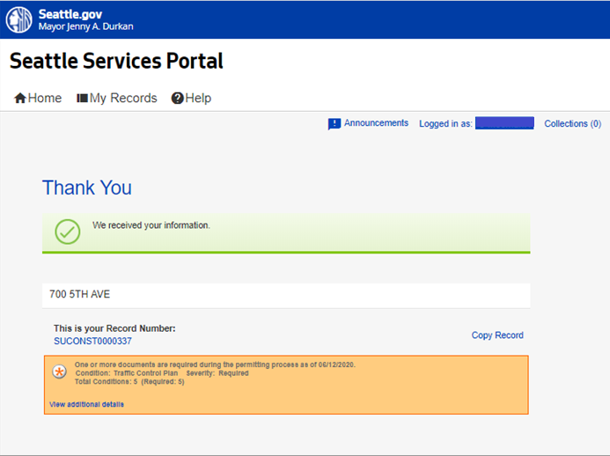
How to apply for a construction permit
How to apply for a construction permit
  Once the application is submitted, you will receive a Thank You confirmation with your Record Number noted
  You can open the permit by clicking on the blue hyperlink permit number
If there are additional documents required later in the permit process, it will show in this box.
25
43
Notes:
Same process for UMPs except document requirements will be different.

Slide 44

Pre-review meetings
ROWM Design Guidance meetings have been renamed to Pre-review meetings
We have also revised the thresholds on when a Pre-review meeting is required to:
  If the project exceeds 6 months in duration AND:
    There is an existing or upcoming construction project on the same corridor within a one-block radius with impacts to the traveling public
    The project proposes to close pedestrian mobility for 6 months or longer without a 24/7 ped reroute (not required on non-arterial streets outside Urban Centers, Urban Villages and Hub areas)
    The project proposes to close a dedicated bus or other transit lane
    The project proposes to reduce a major arterial by 50% or more (e.g. 4 lanes become 2)
Note: Street Use may require a Pre-review meeting outside these thresholds if the impacts of the project warrants a meeting.

Slide 45
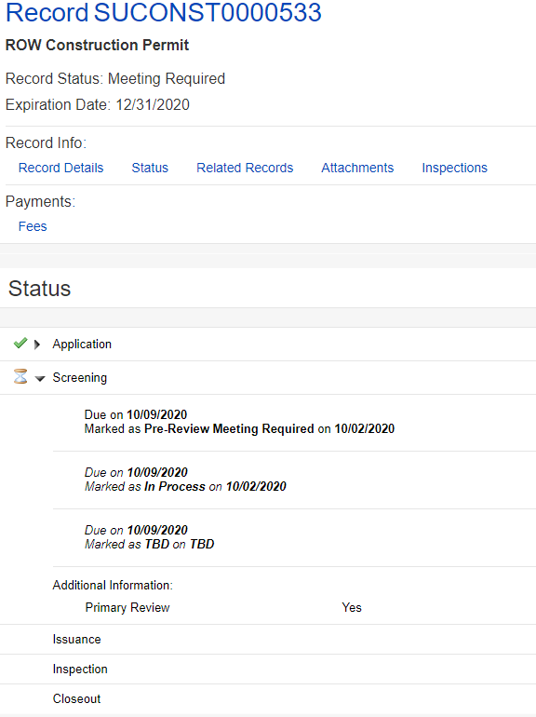

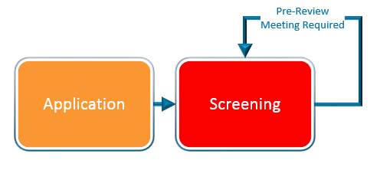
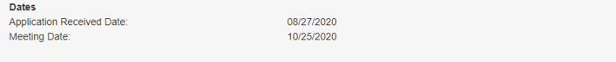
Pre-review meetings
The Street Use Primary Reviewer will determine if a Pre-review meeting is required in the Screening task
If a Pre-review meeting is required, the record status will change from In Process to Pre-Review Meeting Required
When the Pre-review meeting is scheduled, the record status will change from Pre-Review Meeting Required to Meeting Scheduled
The date of meeting will be noted in the application details in the Dates section
b
a
c

Slide 46
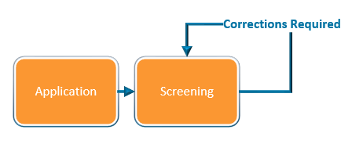
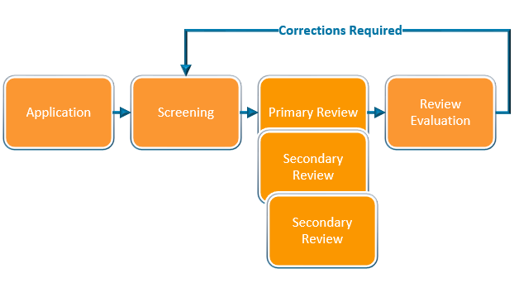
How to respond to corrections
Corrections can be required in the Screening or Review Evaluation task
Once the task is set to request corrections, the record status will change from In Process to Awaiting Corrections
Notes:
Moving on… Now, I will walk you through how to apply for a change (an amendment) to an issued permit.

Slide 47
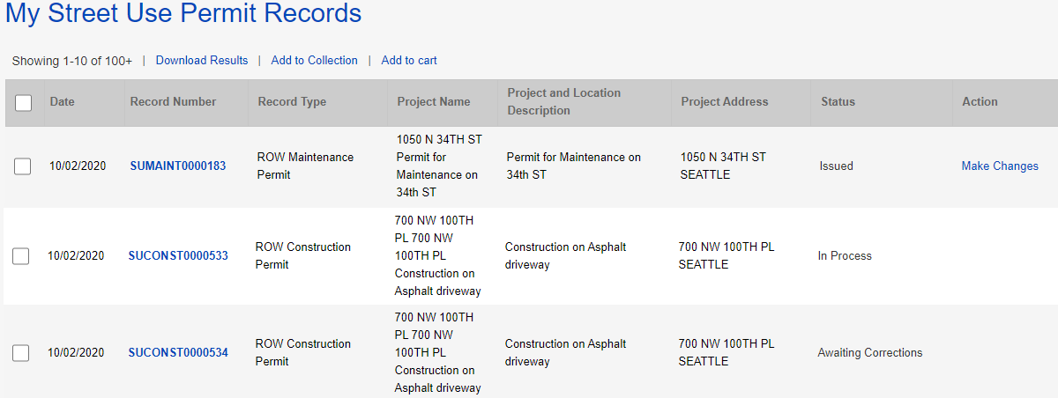
How to respond to corrections
How to respond to corrections
From the My Records page, the Status of the permit will show as Awaiting Corrections
Click on the blue hyperlink permit number
1
2
Notes:
Moving on… Now, I will walk you through how to apply for a change (an amendment) to an issued permit.

Slide 48
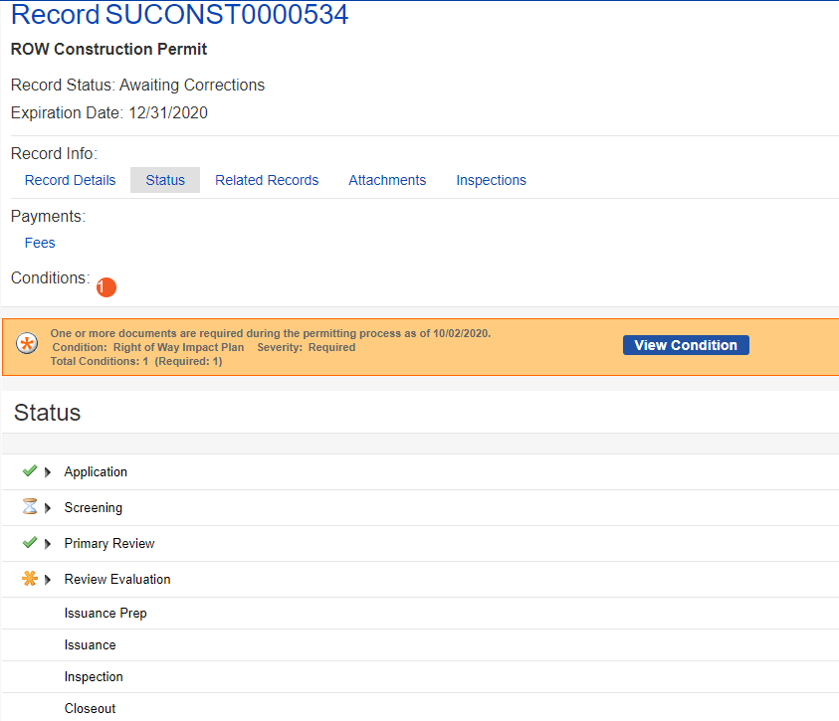
How to respond to corrections
3
How to respond to corrections
Click on the Status tab
  The red banner will indicate what document is required
  Click on the View Condition button for more information about each document/condition
  The Review Evaluation task shows an asterisk indicating there has been at least one corrections cycle
  The Screening task shows as In Process with the hourglass because that is the beginning of the review process
a
b
c
d
Notes:
Moving on… Now, I will walk you through how to apply for a change (an amendment) to an issued permit.

Slide 49
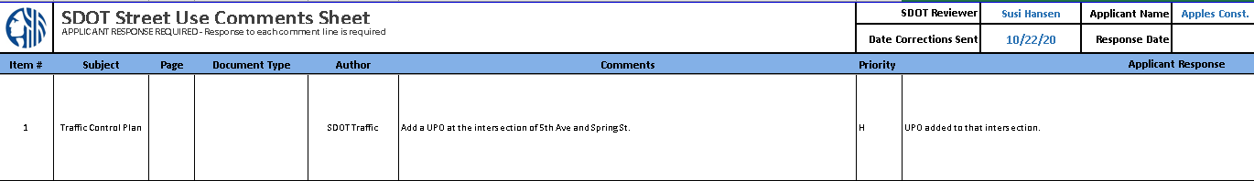
Corrections and Corrections Response documents
The Corrections document is the Street Use Comment Sheet
The Corrections Response document is the Street Use Comment Sheet with your responses added
If there is a Corrections Response condition requirement, you will need to upload the Street Use Comment Sheet with your responses
Notes:
After the fees are paid (or are billed), the permit automatically issues and the permit Status updates to Issued in My Records list.
The applicant can now make changes to the permit using the Make Changes link that shows in My Records list as well as in the record itself.
This change request creates an Amendment record.
Let’s click on the Make Changes button to view the amendment types available.
​

Slide 50
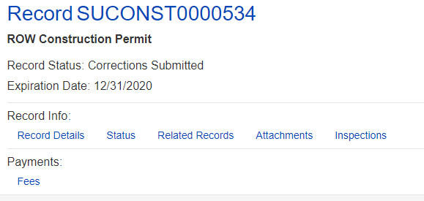

How to find the Street Use Comment Sheet and other documents
Also access to the printed permit and marked up documents
To download the Street Use Comment Sheet:
  Click on the Attachments tab of your permit
  Find the most current Corrections document in the attachments list
  Click on the document blue hyperlink
  Download to your computer
  Add responses to the Street Use Comment Sheet
  Repeat for any other documents needed (e.g. marked up plans, printed permit etc.)
  When revised documents are ready, upload the Street Use Comment Sheet with your responses as the Corrections Response document
a
b
c
Notes:
After the fees are paid (or are billed), the permit automatically issues and the permit Status updates to Issued in My Records list.
The applicant can now make changes to the permit using the Make Changes link that shows in My Records list as well as in the record itself.
This change request creates an Amendment record.
Let’s click on the Make Changes button to view the amendment types available.
​

Slide 51
How to respond to corrections
4
How to respond to corrections
Click the Attachments tab
    Click the Select button
    Choose the desired document from your computer
    From the Document Type drop-down menu, select the type of document required by the condition(s)
    Tip: For us to perform efficient plan review, only upload PDF documents.
    Add a description (optional)
    Click the Save button
    To upload another document, repeat these steps
a
c
d
e
Notes:
Moving on… Now, I will walk you through how to apply for a change (an amendment) to an issued permit.

Slide 52
How to respond to corrections
How to respond to corrections
Once all required documents have been uploaded and there are no more conditions due to submit corrections, the status of your permit will change from Awaiting Corrections to Corrections Submitted
5
Notes:
Moving on… Now, I will walk you through how to apply for a change (an amendment) to an issued permit.

Slide 53

Documents due at Review Evaluation
Documents that are reviewed outside of Street Use are not due until the last step of the review process (Review Evaluation)
Examples include:
  Historic/Landmark District Certification of Approval
  Pavement Moratorium Waiver
  Holiday Construction Moratorium Waiver

Slide 54
Documents due at Review Evaluation
Documents due at the end of review will be added at the Screening task and shown as a required condition due later in the process
The review process will continue, and you can upload the required documents at any time
To know if additional documents are required, you will need to check the status of your permit(s) – an automatic email will not be sent until there is a Corrections Request sent

Slide 55


How to pay fees
1
How to pay fees that are due before issuance
  From your My Records:
    The status will show as Waiting for Payment
    Click the Pay Fees Due link
  From the permit:
    Click on the Fees tab
    Click the Pay Fees link
a
b
2
a
b
Notes:
Once an application has been reviewed and approved, the customer receives an email letting them know the permit is ready to issue and waiting for payment. Fees can be paid online. Online payment only allows full payment and only credit cards.
Remember, for billed customers, the permit is issued without payment.
If it’s a free permit, the customer receives an email stating that the permit has been issued and is ready for printing.
Now let’s look at the Fees tab on the record.

Slide 56

How to pay fees
How to pay fees
  This will take you to the fees due for that application
  To pay for these fees, click on the Check Out button
  Tip: Partial payments are not allowed.
4
Notes:
Once an application has been reviewed and approved, the customer receives an email letting them know the permit is ready to issue and waiting for payment. Fees can be paid online. Online payment only allows full payment and only credit cards.
Remember, for billed customers, the permit is issued without payment.
If it’s a free permit, the customer receives an email stating that the permit has been issued and is ready for printing.
Now let’s look at the Fees tab on the record.

Slide 57

How to pay fees
How to pay fees
  This will take you to your cart
  To pay all fees in your cart, click the Checkout button
  If you have fees in your cart for multiple permits, you can edit those fees by clicking the Edit Cart button
6
7
Notes:
Once an application has been reviewed and approved, the customer receives an email letting them know the permit is ready to issue and waiting for payment. Fees can be paid online. Online payment only allows full payment and only credit cards.
Remember, for billed customers, the permit is issued without payment.
If it’s a free permit, the customer receives an email stating that the permit has been issued and is ready for printing.
Now let’s look at the Fees tab on the record.

Slide 58

How to edit your Cart
How to edit your cart
  To remove a fee from you cart, click the Remove link
  Click the Save and Close button to complete payment
1
2
Notes:
Once an application has been reviewed and approved, the customer receives an email letting them know the permit is ready to issue and waiting for payment. Fees can be paid online. Online payment only allows full payment and only credit cards.
Remember, for billed customers, the permit is issued without payment.
If it’s a free permit, the customer receives an email stating that the permit has been issued and is ready for printing.
Now let’s look at the Fees tab on the record.

Slide 59

How to pay fees
How to pay fees
  Enter credit card information
  If the credit card billing information is the same as the address on the Portal account, check the box next to Auto-fill with
  If you don’t use the Auto-fill with option, enter all required information
  Click the Submit Payment button to make the payment
8
9
10
11
Notes:
Once an application has been reviewed and approved, the customer receives an email letting them know the permit is ready to issue and waiting for payment. Fees can be paid online. Online payment only allows full payment and only credit cards.
Remember, for billed customers, the permit is issued without payment.
If it’s a free permit, the customer receives an email stating that the permit has been issued and is ready for printing.
Now let’s look at the Fees tab on the record.

Slide 60


How to pay fees
12
How to pay fees
  This confirmation will show if the payment is successful
  To print and/or view your receipt, click the Print/View Receipt button
  Once all fees are paid, the permit will automatically issue
13
Notes:
Once an application has been reviewed and approved, the customer receives an email letting them know the permit is ready to issue and waiting for payment. Fees can be paid online. Online payment only allows full payment and only credit cards.
Remember, for billed customers, the permit is issued without payment.
If it’s a free permit, the customer receives an email stating that the permit has been issued and is ready for printing.
Now let’s look at the Fees tab on the record.

Slide 61


How to pay fees - Invoiced fees after issuance
ii
How to pay fees after issuance
  From your My Records list:
    The status will show as Waiting for Payment
    You can select records to pay by either:
      Clicking the Pay Fees Due link under Action of one permit; OR
      Checking the boxes of multiple permits and clicking Add to Cart
i
a
  Tip: For option b-ii, if there are records that are not ready for payment, they will not be added to the cart.
Notes:
Once an application has been reviewed and approved, the customer receives an email letting them know the permit is ready to issue and waiting for payment. Fees can be paid online. Online payment only allows full payment and only credit cards.
Remember, for billed customers, the permit is issued without payment.
If it’s a free permit, the customer receives an email stating that the permit has been issued and is ready for printing.
Now let’s look at the Fees tab on the record.

Slide 62

How to find the status of your permit
How to find the status of your permit
You can find your permit in two ways:
  Find the permit under the My Records page, either in My Records Overview or in Permit – Street Use
  Searching for the individual record under Find Existing in Permits – Street Use
b
a
Notes:
When the task status is changed to Additional Information Required, the applicant receives an email saying that a new document is needed.
When the applicant then goes to his/her SSP account, this is what he/she will see…Additional Info Requested.

Slide 63


How to find the status of your permit
How to find the status of your permit
From the My Records page
  The status of the permit will show in the Status column
a
Notes:
When the task status is changed to Additional Information Required, the applicant receives an email saying that a new document is needed.
When the applicant then goes to his/her SSP account, this is what he/she will see…Additional Info Requested.

Slide 64


How to find the status of your permit
How to find the status of your permit
From the individual permit:
  Click on the Status tab
  The Application task is shown as complete with a green check
  The Screening task is shown as In Process with an hourglass
  When you expand the Screening task, you can see the due date, history of the task processing and the active Primary Review task
  The next task is Primary Review
  If there are required secondary reviewers (e.g. SDOT Traffic), they will show under the Screening task with their due date and status after the Screening task is completed
a
f
b
c
d
e
Notes:
When the task status is changed to Additional Information Required, the applicant receives an email saying that a new document is needed.
When the applicant then goes to his/her SSP account, this is what he/she will see…Additional Info Requested.

Slide 65


How to make a change to a permit
1
How to make a change to an issued permit
  If the permit is in the Issued stage, under Action, Click on the Make Changes link
  From the record page, click on the Make Changes button
2
Notes:
Once an application has been reviewed and approved, the customer receives an email letting them know the permit is ready to issue and waiting for payment. Fees can be paid online. Online payment only allows full payment and only credit cards.
Remember, for billed customers, the permit is issued without payment.
If it’s a free permit, the customer receives an email stating that the permit has been issued and is ready for printing.
Now let’s look at the Fees tab on the record.

Slide 66

How to make a change to a permit
How to make a change to an issued permit
  Select the appropriate amendment (aka modification) type
  Click the Continue Application button to start the amendment application process
3
4
Notes:
Once an application has been reviewed and approved, the customer receives an email letting them know the permit is ready to issue and waiting for payment. Fees can be paid online. Online payment only allows full payment and only credit cards.
Remember, for billed customers, the permit is issued without payment.
If it’s a free permit, the customer receives an email stating that the permit has been issued and is ready for printing.
Now let’s look at the Fees tab on the record.

Slide 67

How to make a change to a permit
1
How to withdraw an application
  If the permit is in the Initiated stage, under Action, Click on the Make Changes link
    Tip: This is only available between application submitted and when SU staff claims the application for processing.
  Select SU Withdrawal
  Click the Continue Application button to start the withdrawal
2
3
Notes:
Once an application has been reviewed and approved, the customer receives an email letting them know the permit is ready to issue and waiting for payment. Fees can be paid online. Online payment only allows full payment and only credit cards.
Remember, for billed customers, the permit is issued without payment.
If it’s a free permit, the customer receives an email stating that the permit has been issued and is ready for printing.
Now let’s look at the Fees tab on the record.

Slide 68
Inspections by permit type
 | ROW Construction | Minor Utility | Heavy Crane | ROW Maintenance | SIP | UMP
Initial | X | X | X | X | X | X
Interim - Amend | X | X | - | - | X | X
Interim | X | X | - | - | X | X
Site | X | X | X | X | X | X
Reinspection | X | X | X | X | X | X
Restoration | X | X | - | X | X | X
Curb Ramp | - | - | - | - | X | X
Off Hours | X | X | X | X | X | X
Mark Out | X | X | - | X | X | X
Pre-Con Meeting | X | X | X | X | X | X
Final | X | X | X | X | X | X
SDOT Asset | X | X | - | - | X | X
Utility | X | X | - | - | X | X
Acceptance | X | X | - | X | - | X
Bond Release | - | - | - | - | X | X

Slide 69
Notifications by permit type
 | ROW Construction | Minor Utility | Heavy Crane | ROW Maintenance | SIP | UMP
Job Start | X | X | X | X | X | X
Site | X | X | X | X | X | X
Restoration | X | X | - | X | X | X
Curb Ramp | - | - | - | - | X | X
Mark Out | X | X | - | X | X | X
Off Hours* | X | X | X | X | X | X
Pre-Con Meeting* | X | X | X | X | X | X

Slide 70


How to schedule an inspection not available on the Portal
Pre-Con Meeting
  Required on UMPs and SIPs only
    For SIPs, the SIP Project Manager will schedule
    For UMPs, the assigned inspector will schedule
  To request a Pre-Con Meeting for non-UMP and non-SIP permits, email the assigned St Use Inspector
Off-Hours
  Work outside of normal working hours, 8:00 AM - 5:00 PM Monday through Friday
  3-business days in advance notice required
  Email DOT_StUse_OffHours_Inspection@seattle.gov

Slide 71

How to schedule an inspection from the Portal
1
How to schedule an inspection
Click the Inspections tab
In the Inspections section on the permit select Actions and then Schedule
Tip: You do not have to be logged in to schedule an inspection.
2

Slide 72

How to schedule an inspection from the Portal
How to schedule an inspection
Select date on the calendar in the timeframe allotted based on the issued start date and duration and click the Continue button
The contact for the inspection will default to the Applicant
To update the onsite contact for this inspection, click Change Contact and fill out the required information
Click the Submit button

Slide 73

How to schedule an inspection from the Portal
How to schedule an inspection
Add notes for the inspector (e.g. time of day, details of work etc.)
Click the Finish button

Slide 74

How to schedule an inspection from the Portal
How to reschedule an inspection
On the Inspections tab on the permit, select Actions and then Reschedule
Follow the previous steps on how to schedule an inspection
Note: a 2-business day notice is required to schedule or reschedule an inspection.

Slide 75
Understanding curb cut permits
SDCI has the authority on new or revised concrete driveway installations
SDCI determines the following related to the concrete driveway per the Land Use code:
  Location
  Width
  Slope
  Number of driveways
Concrete driveways are either part of a SDCI building permit (CN) or a stand-alone curb-cut permit if no other work is occurring
SDOT permits the use of the right-of-way for concrete driveway work and inspects per standard plans and specifications

Slide 76
Old stand-alone curb cut permit process overview
SDCI issues stand-alone curb cut permit
SDOT starts application after SDCI issuance
SDOT issues permits once approved

Slide 77

New stand-alone curb cut permit process
Note: This process is for new applications on or after November 12th, 2020 only.
If a SDCI stand-alone curb cut permit exists prior to November 12th, the applicant will receive two permits, one from each department.

Slide 78
ROW Construction Permit – New/Replace Concrete Driveway (aka curb cut)
Hansen Use Code | Accela Use Type
25 | New/Replace Asphalt Driveway
26/26A | New/Replace Concrete Driveway
29B | Overhead Weather Protection
29B | Sign/Banner
31/44 | Row Construction Staging
31D | Inaccessible Row Construction Staging
34/35 | Clear And Grub/Grading
38/40/51M | Pavement Restoration
41 | Transit Facility
44 | Crane > 100 Ton Operation
44 | Boom/Lift/Crane < 100 Ton
47 | Curb Crossing
50/50A | Scaffolding/Covered Ped Walkway
44/51I | Environmental Remediation
51I | Exploratory Excavation
52C/AVP | Seasonal Lighting
54/54A | Miscellaneous
54A | Private Drainage Facility
54C | Barricades
55 | Sidewalk/Driveway Maintenance < 100 Sf
55A | Sidewalk/Driveway Maintenance > 100 Sf
ROW Construction – New/Replace Concrete Driveway (aka curb cut) permit :
Used to permit the use of the right-of-way for concrete driveway construction
This is the permit and use type needed if SDCI approves a curb cut on a Building (CN) or Stand-alone Curb Cut permit
Required documents: ROWIP, Site Plan, and SDCI Site Plan
Record ID: SUCONST0000001
Notes:
Most of the uses are the same as what you had in Hansen, but some have been combined or split out.
A change for Accela, use types are available on more than one record. For example: Sidewalk / driveway maintenance < 100 can also be done on the maintenance record
Big shifts:
Combined 31 and 44 – staging of things with and without wheels
44 Crane > 100 Ton on the construction record is only for operation after installation, the installation requires a heavy crane permit
Combined 50 and 50A – can take care differences through the mobility impacts settings
Exploratory excavation added to construction so customers don't always have to get a separate (utility) permit for that - it is also under utility
Miscellaneous is used for work in unimproved ROW, or when something new comes up that is not covered under an existing use type
Note: Sq ft = 100 is included in the > 100 sq ft use
[MA] Applicants (external customers) will not see the Accela Use Code value in the Seattle Services Portal, they will only see/know the Use Type name.

Slide 79
ROW Construction – New/Replaced Concrete Driveway (curb cut) Document Requirements
Document Type | Document Description | When it’s Required Along the Permit Path
Right of Way Impact Plan | Row-of-way closures with details per CAM 2116 | Application – cannot submit without uploading this document
Site Plan | Installation details per CAM 2116 | Application – cannot submit without uploading this document if it’s required for that use type
SDCI Site Plan | Per SDCI’s Tip 103 | Application – cannot submit without uploading this document
Letter of Authorization | Required if Applicant or FRP contact is different from the Owner contact | Application – cannot submit without uploading this document
Traffic Control Plan | Temporary traffic control plan per CAM 2111 and the City of Seattle Traffic Control Manual for In-Street Work | Either at Application if the street category is manually set to Arterial or at Screening when the reviewer verifies work is on an arterial or any street in a Hub
Temporary No Parking Confirmation (Paid Parking Permit) | If paid parking is impacted by the project, some sort of proof that a parking permit has been submitted | Review Evaluation
Other documents | Based on project location and impact: Historic District CoA, Holiday Moratorium Waiver per CAM 2107, Pavement Moratorium etc. | Review Evaluation
Corrections Response | Street Use Comments Sheet with responses | Screening – cannot submit Corrections Submitted if this is required
Notes:
TNP Confirmation can be one of the following:
A copy of the Application Received email
A screen image of the application record details page
A copy of the permit
A copy of a signed billing agreement
A copy of an email from Traffic staff indicating no reservation needed

Slide 80

New stand-alone curb cut permit process
In the Use Information section on the ROW Construction permit application, select the New/Replace Concrete Driveway use type
1

Slide 81

New stand-alone curb cut permit process
Complete the Curb Cut Information section that shows up after you finish Step 5: Use Information
Note: The Curb Cut Information section is used for SDCI’s review and to populate SDCI’s curb cut fee on SDOT’s permit
2

Slide 82

New stand-alone curb cut permit process
In the Attachments section, upload the SDOT Right-of-way Impact Plan (ROWIP) and SDOT site plan per CAM 2116, and the SDCI site plan per TIP 103
3

Slide 83
New stand-alone curb cut process summary
The new process will not be in production until November 12th, 2020
One city, one permit!
If an additional curb curt is needed after a stand-alone curb cut permit is issued by SDOT, a new ROW Construction permit needs to be submitted
Fees from both departments will be collected on the SDOT curb cut permit
There will be no SDCI inspections required on the SDOT curb cut permit

Slide 84


How to get to the
Portal from our webpages
Starting November 9th, our permit webpages will have updated information to guide you through the Accela permit process
You can also find a link to the Portal on the right panel of every webpage
http://www.seattle.gov/transportation/permits-and-services/permits
Access to the Portal can be found on the right panel of every webpage
Note: There will be a new Heavy Crane and ROW Maintenance website available just before launch
Notes:
When a user needs help, they can access the Help Center articles by clicking on Help.
The banner is available throughout the portal, and Help can be accessed at any time simply by clicking on the Help button.

Slide 85

Help Center
1
How to find help on the Portal
From the Seattle Services Portal home page, click on Help
Click on any of these pages:
    Getting Started
    Managing Your Account
    Permits - Street Use
2
Notes:
When a user needs help, they can access the Help Center articles by clicking on Help.
The banner is available throughout the portal, and Help can be accessed at any time simply by clicking on the Help button.

Slide 86
Upcoming events
Date, Time | Topic
Sept 14th, 1-2pm | Inspection and Notifications Types Overview
Oct 19th, 3-4pm | Seattle Services Portal (SSP) Overview
Oct 26th, 2-3:30pm | Utility Permit Overview
Oct 28th, 3-4:30pm | Construction Permit Overview
Oct 30th, 11:30am-12:30pm | Street Improvement Permit Overview
Nov 3rd, 11am-12pm | Amendment Types Overview
Week of Nov 9th and 16th | General Q&A’s Sessions
One workshop per topic
Each workshop will be held virtually using Webex Events and recorded
Q&A sessions will be a 1-hour live event once or twice a week using Webex Events
Stay informed with our monthly newsletter and Accela 2 Updates website

Slide 87

Questions?
Melody.Berry@seattle.gov
www.seattle.gov/transportation

