Slide 1

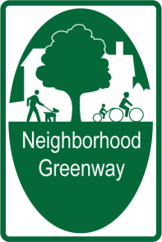


23rd Avenue Corridor Greenway
Community Open House
November 6, 2013

Slide 2

Agenda
Greenways 101
23rd Avenue Corridor Neighborhood Greenway
  Project Goals and Benefits
  Evaluation
  Project Schedule
Questions
Survey

Slide 3
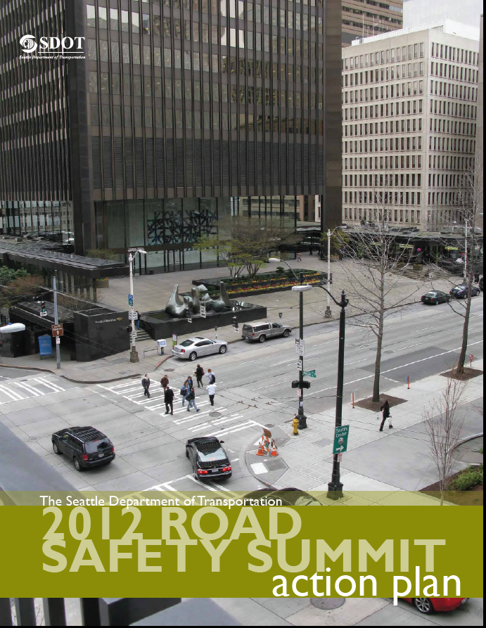
Safety
Seattle has a goal of zero traffic fatalities and serious injuries by 2030.
Our approach: Focus on education, environment, enforcement, evaluation, and empathy

Slide 4
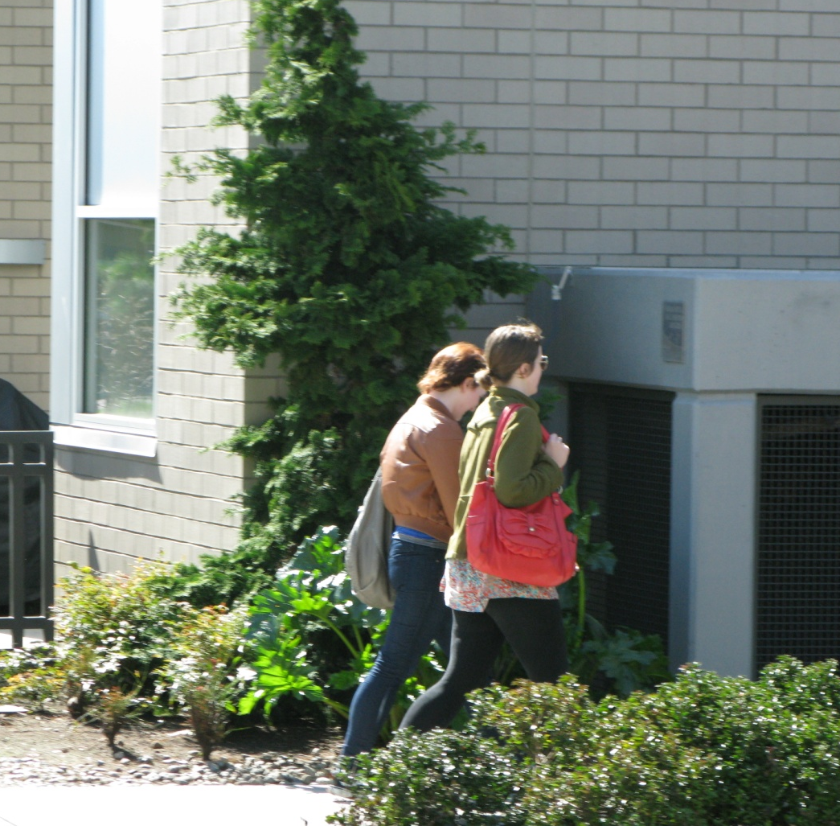
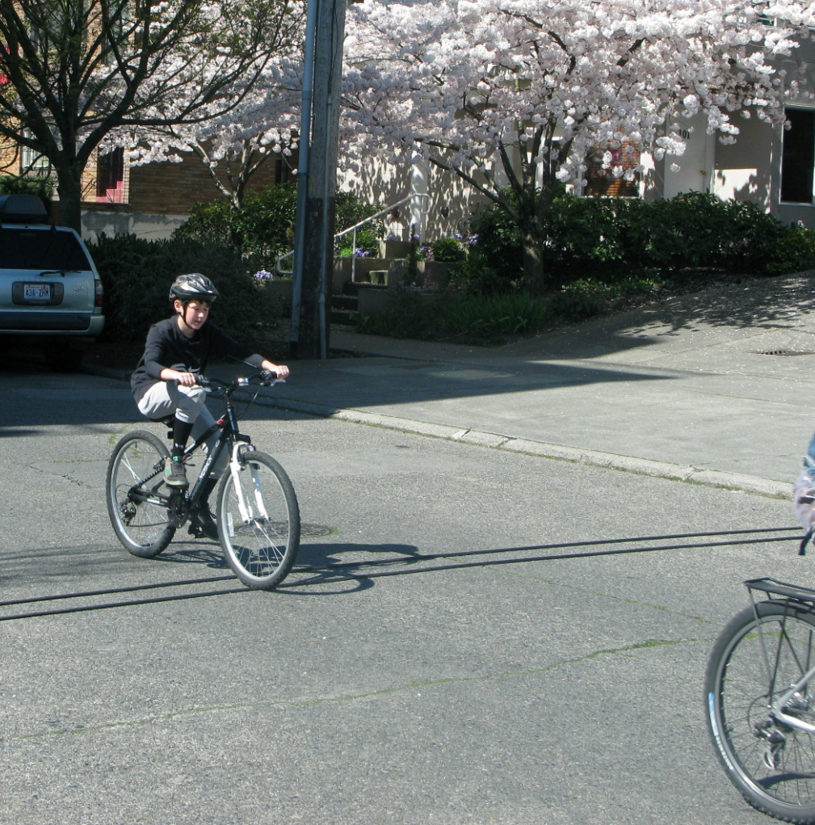
What is a Greenway?
Safer, more comfortable streets for people of all ages and abilities to walk and ride bikes.

Slide 5
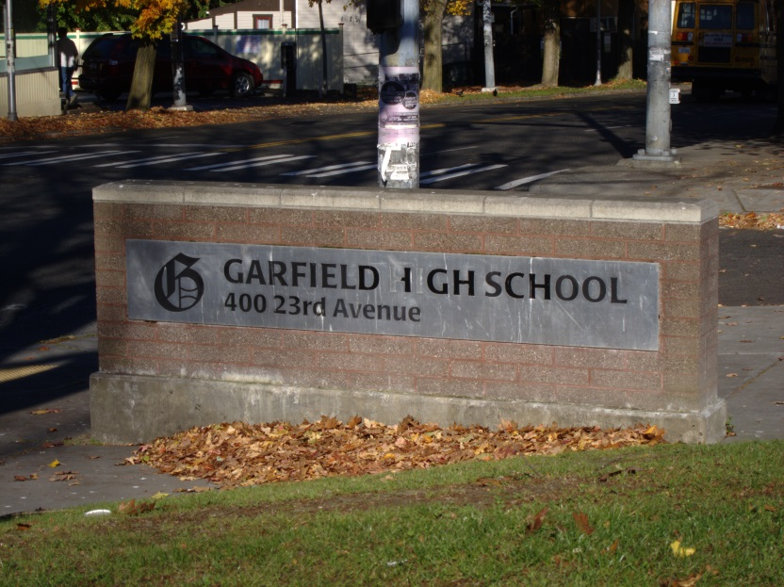
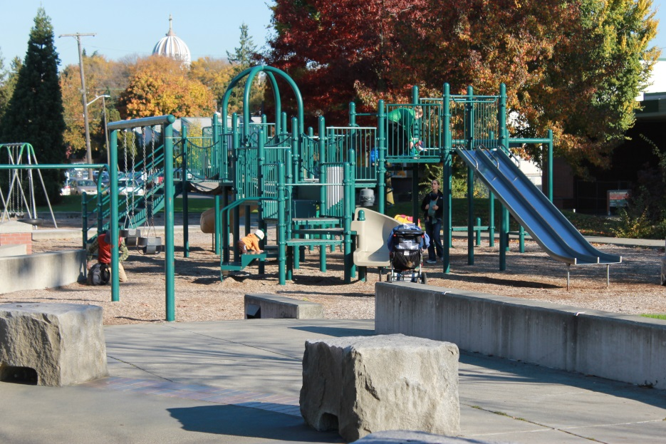
Best Greenway Locations
Residential streets with slower speeds, fewer cars and gentler slopes
Residential streets that connect to schools, parks, libraries and shops

Slide 6
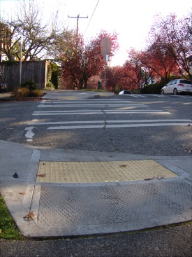
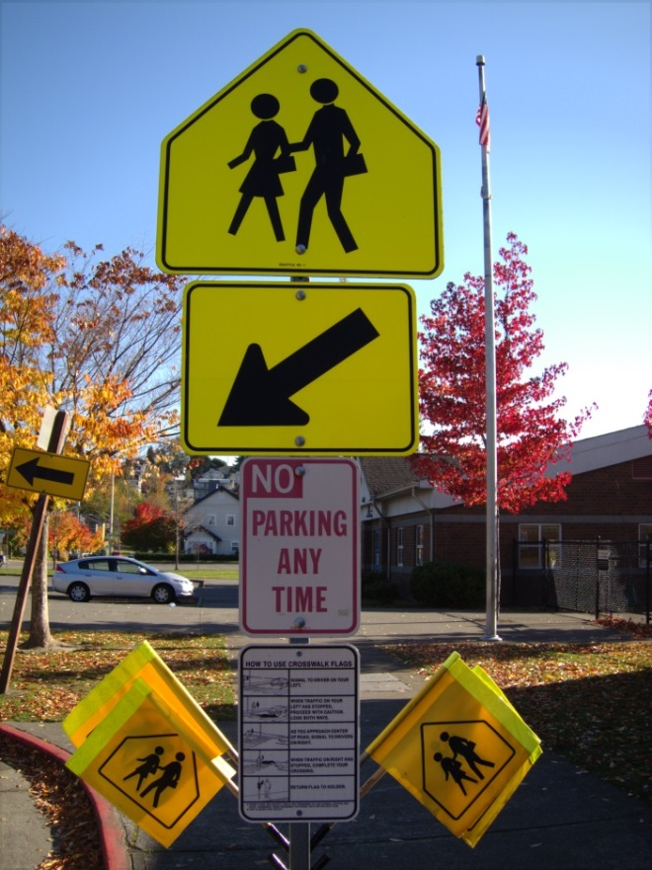
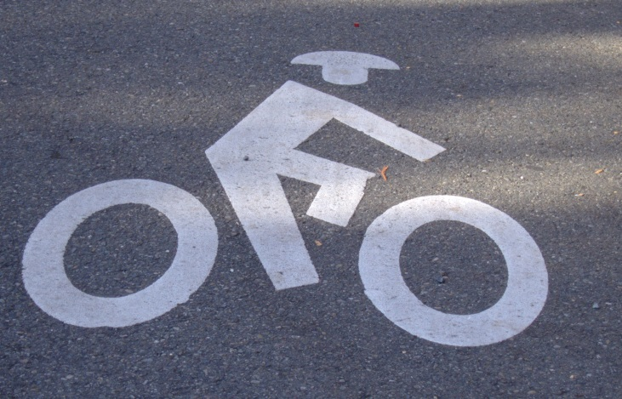
Greenway Design Elements
Greenways may include some combination of the following:
Pavement markings
Wayfinding
Traffic calming
Signage

Slide 7
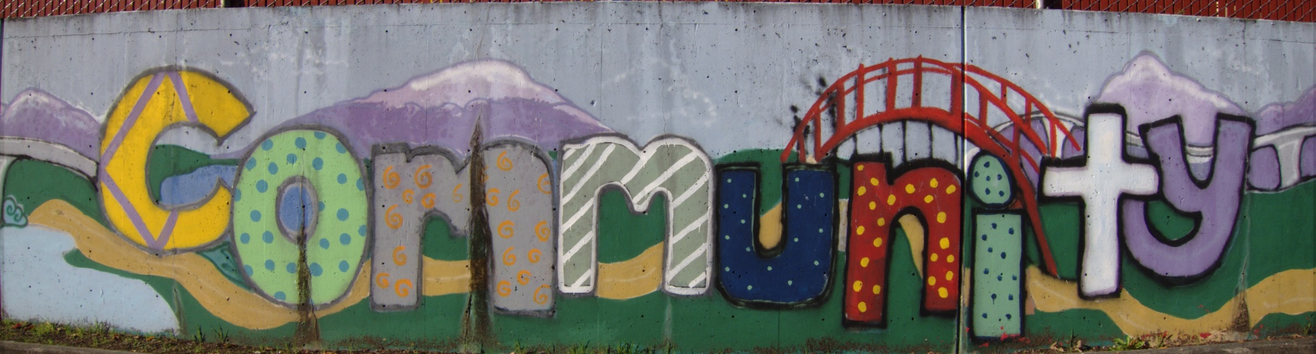
Project Goals
Create an appealing place for residents to walk and ride bikes.
Improve connections to parks, schools, shops and other local amenities.
Create an inviting environment for neighbors to use and enjoy.

Slide 8
Who Benefits?

Slide 9
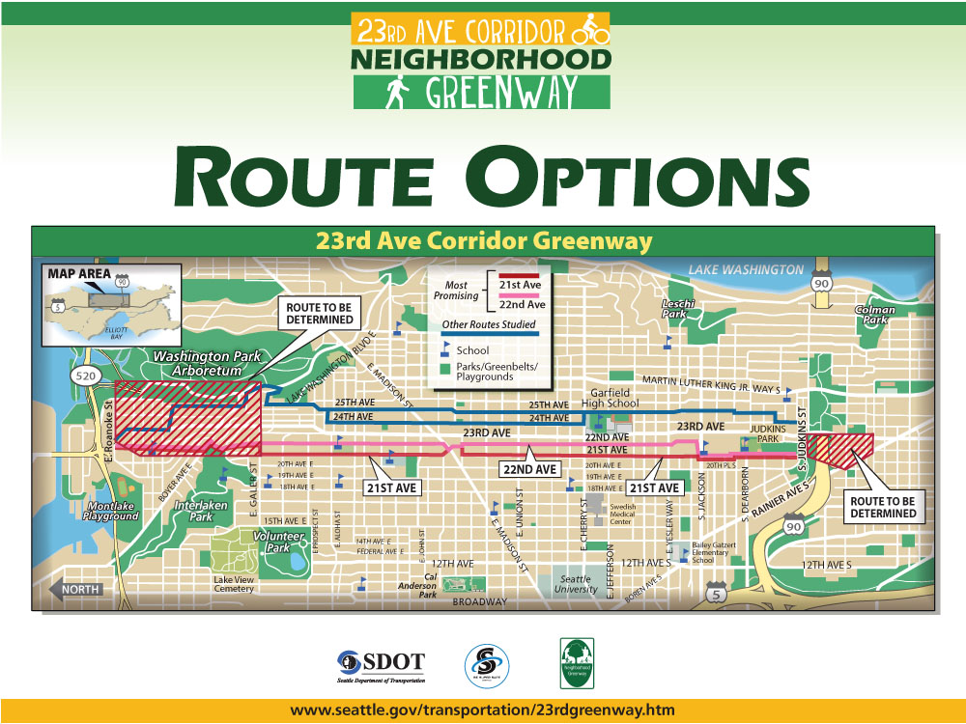

Slide 10
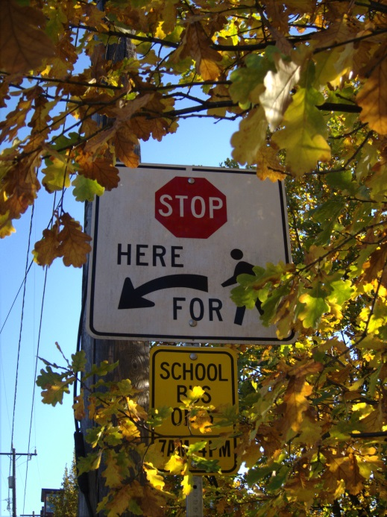
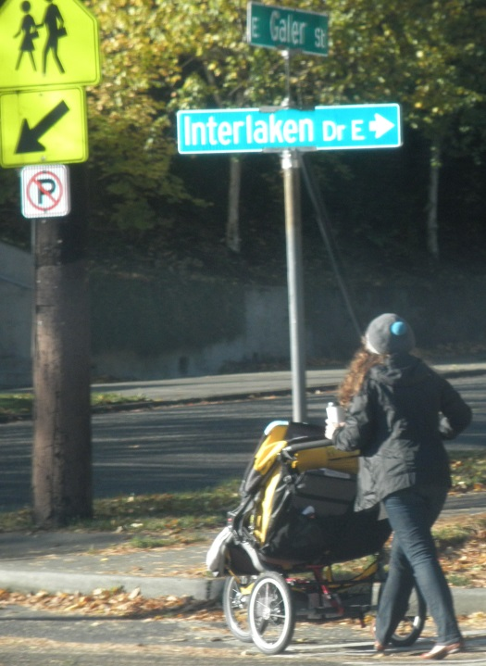
Selection Criteria
Safety
Pavement Conditions
Access
Vehicular Access to Property
Route Continuity
Topography – Grade
Pedestrian Travel
Community Feedback

Slide 11
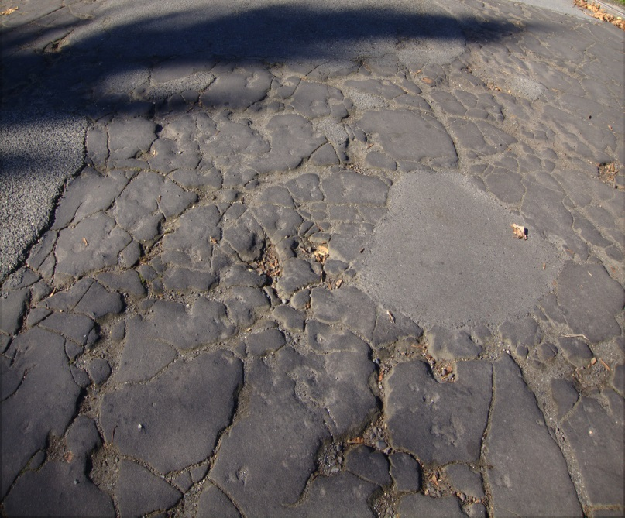
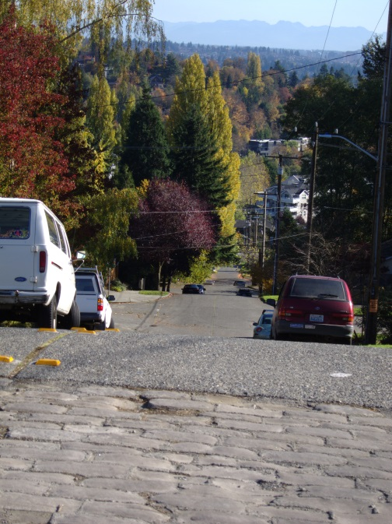
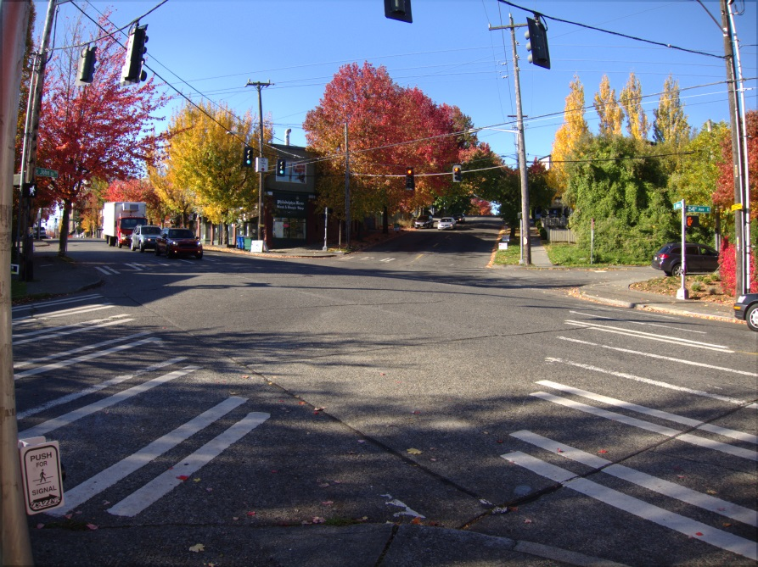
Findings: East Side
24th and 25th
Distinguishing Characteristics
  Poor pavement conditions north of Madison St (24th)
  Steep east/west cross street access
  Crossing at Madison/John/24th difficult for bikes/pedestrians
  Good access to amenities and schools

Slide 12
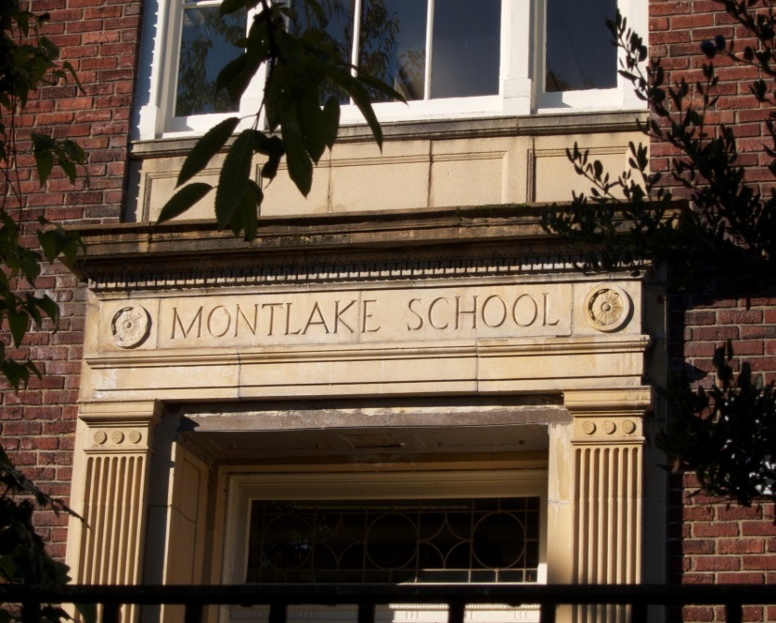
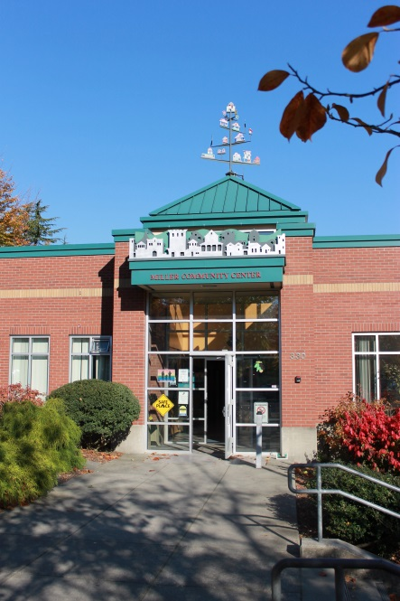
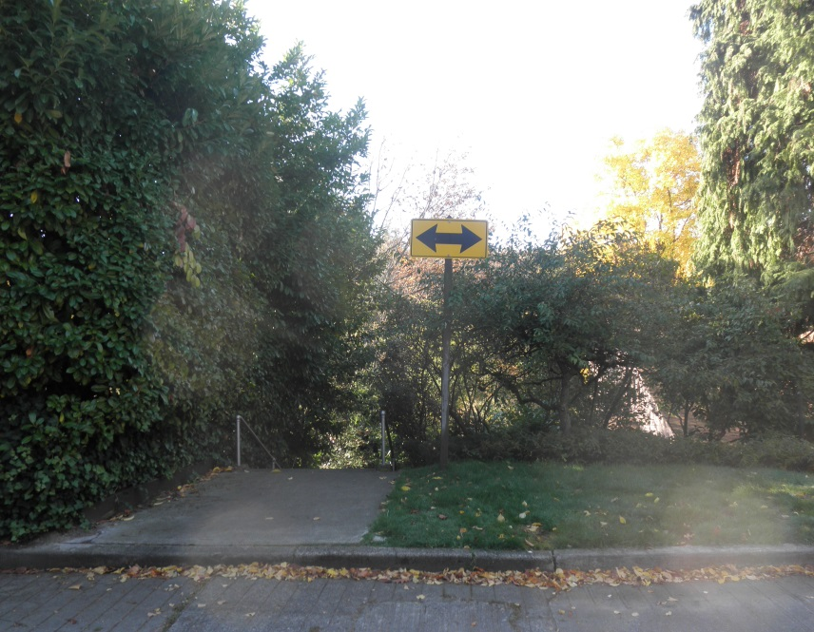
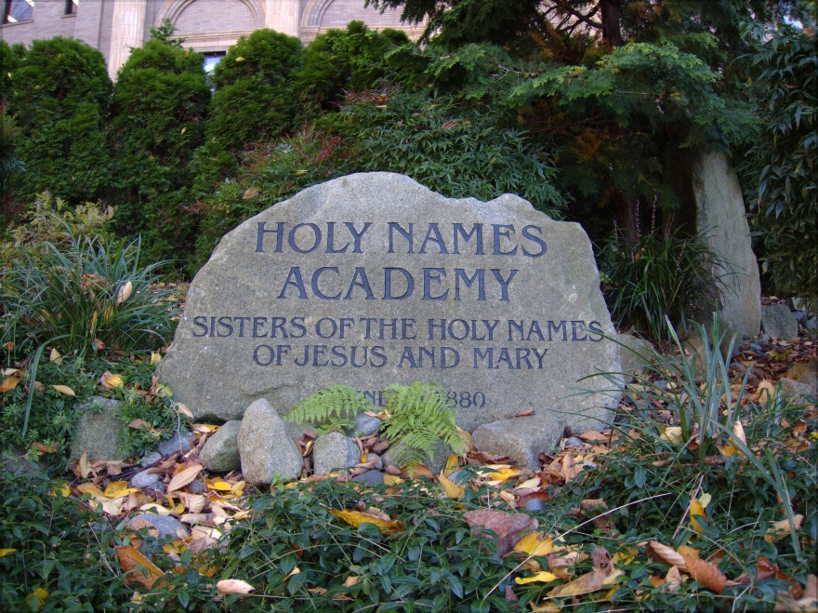
Findings: West Side
21st and 22nd
Distinguishing Characteristics
  Lack of continuity between E Galer St and Boyer Ave
  Good access to amenities and schools
  Better crossings at Madison Street intersection
  Pre-existing traffic calming measures

Slide 13
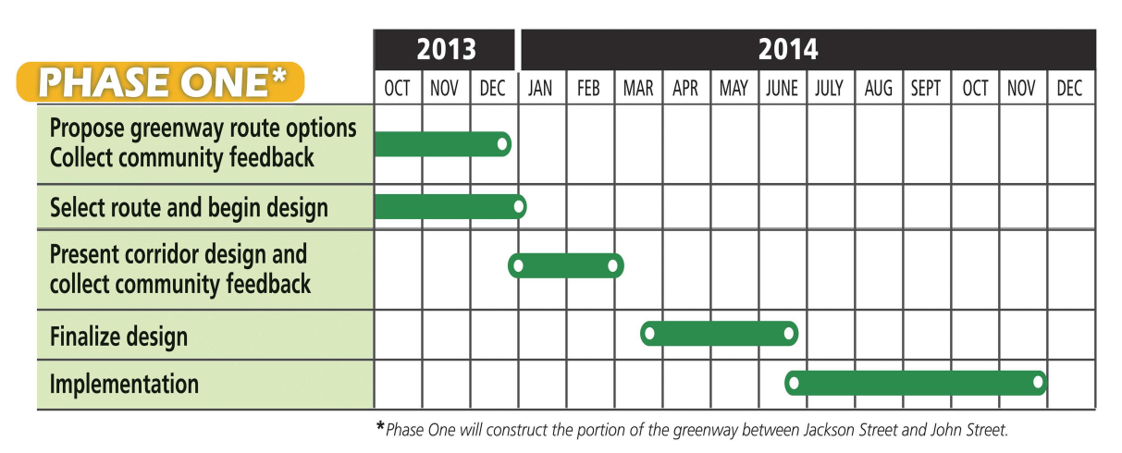
Project Schedule

Slide 14
Questions?

Slide 16
Thank you!

