Slide 1
2026 Home Fair Presentation – Prescriptive Plan Set
Earthquake Home Retrofit
Kristen Malec / Dean Greenleaf

Slide 2
SDCI Vision, Purpose, and Values
Our vision is to set the standard for excellent local government service.
Our purpose is helping people build a safe, livable, and inclusive Seattle.
Our values are equity, respect, quality, integrity, and service.

Slide 3
OBJECTIVES / AGENDA
To help you understand more about Prescriptive Earthquake Home Retrofit (EHR) Plan Set
  Earthquake – Building Safety
  Purpose of EHR Program
  History of EHR
  When is EHR needed and what homes qualify for EHR
  Where and what work is done to your home
  Prescriptive EHR Plan Set – Key Pages
  How to apply
  Other retrofit options
  SDCI Resources

Slide 4
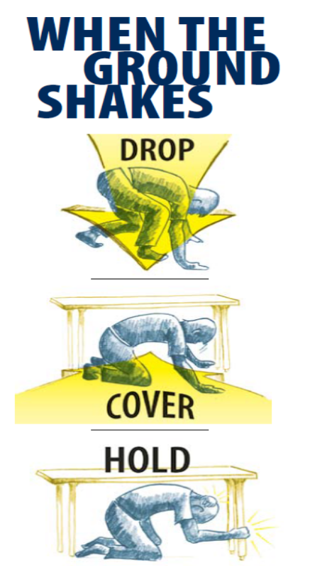

PUBLIC SAFETY IN AN EARTHQUAKE
Seattle Office of Emergency Management
http://www.seattle.gov/sdci/about-us/who-we-are
Notes:
More information on emergency preparedness is available at the City of Seattle Office of Emergency Management.
The intent is to PROTECT yourself from falling debris and get to a safe place. Standing in a doorway or running out of the building may NOT be the safest place to protect yourself in a seismic event.
Please visit the site and develop a personal emergency plan. It is better to think of this before, rather than after an emergency.

Slide 5

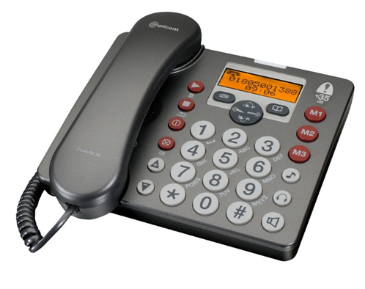
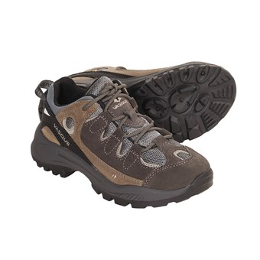


PERSONAL PREPAREDNESS FOR EMERGENCY
Supplies / Tools
Communication -
have a non-local contact
Notes:
ONE THING THAT YOU CAN DO IS HAVE AN EMERGENCY PLAN>
A personal emergency plan should include emergency supplies, one of which many people don’t think about is a pair of sturdy shoes.
Also, You and your family should have an evacuation plan and share a common contact person, preferably NOT a local contact.
In an emergency: texting may work better on damaged or disrupted networks than a phone call. A new item that has been added to the list is a charging bank.
Not a bad idea to have in your home.

Slide 6
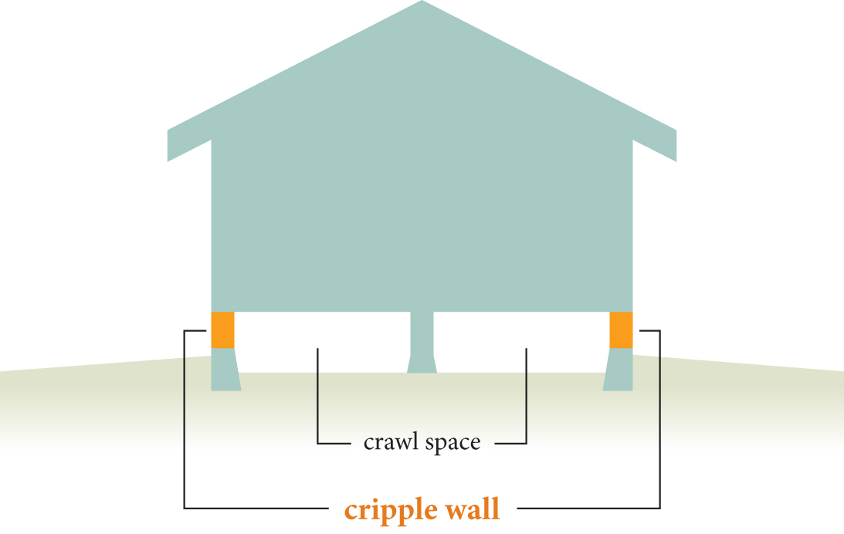
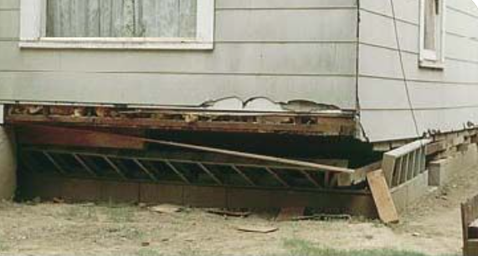
EHR - PURPOSE
Promote public safety by making older homes safer and reduce earthquake-induced damage
Improve earthquake resistance:
  Anchor home to foundation
  Brace cripple walls
Simplify the permit process for “retrofitting” existing homes
This program is designed to work for a typical 2-story, wood framed residence
This program will not “earthquake proof” your home.
Image courtesy of California Department of Insurance
Photo – 1989 Loma Prieta Earthquake

Slide 7
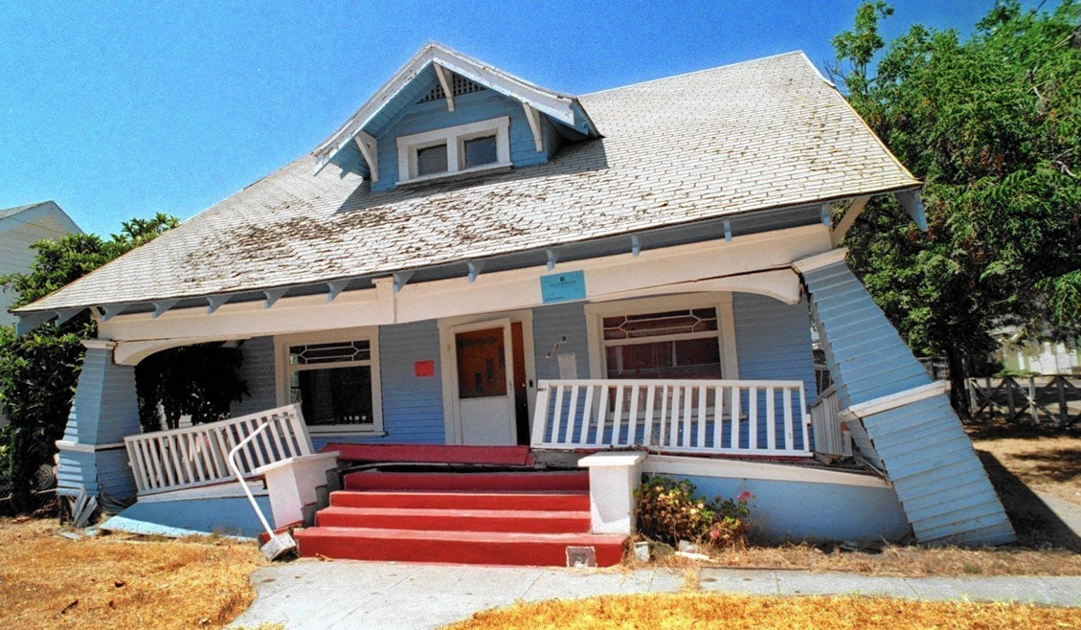
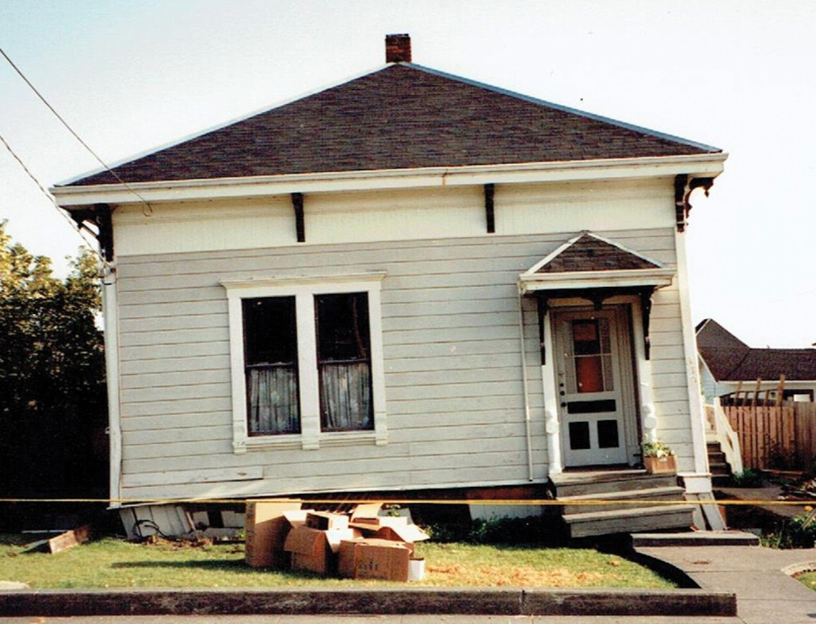
EHR - PURPOSE
These are examples of the type of damage to a home that this program is designed to reduce.
Photo – 1994 California Earthquake
Photo – Washington Association of Building Officials

Slide 8



EHR – HISTORY
The Project Impact prescriptive retrofit program started in California after the 1994 Northridge Earthquake.
FEMA P-1100 was developed in the 2010’s which is intended to be applicable nationwide.
Washington Association of Building Officials (WABO) revised the FEMA drawings to apply to a broad group of existing homes in Washington.
Notes:
More information on this program is available in the Home Earthquake Retrofit Series Overview, one of three publications that support the Project Impact Program. This also discusses the input of Tom Kinsman from the City of Seattle DCLU and Linda Noson from the Permitting and Standards Committee.

Slide 9
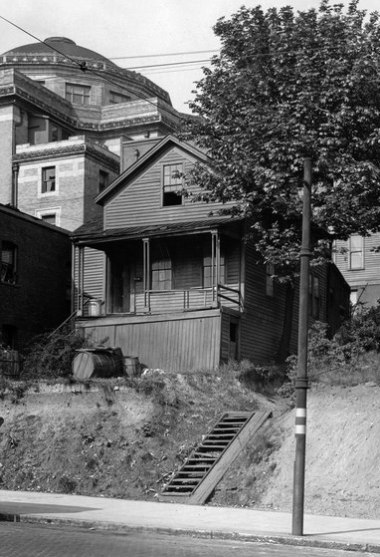
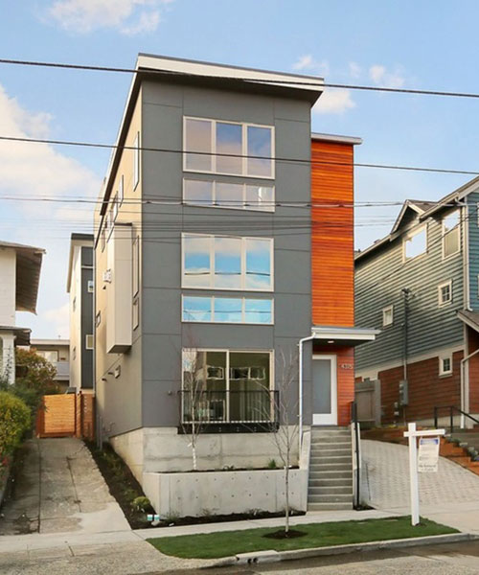
EHR – WHEN IS IT NEEDED?
“INADEQUATE”
“ADEQUATE”
If the house was built after the early 1980’s, it may already have required anchors, bracing, and framing connections.
If your home could be considered “craftsman” or “mid-century modern”, you may need to retrofit.
Visit us online or consult with a contractor, architect, or engineer.
Seattle Times – Hiram Burnett Home built in 1865
Sustainable Connections – modern infill housing
Notes:
The Hiram Burnett home photo was taken in early 1900’s, but the home was built on what is now the corner of fourth and Columbia in 1865. You can see the old First Methodist Church behind it and just a corner of the Rainier Club Building, both of which are still standing today.
The building on the right has a full height concrete wall and was fully engineered under current building codes. It would not need a retrofit as it is current. It is also very skinny, with the total building width being 15-20 feet.
PAUSE FOR QUESTIONS – Does anyone know where the Hiram Burnet house is? The corner of Fourth and Columbia, in what is now the parking lot for the Rainer Club. Behind it is the 1st Methodist Episcopal Church, This important landmark church was largely designed by the Seattle architect James H. Schack and his firm between 1906 and 1907. It is now an event space called the “Sanctuary”.

Slide 10
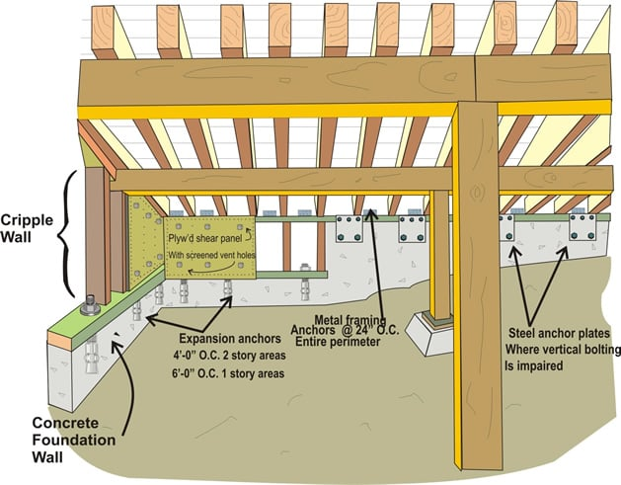
EHR – WHERE WORK IS DONE
EHR prescriptive retrofit plan set focuses on the basement or crawlspace below the first-floor framing.
Crawl space illustration from Seismic Safety, Inc.
Notes:
The floor plan is a two dimensional representation of this three dimensional space, if you have questions on how to do this, you can go to a designer, architect or engineer.

Slide 11
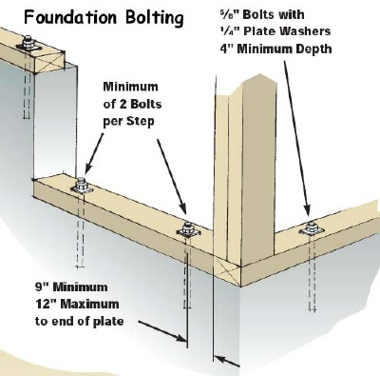
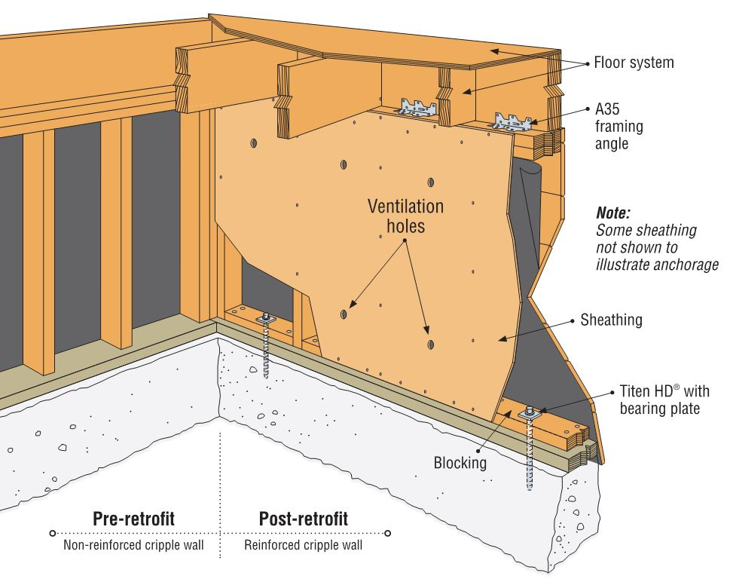
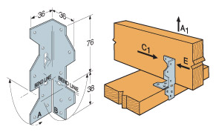
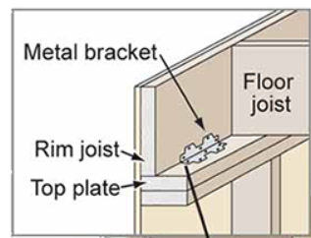
EHR – WHAT WORK IS BEING DONE
Anchor to Foundation
Brace Walls Below 1st Floor
Connect Framing
Images courtesy of Walnut creek Construction, Hipspro.com and Simpson Strong tie Catalog.
Notes:
This is fundamental to seismic retrofits: the ABC’s Anchor, Brace and Connect.
There are several different kinds of bolts, plates and clips, more information on the different kinds is shown in the plan set and discussed in Project Impact publications.
PAUSE FOR QUESTIONS _ CHAT.

Slide 12
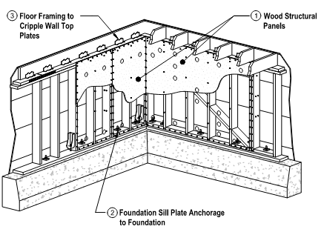

EHR PLAN SET KEY PAGES
The prescriptive plan set is a complete package, with instructions on how to fill it out, details and descriptions of each connection and examples of the retrofit layouts.
These are the Key Pages in the prescriptive 21-page plan set:
  Coversheet: Sheet S0
  Weight Classification: S3
  Earthquake retrofit schedule: Sheet S3.1
  Foundation and retrofit layout plan: Sheet S4
  Details: Sheet D1 through D6
Notes:
ALRIGHT! Now to the main part of the Project Impact Program for Earthquake Home Retrofits: the standard project impact planset.

Slide 13
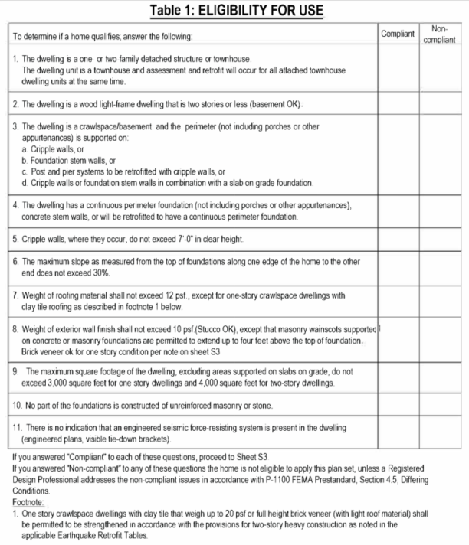
SHEET S0 - ELIGIBILITY FOR USE
How to determine if a home is eligible for EHR:
Cover Sheet: S0 – Table 1
If the answer to any of these questions is NO or “Non-compliant,” the home is not eligible.
If you are not sure about your answer, please ask! We can chat online or through Q&A.
Notes:
Item #7 is new and is different from the older earthquake retrofit prescriptive plan set.
So is Item #9, but that does not come up often, especially in older homes.
Item 11, is a little tricky and references additions or partial work to an existing building. When in doubt. ASK us! We are here to help.

Slide 14
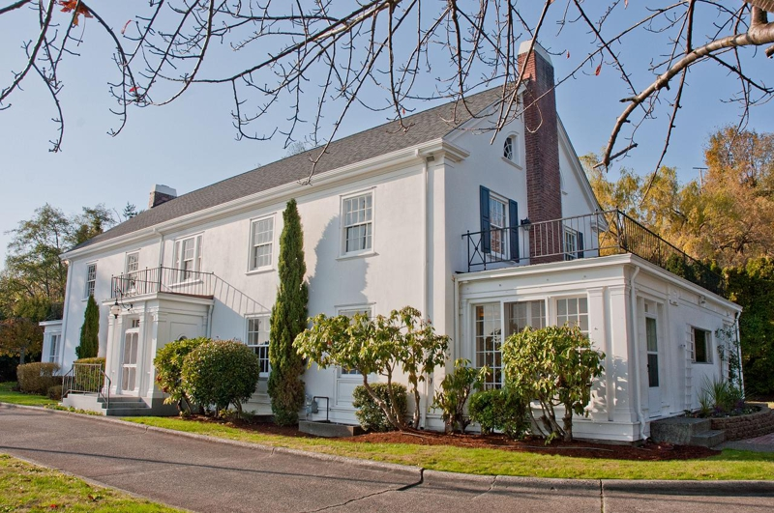
IS THIS DWELLING ELIGIBLE?
  Answers to Questions 1-11 determine if the dwelling qualifies.
✓
      One or two family?
✗
      Two stories and wood light frame construction?
✓
      Crawlspace or basement?
✓
      Continuous foundation?
✓
      Cripple walls, where they occur are under 7’ tall?
✓
      Site is sloped less than 30%?
✓
      Light weight roof less than 12 psf?
✓
      Exterior wall less than 10psf?
✗
      Maximum square footage less than 4,000 sq.ft?
✓
      No masonry or stone foundation?
✓
The Admiral’s House – Formerly Fort Lawton, Magnolia. 2001 W. Garfield Street. Photo courtesy of Cooper Jacobs Real Estate.
      No indication of an existing engineered seismic force resisting system?
Notes:
We’re going to go through a quick example to see if this house qualifies before Dean takes you through the rest of the plan set.
Is this a habitable attic? Unsure? look and research See Item #2
You would use street view, King county, and GIS to verify these items.

Slide 15
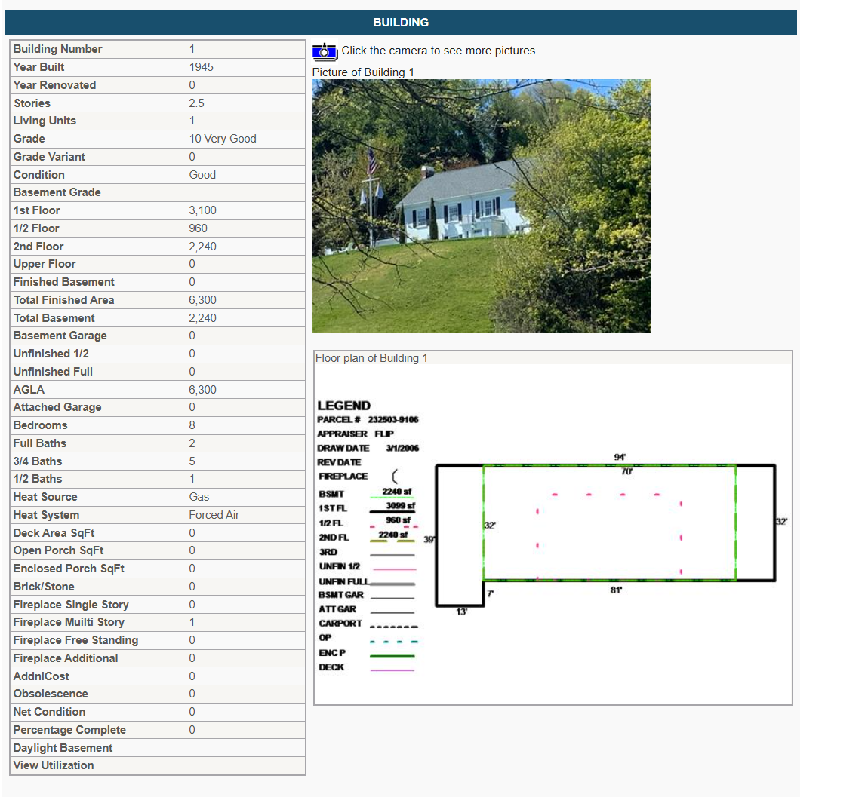
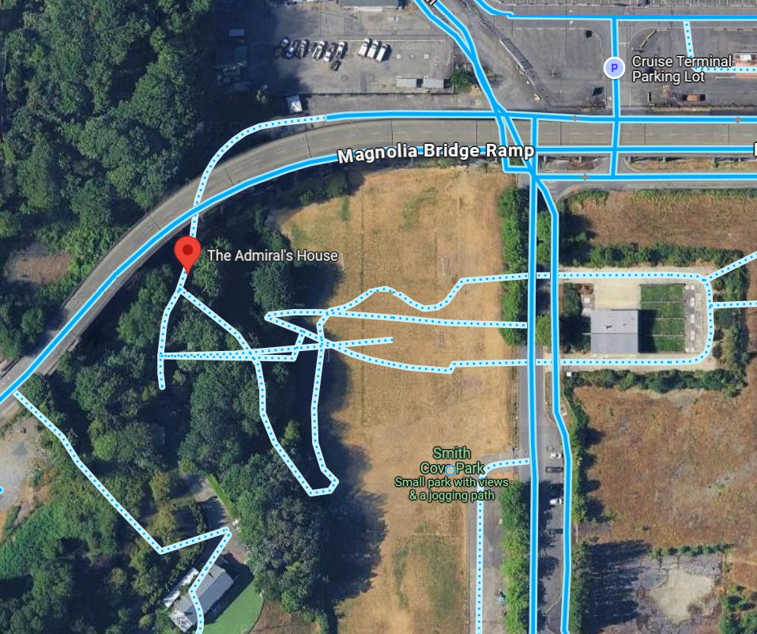
How do we verify eligibility?
Maps / Street View and King County Parcel Viewer

Slide 16
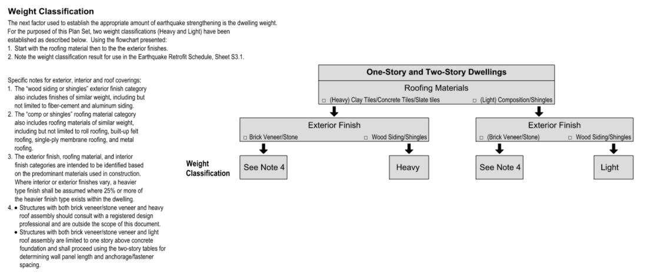
SHEET S3 - WEIGHT CLASSIFICATION
HEAVY OR LIGHT?

Slide 17
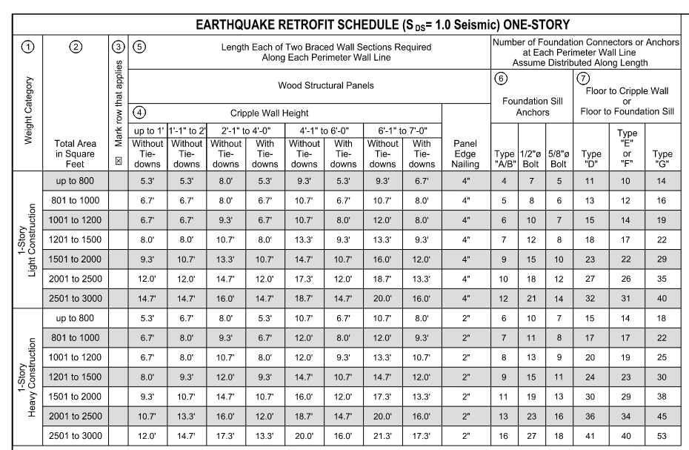
SHEET S3.1 – BRACED WALL LENGTH
This Table is for One-story
Weight Category
Total Area
Mark the row
Cripple Wall Height
Total Wall Section length is twice the length shown here.
Number and type of Sill Anchors
Number and type of Clips / Ties to first floor framing
Notes:
The circled numbers can help. Remember there are two, very similar looking tables, one for single story and one for two story condition!! *** first animation
1.) Most projects will fall into a light construction Weight Category **Second
2.) Total Square footage – First floor, Second, NOT BASEMENT, NOT DECK, NOT GARAGE (typically), - *** Third animation.
3.) Place to mark which row applies. ****Fourth Animation
4.) The cripple wall height is shown as a range, with different values; one WITH and one WITHOUT tie downs. If the cripple wall is stepped, you can average the height of the wall, no heights can exceed 7’ of wood framed cripple wall. … **** Fifth animation.
5.) The length EACH of TWO braced wall sections along each perimeter wall line at exterior walls. ******Sixth Animation
Let’s Try an d EXAMPLE: 1,400 sf area with 4’ tall cripple wall. Area then wall height. IT needs two braced wall sections ___ long. *******Seventh Animation
6.) The number of foundation sill Anchors and Connections ******Eighths and last animation
PAUSE FOR QUESTIONS – THIS IS THE GUTS OF WHAT IS NEEDED> EVERY BODY got an idea on how this works? GREAT!!!

Slide 18
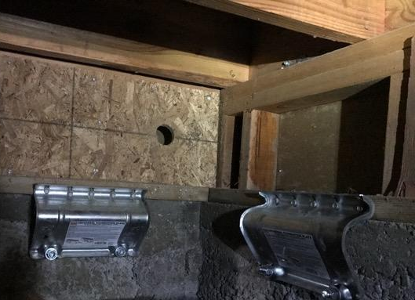
BRACED WALL PANELS
Strengthening the Cripple Wall Using Braced Wall Panels - Sheet S3.1
  Creating a “braced wall panel” beneath the first-floor framing at basement wall or cripple wall
  Cripple Wall Maximum height is 7 feet and minimum length is 2 feet
  All exterior wall lines are required to have a minimum total length of braced wall panels
OSB braced wall panel (with hole) and URFP courtesy of Simpson Strong Tie
Notes:
The wood braced wall panel is shown here, with a hole for ventilation and nailing around the perimeter to stiffen and brace that short pony wall.
The side anchor plates are another way to connect the sill plate to the foundation.
PAUSE FOR QUESTIONS – NOTE what URFP means - Universal Retrofit Foundation Plate

Slide 19
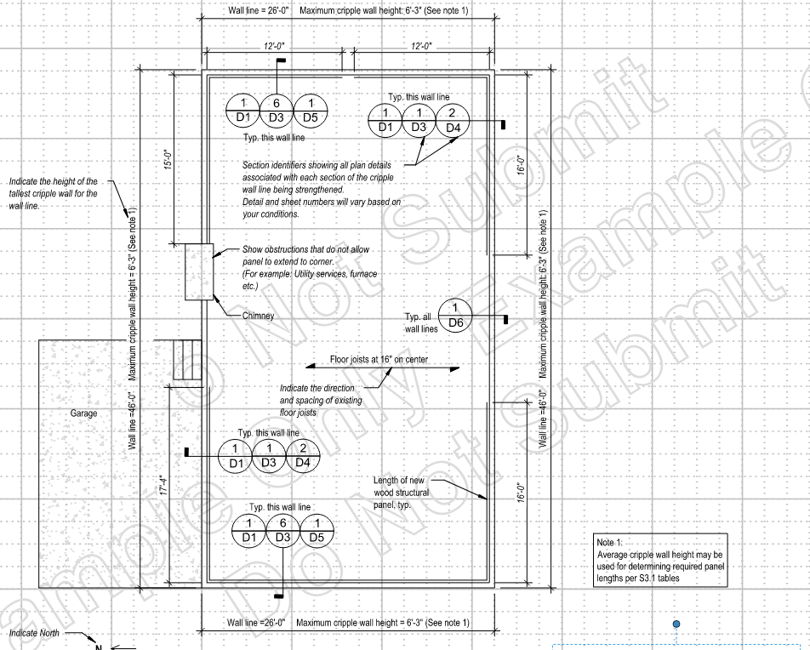
SHEET S4 – FLOOR PLAN
Draw Floor Plan - Sheet S4
Measure and mark existing conditions.
Show which of the details provided will be used.
Mark and note wall bracing for each exterior wall line and show length of braced wall panels.
Refer to example floor plans (Sheets 17-21).
Notes:
Once the assessment is complete, it is time to show how the existing foundation or pony wall below the first floor will be anchored, braced and connected to the first floor framing.
The plan set has general sheets to help with this and also some good example plan sets at the end of the plan set.

Slide 20
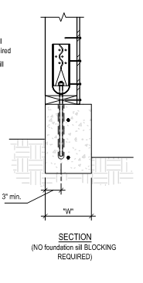
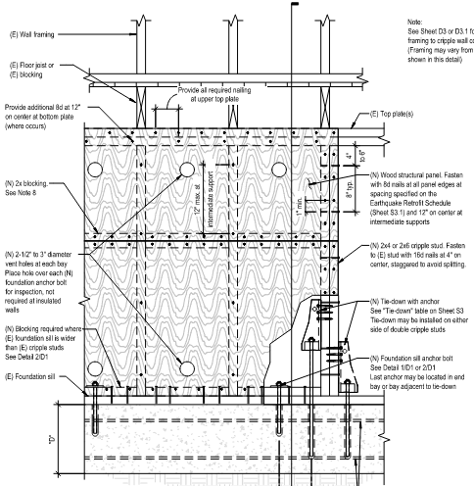
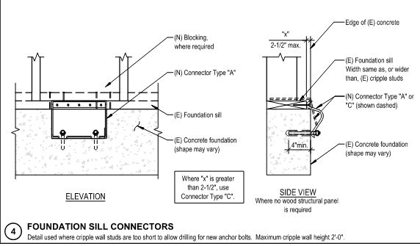
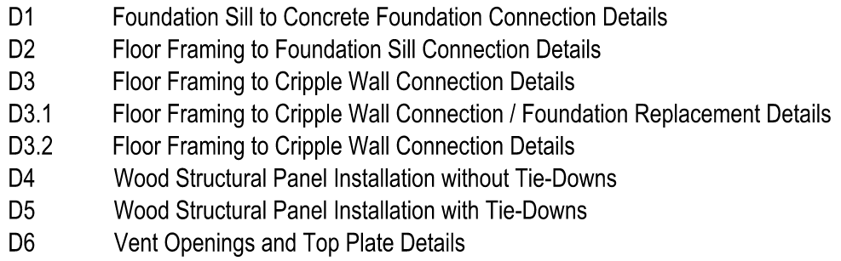
SHEETS D1 THROUGH D6 - DETAILS
Notes:
The standard details shown on the “D” Sheets D1- D6 help to define the scope of work and how the Anchors, Tie-Downs, Wall Panels and Framing Connectors will be installed. They should match what is called out in the floor plan, especially if they are using tie-downs.

Slide 21

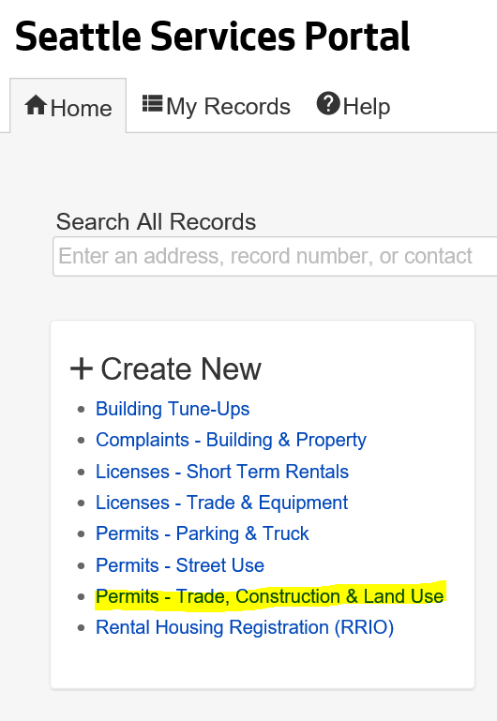
EHR - APPLICATION PROCESS
All Construction Projects, including the EHR Prescriptive start the same way
  Apply on the Seattle Services Portal
  Project review – respond to corrections
  Inspections
EHR PLAN SET– Application Benefits
  No need for an intake appointment
  Plan review is expedited
  EHR Plan review fees are typically cheaper than other permits
Notes:
Research, Assessment, Floor Plan… Now Application.
PAUSE for QUESTIONS

Slide 22
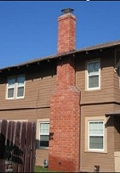
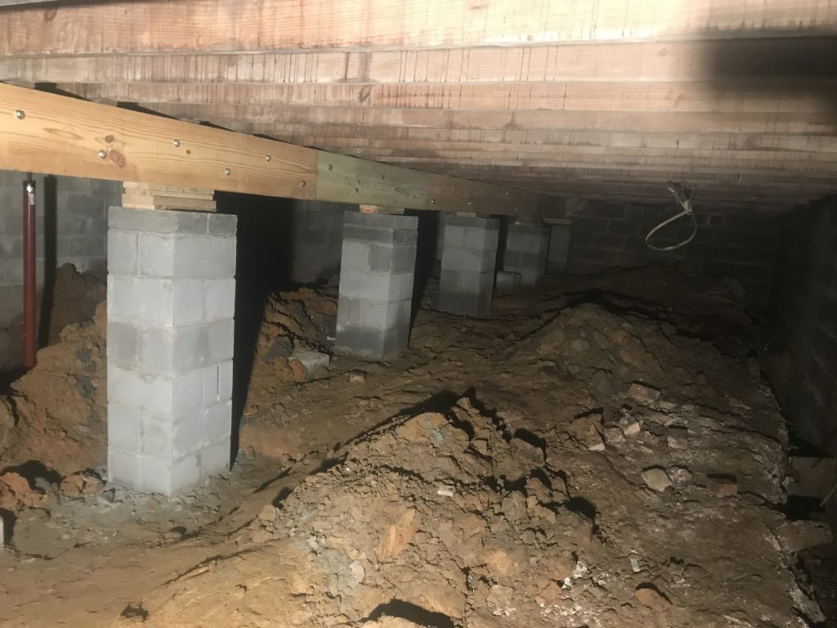
OTHER RETROFIT OPTIONS
Items not addressed by the EHR plan set:
Chimneys
  DR 7-2025
Framing above the first floor
Interior crawl space walls or columns
Notes:
So what is not addressed by the earthquake home retrofit plan set?
Chimneys, framing above the first floor, and interior crawl space walls and columns.
This plan set is focused only on exterior walls below the first floor framing and strengthening the connection between the first floor framing, the cripple walls, and foundation. Historically these other items have not been part of the prescriptive plan set and can be addressed in a separate permit

Slide 23
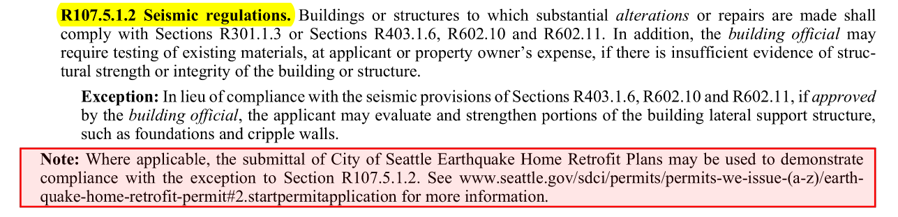
OTHER RETROFIT OPTIONS
Homes that don’t qualify for the EHR plan set
  Submit a voluntary seismic retrofit stamped and designed by an engineer
  Voluntary retrofits can be submitted as an STFI (subject to field inspection) permit
Are you doing other major alterations to your home?
  Plan review may be required
  Your permit might be a substantial alteration per the 2021 Seattle Residential Code section R107.5.1 and may need URM chimney upgrades per R107.5.3
    Seismic upgrades are a requirement for substantial alterations per section R107.5.1.2.
    Options for seismic upgrades are:
      Engineered Design
      EHR plan set

Slide 24
SUMMARY - RECAP
EHR Plan Set offers a prescriptive approach for improvements to existing homes.
Working to build a more disaster resilient community - Be Prepared.
  Focus is on Building Safety. This program will not “earthquake proof” your home.
What Types of Homes Can Use This Plan Set?
  Existing, wood framed homes that are on concrete foundations and are two stories or less in height may qualify.
What work is being done and where?
  Anchor to the foundation, Brace the walls below the first floor and Connect these walls to the first-floor framing.
Key Pages of EHR Plan set and how to apply.
Other retrofit options
Notes:
While we cannot prevent earthquakes, we can better prepare ourselves and our homes for when they occur.
The EHR Plan set has several benefits:
Simplify construction permit process, reduce permit cost.
Calculations or drawings by an engineer are not required.
Plan set can be submitted without an intake appointment.

Slide 25
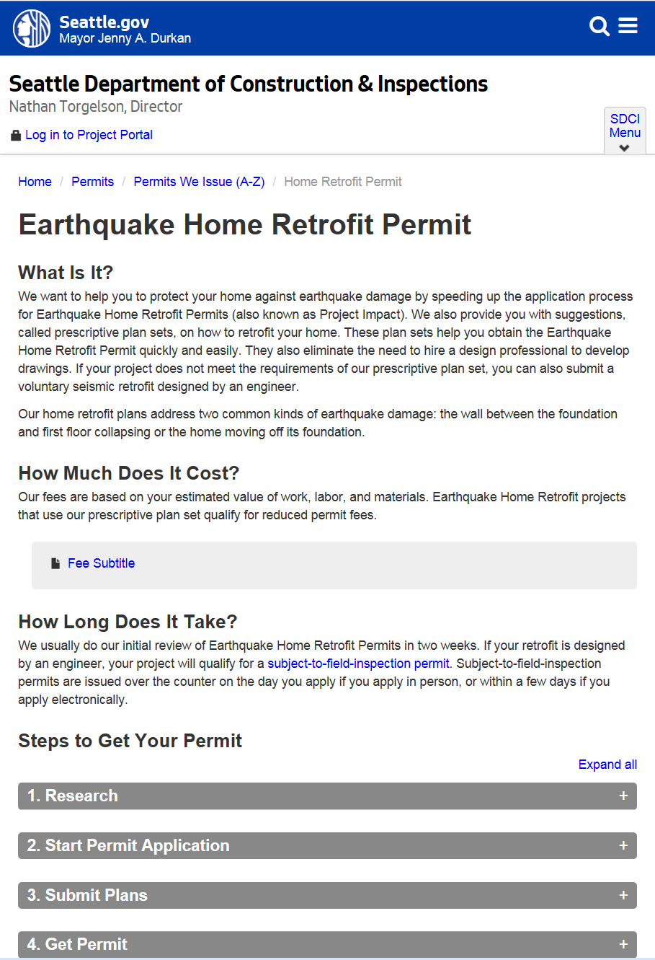

SDCI – PERMIT RESOURCES
SDCI Website / EHR Permit: http://www.seattle.gov/sdci/permits/permits-we-issue-(a-z)/earthquake-home-retrofit-permit
STFI application: https://www.seattle.gov/sdci/permits/permits-we-issue-(a-z)/construction-permit---subject-to-field-inspection
SDCI – Ask us a question Online: www.seattle.gov/sdci/resources/send-us-a-question
  Chat with us online!

Slide 26
Questions?
Kristen Malec
Kristen.Malec@seattle.gov
(206) 256-6423
Dean Greenleaf
Dean.Greenleaf@seattle.gov
(206) 733-9056

