Slide 1
SDCI: Tree Regulations
Seattle Home Fairs
February 11th 2023

Slide 2
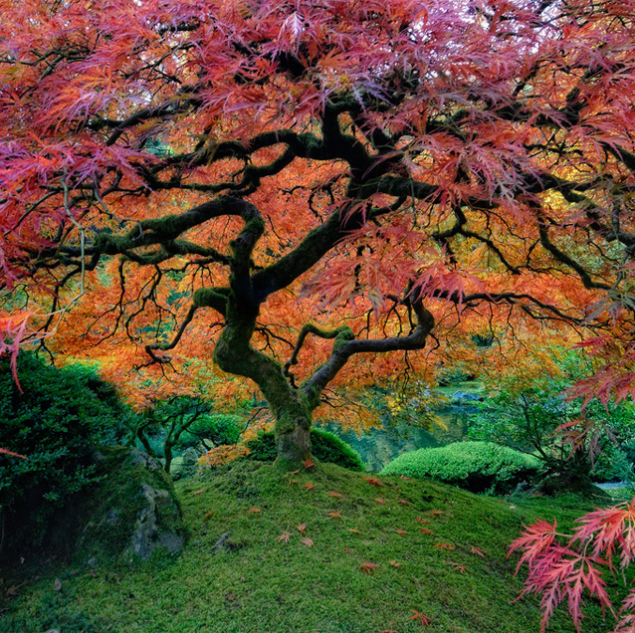
SDCI Home Fair Team
Deborah McGarry
Senior Environmental Analyst (Arborist)
Jonathan Garner
Land Use Planner
Please remember to…
Remain muted during the presentation
Type your questions into the Chat box
Wait to the end to ask your question(s)
This presentation and Q and A session are being recorded.

Slide 3
Presentation Objectives
Explain tree regulations on private property
Inform residents
Not an in-depth discussion of city-wide tree policy
Feel free to use our Q and A portal to submit a question offline. You will receive a response within 2 business days.
https://crosscut.com/sites/default/files/styles/max_1330x1330/public/images/articles/edwards_sidewalks.jpg?itok=b1Y6nCQW

Slide 4
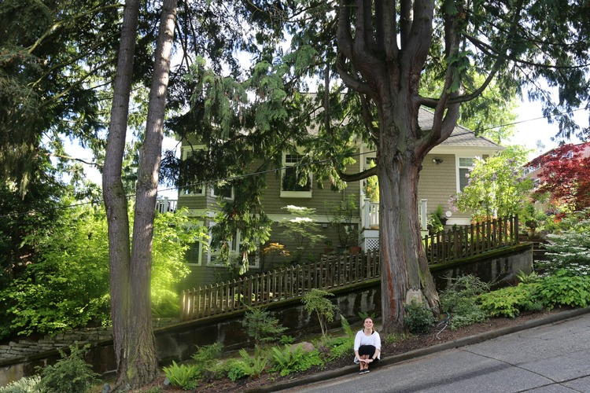
Trees in Seattle
Undeveloped Land
You may not remove trees 6” in diameter or greater on undeveloped lots
Unless hazardous
You must apply for and obtain approval from SDCI prior to tree removal.
Developed Land
Exceptional trees are protected
If hazardous, SDCI approval needed for removal
Removing up to 3 non-exceptional trees/year is allowed
Environmentally Critical Areas (ECAs)
Tree removal in most ECAs requires a permit.

Slide 5
Do I Need Approval?
Within the City of Seattle, removing or pruning a tree on your property may be regulated depending on a number of factors:
Zoning of your property
If your property is in an Environmentally Critical Area
If you are building an addition or new construction
If you have any trees over 6” in diameter
Trees on right-of-way are subject to additional regulations.
This presentation is about trees on private property.
The Seattle Department of Construction & Inspections (SDCI) administers and enforces regulations related to private property and development that affects trees.
The Seattle Department of Transportation (SDOT) regulates trees in the street rights-of-way.

Slide 6
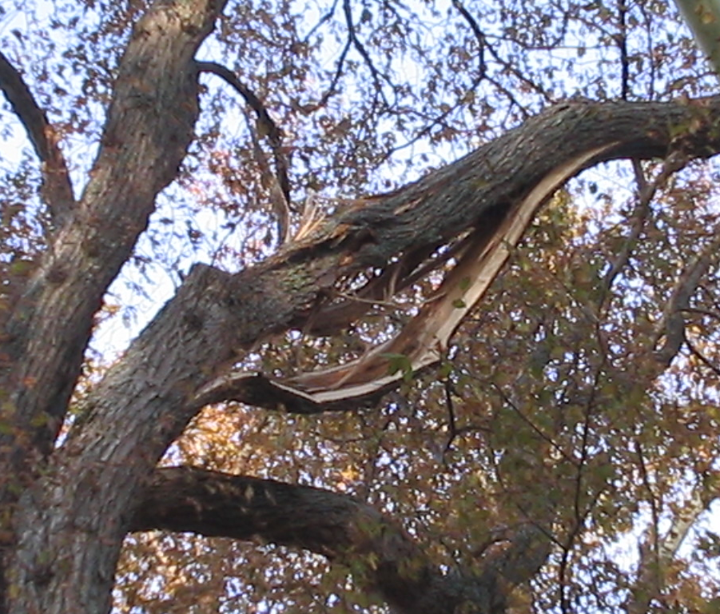
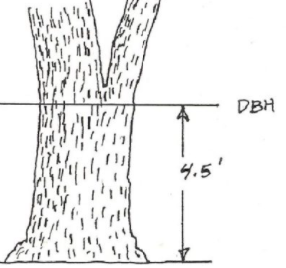
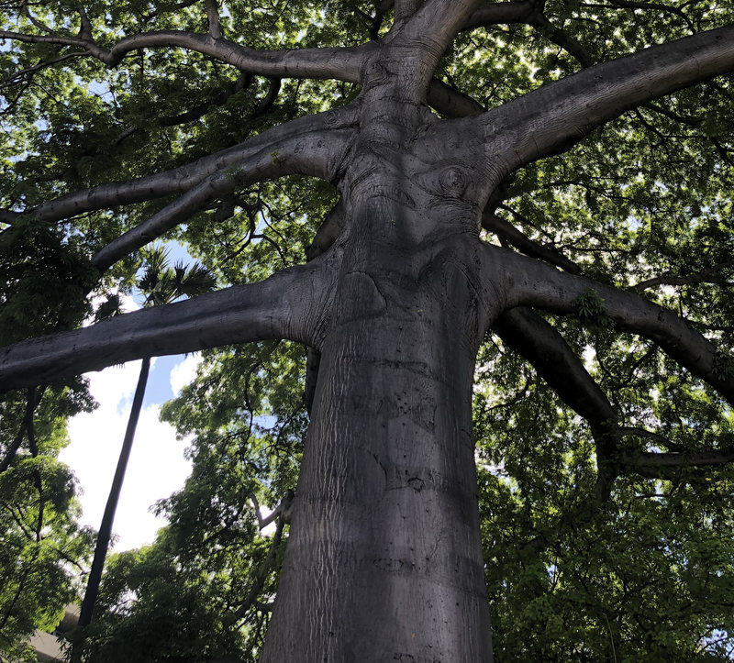
Categories of Trees Affected by Regulation
Trees over six inches in diameter, measured four and one-half feet above the ground known as Diameter at Standard Height (DSH).
Exceptional trees — trees that have significant value due to their size and species as defined in Director’s Rule (DR) 16-2008 which have unique historical, ecological or aesthetic value.
Hazardous trees — trees that pose a high risk of damage to persons or property

Slide 7
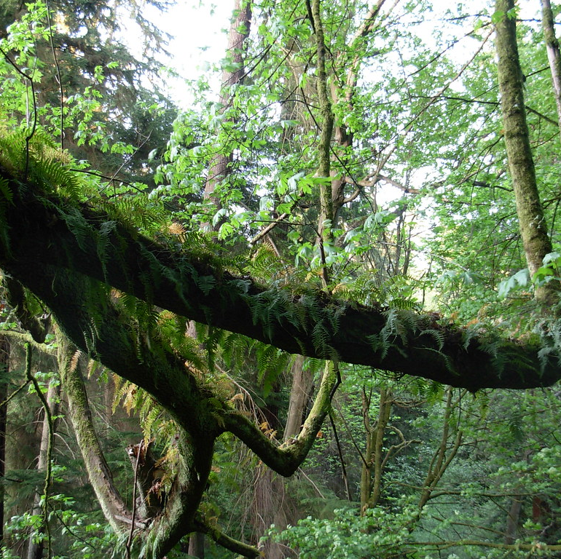
What is allowed in an Environmentally Critical Area (ECA)?
Normal and routine maintenance
Work done as part of an issued building or grading permit

Slide 8
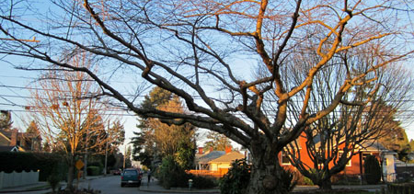
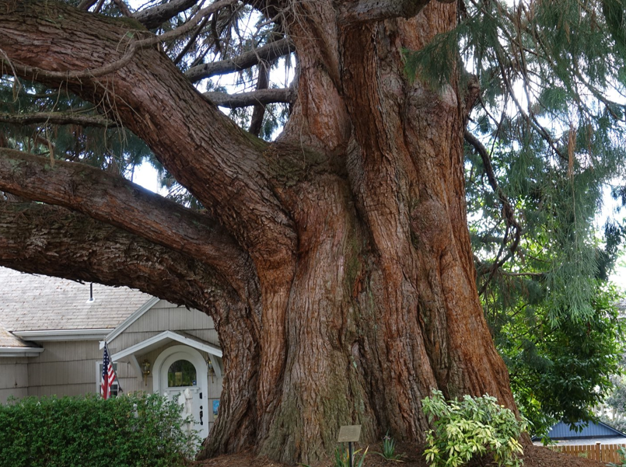
Exceptional Trees
An exceptional tree:
Designated as a heritage tree by the City of Seattle; or
Listed in Director’s Rule 16-2008
75% largest in “Trees of Seattle”
What you must know to determine whether it is exceptional:
The diameter of the tree at 54” above the ground
The scientific name (genus and species)
Heritage tree map

Slide 9
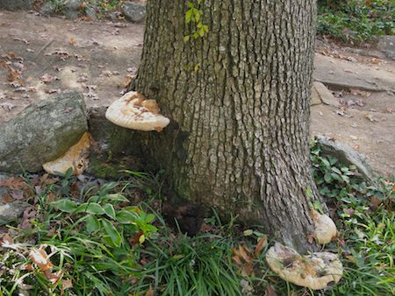
Hazard Trees (Exceptional or ECA)
Structural defects and/ or disease
Near potential targets
ISA-certified arborist qualified in tree risk assessment and on the SDCI registry.
More information in TIP 242B
Removal of a hazard tree requires submitting an application and receiving approval by SDCI prior to removal.
Infrastructure damage
Building foundation
Photos must show damage or proximity
Emergency Tree Removals: Qualify if pose an immediate danger to life or property.
Immediately submit an application for tree removal with documentation and photos clearly demonstrating the defects and emergency conditions.

Slide 10
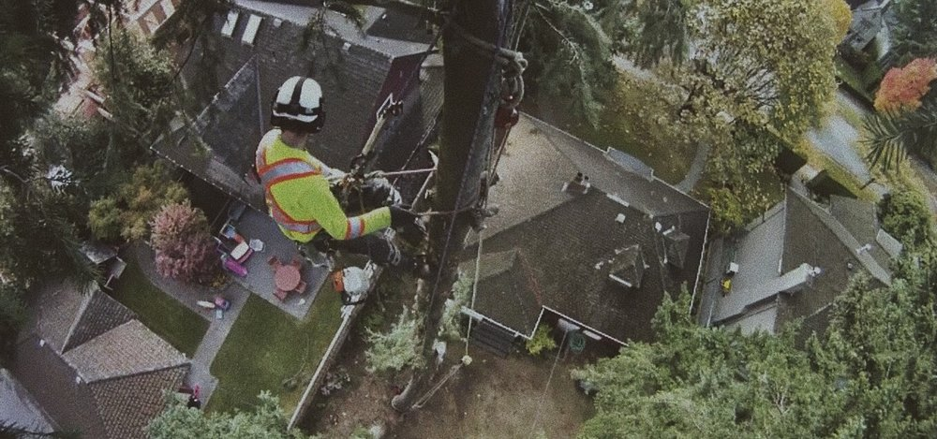
Private Trees: SDCI APPROVAL is REQUIRED if
Tree(s) are exceptional
More than 3 in a one year period
Lot is undeveloped
Street Trees SDOT APPROVAL/PERMIT REQUIRED
you must obtain a permit from SDOT before removing/pruning/planting any tree on a City right-of-way
https://www.seattle.gov/transportation/permits-and-services/permits/street-tree-permits

Slide 11
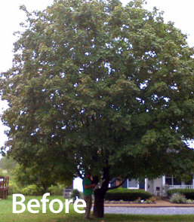
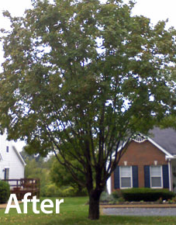
Tree Pruning
The pruning of a tree through crown thinning, crown cleaning, windowing, or crown raising. Does not include the topping of trees or any other trimming which is likely to kill or significantly damage the tree.
Private Trees in Environmentally Critical Areas (ECA’s)
SDCI APPROVAL MAY BE REQUIRED
Pruning must meet ANSI 300 standards and large trees shall be pruned by I.S.A. certified arborists only.
Topping is not allowed.
Street Trees
SDOT PERMIT REQUIRED
Seattle Municipal Code requires that all persons who prune privately maintained trees within the public right-of-way area obtain a street use permit
To apply for a pruning permit, call 206-684-TREE (8733)

Slide 12
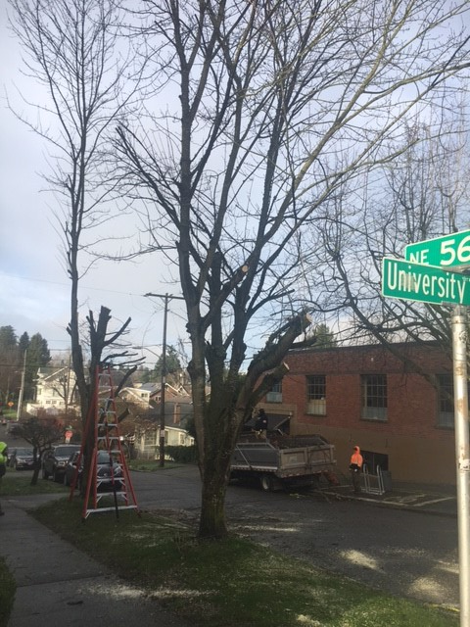
Tree Pruning
Private Trees (outside of Environmentally Critical Areas)
NO APPROVAL REQUIRED*
Topping* = Removal
*Topping—The cutting back of limbs to stubs within the tree's crown, to such a degree as to remove the normal canopy and disfigure the tree; or the cutting back of limbs or branches to lateral branches that are less than one-half ( 1/2) of the diameter of the limb or branch that is cut.
Has to be performed by a registered provider who is current on the SDCI registry.
Pruning of branches or roots 2” in diameter or greater is “major pruning”
Not pruning
Notes:
Pruning should be to industry standards, no specific code requirements though. Started November 2022.

Slide 13
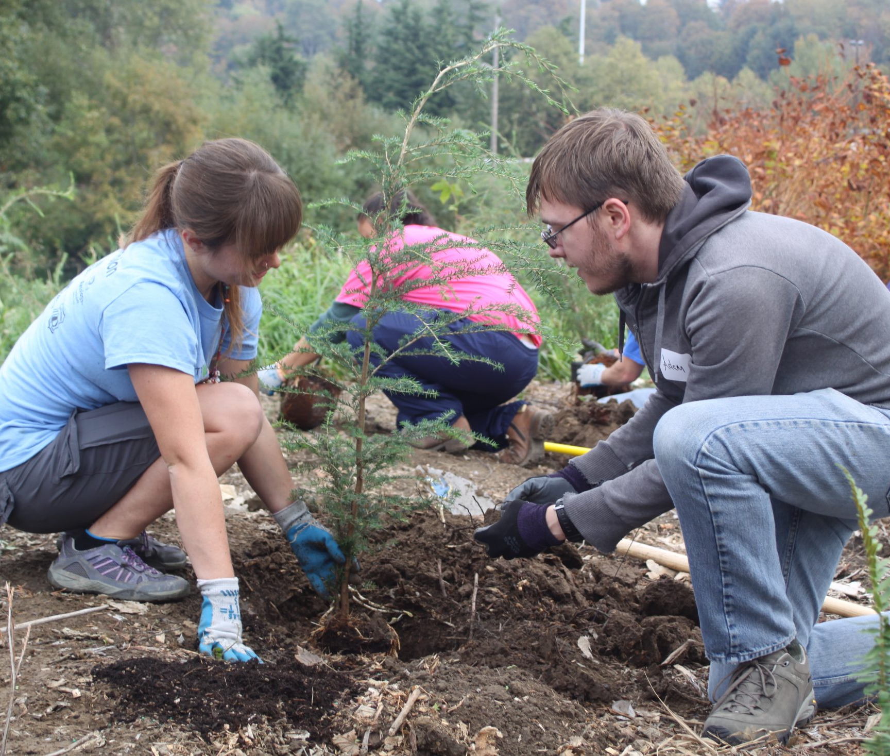
Planting trees
Street Trees
SDOT PERMIT REQUIRED
You must obtain a street use permit from SDOT before planting a tree along the street
Private Trees
NO SDCI APPROVAL REQUIRED (Except in ECA if part of larger restoration)
We encourage tree planting learn more about proper planting and site selection
A great source of tree related information and free trees: http://www.seattle.gov/trees/planting-and-care/trees-for-neighborhoods

Slide 14
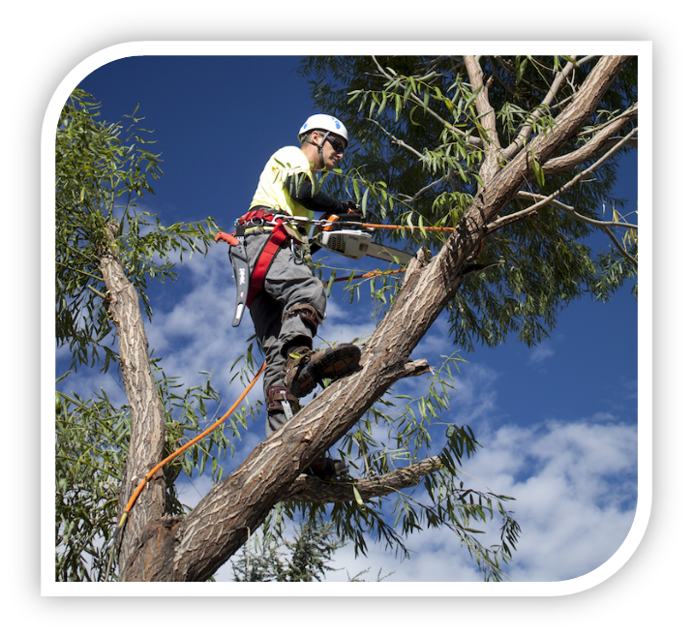
TREE SERVICE PROVIDER registry: New Code
Why?
Reduce loss of protected trees
Tree Service Provider Registry
Commercial Tree Work
Removal
Pruning
Consulting
Noticing requirements
Notes:
If you want to work with an arborist that is not on the list—ask them to get on the list. It’s free. We can help. Free advertising if on it, company and property owner subject to penalties if not on it.

Slide 15
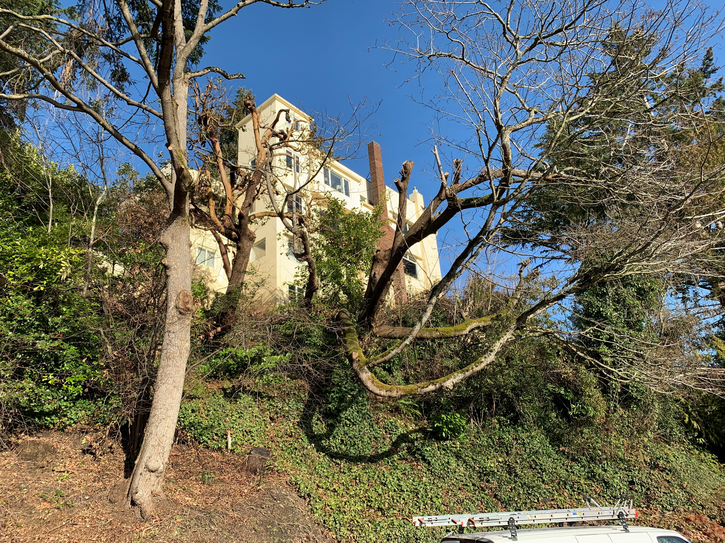
Illegal Cutting
What to do if you suspect Illegal cutting:
Check the permit and property records page:
https://web6.seattle.gov/dpd/edms/
PARKS
206-684-4075
RIGHTS-OF-WAY
206-684-8733
PRIVATE PROPERTY
https://www.seattle.gov/sdci/codes/make%C2%A0a-property-or-building-complaint
Or call 206-615-0808

Slide 16
Where Do I Find More Information?
Information on Tree Protection Regulations in Seattle can be found on the City of Seattle website at http://www.seattle.gov/sdci/codes/codes-we-enforce-(a-z)/tree-protection-code.
Tree Protection SMC 25.11
Environmentally Critical Areas, SMC 25.09
Director’s Rule 17-2018, Calculating Tree Valuations and Civil Penalties for Tree Protection Code Violations
Director’s Rule 16-2008, Designation for Exceptional Trees
Tip 242, Tree Protection Regulations in Seattle
Tip 242B, Hazard Tree
Tip 242C Tree Service Provider Registry
Tip 331, Environmentally Critical Areas-Tree and Vegetation Overview
Tip 331A, Environmentally Critical Areas-Vegetation Restoration
Common Seattle Trees (helpful guide to identifying common trees, including exceptional trees
Tree Protection Area Sign
Tree & Vegetation Protection Detail
Ask a question (SDCI Q and A portal)
Tree Service Provider Registry

Slide 17
Helpful Resources
Seattle Department of Construction and Inspections Tree and Vegetation Removal
Maps to see locations of Environmentally Critical Areas (ECA):
Seattle City Light Vegetation Management
Seattle Department of Transportation Street tree permits
Seattle Parks and Recreation Tree Health and Management
Trees for Seattle program
Plant Amnesty referral service
Great Plant Picks
Verify an ISA credential

Slide 18
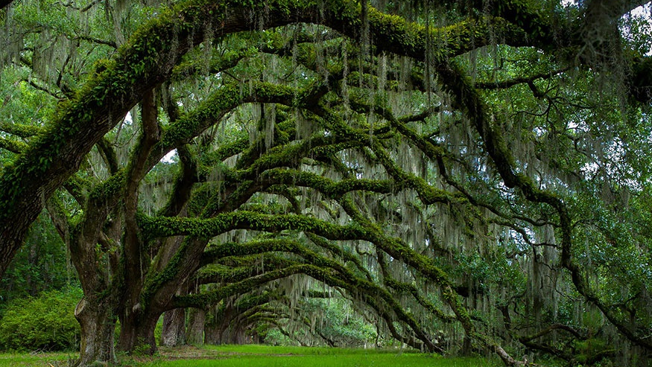
Contacting the Environmental team
https://www.seattle.gov/sdci/about-us/contact-us
Notes:
We are a small team, no live chat but we will answer your email within 2 business days.

