Slide 1

Renting in Seattle
Presented by
Seattle Department of Construction and Inspections

Slide 2
Welcome! Presentation Overview
Introductions
Summary of City Rental Housing Laws & Enforcement
Rental Registration
Economic Displacement Relocation Assistance – EDRA
Questions

Slide 3
      Quick Introduction – City Rental Laws
      Rental Regulations & Fair Housing Laws apply
      The Rental Life-Cycle
      Renting the Unit
      Moving-In
      Rental Relationship
      Moving-Out
Rental Cycle
Renting the Unit
Moving In
Rental Duration
Moving Out

Slide 4
Rental Housing Protections – Where they Apply
Advertising/marketing Habitability Registration Tenant Screening
Application
Rental Cycle
Ready to rent?
Moving In
Rental Duration
Moving Out
Move-in costs Rental Agreement
Service Animals
Rent Payment Landlord Access
ADA Laws Repairs Notices Room-mates
Displacement
Increasing Rent Lease Renewal
Just Cause Eviction Security Deposit Return Retaliation Eviction Defenses

Slide 5
Seattle Rental Housing Protections - Enforcement
Enforcement
SDCI - Seattle Department of Construction and Inspections
Habitability standards
Rental regulations
Land use code
SOCR - Seattle Office for Civil Rights
Based on protected classes
Fair Housing (including first-in-time) and Fair Chance Housing
Reasonable Accommodation/Modification

Slide 6

Is the Unit Ready to Rent?
Is the rental unit registered? Since 2014 the Rental Regulation Inspection Ordinance (RRIO) requires registration that renews every 2 years.
Minimum standards exist for:
Space & Occupancy (floor area)
Light & Ventilation (windows, air flow)
Sanitation (kitchen, bathrooms, plumbing)
Structural (roofs, foundations, chimneys)
Mechanical (heating, electrical)
Fire & Safety (stairs, exits, egress, alarms)
Security (entry locks, observation ports)
Inspections every 5-10 years
RRIO checklist is found at www.seattle.gov/RRIO

Slide 7

Relocation Assistance
Some rental termination notices require payment of relocation assistance to renters
Displacement by development – demolition, substantial rehab, change of use, removal of use restrictions (TRAO)
Illegal unit must be discontinued because of a zoning violation (JCEO)
Emergency order to vacate and close for imminent health and safety risk
EDRA – Economic Displacement by a rent increase 10% or more in a 12-month period (income eligibility required)

Slide 8
EDRA – Economic Displacement Relocation Assistance
July 1, 2022
Housing cost increases totaling 10% or more in the same twelve-month period (by one notice or combined notices) triggers EDRA
Landlords must use the EDRA specific notice which explains to renters their potential right to relocation assistance if they give notice to vacate/actually vacate after receipt
The EDRA notice is translated in Amharic, Chinese (Traditional), Somali, Spanish, and Vietnamese.

Slide 9
Average Median Income – AMI
Who is eligible?
Households at 80% or less of the AMI
Give notice to move/move out after eligible increase
80% AMI (2022) based on Household Sizes:
Household size 1 = $66,750
Household size 2 = $76,250
Household size 3 = $85,800
Household size 4 = $95,300
Household size 5 = $102,950
Household size 6 = $110,550
Household size 7 = $118,200
Household size 8 = $125,800

Slide 10
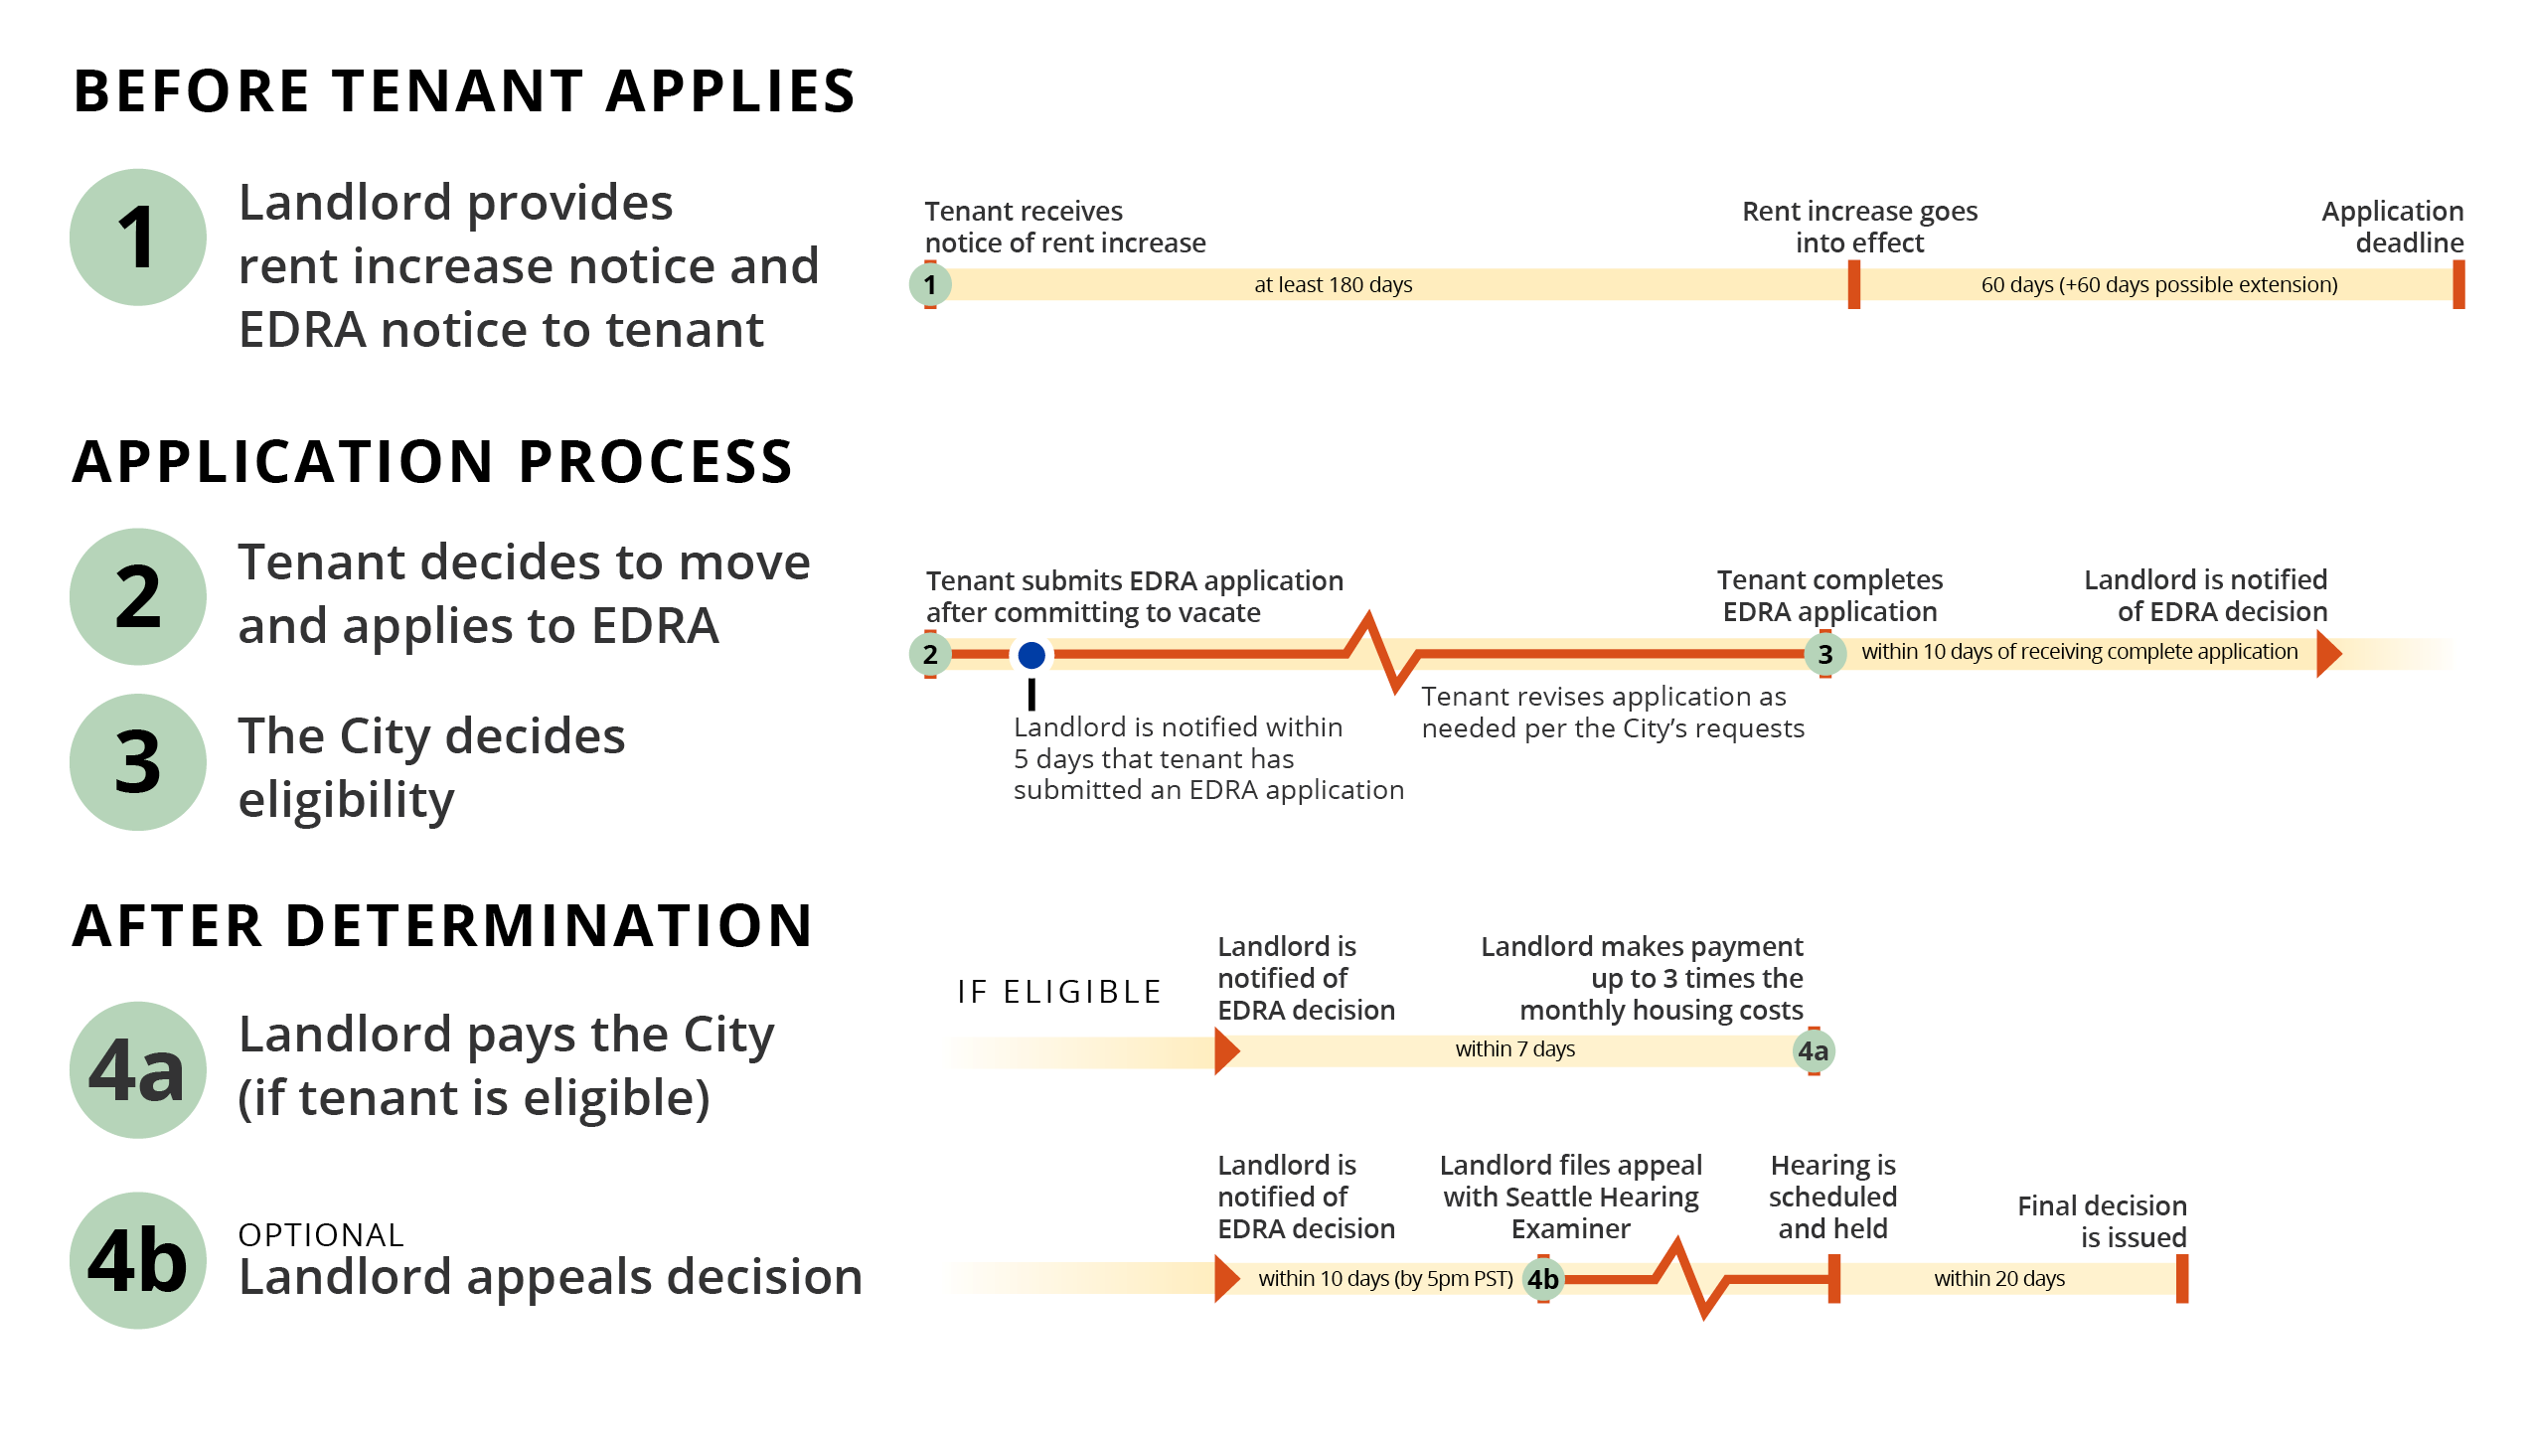
EDRA Application Process
Application is received and reviewed
If incomplete - additional documents or information needed to complete the review required
Up to 30 days to provide information requested
Notification by mail within 10 days of completed application submittal
Eligible households receive a check within 14 days -
Ineligible households can request an appeal within 10 days of being notified
Landlord is notified of payment due and also has a right of appeal

Slide 11
Process in flowchart

Slide 12
Final Thoughts
A simple rule of thumb each party should always consider how the other might feel in any given situation and respond accordingly!
When in doubt, reach out! Call the Renting in Seattle Helpline (206) 684-5700 for guidance and share the resource widely. We are here to help. Language assistance available.
Be informed. Both landlords and tenants can find information on every stage of the renting experience at www.seattle.gov/rentinginseattle
Need help from SOCR, email at: discriminationquestions@seattle.gov

Slide 13

Questions?
Call the Renting in Seattle Helpline(206) 684-5700 www.seattle.gov/rentinginseattle

Slide 14
References
Rental Regulations
Title 22 Subtitle II - Housing Code
Habitable Buildings 22.206
Just Cause Eviction 22.205
Tenant Relocation Assistance 22.210
Economic Displacement Relocation Assistance 22.212
Rental Registration Inspection 22.214
TITLE 23 – Land Use Code
TITLE 7 – Consumer Protection
Rental Agreement Regulation 7.24
  Fair Housing Laws
  Seattle Municipal Code (SMC): https://library.municode.com/wa/seattle/codes/municipal_code
    Unfair Housing Practices (SMC 14.08)
    Fair Chance Housing (SMC 14.09)
  SOCR civil rights enforcement: https://www.seattle.gov/civilrights/civil-rights-enforcement

