Slide 1
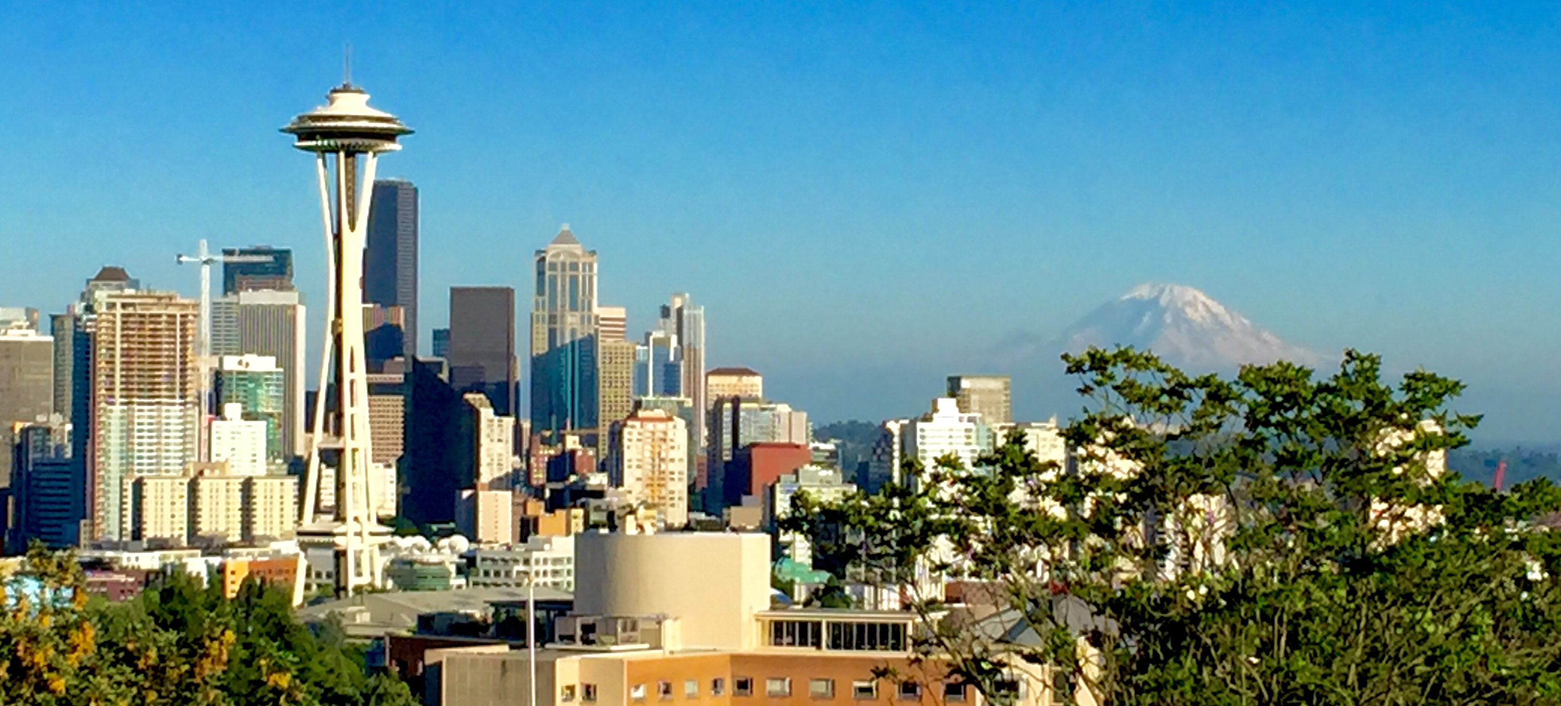

2023 Virtual Home Fair
Photo by John Skelton
Building Inspections
2023

Slide 2


Single Family Renovation/ Addition Construction Inspections
Hosted By: SDCI Building Inspections Group
Building Inspectors: Yavita.Kotomaimoce@seattle.gov and Daniel.Drouhard @seattle.gov

Slide 3
SDCI PURPOSE AND VALUES
Our Purpose
Helping people build a safe, livable and inclusive Seattle.
Our Values
Equity
Inclusion
Learning
Accountability
Stewardship
Notes:
SDCI has developed the purpose and values for this department and we try to achieve these daily.

Slide 4
Or you can call 206-684-8950

Slide 5

Construction Inspections
What type of construction inspections do I need? It depends?
First Ground – Required when there is any ground disturbance.
Foundation - Before pouring concrete.
Setback - Before pouring concrete (same time as foundation).
TESC - Temporary Erosion Sediment Control measures during entire project to prevent soil erosion
Structural - Shear wall nailing, anchor bolt or hold down placement or any retrofit anchorage using epoxy or mechanical anchors.
Framing - Before installing insulation and after all trade permits are approved for a cover inspection. Often times an underfloor inspection is needed if you have a crawl space prior to installing sub-floor sheathing
Insulation - Before installing interior drywall.
Site Final - Final inspection of all permanent erosion control measures for the life of the project.
Final Inspection - To make sure other permits required for occupancy, such as plumbing, electrical, mechanical, sewer, site and any SDOT related right-of-way improvements, are completed.
WHAT INSPECTIONS
DO I NEED?

Slide 6
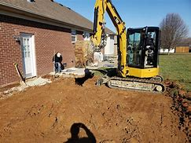
First Ground Inspections
https://rr-constructionky.com/services/dirt-gravel-work/

Slide 7
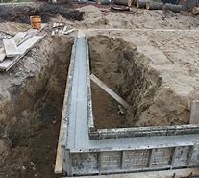

Foundation Inspection: &
Setback
Blogspot.com

Slide 8
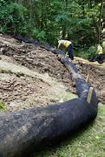
TESC

Slide 9
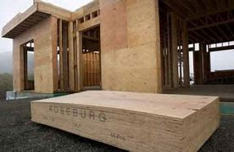
Structural Inspections:

Slide 10
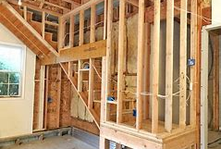
Framing Inspections

Slide 11
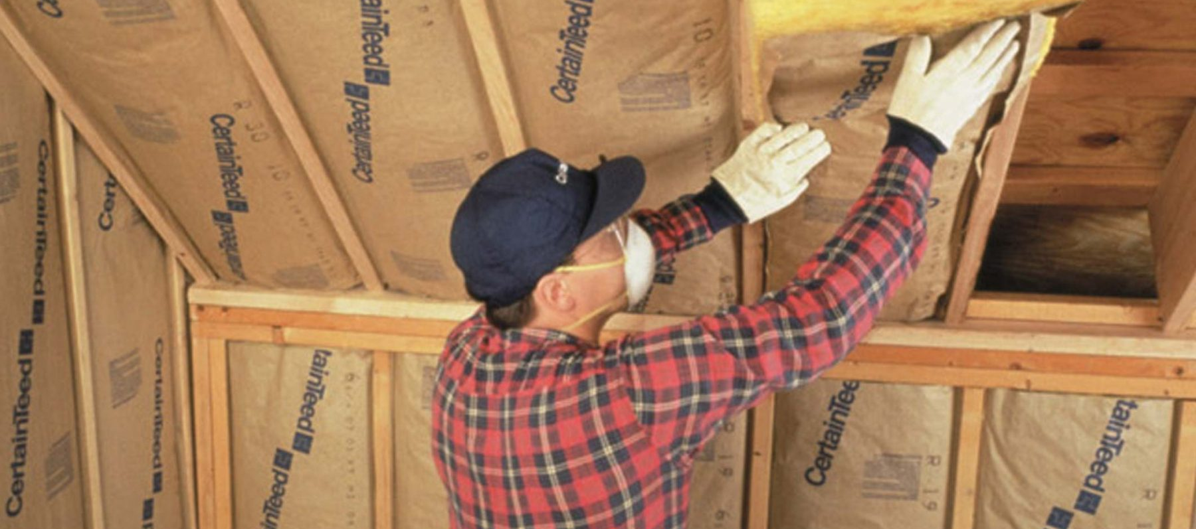
Insulation

Slide 12
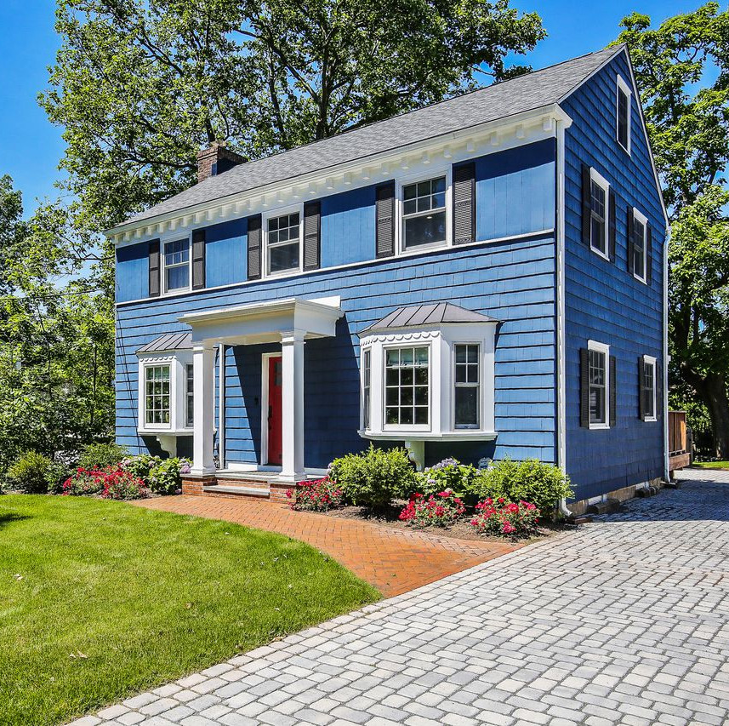
Site Final

Slide 13

Building Final

Slide 14
I HAD MY INSPECTION. WHATS NEXT?
If you didn’t have a correction from your Inspector, you have been given approval for the next step in the construction process.
Here is an example: My project was approved for cover at my framing inspection.
What does that mean? If you have insulation to install for this project that is required to meet energy code, you can install your products and schedule for your insulation inspection when its completed!

Slide 16
Frequently Asked Questions
What does Partial pass mean on my inspection result?
Why are there extra inspections
on my pending inspection list?
Can I continue construction if I fail an inspection?

Slide 18

QUESTIONS FOR US?

