Slide 1

Earthquake Home Retrofit
Prescriptive Approach and Plan Set
Seattle Home Fair – Prescriptive Earthquake Home Retrofit
Kristen Malec / Dean Greenleaf / January 28, 2023
Notes:
Welcome, this is a presentation on the Prescriptive earthquake home retrofit program, also known as Project Impact. The presentation is about to begin and should last just over a half an hour, with time for further discussion after.
My name is Dean Greenleaf and with me today is Kristen Malec. (Introductions here……… )
IF you have any difficulty hearing me or understanding what I am saying, please let me know. - best experience is if you can use the Web ex application and not just your browser, but you should be able to hear me on both
This presentation also has closed captioning and several translation options. HOVER OVER CC icons -.
In general you will be muted, but you can unmute yourselves if you need to and I encourage you to use the “raise hand” feature and chat.
More on that in a minute. Can everyone hear me? Great! Lets get started. Please be aware, this presentation will be recorded and the finished recording will be available on the SDCI website.

Slide 2

SDCI PURPOSE AND VALUES
Seattle Department of Construction and Inspections’ Purpose
Helping people build a safe, livable, and inclusive Seattle.
Our Values
Equity
Respect
Service
Quality
Integrity
Notes:
I have been working for The Seattle Department of Construction and Inspections or SDCI for over 15 years and have worked to become a subject matter expert on this voluntary earthquake home retrofit program.
I am familiar with residential construction and have experience as both a residential contractor, permit specialist and building plans examiner. I am happy to bring both to my service for this great City. This is good . . . . . service is one of the specific values SDCI uses to help people build a safe, livable and inclusive Seattle.

Slide 3


PROJECT IMPACT- OBJECTIVES
To help you understand more about Project Impact program
  Understand what the Project Impact Program is.
  Describe why this program is needed and where it applies.
  Go over what homes can qualify and how to use the free detailed prescriptive plans for Project Impact.
  Become familiar with the Resources we offer and how to apply.
Please feel free to type your question in the presentation chat or to raise your hand if you have a question or comment on what you see.
  For Example, Please raise your hands if you were in Seattle when the Nisqually Earthquake hit, 10:54 on February 28th, 2001? Please let me know where you were in the chat.
Raise Hand
Notes:
Raise hand option is next to your participants name and also an option if you click on the smiley face with a plus icon… let’s try it.

Slide 4
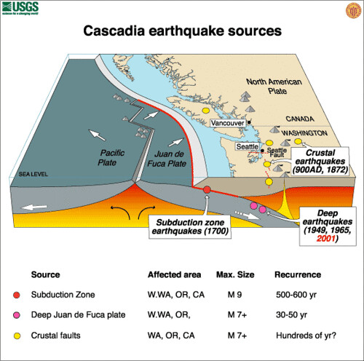
PROJECT IMPACT - AGENDA
What we are going to talk about today
  Earthquake! – Be Prepared!
  Building Safety and Project Impact
  History of Project Impact
  Purpose of Project Impact Program
  What Houses need Project Impact
  Anchor, Brace and Connect – Project Impact ABC’s
  Prescriptive Home Earthquake Plan Set
    Floor Plan and Key Pages
  How To Apply
  Resources

Slide 5

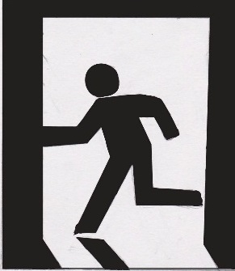
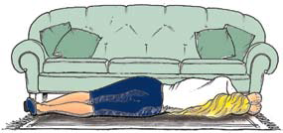
PUBLIC SAFETY IN AN EARTHQUAKE
Seattle Office of Emergency Management
http://www.seattle.gov/sdci/about-us/who-we-are
Think
Beneath
Beside
Between
Notes:
More information on emergency preparedness is available at the City of Seattle Office of Emergency Management.
The intent is to PROTECT yourself from falling debris and get to a safe place. Standing in a doorway or running out of the building may NOT be the safest place to protect yourself in a seismic event.
Please visit the site and develop a personal emergency plan. It is better to think of this before, rather than after an emergency.

Slide 6

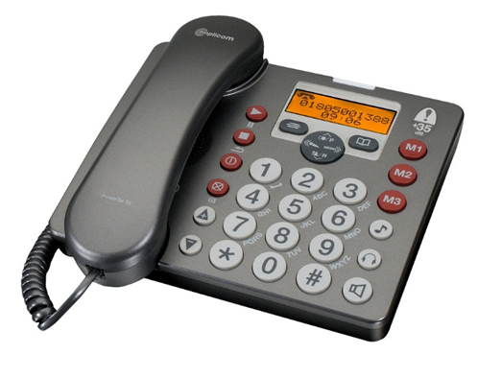
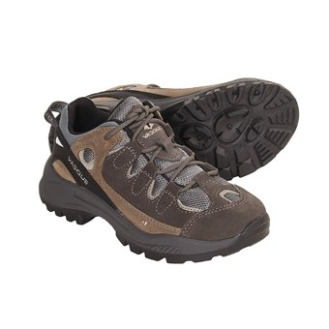


PERSONAL PREPAREDNESS FOR EMERGENCY
Supplies / Tools
Communication -
have a non-local contact
Notes:
ONE THING THAT YOU CAN DO IS HAVE AN EMERGENCY PLAN>
A personal emergency plan should include emergency supplies, one of which many people don’t think about is a pair of sturdy shoes.
Also, You and your family should have an evacuation plan and share a common contact person, preferably NOT a local contact.
In an emergency: texting may work better on damaged or disrupted networks than a phone call. A new item that has been added to the list is a charging bank.
Not a bad idea to have in your home.

Slide 7
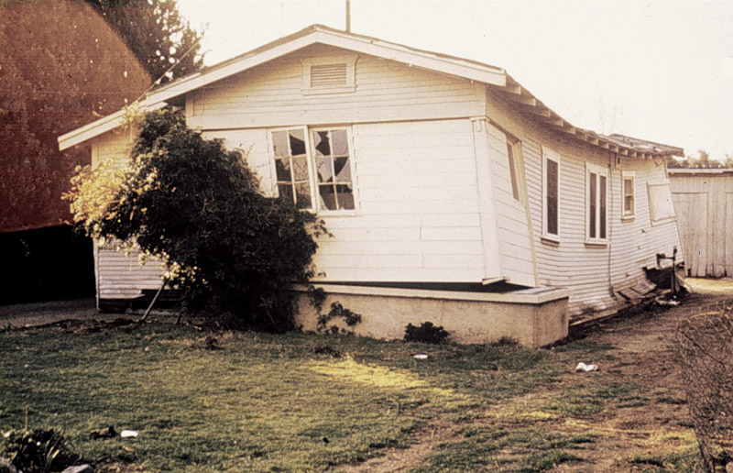
PROJECT IMPACT - BUILDING SAFETY
Project Impact is a prescriptive program to help residents strengthen existing homes
Promote public safety by making older homes safer and reducing damage in an earthquake
Improve resistance: Anchor home to foundation, Brace walls, and Connect to floor framing
To simply permit process for “retrofitting” existing homes for better seismic resistance
This program will not “earthquake proof” your home.
Photo – 1994 California Earthquake

Slide 8



PROJECT IMPACT – HISTORY
The Project Impact prescriptive retrofit program started in California after the 1994 Northridge Earthquake.
Seattle is one of several Jurisdictions that has used the prescriptive “Project Impact” plan set. Other jurisdictions using “mybuildingpermit.com” have a similar plan set.
Washington Association of Building Officials or WABO has recently adopted revised drawings that have been updated to apply to a broader group of existing homes. Seattle is in the process of revising and adopting them for use as part of this program.
Notes:
More information on this program is available in the Home Earthquake Retrofit Series Overview, one of three publications that support the Project Impact Program. This also discusses the input of Tom Kinsman from the City of Seattle DCLU and Linda Noson from the Permitting and Standards Committee.

Slide 9
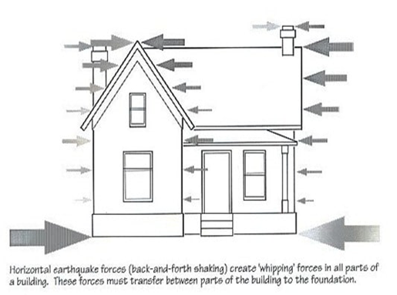
PROJECT IMPACT - PURPOSE
To improve building performance where seismic forces will be greatest.
This is a prescriptive earthquake home retrofit. A "retrofit" is meant to improve existing Buildng structure.
This program is designed to work for a typical 2-story, wood framed residence.
Other options are available for more homes that do not qualify for Project Impact.
Notes:
Earthquake Home Retrofit should Improve Resistance to a Seismic Event.
Seismic forces are greatest between the ground floor and the foundation, noted by the BIG arrow in the house elevation. This slide also includes a picture of the front desk at the SDCI Applicant Services Center, with my good friend Parmenter Welty.
Project Impact Earthquake Home Retrofit is a PRESCRIPTIVE METHOD. It is meant to help homeowners and contractors construct improvements to their homes without extensive engineering at a reduced permit cost. It is a “belt and suspenders approach” and is one of several earthquake home retrofit options. These would also include a ‘braced wall method’ design, as described in the Seattle Residential Building Code or a fully engineered design, specific to the residence and designed to resolve specific building issues.
PAUSE FOR QUESTIONS> remind we are recording, check chat.

Slide 10
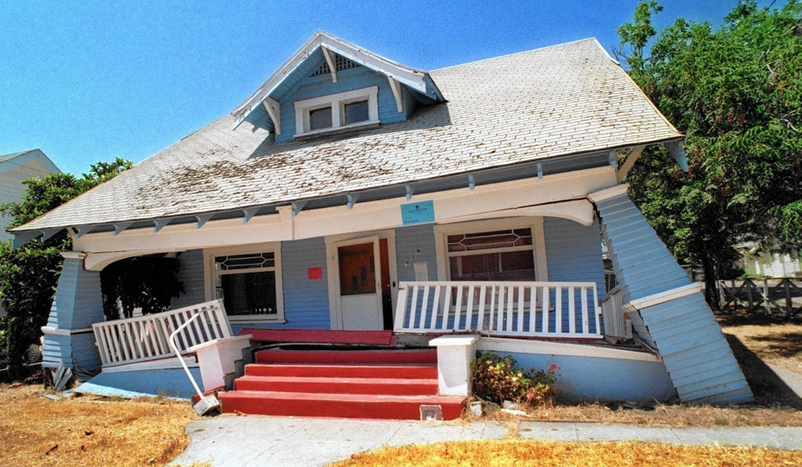
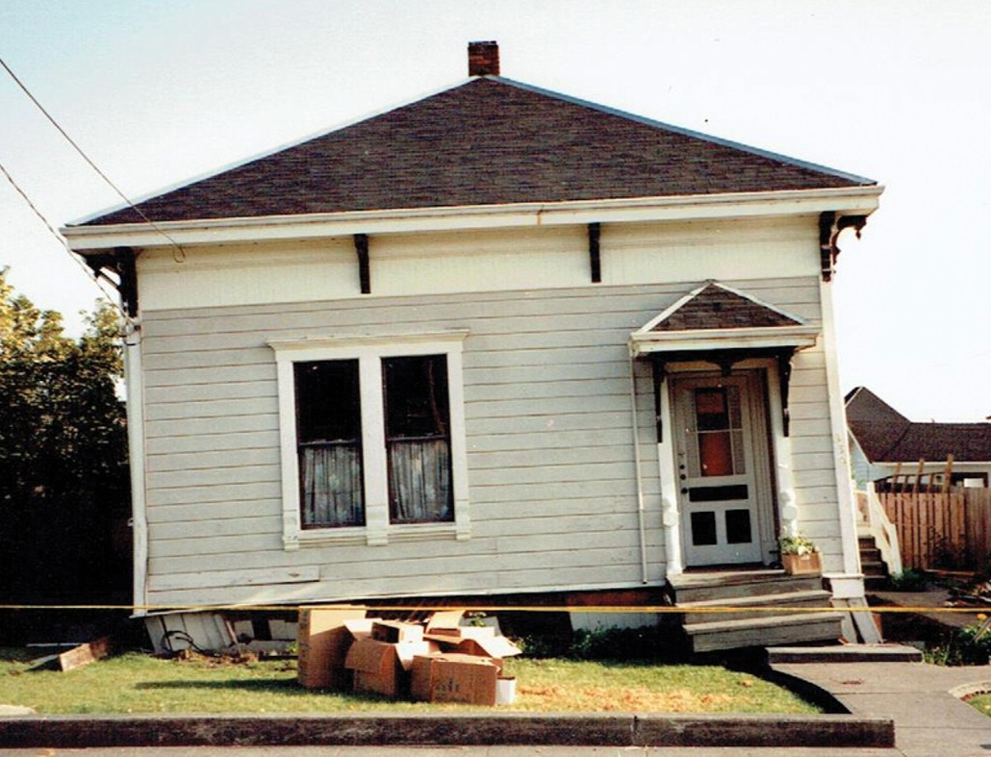
PROJECT IMPACT - PURPOSE
These are examples of the type of damage to a home that Project Impact Program is designed to reduce.
Photo – 1994 California Earthquake
Photo – Washington Association of Building Officials

Slide 11
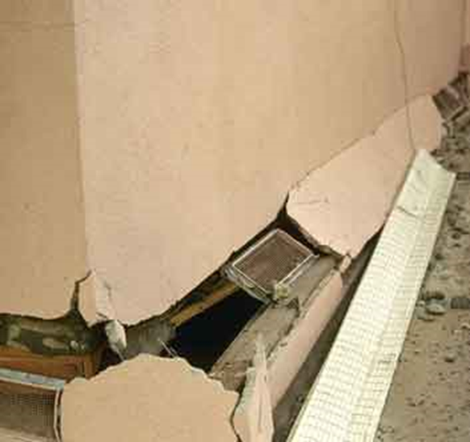
PROJECT IMPACT – WHERE IT IS NEEDED
The foundation below the exterior walls needs repair.
The connections between the home’s first floor framing, exterior wall and the underlying foundation are inadequate.
The short wall between the foundation and the first floor, commonly called the pony wall or cripple wall, is not structurally braced.
To the right is an example of where the foundation and connection to the exterior wall have been broken.
Photos from Bay Area Retrofit ™ Examples of San Fernando Earthquake Damage
Notes:
When looking into retrofitting a home to better resist earthquake forces; these issues are great places to start looking for places to provide improvement.

Slide 12
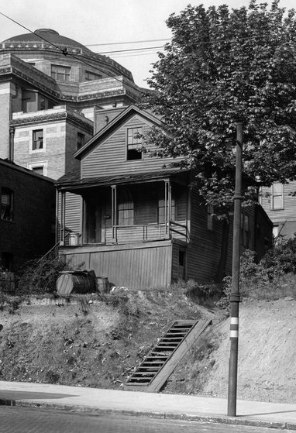
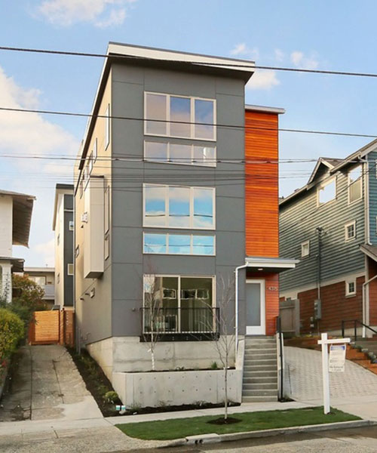
PROJECT IMPACT – WHEN IS IT NEEDED?
If the house was built after the early 1980’s, it may already have required anchors, bracing, and framing connections.
If your home could be considered “craftsman” or “mid-century modern”, you may need to retrofit.
Visit us online or consult with a contractor or architect.
Seattle Times – Hiram Burnett Home built in 1865
Sustainable Connections – modern infill housing “Skinny House”
Notes:
The Hiram Burnett home photo was taken in early 1900’s, but the home was built on what is now the corner of fourth and Columbia in 1865. You can see the old First Methodist Church behind it and just a corner of the Rainier Club Building, both of which are still standing today.
The building on the right has a full height concrete wall and was fully engineered under current building codes. It would not need a retrofit as it is current. It is also very skinny, with the total building width being 15-20 feet.
PAUSE FOR QUESTIONS – Does anyone know where the Hiram Burnet house is? The corner of Fourth and Columbia, in what is now the parking lot for the Rainer Club. Behind it is the 1st Methodist Episcopal Church, This important landmark church was largely designed by the Seattle architect James H. Schack and his firm between 1906 and 1907. It is now an event space called the “Sanctuary”.

Slide 13
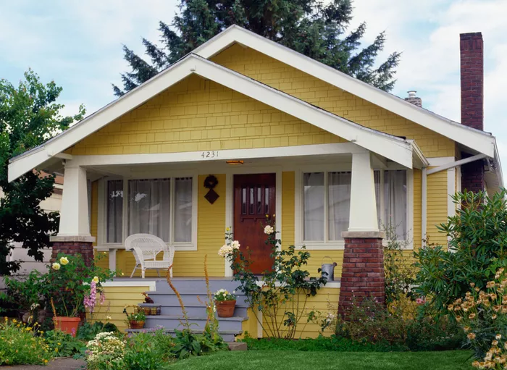

PROJECT IMPACT - APPLICATIONS
Which types of houses benefit from an earthquake retrofit?
  Prior to 1980, homes were typically constructed without adequate foundation anchorage, pony wall bracing, or framing connections
What is NOT in Project Impact?
Chimneys
Work above the first floor
Interior walls or columns
Notes:
Two examples of residential light-wood framing construction. On the left we have a mid century modern type of home, often built in 60’s and early 70’s here. On the right is an older home, probably build in the early 1900’s to the early 1920’s, known as craftsman construction style..

Slide 14
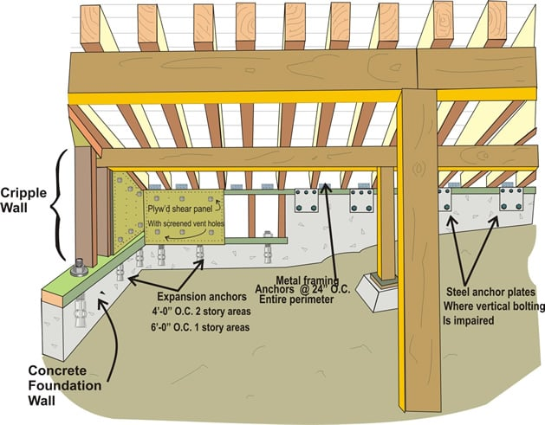
PROJECT IMPACT – WHERE WORK IS DONE
The Project Impact program consists of a set of plans that provide prescriptive improvements to specific areas based on your home’s characteristics:
  Basement or crawlspace
  One or two stories
  Square footage
  Wall and roof finishes
Crawl space illustration from Seismic Safety, Inc.
Notes:
The floor plan is a two dimensional representation of this three dimensional space, if you have questions on how to do this, you can go to a designer, architect or engineer.

Slide 15
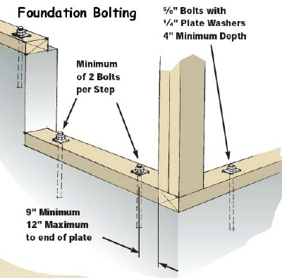
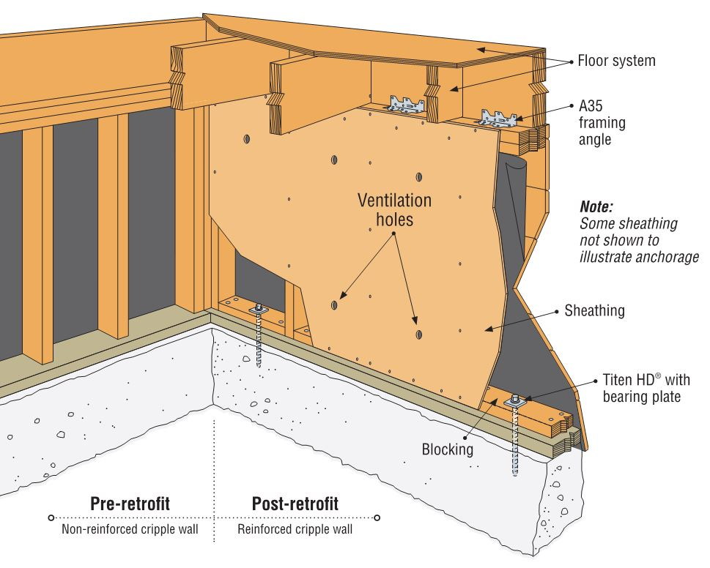
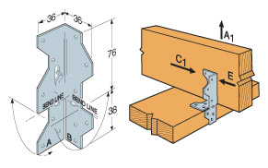
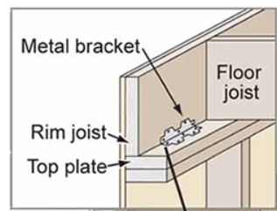
PROJECT IMPACT - A B C’s
Anchor to Foundation
Brace Walls Below 1st Floor
Connect Framing
Images courtesy of Walnut creek Construction, Hipspro.com and Simpson Strong tie Catalog.
Notes:
This is fundamental to seismic retrofits: the ABC’s Anchor, Brace and Connect.
There are several different kinds of bolts, plates and clips, more information on the different kinds is shown in the plan set and discussed in Project Impact publications.
PAUSE FOR QUESTIONS _ CHAT.

Slide 16
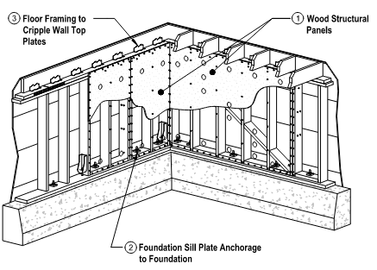

PROJECT IMPACT- PLANSET KEY PAGES
The prescriptive plan set is a complete package, with instructions on how to fill it out, details and descriptions of each connection and example of the retrofit layout.
These are the Key Pages in the prescriptive 21 page plan set:
  Coversheet: Sheet S0
  Foundation and retrofit layout plan: Sheet S4
  Earthquake retrofit schedule: Sheet S3.1
  Examples: Sheets 17-21
Notes:
ALRIGHT! Now to the main part of the Project Impact Program for Earthquake Home Retrofits: the standard project impact planset.

Slide 17
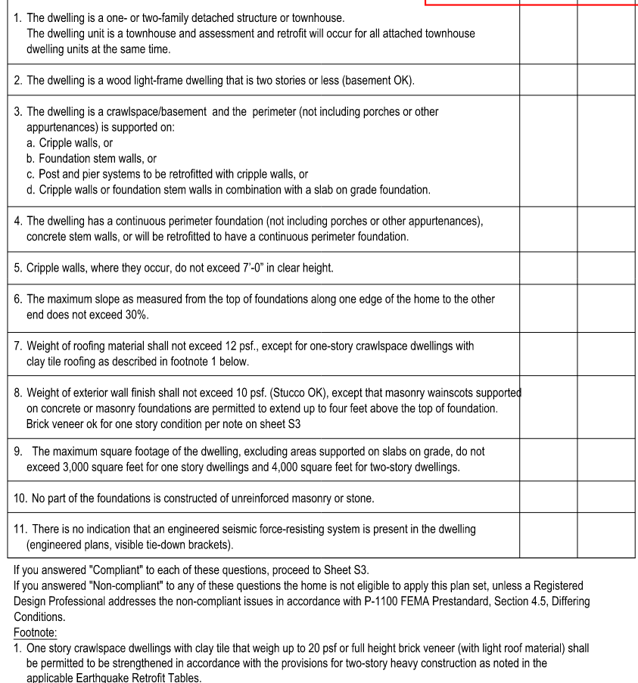
PROJECT IMPACT - QUALIFYING PROJECTS
How to determine if a home is eligible for Project Impact
Cover Sheet: S0
If the answer to any of these questions is NO or “Non-compliant,” the home is not eligible.
Details and examples of connections are provided.
Look for classes through the Seattle Office of Emergency Management.
Notes:
Item #7 is new and is different from the older earthquake retrofit prescriptive plan set.
So is Item #9, but that does not come up often, especially in older homes.
Item 11, is a little tricky and references additions or partial work to an existing building. When in doubt. ASK us! We are here to help.

Slide 18
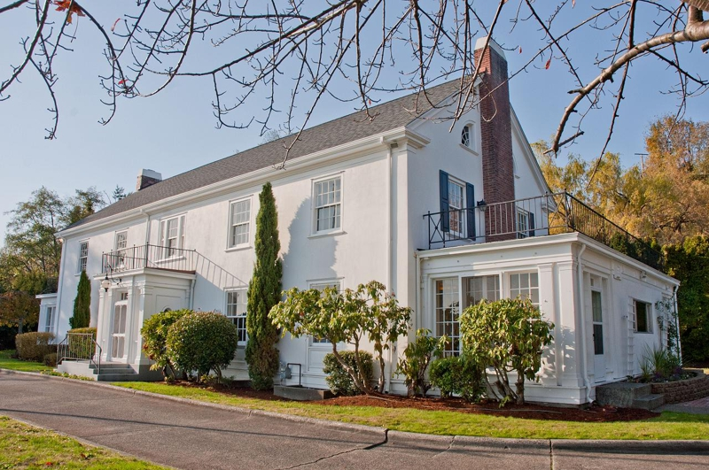
PROJECT IMPACT – DOES THIS HOME QUALIFY?
  Answers to Questions 1-11 help determine if the home qualifies.
      One or two family? Two Stories?
      Crawlspace/Basement? Foundation?
      Cripple Walls Under 7 feet tall?
      Under 30% slope?
      Does it have a lightweight roof? Brick exterior?
      Maximum Square footage of 4,000 Square Feet?
yup!
Sure!
Yes!
FLAT!
Light roof, no brick
Um….
NOPE.
Actual square footage is 7,300 square feet with ballroom and NOT including basement.
The Admiral’s House – Formerly Fort Lawton, Magnolia. 2001 W. Garfield Street. Photo courtesy of Cooper Jacobs Real Estate.
Notes:
Review bulleted items.

Slide 19
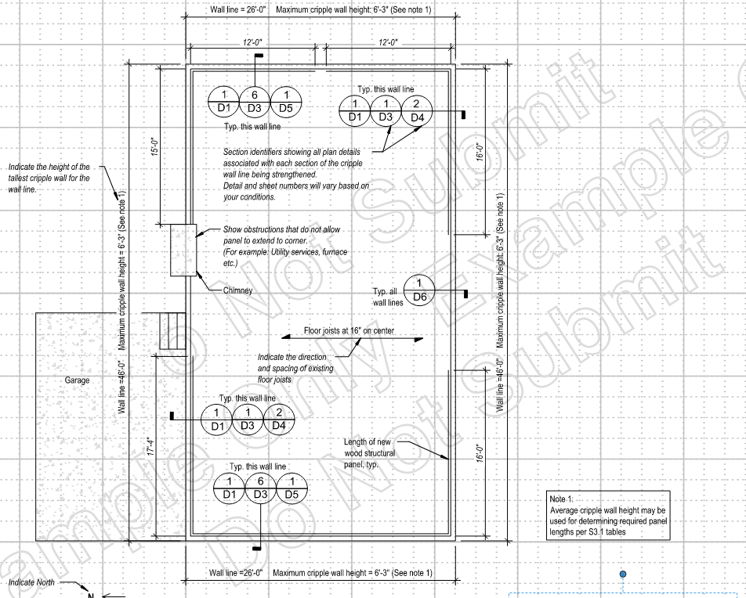
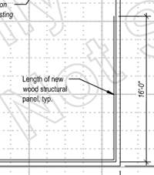
FLOOR PLAN – PROJECT IMPACT
Draw Floor Plan - Sheet S4
Refer to example floor plans, Sheets 17-21.
Measure and mark existing basement walls, doors and windows.
Show which of the details provided will be used.
Determine and mark wall bracing layout for each exterior wall line and length of braced wall panels.
Notes:
Once the assessment is complete, it is time to show how the existing foundation or pony wall below the first floor will be anchored, braced and connected to the first floor framing.
The plan set has general sheets to help with this and also some good example plan sets at the end of the plan set.

Slide 20
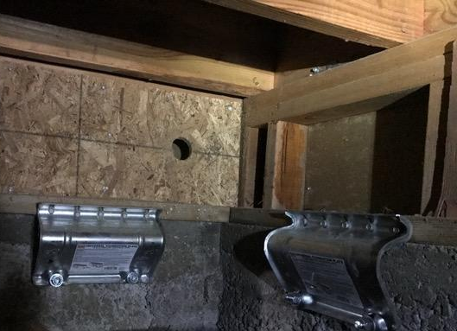
PROJECT IMPACT - BRACED WALL PANELS
Strengthening the Cripple Wall Using Braced Wall Panels - Sheet S3.1
  Creating a “braced wall panel” beneath the first-floor framing at basement wall or cripple wall.
  Cripple Wall Maximum height is 7 feet and minimum length is 2 feet
  All exterior wall lines are required to have a minimum total length of braced wall panels
OSB braced wall panel (with hole) and URFP courtesy of Simpson Strong Tie
Notes:
The wood braced wall panel is shown here, with a hole for ventilation and nailing around the perimeter to stiffen and brace that short pony wall.
The side anchor plates are another way to connect the sill plate to the foundation.
PAUSE FOR QUESTIONS – NOTE what URFP means - Universal Retrofit Foundation Plate

Slide 21
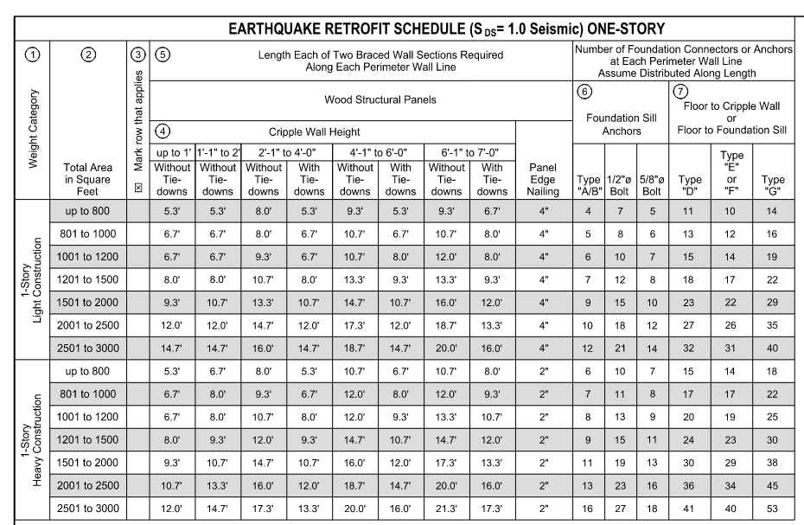
PROJECT IMPACT – BRACED WALL LENGTH
Braced Wall Section length - See Sheet S3.1
This Table is for One-story
Total = 2x value
Cripple Wall Height
Total building area.
EXAMPLE: single-story house, with a 4-foot (4’-0”) cripple wall and 1,400 square feet area would need two braced wall sections of about ___ in length
Notes:
This is a pretty complex table. The circled numbers can help. Remember there are two, very similar looking tables, one for single story and one for two story condition!! *** first animation
1.) Most projects will fall into a light construction table. Tile roofs or brick veneer construction can add weight and seismic mass to a residence. See plan set.
2.) Total Square footage, place to mark which rot applies. *** second animation.
3.) The cripple wall height is shown as a range, with different values for braced wall sections; one with and one without tie downs… *** Third animation.
4.) leaving two length shown. ***Last Animation. This would be the length of one of two required braced wall sections. To make this more usable, this can be the total of ALL the braced wall sections that are over 24” long..

Slide 22

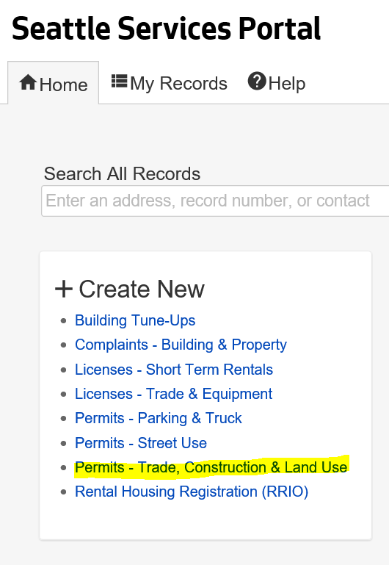
PROJECT IMPACT - APPLICATION PROCESS
All Construction Projects, including Project Impact start the same way
Project Impact – Application Benefits
  Submit plans for screening; similar to a Subject-to-Field-Inspection (STFI) permit. You do not need an intake appointment!
  Plan review is an expedited permit with shorter plan review items
  Prescriptive Home Retrofit Plan review fees are different, often cheaper than other permit fees.
Project review – respond to corrections
Inspections
Notes:
Research, Assessment, Floor Plan… Now Application.
PAUSE for QUESTIONS

Slide 23
SUMMARY - RECAP
Project Impact program offers a prescriptive approach to construct improvements to existing homes.
Working to build a more disaster resistant community
  This program will not “earthquake proof” your home.
Anchor, Brace and Connect
  This program looks to strengthen or “retrofit” the existing structure.
  Anchor to the foundation, Brace the walls below the first floor and connect these walls to the first-floor framing.
What Types of Homes Can Use Project Impact? What are the Benefits?
  Existing, wood framed homes that are on concrete foundations and are two stories or less in height may qualify
  Simplify construction permit process, reduce permit cost.
  Calculations or drawings by an engineer are not required.
  Planset can be submitted without an intake appointment.
Notes:
While we cannot prevent earthquakes, we can better prepare ourselves and our homes for when they occur.

Slide 24
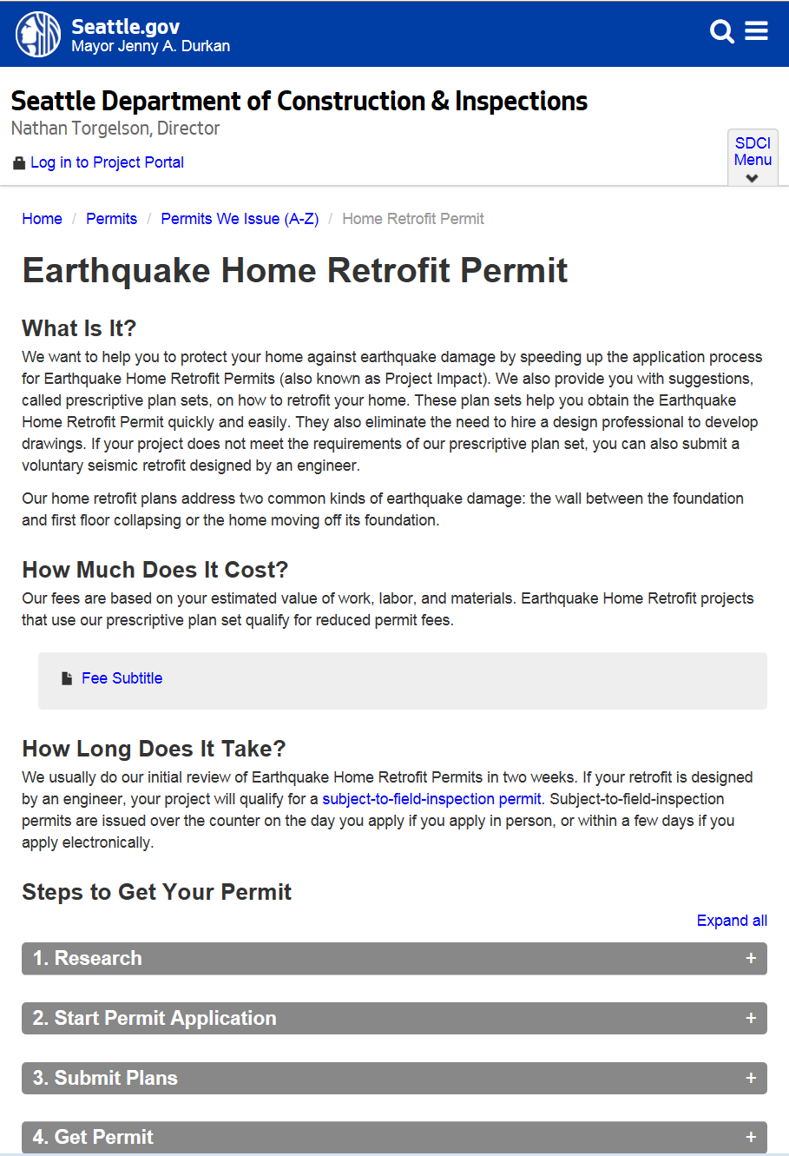

SDCI – PERMIT RESOURCES
SDCI Website: http://www.seattle.gov/sdci/permits/permits-we-issue-(a-z)/earthquake-home-retrofit-permit
WABO Prescriptive PLANSET https://www.wabo.org/index.php?option=com_content&view=article&id=236:earthquake-home-retrofit&catid=20:site-content&Itemid=175
Emergency Management Website: www.seattle.gov/sdci/about-us/who-we-are/emergency-management---landslides-and-earthquakes
SDCI – Ask us a question Online: www.seattle.gov/sdci/resources/send-us-a-question
  NEW! Chat with us online!

Slide 25
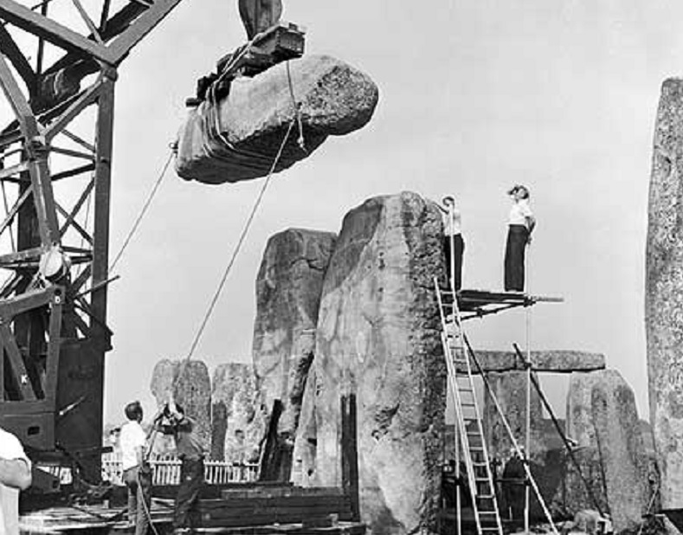
QUESTIONS?
Dean Greenleaf
Dean.Greenleaf@seattle.gov
(206)733-9056
www.seattle.gov/sdci
1901 Stonehenge restoration – from Amazfacts.com

