Slide 1
Making Every Drop Count
SPR’s Water Consumption & Management

Slide 2
Water use & cost portfolio

Slide 3
Where does SPR consume water?

Slide 4
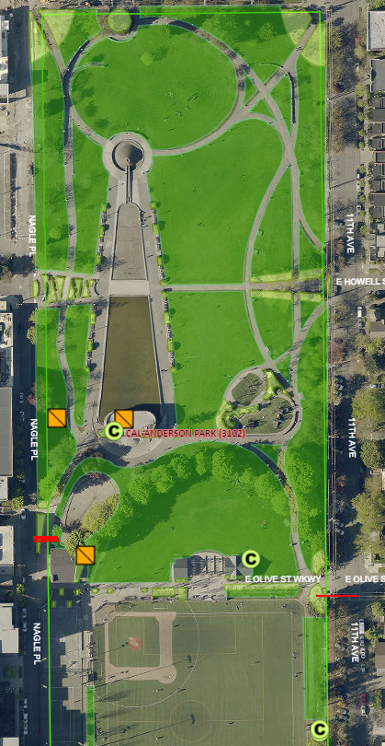
Let’s zoom in
Covers ~600 irrigated acres
450 acres in turf
150 acres in shrubs
About 75% of irrigation applied with Maxicom
SPR maintains ~350 systems

Slide 5
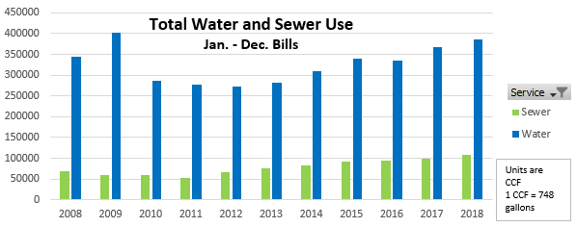
Water and sewer rates continue to rise
Water billing rates have doubled in the past 10 years.
Rates will increase again in 2019 by 5.8% above 2018 rates.

Slide 6
Using technology to support smart water use

Slide 7
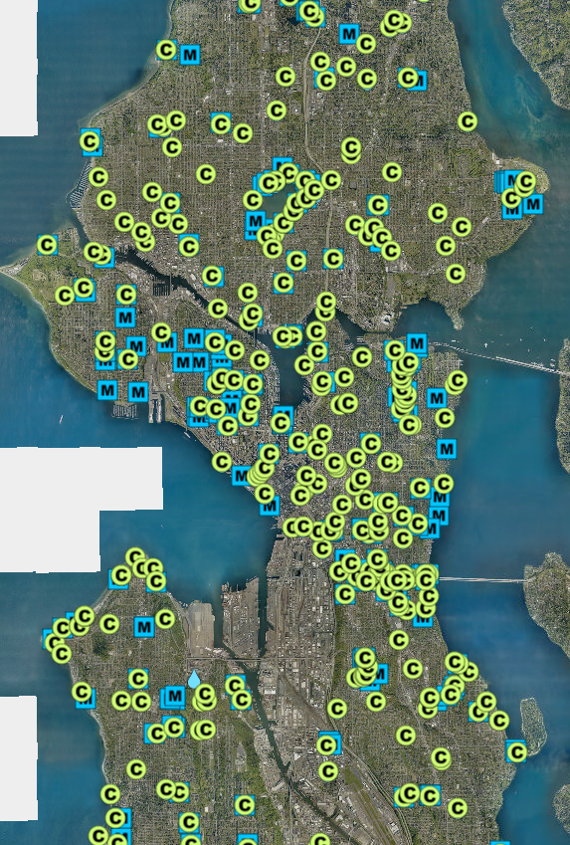
Technology Updates
Cell modem replacements for 114 Maxicom controller locations
Field staff use ArcGIS Collector app to collect asset information, or help them find it!
Controllers, rain sensors, valves, meters, etc.

Slide 8
What about this summer? Supply & Demand

Slide 9
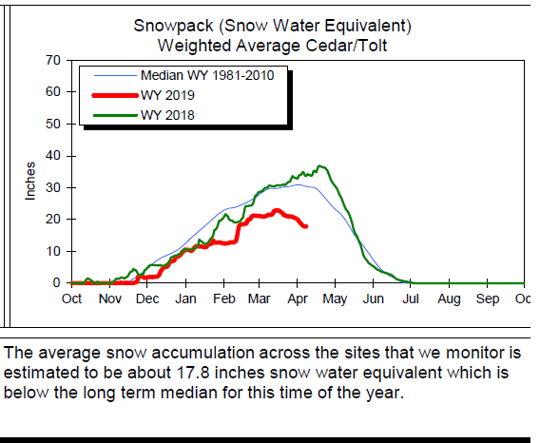
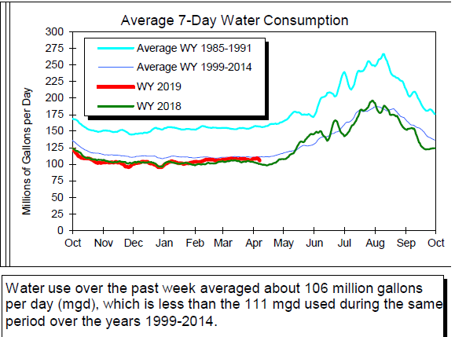
Snowpack and Water Supply Outlook
http://www.seattle.gov/utilities/services/water/water-supply

Slide 10
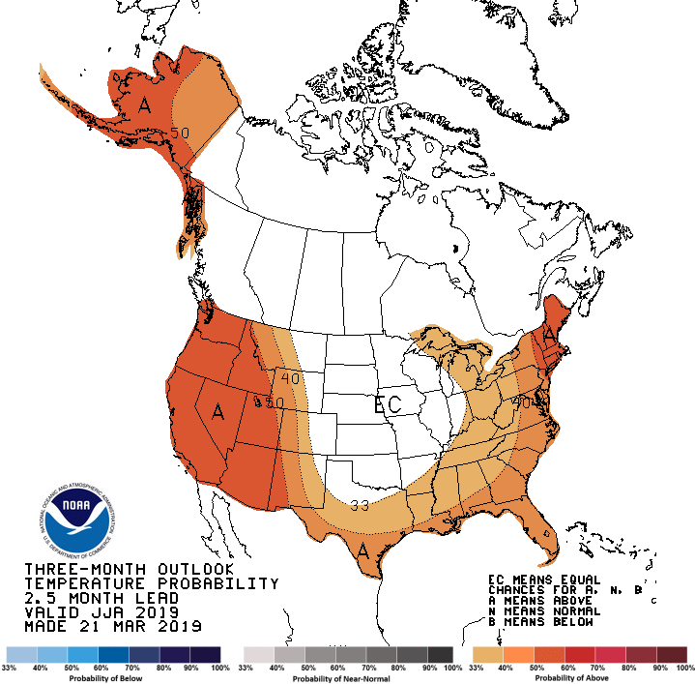
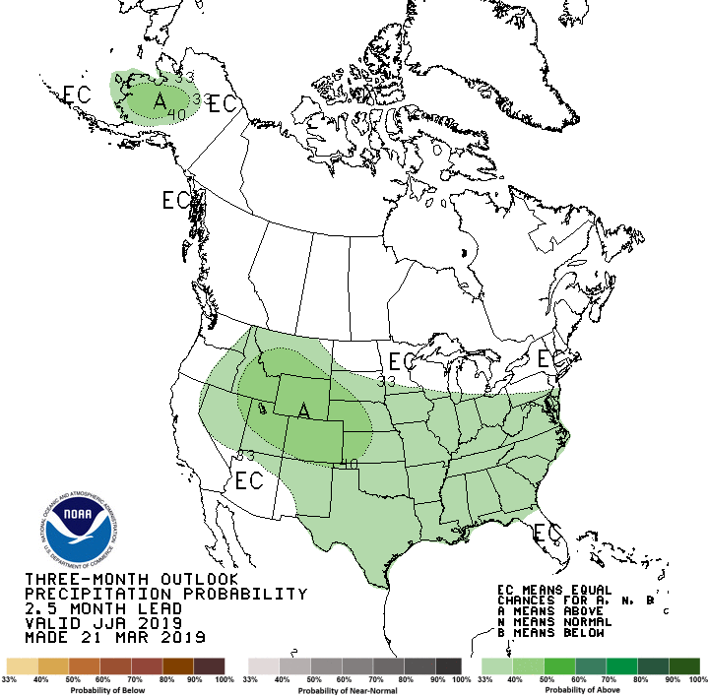
Climate Forecast: Jun-Jul-Aug
https://www.cpc.ncep.noaa.gov/products/predictions/long_range/seasonal.php?lead=3

Slide 11
Climate Change + Water Costs = Adaptation

Slide 12
2018: highest irrigation need
Water needed to maintain living assets: 21.66 inches
Rainfall during irrigation season: 7.6 inches
32-days reaching at least 85-degrees

Slide 13
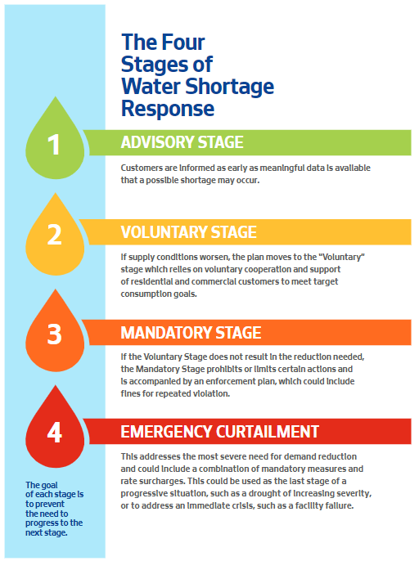
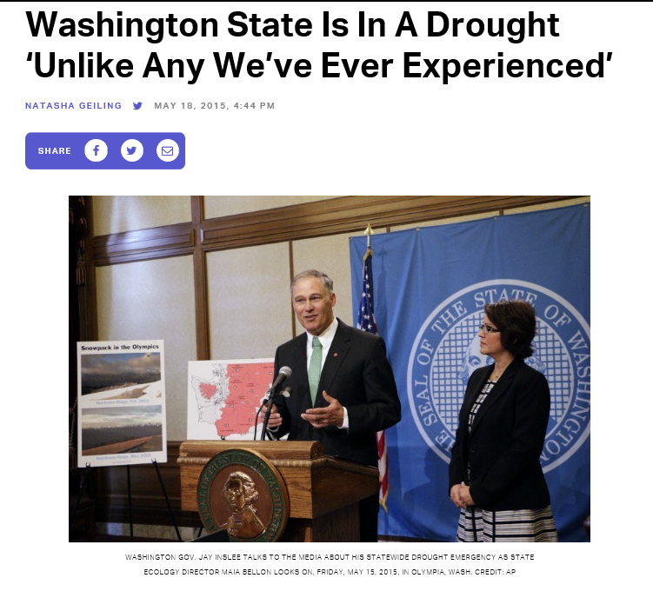
Water Shortage Contingency Plan

Slide 14
Alternative/Recycled Water Study aka Climate Adaptation
Funding allocated
Where does it make sense to recycle water?
Review existing systems for effectiveness
Propose types of conversions that could work in our system
Goal: Integrate recycled water opportunities into upcoming project planning processes.

Slide 15
Joelle Hammerstad, Sustainable Operations Manager, Joelle.Hammerstad@seattle.gov 206-733-9704 Karen Galt, Water Management Coordinator karen.galt@seattle.gov 206- 684-0370

