Slide 1
SPR’s Pathway To Equity
B Hill, Equity and Engagement Strategic Advisor
Shanyanika McElroy, Policy and OPM Analyst

Slide 2
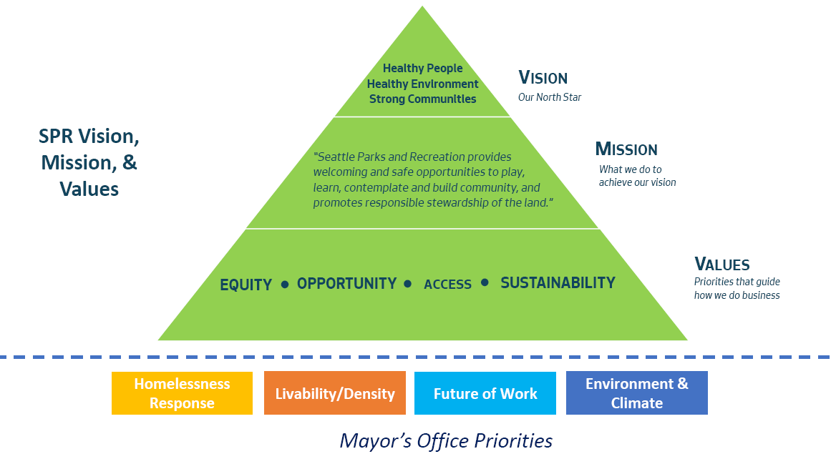
Wait, I thought it was RSJI?
Race and Social Justice Initiative (RSJI)
City of Seattle’s long term commitment to end institutional and structural racism and achieve racial equity in Seattle
Pathway To Equity
SPR’s commitment to the advancement of the RSJI
Organizing and Advocacy
Building Relationships and Infrastructure
Creating Accessible Tools and Resources
Training and Capacity Building
Applied Learning and Accountability
Embedded Practice
Continuous development and measurement on the Anti-Racist Organization Continuum
Notes:
Explain RSJI first
PTE is the model and framework we will use to get there; it is SPR’s commitment to ….

Slide 3
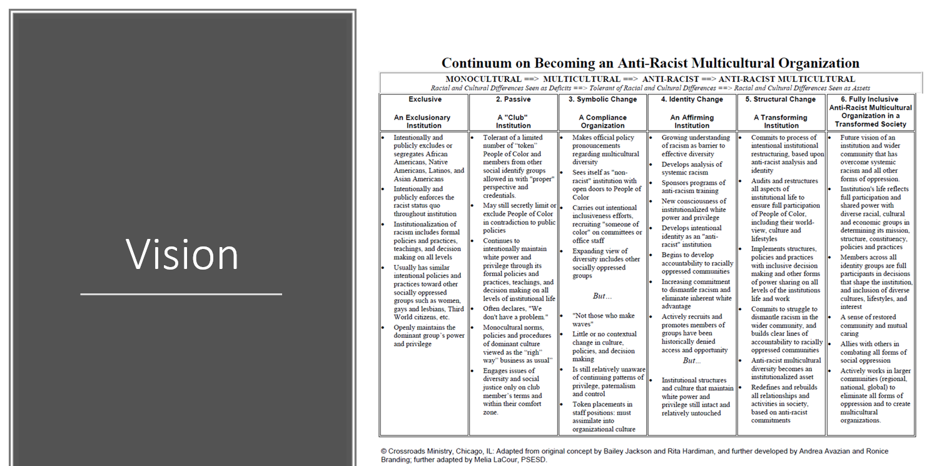
Notes:
To further talk about vision in alignment with the Anti Racist Continuum…
In 2018, we held an all-day “Foundations of Change” training with all staff. As part of the training, each staff person was asked to consider where the department is on the following RSJ Continuum. The results yielded that SPR presents itself as taking diversity as an official priority and is working towards developing and anti-racist identity.
By the numbers:
25.99% - Symbolic Change (Official policy pronouncements regarding multicultural diversity; still working do expand view of diversity however, little/no change in culture, policies, decision making – focus is on staying compliant)
20.58%- in between symbolic and identity
27.23%- Identity Change (analyzes systemic racism and develops anti racist training, new consciousness of white privilege and power; develops identity as anti racist institution, however structures and culture still maintain white privilege and power)
To further this work, SPR will focus on strategic priorities that address Organizational Clarity and Capacity Building, Employee Engagement, Training and Accountability, and Community Engagement.
These priority areas will lead us to Structural Change and through committed and impactful work to being a Fully Inclusive Anti Racist Multicultural Organization

Slide 4
1
Organizing/Advocacy
Pathway to Equity Framework
2
Infrastructure/ Tools/Training
Application/ Accountability
3
4
Vision
Notes:
As a visual aide and model, this is a template of the Pathway to Equity Framework- The Pillars include….
To give examples of the modules under each Pillar
Organizing/Advocacy
Caucusing
Reconciliation and Healing
Community Listening Sessions
Infrastructure/Tools/Training
Strategic Direction (priority/focus areas, timelines w/ performance measurements)
Focus groups
Toolkits development
Policies/procedures that support
Innovation Labs
Trainings such as RPOI, Implicit Bias, FOC
Application/Accountability (equity is institutionalized in the organization; woven into our day to day practices and operations)
E3
ROSA (rsji outcomes strategies and actions)
Toolkit Utilization
Leadership Expectation and Accountability Plan
The realization of the vision - City of Seattle’s long term commitment to end institutional and structural racism and achieve racial equity in Seattle
As we continue RSJ and equity building work, we will build out these pillars along the pathway to recognize the vision

Slide 5
RSJI: Seattle Parks and Recreation’s Approach
A vision of Race and Social Justice: All Seattle Parks and Recreation programs, policies and initiatives are embedded with racial equity outcomes, strategies and actions to provide measurable results to strengthen healthy people, healthy environment, and strong communities.
Our Work
Through policy, procedure review and revision utilizing a lens to identify institutional, structural racism and constructs and systems that cause harm to groups.
Through workforce equity and development/training of ourselves and our employees that places us in a position of accountability
Through comprehensive and balanced programs and service offerings to the community that do not cause harm and eliminate inequities and build accessible and inclusive services across all SPR Divisions.
Notes:
Through the utilization of PTE, SPR will approach the work of rsj and equity with having the following vision
And
Our work will be through….

Slide 6
Change Team Alignment
Change Team
Advance RSJ goals within Department
Implementation of concrete strategies and work items
Policy, practice, and procedure review and recommendation
Advance opportunities, achieving equity, and dismantling institutionalized racism
Engage in processes as voice of membership
CT partners in assisting SA put equity lens at forefront of work
Shared direction and goals moving on parallel paths but working in step.
We are in partnership and collaboration with collaborative bodies of work
Notes:
Alignment of EESA with the change team
Meaning-
Shared direction and goals…

Slide 7
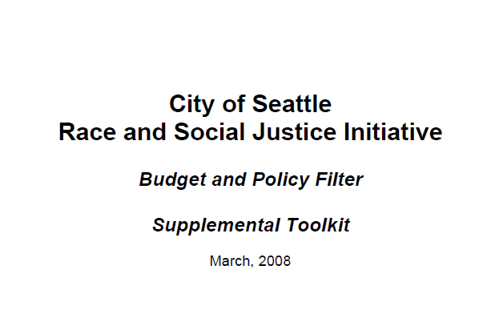
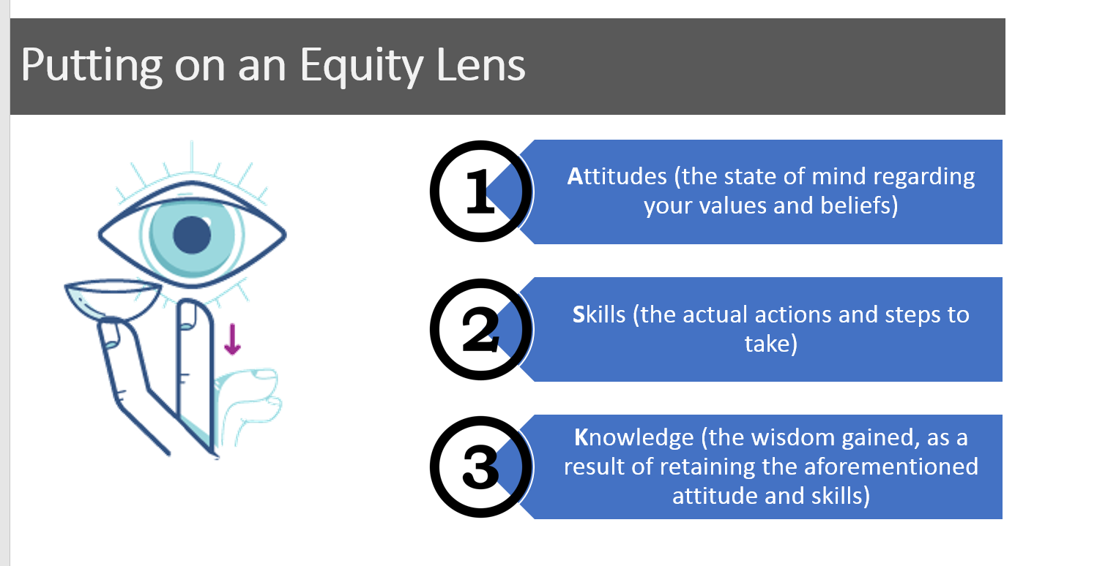
An Impactful Start
Notes:
Budget and Policy Filter – Toolkit to apply equity lens to budgeting and policy development
Racial Equity Toolkit – each division responsible for completing 1 toolkit
Allyship 101 Training – 5 tips for being an impactful ally
Equity Innovation Labs – Facilities (Qtrly), Recreation (Qtrly), Upcoming: Finance, Parks and Environment, EPIC, PDD
Equity Lens Primer session – Policy Unit (again applying an equity lens to policy review and development)
Equity Toolkit Review – Strategic Plan (Master Plan Development),
LeadHership (3/13)-LeadHERship is an SPR program that is designed to help women staff members with their day-to-day work experiences and career goals. (professional development, networking, team building)
Equity Based Budgeting (4/10)
Equity Criteria considerations for budgeting and resource allocation
Equitable funding not equal funding model

Slide 8
Notes:
Show video
Explain how using this media allows for innovative engagement ( speak on self reflection and creating actionable steps activity)

Slide 9
5 Tips For Being An Ally
WHAT?
Take 1 minute alone to process video
What resonated with you?
What did you notice?
What facts or observations stood out?
SO WHAT?
What allyship skills do you currently practice, are familiar or comfortable with?
How does that show up for you in your work?
3 min. total.

Slide 10
5 Tips For Being An Ally
NOW WHAT?
What allyship skills do you find challenging?
What actionable steps will you take to cultivate your skillset in being an impactful ally?
3 min. total.

Slide 11
Key Takeaway
“We are not to blame for what happened in the past, but we are responsible for eliminating racism today. We can end this legacy of inequity. The Initiative is working to eliminate institutional racism and create a community where equity in opportunity exists for everyone.”
SPR’s Pathway to Equity

Slide 12
B Hill 206-386-4381 bianca.hill@seattle.gov

