Slide 1
2016 Proposed Budget Overview
Park District Oversight Committee
October 13, 2015

Slide 2
Annual Budget Process
SPR submits budget issues to the City Budget Office in early April and a draft budget in early June
Mayoral Review and budget refinements June - August
Mayor submits budget to City Council in late September
Council reviews the Mayor’s budget proposal from late September through mid-November
Council adopts the budget in late November

Slide 3
City of Seattle 2016 Budget Overview
Total Operating Budget of $5.1 billion and total Capital Budget of $1 billion.
Total workforce of 11,739.23 FTE
Total General Fund Budget of $1.056 billion
54% of the City’s General Fund is allocated to public safety functions ($599.7m) and 8% allocated to Health and Human Services ($83.3m)
SPR is approximately 9% of the General Fund
$96.6 million in General Fund support

Slide 4
Seattle Parks and Recreation 2016 Budget Overview
Total Operating Budget of $155.2 million(918.68 FTE)
General Fund $96,589,513
Other Funding $58,562,752
Seattle Park District $13,613,159
Total Capital Budget of $54,218,000
Seattle Park District ($34.2M)
Cumulative Reserve Sub-Fund
Real Estate Excise Taxes ($14.3M) and Unrestricted ($400K)
Central Waterfront Improvement Fund ($2.2M)
King County Levy ($1.66M)
Community Development Block Grant ($808K)

Slide 5
Seattle Park District 2016 Budget Overview
CATEGORY TOTALS | 2015 | 2016
Fix it First | $3,946,800 | $28,406,625
Maintaining Parks and Facilities | $2,917,970 | $4,056,216
Programs for People | $2,236,905 | $3,460,786
Building for the Future | $906,333 | $10,387,128
Transition year payback | $0 | $1,487,592
TOTAL | $10,008,008 | $47,798,347

Slide 6
Financial Context Capital Budget
Capital Budget | 2014 Adopted |  | 2015 Adopted |  | 2016 Proposed
Cumulative Reserve Subfund (REET and Unrestricted) | $ 20,613,000 | 55.7% | $ 13,762,000 | 66.4% | $ 14,742,000 | 27.2%
2008 Parks and Greenspaces Levy | $ 7,931,000 | 21.4% | $ 1,727,000 | 8.3% | $ - | 0.0%
2013 King County Levy | $ 1,660,000 | 4.5% | $ 1,404,000 | 6.8% | $ 1,660,000 | 3.0%
Community Development Block Grant | $ 1,208,000 | 3.3% | $ 1,208,000 | 5.8% | $ 808,000 | 1.5%
Limited Tax General Obligation Bonds | $ 5,561,000 | 15.0% | $ - | 0.0% | $ - | 0.0%
Central Waterfront Improvement Fund | $ - | 0.0% | $ 250,000 | 1.2% | $ 2,247,000 | 4.1%
Other Revenue | $ 53,000 | 0.1% | $ 212,000 | 1.0% | $ 575,000 | 1.0%
Park District Revenue | $ - | 0.0% | $ 2,156,000 | 10.4% | $ 34,186,000 | 63.1%
Total CIP | $ 37,026,000 | 100.0% | $ 20,719,000 | 100.0% | $ 54,218,000 | 100.0%
Notes:
FIX 2016 to PROPOSED

Slide 7
Financial Context Operating Budget
Operating Budget | 2014 Adopted |  | 2015 Adopted |  | 2016 Proposed
General Fund | $ 88,977,317 | 65.7% | $ 92,852,622 | 64.4% | $ 96,589,512 | 62.3%
Charges for Services and Facility Fees | $ 33,081,163 | 24.4% | $ 33,014,264 | 22.9% | $ 32,878,450 | 21.1%
Other Revenue | $ 13,273,184 | 9.8% | $ 10,827,736 | 7.5% | $ 12,071,143 | 7.8%
Park District Revenue | $ - | 0.0% | $ 7,536,398 | 5.2% | $ 13,613,159 | 8.8%
Total Operating Budget | $ 135,331,664 | 100.0% | $ 144,231,020 | 100.0% | $ 155,152,265 | 100.0%
Notes:
FIX 2016 to PROPOSED

Slide 8
Financial Context
How Park District Funding Relates to Other Operating Budget Resources

Slide 9
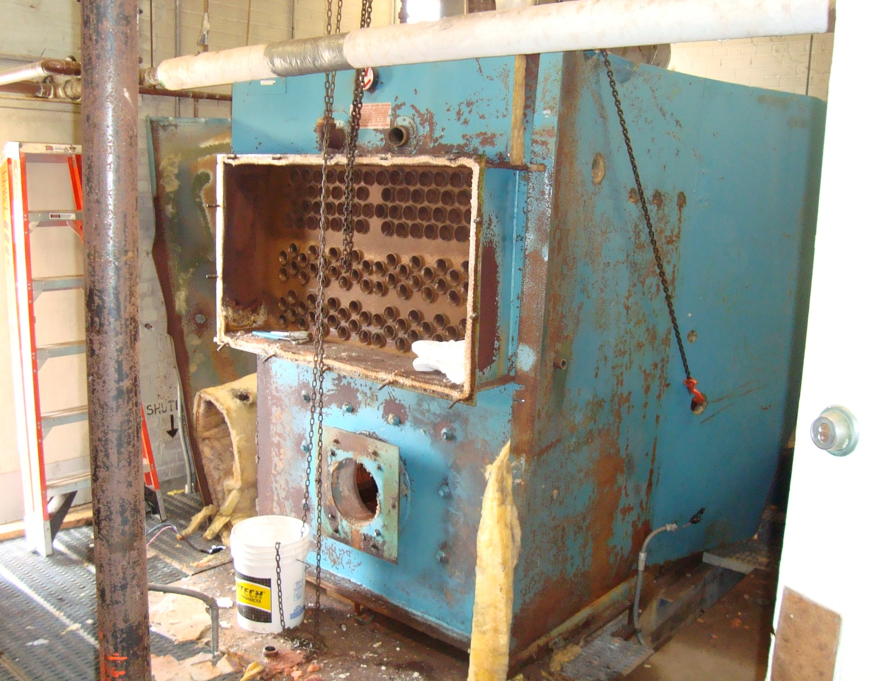
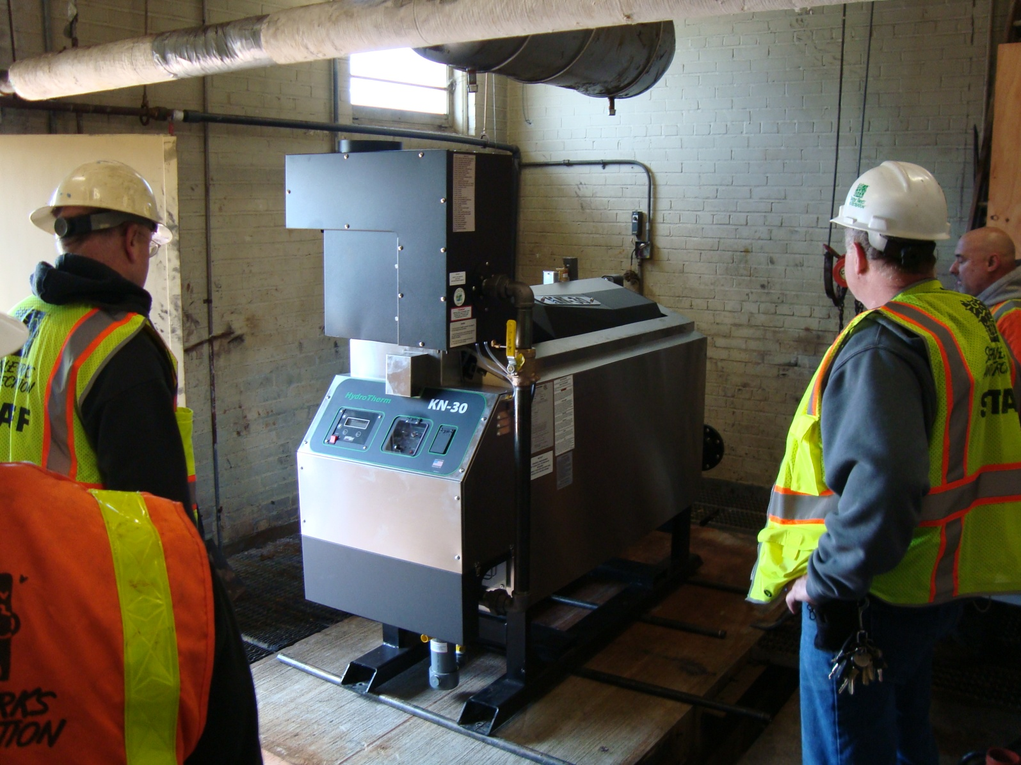
Facilities and Structure Maintenance BCL
Seattle Parks & Recreation Operating Budget by Budget Control Level (BCL) | Expense Authority | General Fund Suppport | Other Revenue Support Park District | Other Revenue Support Non-PD
Facility & Structure Maint BCL | $ 17,709,741 | $ (15,257,146) | $ (1,683,639) | $ (768,956)
1.1 MAJOR MAINTENANCE BACKLOG AND ASSET MANAGEMENT |  |  | $ (107,211)
2.1 INCREASE PREVENTATIVE MAINTENANCE |  |  | $ (1,096,207)
2.4 MAKE PARKS SAFER |  |  | $ (243,248)
2.5 IMPROVE DOG OFF-LEASH AREAS |  |  | $ (106,414)
4.10 PERFORMANCE MONITORING AND STRATEGIC MANAGEMENT |  |  | $ (130,559)
Purpose: to repair and maintain park buildings and infrastructure so that park users can have safe, structurally sound, and attractive parks and recreational facilities.

Slide 10
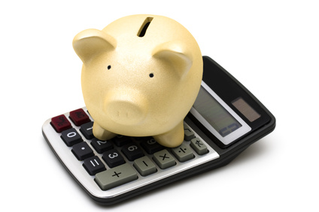
Finance and Administration BCL
Seattle Parks & Recreation Operating Budget by Budget Control Level (BCL) | Expense Authority | General Fund Suppport | Other Revenue Support Park District | Other Revenue Support Non-PD
Finance & Admin BCL | $ 14,294,672 | $ (9,227,376) | $ (3,123,011) | $ (1,944,285)
1.1 MAJOR MAINTENANCE BACKLOG AND ASSET MANAGEMENT |  |  | $ (1,050,000)
3.8 CUSTOMER SERVICE AND TECHNOLOGY |  |  | $ (307,500)
4.10 PERFORMANCE MONITORING AND STRATEGIC MANAGEMENT |  |  | $ (277,919)
5.0 TRANSITION YEAR FUNDING PAYBACK |  |  | $ (1,487,592)
Purpose: to provide the financial, technological, and business development support for the Department.

Slide 11
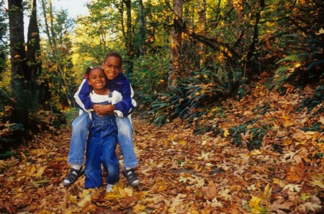
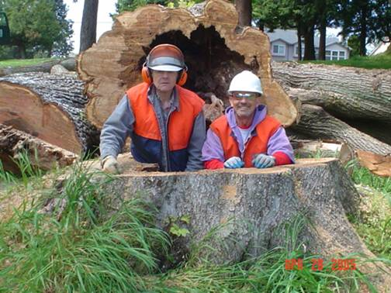
Natural Resources Management BCL
Seattle Parks & Recreation Operating Budget by Budget Control Level (BCL) | Expense Authority | General Fund Suppport | Other Revenue Support Park District | Other Revenue Support Non-PD
Natural Resources Mgmt BCL | $ 9,124,926 | $ (6,069,091) | $ (1,314,879) | $ (1,740,956)
1.3 SAVING OUR CITY FORESTS |  |  | $ (499,175)
2.2 PROVIDE CLEAN SAFE WELCOMING PARKS |  |  | $ (815,704)
Purpose: to provide centralized management for SPR’s living assets; responsibilities include greenhouses, nurseries, the Volunteer Park Conservatory, landscape and urban forest restoration programs, sport field turf management, water conservation programs, pesticide reduction and wildlife management, and heavy equipment support for departmental operations and capital projects.

Slide 12
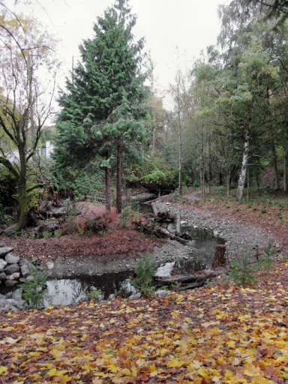
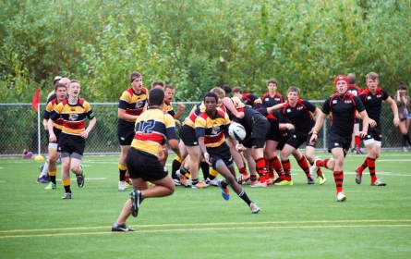
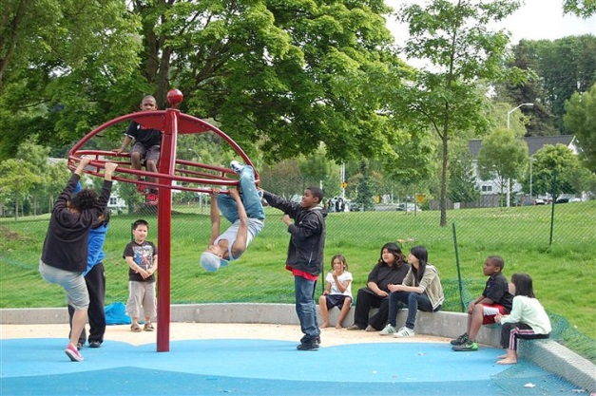
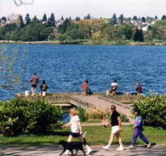
Park Cleaning, Landscaping & Restoration BCL
Seattle Parks & Recreation Operating Budget by Budget Control Level (BCL) | Expense Authority | General Fund Suppport | Other Revenue Support Park District | Other Revenue Support Non-PD
PkCleang,Landscpg &Restor BCL | $ 32,702,665 | $ (30,778,843) | $ (863,150) | $ (1,060,672)
2.2 PROVIDE CLEAN SAFE WELCOMING PARKS |  |  | $ (863,150)
Purpose: to provide custodial, landscape, and forest maintenance and restoration services.

Slide 13
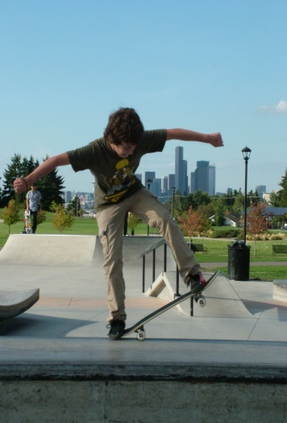
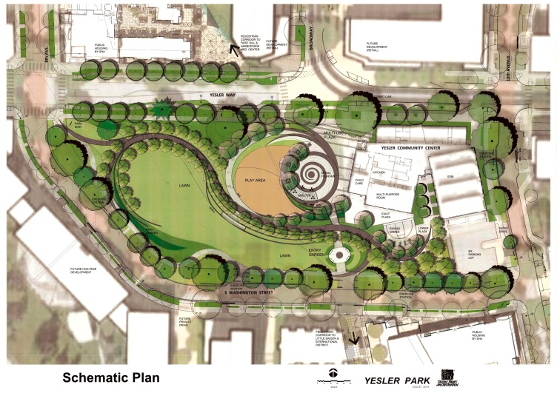
Planning, Development and Acquisition BCL
Seattle Parks & Recreation Operating Budget by Budget Control Level (BCL) | Expense Authority | General Fund Suppport | Other Revenue Support Park District | Other Revenue Support Non-PD
Planning Devel & Acq BCL | $ 7,215,080 | $ (1,483,806) | $ (482,800) | $ (5,248,473)
1.1 MAJOR MAINTENANCE BACKLOG AND ASSET MANAGEMENT |  |  | $ (482,800)
Purpose: to acquire, plan, design, and develop new park facilities, and make improvements to existing park facilities to benefit the public… This BCL also preserves open spaces through a combination of direct purchases, transfers, and consolidations of City-owned lands and resolution of property encroachment issues.

Slide 14
Policy, Direction and Leadership BCL
Seattle Parks & Recreation Operating Budget by Budget Control Level (BCL) | Expense Authority | General Fund Suppport | Other Revenue Support Park District | Other Revenue Support Non-PD
Policy Dirction & Ldrship BCL | $ 4,460,103 | $ (4,043,313) | $ (361,598) | $ (55,192)
4.10 PERFORMANCE MONITORING AND STRATEGIC MANAGEMENT |  |  | $ (361,598)
Purpose: to provide policy guidance within the Department and outreach to the community on policies that have the goal of enabling the Department to offer outstanding parks and recreation opportunities to Seattle residents and our guests. It also provides leadership in establishing new partnerships or strengthening existing ones in order expand recreation services.

Slide 15
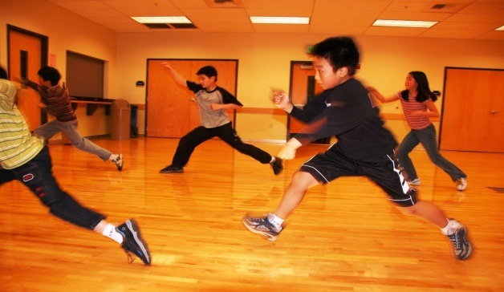
Recreation Facilities and Programs BCL
Seattle Parks & Recreation Operating Budget by Budget Control Level (BCL) | Expense Authority | General Fund Suppport | Other Revenue Support Park District | Other Revenue Support Non-PD
Recreation Facilities BCL | $ 28,000,650 | $ (15,737,705) | $ (3,187,204) | $ (9,075,741)
2.1 INCREASE PREVENTATIVE MAINTENANCE |  |  | $ (247,847)
3.1 RESTORE COMMUNITY CENTER OPERATIONS |  |  | $ (1,385,481)
3.2 RECREATION OPPORTUNITIES FOR ALL |  |  | $ (471,638)
3.3 BETTER PROGRAMS FOR YOUNG PEOPLE - SEATTLE'S FUTURE |  |  | $ (256,729)
3.4 MEETING THE NEEDS OF PEOPLE WITH DISABILITIES |  |  | $ (170,150)
3.5 MORE PROGRAMS FOR OLDER ADULTS |  |  | $ (268,550)
3.7 GET MOVING FUND |  |  | $ (256,250)
4.10 PERFORMANCE MONITORING AND STRATEGIC MANAGEMENT |  |  | $ (130,559)
Purpose: to manage and staff the City's neighborhood community centers and Citywide recreation facilities and programs, which allow Seattle residents to enjoy a variety of social, athletic, cultural, and recreational activities.

Slide 16
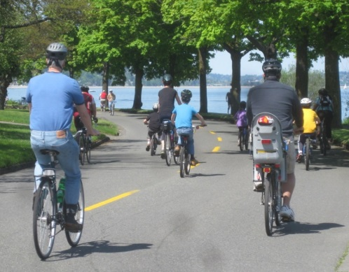
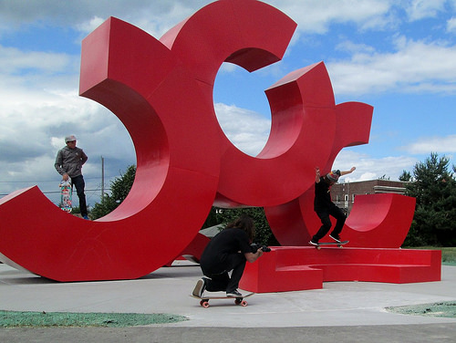
Regional Parks and Strategic Outreach BCL
Seattle Parks & Recreation Operating Budget by Budget Control Level (BCL) | Expense Authority | General Fund Suppport | Other Revenue Support Park District | Other Revenue Support Non-PD
Reg Parks & Strat Outreach BCL | $ 6,146,852 | $ (1,106,727) | $ (1,033,232) | $ (4,006,893)
3.6 PUT ARTS IN PARKS |  |  | $ (344,488)
4.11 URBAN PARKS PARTNERSHIP |  |  | $ (570,000)
4.9 ACTIVATING AND CONNECTING GREENWAYS |  |  | $ (118,744)
Purpose: to provide centralized management for Seattle Parks and Recreation's regional parks such as Magnuson, Discovery, Gas Works, Lincoln, Seward, Green Lake, Alki, and Myrtle Edwards and major partners such as the golf program operator, Woodland Park Zoological Society, Seattle Aquarium Society, Seattle Public Schools, Friends of the Waterfront, and the Olympic Sculpture Park.

Slide 17
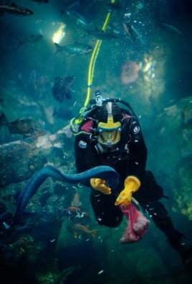
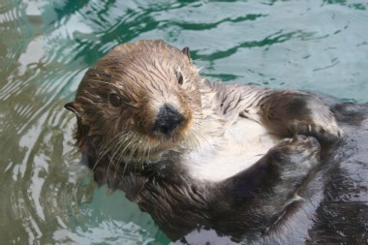
Seattle Aquarium BCL
Seattle Parks & Recreation Operating Budget by Budget Control Level (BCL) | Expense Authority | General Fund Suppport | Other Revenue Support Park District | Other Revenue Support Non-PD
Seattle Aquarium BCL | $ 1,080,000 | $ - | $ (1,080,000) | $ -
1.4 AQUARIUM MAJOR MAINTENANCE |  |  | $ (1,080,000)
Purpose: to provide exhibits and environmental educational opportunities with the goal of expanding knowledge of, inspiring interest in, and encouraging stewardship of the aquatic wildlife and habitats of Puget Sound and the Pacific Northwest.

Slide 18
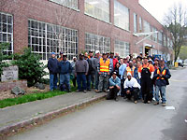
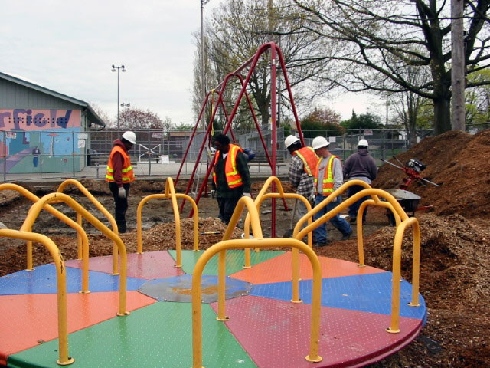
Seattle Conservation Corps BCL
Seattle Parks & Recreation Operating Budget by Budget Control Level (BCL) | Expense Authority | General Fund Suppport | Other Revenue Support Park District | Other Revenue Support Non-PD
Seattle Conservatn Corps BCL | $ 4,080,475 | $ (224,999) | $ (410,000) | $ (3,445,476)
2.2 PROVIDE CLEAN SAFE WELCOMING PARKS |  |  | $ (410,000)
Purpose: to provide training, counseling, and employment to homeless and unemployed people with the goal that they acquire skills and experience leading to long-term employment and stability.

Slide 19
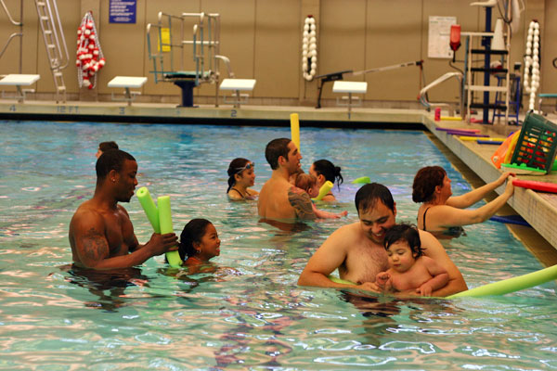
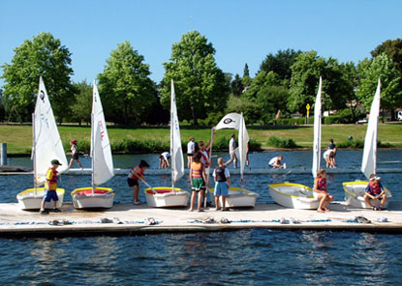
Swimming, Boating and Aquatics BCL
Seattle Parks & Recreation Operating Budget by Budget Control Level (BCL) | Expense Authority | General Fund Suppport | Other Revenue Support Park District | Other Revenue Support Non-PD
Swimng, Boatng & Aquatics BCL | $ 9,537,077 | $ (3,999,231) | $ (73,646) | $ (5,464,200)
2.1 INCREASE PREVENTATIVE MAINTENANCE |  |  | $ (73,646)
Purpose: to provide a variety of structured and unstructured water-related programs and classes so participants can enjoy and develop skills in a range of aquatic activities.

Slide 20
Operating BCLS without Park District Support
Environmental Learning BCL
Purpose: to deliver and manage environmental stewardship programs and SPR’s environmental education centers. The programs are designed to encourage Seattle residents to take actions that respect the rights of all living things and environments, and to contribute to healthy and livable communities.
Golf BCL
Purpose: to manage the City's four golf courses at Jackson, Jefferson, West Seattle, and Interbay to provide top-quality public golf courses that maximize earned revenues.
Judgment and Claims BCL
Purpose: to pay for judgments, settlements, claims, and other eligible expenses associated with legal claims and suits against the City.
Woodland Park Zoo Budget Control Level (Capital Support)
Purpose: to provide funds to contract with the non-profit Woodland Park Zoological Society to operate and manage the Woodland Park Zoo. The purpose of the Zoo is to provide care for animals and offer exhibits, educational programs, and visitor amenities so Seattle residents and visitors have the opportunity to enjoy and learn about animals and wildlife conservation.

Slide 21
To learn more about the proposed budget:
http://murray.seattle.gov/mayor-ed-murrays-2016-proposed-budget/#sthash.uskt5huZ.H1y04bLk.dpbs
Mayor Ed Murray’s budget speech, as prepared
Highlights of Mayor Ed Murray’s budget
Press release about Mayor Ed Murray’s proposed budget
Learn more from the City Budget Office
Mayor unveils $47 million Seattle Park District plan for 2016
http://murray.seattle.gov/mayor-unveils-47-million-seattle-park-district-plan-for-2016/#sthash.UNXjCnNr.dpbs
http://murray.seattle.gov/wp-content/uploads/2015/09/Park-District-Funded-Services.pdf

Slide 22
QUESTIONS?

