Slide 1
Major projects challenge fund
Park District Oversight Committee Meeting
September 18, 2018

Slide 2
Major project challenge fund
Build for the Future is one of the primary areas of focus for the Seattle Park District. Part of Building for the Future includes the Major Projects Challenge Fund. The purpose of the Major Projects Challenge Fund is to provide a funding match, to fund a “major project” on Seattle Parks and Recreation property. The Major Projects Challenge Fund will provide City funding to leverage community-generated funding for renovation of parks and park facilities where other City funding is unavailable.
Purposely defined loosely, it is envisioned that a “major project” is a significant improvement or renovation to an existing SPR owned site or facility. It should significantly expand the life and usability of the subject facility such that it provides more opportunities for people to make use of the facility. The combination of Major Projects Challenge Fund money and community-generated money will allow for major projects to be accomplished throughout the city.
Notes:
Background for the MPCF
Funding available and distribution – projects vs planning/design
Timing of proposals
Established criteria in working with the PDOC on Sept. 8 & Oct. 13, 2015

Slide 3
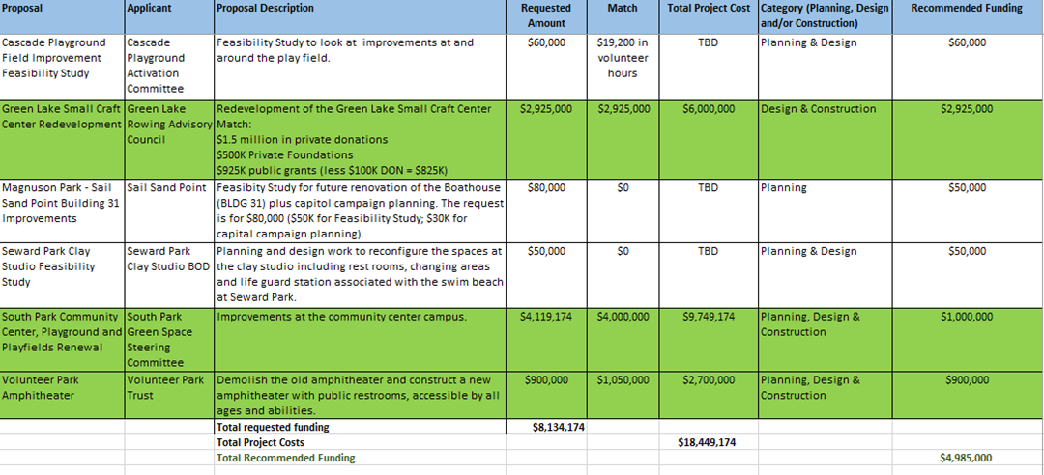
Major projects challenge fund staff recommendation
July 17, 2018

Slide 4
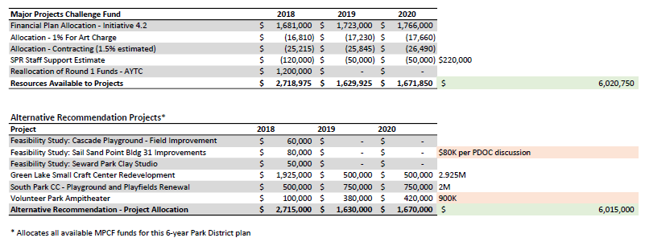
Major projects challenge fund – allocation
Draft for discussion – Park district oversight committee
September 18, 2018

Slide 5
DISCUSSION/Questions
Contact info:
David Graves, AICP, Strategic Advisor
david.graves@seattle.gov
Ph.: 206.684.7048

