Slide 1
  Developing the Second 6-Year Park District Financial Plan & Coordination with New Strategic Plan
  Park District Oversight Committee Retreat
  January 30, 2018

Slide 2
Why Start Now?
Red dates are set; blue dates are tentative
January 2021 Second 6-year financial plan cycle
begins
November 2020: Park District Board (City Council)
adopts second 6-year financial plan
March 2020: SPR includes financial plan in budget memo to Mayor
November 2019: Park District Oversight Committee (PDOC) recommendation
Sept. – Oct. 2019: Second round of public outreach
June-August 2019: Develop draft plan per public input
April-May 2019: Public outreach on financial plan priorities
Jan. – March 2019: Work with PDOC to refine financial plan priorities from new strategic plan
2018 Programming and facilities strategic plan developed
2

Slide 3
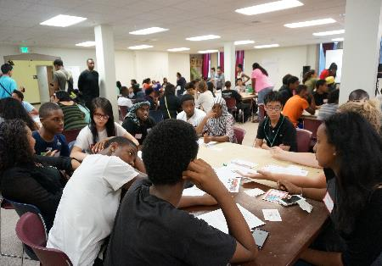
New Plan: Building on Previous Planning Efforts
  2014 Parks Legacy Plan
    Set the stage for the Park District by assessing the condition of all aspects of our parks and recreation system
  2016 Community Center Strategic Plan
    Established operational and facility
    priorities for 27 community centers
    Facility improvements focused on 8 of
    our 27 centers which had not been recently improved
    The new plan will build on this analysis
  2017 Parks and Open Space Plan
    Assessed open space gaps to meet State grant funding requirements
    The new plan will build on this analysis
3

Slide 4

Why a New Plan
  Need a thoughtful, community-engaged, equity-driven process to determine priorities
  Anticipated community priorities and known needs will greatly exceed funding
    Major maintenance estimate now up to about $400 million
    Was $256 million when the Park District was adopted in 2014
4

Slide 5
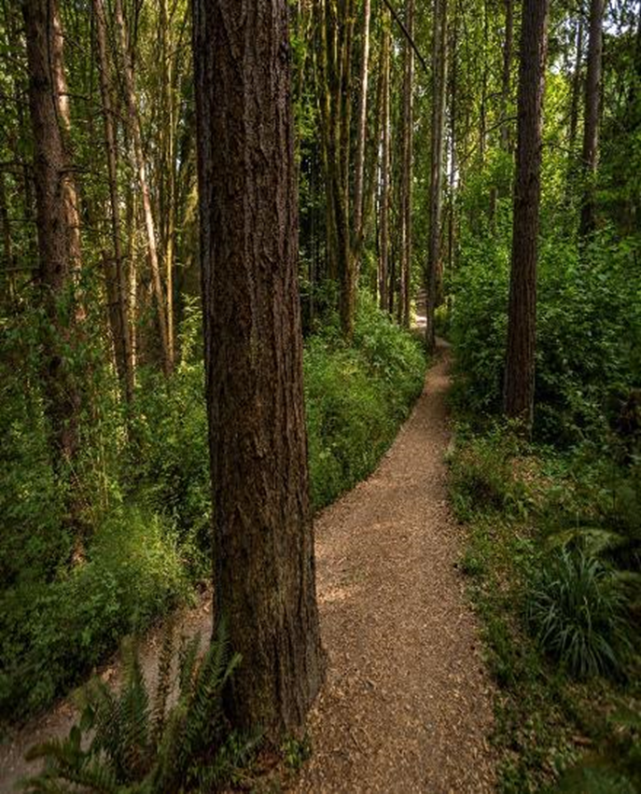
New Plan will have 4 major elements:
  Inventory – to include programming, facilities and recreation trends
  Public Involvement – to include a statistically valid resident survey, focus groups, community meetings and inclusive outreach
  Analysis – to identify opportunities and service needs for programming and facilities; and future financing opportunities
  Future Needs Assessment – scenarios will be developed to identify facility needs to meet resident’s desired future programming.
5

Slide 6

Next Steps:
  Establish Plan scope
    Staffing
    Consultant
    Mayor’s direction
  Clarify the role of the Park Board and of the Park District Oversight Committee?
    Joint meetings?
    Combine into one body?
    Park Board lead for new plan?
    PDOC lead for second financial plan?
6

