Slide 1
Extreme Winter Weather
Notes:
Introduce yourself as the presenter.
Introduce the space.
Have participants introduce themselves.

Slide 2

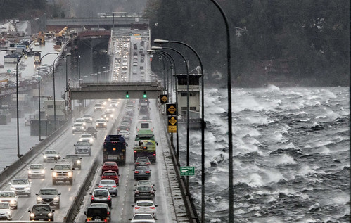
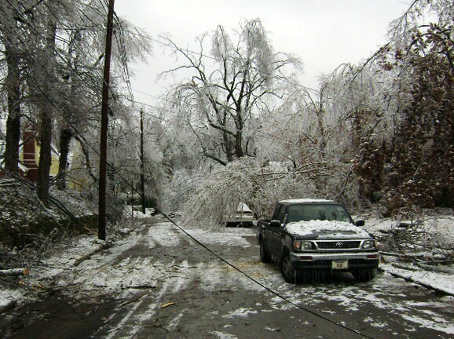
Module Overview
Learn about different types of extreme winter weather.
Observe how winter weather has impacted Seattle communities, infrastructure, and daily life in the past.
Consider how winter weather impacts our health.
Prepare for community needs during extreme winter weather.
Complete a winter weather preparation worksheet.
Notes:
Go over the overview of the day, the space and the purpose of the module

Slide 3
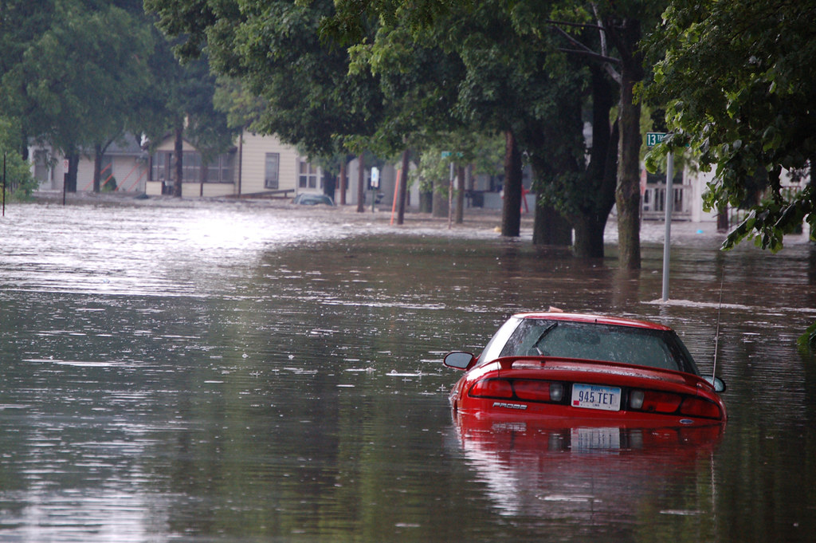
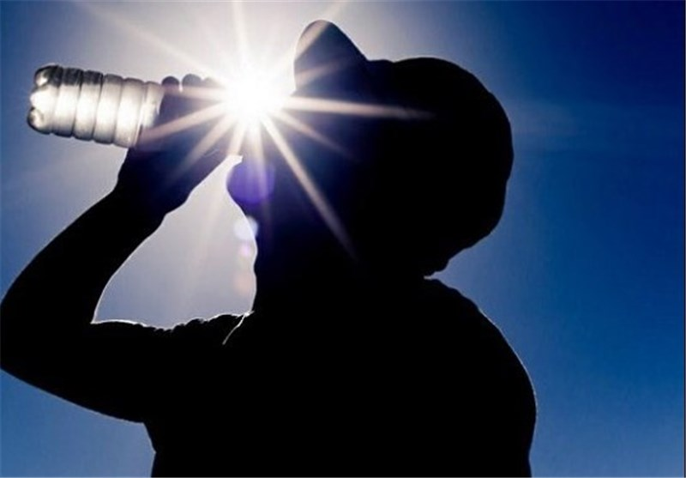
What is Severe Weather
A weather event that causes significant threats to life, property, or major changes in our day-to-day lives.
Think: tornadoes, hurricanes, or thunderstorms. Other events can include extremely cold or hot temperatures, flooding, and more.

Slide 4
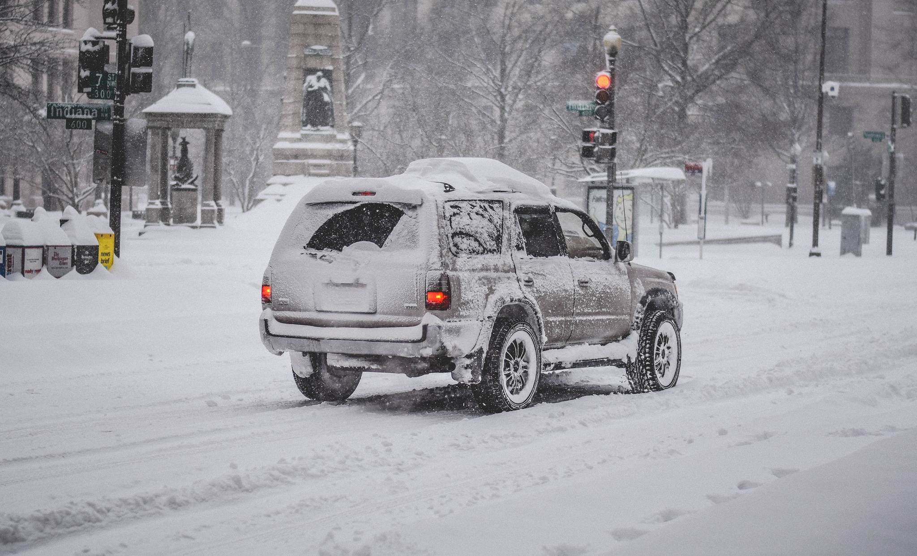
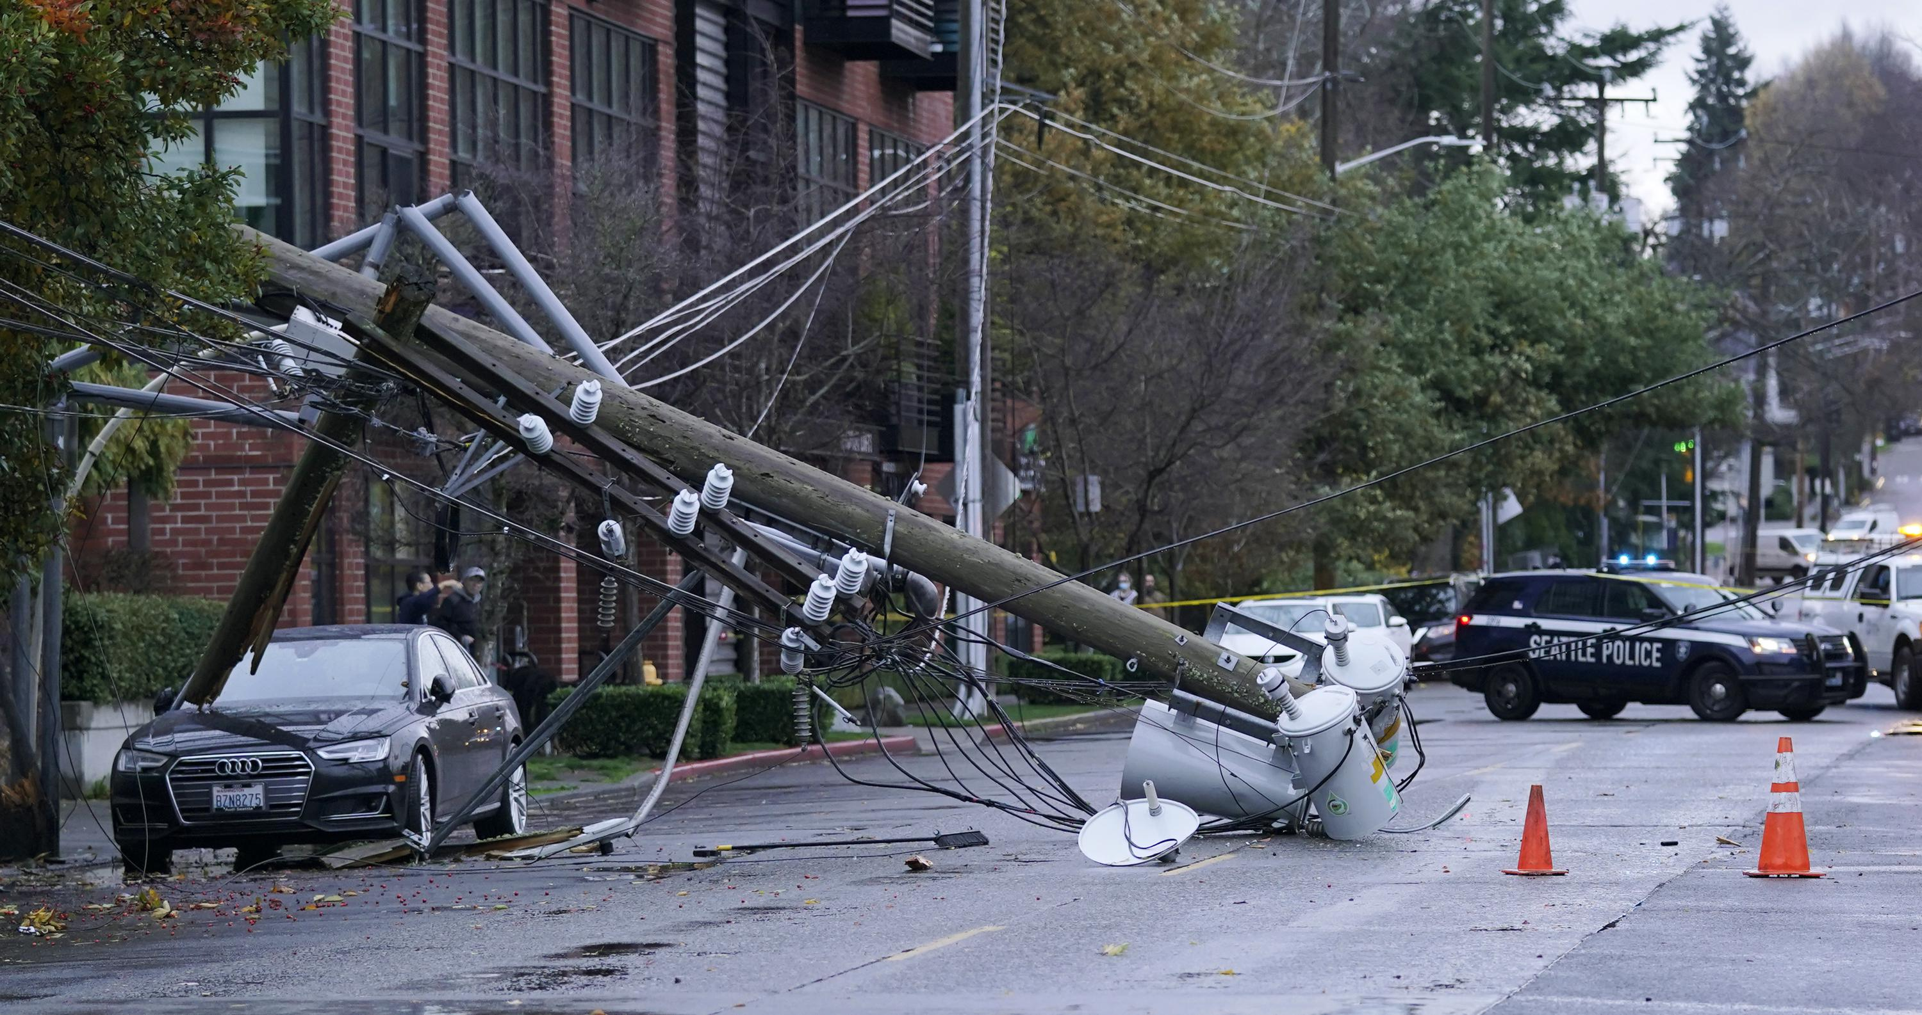
Extreme Winter Weather
Unusually severe conditions, such as extreme cold, heavy snow, ice storms, and windstorms.

Slide 5
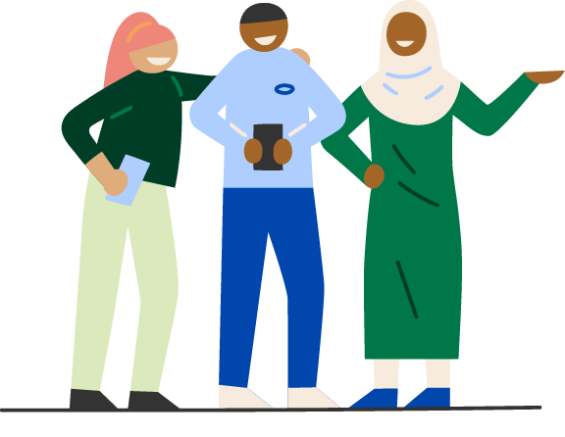
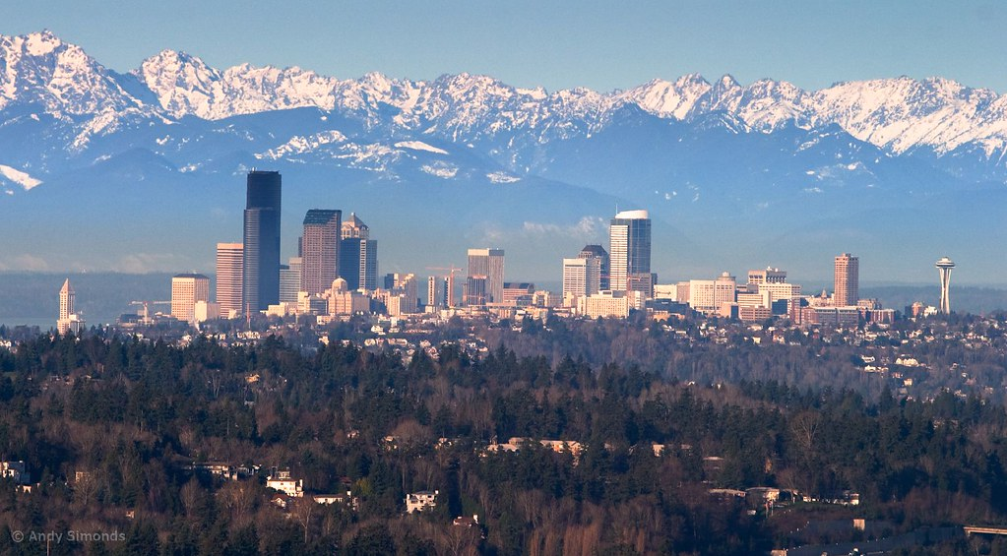
Reflect & Share
Take a minute with yourself to reflect on a time you experienced a severe winter weather event.
Did you have to drive in the snow or ice?
How do you remember feeling?
What did you do to prepare?
How did the weather impact your ability meet your needs?
Notes:
Have participants reflect individually

Slide 6
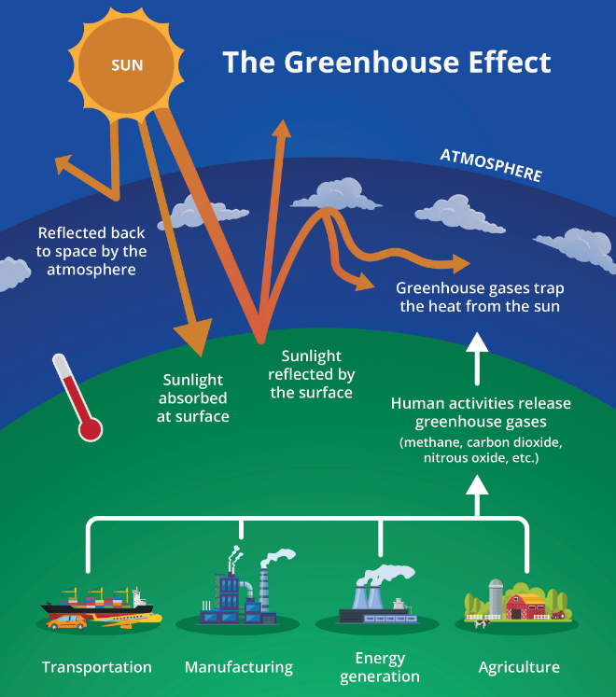
Climate Change & Severe Weather
Notes:
- Explain contributors to climate change (over consumption, industry, agriculture) – all release greenhouse gasses into the environment.
- Greenhouse gases keep heat in the atmosphere, causing global warming.
-Increase in global warming causes climates to change. This can increase severe weather, like extreme cold.
- Optional: Can provide analogy that if climate is your personality, weather would be your mood. They are related, but different.

Slide 7
It’s Important to Be Prepared for Seattle Winters
Notes:
As climate change progresses, severe weather events, like windstorms and snow/ice storms, will increase.
Explain why this matters to participants (Seattle’s infrastructure, vulnerable populations)
Share the disproportionate impacts of extreme winter weather.
Expand to how being prepared is important in mitigating the disproportionate impacts of weather on vulnerable communities

Slide 8
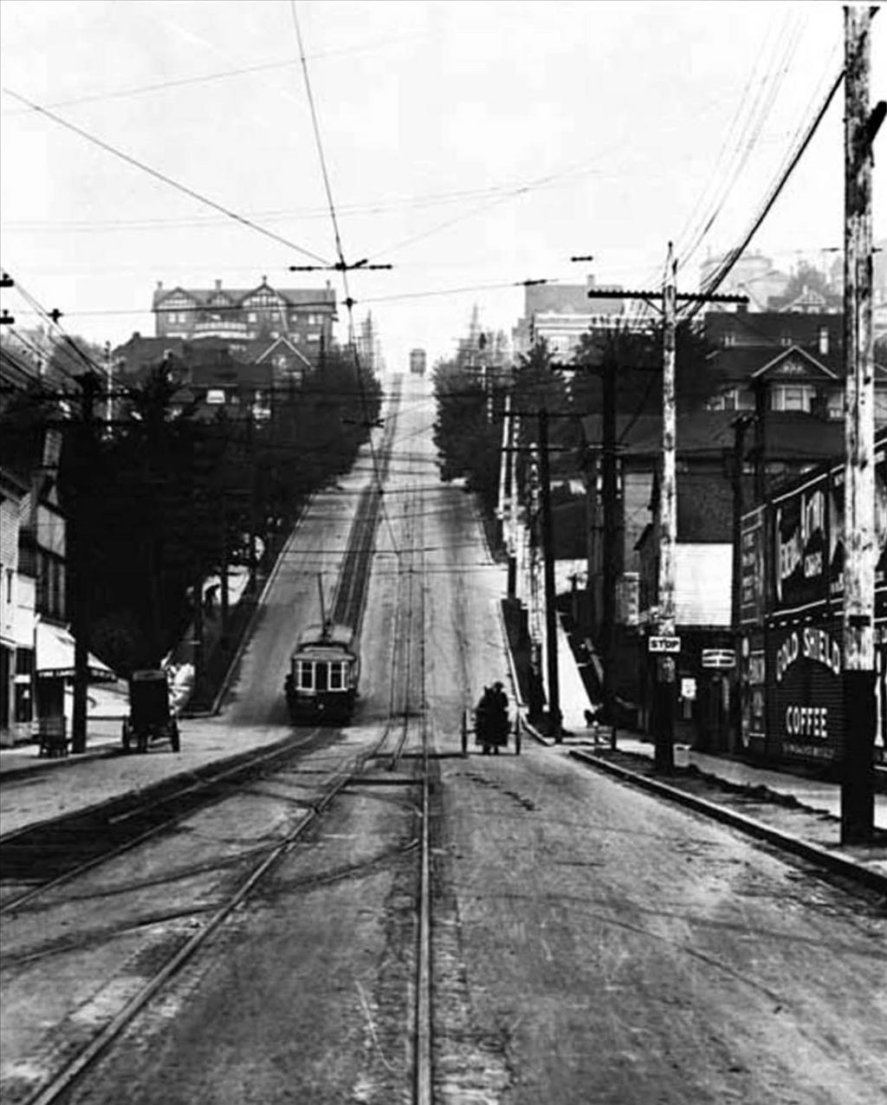
Reflect & Share
In small groups, consider the following questions:
Where in your community do you live?
  Do you live near hills or in a relatively flat area?
How do you navigate your neighborhood?
  Do you drive, walk, or take a different mode of transportation?
This Photo by Unknown Author is licensed under CC BY-NC-ND

Slide 9
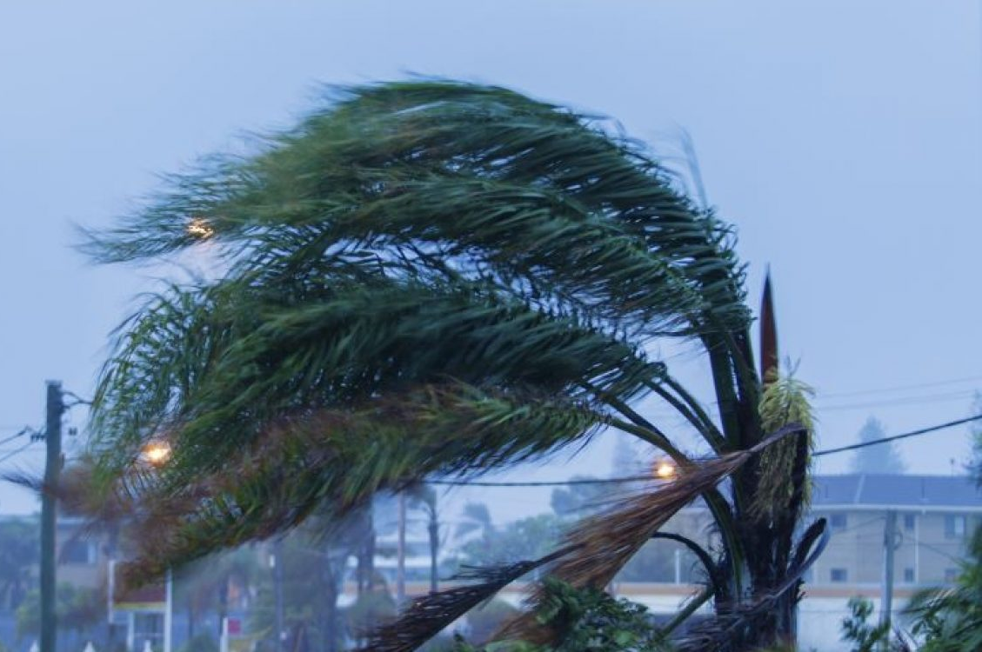
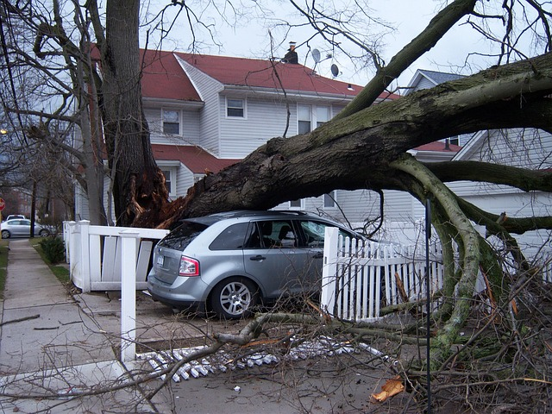
Examples of Winter Weather:
Windstorms
Strong winds that can cause power outages, damage to trees and buildings, and may or may not be accompanied by rain.
Notes:
Seattle experiences different types of winter weather, including windstorms, freezing rain, and black ice.
Share the definition and impacts of windstorm.
Optional: Ask group if they have experienced a windstorm and if they feel comfortable sharing their experience.

Slide 10
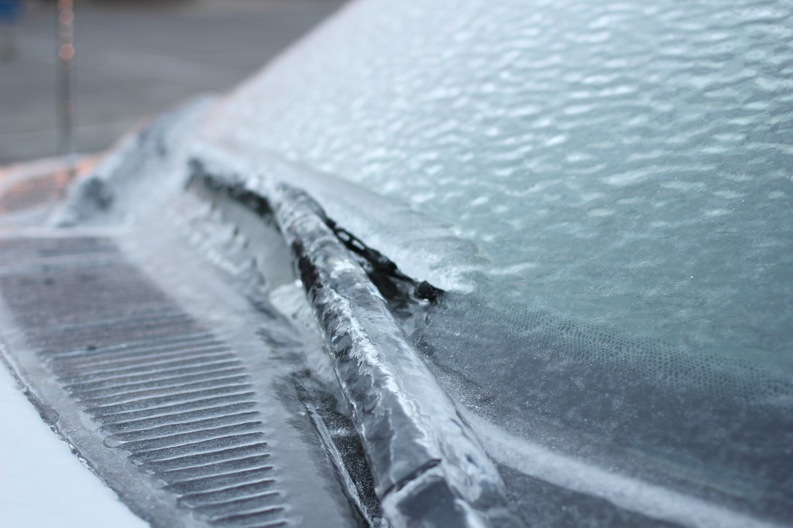
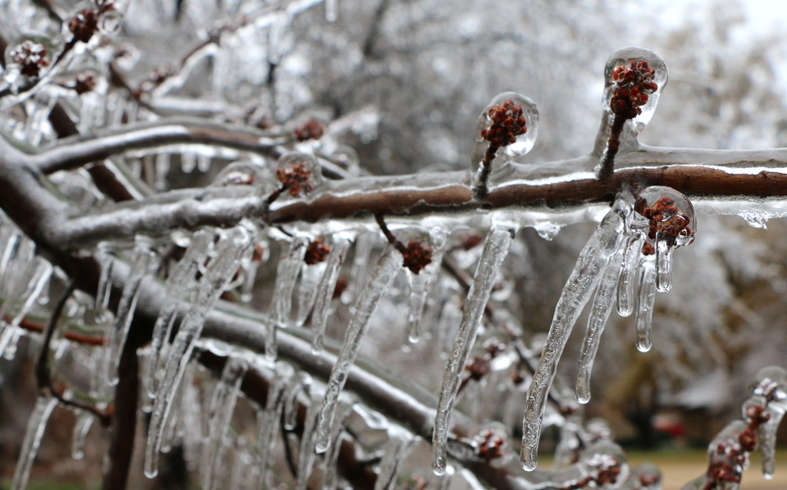
Examples of Winter Weather:
Freezing Rain
Rain that falls onto cold ground and freezes once it makes contact. This results in a layer of ice on objects like trees, powerlines, and on the road.
Notes:
Seattle experiences different types of winter weather, including windstorms, freezing rain, and black ice.
Share the definition and impacts of freezing rain.
Optional: Ask group if they have experienced freezing rain and if they feel comfortable sharing their experience.

Slide 11
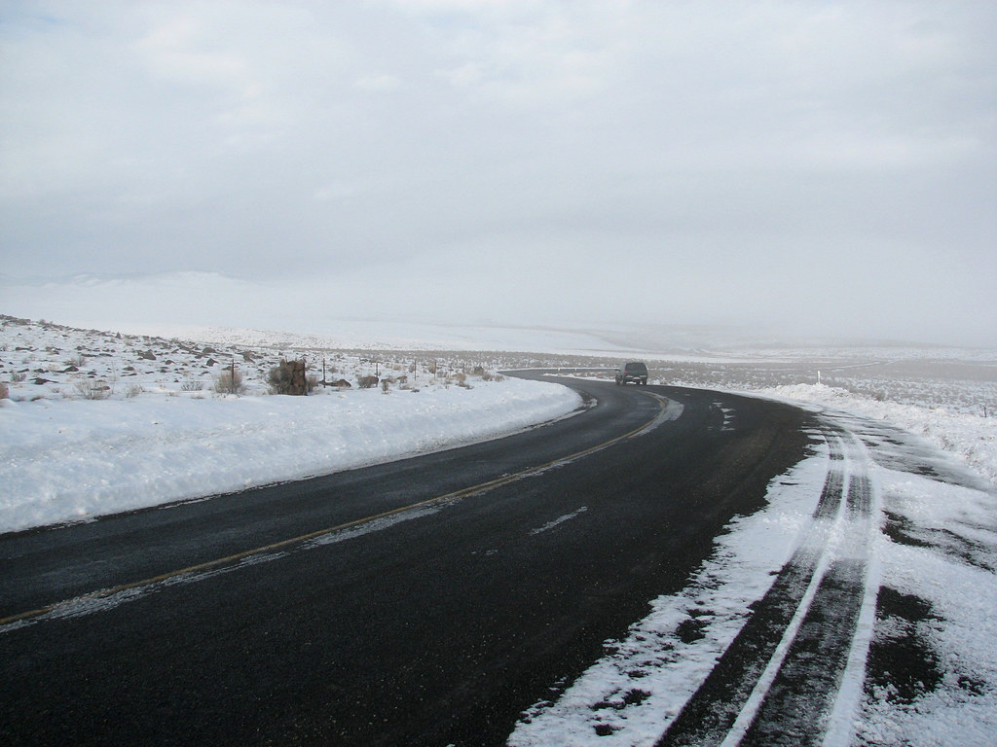
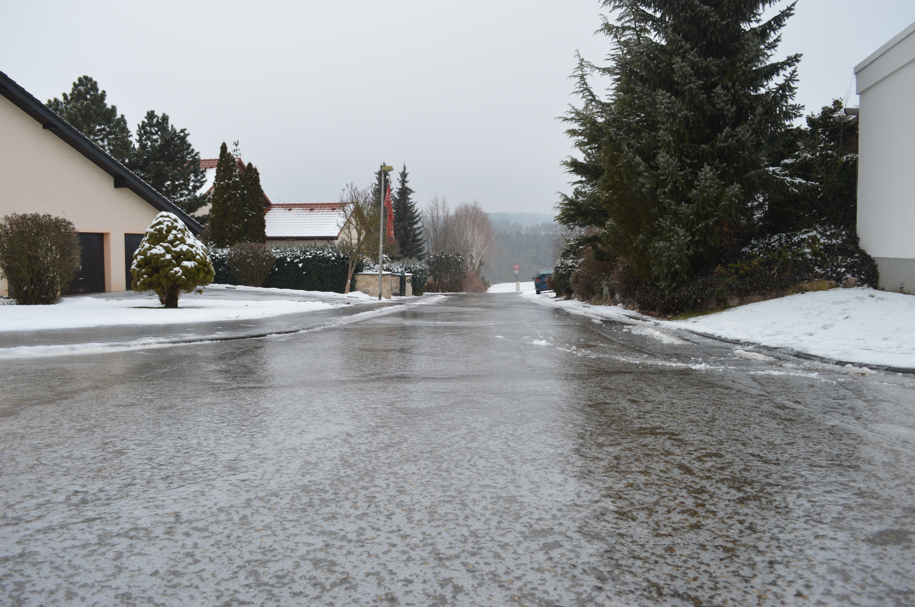
Examples of Winter Weather:
Black Ice
A transparent (see-through) coating of ice, found especially on a road. It can be difficult to see and make it very dangerous to drive. Does not need rain.
Notes:
Seattle experiences different types of winter weather, including windstorms, freezing rain, and black ice.
Share the definition and impacts of black ice.
Connect how black ice is common during Seattle winters and requires same amount of caution as less common, Seattle snowstorms.
Optional: Ask group if they have experienced black ice and if they feel comfortable sharing their experience.

Slide 12
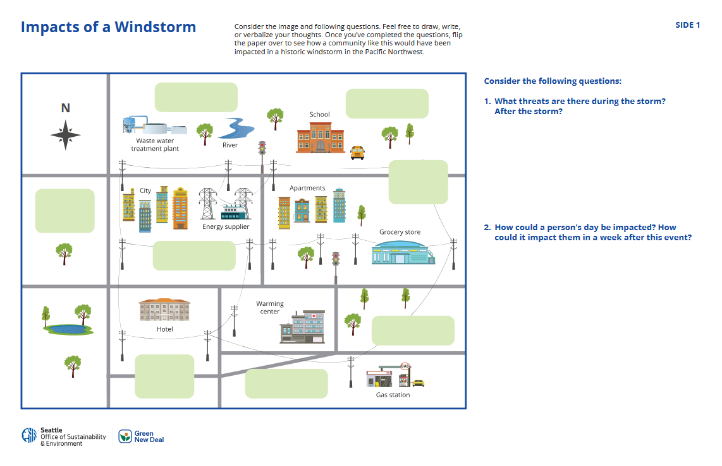
Activity 1: Windstorm Impacts
Notes:
Introduce activity.
Frame that activity is based on a fictional town, but encourage participants to make connections to the places that they live. Let them know that the second part of the activity will connect to impacts on Seattle during a wind storm.

Slide 13
Activity 1: Windstorm Impacts
Working in a group, consider the potential threats or dangers there might be in this neighborhood during a windstorm.
Together, identify:
1. What threats are there during a windstorm? After the storm?
2. How would this impact someone’s typical day?
How could they be impacted in a week from this event?
Draw on your worksheet, write in a notebook, or simply reflect in conversation!

Slide 14
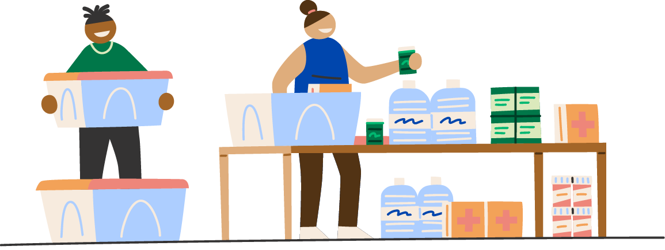
Activity 1: Continued
Flip over your worksheet to see the real-life impacts
of a windstorm that hit the greater Seattle area in 2006.
Answer the following questions in your group:
1. What stands out to you the most?
2. How did the impacts of the windstorm differ from what you thought would happen?
3. What do you think people impacted by the windstorm wish they had prior to the event (preparation, resources, alerts, etc.)?
4. What would you need to feel prepared for severe winter weather?
Be ready to share!

Slide 15
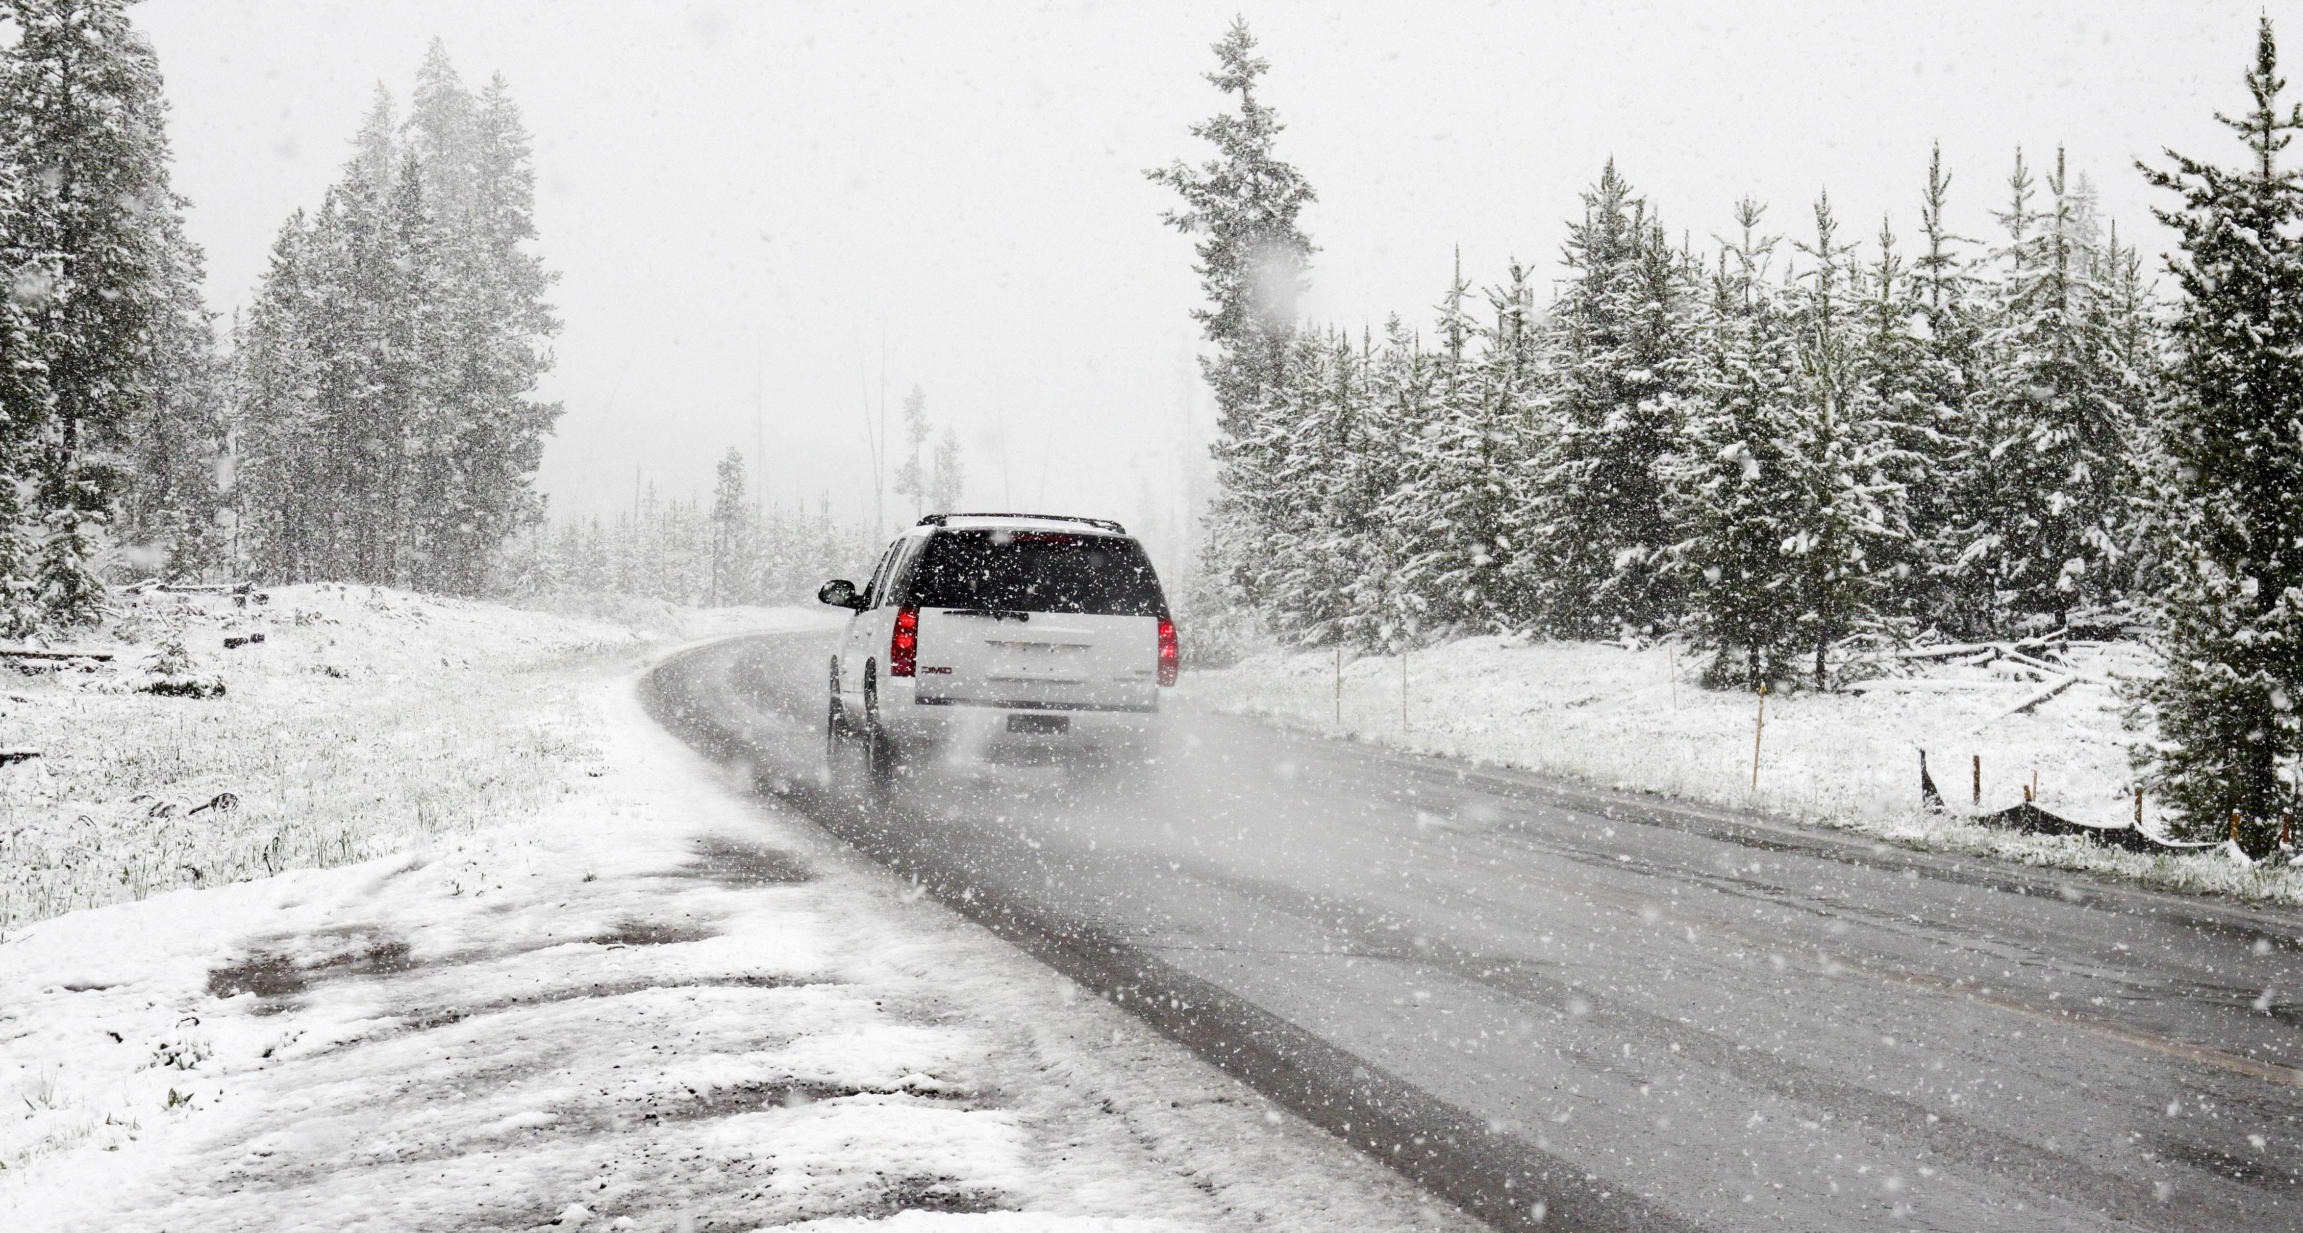
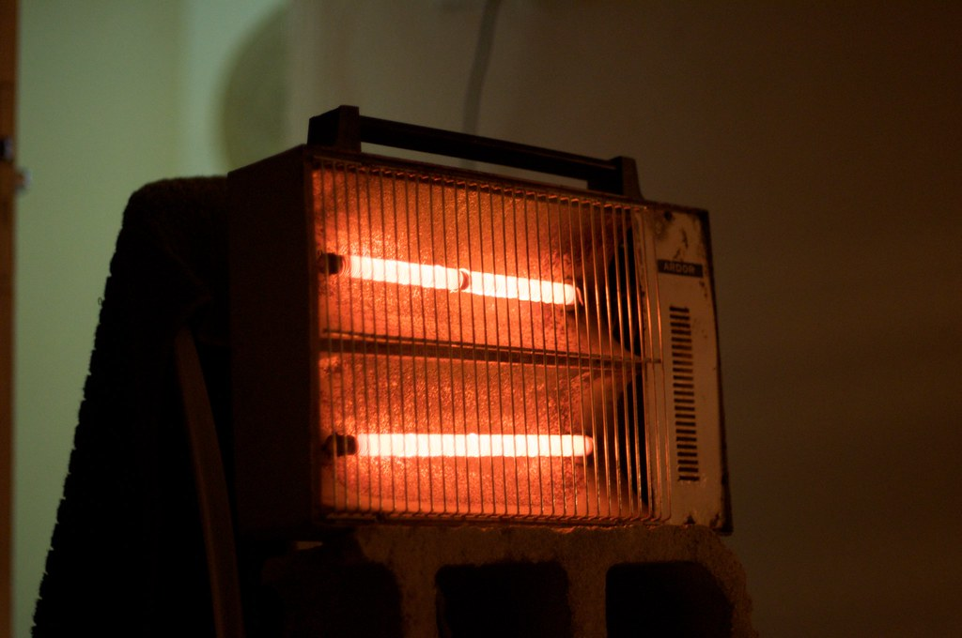

Impacts of Winter Weather
Winter weather can impact people’s health, their ability to get basic needs met, and in some cases can cause death.
We will explore a couple ways that winter weather can impact human health.
Notes:
Serious Impacts: Winter weather can be both a direct and indirect factor that contributes to major health problems. Two major impacts are hypothermia and carbon monoxide poisoning, which both pose a serious threat to human health and in their worst cases can cause death.

Slide 16
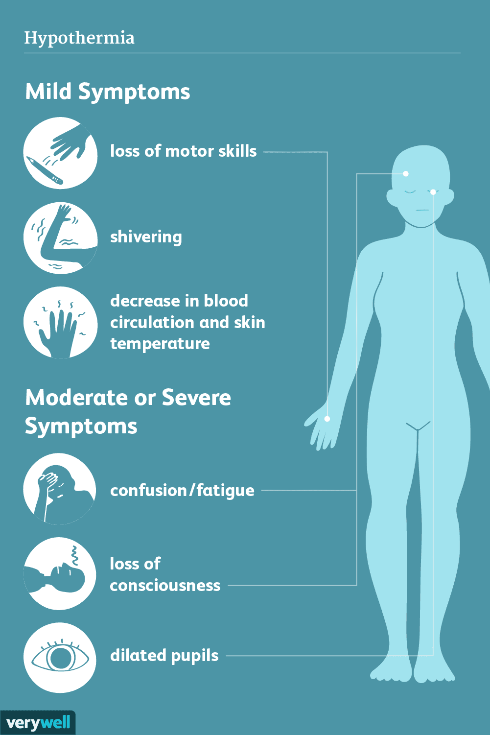
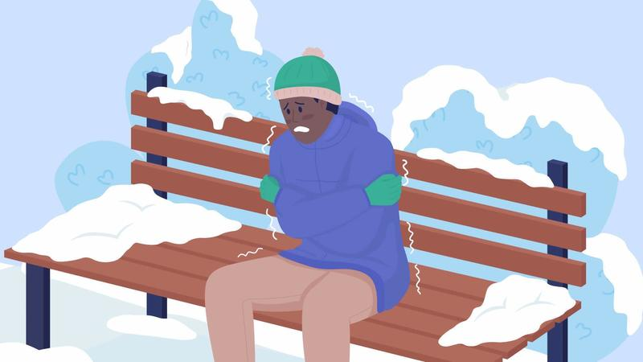
Hypothermia
Definition: Hypothermia is a condition where the body’s temperature drops below 95°F (35°C).
Typical temperatures are 98.6°F (37°C).
Causes: Occurs when the body loses heat faster than it can produce it, typically due to spending long periods of time in cold temperatures.
Notes:
-Define hypothermia.
-Explain the symptoms of hypothermia
-List out vulnerable populations (older adults, folks who don’t have access to adequate food, clothing, or heating
-Define ways to prevent hypothermia (Wear lots of warm layers that can stay dry. Protect your nose, ears, toes, cheeks, chin, and fingers)

Slide 17
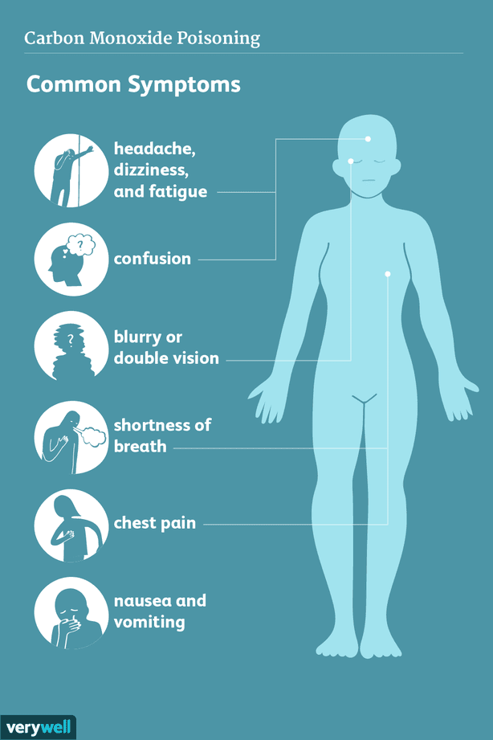
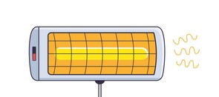
Carbon Monoxide (CO) Poisoning
Definition: CO Poisoning is when someone inhales excessive amount of the colorless, odorless gas, carbon monoxide.
Causes: Carbon monoxide is released when using items like space heaters or grills. CO impacts your blood's ability to deliver oxygen to your body.
Notes:
-Define what Carbon Monoxide poisoning is
-Explain the symptoms of carbon monoxide
-List out vulnerable populations
-Define ways to prevent carbon monoxide poisoning

Slide 18
Reflect & Share
Making decisions in extreme situations can be challenging and often involves making tough choices.
In groups, consider the following questions:
How do you remind yourself to prioritize safety in extreme situations?
Can you think of a situation where you had to make a tough decision to stay safe?
Notes:
Have participants share in small groups.

Slide 19
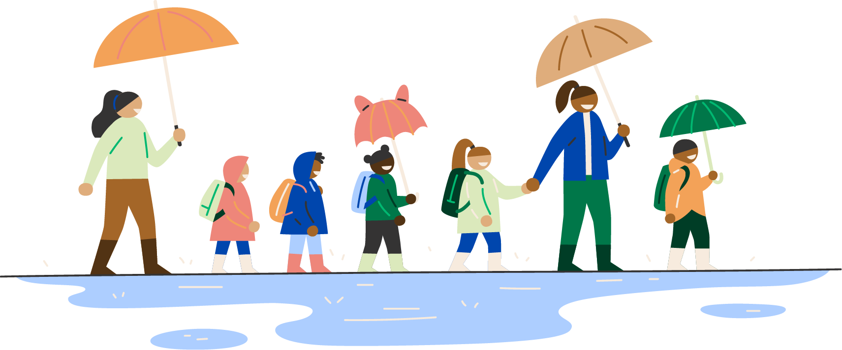
Activity 2: Identify, Prepare
Working in a group, read through the scenario card and identify the concern. Answer the questions on the back.
Possible concerns:
Black Ice
Freezing rain
Hypothermia
Carbon monoxide poisoning
Windstorm (broken trees, downed powerlines, power outage)
Notes:
Give participants time to work through questions.
When conversation begins to die down, ask participants to share out their takeaways.

Slide 20

Prioritization Activity
On your own, read through the questions on the worksheet and complete the following:
Prioritize the questions 1-14 to determine what steps and conversations you will be having first.
    1 being the highest priority, 14 being the lowest priority
Add in additional considerations and questions that are important for you and your community.
The goal is to eventually have conversations about each of these points.
Notes:
Frame activity for group and pass out worksheets

Slide 21
Prioritization Activity Reflection
To the larger group, share:
What steps and/or conversations did you prioritize first?
Did you add preparation steps that might be helpful for others?
Notes:
Facilitate group reflection.

Slide 22

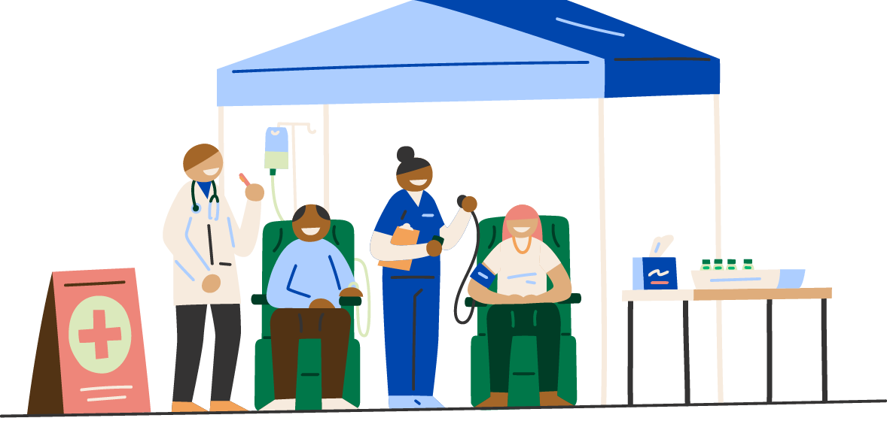
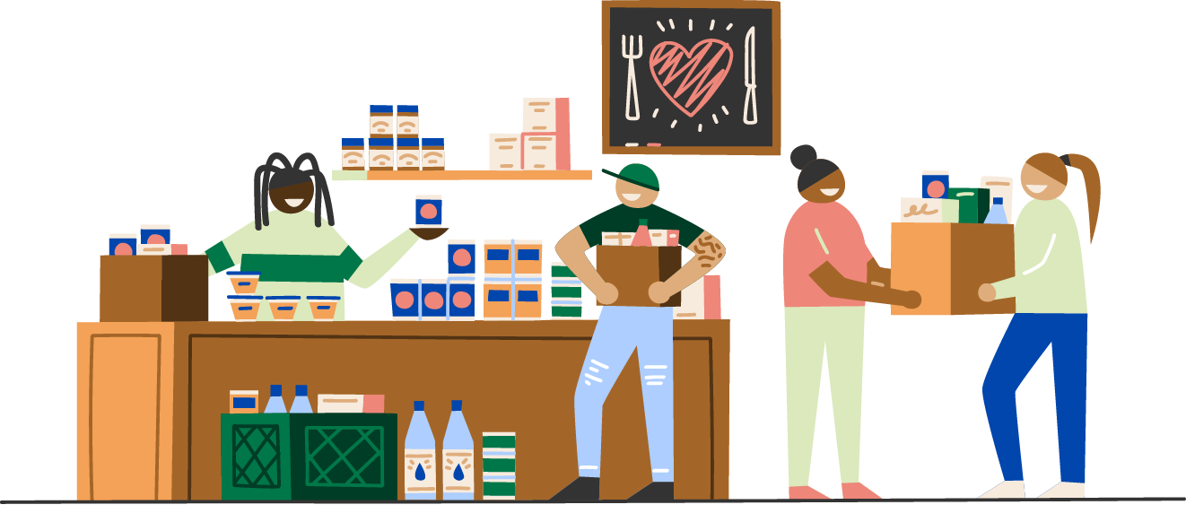
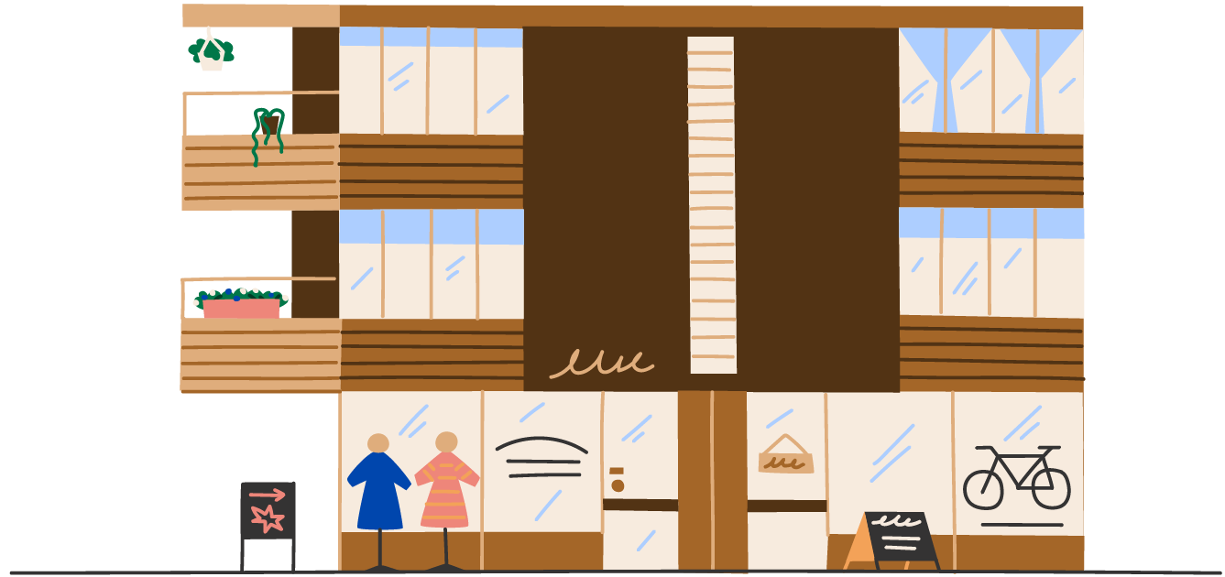
Preparing Yourself
& Your Community is Critical
Notes:
Participants should use information learned in module to have discussions and explore what concrete steps they can take to prepare for winter weather events.
Preparing for extreme winter weather can keep individuals, neighbors, communities, and properties safe.

Slide 23
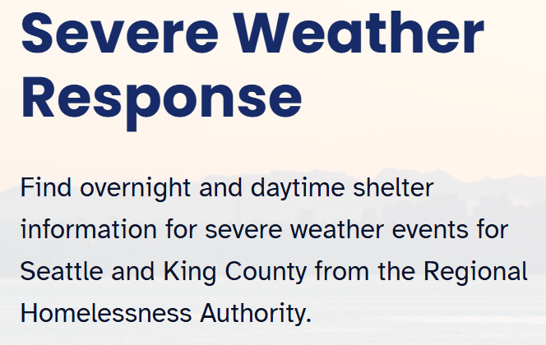
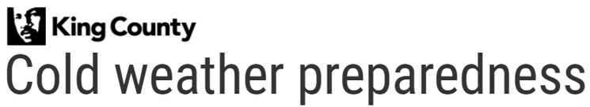


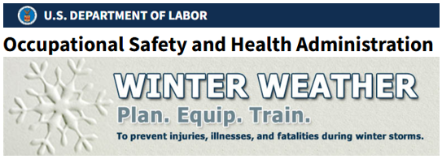

Extreme Winter Weather Resources
Notes:
3-minute discussion
When preparing for extreme weather, it’s important to know there are supports out there from the City of Seattle and King County
You should become familiar with these resources and where to locate them so you can share this information and help others impacted by flooding.

Slide 24
Reflect & Share
Now that we have talked about preparing for extreme weather situations, imagine it’s a year from now and your community feels climate ready and resilient.
In groups, answer the following questions:
What do you think you would see or feel that is different? What would it look like if your community was prepared?
How would your relationship with your community change or grow?
How can you start today to prepare your community for extreme weather events? (i.e. introduce yourself to 2 new neighbors in the next month.)
Notes:
Have groups reflect in small groups.

Slide 25
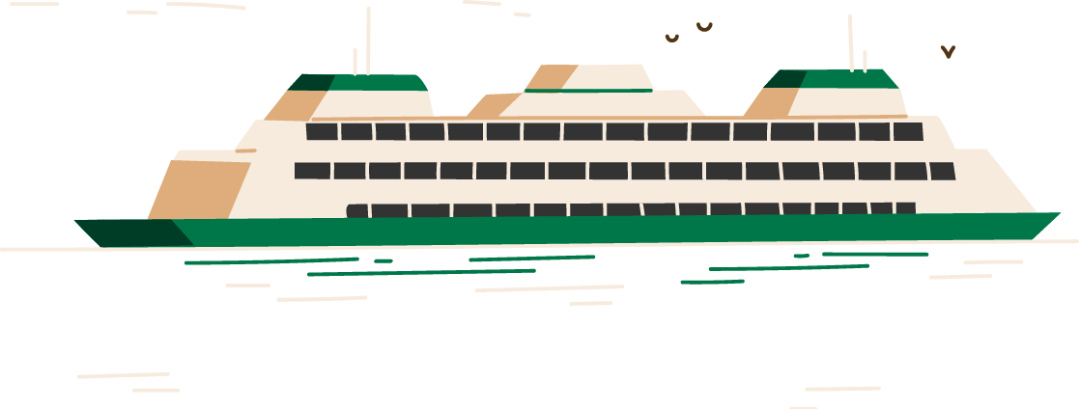
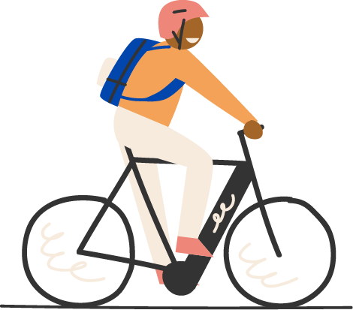

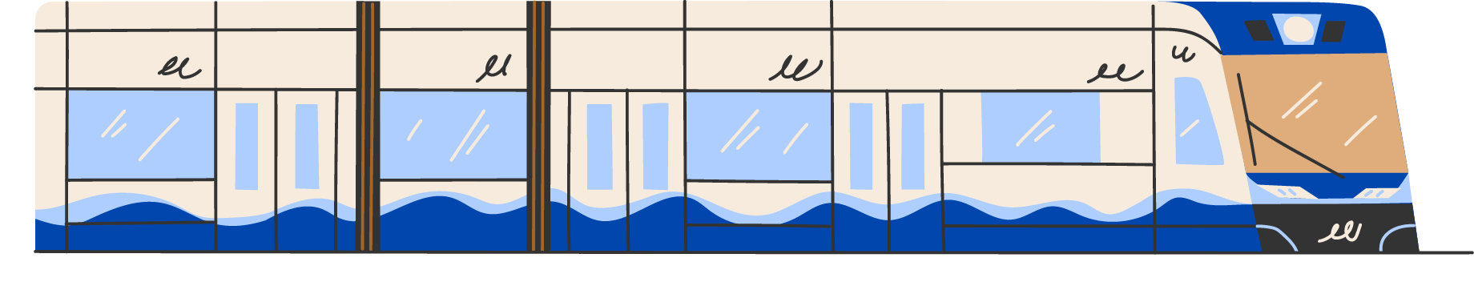

Thank you

