Slide 1
Extreme Rain and Flooding
Notes:
Introduce yourself as the presenter.
Introduce the space.
Have participants introduce themselves.

Slide 2
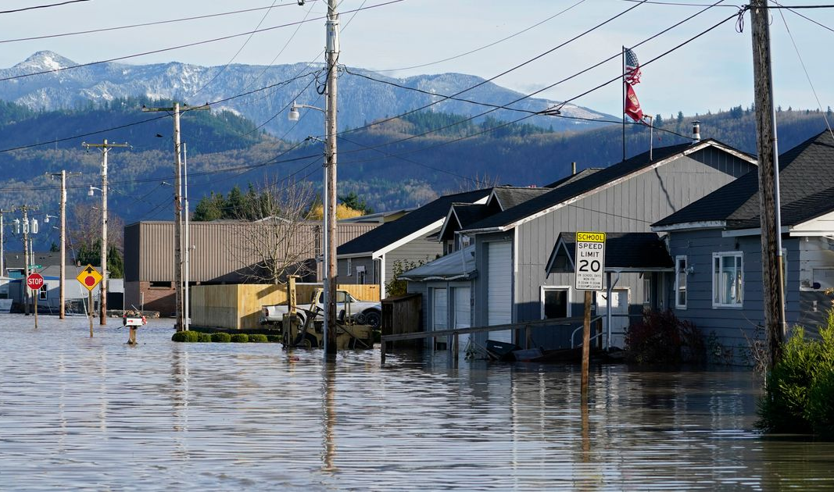

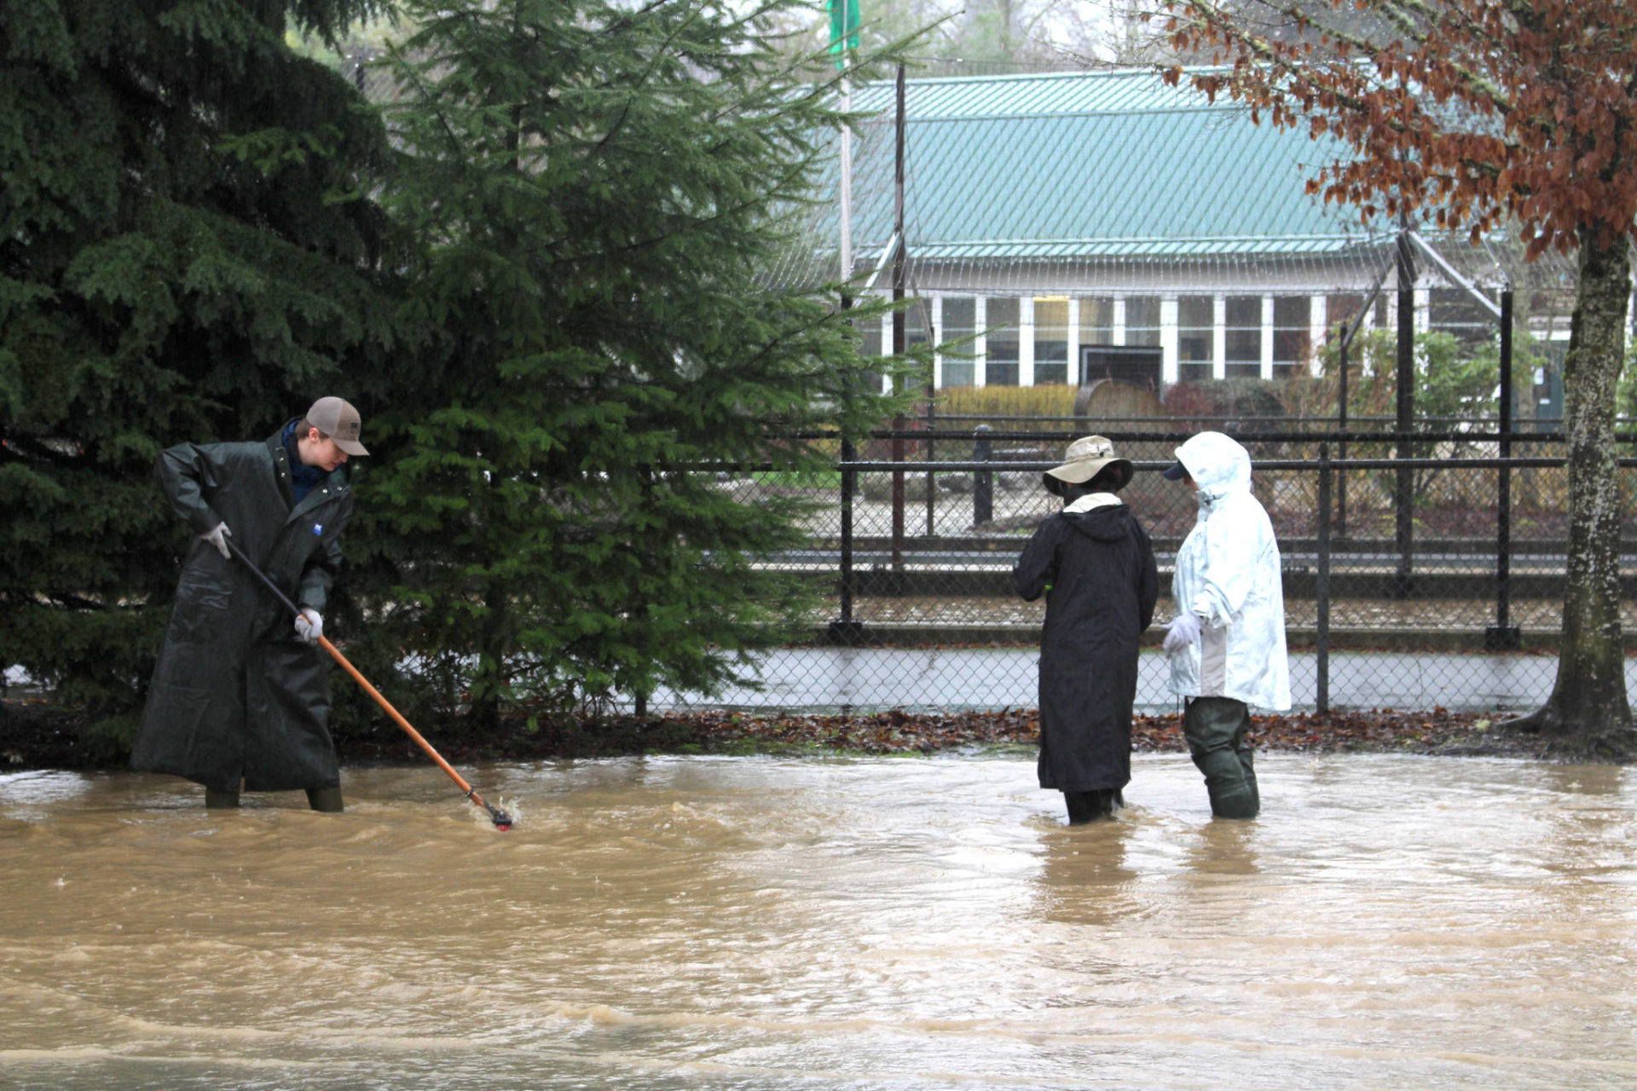
Module Overview
Learn about different types of flooding
Observe different maps of Seattle and reflect on how they relate to modern-day flooding
Complete a flood preparation prioritization worksheet
Read about resilient communities in Washington impacted by flooding
Notes:
Go over the overview of the day, the space and the purpose of the module

Slide 3
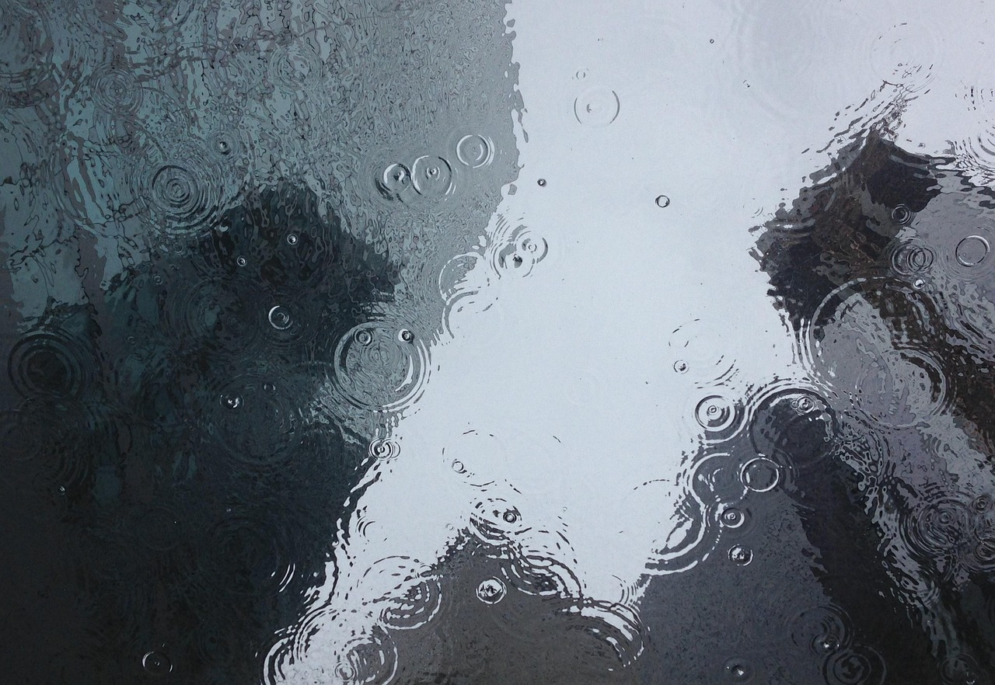

Reflect & Share
Discuss with your table group.
What comes to mind when you think about flooding in this area?
Notes:
Reflect and share in table groups (1 minutes)
Have 2-3 groups share their answers (1 minute)

Slide 4
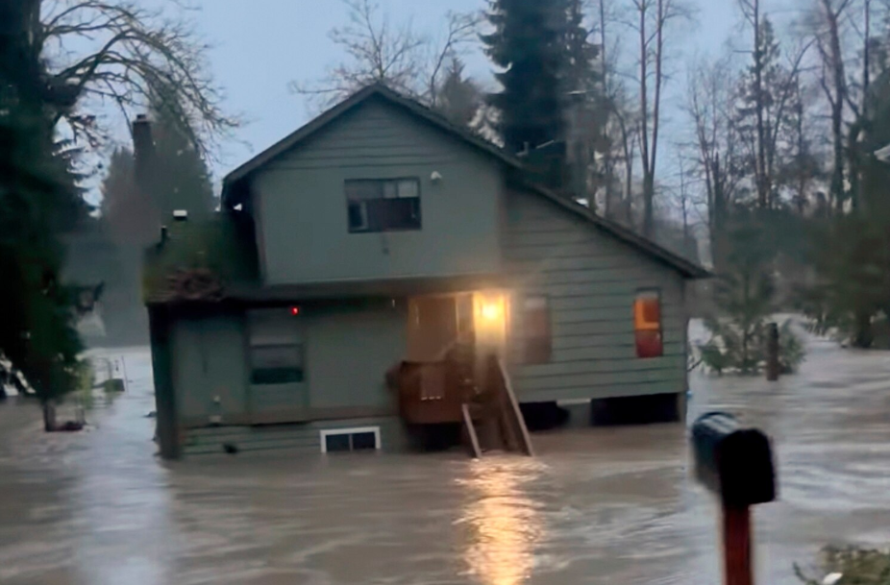
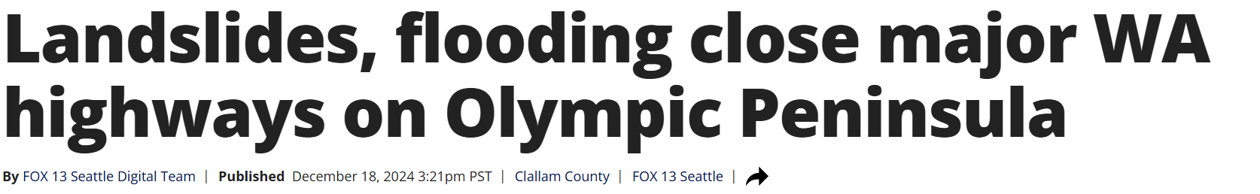
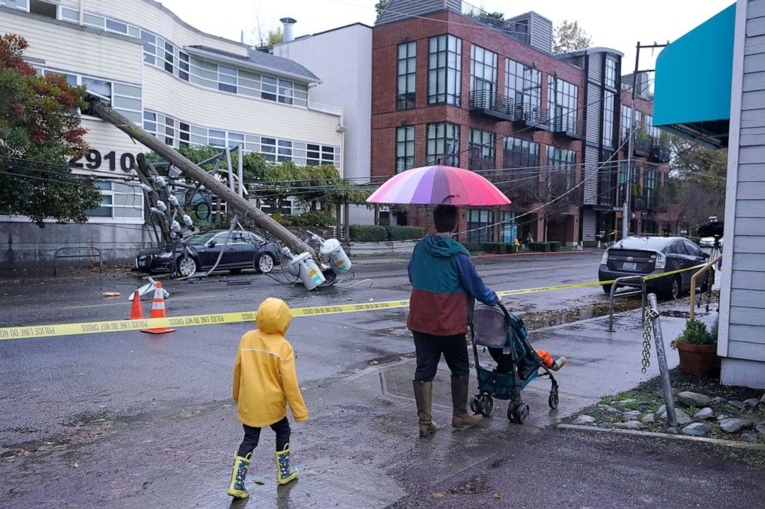
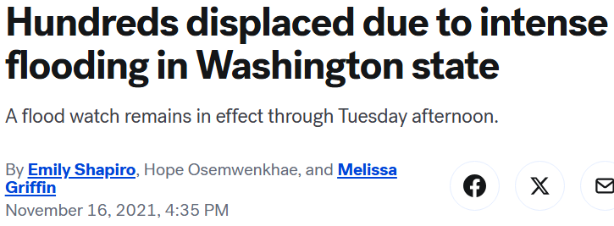
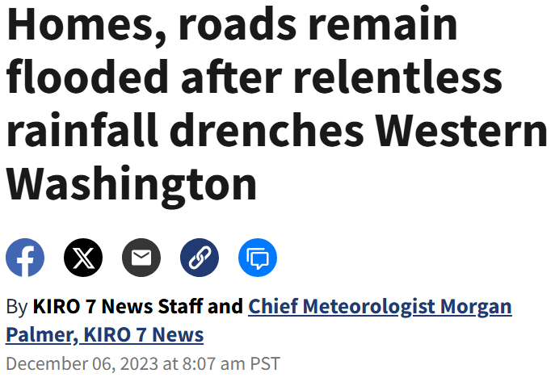
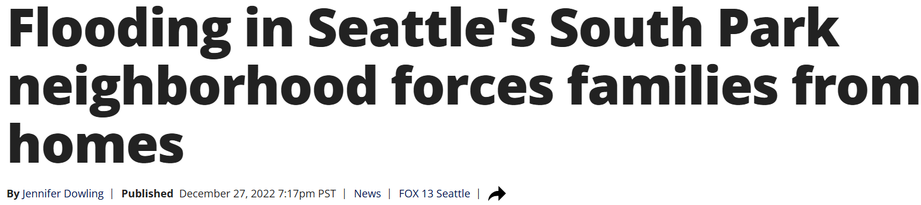
What is Flooding?
Notes:
1-minute explanation
What is flooding?
Water overflows onto land due to extreme rain, or high winds and storm surge on the coast.
Flooding is a frequent severe weather threat that can happen very quickly and with little warning.
The three most common types of flooding are coastal flooding, river flooding, and urban flooding.
We can look at local flooding events that have impacted Washington state in the last few years.
Flooding can close major roads and highways.
Flooding can cause families to evacuate their homes and become displaced.
Flooding can cause power outages and make going outside in neighborhoods unsafe.

Slide 5
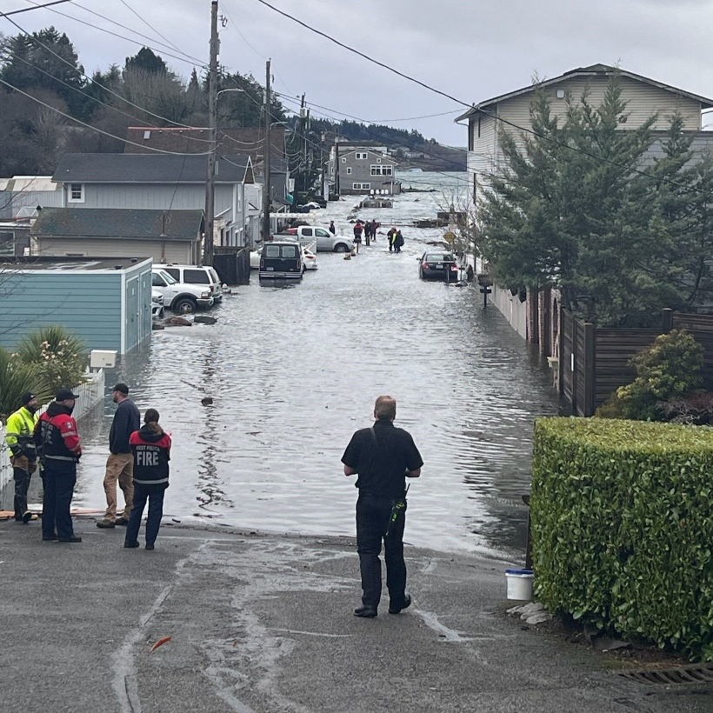
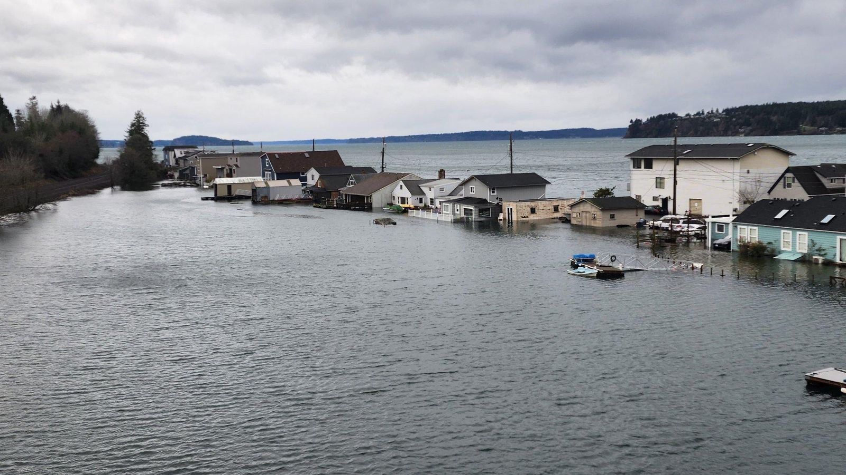
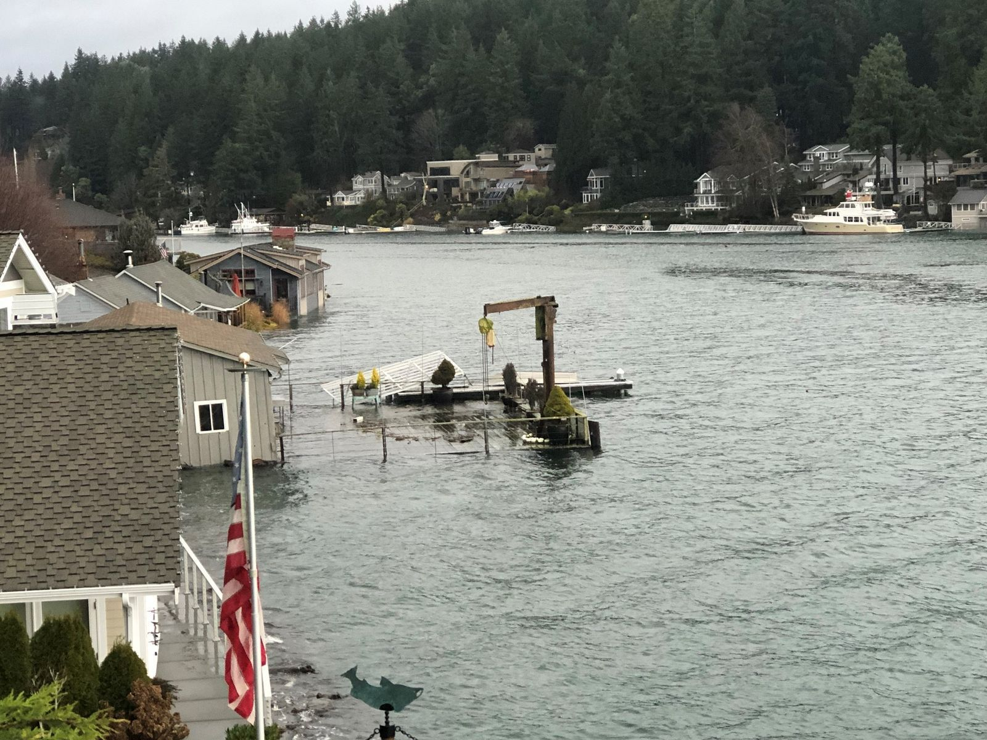
Coastal Flooding
During storms and extreme high tides, land that is close to oceans, bays, and the Puget Sound will flood.
Gig Harbor, Washington
Gig Harbor, Washington
Gig Harbor, Washington
Notes:
45-second explanation
Photos from Gig Harbor, a town located along the Puget Sound, flooded due to storms and extreme high tides.
Communities needed to evacuate their homes due to high water levels.

Slide 6
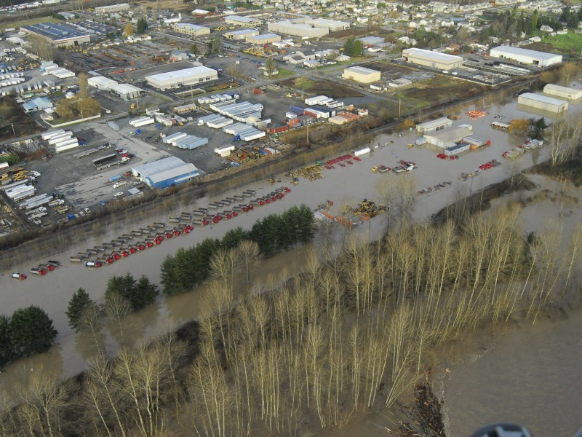
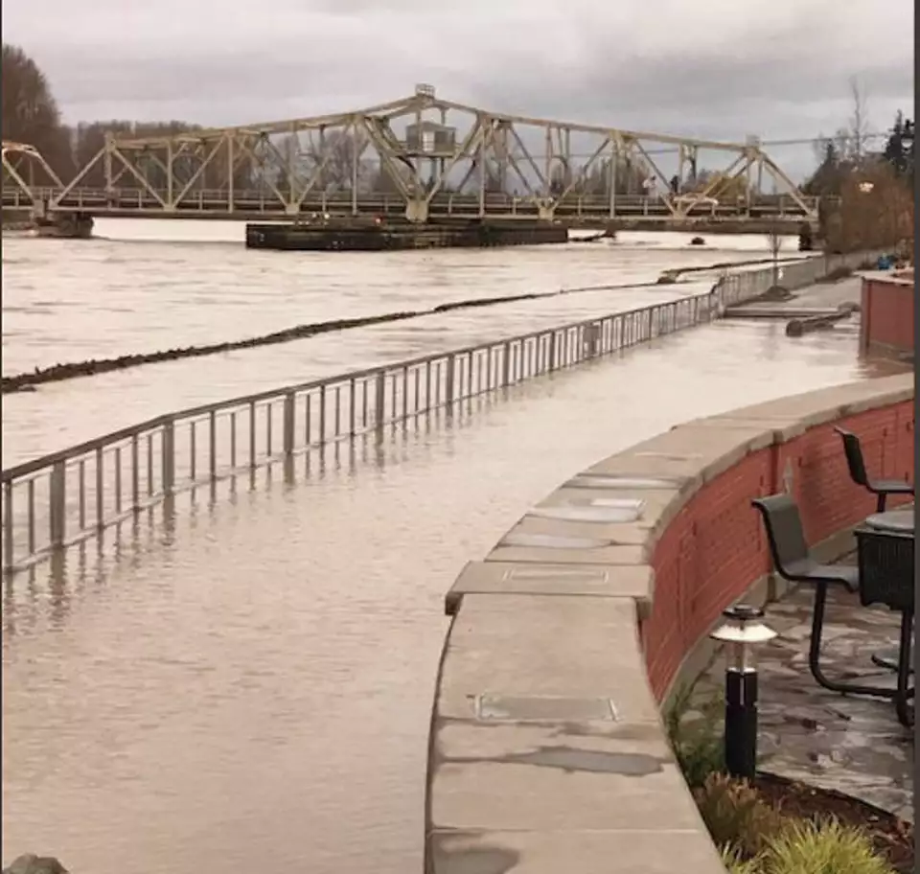
River Flooding
Streams and rivers have more water than they are capable of handling, forcing water to overflow onto nearby land. This typically happens during extreme rain or long periods of heat that melt large amounts of snow and glacial ice.
Puyallup River, Washington
Mount Vernon, Washington
Notes:
45-second explanation
Water levels from rivers can get too high and overflow onto what is typically dry land.
The Puyallup River in Puyallup and the Skagit River in Mount Vernon are two local examples of river flooding.
Rivers can flood into local parks, business areas, parking lots, and communities that are next to the river.
Snow and ice melt from the Cascade Mountains and flow into surrounding rivers. Too much snowmelt and extreme rain can lead to river flooding.

Slide 7
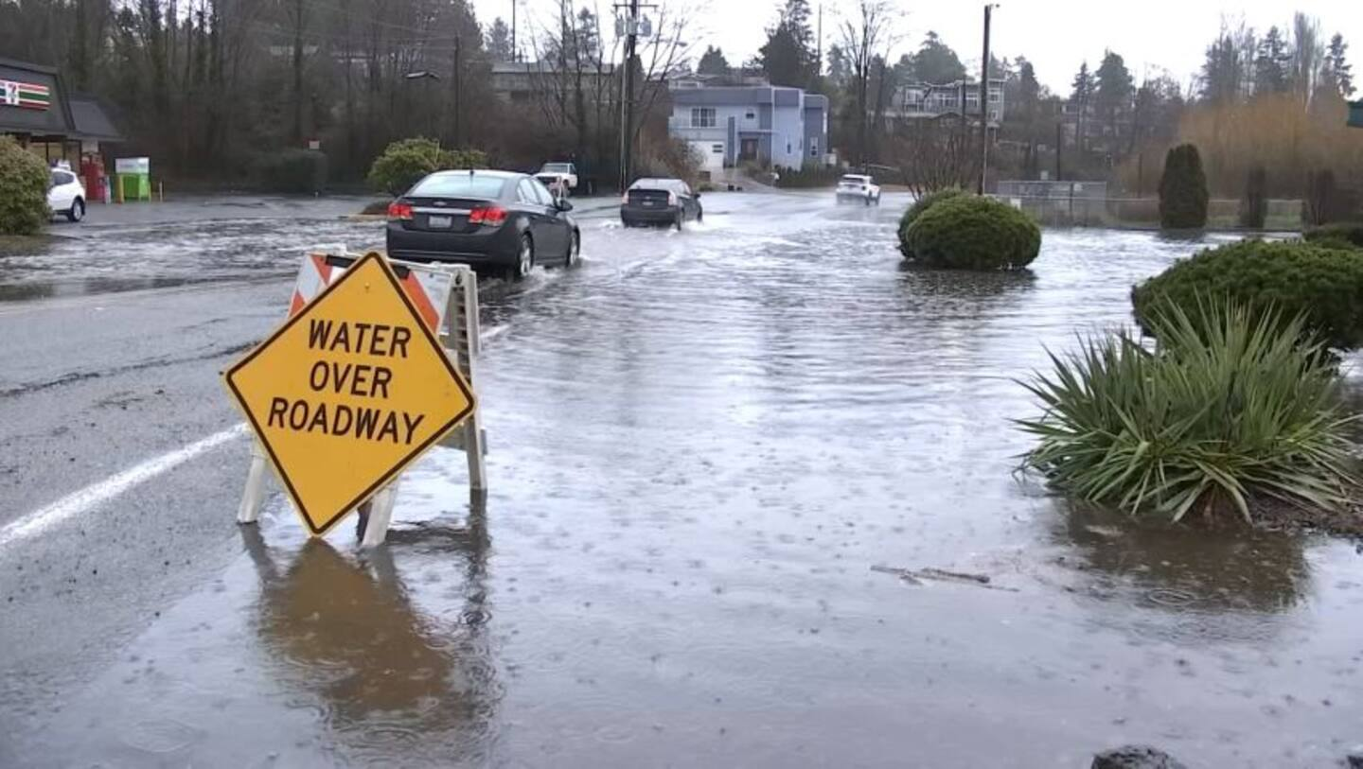
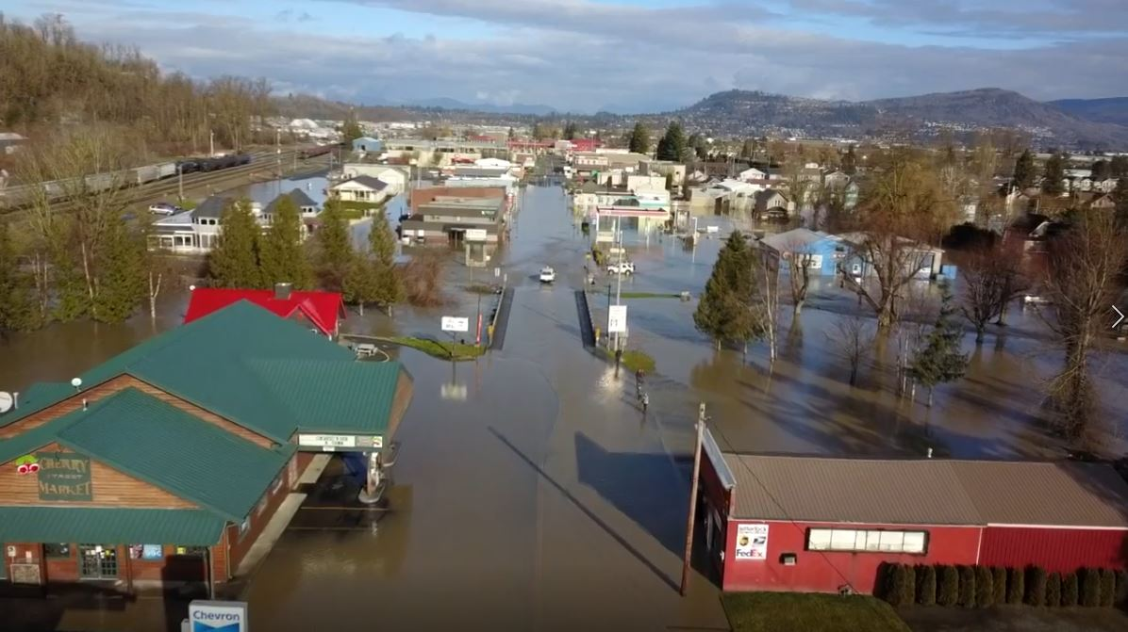
Urban Flooding
This happens when there is more water than the drainage systems (sewer systems and stormwater drains) can handle. This is usually caused by extreme rain events.
Des Moines, Washington
Snohomish County, Washington
Notes:
45-second explanation
Capacity of storm drains and sewer drains are not large enough to allow a higher than expected volume of water to flow though the pipes and off of streets.
Storm drains can become clogged due to leaves, grasses, rocks, dirt, debris, and litter. This stops water from flowing through and leads to flooding.
First picture from Des Moines was taken outside of Taco Time drive-thru was not accessible because of the flood water.

Slide 8
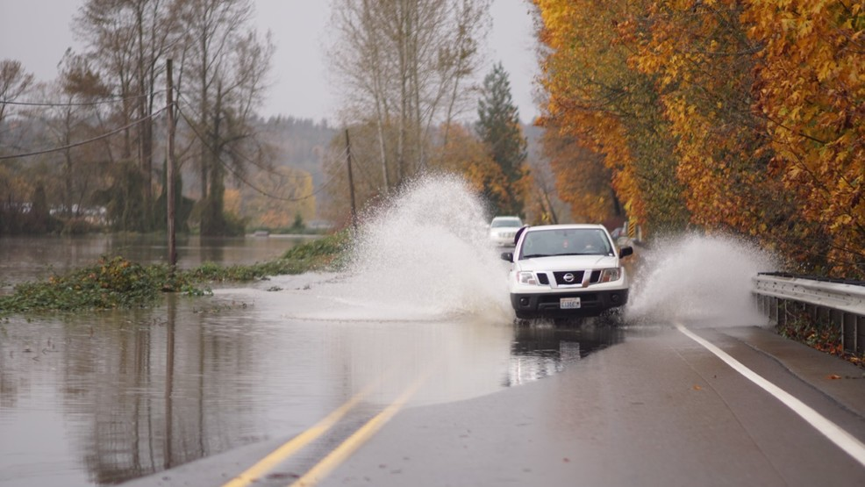
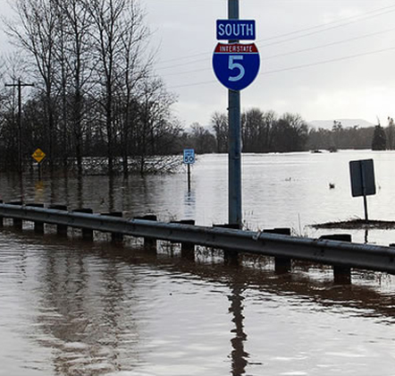
Reflect & Share
Discuss with your table group.
Why do you think urban flooding is happening more frequently?
Why do you think most people in the greater King County area are experiencing urban flooding?
Notes:
5-minute activity
Table groups will reflect and discuss their answers to the questions (2 minutes)
Call on 2-3 groups to share their answers (3 minutes)

Slide 9
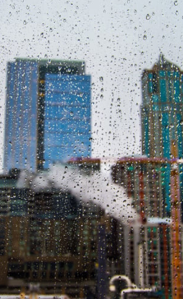
Why Does Flooding Happen?
Extreme rain events are happening more frequently due to global warming and climate change.
Densely populated areas are at a higher risk for urban flooding.
Buildings, roads, and parking lots reduce the amount of water that can be absorbed into the ground.
Current sewage systems and storm drains are not always able to handle the increase of heavy and extreme rain.
Notes:
2-minute explanation
There are more impermeable surfaces (surfaces that do not allow water to pass through) and less permeable surfaces (surfaces that allow water to pass through).
Culverts, drainage ditches, and storm drains can be backed up with debris, leading to flooding.
Our current storm drain and sewage systems do not have the capacity to allow an increased volume of water to flow through the pipes at once.
1-minute transition to next activity
The land that we live on has changed dramatically throughout history, which has had huge impacts on our environment.
We are going to look at how these changes to our land impact fooding during extreme rain events.

Slide 10
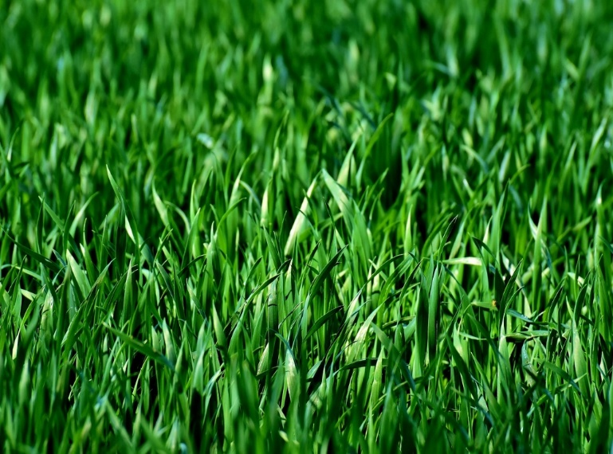
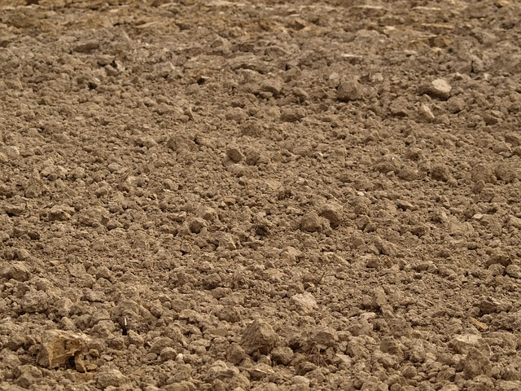



Ground Surfaces
Permeable Surfaces
Impermeable Surfaces
A surface that allows water to flow through or be absorbed.
Solid surfaces that do not allow water to pass through.
Grass
Soil
Concrete
Brick
Gravel
Notes:
2 minutes
Impermeable surfaces lead to more flooding during extreme rain.
There is no place for the water to go on impermeable surfaces when it rains.

Slide 11
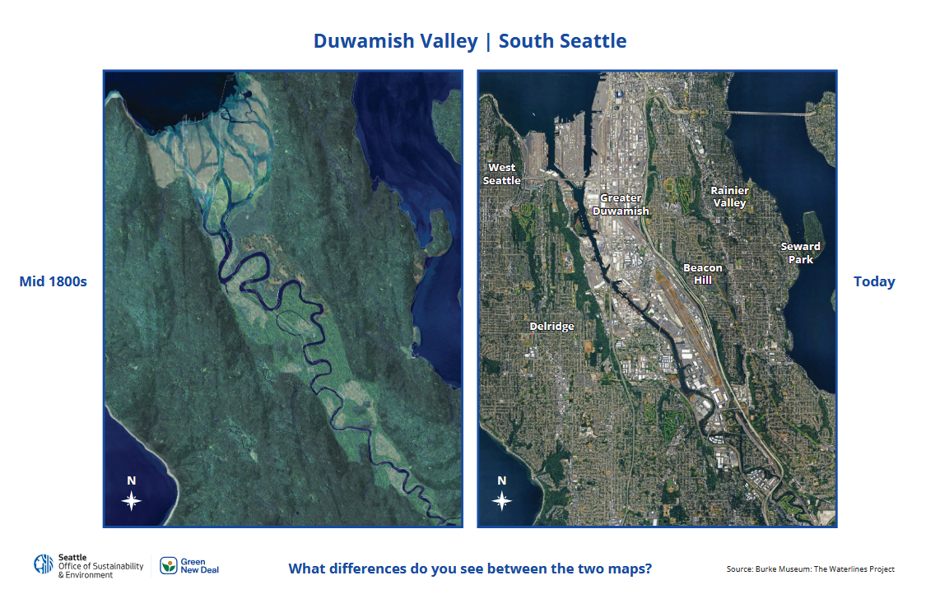
Spot the Difference
In small groups, find as many differences between the two maps as you can.
You can draw on
and mark the maps.
Be ready to share any differences you saw.
Notes:
5-minute activity
These two images are maps of the Duwamish Valley.
The map on the left is a computer generated imaged of what the Duwamish Valley most likely looked like in the mid-1800s.
The image on the left is a satellite image of the current day Duwamish Valley.
Participants can draw on and mark the maps.

Slide 12
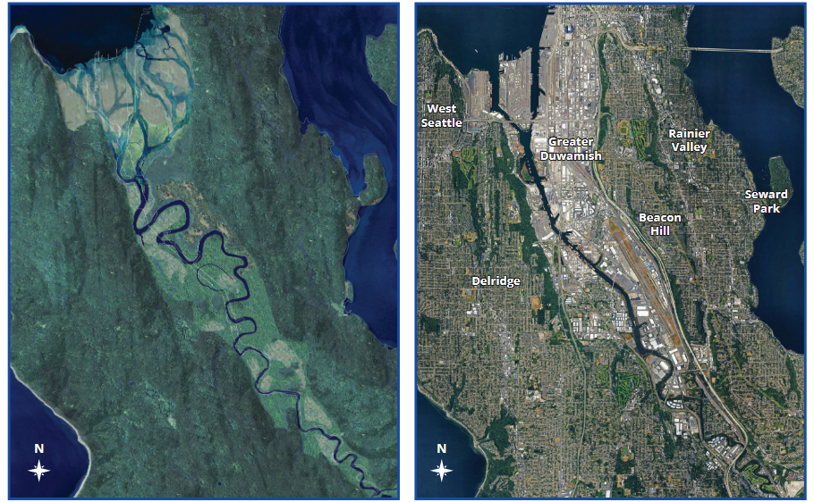
Map of the Duwamish River in the mid 1800s vs Today
Mid 1800s
Today
Notes:
Keep this image of the maps on the screen while participants are working on the activity.

Slide 13
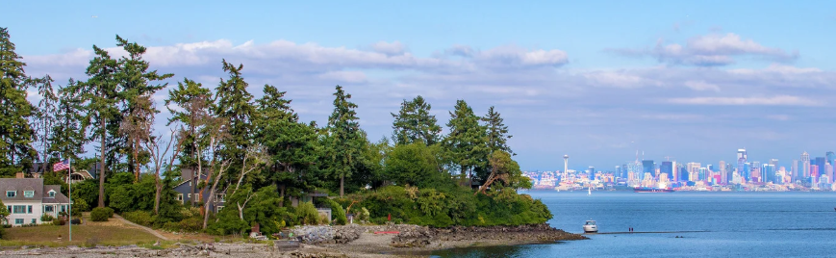
Share Out
What differences did you see between the two maps?
Notes:
2-minute share out
Call on 2-3 groups to share their answers.
Allow participants to guide the course of the discussion.
Examples of talking points that might come up:
Seattle shorelines used to be covered in marshes (ecosystems that have permeable surfaces and can tolerate lots of water).
Modern day Seattle filled in land and permeable surfaces and built buildings, highways, and parking lots which are all impermeable surfaces.
The shape of the Duwamish river changes from curvy to straight. A curvy river helps to slow down the flow of the water and decrease flood risk.

Slide 14

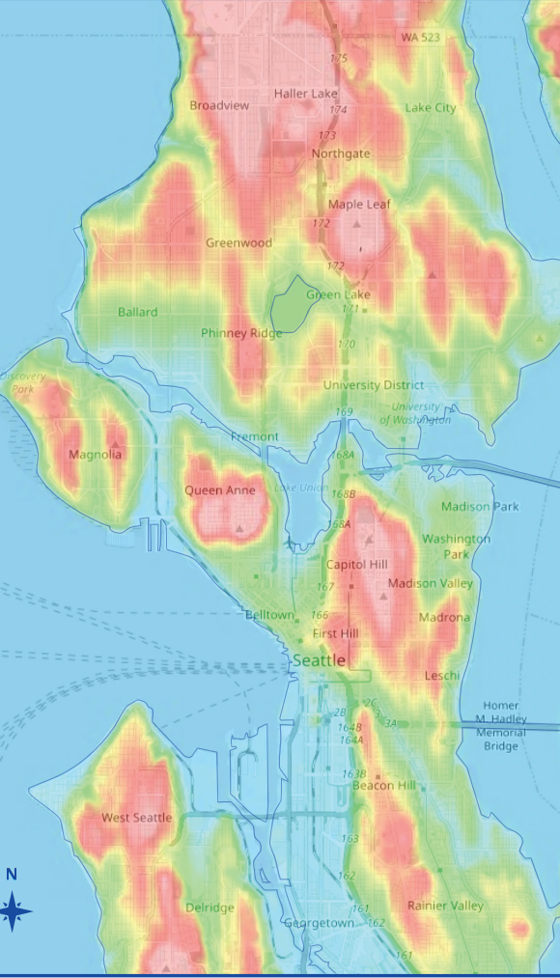
Topographic Map Activity
Identify the low elevation areas and discuss the questions in your group:
Who is living in the low elevation areas?
What challenges might these communities be facing?
How does having money and resources play a role in recovery for communities that live in low elevation areas?
Notes:
5-minute activity
The highest elevation in Seattle is 520 feet in West Seattle at Myrtle Reservoir Park.
Blue/Green = low elevations
Yellow/Red = higher elevations
Participants can mark and draw on maps.

Slide 15
Share Out
What did you notice about the topographic map?
Who/what communities are living in the lowland areas?
What challenges might these communities be facing?
How does having money and resources play a role in recovery for communities living in low elevation areas?
Notes:
3-minute share out
Ask 2-3 groups to share their answers.

Slide 16
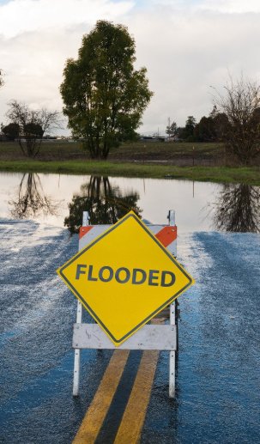
Flood Preparation Prioritization
On your own
Read through all the questions on the worksheet.
Prioritize the questions 1-15 to determine what steps and conversations you will be having first.
      1 being the highest priority, 15 being the lowest priority.
Add in additional considerations and questions that are important for you and your community.
Notes:
10-minute activity
There are no right or wrong answers, your prioritizations are you personal opinions.
It is important to consider and have conversations about each of the questions on the worksheet.
The goal of this activity is to eventually have conversations about each of these points with family members, friends, and neighbors.

Slide 17
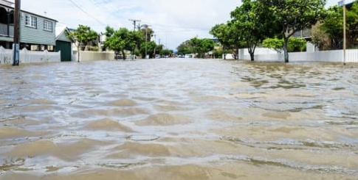
Reflect & Share Out
What steps and/or conversations did you prioritize first?
Did you add preparation steps that might be helpful for others?
Notes:
5-minute share out
Call on 2-3 participants to share their answers.
Participants can use the prioritization worksheet to create a pan for their family in case of flooding.
Participants can share these questions and have conversations with friends, family, and neighbors.
5-minute transition to next activity
Extreme rain and flooding do not impact people and communities equally.
Systemic issues like redlining make recovery resources harder to access.
Recovery after emergencies can take much longer for communities that do not have access to resources and funding.
Communities, neighborhoods, and families need to communicate and make plans to respond to extreme weather in order to be resilient and recover.

Slide 18
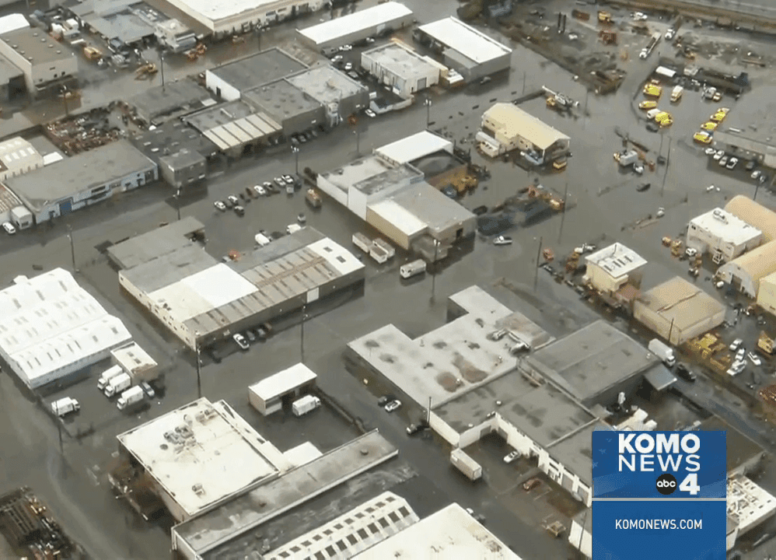
Resilient Communities In Washington
Each group will receive a summarized news article
Read the article together
Discuss the reflection questions as a group
Notes:
1-minute introduction to activity
Participants will read an article in their table groups about a resilient community in Washington that responded to flooding.
These communities did not have emergency plans in place.
By communicating with each other, they were able to connect community members with resources to work towards recovery.
Groups will be reading one of two summarized news articles
One about the South Park Flood
One about the Lummi Nation Flood

Slide 19
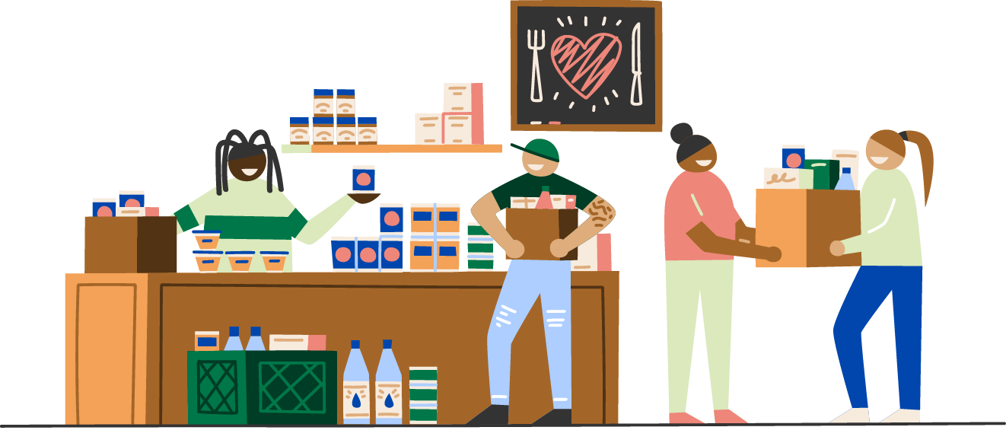
Discussion Questions
In your group, answer the following questions:
What community members were involved in recovery efforts?
What recovery supports were provided to the community?
How do you see resiliency in the community you read about?
What can we learn from this event to prepare for flooding in the future?
Notes:
10-minute activity
Participants will work in their groups to answer the discussion questions after reading their article.
4-minute discussion
Resilient communities were able to respond immediately to the needs that arose during extreme rain and flooding.
By having conversations about preparation for environmental emergencies, you’ll be able to easily communicate your recovery needs during a future flooding event.

Slide 20
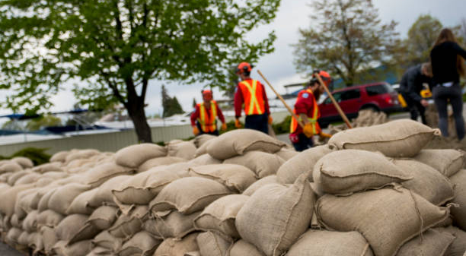

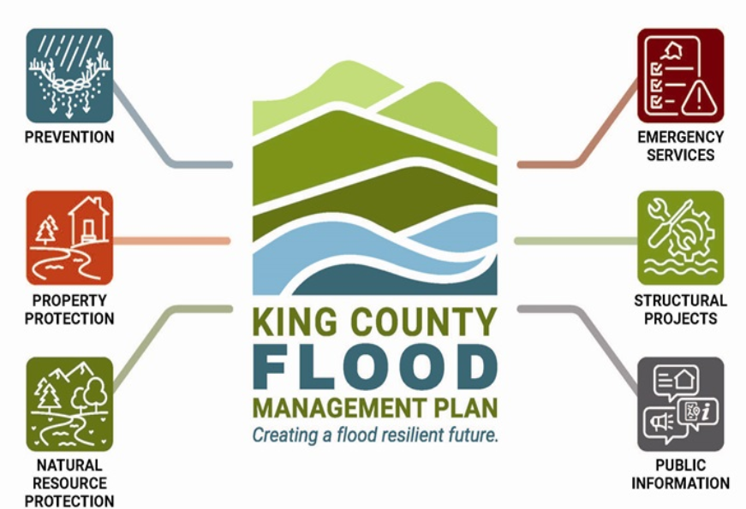
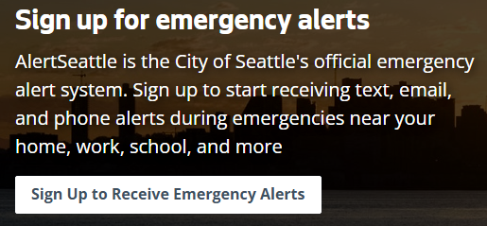




King County Flooding Resources
Notes:
3-minute discussion
When preparing for flooding and extreme rain, it’s important to know there are supports out there from the City of Seattle and King County
You should become familiar with these resources and where to locate them so you can share this information and help others impacted by flooding.
There is a printed document with all of these resources and links for you to take home, explore, and share with your community.

Slide 21
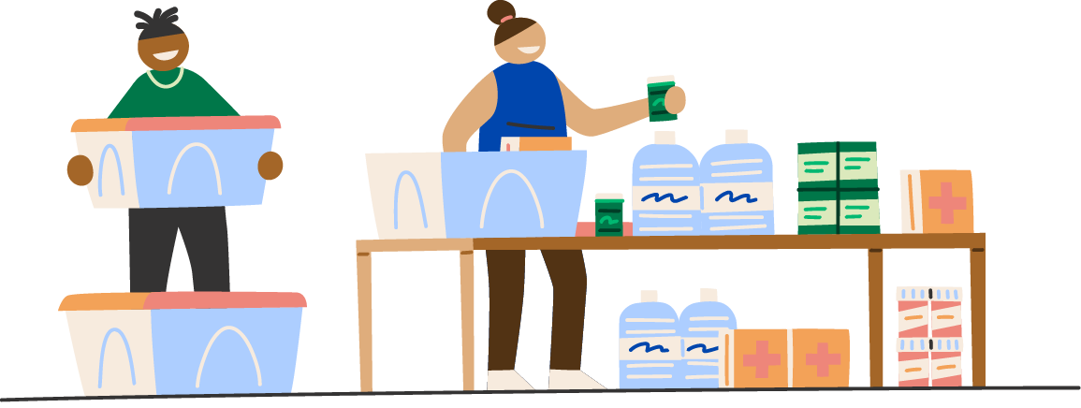

You have the power to build a resilient community
You’re taking the first step in building a resilient community by being here today.
You can continue building resiliency by:
  Connecting with your neighbors
  Having conversations with friends and family
  Sharing resources
  Designing an evacuation plan
Notes:
5-minute discussion
Ask participants if they have knowledge of flood preparation resources they would like the share with the group.
Pass out evacuation plan worksheet for participants.

Slide 22
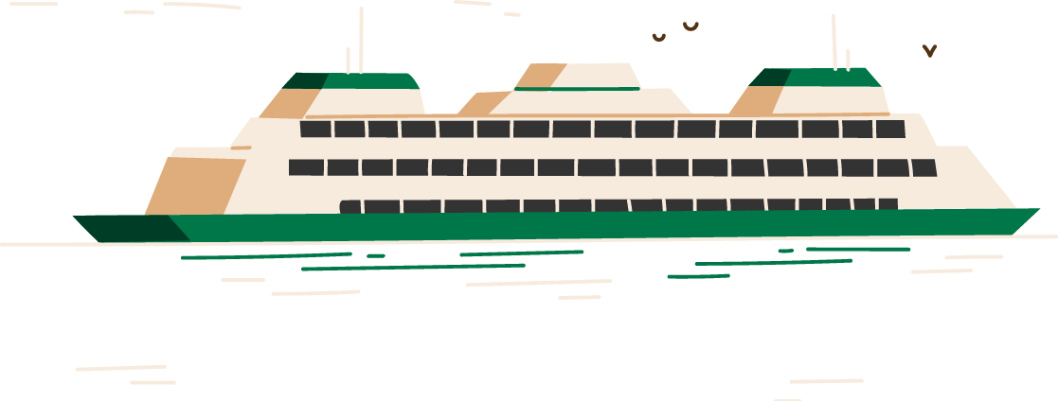

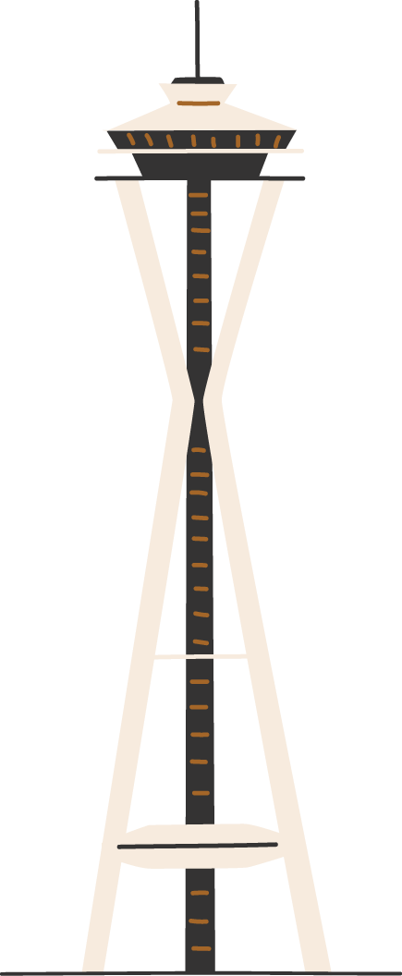
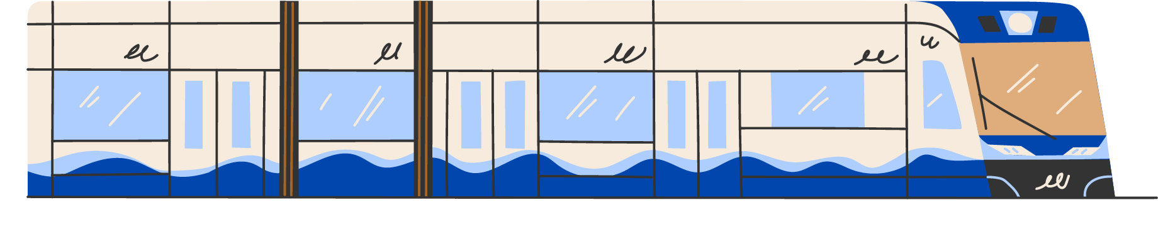

Thank you
Notes:
2-minute discussion
Review key messages:
Learn what extreme rain and flooding is and how it impacts communities differently.
Feel prepared for extreme rain and flooding by taking the first steps to create an evacuation plan.
Learn why it is critical to prepare for future extreme weather events.
Ask participants if they have any final questions.
Ask participants what their key takeaways are and how they will share this knowledge with their friends and family.
Thank participants for coming to the workshop.
Encourage participants to fill out the evacuation plan worksheet and create a plan with their families and communities.

