Slide 1
Extreme Heat and
Wildfire Smoke

Slide 2

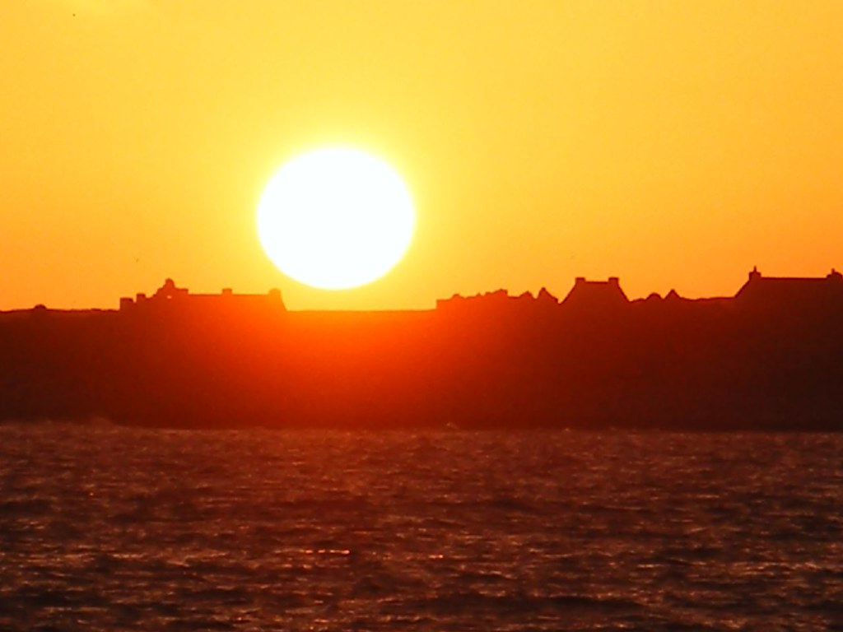
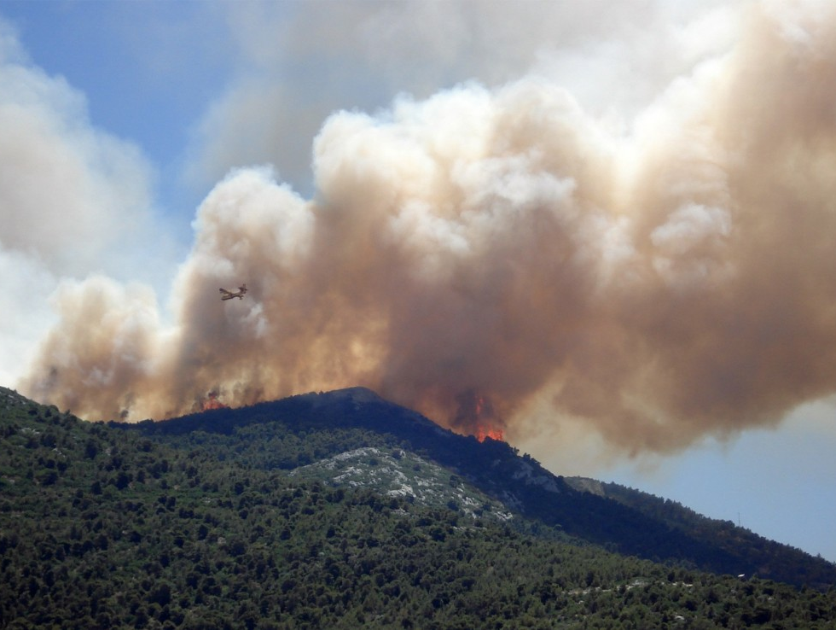
Module Overview
  Provide a deeper understanding of extreme heat and wildfire smoke.
  Understand the impact extreme heat on individuals and communities.
  Support communities in feeling confident and prepared to respond to and plan for severe weather conditions.
Notes:
Go over the overview of the day, the space and the purpose of the module

Slide 3

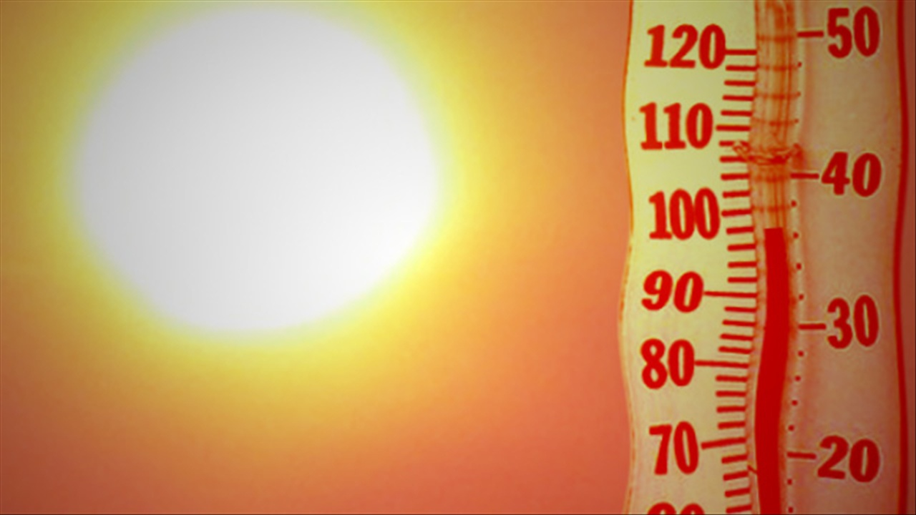
Reflect & Share
Turn and talk to a table partner.
Consider a time when it was hot outside.
Chat with a neighbor and reflect on the following questions.
What did your body feel like?
What did you do to stay cool?
Were there people you knew who needed support? How did you or others support them?
Notes:
Ask group: to turn and talk to someone near them about the questions
Ask for a two people to share out what they talked about.

Slide 4
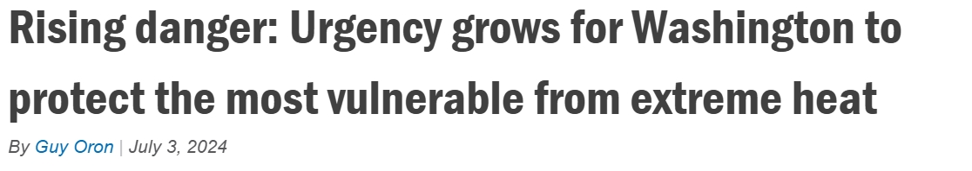
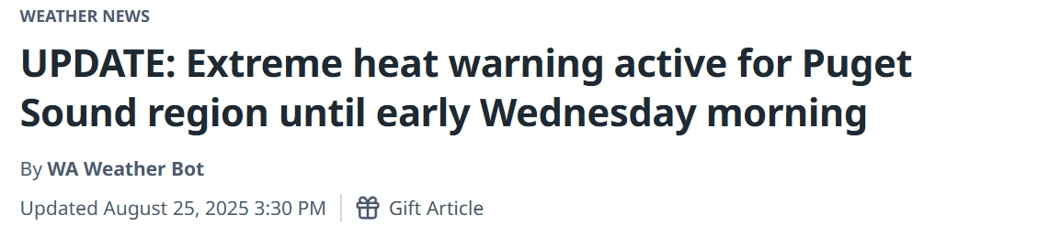
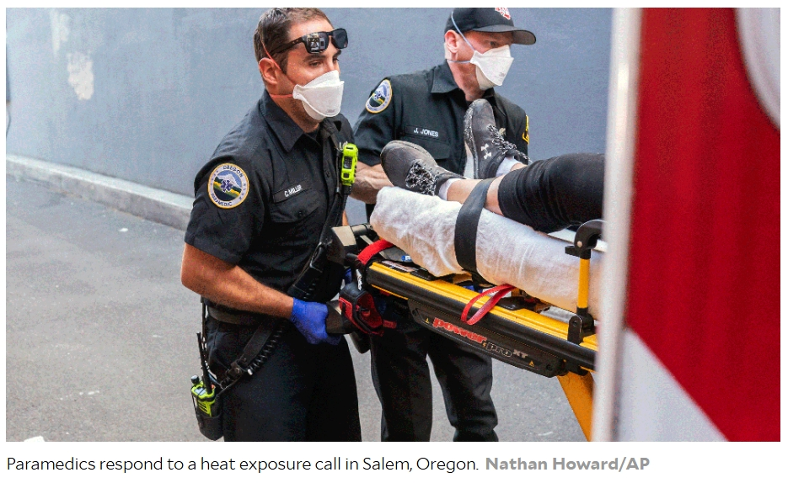
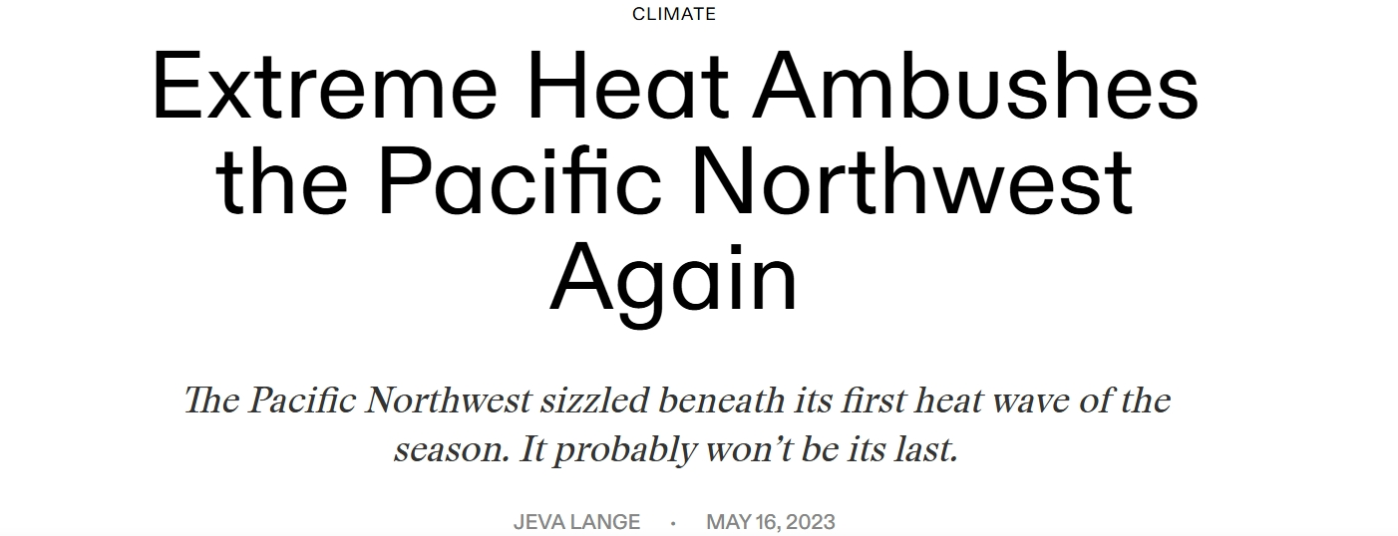
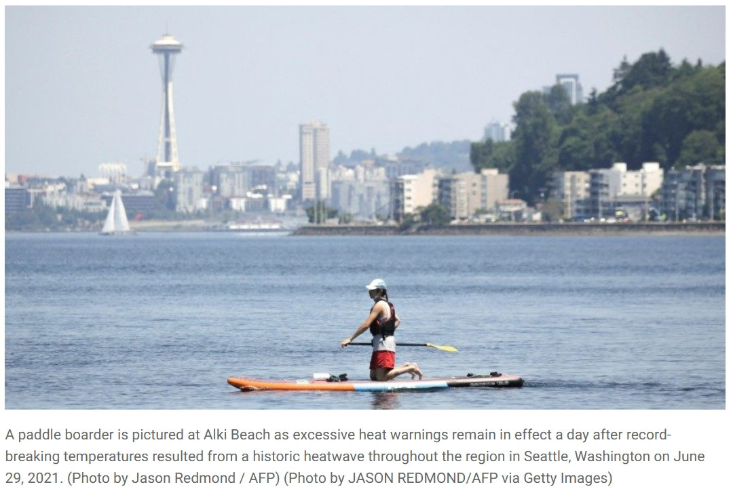
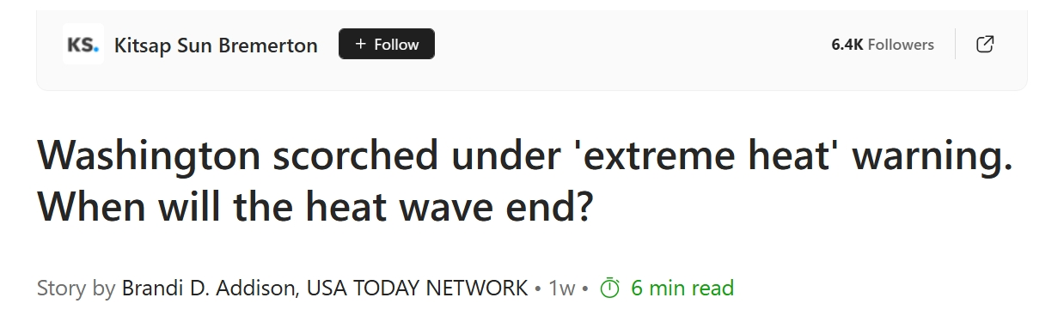
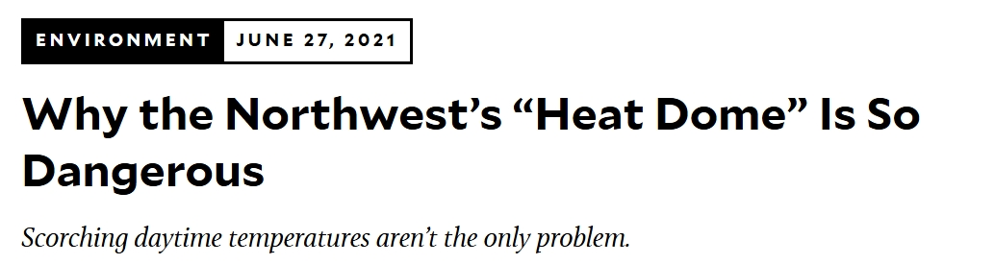
What is Extreme Heat?
The leading cause of death among extreme weather events.
Notes:
Ask group: have any of you heard of extreme heat? How does it differ from warm, summer weather? Do you have any experiences you remember during extreme heat?
Expand on conversation: Extreme heat is different than hot weather.
Temperatures across Seattle have been steadily increasing. Extreme heat is becoming increasingly common in our summers, here in Seattle.
Extreme heat is leading cause of death among weather events.

Slide 5
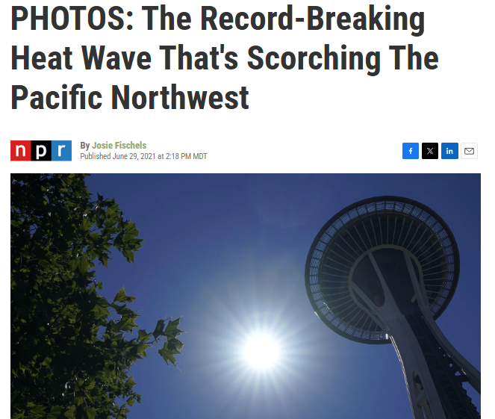
The Heat Dome of 2021
Notes:
Ask group: Do any of you remember experiencing the heat dome or have heard stories of it? (Group members may remember reading headlines such as this one)
Introduce Heat Dome, 2021 and what a heat dome is.
This is far outside the normal of the thousands of years of lived experience of local tribal communities who have resided in this area since time immemorial.
Transition: What caused the heat dome?

Slide 6
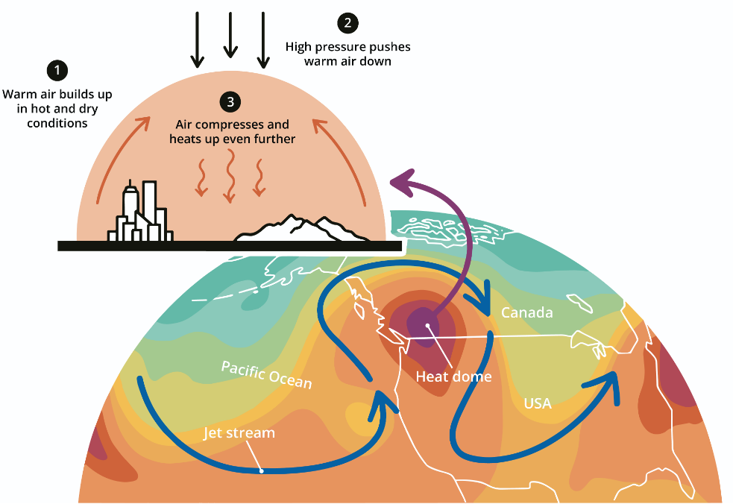
Heat Dome Impacts
How a Heat Dome Forms
Lasted from late-June through mid-July
Took the lives of more than 600 people
Cost at least $8.9 billion in damages
Loss of many crops and death of more than 650,000 farm animals
Number of fires sparked across the Pacific Northwest, impacting air quality
Notes:
The heat dome forms when there is hot air trapped near Earth’s surface, acting like a lid (dome). Because of pressure, air can’t rise well, causing it to get hotter closer to the earth’s surface.
Talk through some of the impacts of the 2021 heat dome.
Ask participants questions about their experience. i.e.: “Were you or anyone you know severely impacted by the heat dome?”

Slide 7
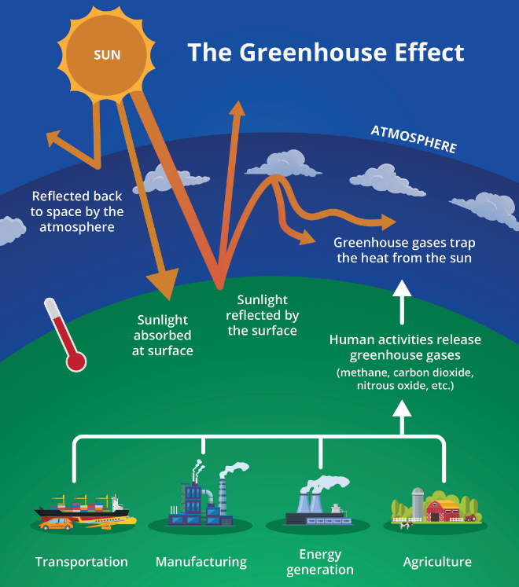
Climate Change & Severe Weather
Notes:
- Explain contributors to climate change (over consumption, industry, agriculture) – all release greenhouse gasses into the environment.
- Greenhouse gases keep heat in the atmosphere, causing global warming.
-Increase in global warming causes climates to change. This can increase severe weather, like extreme cold.
- Optional: Can provide analogy that if climate is your personality, weather would be your mood. They are related, but different.

Slide 8
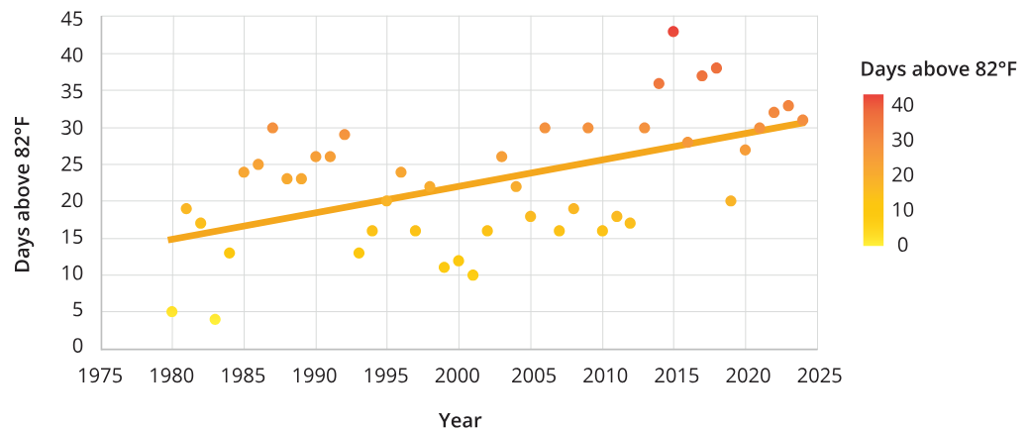
Seattle Temperatures Increase >50% Over 20 Years
Notes:
Orient people to graph on slide (read axis and what is being plotted)
Facilitator tip: Ask participants – what does that graph tell us?
Takeaway: Seattle summers are getting warmer.
This causes an increase in extreme heat events that we see, which requires us to be prepared on how to handle them.

Slide 9
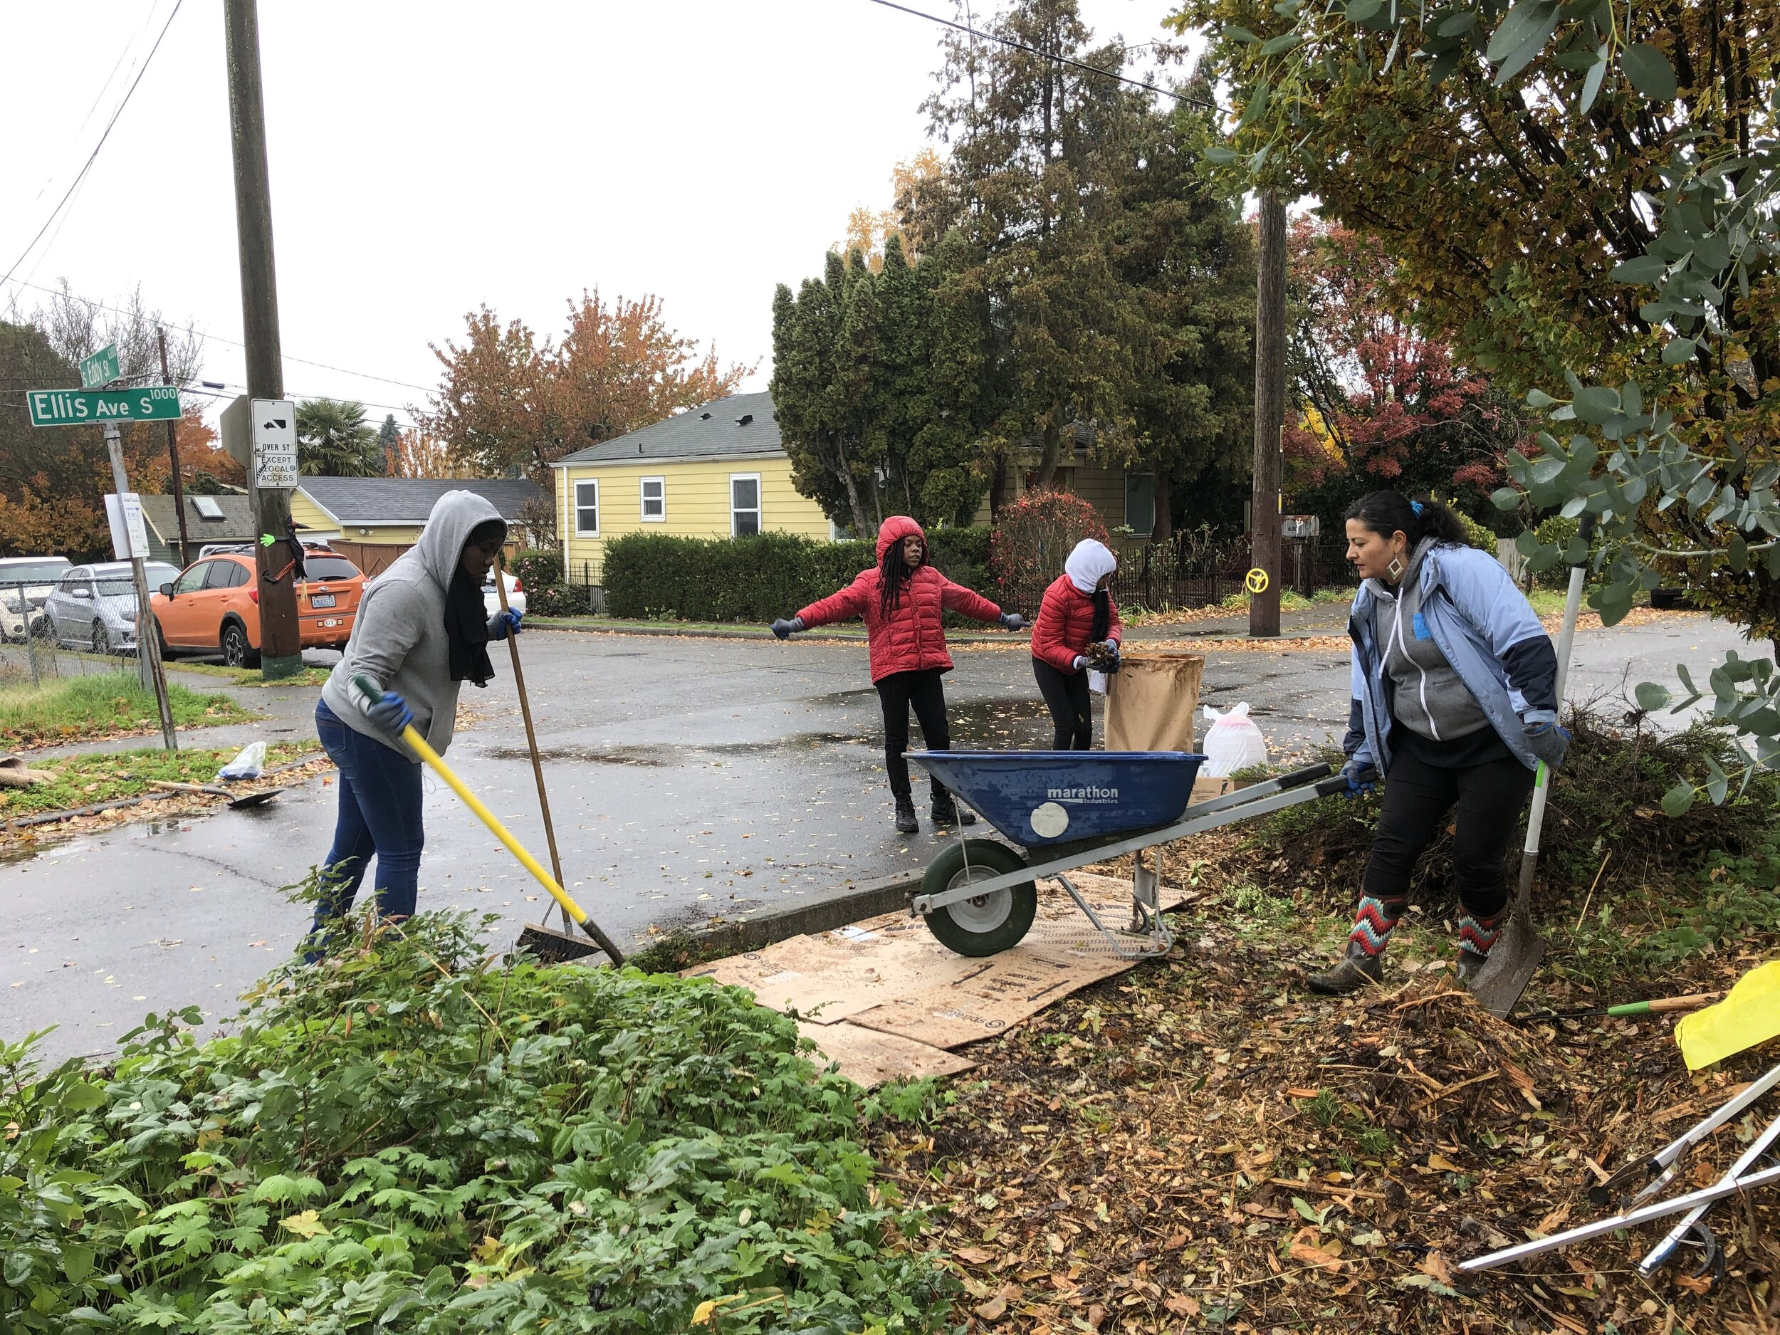
Resiliency
The Duwamish Valley Action Plan defines it as the ability to use (community) assets to improve the health of individuals, organizations, and businesses, and to withstand, adapt to, and recover from adversity.
Duwamish River Community Coalition expands green spaces and tree canopy to reduce the impacts of extreme heat on communities in the Duwamish Valley.
Notes:
Define the word ‘resiliency’.
Give examples of local communities working to build resilience (i.e. the Duwamish River Community Coalition).
Ask participants to reflect on their own experiences with resiliency.

Slide 10
Reflect & Share
Turn and talk to a table partner.
How have you seen resiliency show up in your own life?
(Does not have to be weather related).
How have you seen resiliency show up connected to extreme heat and climate change?
Notes:
Have groups share in groups or reflect to themselves. After reflection, share takeaways as a group.
Transition: Emphasize that systemic and community support is critical to be climate resilient. Understanding how extreme heat impacts us differently is an important piece of climate resiliency.

Slide 11
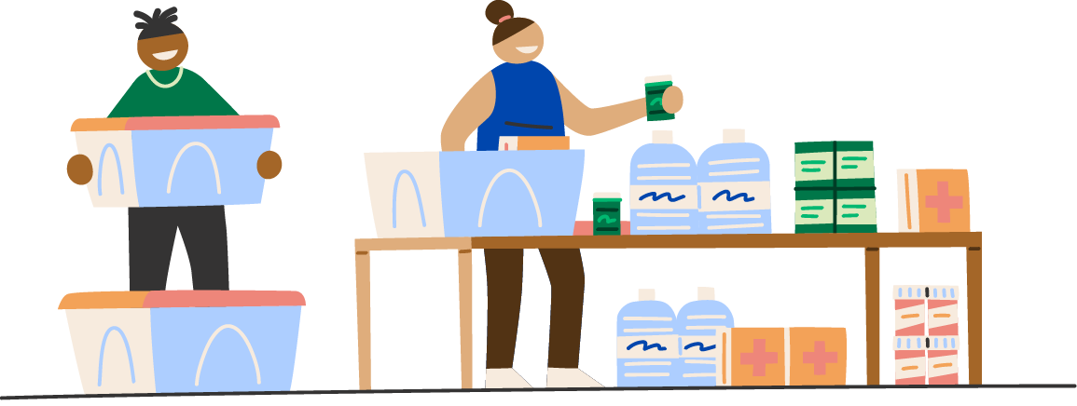
The Importance of Community
Preparedness
Notes:
Emphasize that systemic and community support is critical to be climate resilient. Understanding how extreme heat impacts us differently is an important piece of climate resiliency.

Slide 12
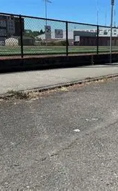
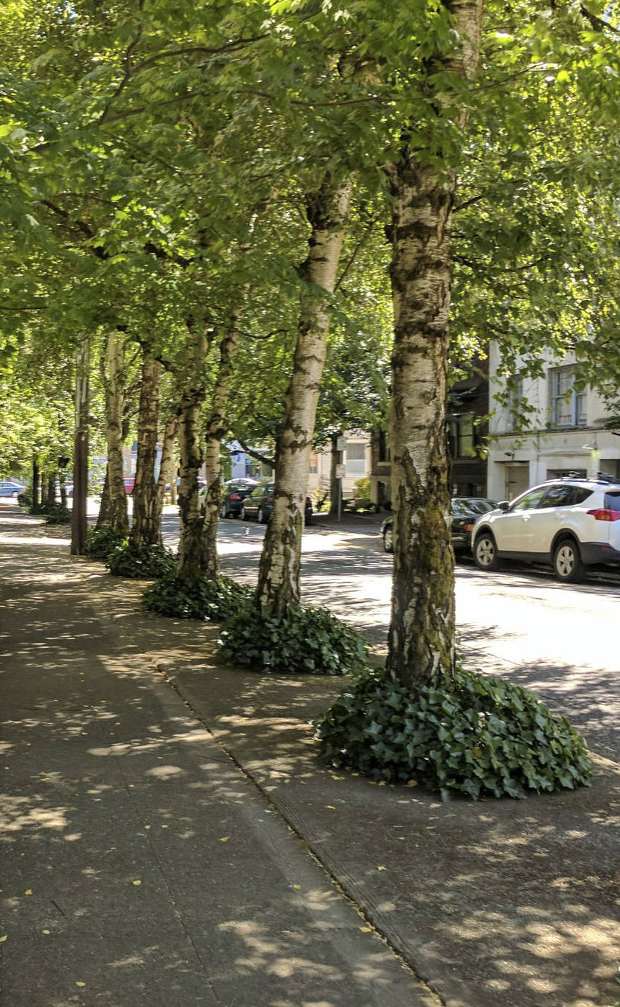
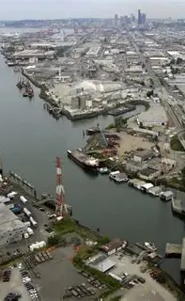
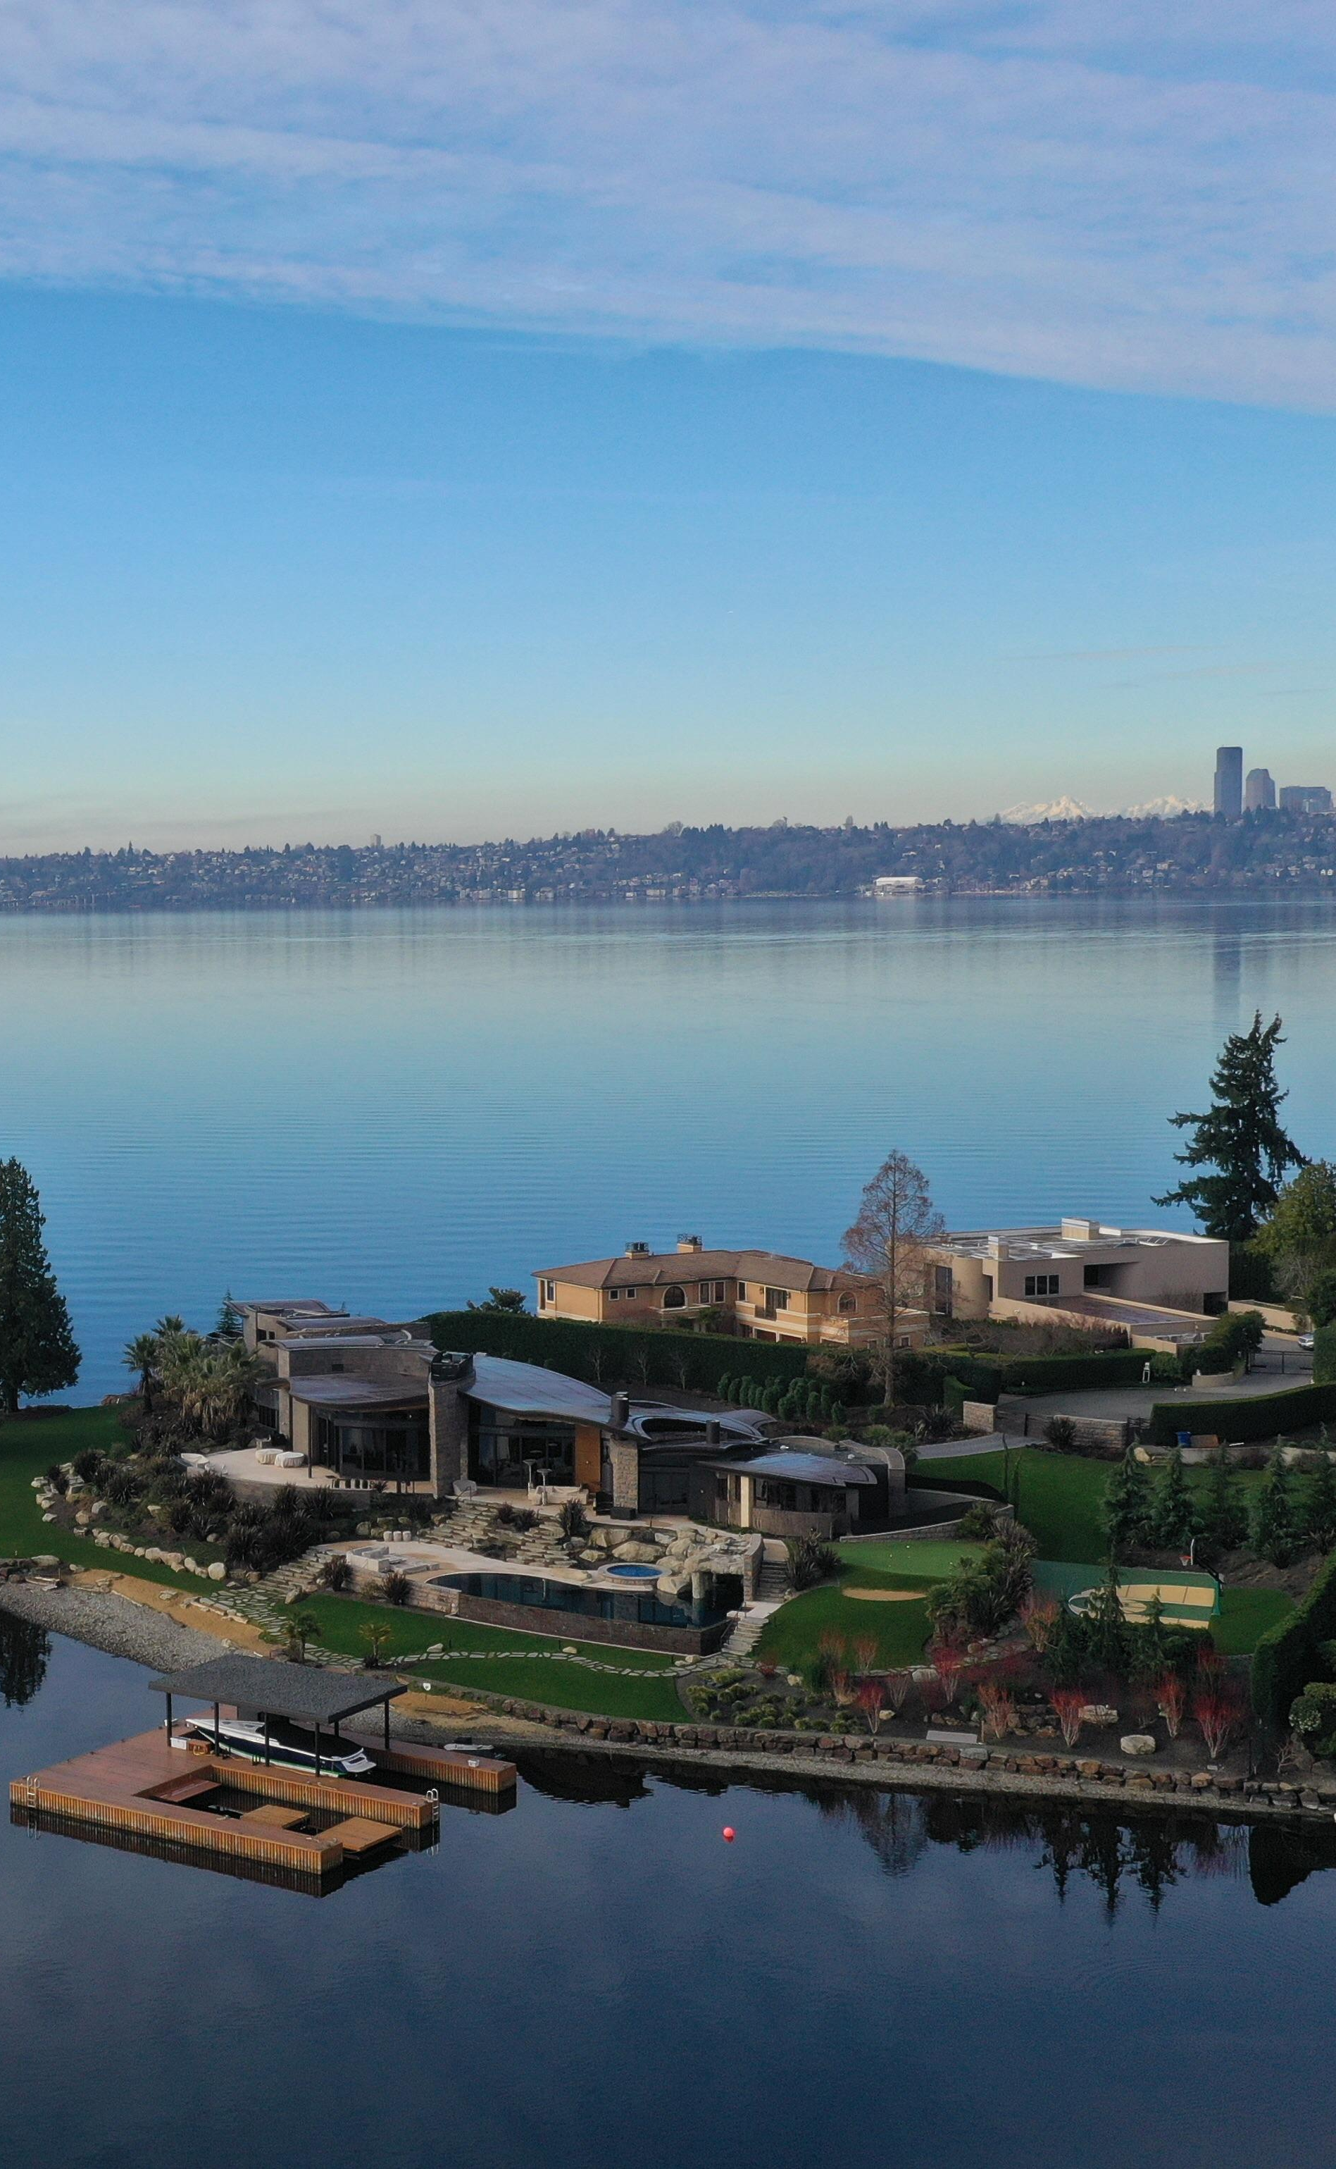
Extreme heat impacts people disproportionately.
This is an environmental justice issue.
Notes:
Define disproportionate.
Point out difference in tree coverage and proximity to public swimming spaces. Chat about the real-life impact of these differences during a heat wave.
Additionally, factors like pregnancy, socioeconomic status, etc., impact the way we experience heat waves.
Optional: Ask group - What other factors change the way people may experience extreme heat?

Slide 13
Activity: Impacts of Extreme Heat
In groups, review the vulnerable populations sheet and the impacts of extreme heat to your body.
Answer the following questions:
What are the short-term and long-term impacts of extreme heat?
Which groups are more frequently exposed to extreme heat? How do factors like where they work, housing, and access to resources contribute to this difference?​
Who faces the greatest health and safety risks from extreme heat? Why are they more vulnerable than others?
Which vulnerabilities are most relevant to your community or the people in your circle?
Notes:
Have groups share in groups, the share out to the entire group.

Slide 14
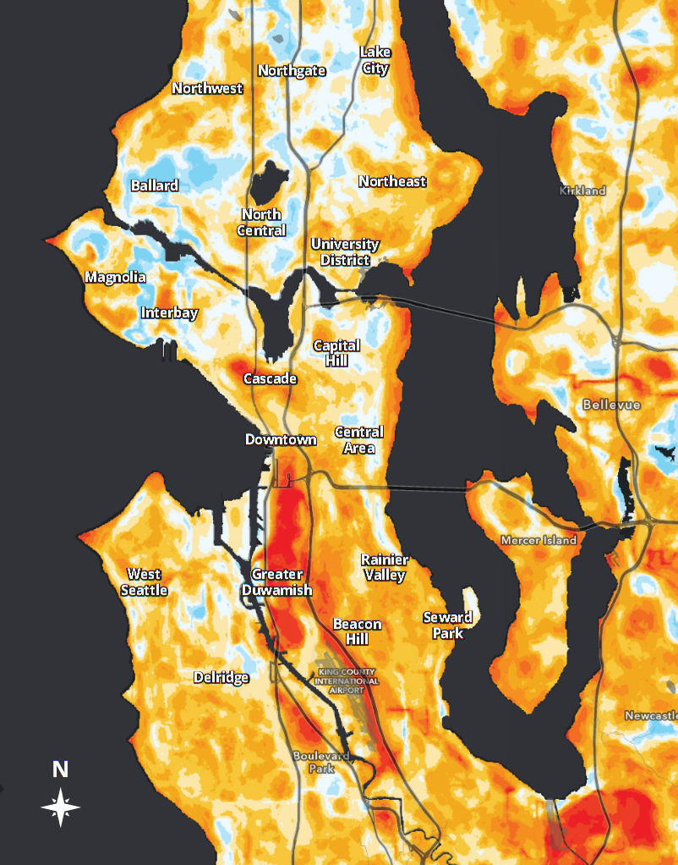
Neighborhoods Experience Extreme Heat Differently
Seattle Heat Map
Reflect & Share
Turn and talk to a partner
What stands out to you about this heat map?
Notes:
Introduce map and it’s relevance to heat islands.
Ask group question. Reflect in groups or as a whole.
Transition: It’s important we know our own risk to heat based on where we live and our access to resources that keep us cool.
How Cities Can Adapt to a Hotter Planet » The Urbanist

Slide 15
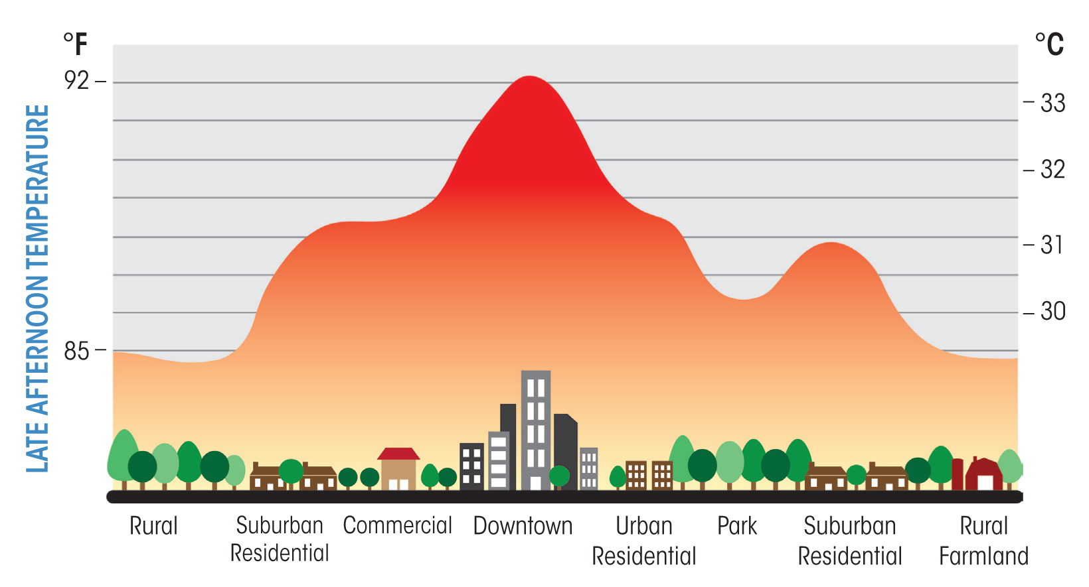
Late Afternoon Temperatures Are Higher in Downtown, Commercial, and Urban Residential Areas
Late Afternoon Temperatures
Notes:
Define heat islands and why they occur.
During the 2021 heat dome, there were recorded temperatures of up to 14F between neighborhoods.
Connect back to environmental and climate justice.

Slide 16
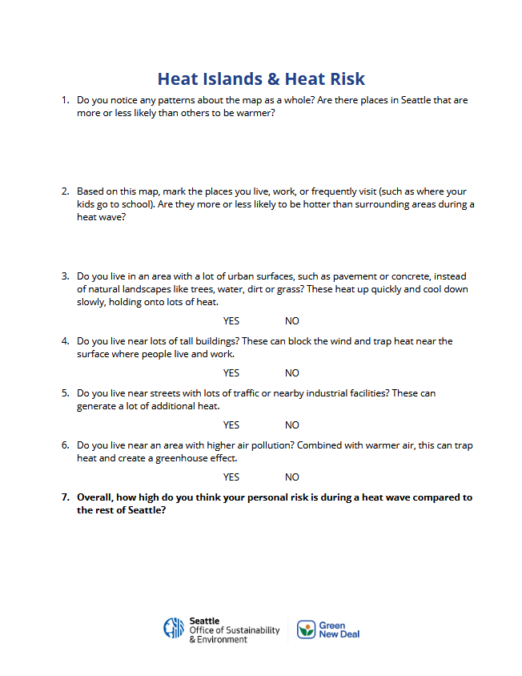

Activity: Identify Your Personal Risk
In groups, or individually, use the Heat Islands and Heat Risk Worksheet to identify your personal risk during extreme heat.
Write, draw, or simply chat about your responses and be ready to share.
Notes:
Have groups share in groups, the share out to the entire group.

Slide 17
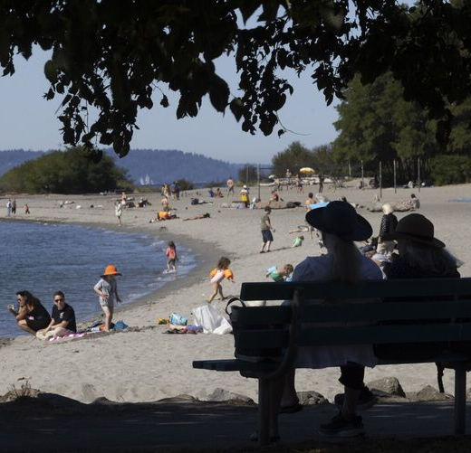
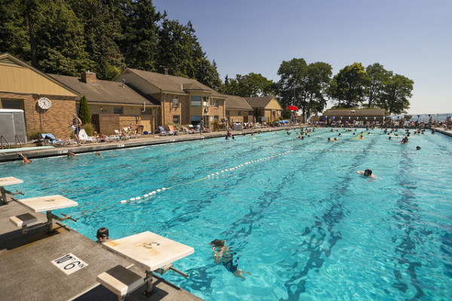
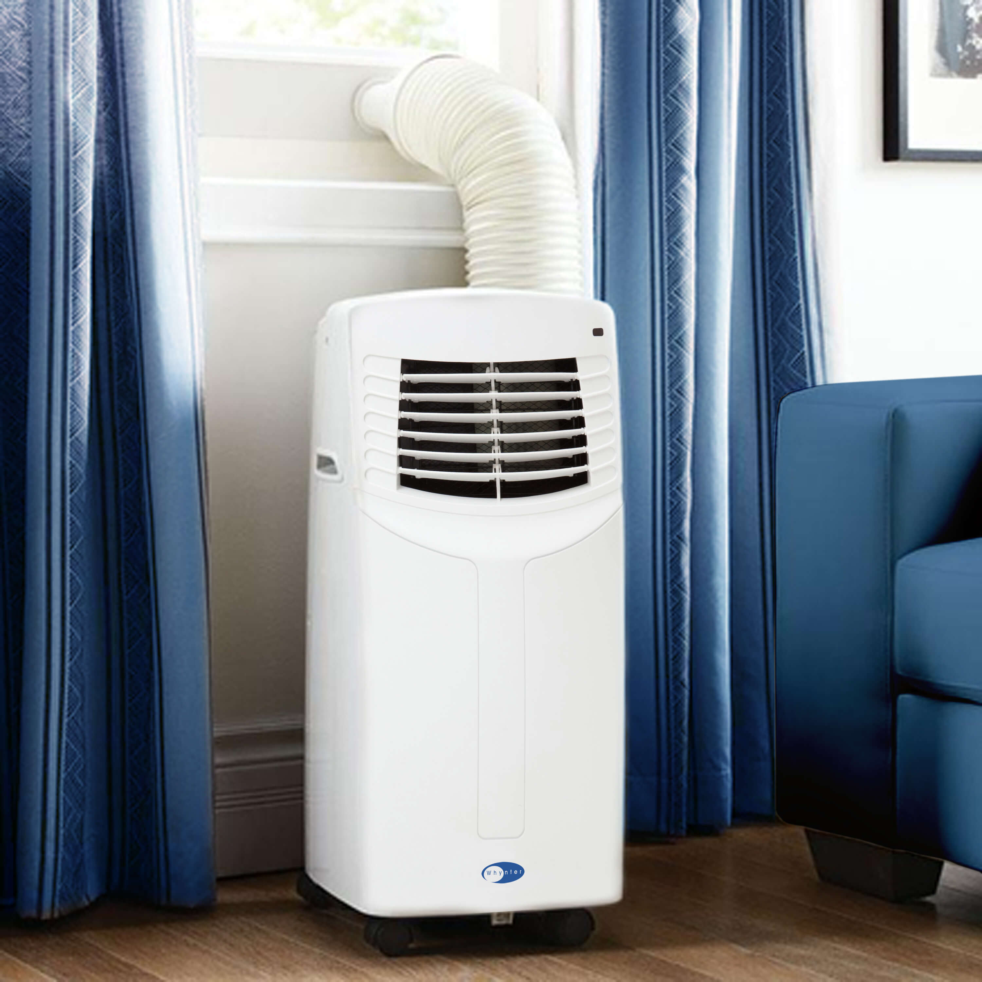
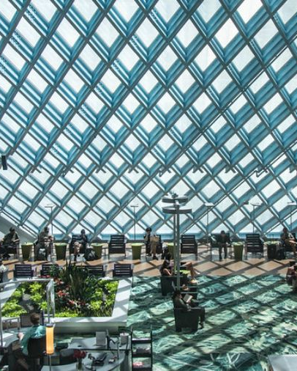
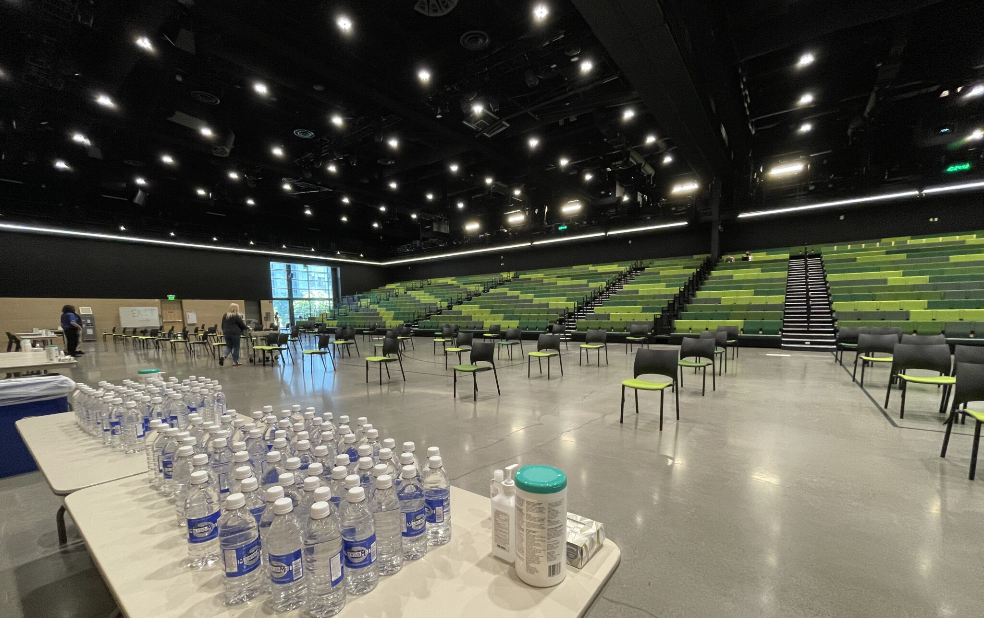
Cooling Centers
Public Lakes, Rivers, or Waterways
Public Pools and Splash Pads
Libraries and
Air-Conditioned Public Spaces
Reach out to a friend or someone you know who has access to air conditioning or a cooler space.
Official Cooling Centers
Notes:
Define cooling centers.
One tool we can use when experiencing extreme heat are cooling centers.
Optional: Ask the group - Have any of you utilized a cooling center before? Or maybe a public place to keep cool – like a park or pool?

Slide 18
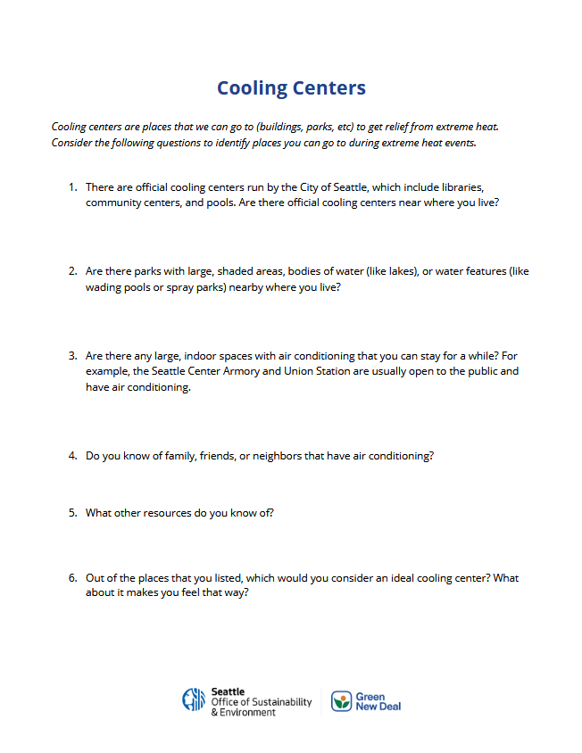
Activity: Cooling Centers
In groups, or individually, use the Cooling Centers worksheet to identify what resources you have nearby to keep cool during extreme heat.
Write, draw, or simply chat about your responses and be ready to share.
Notes:
Have groups share in groups, the share out to the entire group.
Optional: Have groups resort and share what they chatted about with other individuals to share knowledge and resources.
Transition: Extreme heat impacts everyone – our families, our neighbors, our friends, colleagues, etc. It’s important that we are prepared to support each other, and be supported by each other, when these extreme weather events inevitably come around.

Slide 19


Wildfire Smoke and Air Quality
Notes:
Introduce Section 2
Reemphasize the need to support our people and it’s important to resiliency
Introduce wildfire smoke and it’s connection to climate change and extreme heat

Slide 20
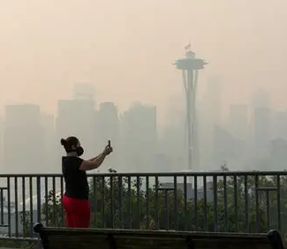
Reflect & Share
Get up and chat with someone you haven’t talked to today.
Think about a time there was wildfire smoke (or an emergency if you have not experienced smoke).
How did you get the information that the air quality was bad?
How did you know what to do about the smoke?
Who did you talk to about the situation?
Notes:
Wildfire smoke and it’s connection to extreme heat and climate change.
Ask group to turn and talk or share to the group

Slide 21
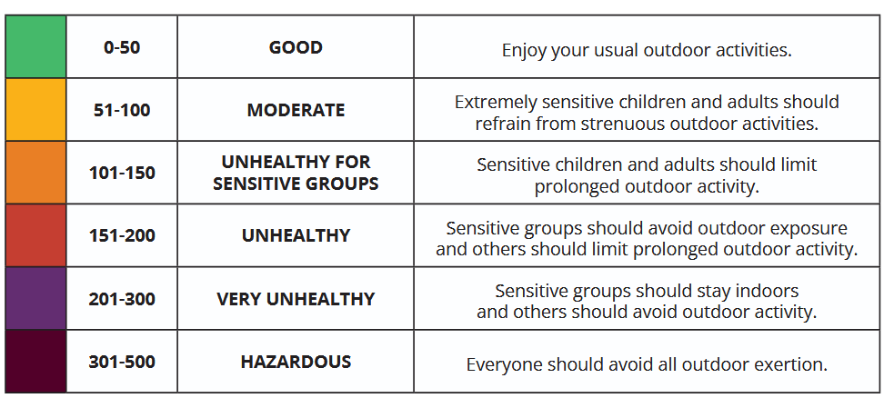
Air Quality Index
Notes:
Air Quality Index (AQI) is a way we can communicate how healthy the air is.
Air quality cannot always be seen with the naked eye – a 200 score could still look like a clear day.
Demonstrate how to find AQI if necessary.
Optional: Ask group - Have any of you relied on the AQI before? How do you like to access that information?

Slide 22
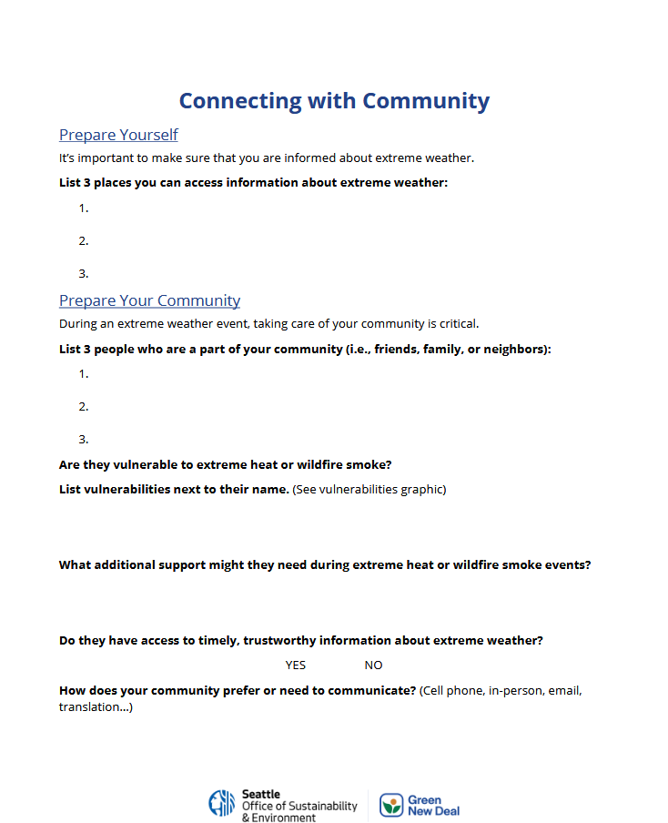
Activity: Preparing Your Community
In groups, or individually, use the Connecting with Community Worksheet to prepare yourself and people you know for an extreme heat or wildfire smoke event.
When complete, write down any questions you still have so we can answer them as a group.

Slide 23
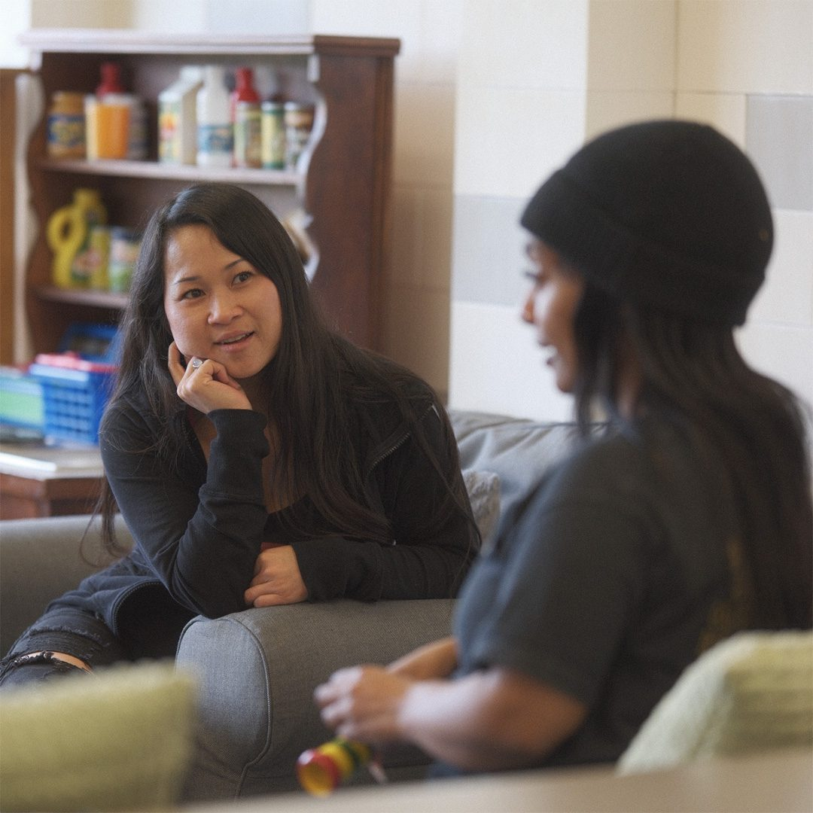
Reflect & Share
Turn and talk to a neighbor.
Think about who you consider part of your community.
What is one experience, skill, or value that you or the people you are close to have that might help you be resilient?
Notes:
Ask group to turn and talk or share to the group

Slide 24


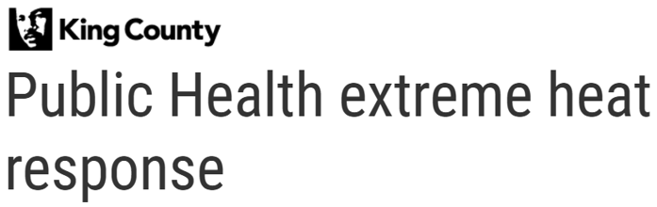

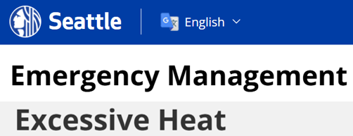

Extreme Heat and Wildfire Smoke Resources
Notes:
When preparing for extreme weather, it’s important to know there are supports out there from the City of Seattle and King County
You should become familiar with these resources and where to locate them so you can share this information and help others impacted by extreme heat and wildfire smoke.

Slide 25

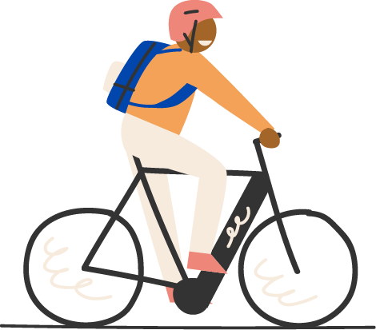

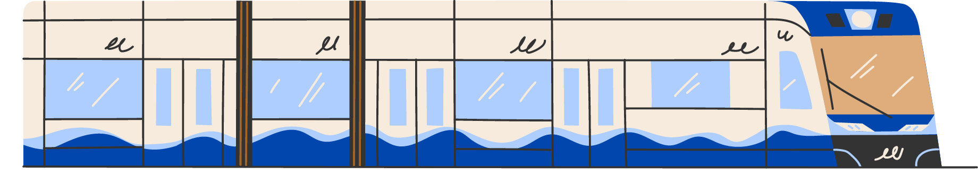

Thank you

