Slide 1
SPD Budget Presentation for Seattle City Boards and Commissions
Presented by Seattle City Budget Office, Seattle Police Department, Seattle Mayor’s Office

Slide 2
SPD Budget Presentation for Seattle City Boards and Commissions Agenda
1
2021-22 Budget Impact of COVID-19
SPD Budget
Proposed Reductions
Budget Process
Q&A
2
z
3
4
5

Slide 3
How the pandemic is expected to impact 2021 Revenues
1
General Fund Budget Shortfall - 2021

Slide 4
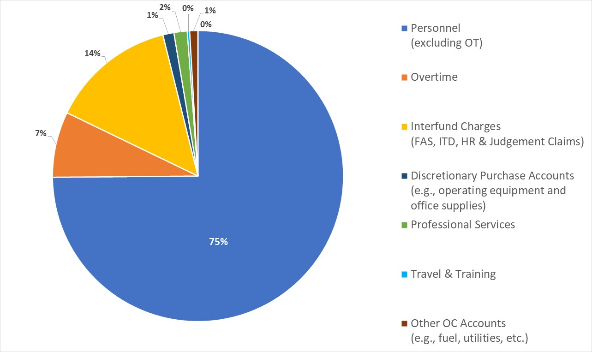
2
General Fund Expenditures
SPD Budget
$400 million
Judgment Claims)

Slide 5
SPD
Budget-by-Bureau
$400 million
2

Slide 6
2020 SPD Budget Reductions
3
Source | Amount
Hiring Freeze | ($2,100,000)
Reduce Overtime | ($8,600,000)
Travel, training, supplies, etc. | ($5,700,000)
Delay Facilities and IT Projects | ($4,000,000)
Total | ($20,400,000)

Slide 7
2021 Budget Process (GF Revenue Shortfall $124M)
4

Slide 8
SPD Budget Overview, 2020-21 with Proposed Reductions
4
Initial change from 2021 Baseline:
$76M (18%)

Slide 9
Preliminary 2021 SPD Budget Reductions and Transfers Proposed by Mayor
4
Source | Amount
SPD will not expand the force | ($13,700,000)
Do not fill 40 civilian staff vacancies | ($4,000,000)
Reduce OT by 10% (30,000 hours) | ($2,700,000)
911 Call Center Transfer | ($34,200,000)
Parking Enforcement Unit Transfer | ($13,700,000)
Office of Emergency Management Transfer | ($3,300,000)
Office of Police Accountability Transfer | ($4,500,000)
Total Reduction | ($76,500,000)

Slide 10
Potential Challenges
4
Some services are potentially required to be provided by sworn officers according to RCW on SMC right now
Some reductions may be subject to collective bargaining
A portion of SPD's overtime budget is supported by revenue from external parties, like the Seahawks, in exchange for police services. If the department did not provide those services, the City's revenue would decrease, along with SPD's overtime budget.
For today’s conversation, do not let these potential challenges impede our imaginative processes, but please keep them in mind as we move from this conversation into forward action

Slide 11
Q&A
5

