Slide 1
King County Eviction Prevention and Rental Assistance Program
Sunaree Marshall
King County Department of Community and Human Services

Slide 2
The Need
Need far outweighs resources
  King County DCHS estimates 58K households at risk of eviction
    Estimate based on number of rent-burdened households impacted by COVID-19 and of undocumented renters who have lost jobs (and do not qualify for unemployment)
  Resources available will likely support approximately 10K households
Need is urgent
  Reports of households self-evicting, even with the moratorium
Notes:
Estimate based on number of rent-burdened households impacted by COVID-19 and of undocumented renters who have lost jobs (and do not qualify for unemployment)
Sources: Migration Policy Institute (MPI) analysis of U.S. Census Bureau data from the pooled 2012-16 American Community Survey (ACS) and the 2008 Survey of Income and Program Participation (SIPP), drawing on a methodology developed in consultation with James Bachmeier of Temple University and Jennifer Van Hook of The Pennsylvania State University, Population Research Institute. https://www.migrationpolicy.org/data/unauthorized-immigrant-population/county/53033
King County Labor Area Summary 2020, Employment Security Department Washington State
Method: Looked at the number of undocumented workers in each occupation and compared the reduction in jobs from last year to now, and used this to estimate the number of people who will have lost jobs.
Assumptions: Undocumented workers faced unemployment at the same rate as the general population. In actuality, since undocumented workers have fewer labor protections, the number who lost their jobs may actually be higher. Additionally, while 35% of the undocumented population are considered homeowners, many of them live in manufactured homes. While they own the home, they are still responsible for paying rent for the land which the home is located on, and thus might still be at risk of the same eviction process that residential renters face. These individuals are excluded from the estimate, so the number facing eviction might be higher. We also assume that there is no correlation between the industry that someone works in and whether they are a renter. Finally, some of the individuals who lost their jobs as a result of the COVID crisis might be part of multi-earner households. Therefore, the number of households at risk of eviction might be lower than 10,105. However, given that the other assumptions would presumably lead to an underestimate, and that there were 4,000 unemployed undocumented individuals prior to the COVID crisis, 10,105 is a reasonable estimate.
Sources:
https://ternercenter.berkeley.edu/blog/estimating-covid-19-impact-renters
2018 ACS
Method: Adjusted the Terner Center’s metro area estimates to King County. Focused on the number of rent-burdened households who have lost income/jobs due to COVID-19
Assumptions: Renters impacted by COVID job/income loss are evenly distributed across the MSA; rent burdened % is the same across the MSA (could be adjusted); plus all assumptions of the initial estimate.
-

Slide 3
Program Goals
  Prevent evictions
  Target limited resources to people most likely to become homeless after eviction
  Target limited resources to people most likely to suffer severe health consequences as a result of eviction
  Promote equity in who is served, with a focus on equity for groups of people who historically have not been provided equitable access to rent assistance and those disproportionately impacted by the COVID-19 outbreak.

Slide 4
Lessons Learned To Date
National
  Lack of Central Coordination Results in Months Long Backlog
  Local
  First Come First Served System Advantages Most Privileged
  Resources Needed for Outreach and Application Assistance
  In Language Materials
  Tenants Need Routine Status Update

Slide 5
Resources & Restrictions
Funding
  $9.8M King County CRF
  $28.7M Dept. of Commerce CRF
  $1.7 CDBG-CV
  $1.2 VSHSL
  $41.4M Total
  Restrictions
  Spend the CARES Act dollars by December 30, 2020
  Prevent duplication of benefits
  Reimbursement based contracts
  CDBG-CV has additional criteria like COVID-19 impact and geographic limitations
  WA Department of Commerce set tenant eligibility and King County cannot change it

Slide 6
Tenant Eligibility
Tenants must meet BOTH of the following eligibility requirements:
  Income is at or below 50% of the Area Median Income over the past 60 days; and
  At least one month of rent is not paid or partially unpaid since March 1, 2020.
In addition, tenants must meet ONE or more of the following requirements:
  Rent-burdened: 50% or more of current monthly income is needed to pay rent.
  Previously homeless within last five years; includes experiences of couch surfing/doubled up.
  Eviction history within last seven years.
  Housing disrupted due to household member race, ethnicity, gender identity, sexual orientation, or religion.
  At risk of severe illness as per the Centers for Disease Control: 62 years old or older, underlying health condition.
  Disability of any household member. Includes a physical, developmental, mental, or emotional impairment, including impairment caused by alcohol or drug abuse, post-traumatic stress disorder, or brain injury. A person with HIV/AIDS is considered disabled.

Slide 7
Landlord conditions
As a condition of receiving funding, landlords must agree to:
1. Accept three months of rental assistance on behalf of the participating tenant at the lesser of either (a) 80 percent of the otherwise applicable total rent for three months; or (b) fair market rent for the three months.
  Any rental debt owed by the tenant for more than three months must be forgiven. If rental debt is less than three months, assistance may be paid for past due and current rent up to three months not to extend beyond December 2020.
2. Not terminate or refuse to renew the participating tenant’s tenancy absent good-cause until March 31, 2021.
3. Not raise rent on current tenant(s) served by this program until March 31, 2021.
  Tenancies using Section 8 vouchers are exempted from the “no rent increases” conditions if the rent increase is based on an increase in the tenant’s income.
  NOTE: If landlord does not agree to conditions, the household will not be served.

Slide 8
The Doors into the process
1. Landlord Doors
  Large Landlord Fund & Manufactured Park Fund
  Small Landlord Lottery
2. Tenant Door - Tenant Lottery
  NOTE: Landlords will NOT screen tenants; they will only know that a tenant is behind in rent and how much they owe. Nonprofit agencies will screen tenants with an application. Landlords will NOT know why a tenant is/is not served.

Slide 9
Large Residential Landlord Fund
  Pays participating landlords in bulk for every eligible tenant behind in rent
  Large landlord has 10 or more tenants behind in rent and meets ONE of the follow eligibility criteria:
    Any publicly subsidized property located in King County OR
    Located in a high-needs zip code
  Over 200 large landlords have submitted interest to participate in this fund, representing approximately 4,000 households

Slide 10
Manufactured Housing Park Fund
  Pays participating park owners in bulk for every eligible tenant behind in rent
  Any manufactured park owner in King County can participate
  Five properties have submitted interest so far

Slide 11
Small Landlord / Tenant Fund
Tenants
  All tenants countywide eligible for lottery
  Referrals will be made weekly to non-profits meeting tenant demographic and linguistic needs
  Over 4,000 tenants have submitted interest
Small Landlords
  All small landlords countywide (those with 9 or fewer tenants behind in rent) eligible for lottery
  If small landlord selected, all tenants behind in rent will be screened
  Referrals made on nonprofit capacity to pay bulk payment to small landlords
  Over 100 small landlords have submitted interest, averaging 2 units a landlord
Lottery Runs on a Weekly Basis
  People not selected will be alerted via email every Friday

Slide 12
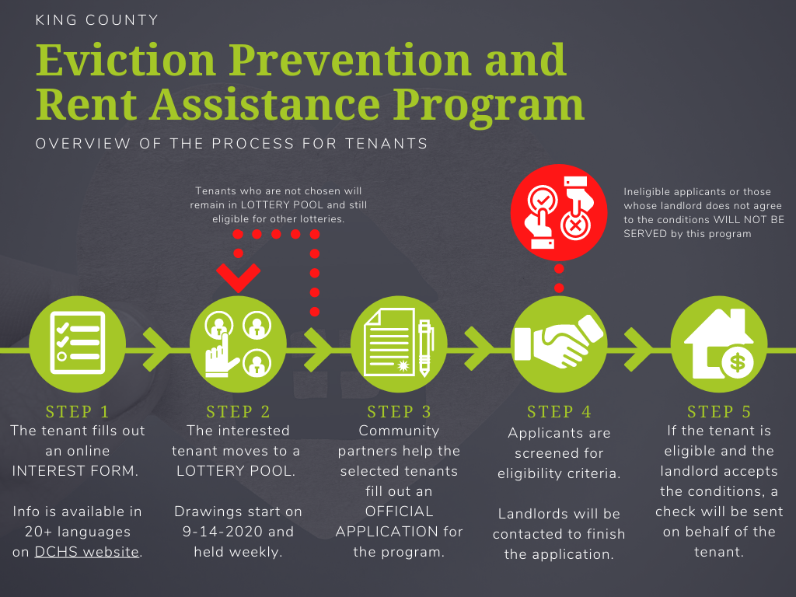

Slide 13
Language Access and Other Considerations
General Access
  Spreading program info through media, listservs, and membership-based organizations
Language
  Translating all materials, including materials used by CBOs
  Prioritizing contracting with CBOs with language ability
Technology
  CBOs will manage phone line for tenants to call if they can’t fill out form themselves
  Prioritizing contracting with CBOs who can overcome tech barriers
Notes:
Unite HERE alerting members on their hotline, texting their membership on 9/2
Washington Immigrant Solidarity Network alerting community members on their hotline

Slide 14
Grievance Process
Any tenant denied assistance can appeal decision to DCHS
  Tenant has option to get help from Housing Justice Project
  Appeal must be filed within two weeks of denial
Purpose is to catch mistaken denials. However, if a landlord refuses to accept conditions, the household cannot be served

Slide 15
Program Timeline
Contracting
  Contracting underway, with the Outreach and Application Assistance and Large Residential Landlord Fund agencies launching first
Lottery
  Lottery began on September 14, 2020, and continue weekly until funds run out
Review
  Review of program will happen in early October, with DCHS ready to make program adjustments as necessary

Slide 16

Time for Q&A

Slide 17
For More Information
www.kingcounty.gov/covid/rent

Slide 18
How does the lottery work?
  On a weekly basis King County staff will create the lottery pool from all tenant interest forms that have been received
    Households already served by program and ineligible households will be removed
  King County staff will then run a randomized lottery
    The number of tenants selected each week will be determined by the capacity of nonprofit agencies to serve tenants that week
    Tenants not selected will be emailed every Friday about their status
    Selected tenants will be contacted by the nonprofit agency to complete their application
    Tenants not selected in lottery will remain in the lottery each week until the funds run out
  Selected tenants will be sent to a nonprofit agency to process their application
    Referrals will be made based on the capacity of the agency and needs of the tenant (such as language need)

Slide 19
Why a lottery? Why do tenants STAY IN LOTTERY EVERY WEEK UNLESS THEY ARE SELECTED?
  Estimate of 60,000 households in need of services, but funding only serves 10,000 households
  Lottery prevents only serving tenants with the fewest barriers
    Weekly lottery gives tenants more time to access funds, even if they do not learn about this opportunity for several weeks
  Will contract with community-based organizations to overcome tech and language barriers

Slide 20
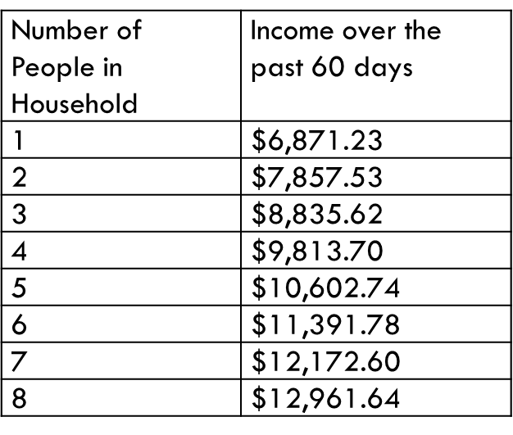
What is 50% AMI (Area median income) over the past 60 days?
Over the past 60 days, your income must have been at or below the following, based on your household size:

Slide 21
Do tenants need to provide documentation to prove their eligibility?
  NO.
  A tenant will be asked to provide income documentation, but if they do not have it, they can self-certify their income eligibility. Tenants will not be asked to provide any documentation to prove the secondary criteria.

Slide 22
Does the tenant have to ask their landlord if the landlord will agree to conditions? Who does this?
NO.
  After a tenant has been found to be eligible by a nonprofit agency, the nonprofit agency will contact the landlord to discuss the program and get their agreement. If tenants feel comfortable, alerting their landlord to the program once the tenant is selected from the lottery might help ensure applications are processed quicker, but it is not necessary. If the landlord does not accept the conditions, the tenant will not be served.

Slide 23
How will the landlord conditions be enforced?
Landlords will sign an agreement stating they agree to the landlord conditions and that the tenant has been made current in rent. This agreement can be enforced in court by the tenant if necessary.

Slide 24
What is good cause?
A participating landlord may only terminate or refuse to renew a tenancy for one of the below reasons until March 31, 2021:
  A household member materially violates the terms of the lease (including, among other reasons, nonpayment of rent after the tenant is served by the program)
  A household member is creating a significant and immediate risk to the health, safety, or property of others; or
  At least 60 days’ written termination notice is provided to the household based on the Landlords intent to (i) personally occupy the premises as a primary residence, or (ii) sell the property.
The landlord agreement does not supersede local, state, or federal laws or orders that provide tenants further protections

Slide 25
Will payments be made to the tenant or to the landlord?
All payments will be made directly to the landlord, not the tenant.
  Landlords will be required to sign a contract agreeing to the terms of the program for every tenant served in the program. Tenants will receive a copy of this agreement. Paying tenants directly would be difficult with the constraints on the funding. In addition, it would not be possible to require landlords to agree to the landlord conditions if they were not paid directly.

Slide 26
RESOURCES
  Questions about EPRAP? Email commerceRAgrant@kingcounty.gov
  Other resources:
  Washington state eviction moratorium
  Attorney General eviction moratorium complaint form
  Centers for Disease Control and Prevention eviction moratorium
  Housing Justice Project: free legal aid, call (206) 267-7069 or go to www.housingjusticeproject.org

