Slide 1
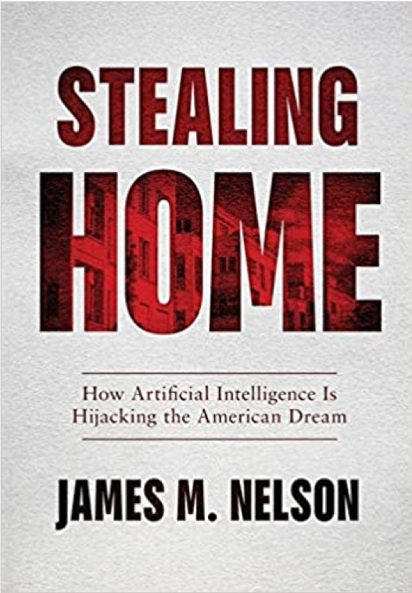
This Slide Contains Proprietary Information
Disclaimer:
Nelson took a 2-year sabbatical to write and research this book.
The information in this presentation is true and complete to the best of the author’s knowledge. Any advice or recommendations are made without guarantee on the part of the author or publisher. The author and publisher disclaim any liability in connection with the use of this information.

Slide 2

There is a New Landlord
Rising Rental Rates and Homelessness, Discrimination, and Aggressive Leasing Tactics Explained

Slide 3
Part I
How AI Sets the Rates of Rent

Slide 4
Rental Rates Increasing
Most believe this is just Supply and Demand
Large Influx of Workers with only a Small Increase in Housing
Notes:
The Multifamily rental market in metropolitan areas has experienced a dramatic surge in prices over the past decade. Many casual observers believe the cause of this surge is the rapid influx of new residents in urban areas. Just a simple supply and demand logic: demand went up, and supply did not rise with it, leading to rising rental rates.

Slide 5
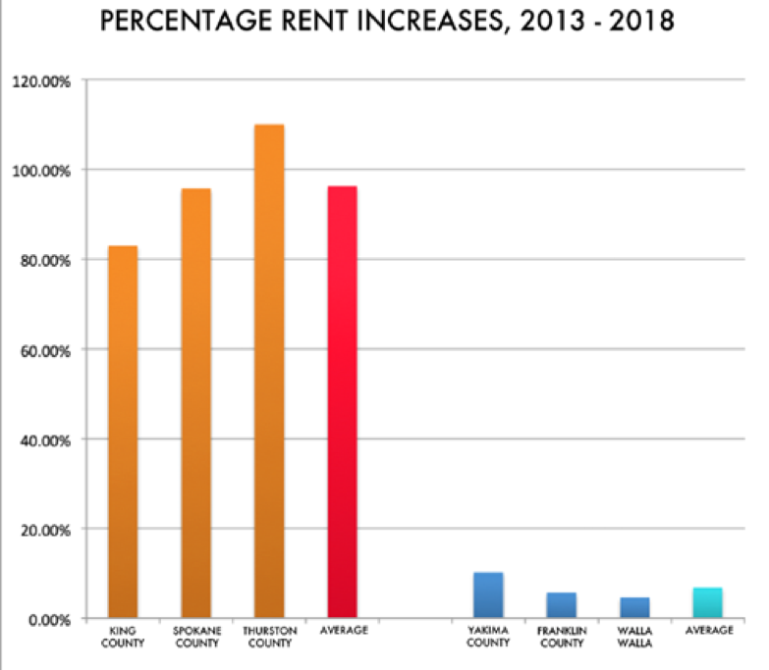
Rental Rate Price Fixing
RealPage is a software Platform used widely by Property Managers and Owners
Property Managers Have used RealPage to Form a Cartel
They are Price Fixing
Notes:
However, strong evidence has been accumulated, which suggests that Property managers have implemented the practice of Rental Rate Price Fixing by employing the Artificial Intelligence Technology platform created by RealPage to manipulate the rate of rents charged.

Slide 6
The purpose of this presentation:
  To present the background information on this phenomenon
  Analyze the potential for discrimination and price-fixing.
Governmental officials:
  Examine this evidence
  Analyze the legal implications of this evidence
  Take action based upon the conclusion of their review
Notes:
Responsible public and governmental officials should examine this evidence, analyze the legal implications of this evidence, and take action based upon the conclusion of their review. The purpose of this presentation is to present the background information on this phenomenon, analyze the potential for discrimination and price-fixing.

Slide 7

AI is a Game-Changer
Amazon
Netflix
Notes:
AI technology is a game-changer. It has disrupted each and every industry it has entered. Look at what Amazon did to the retail market and Netflix to home entertainment. Those industries have never been the same—the entire landscape of our economy has been forever altered.

Slide 8

The Question is:
Should We Expect Anything Different from the Housing Industry?
Notes:
The question of the day is, why should we expect anything different from the use of AI in the housing markets?

Slide 9
AI and Big Data
Property Managers are implementing AI at a rapid pace
One of the downsides to AI:
It requires massive amounts of data to run
Notes:
Today Property Managers are implementing this AI technology at a very rapid pace throughout the housing market.
Now, one of the downsides to AI technology is that it requires massive amounts of data to be effective

Slide 10
AI and Big Data
Property Managers have been gathering and sharing data on:
  Tenants
  Properties they manage
Notes:
So, property managers have been gathering massive amounts of data not only on their tenants—and believe me, the amount of data they probably have on you would shock you—but also on the properties, they manage.

Slide 11
RealPage: The Shared Platform
Property Managers are sharing private tenant information with each other
Property Managers are sharing the decision-making algorithm
This platform is sourced from over 18 million rental units and well over 12 thousand platform members in more than 180 markets across the country and 400 markets around the world.
Notes:
The Shared Platform
Through the platform, the property managers and landlords are sharing private information on tenants as well as the decision-making algorithm.
This platform is sourced from over 18 million rental units and well over 12 thousand platform members in more than 180 markets across the country and 400 markets around the world.

Slide 12
RealPage: The Shared Platform
They collect and correlate data on the current rent rolls using the private and personal applications of millions of tenants to decide whom to rent to and how much to charge
Notes:
They collect and correlate data on the current rent rolls using the private and personal applications of millions of tenants to decide whom to rent to and how much to charge.

Slide 13
Tenants and Big Data
Historically, tenant screening was based on credit score and wages
AI programs require a lot more data
Property managers promised to predict not only the applicant's ability to pay the rent but also the applicant's willingness to pay
Notes:
Information on the Tenants
Now, historically, tenant screening was based on credit score and wages. The new AI programs, however, require a lot more data than that. Property managers promised to predict not only the applicant's ability to pay the rent but also the applicant's willingness to pay.

Slide 14
Tenants and Big Data
To accomplish this, Property Managers use RealPage
RealPage:
  Industry's largest rental payment history database
  Integrates with a central repository of lease transaction information
  Access to 30 million actual lease outcomes (leases with full lease performance history) to evaluate tenant performance, along with 3rd party consumer financial data
  The data is held "indefinitely”
Notes:
To accomplish this:
The shared platform, the industry's largest rental payment history database, integrates with a central repository of lease transaction information, (The company has access to 30 million actual lease outcomes(leases with full lease performance history) to evaluate tenant performance, along with 3rd party consumer financial data.) The data is held "indefinitely.“

Slide 15
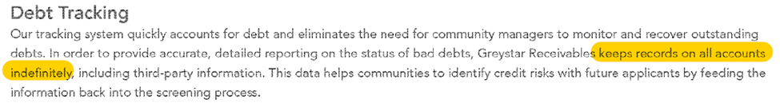
Tenants and Big Data

Slide 16
RealPage and Property Data
Per their website, RealPage promises unparalleled visibility into real submarket performance that no one else can produce
RealPage Market Analytics is the industry's only lease transaction-driven Platform that delivers broad transparency into real-time rent roll and revenue, revealing the most current and accurate data critical to making investment decisions.
Notes:
On the Properties, they Manage
Per their website, RealPage promises unparalleled visibility into real submarket performance that no one else can produce. RealPage Market Analytics is the industry's only lease transaction-driven Platform that delivers broad transparency into real-time rent roll and revenue, revealing the most current and accurate data critical to making investment decisions.

Slide 17
RealPage: The Intermediary for Price-Fixing
To accomplish this:
The AI-driven platform, RealPage, is the hub or intermediary that speaks to each of the competitors in the apartment housing market and then relays each competitor's "agreement" to set rental prices to increase their income
Notes:
To accomplish this:
The AI-driven platform, RealPage, is the hub or intermediary that speaks to each of the competitors in the apartment housing market and then relays each competitor's "agreement" to set rental prices to increase their income.

Slide 18
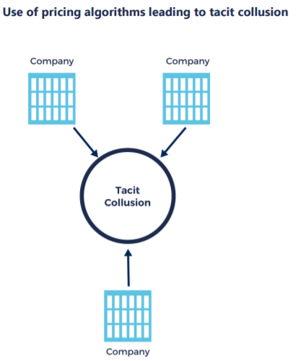

Slide 19
RealPage: The Intermediary for Price-Fixing
RealPage shares data between the members that would not otherwise be available to those managers and owners, were it not for their association to the platform
The purpose of the platform is specifically to control supply and to influence prices as if they were a single producer
Thus, Property Managers can fix rents they render without competition
The Property Managers are sharing information that competitors would normally not share
Notes:
The platform shares data between the members that would not otherwise be available to those managers and owners, were it not for their association to the platform. The purpose of the platform is specifically to control supply and to influence prices as if they were a single producer and thus can fix rents they render without competition.
The Property Managers are sharing information that competitors would normally not share.

Slide 20
Rising Rental Rates Caused by Price-Fixing
Property Managers (it appears) have formed a cartel and are Price-Fixing
This is causing skyrocketing rental rates
The American people are suffering
Notes:
They are using a huge collection of data to fix prices and artificially push rental prices up, causing skyrocketing rental rates
Essentially, they have formed a cartel and are fixing prices, and the American people are facing higher and higher rental rates because of it.

Slide 21
Correlation between AI and Rising Rent
The Economic Studies I performed found a correlation between the use of AI technology and the skyrocketing rental rates in metropolitan markets and the ballooning homelessness in these same markets, including a specific study involving the state of Washington
Notes:
The Economic Studies I performed found a correlation between the use of AI technology and the skyrocketing rental rates in metropolitan markets and the ballooning homelessness in these same markets, including a specific study involving the state of Washington.

Slide 22
The Technology Provides the ‘Fixed’ Rate
Once the Property Manager enters the property units to be priced, human interaction stops here, and the system algorithms take over
The AI Technology provides the rental rate to be used for the new rent payment
AI Technology, not the market, is setting the rates of rents
Those rates are being priced based on the massive shared private data
Notes:
The Technology Provides The "Fixed" Rate:
Once the Property Manager enters the property units to be priced, human interaction stops here, and the system algorithms take over. The AI Technology provides the rental rate to be used for the new rent payment. Yes, our study concludes that the AI Technology, not the market, is setting the rates of rents, and those rates are being priced based on the massive shared private data.

Slide 23
Additional significant accomplishments include: annualized EBITDA (Earnings Before Income Tax and Debt Amortization) swing within the multifamily business line from negative $2.4 million (loss) to positive $16.4 million (profit), proving the AI Technology works.
Michael Hoffman, Chief Legal Officer at Greystar
The Benefits of Price-Fixing
Notes:
Benefits of Price Fixing
Chief Legal Officer at Greystar, Michael Hoffman, says, "Additional significant accomplishments include: annualized EBITDA (Earnings Before Income Tax and Debt Amortization) swing within the multifamily business line from negative $2.4 million (loss) to positive $16.4 million (profit), proving the AI Technology works."

Slide 24
Stealing Home: How AI is Hijacking the American Dream
Details the correlation between the use of AI technology, the skyrocketing rental rates in metropolitan markets, and the ballooning homelessness in these same markets
I explain what this technology is and what technology developers are promising in exchange for the billions of dollars property managers are investing in
Notes:
My book Stealing Home, How AI is Hijacking the American Dream, details the correlation between the use of AI technology, the skyrocketing rental rates in metropolitan markets, and the ballooning homelessness in these same markets.
I explain what this technology is and what technology developers are promising in exchange for the billions of dollars property managers are investing in.

Slide 25
Washington Study
Analyzed the increase in rental rates for two segments of the housing market in Washington State from 2013-2018
Compared rents in counties where Artificial Technology (RealPage) was deployed (Segment 1: King, Spokane, and Thurston County-Segment 1) to those where it was not (Segment 2: Franklin, Yakima, and Walla Walla)
Notes:
Washington Study
The study detailed rent analysis of the increase in rental rates for two segments of the housing market in Washington State from 2013-2018. To compare rents in counties where Artificial Technology (RealPage) was deployed (in King, Spokane, and Thurston County-Segment 1) to those where it was not (Franklin, Yakima, and Walla Walla-Segment 2).

Slide 26
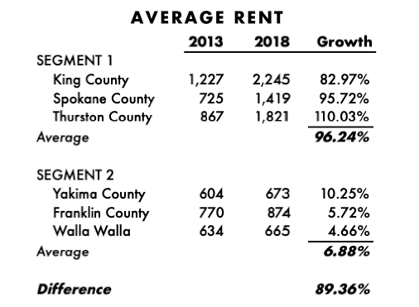

Slide 27
Study Conclusions
Segment 1: AI Present
Segment 2: AI Absent
Rents are increasing 89.36% faster and higher in Segment 1 where AI technology is being deployed
82% in King
96% in Spokane
110% in Thurston
10.25% in Yakima
5.72% in Franklin
4.75 % in Walla Walla
Notes:
The study found that rents are increasing 89.36% faster and higher in Segment 1, (including increases of 82% in King, 96% in Spokane and 110% in Thurston) where AI technology is being deployed. In Segment 2, the rent increases were far more modest (10.25% in Yakima, 5.72% in Franklin, and 4.75 % in Walla Walla).

Slide 28
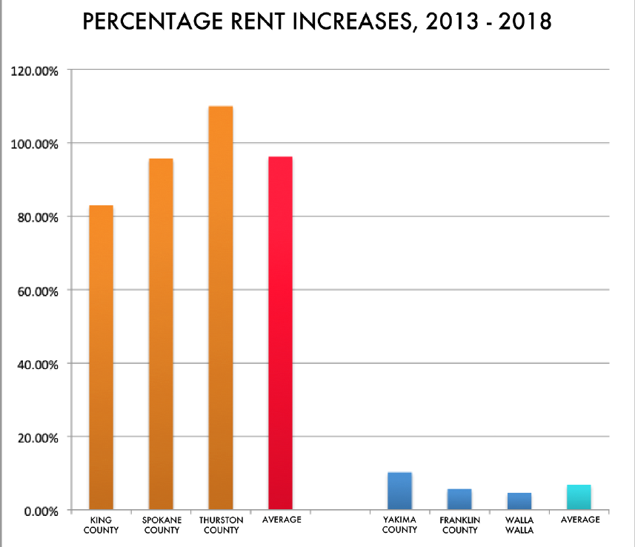

Slide 29
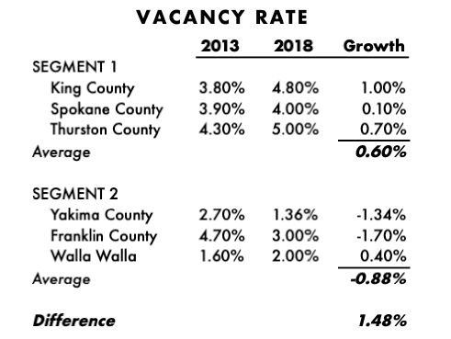

Slide 30



Slide 31
Cost-Burdening
Result: Segment 1 having 3% more of its population experiencing housing cost burdening
Cost Burdening: wherein over 30% of the population's income is used for housing costs.
Notes:
However, at the end of the day, all of the other economic factors lead to cost burdening on housing with Segment 1 having 3% more of its population experiencing housing cost burdening--wherein over 30% of the population's income is used for housing costs.

Slide 32
Abnormal Market
No economic reasons for the skyrocketing rental rates of 96.24 percent in Segment 1 when compared to the modest rental rate increase of 7 percent in Segment 2
Verified the economies of both control groups
In a normal market setting when applying regular economic principals to typical markets, the rental rate increases should have been much higher in Segment 2 as opposed to Segment 1
This appears to be no normal market
Notes:
He found no economic reasons for the skyrocketing rental rates of 96.24 percent in Segment 1 when compared to the modest rental rate increase of 7 percent in Segment 2. We verified the economies of both control groups. However, in a normal market setting when applying regular economic principals to typical markets, the rental rate increases should have been much higher in Segment 2 as opposed to Segment 1; however, this appears to be no normal market.

Slide 33
Conclusion
A correlation exists between the use of AI technology and the skyrocketing rental rates in metropolitan markets and the ballooning homelessness in these same markets
Notes:
I conclude that a correlation exists between the use of AI technology and the skyrocketing rental rates in metropolitan markets and the ballooning homelessness in these same markets.

Slide 34
Part II
Aggressive Leasing Tactics
Notes:
Unfortunately, our story does not end here. While rising rents are bad and are indeed meaning more and more middle-class Americans are struggling with their monthly budgets and homelessness is on the rise—the explanation is still incomplete until we discuss something Property Managers call 'Aggressive Leasing Tactics.'

Slide 35
Locking Tenants In
Aggressive Leasing Tactics: The process by which Property Managers lock tenants into the high rental rates
Notes:
The process begins with the Algorithm setting the above-market fixed rate.
However, it is the property managers who lock the tenant into the high rental rates by utilizing the process the managers call, aggressive leasing tactics.

Slide 36
Old Leasing Policies
Far less information needed
Far less aggressive
Notes:
Like, many from my generation, it has been decades since I rented an apartment. So I had never encountered Aggressive Leasing tactics before. This might be why I was so shocked by my landlord's behavior. Let me tell you, folks, it's a very different rental world out there than what I grew up with. The financial information tenants are required to provide; bank account numbers, proof of income, and in many cases, tax returns. In my day, this was unheard of, and there were laws. But that was then.

Slide 37
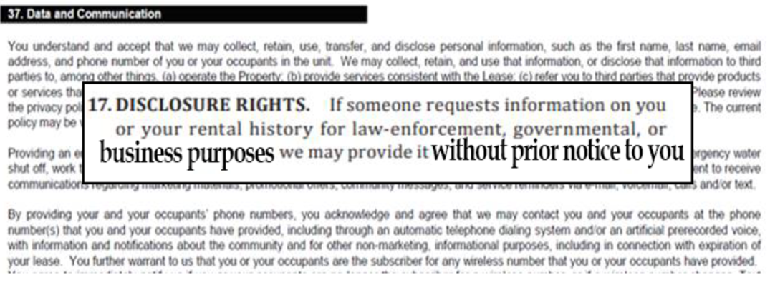

Slide 38
My Own Example
Signed 1-year lease in Seattle
Made contact with Property Manager as lease was coming due
Notified her we wanted to go to a month to month agreement
Notes:
Let me explain to you how this works, and I'll give my own example
When we moved to Seattle, we decided to rent
After the first year, the lease was coming due
I made contact with the property manager—I went to the property manager and notified her we wanted to go to a month to month agreement
So, when we sat down to renegotiate the lease with the PM

Slide 39
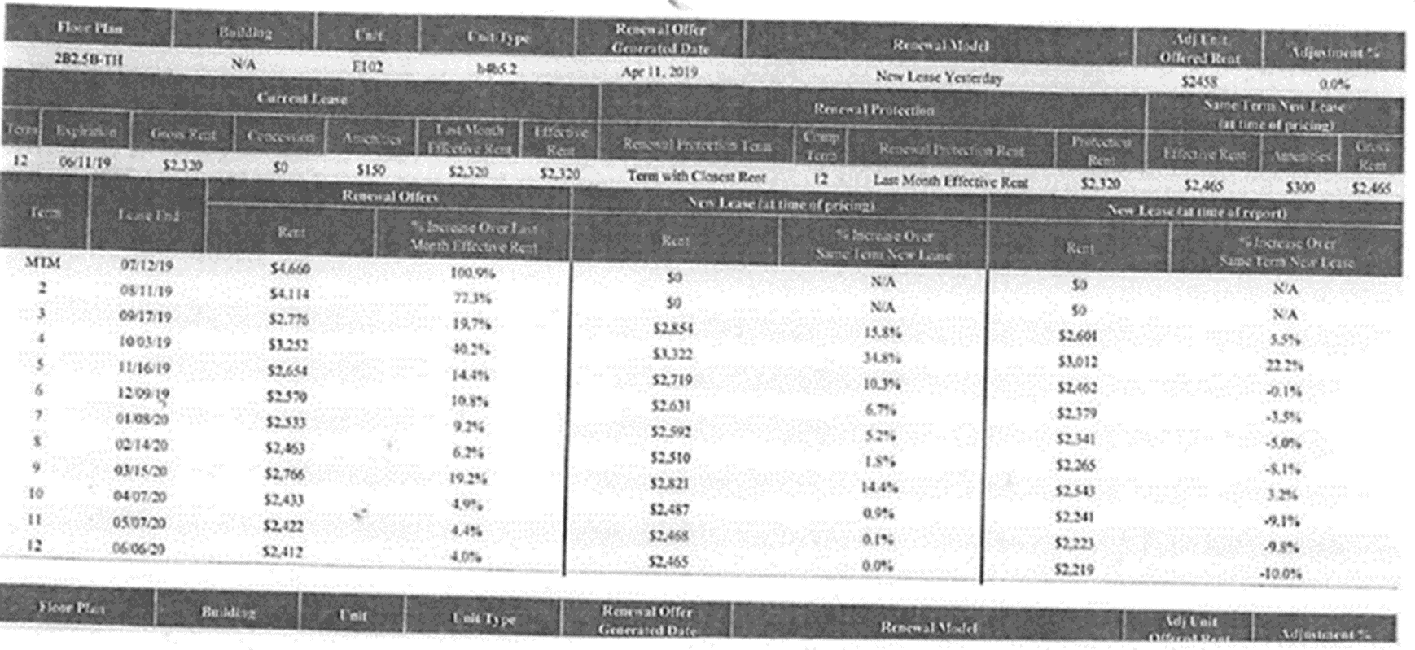
Notes:
The First thing she did was hand us this rental-rate pricing sheet

Slide 40
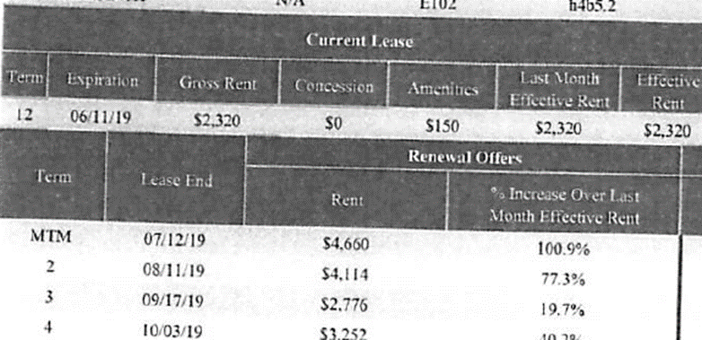




Notes:
First, we were shocked to see the monthly rent would double from $2300/month to $4600/month

Slide 41
Pressure Added
    Failure to give 30-day notice meant already owing the first month’s rent of $4600
    As well as the second month's rent of $4600
    We objected
Notes:
But then she was quick to point out since you didn't give us that 30-day notice, you now owe the first month's of $4600
And since you haven't given us that 30-day notice, you now owe us the second month's rent as well
And then, of course, we objected

Slide 42
Threats
    If we refused to pay
      They had the ability to mess up our credit
      They would make it difficult for us to get future housing
Notes:
But then came those underlying threats, if we refuse to pay
They had the ability to mess up our credit
Make it difficult for us to get future housing

Slide 43
Aggressive Leasing: The Result
    Only feasible option was to accept the 12-month lease
        Which was a 5% increase over the market rate
Notes:
Our only other option then was to accept the 12-month lease
Which was at a 5% increase over the market rate

Slide 44
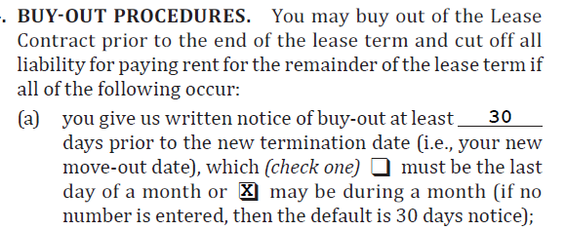

Early Termination Type Fees from Actual Contract
Notes:
To lock us into this contract, they put in an early termination fee of $4,824; and,

Slide 45
Notes:
Also, a fee for rewriting the contract of $2,050

Slide 46
Locking Tenants In
Once in a lease, it will become very difficult to get out without paying all those fees
  Unless you know what to look for and how to protect yourself
Notes:
Now they got us. And that's what the whole rental process is about, the new lease contracts are massive fee-traps
Once in this lease it will become very difficult to get out without paying all those fees unless you know what to look for and how to protect yourself.

Slide 47
Two Types of Tenants
  Those that can afford all of these extra fees and rent
  Those that are struggling to afford their monthly rental payments and cannot afford the extra fees
Notes:
You see, we all know there are two types of tenants
Those that can afford all of these extra fees and rent
Those that are struggling to afford their monthly rental payments and cannot afford the extra fees

Slide 48
Struggling Tenant
I found Property Managers are using this process to erect barriers to housing
  Forcing these tenants to pay these high rents and these high fees
Notes:
Now, it gets worse for the tenants that are struggling to pay their rent
What I found is that property managers are using this process to erect barriers to housing
Forcing these tenants to pay these high rents and these high fees

Slide 49
Fee-Stacking
Fee-Stacking happens when a tenant incurs a fee when making their monthly rent payment, either by paying rent late (even by just 4 days) or paying less than was due. Even when, in the end, the tenant pays the entire amount of rent due, the fees continue to compound.
Notes:
So the real nail-in-the-coffin for these rent-strapped tenants are the fees and something called
'Fee-Stacking.'
Fee-Stacking happens when a tenant incurs a fee when making their monthly rent payment, either by paying rent late (even by just 4 days) or paying less than was due. Even when, in the end, the tenant pays the entire amount of rent due, the fees continue to compound.

Slide 50
Fee-Stacking: Example
Tenant has paid all rent due (just not timely):
  Each month the manager charges fees
  When the tenant makes the next monthly payment (on time)
    The manager applies the rent payment to previous months fees first
    The rest of the payment the goes toward the current rent due [a violation of the law—fee stacking]
  Now the tenant remains in delinquent status, even though they have paid the rent payment
Notes:
For example, even when the tenant has actually paid all rent due (just not timely); each month the manager charges fees, and when the tenant makes the next monthly payment, even when payment is made on time, the manager applies the rent payment, first, to previous months fees and the remainder to the current rent due [a violation of the law—fee stacking]. Now the tenant remains in delinquent status, even though they have paid the rent payment.

Slide 51
Example Continued: Toward Eviction
The property manager can call the rest of the tenant's contract due and payable
Property Manager begins to charge excessive fees on that total rent balance
Late payments can now trigger the early termination fee, which financially cripples the tenant
This tenant is unable to make these payments, and now, the manager begins the eviction process
Notes:
The Eviction Process
Now the property manager can call the rest of the tenant's contract due and payable and begins to charge excessive fees on that total rent balance. Furthermore, (as in tenant 1, the $4,824 early termination fee), late payments can now trigger the early termination fee, which financially cripples the tenant.
This tenant is unable to make these payments, and now, the manager begins the eviction process.

Slide 52
Looking for Housing
Tenant begins to look for housing elsewhere
The AI technology has been trained to alert the Property Managers of the tenant's internet activity
Notes:
The tenant begins to look for housing elsewhere in an attempt to provide safety and security for their family. However, the AI technology has been trained to alert the property managers of the tenant's internet activity.

Slide 53
Locked Out of Housing
Property Manager reports the delinquent tenant
The rental history data is immediately available to other owners/managers through the shared platform (over 12 thousand of them)
Property Managers connected to the platform can support each other by not allowing tenants to move without the "group's" consent
Notes:
Once the property manager reports the delinquent tenant, the rental history data is immediately available to other owners/managers through the shared platform (over 12 thousand of them). Managers connected to the platform can support each other by not allowing tenants to move without the "group's" consent.

Slide 54
On the collections side, we have a lot of examples where we don’t have to contact former residents. They contact us to clear up an outstanding balance when their rental payment history appears in connection with trying to rent another apartment. So, it absolutely does work.
Chris Jenkins, Vice President of Financial Planning at Equity Residential
Notes:
According to Chris Jenkins, Vice President of Financial Planning at Equity Residential, “On the collections side, we have a lot of examples where we don’t have to contact former residents. They contact us to clear up an outstanding balance when their rental payment history appears in connection with trying to rent another apartment. So, it absolutely does work.”

Slide 55
RentBureau Providing Blockade
For example, in just one study, completed by Experian, the property manager who provided the tenant payment history with Experian RentBureau received more than 400 "hits" of rental applicants attempting to move into a community while still owing a rental payment debt elsewhere
Notes:
Experian RentBureau received more than 400 "hits"
For example, in just one study, completed by Experian, the property manager who provided the tenant payment history with Experian RentBureau received more than 400 "hits" of rental applicants attempting to move into a community while still owing a rental payment debt elsewhere. (lack of due process for tenants)

Slide 56
The Result
The tenant is locked into their current community
  Must find a safe haven such as family or friends
  Forced into homeless shelters or the streets
Notes:
The tenant is locked into their current community, or they must find a safe haven such as family or friends; otherwise, they are forced into homeless shelters or the streets.

Slide 57
Conclusion
Aggressive Leasing Tactics is one of the primary cause of homelessness in our country
Notes:
My studies concluded that the Aggressive Leasing Tactics is one of the primary cause of homelessness in our country.

Slide 58
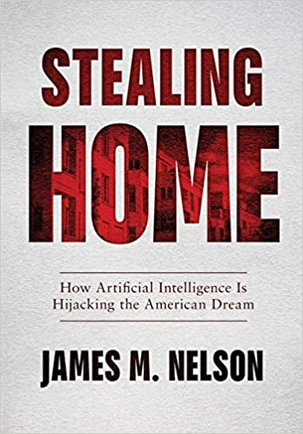
Notes:
Of course, I go into a lot more detail about these Aggressive Leasing Tactics in my book.
I look at the various legal and illegal tactics these property managers have been using

Slide 59
We Need Your Help
LinkedIn: @JamesMartinNelson
Twitter: @JamesM_Nelson
YouTube: https://www.youtube.com/watch?v=vHyjLpUcNd0&feature=youtu.be
See the Website for details
www.jamesmartinnelson.com

