Slide 1
2017 Kinship Caregiver Support Program Information Session
January 23, 2017
Catherine Lester, Director | Ed Murray, Mayor | Hyeok Kim, Deputy Mayor | Kate Joncas, Deputy Mayor

Slide 2
Summary
Review timeline
Overview of Kinship Caregiver Support Program RFP
Investment area and funding source
HSD’s Outcomes Framework
Service Delivery Framework
Focus Population and Priority Communities
Outcomes
Agency Eligibility
Submission Process
Review and Rating Process
Appeal Process
Coordinator: Karen Winston, karen.Winston@seattle.gov
Notes:
Karen

Slide 3
Area Agency on Aging
13 AAAs in Washington State
Sponsored by United Way, City of Seattle and King County
Administered by the Seattle Human Services Department, Aging and Disability Services
Serves all of King County

Slide 4
Timeline
Funding Opportunity Announcement January 17, 2017
Seattle Daily Journal of Commerce
HSD Funding Opportunities Web Page http://www.seattle.gov/humanservices/information-for-grantees
Mayor’s Weekly/HSD Blog website/Life Lines newsletter
Info Session Monday, Jan. 23, 2017, 10:30-Noon
Rainier Beach Library, Seattle
Application Deadline Friday, February 24, 2017
Appeal Process February 27 to March 3
Review & Rating Process March 2 – 16, 2017
Agency Notification May 30, 2017
Announcement of Awards May 30, 2017
Contract Start Date July 1, 2017
Notes:
Karen

Slide 5
Investment Area and Funding Source
This Kinship Caregiver Support Program RFP is an open and competitive funding process.
Approximately $191,500 is available through the following fund sources.
Funding awards will be made for the period of July 1, 2017 to June 30, 2018.
Continued investment after the initial contract period will be contingent on successful performance and funding availability.
Fund Sources | Program | Fund Amount
Older Americans Act Title 3E – Services for Grandparents | Kinship Caregiver Support Program | $76,194
Aging and Long Term Care Support Administration Kinship Navigator state funds | Kinship Navigator | $76, 306
Unrestricted Funds | Kinship Collaboration Coordinator | $39,000
Notes:
Karen

Slide 6
HSD’s Outcomes Framework: Results-Based Accountability
HSD has developed a strategy for results-based accountability and addressing disparities to ensure that the most critical human service needs are met by:
Defining the desired results for the department’s investments;
Aligning the department’s resources to the desired results; and
Evaluating the result progress to ensure return on investment.
Notes:
Andrea

Slide 7
Results-Based Accountability Framework
The following desired results that would indicate success have been established based on identified community values.

Slide 8
HSD’s Outcomes Framework: Results-Based Accountability
HSD’s Theory of Change ensures that data informs our investments – particularly around addressing disparities – and shows the logical link between the desired results, indicators of success, racial equity goals based on disparity data, strategies for achieving the desired results, and performance measures. With this model, HSD can ensure that resources are appropriately aligned to address the most critical human service needs based on the analysis of the entire population level data.
All investments resulting from HSD’s funding opportunities will align with the Theory of Change.
Whole Population Data
Desired Results
Strategy
Indicators
Racial Equity Goal
Performance Measure
Racial Disparity Data
Notes:
Andrea

Slide 9
HSD’s Outcomes Framework: Results-Based Accountability
HSD’s Theory of Change:
Whole Population Data
Desired Results
Strategy
Indicators
Racial Equity Goal
Performance Measure
Racial Disparity Data
Data that reflects a whole population | Condition of wellbeing for an entire population | The achievement benchmark –how we know the “result” was achieved? | Data depicting socioeconomic disparities and disproportionality between ethnic/racial populations; specifically between White populations and populations of Color | The stretch goal for reducing and/or impacting the racial equity disparity | Activities or interventions that align to the results and indicators, and are informed by best or promising practices, cultural competency and community engagement | What gets counted, demonstration of how well a program, agency or service is doing Quantity, Quality, and Impact
Notes:
Andrea

Slide 10
Overview of RFP/Q: Service/Program Model
Kinship Navigator
kinship caregivers 18+ caring for a family member’s child
outreach, information & assistance level services
Kinship Collaboration Coordinator
grandparents and other relatives who are caregivers
agencies that provide services to kinship caregivers
public and private funders
to support kinship caregivers and their children
Kinship Caregiver Support Program Services
provides culturally appropriate supportive services to Kinship caregivers age 55 and up who are caring for a family member’s child.
Notes:
Milica
Kinship Navigator provides outreach and information about available resources and services to kinship caregivers age 18 and up who are caring for a family member’s child. In addition, the Kinship Navigator provides assistance level services to kinship caregivers who are unable to access services and resources on their own behalf.
Kinship Collaboration Coordinator
Since August 2005, kinship caregivers and representatives from more than 30 agencies from throughout King County have participated.
kinship caregivers and representatives from agencies throughout King County
Kinship Caregiver Support Program Services
The KCSP provides supportive services to Kinship caregivers age 55 and up who are caring for a family member’s child. Kinship caregivers in King County represent a diverse population. KCSP services will be provided in a culturally appropriate manner with a support group and other activities tailored to fit the interests and needs of the focus population.

Slide 11
Overview of RFP/Q: Criteria for Eligible Clients
King County resident
Providing informal care for another family member’s child or children age 18 or younger
Kinship Navigator Program: caregivers age 18 and up
Kinship Caregiver Support Program: caregivers 55 and up
Notes:
Milica

Slide 12
Overview of RFP/Q: Focus Population and Priority Community
Priority Communities
“Informal” kinship caregivers
Caregiver-child dyads in the most unstable living situations
Communities of color, including immigrants/refugees
Focus Populations
African American
Alaska Native/American Indian
Hispanic/Latino
Notes:
Karen
Priority communities for this investment opportunity include:
“Informal” kinship caregivers who do not have legal custody of the children in their care.
Caregiver-child dyads in the most unstable living situations. Often the most unstable period is when the child has recently been taken in by the relative – a time when substantial new costs for clothing, food, and school supplies are incurred by the caregiver, causing financial stress. Other situations can lead to instability in the caregiving relationship, such as a sudden health problem or the loss of a job.
Communities of color, including immigrants/refugees. Given the data provided, focus population(s) for this investment opportunity are:
African American
Alaska Native/American Indian
Hispanic/Latino

Slide 13
Overview of RFP/Q: Expected Service Components
Navigator Program
Outreach to caregivers
Direct assistance-level services
Maintains up-to-date resource information
Information on available services
Coordination with other agencies
Notes:
Karen

Slide 14
Overview of RFP/Q: Expected Service Components
Collaboration Coordinator
Outreach, training & support, and partnership development
Facilitates KCKC meetings, events and advocacy efforts
Plans/coordinates events for kinship caregivers
Outreach/support/training for kinship support groups
Kinship Caregiver Support Program Services
Outreach and recruitment
Group services
Information & Assistance
Training
Page 12
Notes:
Karen – You’ll find these on page 12

Slide 15
Overview of RFP/Q: Performance Measures
Kinship Navigator - # of caregivers; contacts; outreach activities; completed surveys; and clients reporting positive impact
Kinship Collaboration Coordinator - # of new partnerships; support groups, events and meetings, and outreach activities
Kinship Caregiver Support Program Services – # of caregivers receiving services; outreach activities; group activities; assistance contacts; trainings; completed surveys; clients reporting good service and positive impact due to services
See application, page 13
Notes:
Karen – When awards have been announced, these are the performance measures that will be spelled out in the contracts

Slide 16
Overview of RFP/Q: Other Regulations
Funding for these programs is provided by:
Older Americans Act
WA State DSHS, Aging and Long Term Support Administration
City of Seattle
Notes:
Agencies awarded a contract through this RFP are required to comply with the program rules, regulations, policies, and procedures spelled out by these funders.
But, HSD/ADS will inform the awarded contractors of any modifications during the contracted period. HSD/ADS also has the flexibility under state guidelines to modify certain program and procedures as needed before or during the contracted period.

Slide 17
Agency Eligibility
Meet all licensing requirements
Nonprofit corporation - 501(C) (3) tax exempt status
In good standing
Federal Tax ID number/employer identification number (EIN)
Must have 2 years of experience working with kinship caregivers or providing services to focus populations.
Notes:
Karen - Summarize

Slide 18
Review and Rating Process
Review for minimum eligibility and application completeness. Applications that are late, incomplete, or did not follow the required format will be deemed ineligible and will not be rated. Applications must include: (Page 23)
A completed and signed one-page Application Cover Sheet
A completed Narrative response
A completed Proposed Program Budget
A completed Proposed Personnel Detail Budget
A completed Summary of Proposed Performance Deliverables
Current agency Board of Director Roster.
Minutes from last three Board of Directors meetings.
Current verification of nonprofit status or evidence of incorporation or status as a legal entity. Your agency must have a federal tax identification number/employer identification number.
If your agency has an approved indirect rate, a copy of proof that the rate is approved by an appropriate federal agency or another entity.
If you are proposing to provide any new (for your agency) services, attach a start-up timeline for each service.
On-time, complete applications meeting all eligibility requirements are forwarded to the Rating Committee for their review and rating according to the rating guidelines. The Rating Committee will make funding recommendations to the HSD Director.
Notes:
Karen – This is the application checklist, also summarized on page 23 in the application.
To make sure your application is reviewed, make sure everything on the checklist is turned in.

Slide 19
Review and Rating Process
Agency Financials and Insurance information will be requested only of agencies whose applications meet minimum eligibility and move to the rating committee.
Agencies for which we have current financial and insurance documents will not be required to resubmit.
Agencies for which we have incomplete or no financial and/or insurance documents will be notified by the Coordinator and required to submit ALL requested documents within 4 business days from the date of written request.
Financial and Insurance documentation that may be requested are listed in pg. 23 of the application. Be sure you are prepared to provide these to the Coordinator upon request.
Notes:
Karen
After the initial screening of the proposals are checked, the review process will begin.
The first step is a review of the agencies financials and insurance documentation.
HSD may have this for some agencies, but if we don’t, you will be notified and will have 4 days to submit.
Listed on page 23 of the application.

Slide 20
Review & Rating Process
Minimum eligibility and application screen
Complete applications forwarded to the Review Committee
Incomplete applications or not meeting minimum eligibility will not be forwarded
Appeal process (page 16–18)
Post-notice award appeal process (page 17)

Slide 21
Rating Guidelines
Program Design 35 points
Capacity and Experience 25 points
Partnership and Collaboration 15 points
Cultural Competency 15 points
Budget and Leveraging 10 points
TOTAL 100 pts.
Notes:
In the application, the Narrative Questions begin on page 20.
Also listed is the Rating Criteria – so you’ll know what the rating committee will be looking for during their review
Review maximum points for each component.
Program Design – There should be a separate description for each service component, and each component description will be worth 35 points
Tips on how to respond…

Slide 22
Submission Deadline
Submission deadline is Friday, February 24, 2017, by 12:00 p.m.
All applications must be received in person, by mail, or electronic submission by deadline.
No faxed or e-mailed applications will be accepted.

Slide 23
Methods of submission
Applications can be mailed or hand delivered to:
Seattle Human Services Department
RFP – Kinship Caregiver Support Program
ATTN: Karen Winston
700 Fifth Ave, Suite 5800 (if hand delivered)
P.O. Box 34215 (by mail)
Seattle, WA 98124-4215
Applications can be submitted online at: http://web6.seattle.gov/hsd/rfi/index.aspx.

Slide 24
HSD Online Submission System
The HSD Online Submission System is a web-based program that allows applicants to upload their application for HSD Funding Opportunities (e.g. RFI, RFP, RFQ)
The system is NOT an online Application (e.g. it does not include assigned logins, ability to insert narrative responses within the system, manage your applications, etc.)
You may upload files up to a maximum of 100 MB
Acceptable file types include: .pdf .doc .docx .rtf .xls .xlsx
There are required fields to be completed as well, depending on how many files you are uploading. Ensure you allow sufficient time to complete the steps in order to submit your application by the deadline.
The system automatically sends out an e-mail confirmation to all the e-mail addresses you entered.
Notes:
Tips for submitting online…

Slide 25
http://www.seattle.gov/humanservices/information-for-grantees/funding-opportunities/kinship-caregiver-support-program-rfp
Notes:
I’ve listed the link where you can find the application online and this is what it looks like…

Slide 26
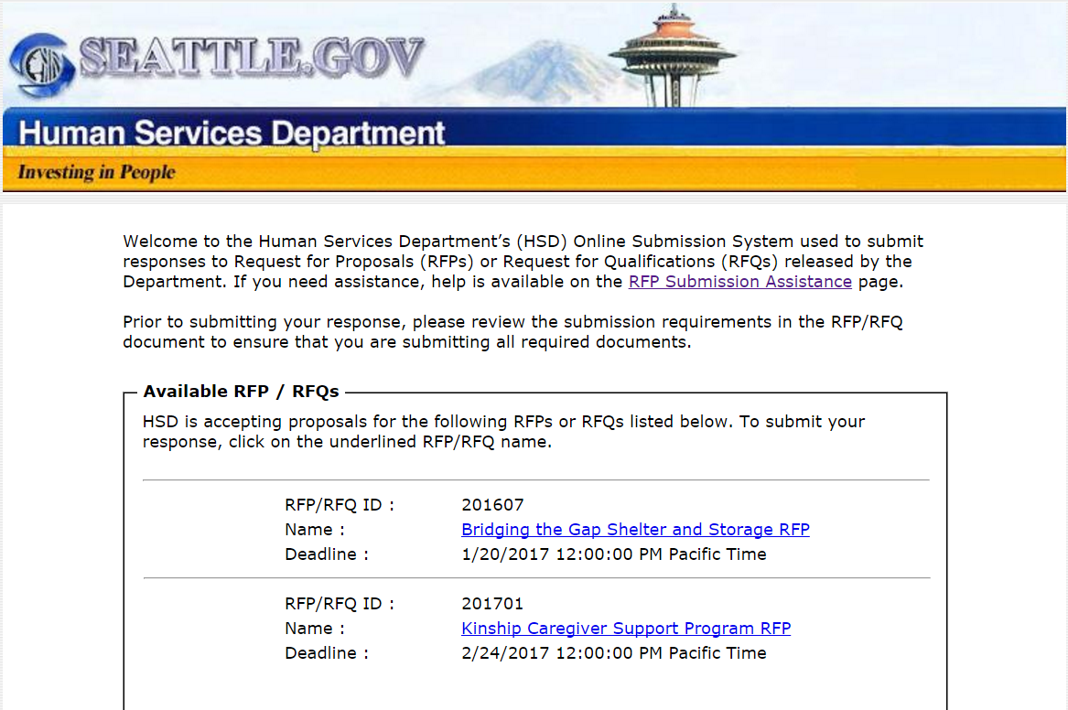
http://web6.seattle.gov/hsd/rfi/index.aspx
Notes:
Here’s the link for submitting your documents and this is what the page looks like…

Slide 27
HSD Online Submission System
Review the Online Submission Assistance Page for helpful information: http://web6.seattle.gov/hsd/rfi/help.aspx.
All applicants are expected to make arrangements to ensure that applications are received by HSD by the funding opportunity application deadline. You are encouraged to submit your application early when possible. It is advisable to upload your documents several hours prior to the deadline in case you encounter an issue with your internet connectivity which impacts your ability to upload documents. If you encounter internet connectivity issues, attempting to submit your application early will allow time for you to submit a hard copy by the deadline instead.
HSD is not responsible for ensuring that applications are received by the deadline.
If you experience any issues and/or have questions about the online submission system, please contact Jenifer Chao, HSD Funding Process Advisor (OOC), by phone at (206) 233-0014 or e-mail at jenifer.chao@seattle.gov.
Notes:
If you have questions about submitting online, here’s a link to where you can find help.
You are encouraged to submit your application as early as possible – just in case you run into problems.
If you experience any issues, contact Jenifer Chao for assistance.

Slide 28
Before you respond…
Understand the focus and outcomes of the funding opportunity.
Do they match your agency’s mission and goals?
Evaluate your agency’s service capacity.
Ask questions!

Slide 29
More tips…
Follow the required format defined in the Guidelines
Be specific, detailed, and concise
Answer all questions and in the context of your proposed program(s)
Submit an accurate budget; double check your numbers
Highlight partnerships and collaborations and not duplicating services
Clearly label all attachments
Use the application submission checklist
Ensure enough time for application to get to HSD on time.

Slide 30
Questions and Answers
Questions and Answers from the information session will be posted online within the next five (5) business days at http://www.seattle.gov/humanservices/funding
Questions and Answers will be posted online regularly. Last day to submit questions: February 8, 2017
E-mail any questions by the Q&A deadline to Karen Winston at karen.Winston@seattle.gov
Application Deadline:
February 24, 2017, by 12:00 p.m.
Notes:
Questions and answers will be posted under “Application Resources”

