Slide 1
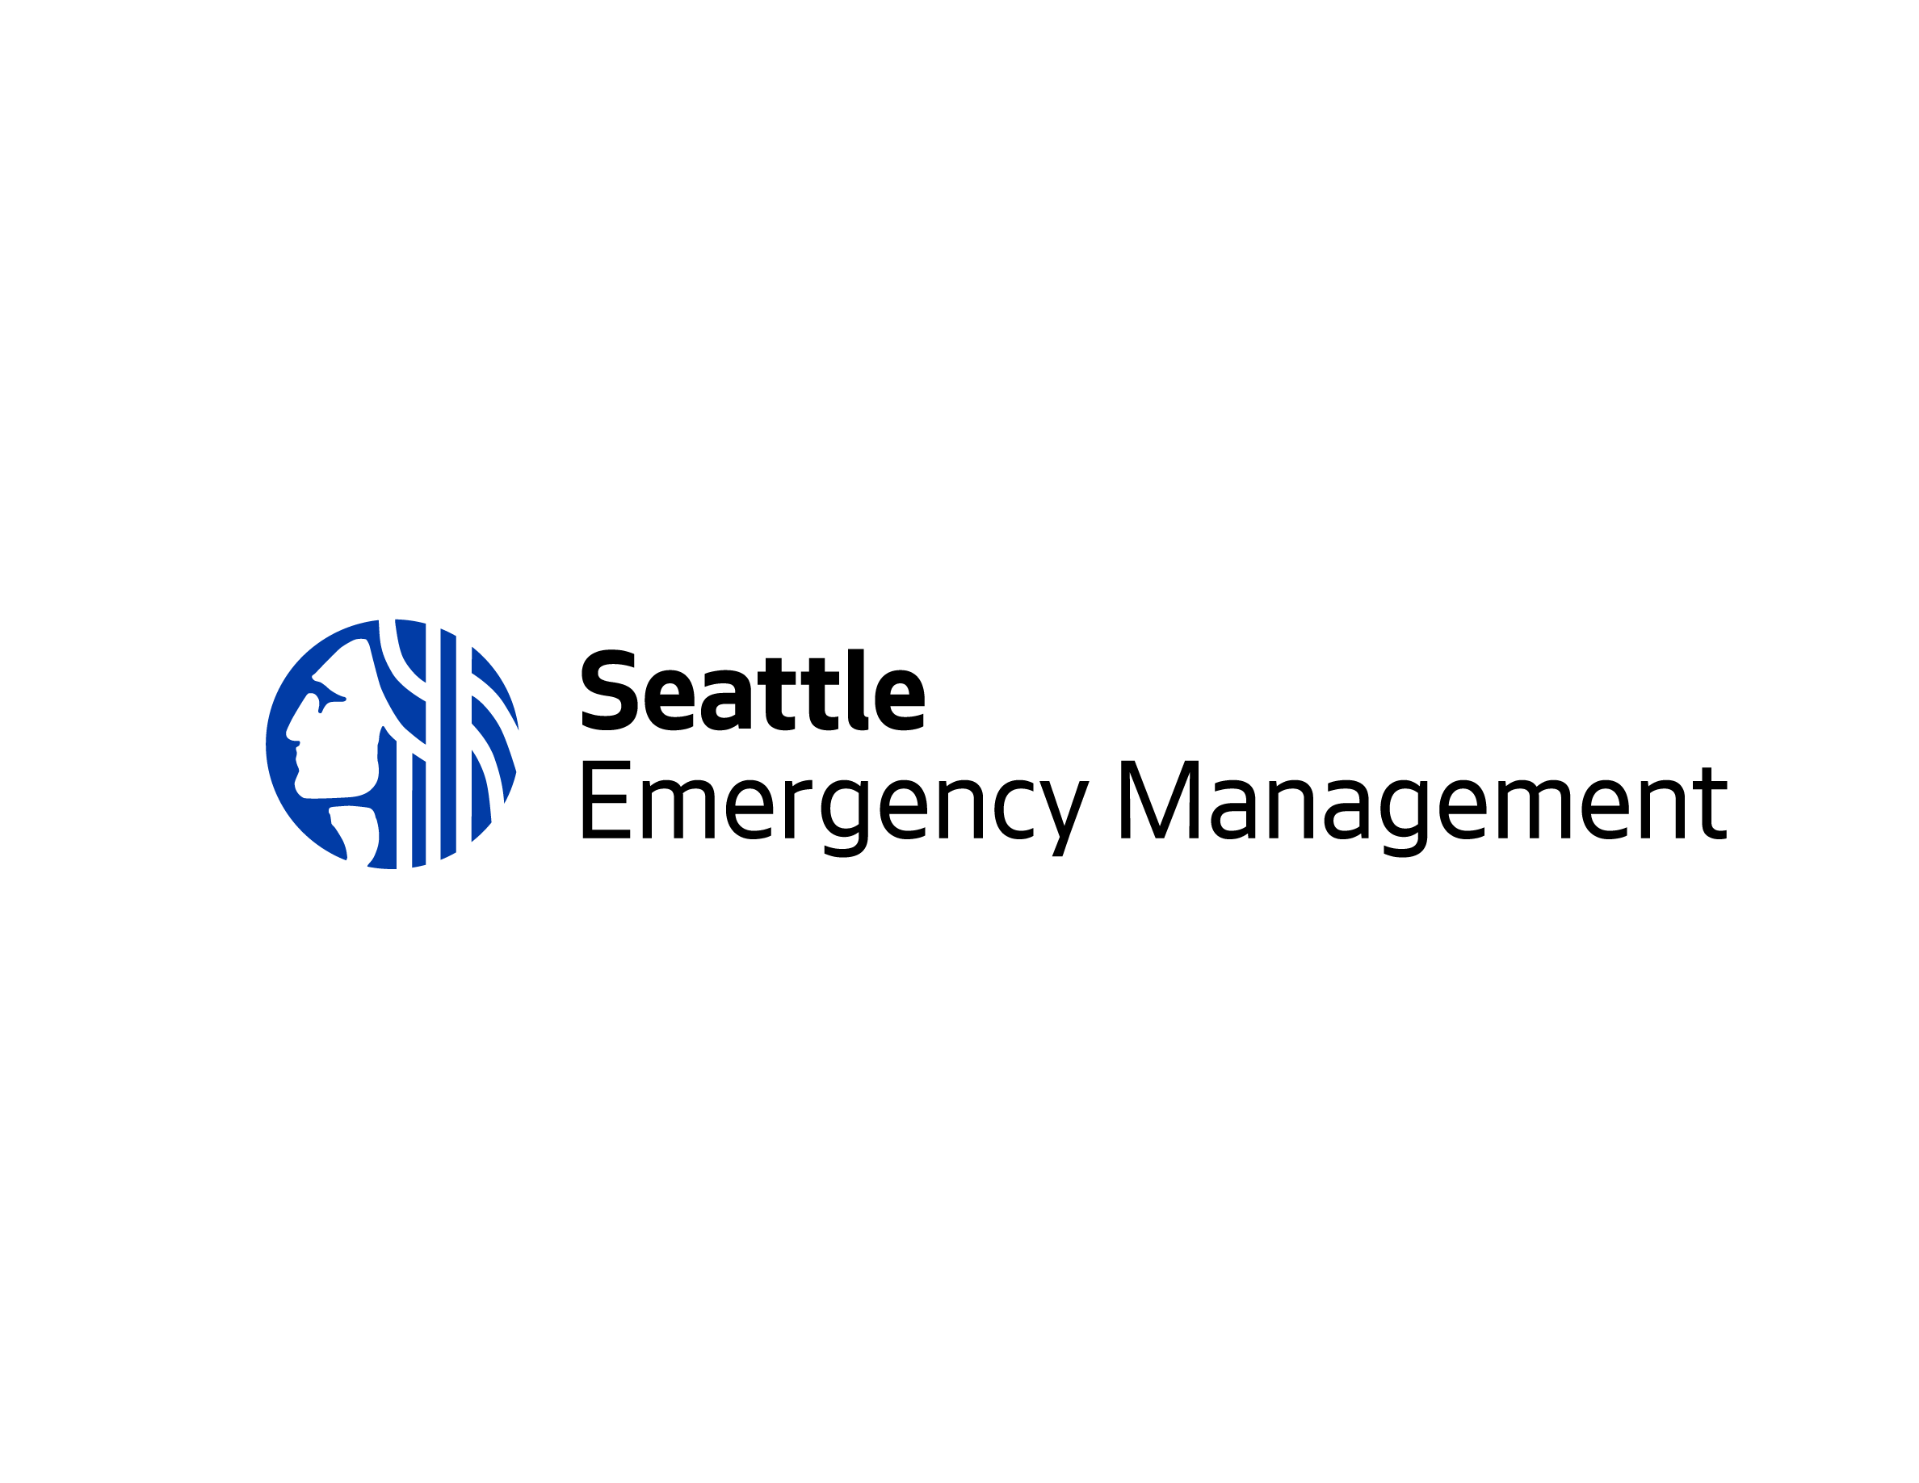
Emergency Preparedness
Presented by:
Community Safety Ambassador

Slide 2
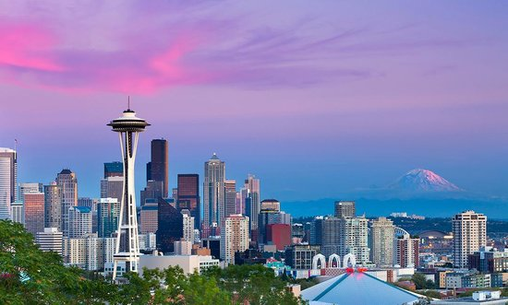
Seattle residents need to be prepared for many disasters

Slide 3
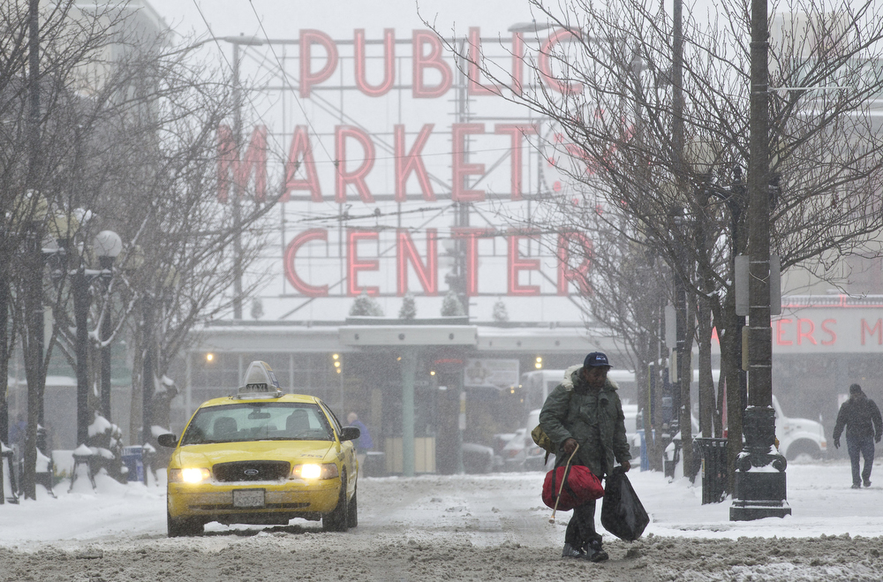
Ice and Snow Storms

Slide 4
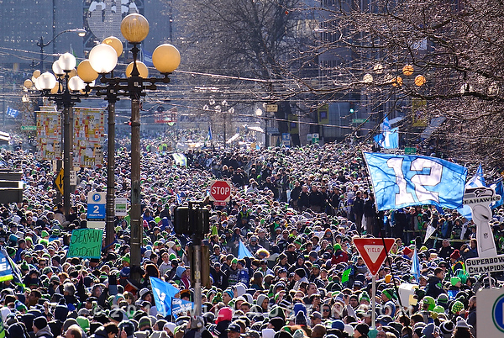
Large Crowds

Slide 5
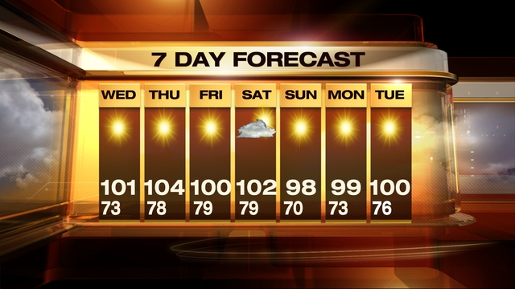
Excessive Heat

Slide 6
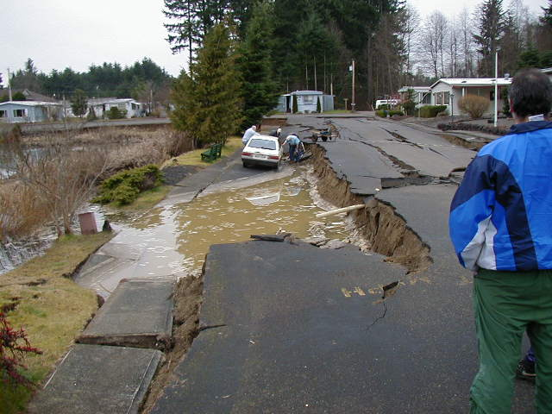
Earthquakes

Slide 7
Seattle’s Top Hazards
Earthquakes
Snow and Ice
Infrastructure/Cyber
Windstorms
Power Outages
Terrorism
Disease Outbreaks
Flooding
Excessive Heat
10. Fires
11. Tsunamis/Seiches
12. Landslides
13. Transportation Accidents
14. Water Shortages
15. Social Unrest
16. HAZMAT Incidents
17. Volcano
18. Active Shooter

Slide 8
Know what could happen
Earthquakes are our largest hazard
The things you rely on will be significantly disrupted
People may not be able to get anywhere easily (roads, bridges damaged; transit will stop)
Stores may quickly run out of supplies
Utilities may be damaged (electricity, water, sewer)
Gas stations and ATM machines may not work
Hospitals may be overwhelmed
Phones, cable TV, and internet may not work
Fire, Ambulances and Police may not be able to help you for some time

Slide 9
What to do to make it through
Get prepared before the next disaster strikes

Slide 10
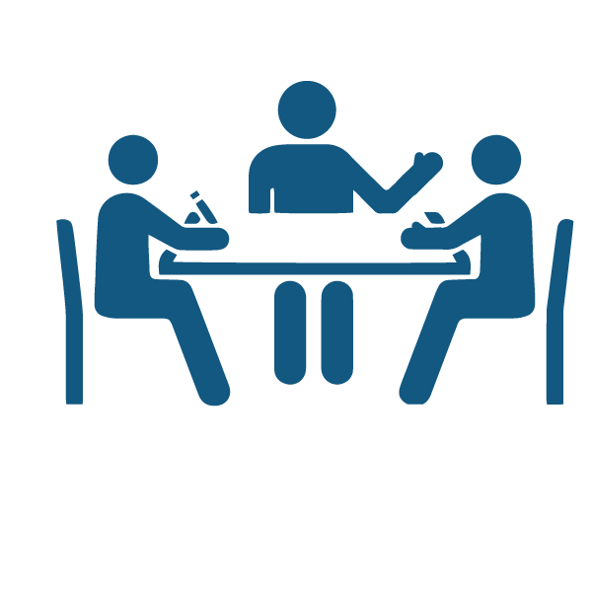
Develop a disaster plan
Develop a communications plan
Know your neighborhood’s plan
Retrofit your home
Sign-up for emergency alerts
Know how to turn off utilities

Slide 11
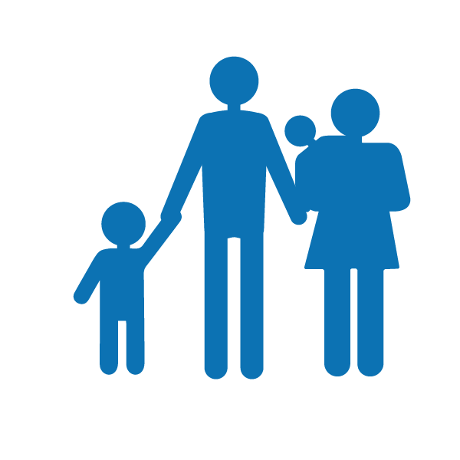
Develop a Disaster Plan
Always plan for:
If you lose power
If you have to evacuate your home
If you are unable to travel
If you are unable to communicate
If your property is damaged
Ask yourself these questions:
What happens if we are separated?
Where can we meet?
How will we contact each other?
What if I have to report to work?
What about our pets?
Who will watch the kids?
What about the school?
Plan for people, pets and property

Slide 12
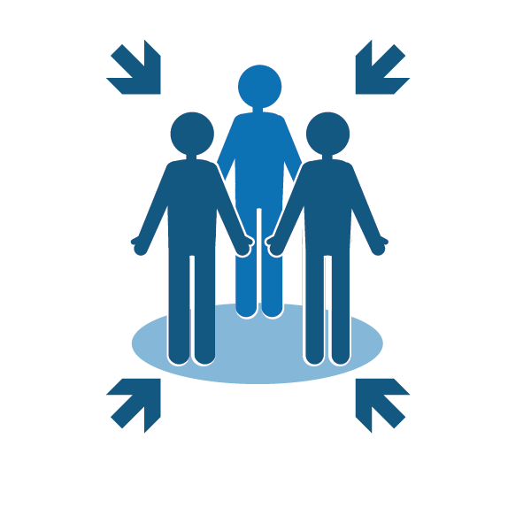
Communications Plan
Include the following in your communications plan:
Out-of-area contact
Emergency contacts
Meeting location

Slide 13
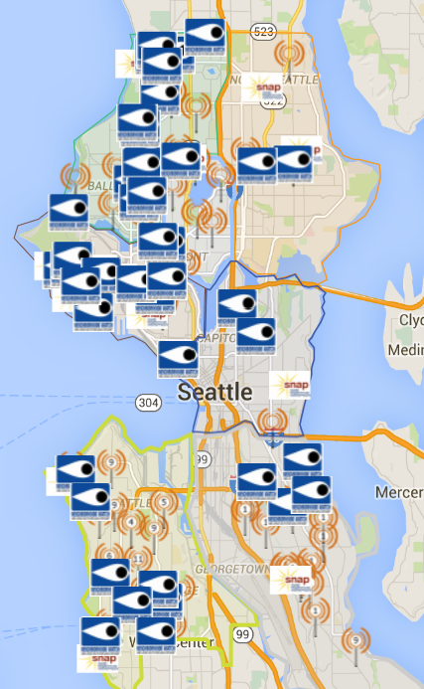
Know your neighborhood’s plan
Community Emergency Hubs
Seattleemergencyhubs.org
SNAP Groups
Seattle.gov/emergency
Disaster Skills Workshops Coming in 2016…

Slide 14
Retrofit your home
Secure the following:
Large furniture
Wall hangings
Kitchen cabinets & contents
Water heater
Hazardous materials
Go on a 30 min. hazard hunt
Attend a free home retrofit class Was your home built before 1980?
Retrofit your home
See list of contractors on OEM’s webpage

Slide 15
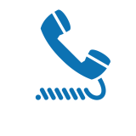
Sign-up for Emergency Alerts
Types of Alerts:
Emergency Alerts
Community Notifications
Severe weather
Safety
Health
Special events
Utility disruptions
Major traffic disruptions
Emergency preparedness
Test messages
When emergencies happen, be the first to know. Stay informed with AlertSeattle to receive real-time, official notifications from the City of Seattle. This is a free service.
Alert.seattle.gov

Slide 16
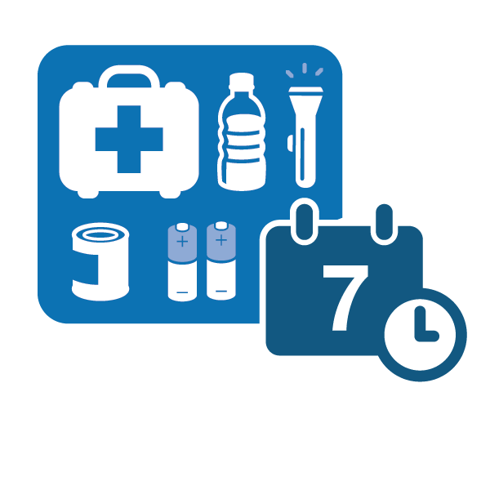
Be prepared to be on your own for 7-10 days
Think about what you use on a daily basis, and include those items in your kit
Food and water are the most important

Slide 17
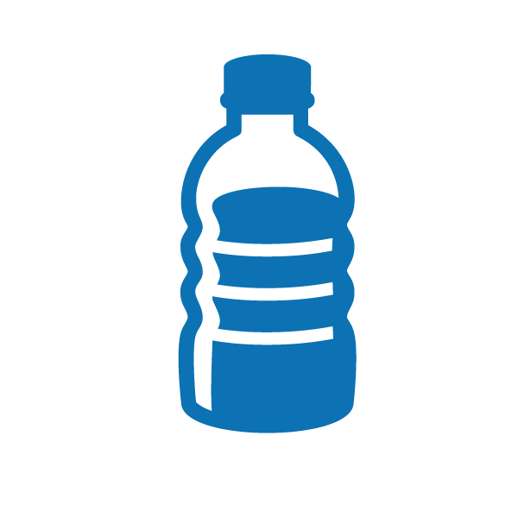
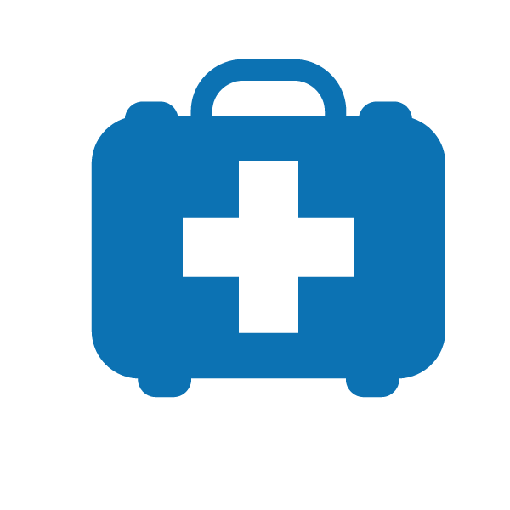
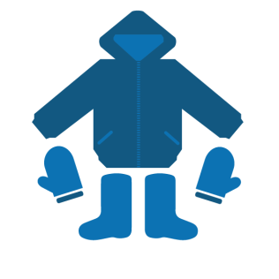
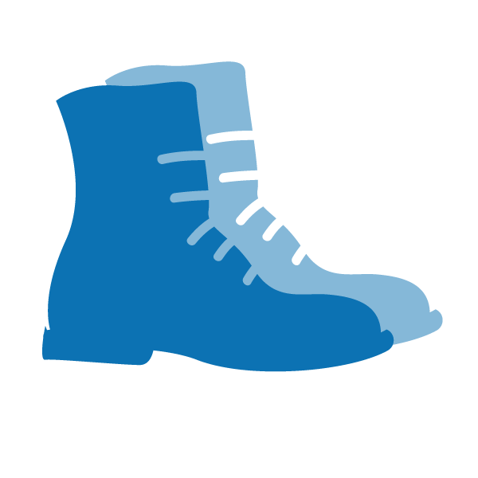
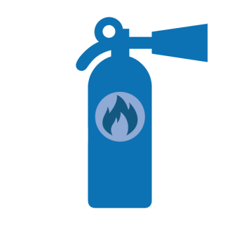
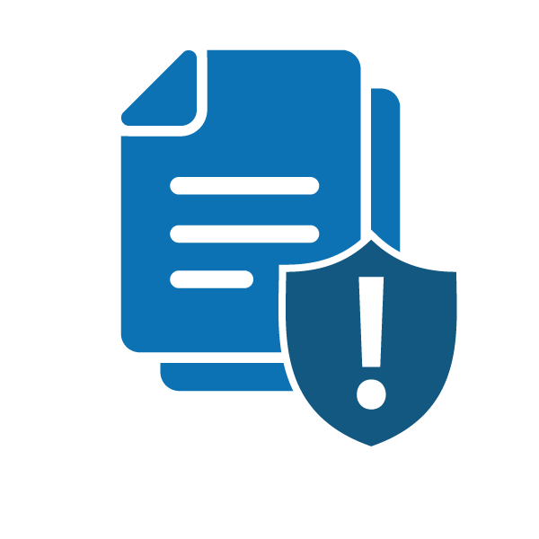
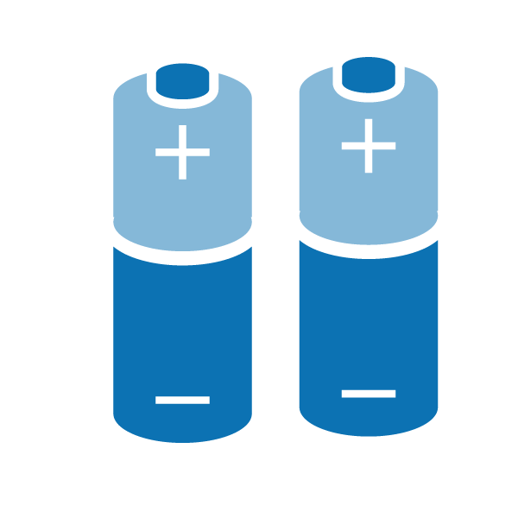
Basic Kit Supplies

Slide 18
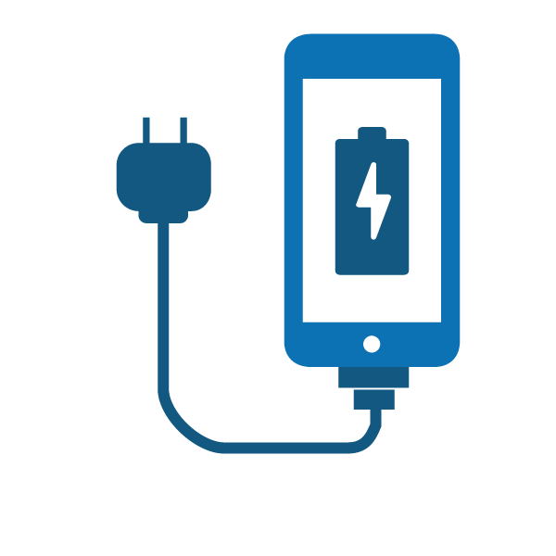
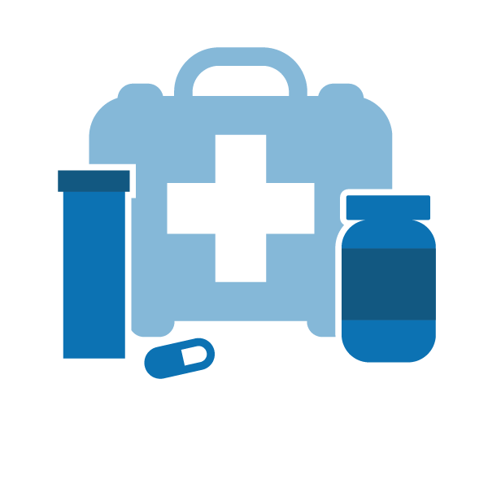
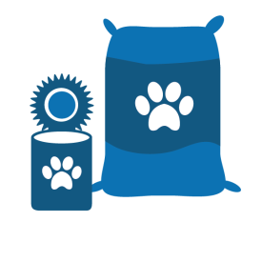
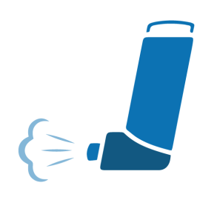
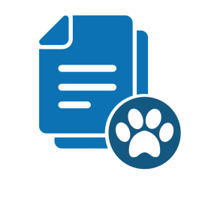
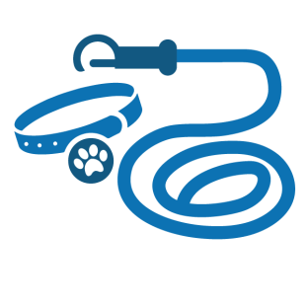
Include your special needs

Slide 19
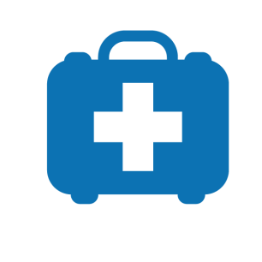
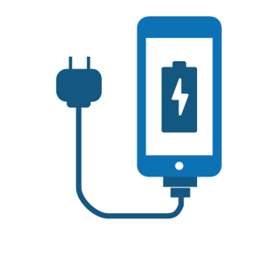
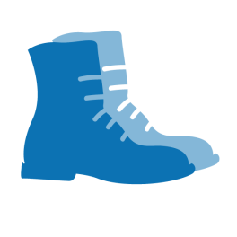
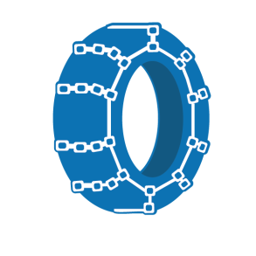
Vehicle Kit Supplies
You don’t know where you’ll be when the disaster strikes. Have smaller kits in your car and at work.

Slide 20
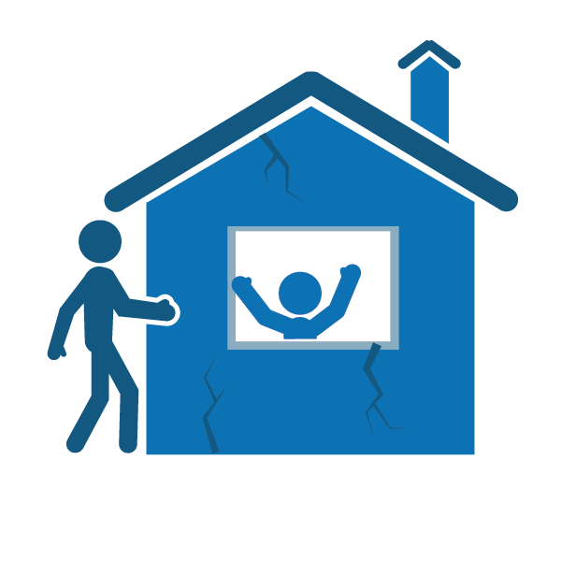
Start by planning with 1-2 people who live near you
Check on one another after a disaster (who has children, pets, lives alone, special needs?)
Helping may also include sharing supplies, a mutual agreement of checking on each other’s home if the disaster strikes when your away
Find out your neighbor’s unique skills (i.e. CPR cert, first aid, mechanic, etc.)
It will make getting through a disaster more manageable until help arrives

Slide 21
What to do during an earthquake
Quake Advice:
Don’t run during the shaking
Drop, Cover and Hold under a desk or table
If there’s not table, find the nearest safe place beside an inside wall or lower than furnishings; get into a corner or against a supporting column
If outside and in an open area, sit down and cover your head with your arms
If in the ‘danger zone’ next to a building, try to get back into the building to find shelter
Myth buster: Doorways are not a safe place to be

Slide 22
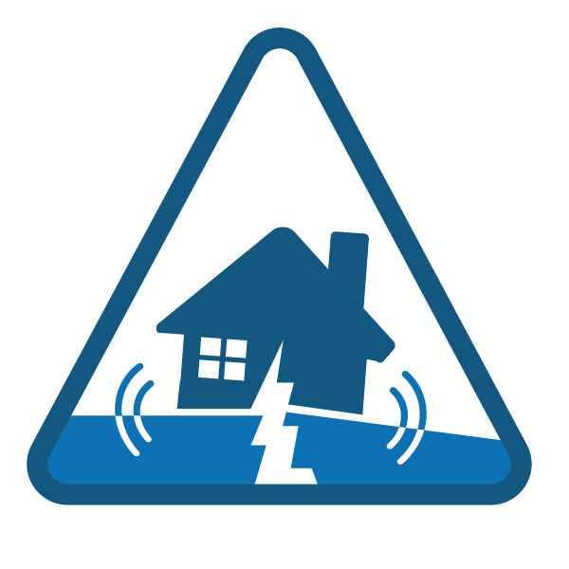
What to do after an earthquake
Check on yourself and your family for injuries
Check on your home
Check on others
Find out more information

Slide 23
Check on yourself and family
Your safety comes first
Check yourself for injuries
Put on sturdy shoes
Check family members for injuries
Do basic first aid if needed

Slide 24
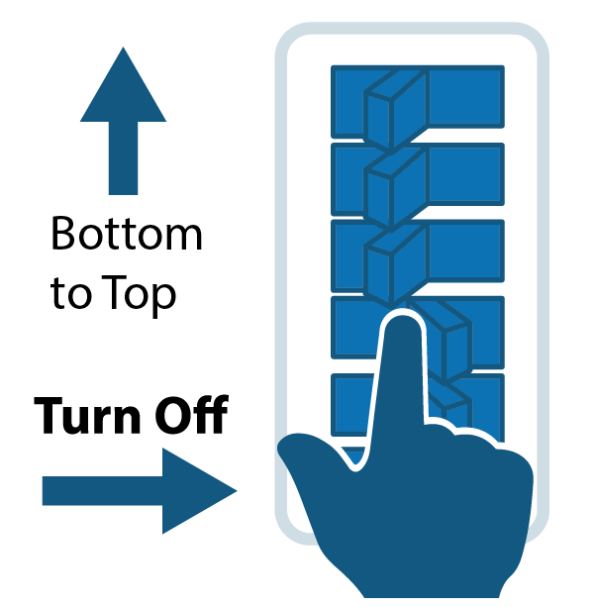
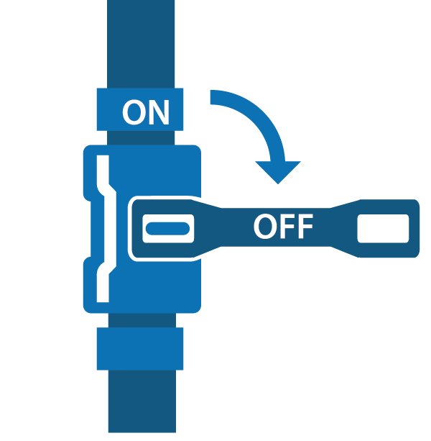
Check on your home
Check on utilities and structure of your home
Shut off water at the main house valve
Typically located right outside your house or inside
This saves the water in your hot water heater and toilet from possible contamination
Turn off power to the water heater – attach a hose
Shut off natural gas ONLY if necessary
Only shut it off if you smell natural gas, hear a hissing sound, or dial is spinning rapidly
Shut off electricity ONLY if natural gas meter is damaged
This will help prevent a fire
Check to see if your home sustained structural damage
Rope off damaged areas so others know

Slide 25
Check on others
Go to your neighborhood meeting place
Focus on three priorities:
Control utilities and fire
Check on others
Care for injuries

Slide 26
Find our more information
Find out what is happening in the region
Get AlertSeattle messages
Sign up online at alert.seattle.gov
Tune in to local emergency radio stations
AM 710, AM 1000, FM 97.3, FM 97.7 and FM 94.9
Tune into local television
Follow City departments on social media
(Twitter, Facebook, NextDoor, Reddit) @CityofSeattle, @SeattlePD, @SeattleFire, @AlertSeattle, @SeattleDOT, @SeattleSPU, @SEAcitylight
Go to your nearest emergency hub

Slide 27
Questions?

