Slide 1
Boil Water Advisories – Notification
Operating Board
April 2, 2015

Slide 2
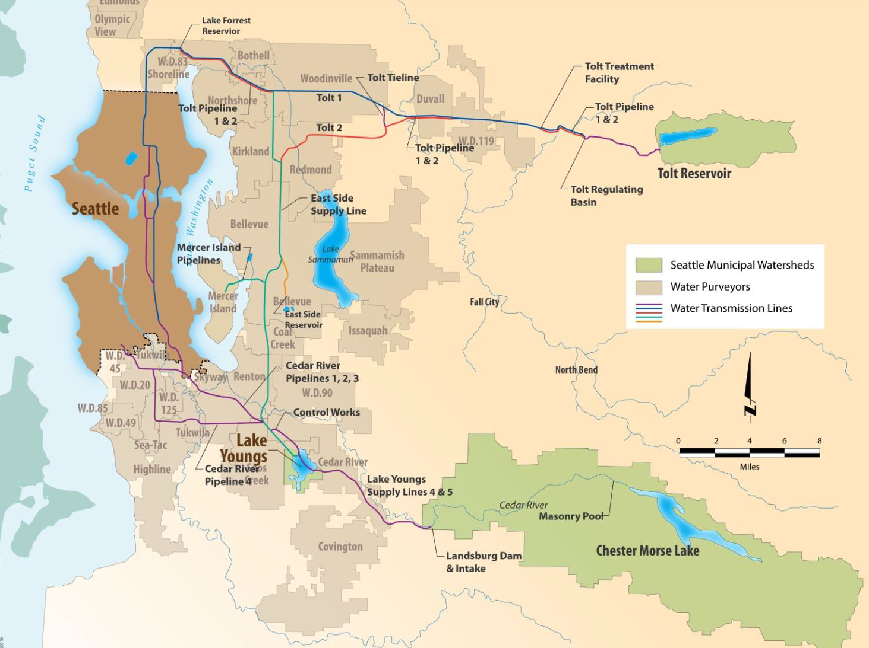
SPU Drinking Water System
Notes:
The Cedar River begins within a protected watershed on the west side of the Cascade Mountains and eventually drains into the south end of Lake Washington. The watershed area totals about 79,700 acres of which 99.7 percent is owned by SPU. The Cedar River water supply system also consists of Chester Morse Lake, the Landsburg Facilities, the Cedar Supply Pipelines, Lake Youngs, the Cedar Water Treatment Facility, the Lake Youngs Tunnel and Pump Station, and Control Works.
The South Fork Tolt River watershed has a drainage area of approximately 12,100 acres in northeastern King County. The south fork of the river eventually flows into the Snoqualmie River. The watershed is controlled by SPU, which owns 69 percent of the area. The remainder is owned by the US Forest Service. The Tolt River water supply system consists of the Tolt Reservoir, the Tolt Penstock, the Regulating Basin, the Tolt Treatment Facilities, and the Tolt Pipelines.

Slide 3
10 Year Regional TCR Summary
 | Name | 2005 | 2006 | 2007 | 2008 | 2009 | 2010 | 2011 | 2012 | 2013 | 2014 | Grand Total
 | Port of Seattle | 1 | 1 | 1 |  |  |  |  | 1 |  |  | 4
 | Bellevue |  | 5 |  | 2 | 1 | 1 |  |  | 2 | 2 | 13
 | Bothell |  |  |  | 1 |  |  |  |  |  | 1 | 2
 | Skyway | 1 |  |  |  |  |  |  |  |  |  | 1
 | KCWD 20 |  |  | 1 |  |  |  |  |  |  | 1 | 2
 | North City |  | 1 |  |  |  |  |  |  |  |  | 1
 | KCWD 49 |  |  |  |  |  |  |  |  | 1 |  | 1
 | Soos Creek | 1 |  |  |  | 2 |  |  |  |  | 2 | 5
 | Highline |  |  | 1 |  | 1 |  |  |  | 1 | 1 | 4
 | Northshore |  |  |  |  | 2 | 1 | 1 |  | 3 |  | 7
 | KCWD 90 |  |  |  |  |  | 1 |  |  | 3 |  | 4
 | Woodinville | 1 |  |  |  |  |  |  |  |  |  | 1
 | Cedar River |  |  |  |  |  | 1 |  |  |  |  | 1
 | KCWD 119 |  | 1 |  |  |  |  |  |  |  |  | 1
 | KCWD 125 |  |  |  |  | 2 |  |  |  |  |  | 2
 | Kirkland |  |  |  |  | 1 |  |  |  |  |  | 1
 | Mercer Island |  |  |  |  | 1 |  |  |  |  | 1 | 2
 | Seattle | 6 | 7 | 6 | 8 | 2 | 6 | 0 | 3 | 4 | 5 | 47
 | Tukwila |  |  |  |  |  |  |  |  |  | 1 | 1
Grand Total |  | 10 | 15 | 9 | 11 | 12 | 10 | 1 | 4 | 14 | 14 | 100

Slide 4
TCR Compliance Flow Chart
YES
YES
YES
YES
PWS collects required ROUTINE samples?
ROUTINE sample TC+?
TC+ ROUTINE sample analyzed for FC/EC?
PWS collects REPEAT samples within 24 hrs?
NO
NO
NO
NO
M/R VIOL
No Further Action
M/R VIOL
M/R VIOL
REPEAT Samples TC+?
YES
Must continue collecting REPEAT samples until all are TC negative or an MCL is violated
TC+ REPEATS Analyzed for FC/EC?
YES
NO
No Further Action
M/R VIOL
NO
ROUTINE TC+ and REPEAT FC/EC+?
Or
ROUTINE FC/EC+ and REPEAT TC+?
Is the percent of ROUTINE TC+’s plus REPEAT TC+’s >5% of total (this is 10 or more samples for Seattle Public Utilities)
Definitions:
PWS = Public Water System
TC = Total Coliform
TC+ = Total Coliform Positive
FC = Fecal Coliform
EC = E. Coli
M/R = Monitoring/Reporting
MCL = Maximum Contaminant Level
VIOL = Violation
NO
NO
No Further Action
YES
YES
24hr Acute MCL VIOL
Monthly MCL VIOL

Slide 5
Timing (Tier 1 Acute MCL Violation)
24 hrs
Within 24 hrs
24 hrs
Within 24 hrs
Collect Routine Sample
Routine Result TC+ or EC+
Collect Repeat Samples
Repeat Result EC+ or TC+
Issue Public Notice
Elapsed Time
Up to 4 days from 1st sample collection
0

Slide 6
Questions?

