Slide 1

Freight System Plan
Seattle Freight Advisory Board
Seattle, WA
August 10, 2017
Jason Beloso – Rail, Freight, and Ports Division
Notes:
Thank you and introduction
Can you please hold your questions until the end of our presentation? Thank you

Slide 2
Purpose of Freight System Plan
Economy:
Washington is second most trade-dependent state in the nation
  $126.8 billion in total imports and exports value
  1.41 million jobs in freight-dependent industries (including wholesale, retail, manufacturing, construction, transportation, and agriculture/timber and wood products)
  $550.5 billion in gross business income for freight-dependent sectors
Freight Components in Washington:
Global Gateway - access to international markets
Made in Washington - manufactured or produced in Washington
Delivering Goods to You - representing local freight delivery
Notes:
To emphasize the importance of freight, identify specific information in the region before the meeting related to:
Truck – Truck Freight Economic Corridors
Rail – Major routes; crossings
Marine – routes and ports
Air Cargo – ports
Specific issues to address should be identified in advance.

Slide 3
Purpose of Freight System Plan
Objectives:
To provide information on the importance of freight to the economy of the state
To develop a working definition of the freight transportation system
To provide an analysis of conditions and volumes, and a forecast for freight
To identify the major freight trends, issues, and needs
To provide a blueprint of strategies to address the identified trends, issues, and needs.
Key Components:
A Freight Investment Plan that describes key funding sources, networks eligible for funding, and projects identified on those networks
A Marine Ports and Navigation Plan that describes the marine system and assesses the transportation needs of marine ports, including navigation

Slide 4
Purpose of Freight System Plan
Key Federal Requirements:
Identification of multimodal freight corridors and facilities
Description of how the plan meets the national multimodal freight policy goals and the national highway freight program goals
Strategies to mitigate significant congestion or delay caused by freight movement
Development of a Freight Investment Plan, including a list of freight priority projects
Notes:
National Multimodal Freight Network: interim network designated; final will be designated by USDOT later in 2017
National Highway Freight Network: WSDOT and MPOs designated corridors in 2016
Freight Investment Plan: WSDOT is working with the state freight advisory committee to validate freight projects in 2017

Slide 5

Trends and Issues
Economic Vitality
Efficient flow of freight through gateways: border crossings, airports, seaports
Competition facing ports
Preservation of industrial sites
Preservation
Aging infrastructure
Waterway channel maintenance
Safety
Truck related crashes
Truck parking shortages
Highway-rail grade crossing improvements
Notes:
Ask audience for other topics for each goal

Slide 6
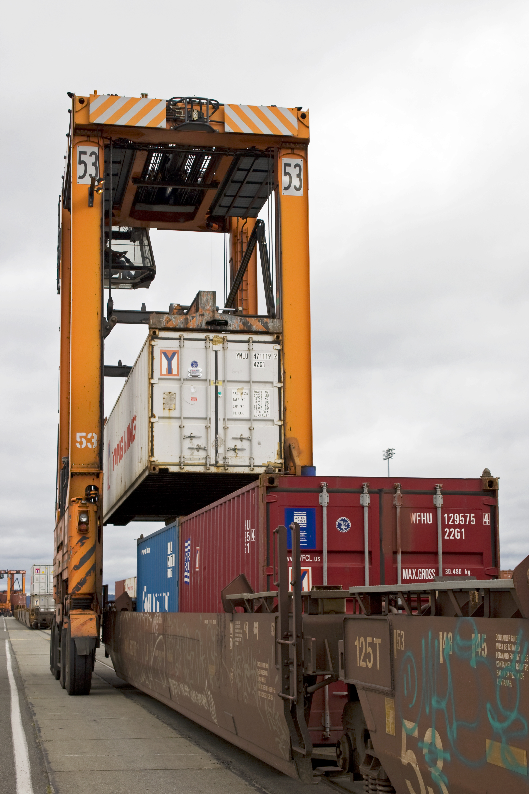
Trends and Issues
Mobility
Intermodal connections: inland ports
New logistics and distribution models
Urban goods movement
Environment
Climate impact vulnerability
Emissions
Hazardous material risks: crude by rail
Stewardship
System resilience (e.g., landslides)
Congestion caused by freight
Data and communication
Notes:
Ask audience for other topics for each goal

Slide 7
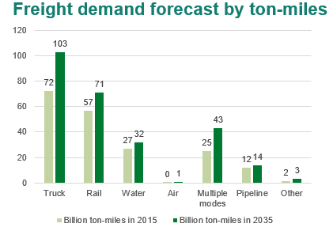
New Volumes and Forecasts
Washington state’s freight network moved 436.6 million tons of freight in 2015, with a total of 194.9 billion ton-miles traveled.
Freight demand by weight is projected to grow 29% in next 20 years, while the total ton-miles traveled is projected to increase 60%. (Source: FAF 4)

Slide 8
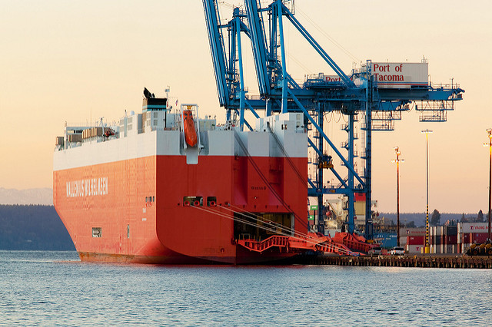
Marine Ports and Navigation Plan
  Foundation Setting
  Accounting of issues, trends, challenges, and needs
  Develop as a stand alone document
  Findings integrated into Freight System Plan and Statewide Multimodal Transportation Plan
  RCW 47.06.070 | Marine ports and navigation plan
  The state-interest component of the statewide multimodal transportation plan shall include a state marine ports and navigation plan, which shall assess the transportation needs of Washington's marine ports, including navigation, and identify transportation system improvements needed to support the international trade and economic development role of Washington's marine ports.

Slide 9
Outreach and Schedule - 2017
February – March
Initial scoping
Solicit input and information, focusing on our scope and approach for the 2017 Plan update, and present the issues and trends identified in 2014.
April – June
In-progress update
Present our preliminary analysis of issues and trends for 2017, and present the recommendations and strategies identified in 2014.
June – September
Review of findings
Share the final draft of the plan
Solicit feedback on recommendations and strategies.
December
Final plan submitted

Slide 10
Contact Information
Jason Beloso
belosoj@wsdot.wa.gov
206-464-1259
http://www.wsdot.wa.gov/Freight/
10

